Slide 1

Transitioning to IPv6
Address Space Management
© 2007 Cisco Systems, Inc. All rights reserved.
ICND2 v1.0—7-1
The PDF files and any printed representation for this material are the property of Cisco Systems, Inc., for the sole use by Cisco employees for personal study. The files or printed representations may not be used in commercial training, and may not be distributed for purposes other than individual self-study.

Slide 2
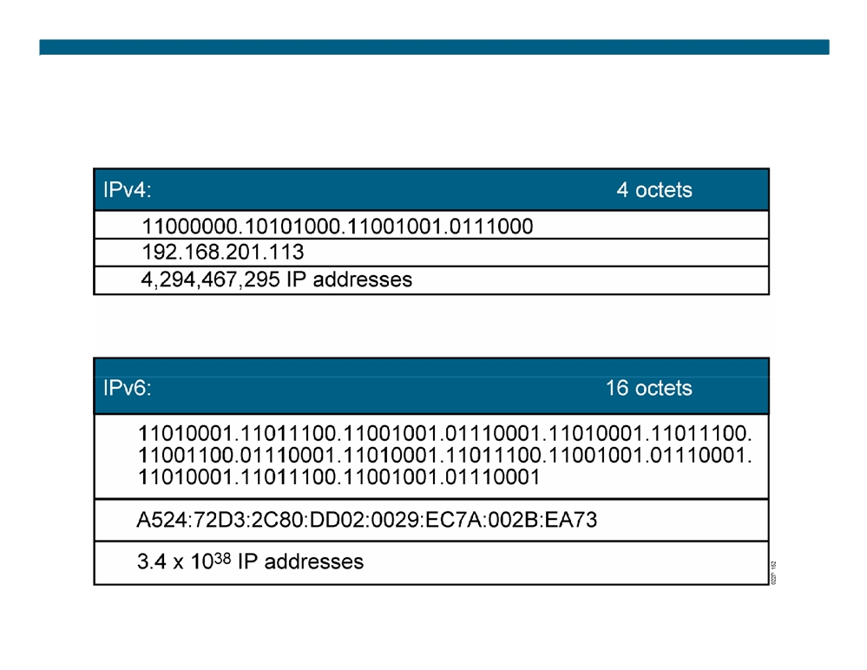
IPv4 and IPv6
ƒ Currently, there are approximately 1.3 billion usable IPv4 addresses available.
© 2007 Cisco Systems, Inc. All rights reserved.
ICND2 v1.0—7-2
The PDF files and any printed representation for this material are the property of Cisco Systems, Inc., for the sole use by Cisco employees for personal study. The files or printed representations may not be used in commercial training, and may not be distributed for purposes other than individual self-study.

Slide 3

Why Do We Need a Larger Address Space?
ƒ Internet population
- Approximately 973 million users in November 2005 - Emerging population and geopolitical address space ƒ Mobile users
- PDA, pen tablet, notepad, and so on - Approximately 20 million in 2004 ƒ Mobile phones
- Already 1 billion mobile phones delivered by the industry ƒ Transportation
- 1 billion automobiles forecast for 2008 - Internet access in planes, for example, Lufthansa ƒ Consumer devices
- Sony mandated that all its products be IPv6-enabled by 2005 - Billions of home and industrial appliances
© 2007 Cisco Systems, Inc. All rights reserved.
ICND2 v1.0—7-3
The PDF files and any printed representation for this material are the property of Cisco Systems, Inc., for the sole use by Cisco employees for personal study. The files or printed representations may not be used in commercial training, and may not be distributed for purposes other than individual self-study.

Slide 4
IPv6 Advanced Features
Larger address space:
Simpler header:
ƒ Global reachability and flexibility
ƒ Routing efficiency
ƒ Aggregation
ƒ Performance and forwarding rate
ƒ Multihoming
scalability
ƒ Autoconfiguration
ƒ No broadcasts
ƒ Plug-and-play
ƒ No checksums
ƒ End-to-end without NAT
ƒ Extension headers
ƒ Renumbering
ƒ Flow labels
Mobility and security:
Transition richness:
ƒ Mobile IP RFC-compliant
ƒ Dual stack
ƒ IPsec mandatory (or native)
ƒ 6to4 and manual tunnels
for IPv6
ƒ Translation
© 2007 Cisco Systems, Inc. All rights reserved.
ICND2 v1.0—7-4
The PDF files and any printed representation for this material are the property of Cisco Systems, Inc., for the sole use by Cisco employees for personal study. The files or printed representations may not be used in commercial training, and may not be distributed for purposes other than individual self-study.

Slide 5
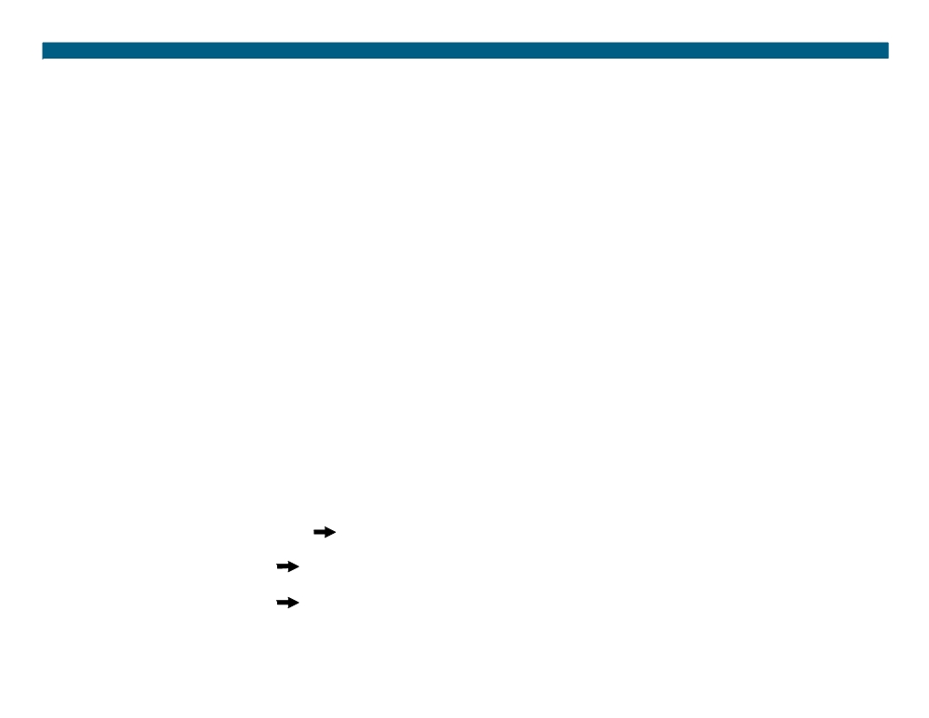
IPv6 Address Representation
Format:
ƒ x:x:x:x:x:x:x:x, where x is a 16-bit hexadecimal field - Case-insensitive for hexadecimal A, B, C, D, E, and F ƒ Leading zeros in a field are optional
ƒ Successive fields of zeros can be represented as :: only once per address Examples:
ƒ 2031:0000:130F:0000:0000:09C0:876A:130B - Can be represented as 2031:0:130f::9c0:876a:130b - Cannot be represented as 2031::130f::9c0:876a:130b
ƒ FF01:0:0:0:0:0:0:1
FF01::1
ƒ 0:0:0:0:0:0:0:1
::1
ƒ 0:0:0:0:0:0:0:0
::
© 2007 Cisco Systems, Inc. All rights reserved.
ICND2 v1.0—7-5
The PDF files and any printed representation for this material are the property of Cisco Systems, Inc., for the sole use by Cisco employees for personal study. The files or printed representations may not be used in commercial training, and may not be distributed for purposes other than individual self-study.

Slide 6
IPv6 Address Types
ƒ Unicast:
- Address is for a single interface
- IPv6 has several types (for example, global, reserved, link-local, and site-local) ƒ Multicast:
- One-to-many
- Enables more efficient use of the network - Uses a larger address range
ƒ Anycast:
- One-to-nearest (allocated from unicast address space) - Multiple devices share the same address - All anycast nodes should provide uniform service - Source devices send packets to anycast address - Routers decide on closest device to reach that destination - Suitable for load balancing and content delivery services
© 2007 Cisco Systems, Inc. All rights reserved.
ICND2 v1.0—7-6
The PDF files and any printed representation for this material are the property of Cisco Systems, Inc., for the sole use by Cisco employees for personal study. The files or printed representations may not be used in commercial training, and may not be distributed for purposes other than individual self-study.

Slide 7
IPv6 Unicast Addressing
ƒ Types of IPv6 unicast addresses:
- Global: Starts with 2000::/3 and assigned by IANA - Reserved: Used by the IETF
- Private: Link local (starts with FE80::/10) - Loopback (::1)
- Unspecified (::)
ƒ A single interface may be assigned multiple IPv6 addresses of any type: unicast, anycast, or multicast.
ƒ IPv6 addressing rules are covered by multiple RFCs. - Architecture defined by RFC 4291
© 2007 Cisco Systems, Inc. All rights reserved.
ICND2 v1.0—7-7
The PDF files and any printed representation for this material are the property of Cisco Systems, Inc., for the sole use by Cisco employees for personal study. The files or printed representations may not be used in commercial training, and may not be distributed for purposes other than individual self-study.

Slide 8
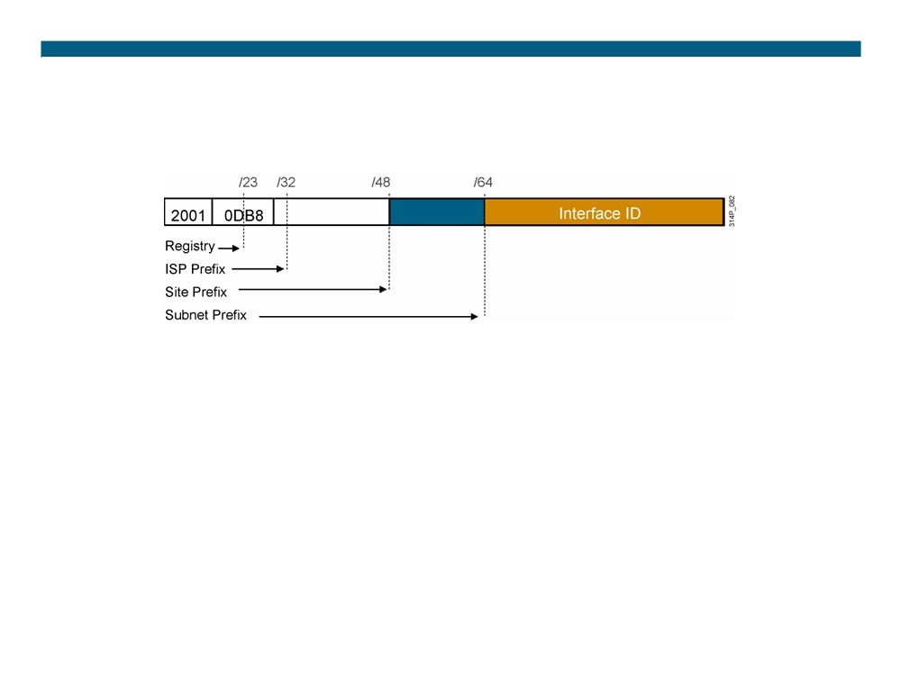
IPv6 Global Unicast (and Anycast) Addresses
IPv6 has the same address format for global unicast and for anycast addresses.
 Uses a global routing prefix—a structure that enables aggregation upward, eventually to the ISP.
ƒ A single interface may be assigned multiple addresses of any type (unicast, anycast, multicast).
ƒ Every IPv6-enabled interface contains at least one loopback (::1/128) and one link-local address.
ƒ Optionally, every interface can have multiple unique local and global addresses.
© 2007 Cisco Systems, Inc. All rights reserved.
ICND2 v1.0—7-8
The PDF files and any printed representation for this material are the property of Cisco Systems, Inc., for the sole use by Cisco employees for personal study. The files or printed representations may not be used in commercial training, and may not be distributed for purposes other than individual self-study.

Slide 9
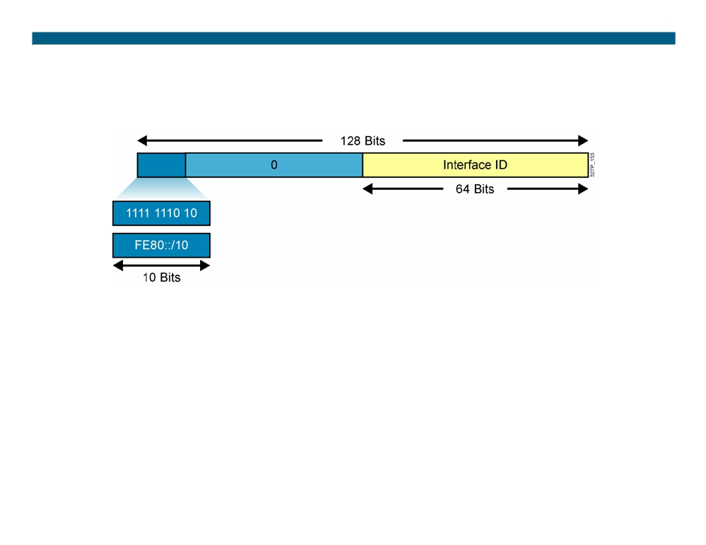
Link-Local Addresses
ƒ Link-local addresses have a scope limited to the link and are dynamically created on all IPv6 interfaces by using a specific link-local prefix FE80::/10 and a 64-bit interface identifier.
ƒ Link-local addresses are used for automatic address configuration, neighbor discovery, and router discovery. Link-local addresses are also used by many routing protocols.
ƒ Link-local addresses can serve as a way to connect devices on the same local network without needing global addresses.
ƒ When communicating with a link-local address, you must specify the outgoing interface because every interface is connected to FE80::/10.
© 2007 Cisco Systems, Inc. All rights reserved.
ICND2 v1.0—7-9
The PDF files and any printed representation for this material are the property of Cisco Systems, Inc., for the sole use by Cisco employees for personal study. The files or printed representations may not be used in commercial training, and may not be distributed for purposes other than individual self-study.

Slide 10
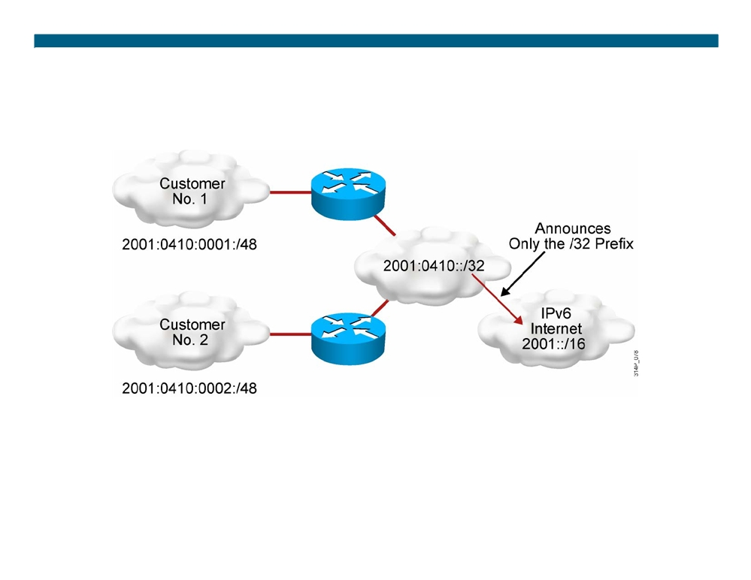
Larger Address Space Enables Address Aggregation
Address aggregation provides the following benefits:
ƒ Aggregation of prefixes announced in the global routing table ƒ Efficient and scalable routing
ƒ Improved bandwidth and functionality for user traffic
© 2007 Cisco Systems, Inc. All rights reserved.
ICND2 v1.0—7-10
The PDF files and any printed representation for this material are the property of Cisco Systems, Inc., for the sole use by Cisco employees for personal study. The files or printed representations may not be used in commercial training, and may not be distributed for purposes other than individual self-study.

Slide 11
Assigning IPv6 Global Unicast Addresses
ƒ Static assignment
- Manual interface ID assignment - EUI-64 interface ID assignment ƒ Dynamic assignment
ƒ Stateless autoconfiguration ƒ DHCPv6 (stateful)
© 2007 Cisco Systems, Inc. All rights reserved.
ICND2 v1.0—7-11
The PDF files and any printed representation for this material are the property of Cisco Systems, Inc., for the sole use by Cisco employees for personal study. The files or printed representations may not be used in commercial training, and may not be distributed for purposes other than individual self-study.

Slide 12
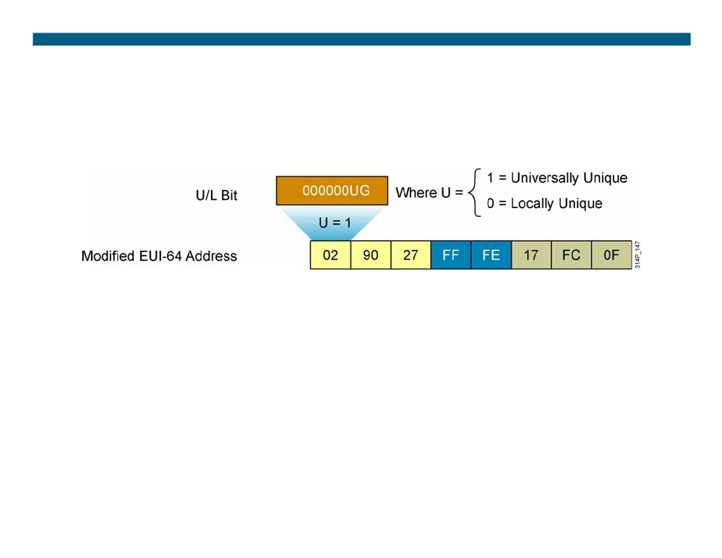
IPv6 EUI-64 Interface Identifier
 Cisco can use the EUI-64 format for interface identifiers.  This format expands the 48-bit MAC address to 64 bits by inserting “FFFE” into the middle 16 bits.
ƒ To make sure that the chosen address is from a unique Ethernet MAC address, the U/L bit is set to 1 for global scope (0 for local scope).
© 2007 Cisco Systems, Inc. All rights reserved.
ICND2 v1.0—7-12
The PDF files and any printed representation for this material are the property of Cisco Systems, Inc., for the sole use by Cisco employees for personal study. The files or printed representations may not be used in commercial training, and may not be distributed for purposes other than individual self-study.

Slide 13
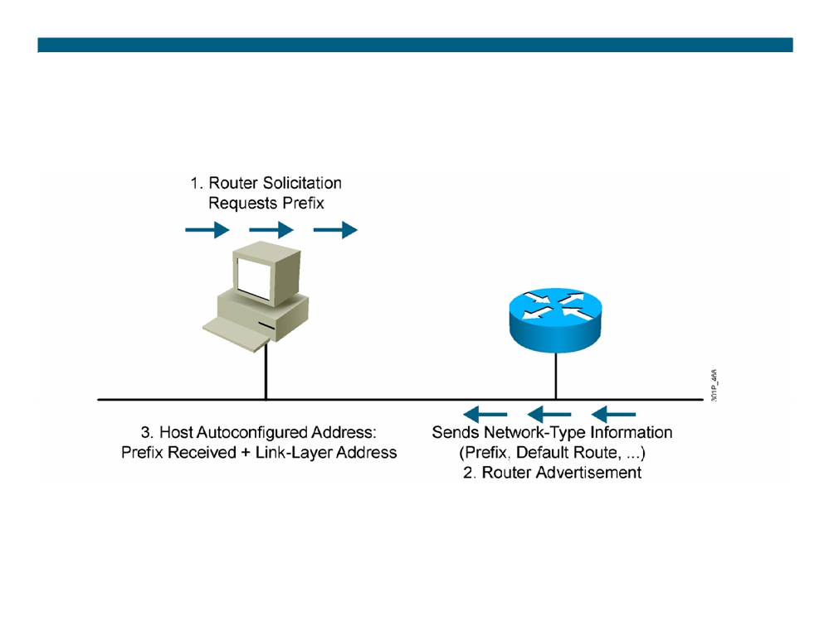
Stateless Autoconfiguration
© 2007 Cisco Systems, Inc. All rights reserved.
ICND2 v1.0—7-13
The PDF files and any printed representation for this material are the property of Cisco Systems, Inc., for the sole use by Cisco employees for personal study. The files or printed representations may not be used in commercial training, and may not be distributed for purposes other than individual self-study.

Slide 14
DHCPv6 (Stateful)
DHCPv6 is an updated version of DHCP for IPv4:
ƒ Supports new addressing
ƒ Enables more control than stateless autoconfiguration ƒ Can be used for renumbering
ƒ Can be used for automatic domain name registration of hosts using dynamic DNS
© 2007 Cisco Systems, Inc. All rights reserved.
ICND2 v1.0—7-14
The PDF files and any printed representation for this material are the property of Cisco Systems, Inc., for the sole use by Cisco employees for personal study. The files or printed representations may not be used in commercial training, and may not be distributed for purposes other than individual self-study.

Slide 15
DHCPv6 Operation
DHCPv6 operates in a way that is similar to DHCPv4, except:
ƒ Client first detects the presence of routers on the link. ƒ If a router is found, the router advertisement is examined to determine if DHCP can be used.
ƒ If no router is found, or if the router says DHCP can be used, then:
- A DHCP solicit message is sent to the all-DHCP-agents multicast address.
- The client uses the link-local address as the source address.
© 2007 Cisco Systems, Inc. All rights reserved.
ICND2 v1.0—7-15
The PDF files and any printed representation for this material are the property of Cisco Systems, Inc., for the sole use by Cisco employees for personal study. The files or printed representations may not be used in commercial training, and may not be distributed for purposes other than individual self-study.

Slide 16
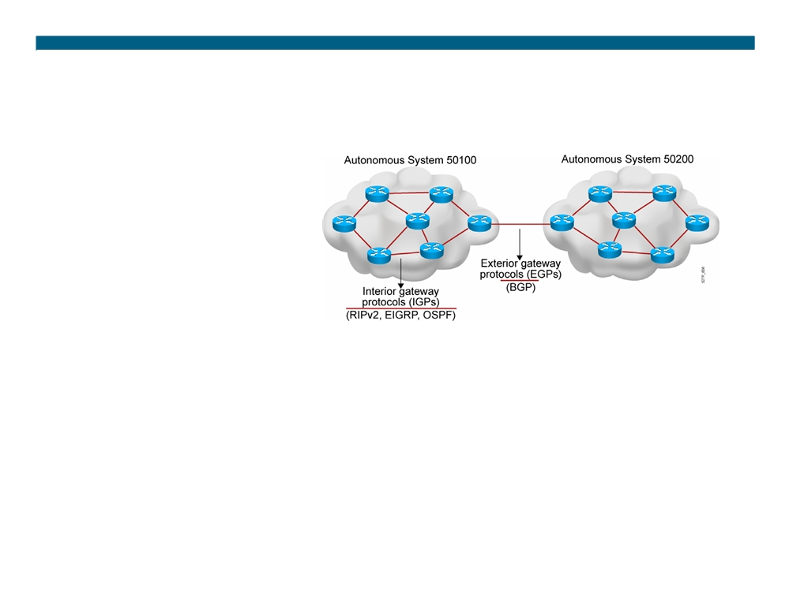
IPv6 Routing Protocols
ƒ IPv6 routing types:
- Static
- RIPng (RFC 2080) - OSPFv3 (RFC 2740) - IS-IS for IPv6
- MP-BGP4 (RFC 2545/2858) - EIGRP for IPv6
ƒ The ipv6 unicast-routing command is required to enable IPv6 before any routing protocol is configured.
© 2007 Cisco Systems, Inc. All rights reserved.
ICND2 v1.0—7-16
The PDF files and any printed representation for this material are the property of Cisco Systems, Inc., for the sole use by Cisco employees for personal study. The files or printed representations may not be used in commercial training, and may not be distributed for purposes other than individual self-study.

Slide 17
RIPng (RFC 2080)
Similar IPv4 features:
ƒ Distance vector, radius of 15 hops, split horizon, and poison reverse
ƒ Based on RIPv2
Updated features for IPv6:
ƒ IPv6 prefix, next-hop IPv6 address
ƒ Uses the multicast group FF02::9, the all-rip-routers multicast group, as the destination address for RIP updates ƒ Uses IPv6 for transport
ƒ Named RIPng
© 2007 Cisco Systems, Inc. All rights reserved.
ICND2 v1.0—7-17
The PDF files and any printed representation for this material are the property of Cisco Systems, Inc., for the sole use by Cisco employees for personal study. The files or printed representations may not be used in commercial training, and may not be distributed for purposes other than individual self-study.

Slide 18
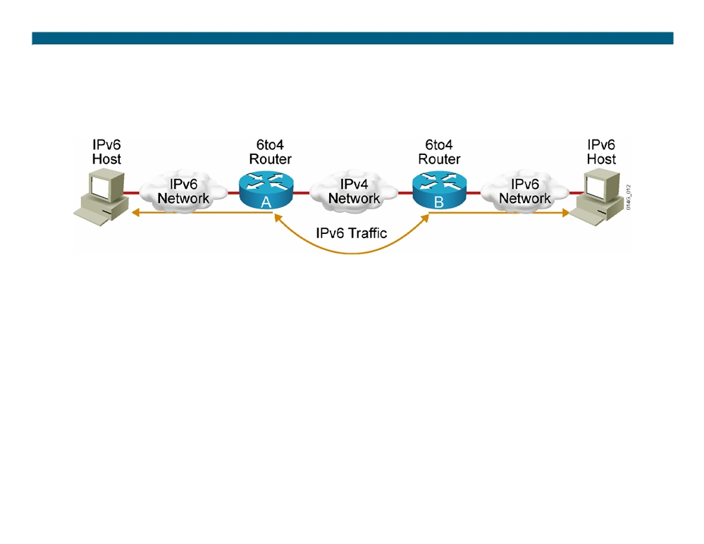
IPv4-to-IPv6 Transition
Transition richness means:
ƒ No fixed day to convert; no need to convert all at once ƒ Different transition mechanisms are available: - Dual stack
- Manual tunnel - 6to4 tunnel - ISATAP tunnel - Teredo tunnel
ƒ Different compatibility mechanisms: - Proxying and translation (NAT-PT)
© 2007 Cisco Systems, Inc. All rights reserved.
ICND2 v1.0—7-18
The PDF files and any printed representation for this material are the property of Cisco Systems, Inc., for the sole use by Cisco employees for personal study. The files or printed representations may not be used in commercial training, and may not be distributed for purposes other than individual self-study.

Slide 19
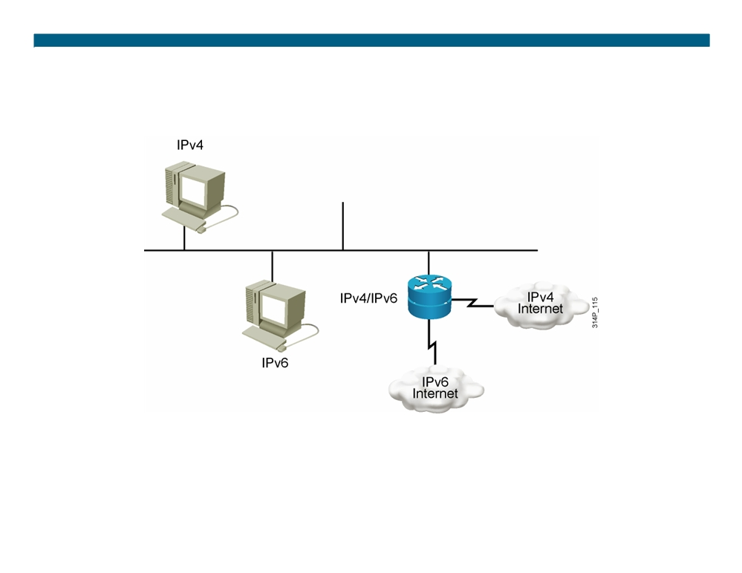
Cisco IOS Dual Stack
Dual stack is an integration method in which a node has implementation and connectivity to both an IPv4 and IPv6 network.
© 2007 Cisco Systems, Inc. All rights reserved.
ICND2 v1.0—7-19
The PDF files and any printed representation for this material are the property of Cisco Systems, Inc., for the sole use by Cisco employees for personal study. The files or printed representations may not be used in commercial training, and may not be distributed for purposes other than individual self-study.

Slide 20
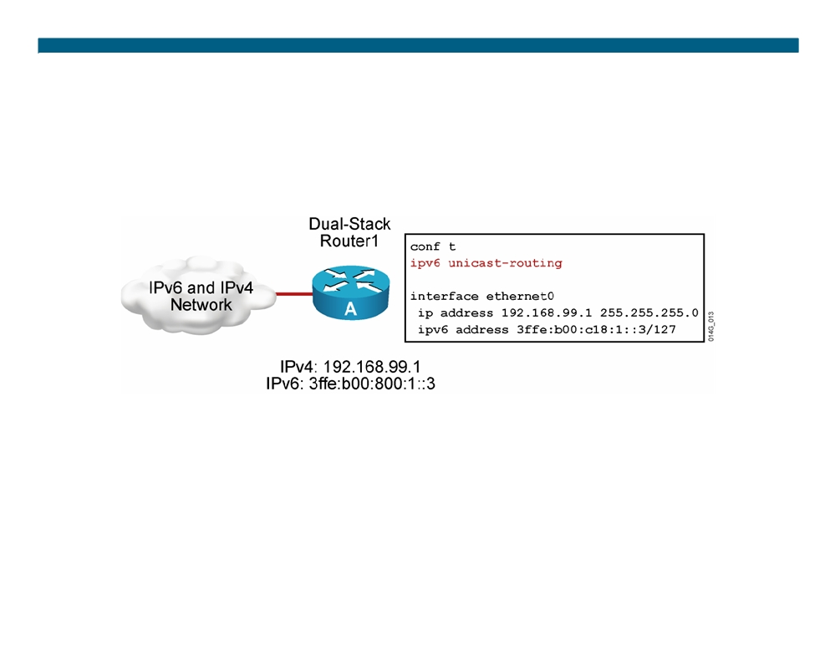
Cisco IOS Dual Stack (Cont.)
When both IPv4 and IPv6 are configured on an interface, the interface is considered dual-stacked.
© 2007 Cisco Systems, Inc. All rights reserved.
ICND2 v1.0—7-20
The PDF files and any printed representation for this material are the property of Cisco Systems, Inc., for the sole use by Cisco employees for personal study. The files or printed representations may not be used in commercial training, and may not be distributed for purposes other than individual self-study.

Slide 21
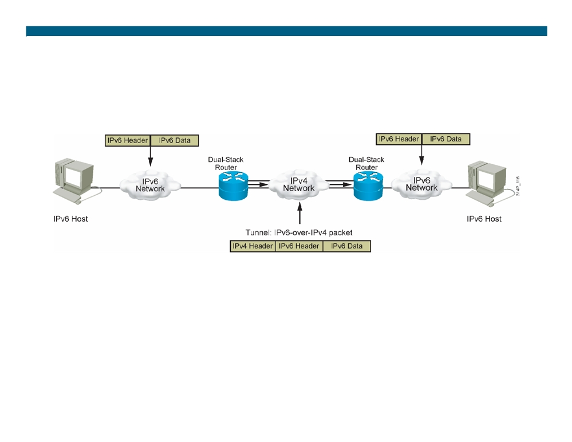
IPv6 Tunneling
Tunneling is an integration method in which an IPv6 packet is encapsulated within another protocol, such as IPv4. This method of encapsulation is IPv4.
ƒ Includes a 20-byte IPv4 header with no options and an IPv6 header and payload
ƒ Requires dual-stack routers
© 2007 Cisco Systems, Inc. All rights reserved.
ICND2 v1.0—7-21
The PDF files and any printed representation for this material are the property of Cisco Systems, Inc., for the sole use by Cisco employees for personal study. The files or printed representations may not be used in commercial training, and may not be distributed for purposes other than individual self-study.

Slide 22
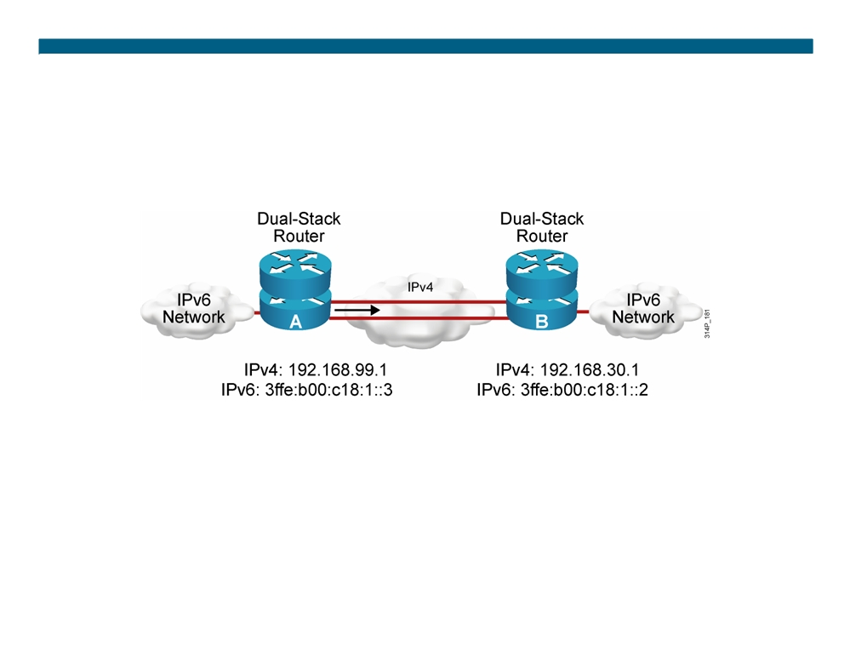
Manually Configured IPv6 Tunnel
Configured tunnels require:
ƒ Dual-stack endpoints
ƒ IPv4 and IPv6 addresses configured at each end
© 2007 Cisco Systems, Inc. All rights reserved.
ICND2 v1.0—7-22
The PDF files and any printed representation for this material are the property of Cisco Systems, Inc., for the sole use by Cisco employees for personal study. The files or printed representations may not be used in commercial training, and may not be distributed for purposes other than individual self-study.

Slide 23
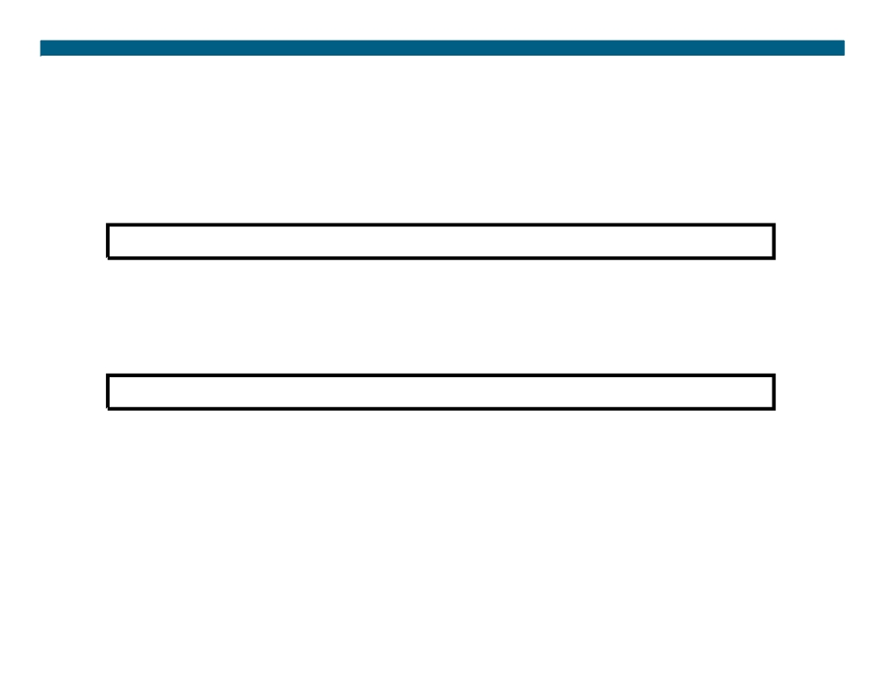
Enabling IPv6 on Cisco Routers
RouterX(config)#
ipv6 unicast-routing
ƒ Enables IPv6 traffic forwarding
RouterX(config-if)#
ipv6 address ipv6prefix/prefix-length eui-64 ƒ Configures the interface IPv6 addresses
© 2007 Cisco Systems, Inc. All rights reserved.
ICND2 v1.0—7-23
The PDF files and any printed representation for this material are the property of Cisco Systems, Inc., for the sole use by Cisco employees for personal study. The files or printed representations may not be used in commercial training, and may not be distributed for purposes other than individual self-study.

Slide 24
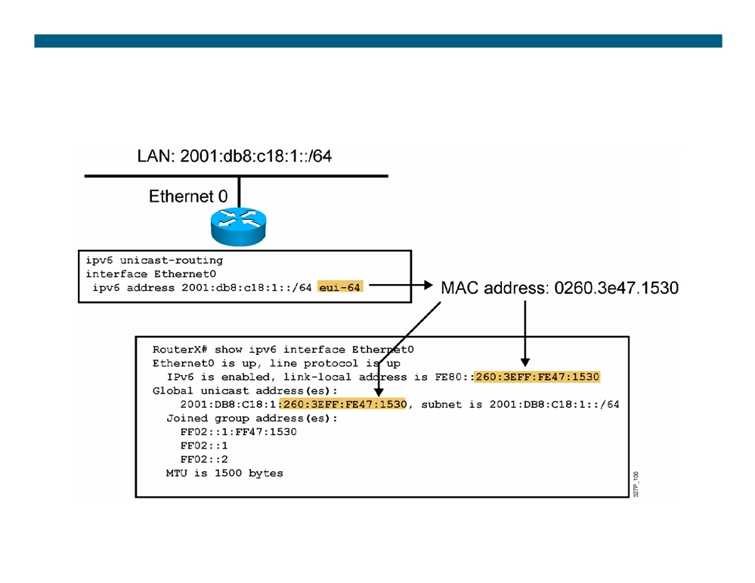
IPv6 Address Configuration Example
© 2007 Cisco Systems, Inc. All rights reserved.
ICND2 v1.0—7-24
The PDF files and any printed representation for this material are the property of Cisco Systems, Inc., for the sole use by Cisco employees for personal study. The files or printed representations may not be used in commercial training, and may not be distributed for purposes other than individual self-study.

Slide 25
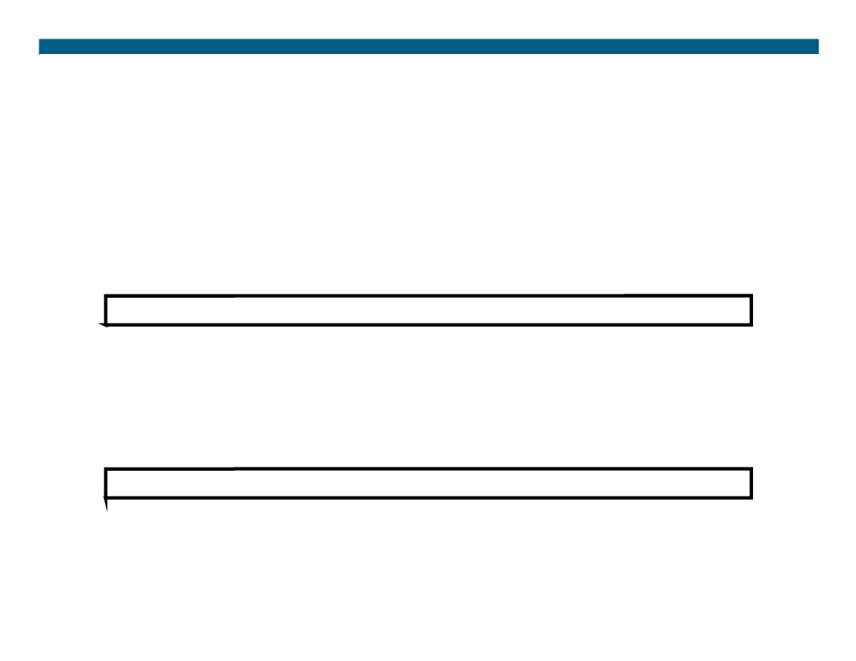
Cisco IOS IPv6 Name Resolution
Two ways to perform Cisco IOS name resolution for IPv6:
ƒ Define a static name for IPv6 addresses
RouterX(config)#
ipv6 host name [port] ipv6addr [{ipv6addr} ...]
RouterX(config)# ipv6 host router1 3ffe:b00:ffff:b::1
ƒ Configure a DNS server or servers to query
RouterX(config)#
ip name-server address
RouterX(config)#ip name-server 3ffe:b00:ffff:1::10
© 2007 Cisco Systems, Inc. All rights reserved.
ICND2 v1.0—7-25
The PDF files and any printed representation for this material are the property of Cisco Systems, Inc., for the sole use by Cisco employees for personal study. The files or printed representations may not be used in commercial training, and may not be distributed for purposes other than individual self-study.

Slide 26
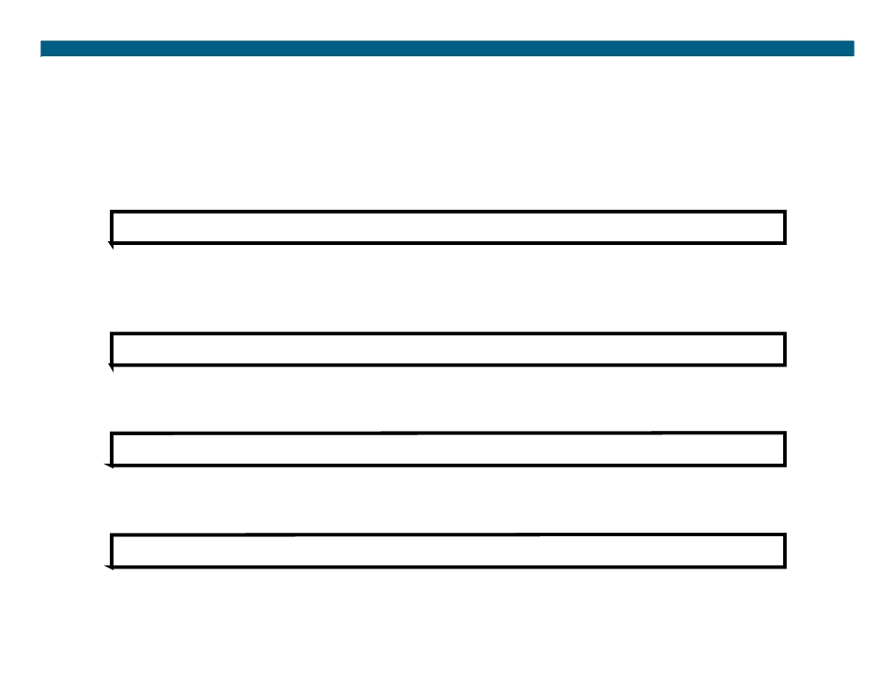
Configuring and Verifying RIPng for IPv6
RouterX(config)#
ipv6 router rip tag
ƒ Creates and enters RIP router configuration mode
RouterX(config-if)#
ipv6 rip tag enable
ƒ Configures RIP on an interface
show ipv6 rip
ƒ Displays the status of the various RIP processes
show ipv6 route rip
ƒ Shows RIP routes in the IPv6 route table
© 2007 Cisco Systems, Inc. All rights reserved.
ICND2 v1.0—7-26
The PDF files and any printed representation for this material are the property of Cisco Systems, Inc., for the sole use by Cisco employees for personal study. The files or printed representations may not be used in commercial training, and may not be distributed for purposes other than individual self-study.

Slide 27
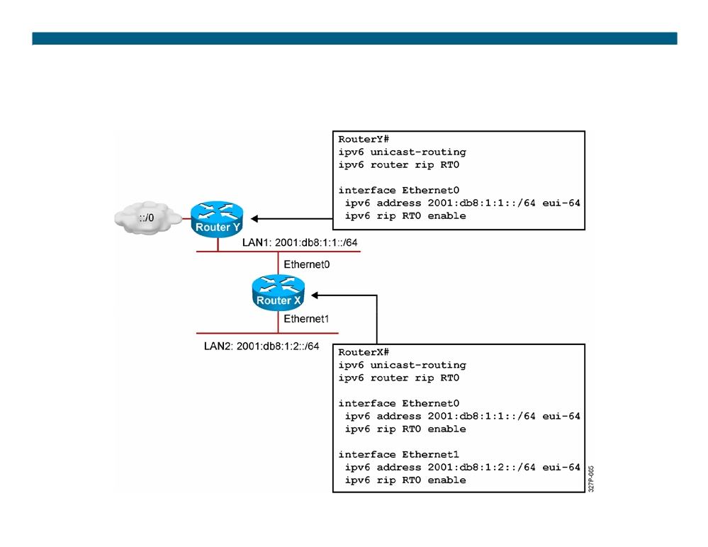
RIPng for IPv6 Configuration Example
© 2007 Cisco Systems, Inc. All rights reserved.
ICND2 v1.0—7-27
The PDF files and any printed representation for this material are the property of Cisco Systems, Inc., for the sole use by Cisco employees for personal study. The files or printed representations may not be used in commercial training, and may not be distributed for purposes other than individual self-study.

Slide 28
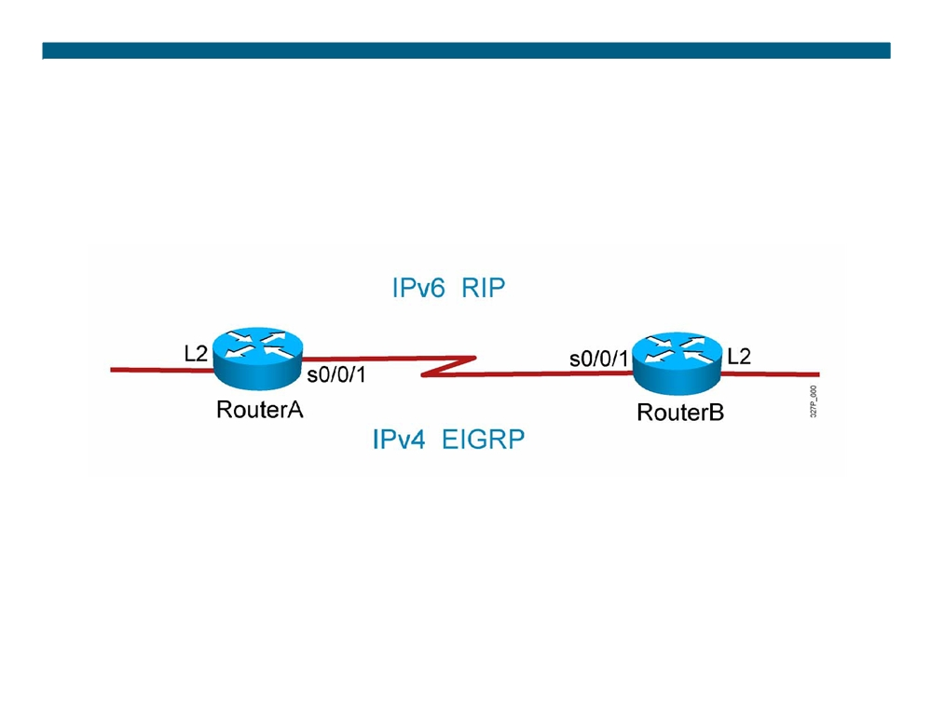
Visual Objective 7-2: Implementing IPv6
© 2007 Cisco Systems, Inc. All rights reserved.
ICND2 v1.0—7-28
The PDF files and any printed representation for this material are the property of Cisco Systems, Inc., for the sole use by Cisco employees for personal study. The files or printed representations may not be used in commercial training, and may not be distributed for purposes other than individual self-study.

Slide 29
Summary
ƒ IPv6 offers many additional benefits to IPv4 including a larger address space, easier address aggregation, and integrated security. ƒ The IPv6 address is 128 bits long and is made up of a 48-bit global prefix, a 16-bit subnet ID, and a 64-bit interface identifier. ƒ There are several ways to assign IPv6 addresses: statically, stateless autoconfiguration, and DHCPv6.
ƒ Cisco supports all of the major IPv6 routing protocols: RIPng, OSPFv3, and EIGRP.
ƒ Transitioning from IPv4 to IPv6 requires dual stacks, tunneling, and possibly NAT-PT.
ƒ Use the ipv6 unicast-routing command to enable IPv6 and the ipv6 address ipv6-address/prefix-length command to assign interface addresses and enable an IPv6 routing protocol.
© 2007 Cisco Systems, Inc. All rights reserved.
ICND2 v1.0—7-29
The PDF files and any printed representation for this material are the property of Cisco Systems, Inc., for the sole use by Cisco employees for personal study. The files or printed representations may not be used in commercial training, and may not be distributed for purposes other than individual self-study.

Slide 30
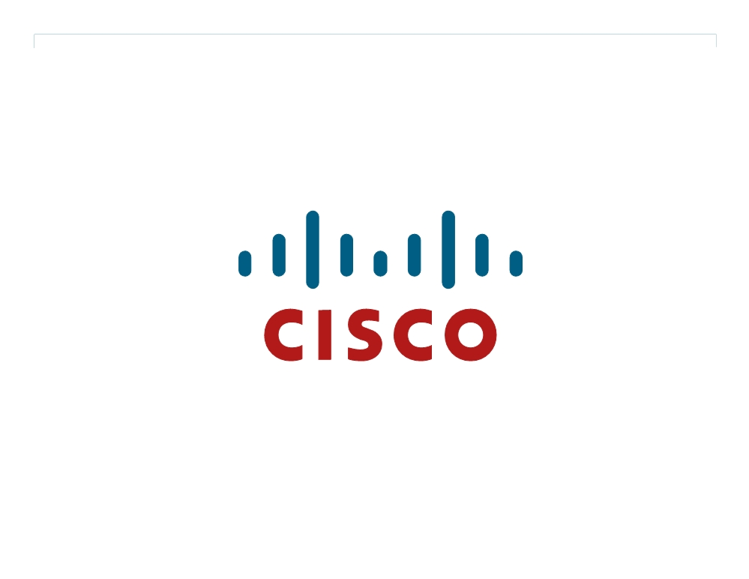
© 2007 Cisco Systems, Inc. All rights reserved.
ICND2 v1.0—7-30 The PDF files and any printed representation for this material are the property of Cisco Systems, Inc., for the sole use by Cisco employees for personal study. The files or printed representations may not be used in commercial training, and may not be distributed for purposes other than individual self-study.

Slide 31
Module Summary
ƒ NAT is a short-term solution to the limited number of unique IP addresses that IPv4 provides. The types of NAT you can configure include static, dynamic, and overloading (PAT). ƒ IPv6 is a long-term solution to running out of IPv4 addresses. IPv6 increases the size of the IP address to 128 bits and incorporates features such as autoconfiguration, security, and several solutions for transitioning from IPv4 to IPv6.
© 2007 Cisco Systems, Inc. All rights reserved.
ICND2 v1.0—7-1
The PDF files and any printed representation for this material are the property of Cisco Systems, Inc., for the sole use by Cisco employees for personal study. The files or printed representations may not be used in commercial training, and may not be distributed for purposes other than individual self-study.

Slide 32
© 2007 Cisco Systems, Inc. All rights reserved.
ICND2 v1.0—7-2 The PDF files and any printed representation for this material are the property of Cisco Systems, Inc., for the sole use by Cisco employees for personal study. The files or printed representations may not be used in commercial training, and may not be distributed for purposes other than individual self-study.

