Slide 1

Scaling the Network with NAT and PAT
Address Space Management
© 2007 Cisco Systems, Inc. All rights reserved.
ICND2 v1.0—7-1
The PDF files and any printed representation for this material are the property of Cisco Systems, Inc., for the sole use by Cisco employees for personal study. The files or printed representations may not be used in commercial training, and may not be distributed for purposes other than individual self-study.

Slide 2
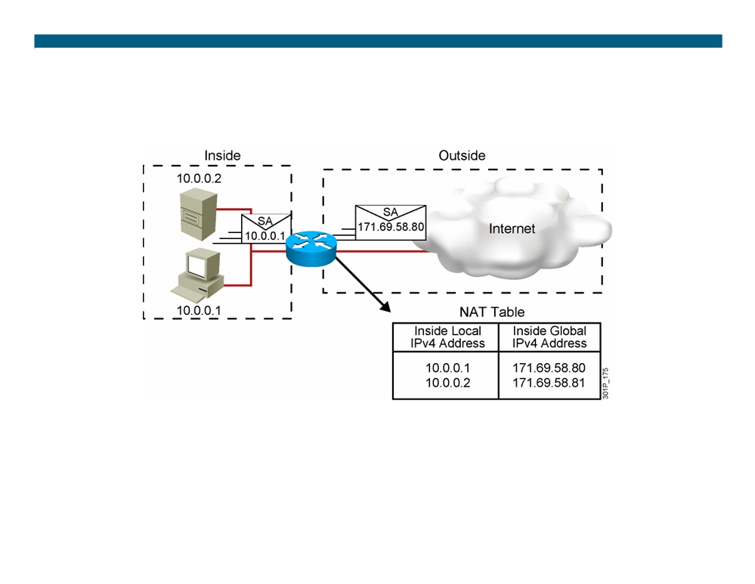
Network Address Translation
ƒ An IP address is either local or global.
ƒ Local IPv4 addresses are seen in the inside network. ƒ Global IPv4 addresses are seen in the outside network.
© 2007 Cisco Systems, Inc. All rights reserved.
ICND2 v1.0—7-2
The PDF files and any printed representation for this material are the property of Cisco Systems, Inc., for the sole use by Cisco employees for personal study. The files or printed representations may not be used in commercial training, and may not be distributed for purposes other than individual self-study.

Slide 3
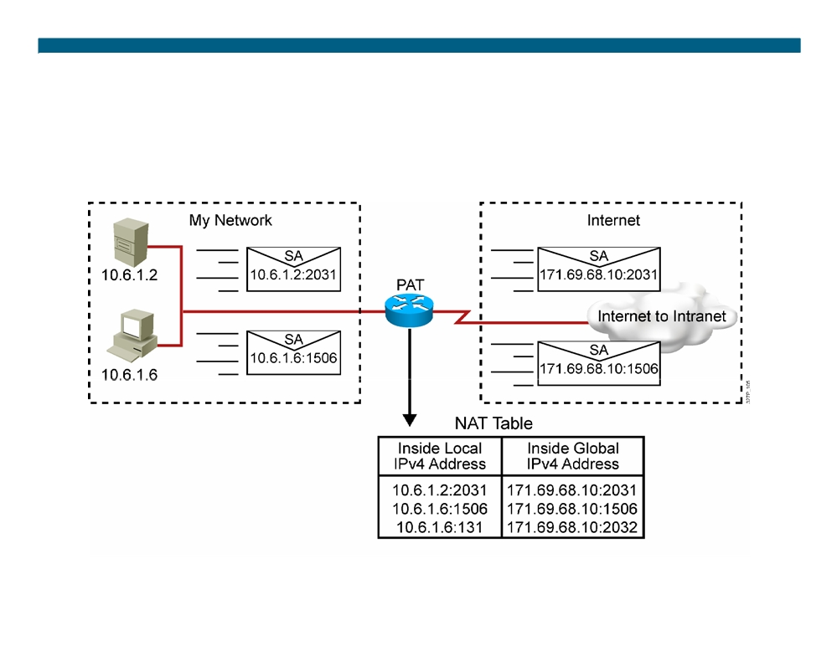
Port Address Translation
© 2007 Cisco Systems, Inc. All rights reserved.
ICND2 v1.0—7-3
The PDF files and any printed representation for this material are the property of Cisco Systems, Inc., for the sole use by Cisco employees for personal study. The files or printed representations may not be used in commercial training, and may not be distributed for purposes other than individual self-study.

Slide 4
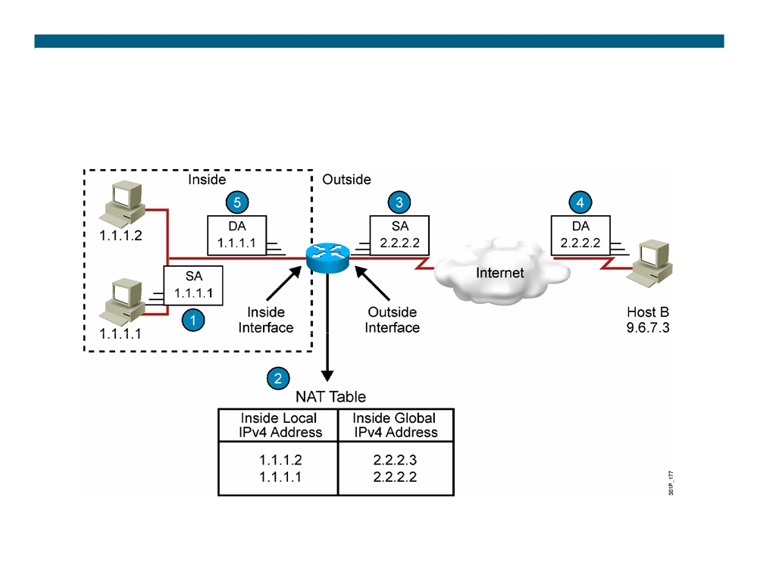
Translating Inside Source Addresses
© 2007 Cisco Systems, Inc. All rights reserved.
ICND2 v1.0—7-4
The PDF files and any printed representation for this material are the property of Cisco Systems, Inc., for the sole use by Cisco employees for personal study. The files or printed representations may not be used in commercial training, and may not be distributed for purposes other than individual self-study.

Slide 5
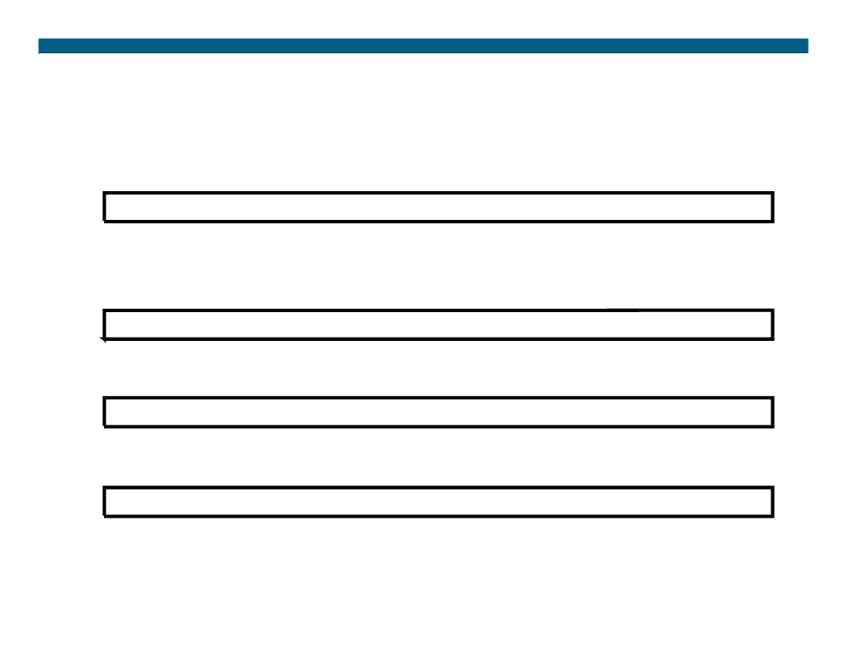
Configuring and Verifying Static Translation
RouterX(config)# ip nat inside source static local-ip global-ip ƒ Establishes static translation between an inside local address and an inside global address
RouterX(config-if)# ip nat inside ƒ Marks the interface as connected to the inside
RouterX(config-if)# ip nat outside ƒ Marks the interface as connected to the outside
RouterX# show ip nat translations ƒ Displays active translations
© 2007 Cisco Systems, Inc. All rights reserved.
ICND2 v1.0—7-5
The PDF files and any printed representation for this material are the property of Cisco Systems, Inc., for the sole use by Cisco employees for personal study. The files or printed representations may not be used in commercial training, and may not be distributed for purposes other than individual self-study.

Slide 6
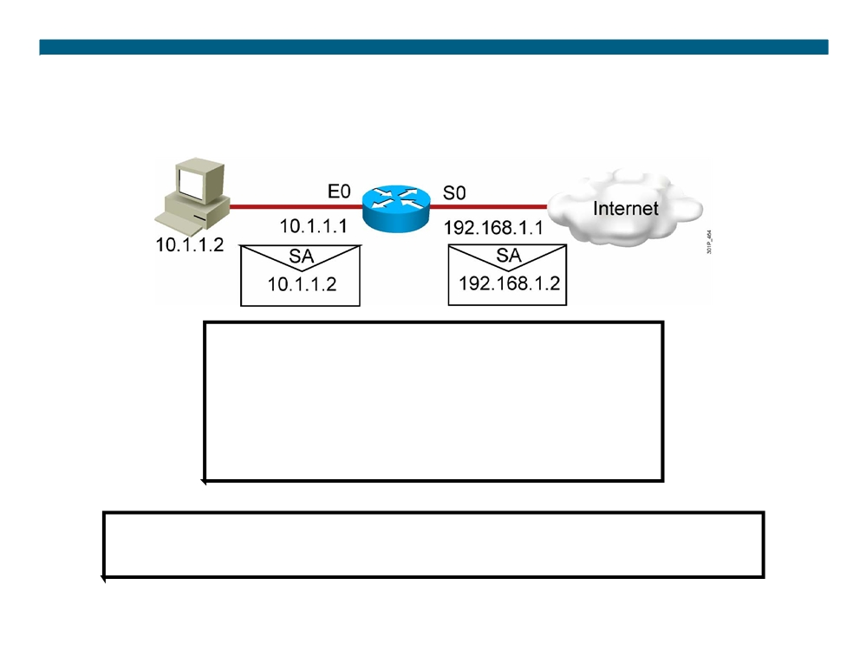
Enabling Static NAT
Address Mapping Example
interface s0
ip address 192.168.1.1 255.255.255.0 ip nat outside
!
interface e0
ip address 10.1.1.1 255.255.255.0 ip nat inside
!
ip nat inside source static 10.1.1.2 192.168.1.2
RouterX# show ip nat translations
Pro Inside global Inside local Outside local Outside global
--- 192.168.1.2
10.1.1.2
---
---
© 2007 Cisco Systems, Inc. All rights reserved.
ICND2 v1.0—7-6
The PDF files and any printed representation for this material are the property of Cisco Systems, Inc., for the sole use by Cisco employees for personal study. The files or printed representations may not be used in commercial training, and may not be distributed for purposes other than individual self-study.

Slide 7
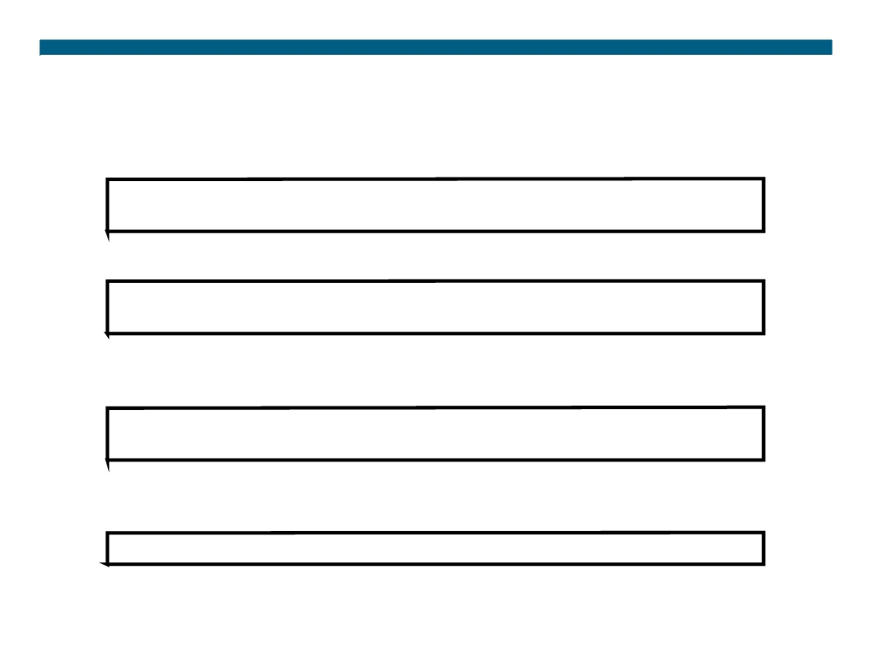
Configuring and Verifying Dynamic Translation
RouterX(config)# ip nat pool name start-ip end-ip {netmask netmask | prefix-length prefix-length}
ƒ Defines a pool of global addresses to be allocated as needed
RouterX(config)# access-list access-list-number permit source [source-wildcard]
ƒ Defines a standard IP ACL permitting those inside local addresses that are to be translated
RouterX(config)# ip nat inside source list access-list-number pool name
ƒ Establishes dynamic source translation, specifying the ACL that was defined in the previous step
RouterX# show ip nat translations ƒ Displays active translations
© 2007 Cisco Systems, Inc. All rights reserved.
ICND2 v1.0—7-7
The PDF files and any printed representation for this material are the property of Cisco Systems, Inc., for the sole use by Cisco employees for personal study. The files or printed representations may not be used in commercial training, and may not be distributed for purposes other than individual self-study.

Slide 8
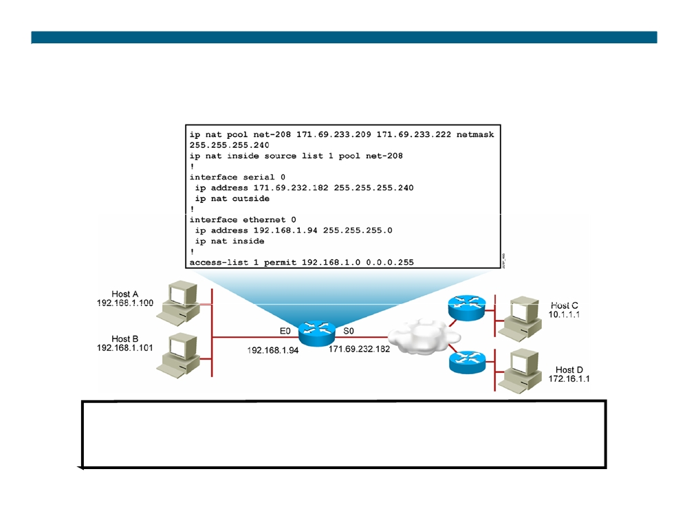
Dynamic Address Translation Example
RouterX# show ip nat translations
Pro Inside global
Inside local
Outside local Outside global
--- 171.69.233.209
192.168.1.100
---
---
--- 171.69.233.210
192.168.1.101
---
---
© 2007 Cisco Systems, Inc. All rights reserved.
ICND2 v1.0—7-8
The PDF files and any printed representation for this material are the property of Cisco Systems, Inc., for the sole use by Cisco employees for personal study. The files or printed representations may not be used in commercial training, and may not be distributed for purposes other than individual self-study.

Slide 9
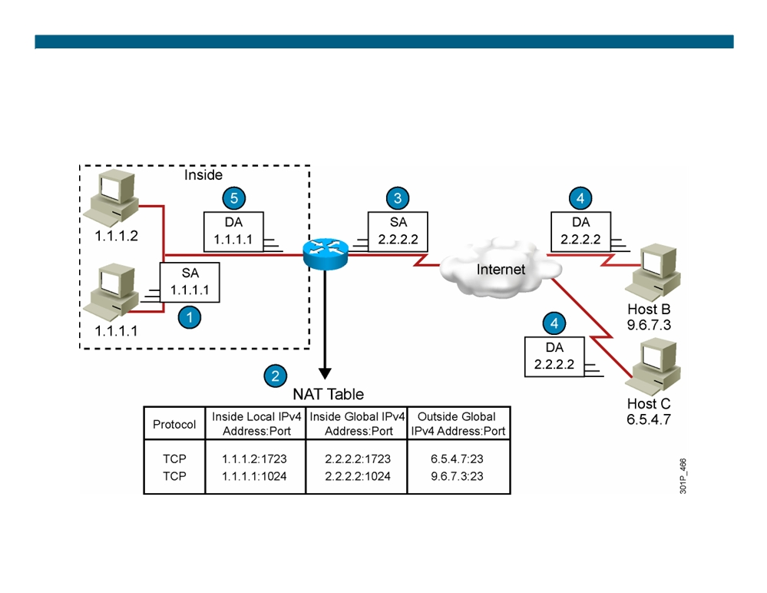
Overloading an Inside Global Address
© 2007 Cisco Systems, Inc. All rights reserved.
ICND2 v1.0—7-9
The PDF files and any printed representation for this material are the property of Cisco Systems, Inc., for the sole use by Cisco employees for personal study. The files or printed representations may not be used in commercial training, and may not be distributed for purposes other than individual self-study.

Slide 10
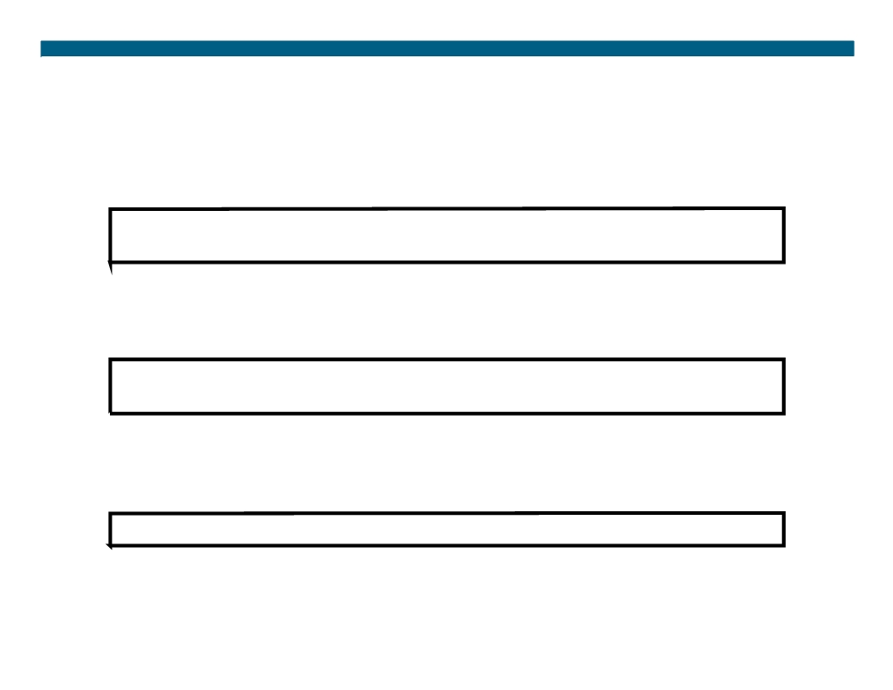
Configuring Overloading
RouterX(config)# access-list access-list-number permit source source-wildcard
ƒ Defines a standard IP ACL that will permit the inside local addresses that are to be translated
RouterX(config)# ip nat inside source list access-list-number interface interface overload
ƒ Establishes dynamic source translation, specifying the ACL that was defined in the previous step
RouterX# show ip nat translations ƒ Displays active translations
© 2007 Cisco Systems, Inc. All rights reserved.
ICND2 v1.0—7-10
The PDF files and any printed representation for this material are the property of Cisco Systems, Inc., for the sole use by Cisco employees for personal study. The files or printed representations may not be used in commercial training, and may not be distributed for purposes other than individual self-study.

Slide 11
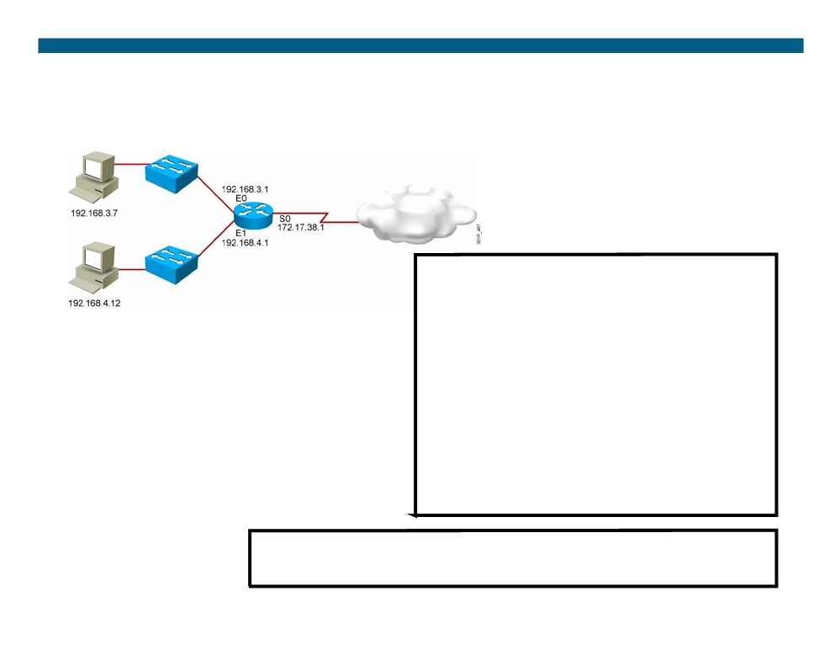
Overloading an Inside Global Address Example
hostname RouterX
!
interface Ethernet0
ip address 192.168.3.1 255.255.255.0 ip nat inside
!
interface Ethernet1
ip address 192.168.4.1 255.255.255.0 ip nat inside
!
interface Serial0 description To ISP
ip address 172.17.38.1 255.255.255.0 ip nat outside
!
ip nat inside source list 1 interface Serial0 overload !
ip route 0.0.0.0 0.0.0.0 Serial0 !
access-list 1 permit 192.168.3.0 0.0.0.255 access-list 1 permit 192.168.4.0 0.0.0.255 !
RouterX# show ip nat translations
Pro Inside global
Inside local
Outside local
Outside global
TCP 172.17.38.1:1050
192.168.3.7:1050
10.1.1.1:23
10.1.1.1:23
TCP 172.17.38.1:1776
192.168.4.12:1776
10.2.2.2:25
10.2.2.2:25
© 2007 Cisco Systems, Inc. All rights reserved.
ICND2 v1.0—7-11
The PDF files and any printed representation for this material are the property of Cisco Systems, Inc., for the sole use by Cisco employees for personal study. The files or printed representations may not be used in commercial training, and may not be distributed for purposes other than individual self-study.

Slide 12
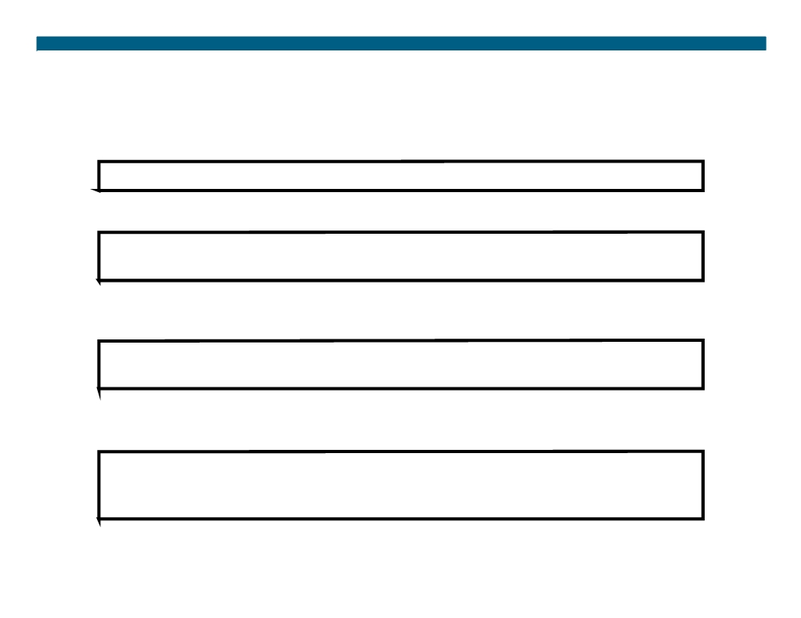
Clearing the NAT Translation Table
RouterX# clear ip nat translation *
ƒ Clears all dynamic address translation entries
RouterX# clear ip nat translation inside global-ip local-ip [outside local-ip global-ip]
ƒ Clears a simple dynamic translation entry that contains an inside translation or both an inside and outside translation
RouterX# clear ip nat translation outside local-ip global-ip
ƒ Clears a simple dynamic translation entry that contains an outside translation
RouterX# clear ip nat translation protocol inside global-ip global-port local-ip local-port [outside local-ip local-port global-ip global-port]
ƒ Clears an extended dynamic translation entry (PAT entry)
© 2007 Cisco Systems, Inc. All rights reserved.
ICND2 v1.0—7-12
The PDF files and any printed representation for this material are the property of Cisco Systems, Inc., for the sole use by Cisco employees for personal study. The files or printed representations may not be used in commercial training, and may not be distributed for purposes other than individual self-study.

Slide 13

Translation Not Occurring:
Translation Not Installed in the Table
Verify that:
ƒ There are no inbound ACLs that are denying the packets entry to the NAT router
ƒ The ACL referenced by the NAT command is permitting all necessary networks
ƒ There are enough addresses in the NAT pool
ƒ The router interfaces are appropriately defined as NAT inside or NAT outside
© 2007 Cisco Systems, Inc. All rights reserved.
ICND2 v1.0—7-13
The PDF files and any printed representation for this material are the property of Cisco Systems, Inc., for the sole use by Cisco employees for personal study. The files or printed representations may not be used in commercial training, and may not be distributed for purposes other than individual self-study.

Slide 14
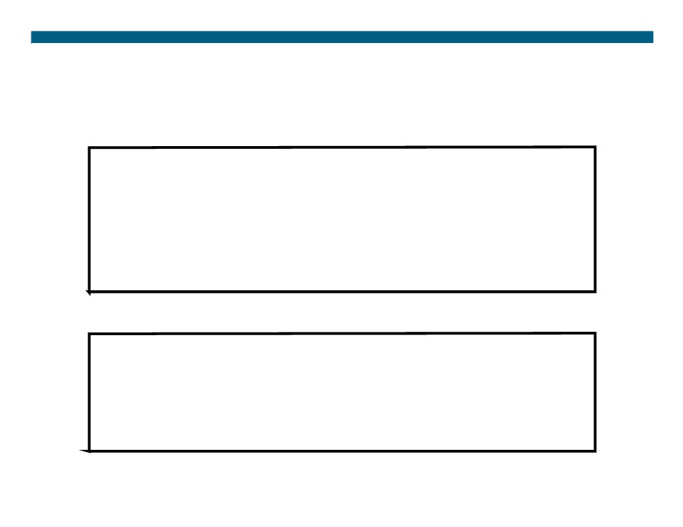
Displaying Information with show and debug Commands
RouterX# debug ip nat
NAT: s=192.168.1.95->172.31.233.209, d=172.31.2.132 [6825] NAT: s=172.31.2.132, d=172.31.233.209->192.168.1.95 [21852] NAT: s=192.168.1.95->172.31.233.209, d=172.31.1.161 [6826] NAT*: s=172.31.1.161, d=172.31.233.209->192.168.1.95 [23311] NAT*: s=192.168.1.95->172.31.233.209, d=172.31.1.161 [6827] NAT*: s=192.168.1.95->172.31.233.209, d=172.31.1.161 [6828] NAT*: s=172.31.1.161, d=172.31.233.209->192.168.1.95 [23312] NAT*: s=172.31.1.161, d=172.31.233.209->192.168.1.95 [23313]
RouterX# show ip nat statistics
Total active translations: 1 (1 static, 0 dynamic; 0 extended) Outside interfaces:
Ethernet0, Serial2 Inside interfaces: Ethernet1
Hits: 5 Misses: 0 …
© 2007 Cisco Systems, Inc. All rights reserved.
ICND2 v1.0—7-14
The PDF files and any printed representation for this material are the property of Cisco Systems, Inc., for the sole use by Cisco employees for personal study. The files or printed representations may not be used in commercial training, and may not be distributed for purposes other than individual self-study.

Slide 15
Translation Occurring: Installed Translation Entry Not Being Used
Verify:
ƒ What the NAT configuration is supposed to accomplish ƒ That the NAT entry exists in the translation table and that it is accurate
ƒ That the translation is actually taking place by monitoring the NAT process or statistics
ƒ That the NAT router has the appropriate route in the routing table if the packet is going from inside to outside
ƒ That all necessary routers have a return route back to the translated address
© 2007 Cisco Systems, Inc. All rights reserved.
ICND2 v1.0—7-15
The PDF files and any printed representation for this material are the property of Cisco Systems, Inc., for the sole use by Cisco employees for personal study. The files or printed representations may not be used in commercial training, and may not be distributed for purposes other than individual self-study.

Slide 16
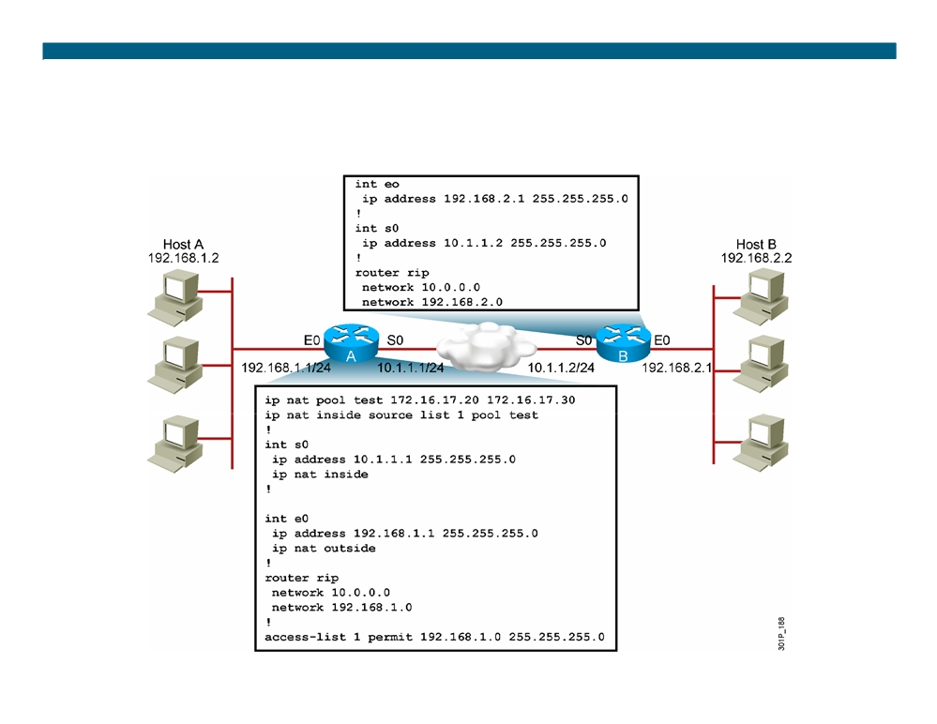
Sample Problem: Cannot Ping Remote Host
© 2007 Cisco Systems, Inc. All rights reserved.
ICND2 v1.0—7-16
The PDF files and any printed representation for this material are the property of Cisco Systems, Inc., for the sole use by Cisco employees for personal study. The files or printed representations may not be used in commercial training, and may not be distributed for purposes other than individual self-study.

Slide 17
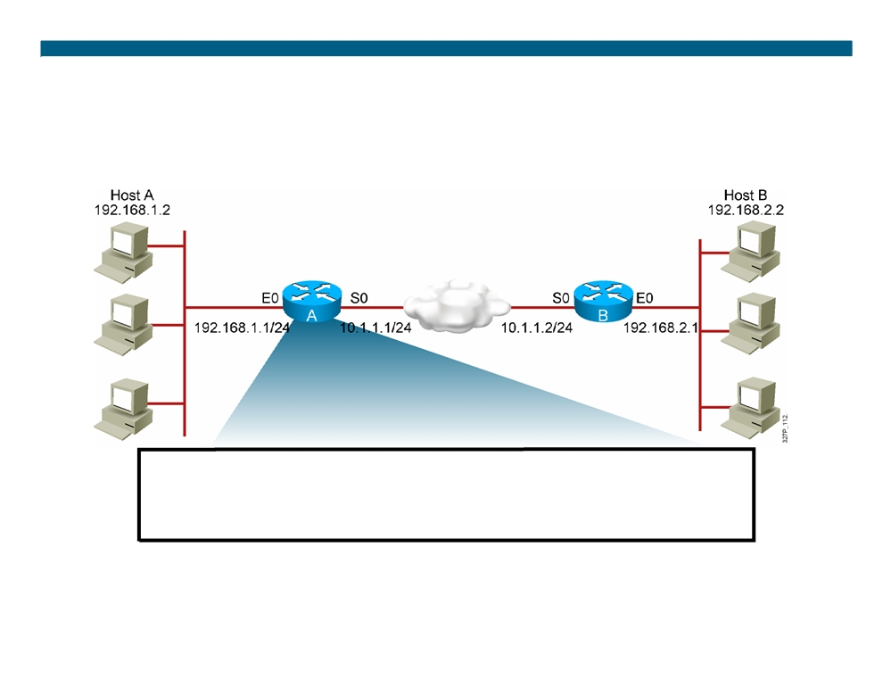
Sample Problem: Cannot Ping Remote Host (Cont.)
RouterA# show ip nat translations
Pro Inside global
Inside local
Outside local
Outside global
---
---
---
---
---
---
There are no translations in the table.
© 2007 Cisco Systems, Inc. All rights reserved.
ICND2 v1.0—7-17
The PDF files and any printed representation for this material are the property of Cisco Systems, Inc., for the sole use by Cisco employees for personal study. The files or printed representations may not be used in commercial training, and may not be distributed for purposes other than individual self-study.

Slide 18
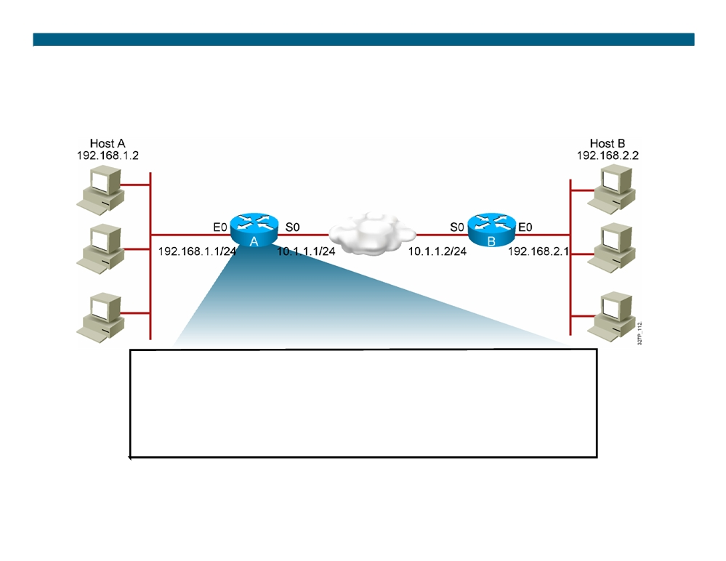
Sample Problem: Cannot Ping Remote Host (Cont.)
RouterA# show ip nat statistics
Total active translations: 0 (0 static, 0 dynamic; 0 extended) Outside interfaces:
Ethernet0
Inside interfaces: Serial0
Hits: 0 Misses: 0 …
The router interfaces are inappropriately defined as NAT inside and NAT outside.
© 2007 Cisco Systems, Inc. All rights reserved.
ICND2 v1.0—7-18
The PDF files and any printed representation for this material are the property of Cisco Systems, Inc., for the sole use by Cisco employees for personal study. The files or printed representations may not be used in commercial training, and may not be distributed for purposes other than individual self-study.

Slide 19
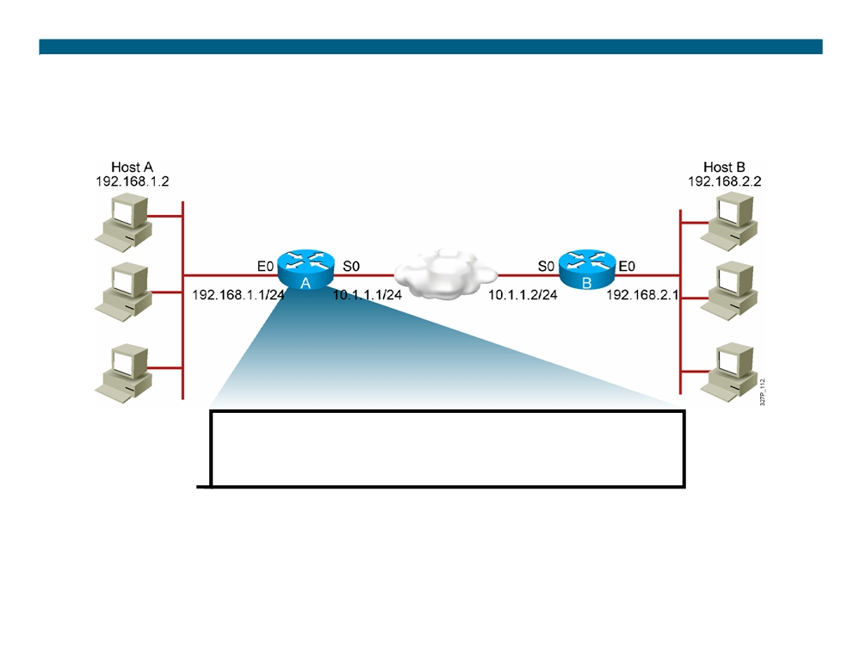
Sample Problem: Cannot Ping Remote Host (Cont.)
RouterA# show access-list
Standard IP access list 20
10 permit 0.0.0.0, wildcard bits 255.255.255.0
ƒ Pings are still failing and there are still no translations in the table. ƒ There is an incorrect wildcard bit mask in the ACL that defines the addresses to be translated.
© 2007 Cisco Systems, Inc. All rights reserved.
ICND2 v1.0—7-19
The PDF files and any printed representation for this material are the property of Cisco Systems, Inc., for the sole use by Cisco employees for personal study. The files or printed representations may not be used in commercial training, and may not be distributed for purposes other than individual self-study.

Slide 20
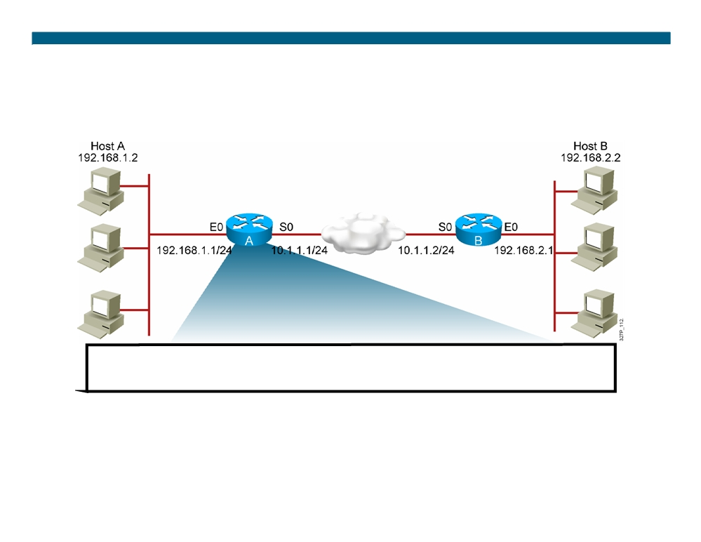
Sample Problem: Cannot Ping Remote Host (Cont.)
RouterA# show ip nat translations
Pro Inside global
Inside local
Outside local
Outside global
---
172.16.17.20
192.168.1.2
---
---
ƒ Translations are now occurring. ƒ Pings are still failing.
© 2007 Cisco Systems, Inc. All rights reserved.
ICND2 v1.0—7-20
The PDF files and any printed representation for this material are the property of Cisco Systems, Inc., for the sole use by Cisco employees for personal study. The files or printed representations may not be used in commercial training, and may not be distributed for purposes other than individual self-study.

Slide 21
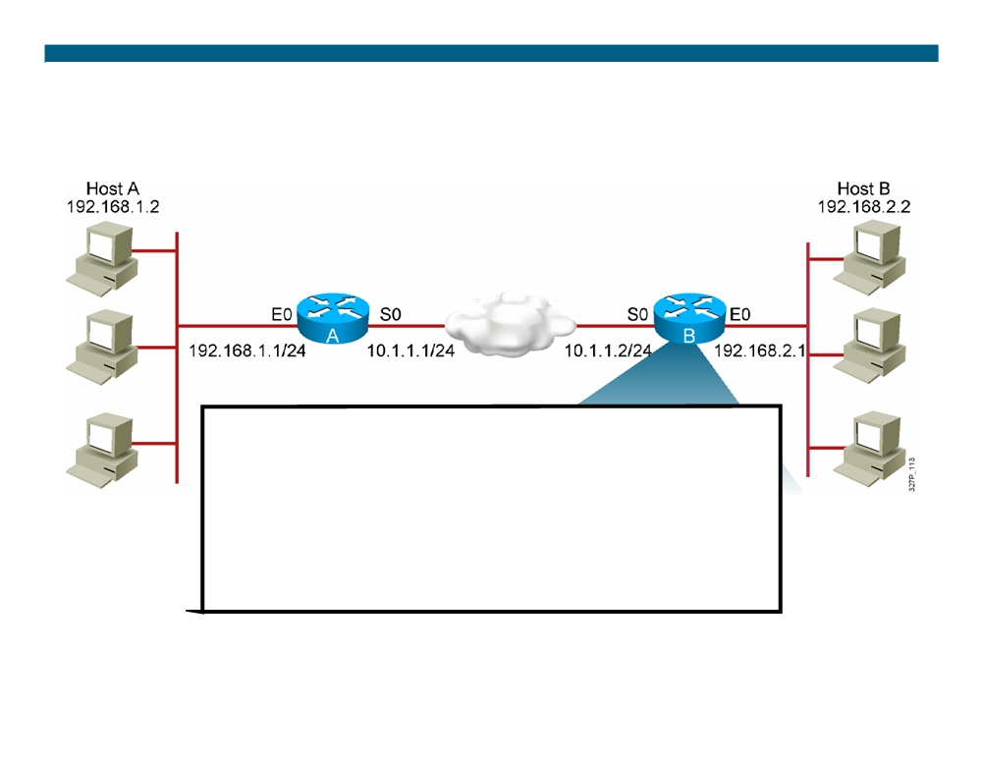
Sample Problem: Cannot Ping Remote Host (Cont.)
RouterB# sh ip route
Codes: C - connected, S - static, R - RIP, M - mobile, B - BGP Gateway of last resort is not set
10.0.0.0/24 is subnetted, 1 subnets
C
10.1.1.0/24 is directly connected, Serial0
192.168.2.0/24 is subnetted, 1 subnets
R
192.168.2.0/24 is directly connected, Ethernet0
192.168.1.0/24 is variably subnetted, 3 subnets, 2 masks
R
192.168.1.0/24 [120/1] via 10.1.1.1, 2d19h, Serial0
Router B has no route to the translated network address of 172.16.0.0.
© 2007 Cisco Systems, Inc. All rights reserved.
ICND2 v1.0—7-21
The PDF files and any printed representation for this material are the property of Cisco Systems, Inc., for the sole use by Cisco employees for personal study. The files or printed representations may not be used in commercial training, and may not be distributed for purposes other than individual self-study.

Slide 22
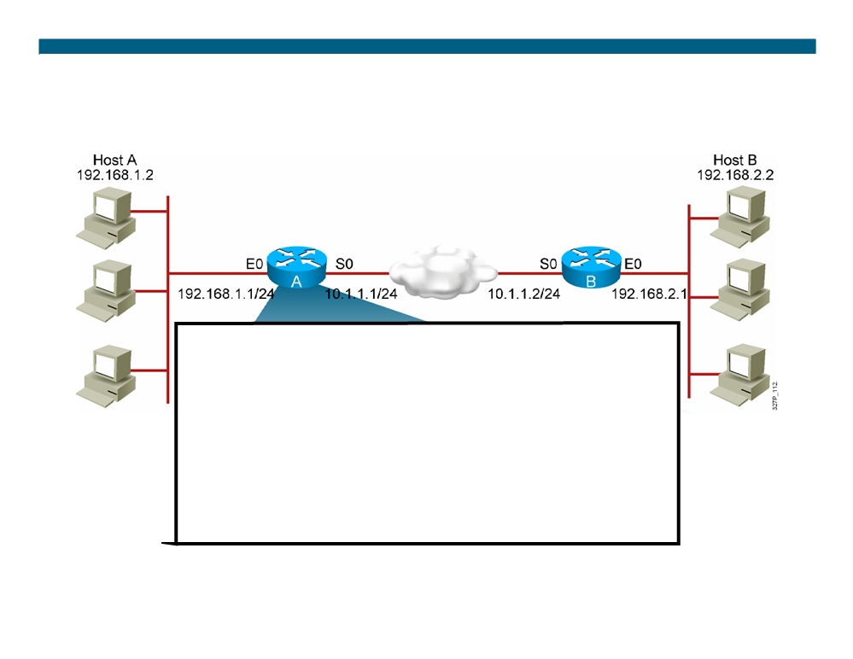
Sample Problem: Cannot Ping Remote Host (Cont.)
RouterA# sh ip protocol
Routing Protocol is "rip"
Outgoing update filter list for all interfaces is not set Incoming update filter list for all interfaces is not set Sending updates every 30 seconds, next due in 0 seconds Invalid after 180 seconds, hold down 180, flushed after 240 Redistributing: rip
Default version control: send version 1, receive any version Automatic network summarization is in effect
Maximum path: 4
Routing for Networks: 192.168.0.0
Routing Information Sources:
Gateway
Distance
Last Update
Distance: (default is 120)
Router A is advertising the network that is being translated, 192.168.1.0, instead of the network address the router is translating into,172.16.0.0.
© 2007 Cisco Systems, Inc. All rights reserved.
ICND2 v1.0—7-22
The PDF files and any printed representation for this material are the property of Cisco Systems, Inc., for the sole use by Cisco employees for personal study. The files or printed representations may not be used in commercial training, and may not be distributed for purposes other than individual self-study.

Slide 23
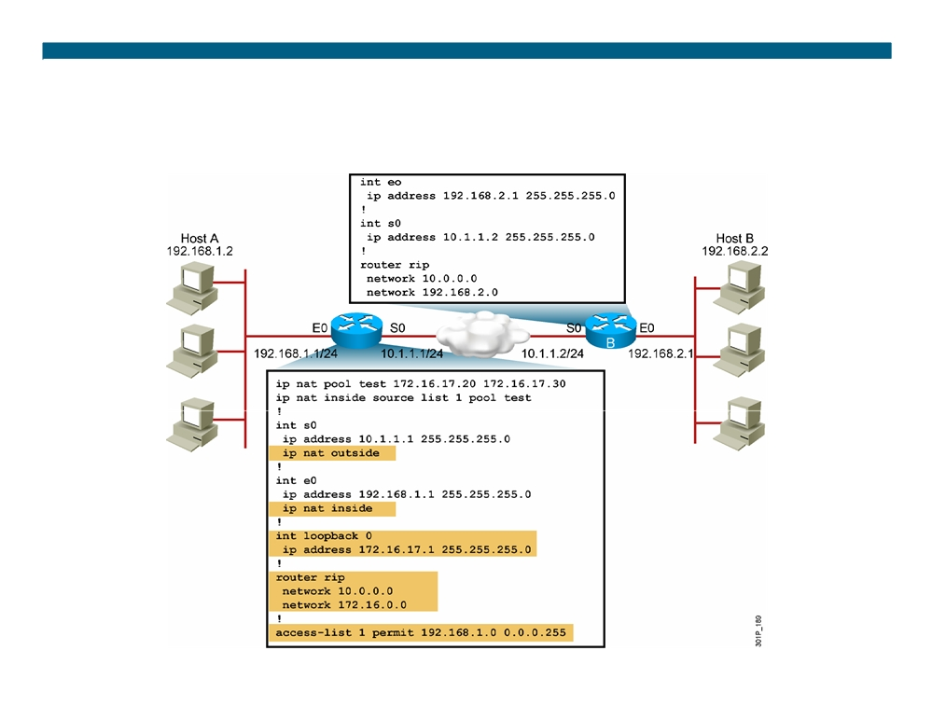
Solution: Corrected Configuration
© 2007 Cisco Systems, Inc. All rights reserved.
ICND2 v1.0—7-23
The PDF files and any printed representation for this material are the property of Cisco Systems, Inc., for the sole use by Cisco employees for personal study. The files or printed representations may not be used in commercial training, and may not be distributed for purposes other than individual self-study.

Slide 24
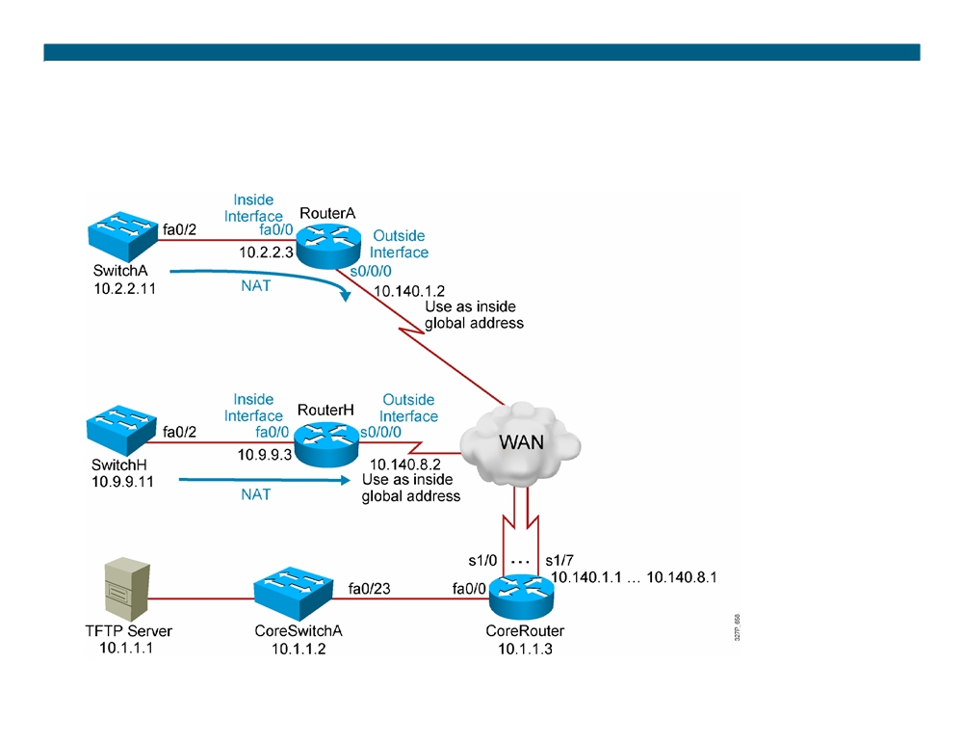
Visual Objective 7-1: Configuring NAT and PAT
WG Router s0/0/0
Router fa0/0
Switch
A
10.140.1.2
10.2.2.3
10.2.2.11
B
10.140.2.2
10.3.3.3
10.3.3.11
C
10.140.3.2
10.4.4.3
10.4.4.11
D
10.140.4.2
10.5.5.3
10.5.5.11
E
10.140.5.2
10.6.6.3
10.6.6.11
F
10.140.6.2
10.7.7.3
10.7.7.11
G
10.140.7.2
10.8.8.3
10.8.8.11
H
10.140.8.2
10.9.9.3
10.9.9.11
© 2007 Cisco Systems, Inc. All rights reserved.
ICND2 v1.0—7-24 The PDF files and any printed representation for this material are the property of Cisco Systems, Inc., for the sole use by Cisco employees for personal study. The files or printed representations may not be used in commercial training, and may not be distributed for purposes other than individual self-study.

Slide 25
Summary
ƒ There are three types of NAT: static, dynamic, and overloading (PAT).
ƒ Static NAT is one-to-one address mapping. Dynamic NAT addresses are picked from a pool.
ƒ NAT overloading (PAT) allows you to map many inside addresses to one outside address.
ƒ Use the show ip nat translation command to display the translation table and verify that translation has occurred. ƒ To determine if a current translation entry is being used, use the show ip nat statistics command to check the hits counter.
© 2007 Cisco Systems, Inc. All rights reserved.
ICND2 v1.0—7-25
The PDF files and any printed representation for this material are the property of Cisco Systems, Inc., for the sole use by Cisco employees for personal study. The files or printed representations may not be used in commercial training, and may not be distributed for purposes other than individual self-study.

Slide 26

© 2007 Cisco Systems, Inc. All rights reserved.
ICND2 v1.0—7-26 The PDF files and any printed representation for this material are the property of Cisco Systems, Inc., for the sole use by Cisco employees for personal study. The files or printed representations may not be used in commercial training, and may not be distributed for purposes other than individual self-study.

