Slide 1
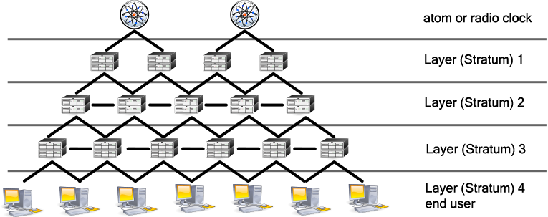
NETWORK TIME PROTOCOL -NTP
Routers, switches, other networking devices, and pretty much every device known in the IT world has a time-of day clock. For a variety of reasons, it makes sense to synchronize those clocks so that all devices have the same time of day, other than differences in time zone.
The Network Time Protocol (NTP) provides the means to do just that.
We need to synchronize syslog messages to to define certainly what is happening.
Or digital certificates expire depending on time. So we need to synchronize time for all devices.
There are some atomic clocks sources that gives exact time of the world.
Depending on the where from the time is recived every clock server has a STRATUM value.
Stratum value define how trustable the server.Stratum 16 means not trustable
Atomic sources has stratum 0 and one that get time from this atomic server has startum 1.
© 2007 Cisco Systems, Inc. All rights reserved.
ICND2 v1.0—5-14
The PDF files and any printed representation for this material are the property of Cisco Systems, Inc., for the sole use by Cisco employees for personal study. The files or printed representations may not be used in commercial training, and may not be distributed for purposes other than individual self-study.

Slide 2
NTP
Cisco device can be NTP Master(Time Server) or Client (Time Client)
To configure a Router as a master : Means can distribute time to clients.
Router# conf ter
Enter configuration commands, one per line. End with CNTL/Z.
Router(config)#ntp master 2 (2 is startum value)
Router(config)#
We can also configure time, time zone and summer-time.
R1(config)# clock timezone EST -5 ( 5 hours behinde the UTC)
R1(config)# clock summer-time EDT recurring (summer time defined)
R1#
R1# clock set 20:52:49 21 October 2015 (set clock).
© 2007 Cisco Systems, Inc. All rights reserved.
ICND2 v1.0—5-14
The PDF files and any printed representation for this material are the property of Cisco Systems, Inc., for the sole use by Cisco employees for personal study. The files or printed representations may not be used in commercial training, and may not be distributed for purposes other than individual self-study.

Slide 3
NTP
Cisco device can be NTP Client ( Receives time form s NTP Server)
To configure a Router as a NTP Client :
Router# conf ter
Router(config)#ntp server <ip of time server>(better to use loopback interface of server)
Router(config)#
To see NTP configs:
show clock
show ntp status
Show ntp associations
NTP works on UDP port 123.
NTP clients-server communication can use authentication.
© 2007 Cisco Systems, Inc. All rights reserved.
ICND2 v1.0—5-14
The PDF files and any printed representation for this material are the property of Cisco Systems, Inc., for the sole use by Cisco employees for personal study. The files or printed representations may not be used in commercial training, and may not be distributed for purposes other than individual self-study.

