Slide 1

Implementing OSPF
Single-Area OSPF Implementation
© 2007 Cisco Systems, Inc. All rights reserved.
ICND2 v1.0—4-1
The PDF files and any printed representation for this material are the property of Cisco Systems, Inc., for the sole use by Cisco employees for personal study. The files or printed representations may not be used in commercial training, and may not be distributed for purposes other than individual self-study.

Slide 2

OSPF Overview
ƒ Creates a neighbor relationship by exchanging hello packets ƒ Propagates LSAs rather than routing table updates - Link: Router interface
- State: Description of an interface and its relationship to neighboring routers
ƒ Floods LSAs to all OSPF routers in the area, not just directly connected routers
ƒ Pieces together all the LSAs generated by the OSPF routers to create the OSPF link-state database
ƒ Uses the SPF algorithm to calculate the shortest path to each destination and places it in the routing table
© 2007 Cisco Systems, Inc. All rights reserved.
ICND2 v1.0—4-2
The PDF files and any printed representation for this material are the property of Cisco Systems, Inc., for the sole use by Cisco employees for personal study. The files or printed representations may not be used in commercial training, and may not be distributed for purposes other than individual self-study.

Slide 3
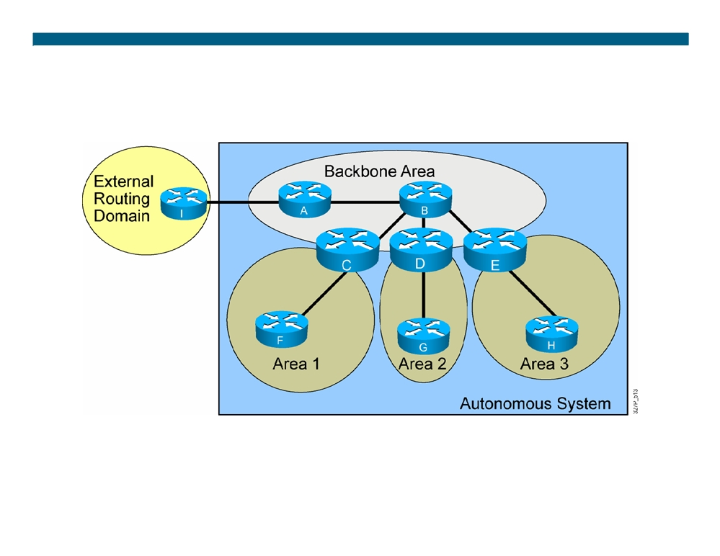
OSPF Hierarchy Example
ƒ Minimizes routing table entries
ƒ Localizes the impact of a topology change within an area
© 2007 Cisco Systems, Inc. All rights reserved.
ICND2 v1.0—4-3
The PDF files and any printed representation for this material are the property of Cisco Systems, Inc., for the sole use by Cisco employees for personal study. The files or printed representations may not be used in commercial training, and may not be distributed for purposes other than individual self-study.

Slide 4
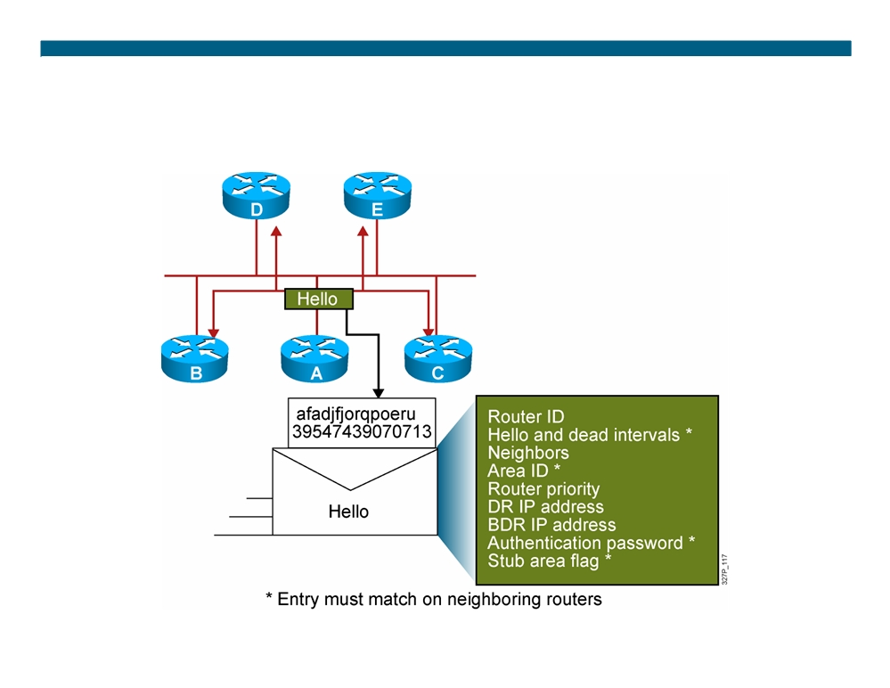
Neighbor Adjacencies: The Hello Packet
© 2007 Cisco Systems, Inc. All rights reserved.
ICND2 v1.0—4-4
The PDF files and any printed representation for this material are the property of Cisco Systems, Inc., for the sole use by Cisco employees for personal study. The files or printed representations may not be used in commercial training, and may not be distributed for purposes other than individual self-study.

Slide 5
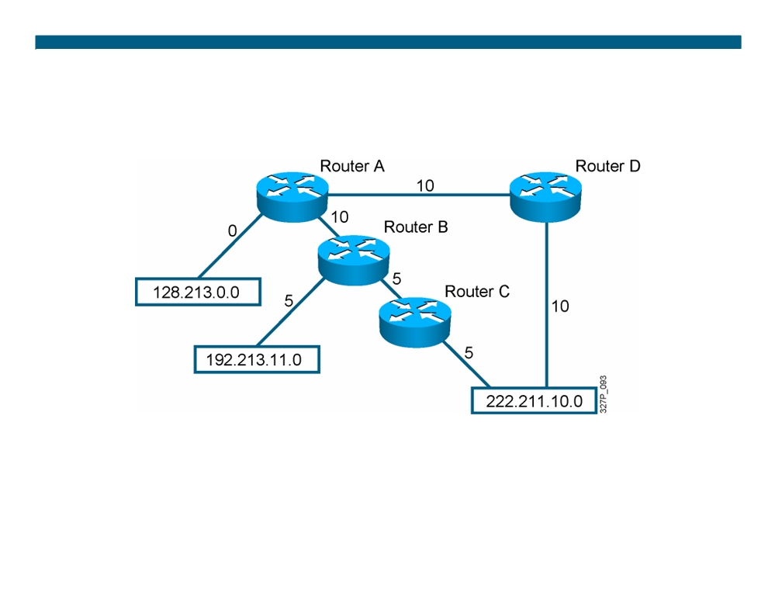
SPF Algorithm
10
10
1
1
1
ƒ Places each router at the root of a tree and calculates the shortest path to each destination based on the cumulative cost ƒ Cost = Reference Bandwidth / Interface Bandwidth (b/s)
© 2007 Cisco Systems, Inc. All rights reserved.
ICND2 v1.0—4-5
The PDF files and any printed representation for this material are the property of Cisco Systems, Inc., for the sole use by Cisco employees for personal study. The files or printed representations may not be used in commercial training, and may not be distributed for purposes other than individual self-study.

Slide 6
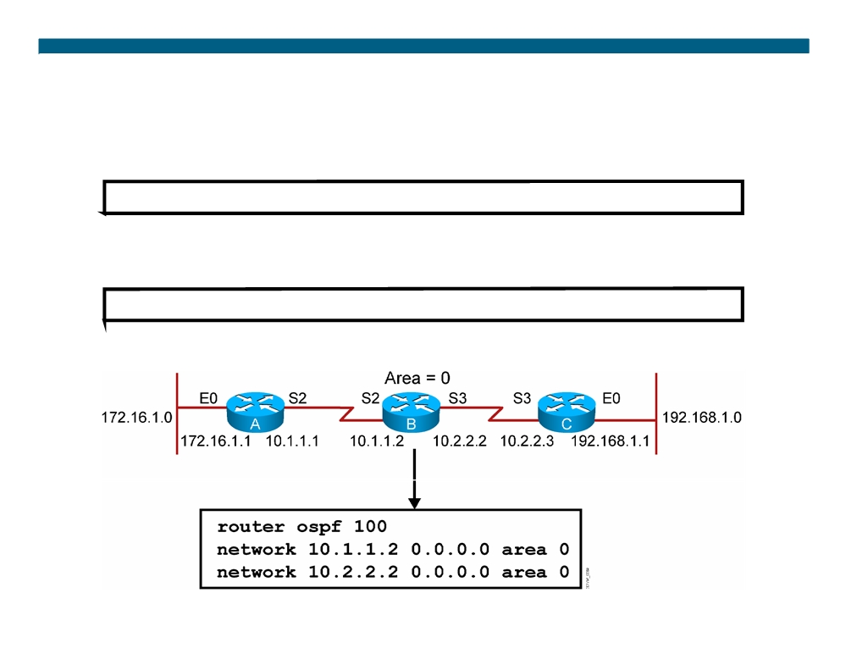
Configuring Single-Area OSPF
RouterX(config)#
router ospf process-id
ƒ Defines OSPF as the IP routing protocol
RouterX(config-router)#
network address wildcard-mask area area-id ƒ Assigns networks to a specific OSPF area
© 2007 Cisco Systems, Inc. All rights reserved.
ICND2 v1.0—4-6
The PDF files and any printed representation for this material are the property of Cisco Systems, Inc., for the sole use by Cisco employees for personal study. The files or printed representations may not be used in commercial training, and may not be distributed for purposes other than individual self-study.

Slide 7
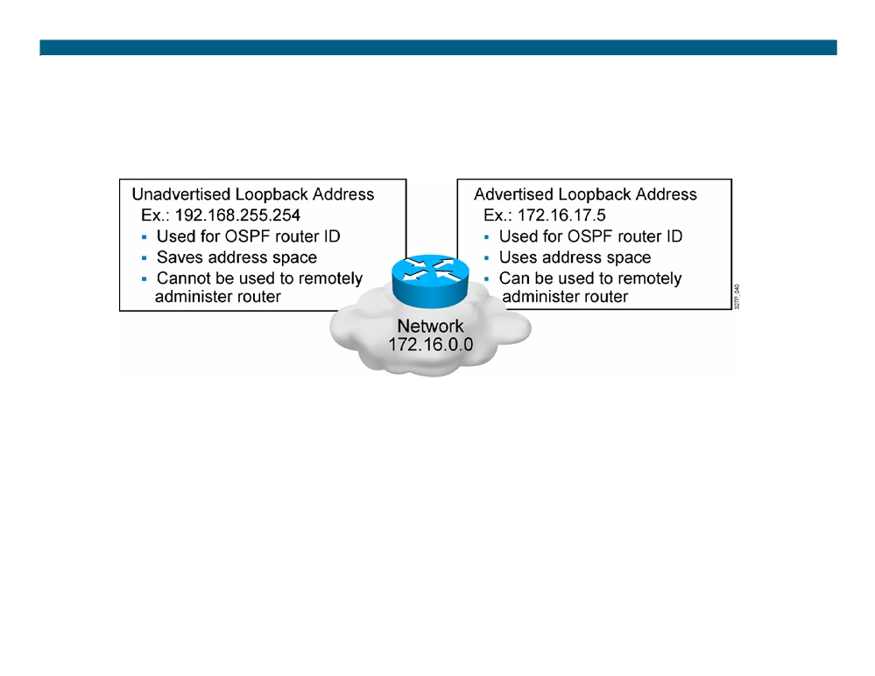
Configuring Loopback Interfaces
Router ID:
ƒ Number by which the router is known to OSPF
ƒ Default: The highest IP address on an active interface at the moment of OSPF process startup
ƒ Can be overridden by a loopback interface: Highest IP address of any active loopback interface
ƒ Can be set manually using the router-id command
© 2007 Cisco Systems, Inc. All rights reserved.
ICND2 v1.0—4-7
The PDF files and any printed representation for this material are the property of Cisco Systems, Inc., for the sole use by Cisco employees for personal study. The files or printed representations may not be used in commercial training, and may not be distributed for purposes other than individual self-study.

Slide 8
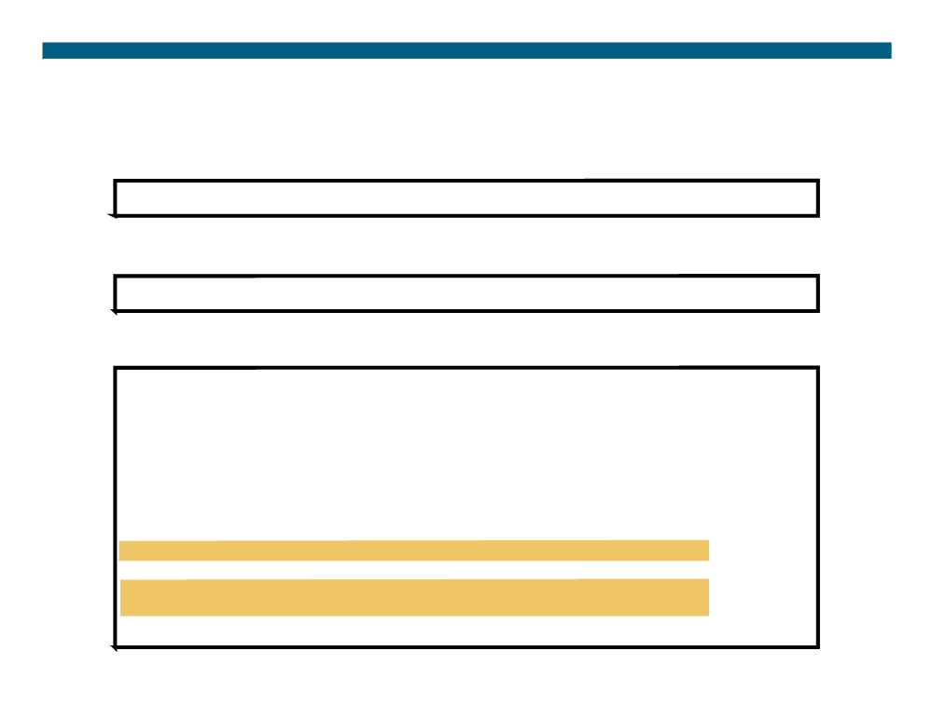
Verifying the OSPF Configuration
RouterX# show ip protocols
ƒ Verifies that OSPF is configured
RouterX# show ip route
ƒ Displays all the routes learned by the router
RouterX# show ip route
Codes: I - IGRP derived, R - RIP derived, O - OSPF derived, C - connected, S - static, E - EGP derived, B - BGP derived, E2 - OSPF external type 2 route, N1 - OSPF NSSA external type 1 route, N2 - OSPF NSSA external type 2 route
Gateway of last resort is 10.119.254.240 to network 10.140.0.0
O 10.110.0.0 [110/5] via 10.119.254.6, 0:01:00, Ethernet2 O IA 10.67.10.0 [110/10] via 10.119.254.244, 0:02:22, Ethernet2 O 10.68.132.0 [110/5] via 10.119.254.6, 0:00:59, Ethernet2 O 10.130.0.0 [110/5] via 10.119.254.6, 0:00:59, Ethernet2 O E2 10.128.0.0 [170/10] via 10.119.254.244, 0:02:22, Ethernet2
© 2007 Cisco Systems, Inc. All rights reserved.
ICND2 v1.0—4-8
The PDF files and any printed representation for this material are the property of Cisco Systems, Inc., for the sole use by Cisco employees for personal study. The files or printed representations may not be used in commercial training, and may not be distributed for purposes other than individual self-study.

Slide 9
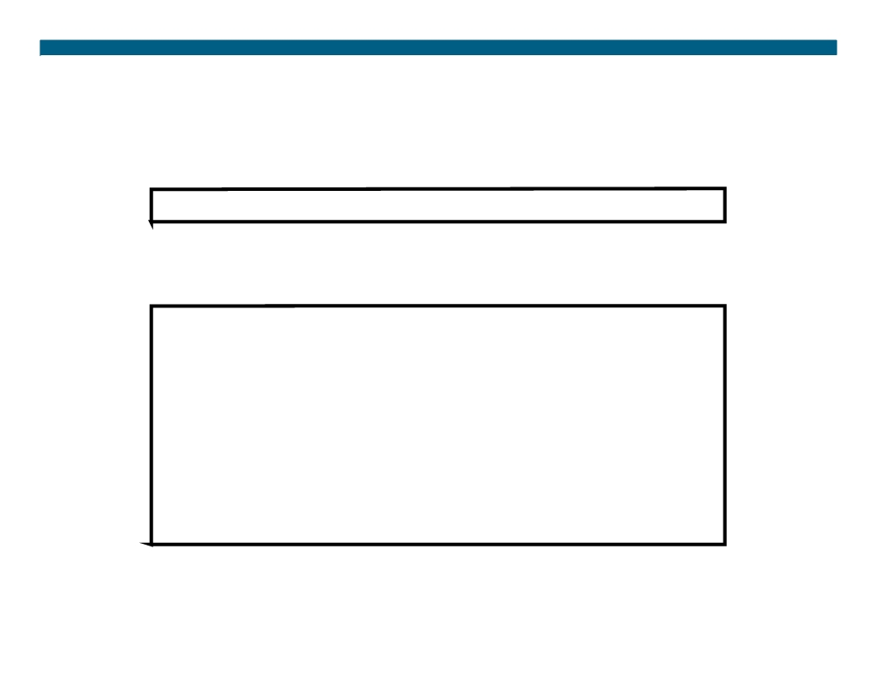
Verifying the OSPF Configuration (Cont.)
RouterX# show ip ospf
ƒ Displays the OSPF router ID, timers, and statistics
RouterX# show ip ospf
Routing Process "ospf 50" with ID 10.64.0.2 <output omitted>
Number of areas in this router is 1. 1 normal 0 stub 0 nssa Number of areas transit capable is 0
External flood list length 0 Area BACKBONE(0)
Area BACKBONE(0)
Area has no authentication
SPF algorithm last executed 00:01:25.028 ago SPF algorithm executed 7 times
<output omitted>
© 2007 Cisco Systems, Inc. All rights reserved.
ICND2 v1.0—4-9
The PDF files and any printed representation for this material are the property of Cisco Systems, Inc., for the sole use by Cisco employees for personal study. The files or printed representations may not be used in commercial training, and may not be distributed for purposes other than individual self-study.

Slide 10
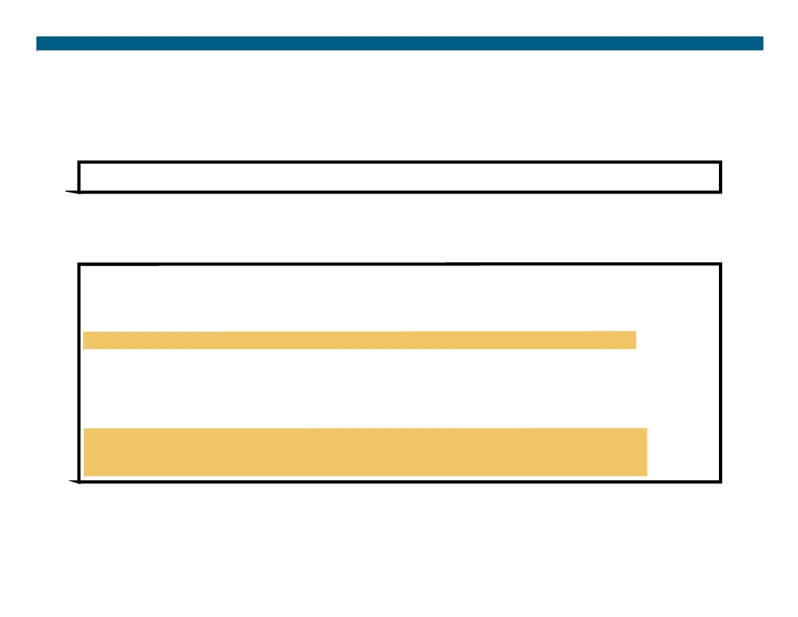
Verifying the OSPF Configuration (Cont.)
RouterX# show ip ospf interface
ƒ Displays the area ID and adjacency information
RouterX# show ip ospf interface ethernet 0
Ethernet 0 is up, line protocol is up
Internet Address 192.168.254.202, Mask 255.255.255.0, Area 0.0.0.0 AS 201, Router ID 192.168.99.1, Network Type BROADCAST, Cost: 10 Transmit Delay is 1 sec, State OTHER, Priority 1
Designated Router id 192.168.254.10, Interface address 192.168.254.10 Backup Designated router id 192.168.254.28, Interface addr 192.168.254.28 Timer intervals configured, Hello 10, Dead 60, Wait 40, Retransmit 5 Hello due in 0:00:05
Neighbor Count is 8, Adjacent neighbor count is 2 Adjacent with neighbor 192.168.254.28 (Backup Designated Router) Adjacent with neighbor 192.168.254.10 (Designated Router)
© 2007 Cisco Systems, Inc. All rights reserved.
ICND2 v1.0—4-10
The PDF files and any printed representation for this material are the property of Cisco Systems, Inc., for the sole use by Cisco employees for personal study. The files or printed representations may not be used in commercial training, and may not be distributed for purposes other than individual self-study.

Slide 11
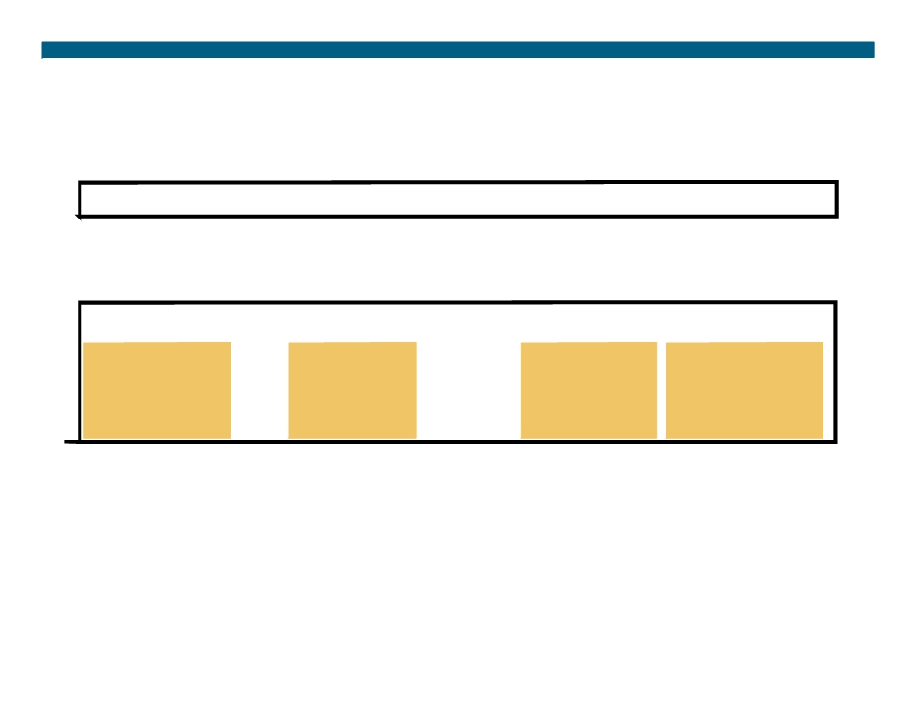
Verifying the OSPF Configuration (Cont.)
RouterX# show ip ospf neighbor
ƒ Displays the OSPF neighbor information on a per-interface basis
RouterX# show ip ospf neighbor
ID
Pri State
Dead Time Address
Interface
10.199.199.137
1
FULL/DR
0:00:31
192.168.80.37 FastEthernet0/0
172.16.48.1
1
FULL/DROTHER
0:00:33
172.16.48.1
FastEthernet0/1
172.16.48.200
1
FULL/DROTHER
0:00:33
172.16.48.200 FastEthernet0/1
10.199.199.137
5
FULL/DR
0:00:33
172.16.48.189 FastEthernet0/1
© 2007 Cisco Systems, Inc. All rights reserved.
ICND2 v1.0—4-11
The PDF files and any printed representation for this material are the property of Cisco Systems, Inc., for the sole use by Cisco employees for personal study. The files or printed representations may not be used in commercial training, and may not be distributed for purposes other than individual self-study.

Slide 12
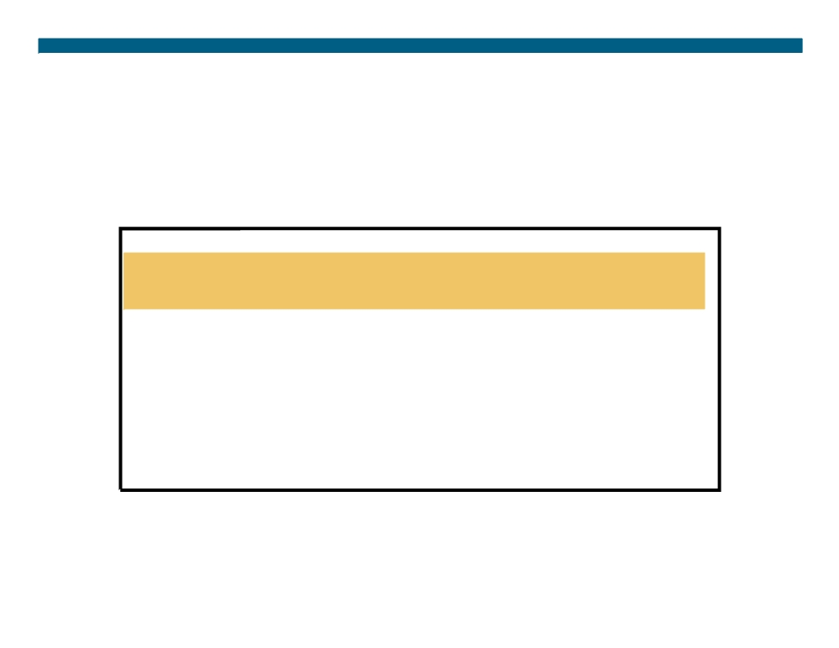
Verifying the OSPF Configuration (Cont.)
RouterX# show ip ospf neighbor 10.199.199.137
Neighbor 10.199.199.137, interface address 192.168.80.37 In the area 0.0.0.0 via interface Ethernet0 Neighbor priority is 1, State is FULL Options 2
Dead timer due in 0:00:32
Link State retransmission due in 0:00:04
Neighbor 10.199.199.137, interface address 172.16.48.189 In the area 0.0.0.0 via interface Fddi0
Neighbor priority is 5, State is FULL Options 2
Dead timer due in 0:00:32
Link State retransmission due in 0:00:03
© 2007 Cisco Systems, Inc. All rights reserved.
ICND2 v1.0—4-12
The PDF files and any printed representation for this material are the property of Cisco Systems, Inc., for the sole use by Cisco employees for personal study. The files or printed representations may not be used in commercial training, and may not be distributed for purposes other than individual self-study.

Slide 13
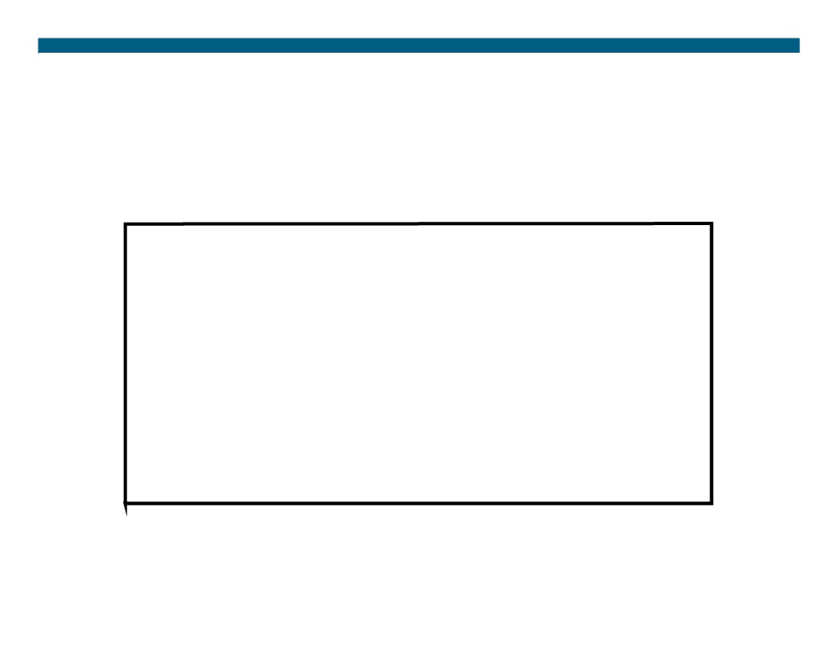
OSPF debug Commands
RouterX# debug ip ospf events
OSPF:hello with invalid timers on interface Ethernet0 hello interval received 10 configured 10
net mask received 255.255.255.0 configured 255.255.255.0 dead interval received 40 configured 30
OSPF: rcv. v:2 t:1 l:48 rid:200.0.0.117 aid:0.0.0.0 chk:6AB2 aut:0 auk:
RouterX# debug ip ospf packet
OSPF: rcv. v:2 t:1 l:48 rid:200.0.0.116 aid:0.0.0.0 chk:0 aut:2 keyid:1 seq:0x0
© 2007 Cisco Systems, Inc. All rights reserved.
ICND2 v1.0—4-13
The PDF files and any printed representation for this material are the property of Cisco Systems, Inc., for the sole use by Cisco employees for personal study. The files or printed representations may not be used in commercial training, and may not be distributed for purposes other than individual self-study.

Slide 14
Load Balancing with OSPF
OSPF load balancing:
ƒ Paths must be equal cost
ƒ By default, up to four equal-cost paths can be placed into the routing table
ƒ With a configuration change, up to a maximum of 16 paths can be configured:
-(config-router)# maximum-paths <value> ƒ To ensure paths are equal cost for load balancing, you can change the cost of a particular link:
-(config-if)# ip ospf cost <value>
© 2007 Cisco Systems, Inc. All rights reserved.
ICND2 v1.0—4-14
The PDF files and any printed representation for this material are the property of Cisco Systems, Inc., for the sole use by Cisco employees for personal study. The files or printed representations may not be used in commercial training, and may not be distributed for purposes other than individual self-study.

Slide 15
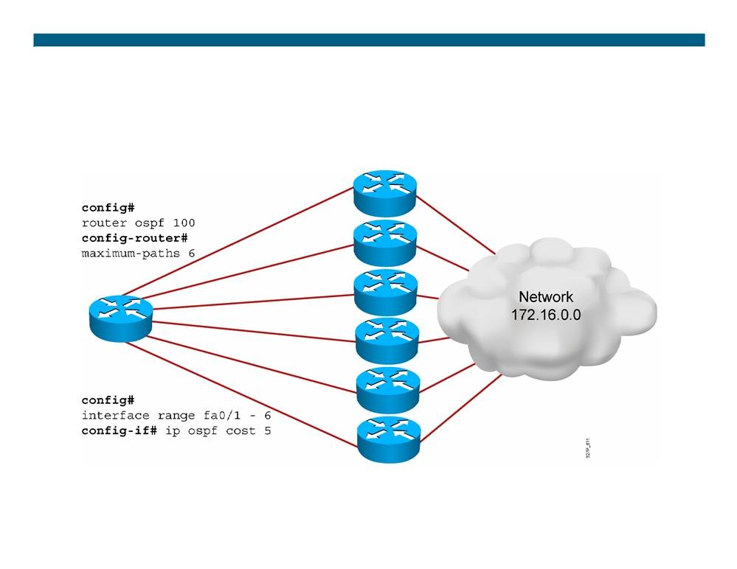
Load Balancing with OSPF
© 2007 Cisco Systems, Inc. All rights reserved.
ICND2 v1.0—4-15
The PDF files and any printed representation for this material are the property of Cisco Systems, Inc., for the sole use by Cisco employees for personal study. The files or printed representations may not be used in commercial training, and may not be distributed for purposes other than individual self-study.

Slide 16
OSPF Authentication
ƒ OSPF supports two types of authentication: - Plaintext (or simple) password authentication - MD5 authentication
ƒ The router generates and checks every OSPF packet. ƒ The router authenticates the source of each routing update packet that it receives.
 Configure a “key” (password); each participating neighbor must have the same key configured.
© 2007 Cisco Systems, Inc. All rights reserved.
ICND2 v1.0—4-16
The PDF files and any printed representation for this material are the property of Cisco Systems, Inc., for the sole use by Cisco employees for personal study. The files or printed representations may not be used in commercial training, and may not be distributed for purposes other than individual self-study.

Slide 17
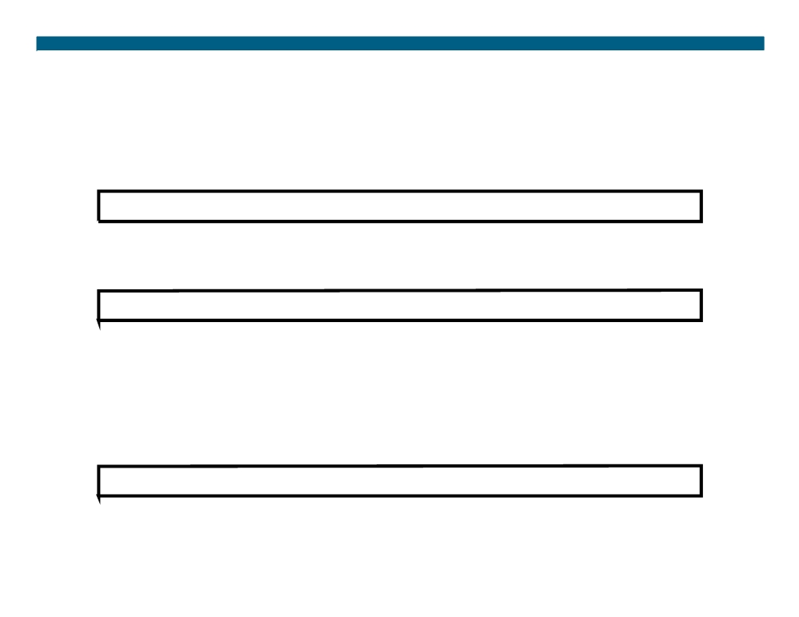
Configuring OSPF Plaintext Password Authentication
RouterX(config-if)#
ip ospf authentication-key password ƒ Assigns a password to use with neighboring routers
RouterX(config-if)#
ip ospf authentication [message-digest | null]
ƒ Specifies the authentication type for an interface (as of Cisco IOS Release 12.0)
OR
RouterX(config-router)#
area area-id authentication [message-digest] ƒ Specifies the authentication type for an area
© 2007 Cisco Systems, Inc. All rights reserved.
ICND2 v1.0—4-17
The PDF files and any printed representation for this material are the property of Cisco Systems, Inc., for the sole use by Cisco employees for personal study. The files or printed representations may not be used in commercial training, and may not be distributed for purposes other than individual self-study.

Slide 18
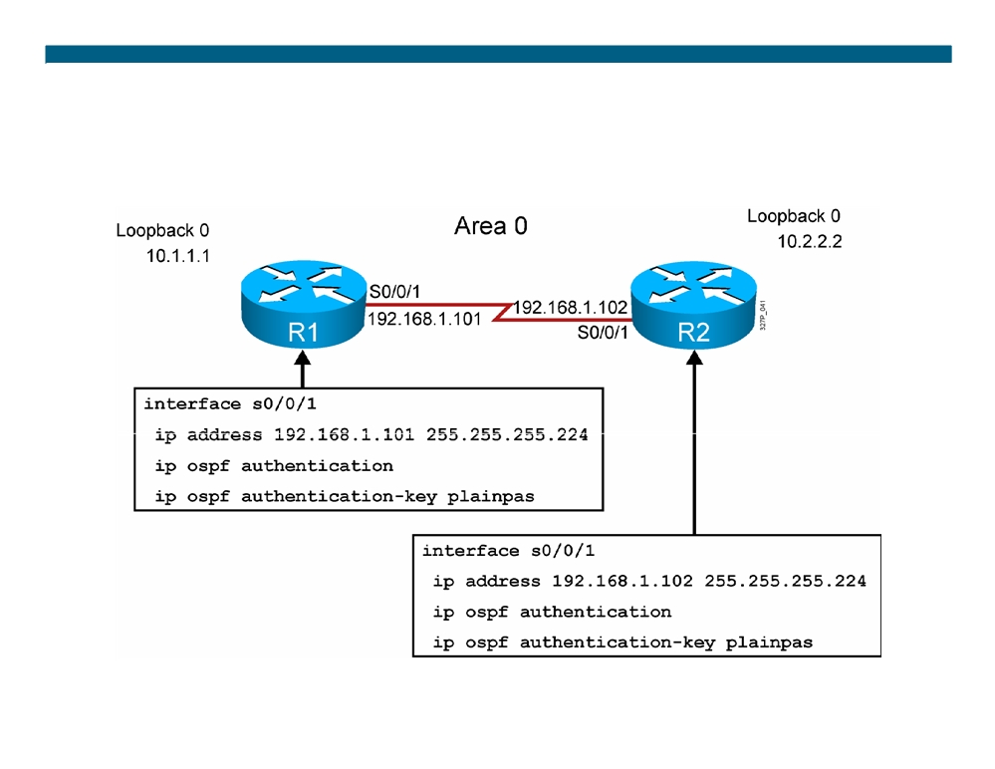
Plaintext Password Authentication Configuration Example
© 2007 Cisco Systems, Inc. All rights reserved.
ICND2 v1.0—4-18
The PDF files and any printed representation for this material are the property of Cisco Systems, Inc., for the sole use by Cisco employees for personal study. The files or printed representations may not be used in commercial training, and may not be distributed for purposes other than individual self-study.

Slide 19
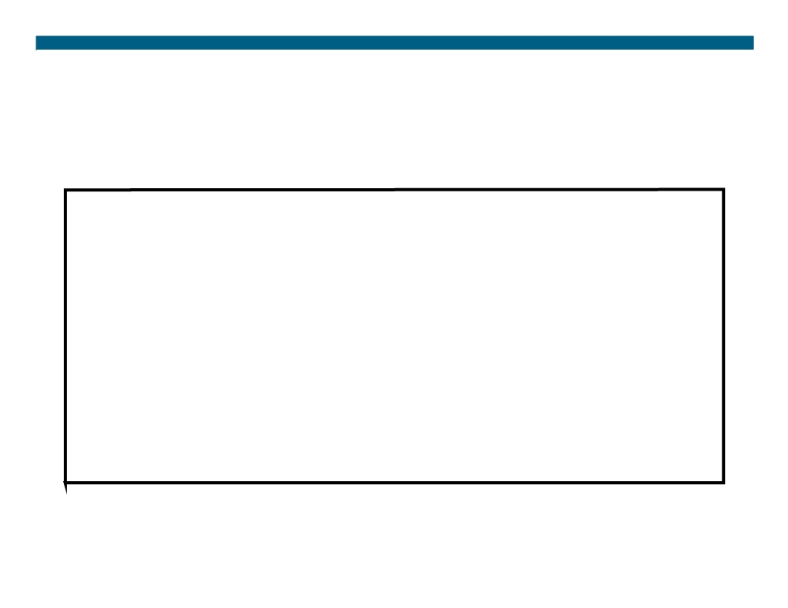
Verifying Plaintext Password Authentication
RouterX#show ip ospf neighbor
Neighbor ID
Pri State
Dead Time Address
Interface
10.2.2.2
0
FULL/
-
00:00:32
192.168.1.102
Serial0/0/1
RouterX#show ip route <output omitted>
Gateway of last resort is not set
10.0.0.0/8 is variably subnetted, 2 subnets, 2 masks
O
10.2.2.2/32 [110/782] via 192.168.1.102, 00:01:17, Serial0/0/1
C
10.1.1.0/24 is directly connected, Loopback0
192.168.1.0/27 is subnetted, 1 subnets
C
192.168.1.96 is directly connected, Serial0/0/1
RouterX#ping 10.2.2.2
Type escape sequence to abort.
Sending 5, 100-byte ICMP Echos to 10.2.2.2, timeout is 2 seconds: !!!!!
Success rate is 100 percent (5/5), round-trip min/avg/max = 28/29/32 ms
© 2007 Cisco Systems, Inc. All rights reserved.
ICND2 v1.0—4-19
The PDF files and any printed representation for this material are the property of Cisco Systems, Inc., for the sole use by Cisco employees for personal study. The files or printed representations may not be used in commercial training, and may not be distributed for purposes other than individual self-study.

Slide 20
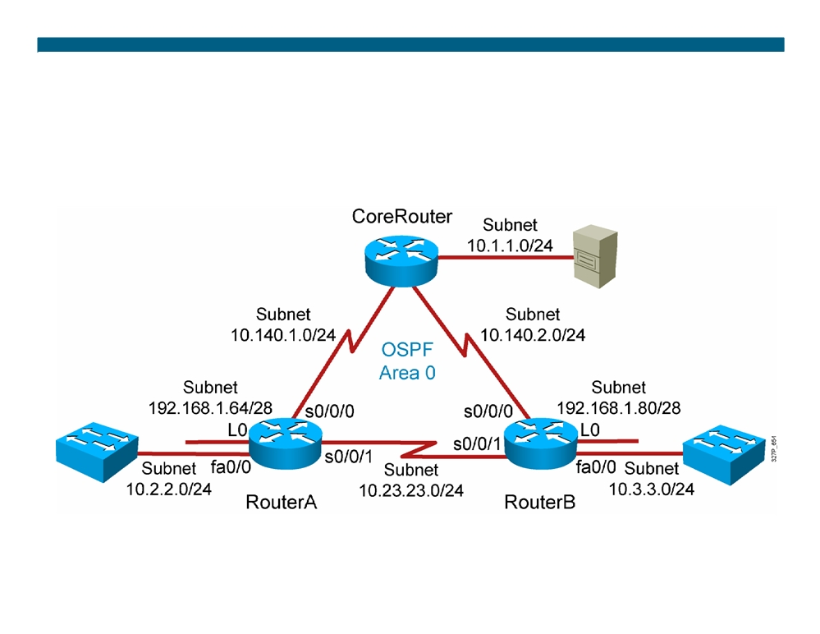
Visual Objective 4-1: Implementing OSPF
© 2007 Cisco Systems, Inc. All rights reserved.
ICND2 v1.0—4-20
The PDF files and any printed representation for this material are the property of Cisco Systems, Inc., for the sole use by Cisco employees for personal study. The files or printed representations may not be used in commercial training, and may not be distributed for purposes other than individual self-study.

Slide 21
Summary
ƒ OSPF is a classless, link-state routing protocol that uses an area hierarchy for fast convergence.
ƒ OSPF exchanges hello packets to establish neighbor adjacencies between routers.
ƒ The SPF algorithm uses a cost metric to determine the best path. Lower costs indicate a better path.
ƒ The router ospf process-id command is used to enable OSPF on the router.
ƒ Use a loopback interface to keep the OSPF router ID consistent. ƒ The show ip ospf neighbor command displays OSPF neighbor information on a per-interface basis.
ƒ The commands debug ip ospf events and debug ip ospf packets can be used to troubleshoot OSPF problems.
ƒ OSPF will load-balance across up to four equal-cost metric paths by default. ƒ There are two types of OSPF authentication: Plaintext and MD5.
© 2007 Cisco Systems, Inc. All rights reserved.
ICND2 v1.0—4-21
The PDF files and any printed representation for this material are the property of Cisco Systems, Inc., for the sole use by Cisco employees for personal study. The files or printed representations may not be used in commercial training, and may not be distributed for purposes other than individual self-study.

Slide 22
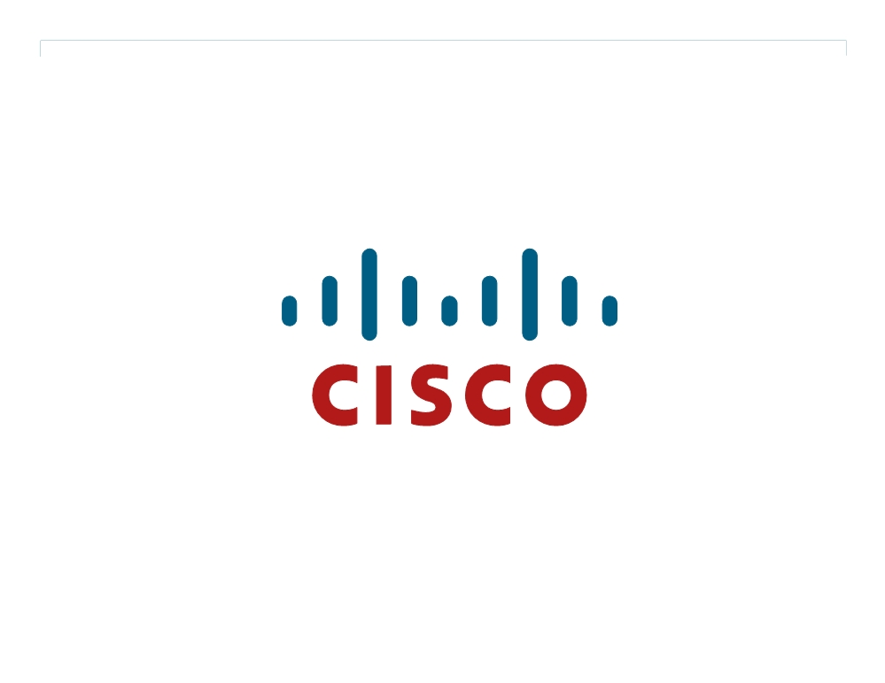
© 2007 Cisco Systems, Inc. All rights reserved.
ICND2 v1.0—4-22 The PDF files and any printed representation for this material are the property of Cisco Systems, Inc., for the sole use by Cisco employees for personal study. The files or printed representations may not be used in commercial training, and may not be distributed for purposes other than individual self-study.

Slide 23
Troubleshooting OSPF
Single-Area OSPF Implementation
© 2007 Cisco Systems, Inc. All rights reserved.
ICND2 v1.0—4-1
The PDF files and any printed representation for this material are the property of Cisco Systems, Inc., for the sole use by Cisco employees for personal study. The files or printed representations may not be used in commercial training, and may not be distributed for purposes other than individual self-study.

Slide 24
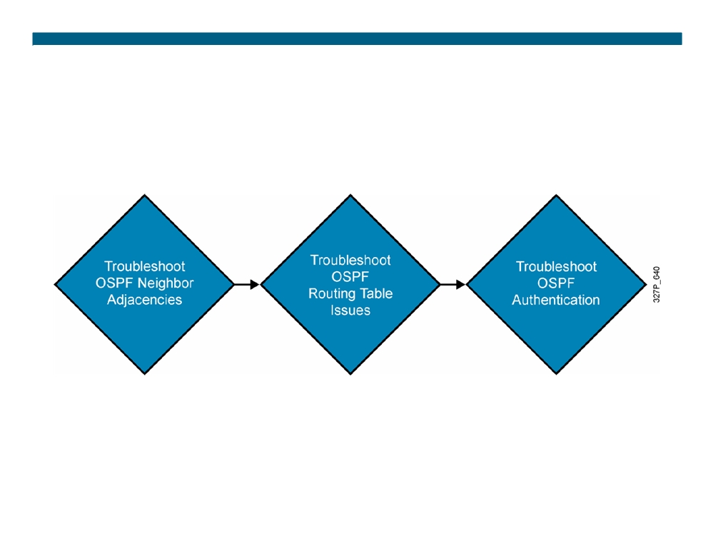
Components of Troubleshooting OSPF
© 2007 Cisco Systems, Inc. All rights reserved.
ICND2 v1.0—4-2
The PDF files and any printed representation for this material are the property of Cisco Systems, Inc., for the sole use by Cisco employees for personal study. The files or printed representations may not be used in commercial training, and may not be distributed for purposes other than individual self-study.

Slide 25
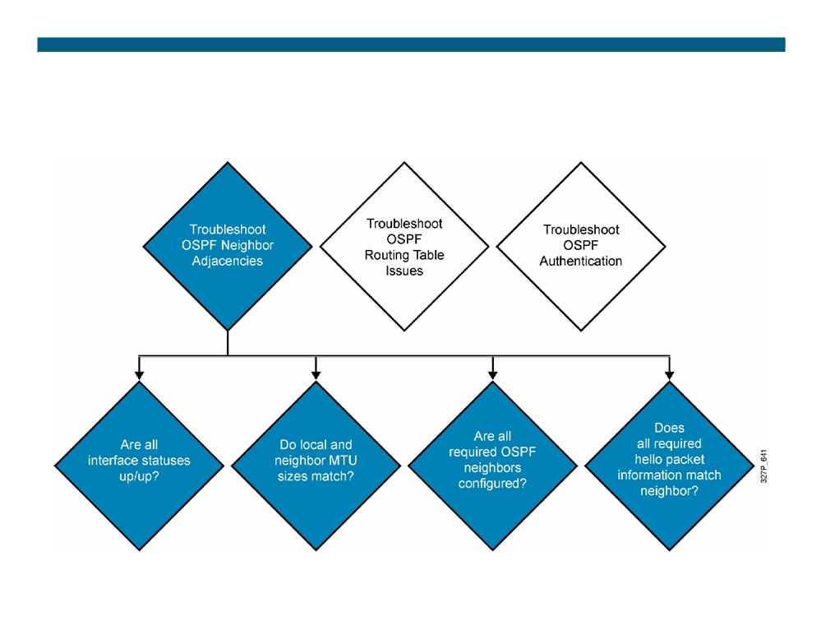
Troubleshooting OSPF Neighbor Adjacencies
© 2007 Cisco Systems, Inc. All rights reserved.
ICND2 v1.0—4-3
The PDF files and any printed representation for this material are the property of Cisco Systems, Inc., for the sole use by Cisco employees for personal study. The files or printed representations may not be used in commercial training, and may not be distributed for purposes other than individual self-study.

Slide 26
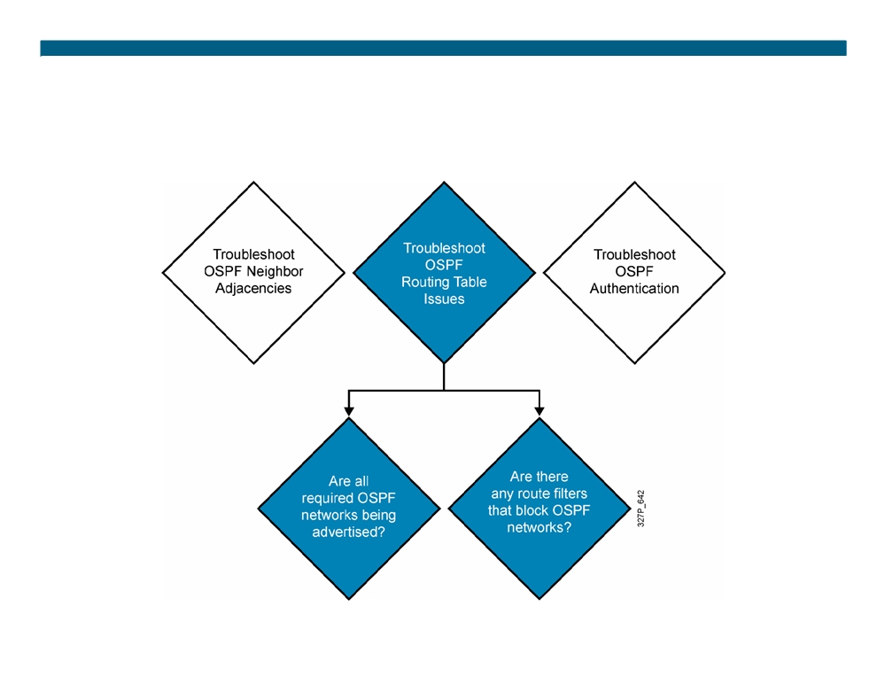
Troubleshooting OSPF Routing Tables
© 2007 Cisco Systems, Inc. All rights reserved.
ICND2 v1.0—4-4
The PDF files and any printed representation for this material are the property of Cisco Systems, Inc., for the sole use by Cisco employees for personal study. The files or printed representations may not be used in commercial training, and may not be distributed for purposes other than individual self-study.

Slide 27
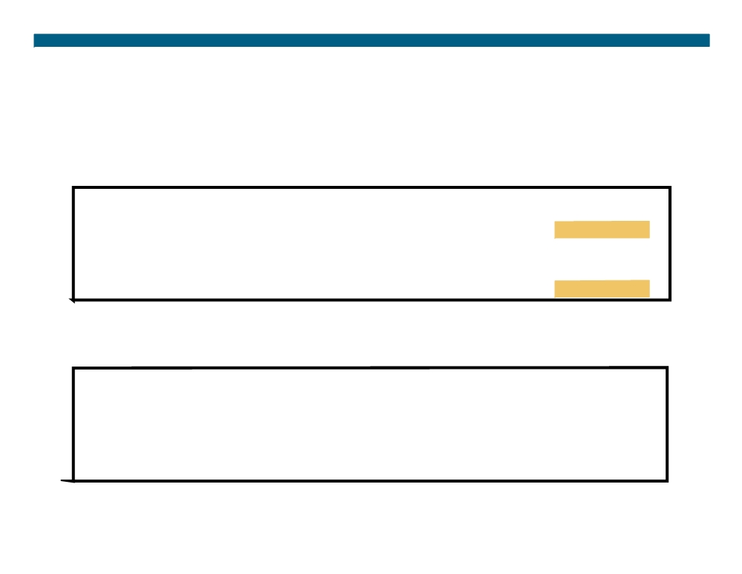
Troubleshooting Plaintext Password Authentication Problems
ƒ Plaintext authentication on routerX, no authentication on routerY
RouterX#debug ip ospf adj
*Feb 17 18:51:31.242: OSPF: Rcv pkt from 192.168.1.102, Serial0/0/1 : Mismatch Authentication type. Input packet specified type 0, we use type 1
RouterY#debug ip ospf adj
*Feb 17 18:50:43.046: OSPF: Rcv pkt from 192.168.1.101, Serial0/0/1 : Mismatch Authentication type. Input packet specified type 1, we use type 0
ƒ Authentication on routerX and routerY, but different passwords
RouterX#debug ip osp adj
*Feb 17 18:54:01.238: OSPF: Rcv pkt from 192.168.1.102, Serial0/0/1 : Mismatch Authentication Key - Clear Text
RouterY#debug ip ospf adj
*Feb 17 18:53:13.050: OSPF: Rcv pkt from 192.168.1.101, Serial0/0/1 : Mismatch Authentication Key - Clear Text
© 2007 Cisco Systems, Inc. All rights reserved.
ICND2 v1.0—4-5
The PDF files and any printed representation for this material are the property of Cisco Systems, Inc., for the sole use by Cisco employees for personal study. The files or printed representations may not be used in commercial training, and may not be distributed for purposes other than individual self-study.

Slide 28
Visual Objective 4-2: Troubleshooting OSPF
© 2007 Cisco Systems, Inc. All rights reserved.
ICND2 v1.0—4-6
The PDF files and any printed representation for this material are the property of Cisco Systems, Inc., for the sole use by Cisco employees for personal study. The files or printed representations may not be used in commercial training, and may not be distributed for purposes other than individual self-study.

Slide 29
Summary
ƒ Troubleshooting OSPF involves looking at neighbor adjacencies, routing tables, and authentication issues.
ƒ Use the show ip interface command to verify the MTU of an OSPF interface.
ƒ Use the show ip ospf interface command to help troubleshoot whether OSPF is enabled on an interface.
ƒ Use the debug ip ospf adj command to troubleshoot OSPF authentication.
© 2007 Cisco Systems, Inc. All rights reserved.
ICND2 v1.0—4-7
The PDF files and any printed representation for this material are the property of Cisco Systems, Inc., for the sole use by Cisco employees for personal study. The files or printed representations may not be used in commercial training, and may not be distributed for purposes other than individual self-study.

Slide 30
© 2007 Cisco Systems, Inc. All rights reserved.
ICND2 v1.0—4-8 The PDF files and any printed representation for this material are the property of Cisco Systems, Inc., for the sole use by Cisco employees for personal study. The files or printed representations may not be used in commercial training, and may not be distributed for purposes other than individual self-study.

Slide 31
Module Summary
ƒ The routing algorithm of OSPF maintains a complex database of topology information, which routers use to maintain full knowledge of distant routers.
ƒ OSPF is a classless, link-state routing protocol that is widely deployed in many networks.
ƒ OSPF load-balances across four equal metric paths by default on Cisco routers.
ƒ OSPF supports plaintext and MD5 authentication. ƒ There are several components to troubleshooting OSPF, including OSPF neighbor adjacencies and routing tables.
© 2007 Cisco Systems, Inc. All rights reserved.
ICND2 v1.0—4-1
The PDF files and any printed representation for this material are the property of Cisco Systems, Inc., for the sole use by Cisco employees for personal study. The files or printed representations may not be used in commercial training, and may not be distributed for purposes other than individual self-study.

Slide 32
© 2007 Cisco Systems, Inc. All rights reserved.
ICND2 v1.0—4-2 The PDF files and any printed representation for this material are the property of Cisco Systems, Inc., for the sole use by Cisco employees for personal study. The files or printed representations may not be used in commercial training, and may not be distributed for purposes other than individual self-study.

