Slide 1

Enabling RIP
WAN Connections
© 2007 Cisco Systems, Inc. All rights reserved.
ICND1 v1.0—-5-1
The PDF files and any printed representation for this material are the property of Cisco Systems, Inc., for the sole use by Cisco employees for personal study. The files or printed representations may not be used in commercial training, and may not be distributed for purposes other than individual self-study.

Slide 2
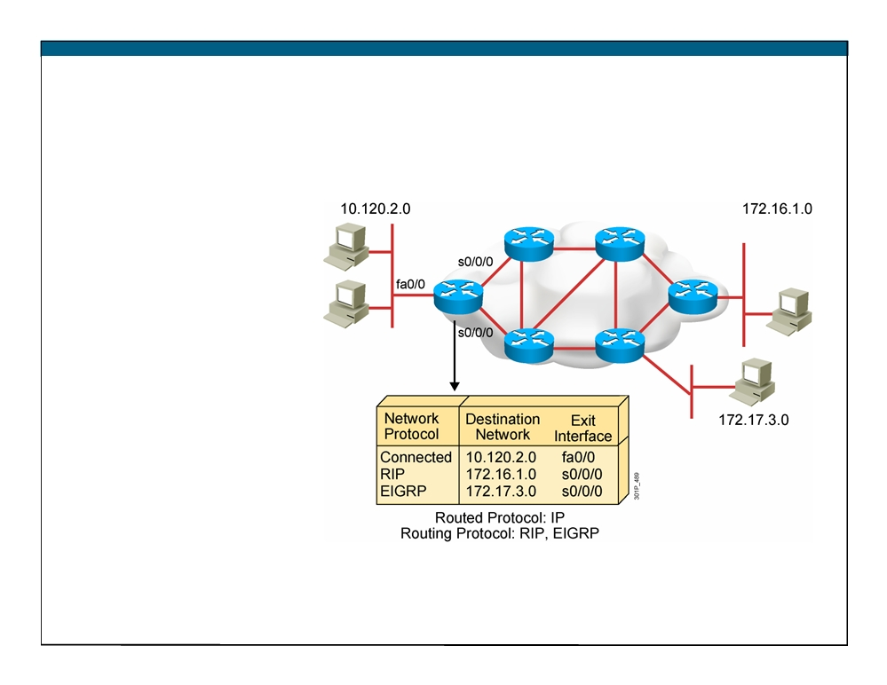
What Is a Routing Protocol?
ƒ Routing protocols
are used between routers to determine paths and maintain routing tables.
ƒ After the path is determined, a router can route a routed protocol.
© 2007 Cisco Systems, Inc. All rights reserved.
ICND1 v1.0—5-2
The PDF files and any printed representation for this material are the property of Cisco Systems, Inc., for the sole use by Cisco employees for personal study. The files or printed representations may not be used in commercial training, and may not be distributed for purposes other than individual self-study.

Slide 3
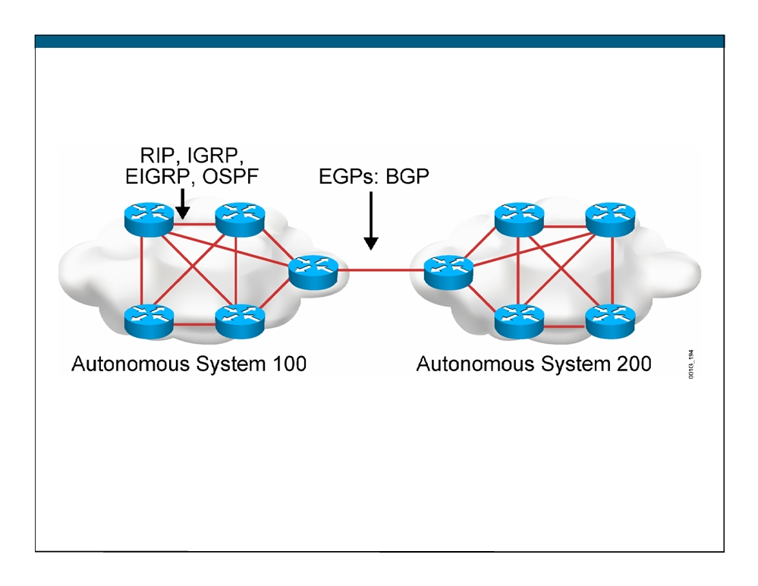
Autonomous Systems: Interior or Exterior Routing Protocols
ƒ An autonomous system is a collection of networks under a common administrative domain.
ƒ IGPs operate within an autonomous system. ƒ EGPs connect different autonomous systems.
© 2007 Cisco Systems, Inc. All rights reserved.
ICND1 v1.0—5-3
The PDF files and any printed representation for this material are the property of Cisco Systems, Inc., for the sole use by Cisco employees for personal study. The files or printed representations may not be used in commercial training, and may not be distributed for purposes other than individual self-study.

Slide 4
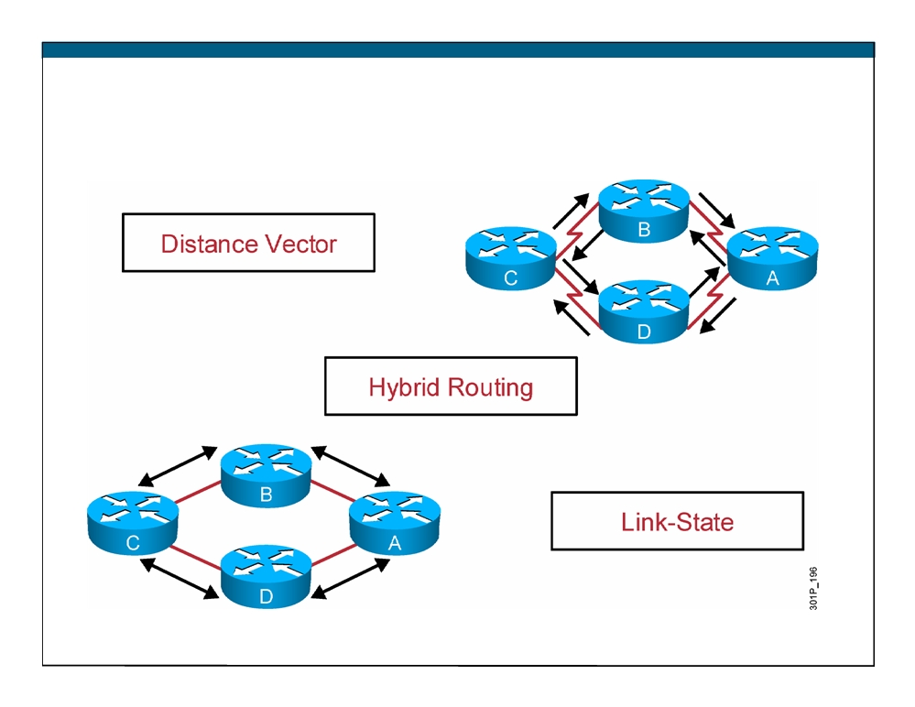
Classes of Routing Protocols
© 2007 Cisco Systems, Inc. All rights reserved.
ICND1 v1.0—5-4
The PDF files and any printed representation for this material are the property of Cisco Systems, Inc., for the sole use by Cisco employees for personal study. The files or printed representations may not be used in commercial training, and may not be distributed for purposes other than individual self-study.

Slide 5
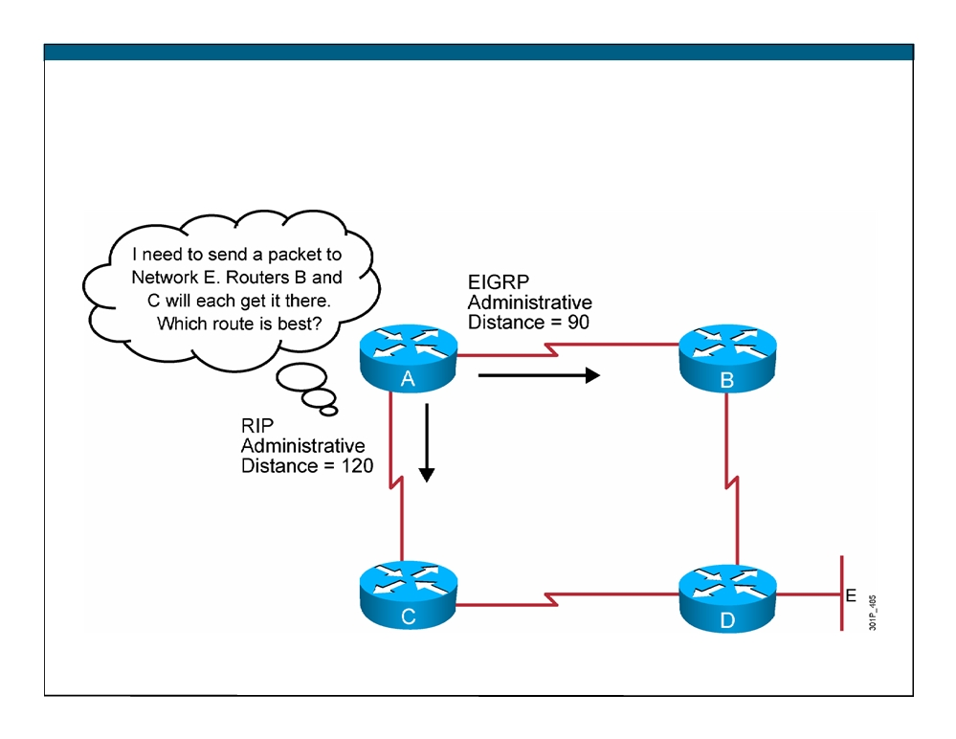
Administrative Distance: Ranking Routes
© 2007 Cisco Systems, Inc. All rights reserved.
ICND1 v1.0—5-5
The PDF files and any printed representation for this material are the property of Cisco Systems, Inc., for the sole use by Cisco employees for personal study. The files or printed representations may not be used in commercial training, and may not be distributed for purposes other than individual self-study.

Slide 6

Classful Routing Protocol
ƒ Classful routing protocols do not include the subnet mask with the route advertisement.
ƒ Within the same network, consistency of the subnet masks is assumed.
ƒ Summary routes are exchanged between foreign networks. ƒ These are examples of classful routing protocols: - RIPv1
IGRP
RIPv1
© 2007 Cisco Systems, Inc. All rights reserved.
ICND1 v1.0—5-6
The PDF files and any printed representation for this material are the property of Cisco Systems, Inc., for the sole use by Cisco employees for personal study. The files or printed representations may not be used in commercial training, and may not be distributed for purposes other than individual self-study.

Slide 7
Classless Routing Protocol
ƒ Classless routing protocols include the subnet mask with the route advertisement.
ƒ Classless routing protocols support a variable-length subnet mask (VLSM).
ƒ Summary routes can be manually controlled within the network.
ƒ These are examples of classless routing protocols: - RIPv2
- EIGRP
OSPF
- IS-IS
© 2007 Cisco Systems, Inc. All rights reserved.
ICND1 v1.0—5-7
The PDF files and any printed representation for this material are the property of Cisco Systems, Inc., for the sole use by Cisco employees for personal study. The files or printed representations may not be used in commercial training, and may not be distributed for purposes other than individual self-study.

Slide 8
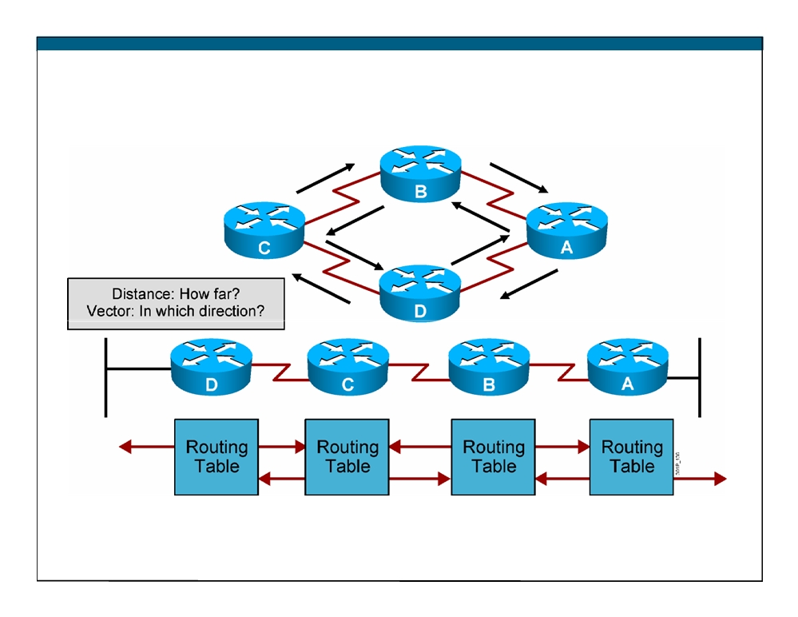
Distance Vector Routing Protocols
ƒ Routers pass periodic copies of their routing table to neighboring routers and accumulate distance vectors
© 2007 Cisco Systems, Inc. All rights reserved.
ICND1 v1.0—5-8
The PDF files and any printed representation for this material are the property of Cisco Systems, Inc., for the sole use by Cisco employees for personal study. The files or printed representations may not be used in commercial training, and may not be distributed for purposes other than individual self-study.

Slide 9
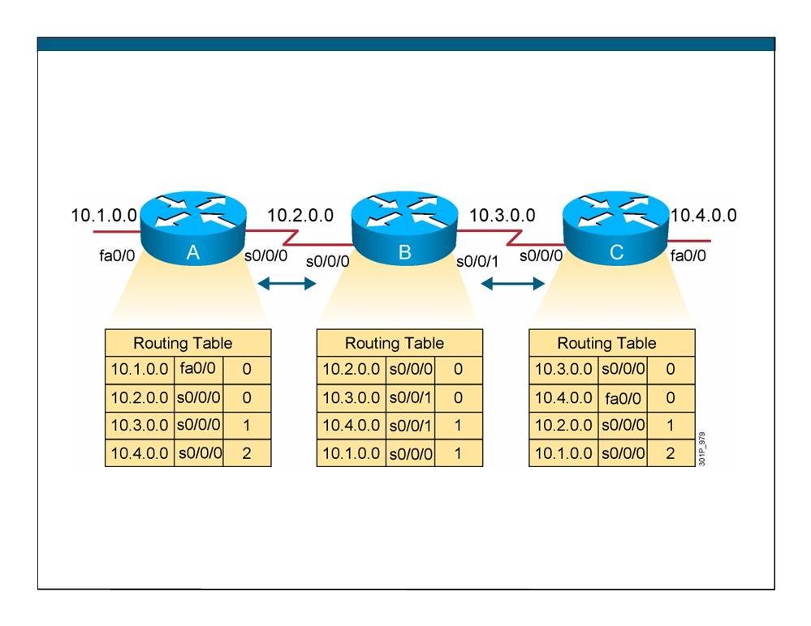
Sources of Information and Discovering Routes
ƒ Routers discover the best path to destinations from each neighbor.
© 2007 Cisco Systems, Inc. All rights reserved.
ICND1 v1.0—5-9
The PDF files and any printed representation for this material are the property of Cisco Systems, Inc., for the sole use by Cisco employees for personal study. The files or printed representations may not be used in commercial training, and may not be distributed for purposes other than individual self-study.

Slide 10
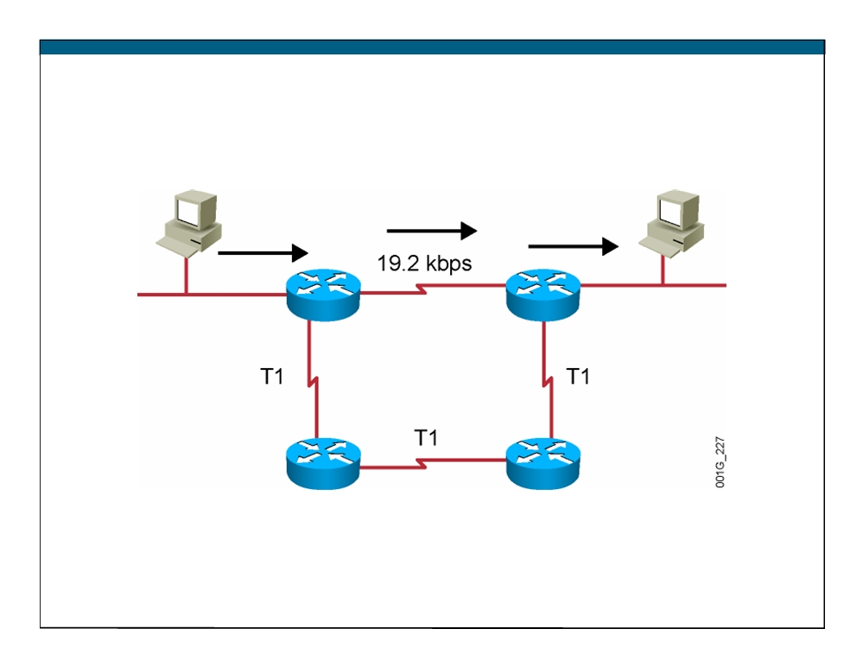
RIP Overview
ƒ Maximum is 16 equal-cost paths (default = 4) ƒ Hop-count metric selects the path ƒ Routes update every 30 seconds
© 2007 Cisco Systems, Inc. All rights reserved.
ICND1 v1.0—5-10
The PDF files and any printed representation for this material are the property of Cisco Systems, Inc., for the sole use by Cisco employees for personal study. The files or printed representations may not be used in commercial training, and may not be distributed for purposes other than individual self-study.

Slide 11
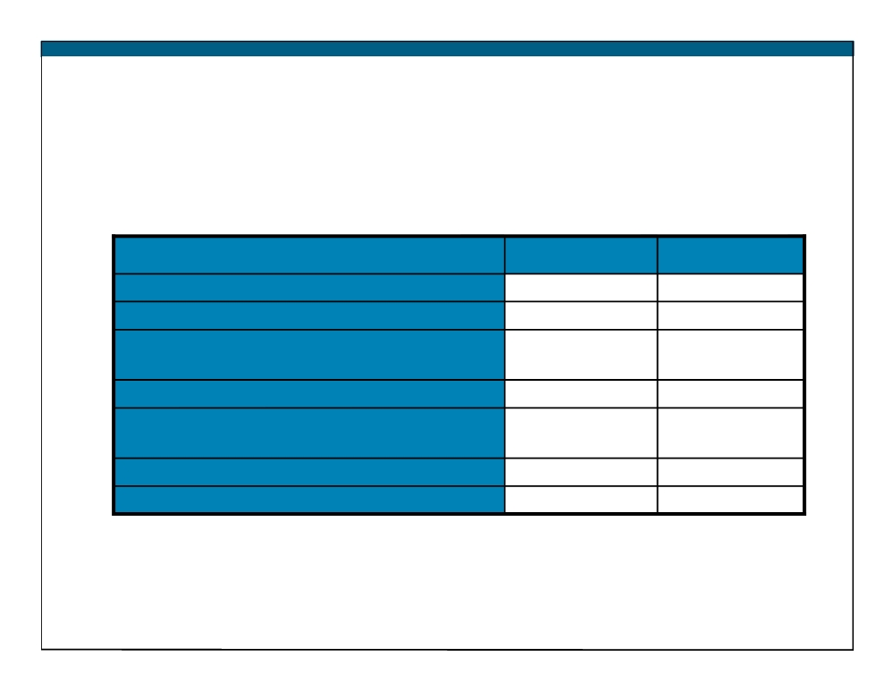
RIPv1 and RIPv2 Comparison
RIPv1
RIPv2
Routing protocol
Classful
Classless
Supports variable-length subnet mask?
No
Yes
Sends the subnet mask along with the routing
No
Yes
update?
Addressing type
Broadcast
Multicast
Defined in …
RFC 1058
RFCs 1721,
1722, and 2453
Supports manual route summarization?
No
Yes
Authentication support?
No
Yes
ICND1 v1.0—5-11 The PDF files and any printed representation for this material are the property of Cisco Systems, Inc., for the sole use by Cisco employees for personal study. The files or printed representations may not be used in commercial training, and may not be distributed for purposes other than individual self-study.
© 2007 Cisco Systems, Inc. All rights reserved.

Slide 13
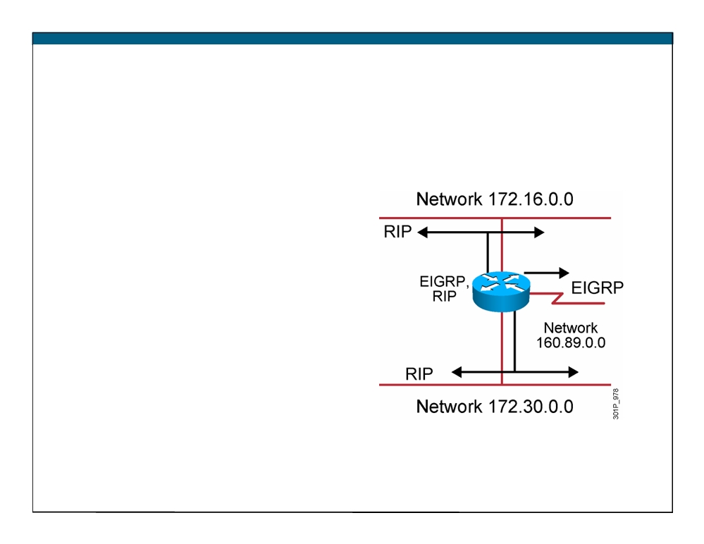
IP Routing Configuration Tasks
ƒ Router configuration
- Select routing protocols - Specify networks or interfaces
© 2007 Cisco Systems, Inc. All rights reserved.
ICND1 v1.0—5-12
The PDF files and any printed representation for this material are the property of Cisco Systems, Inc., for the sole use by Cisco employees for personal study. The files or printed representations may not be used in commercial training, and may not be distributed for purposes other than individual self-study.

Slide 14
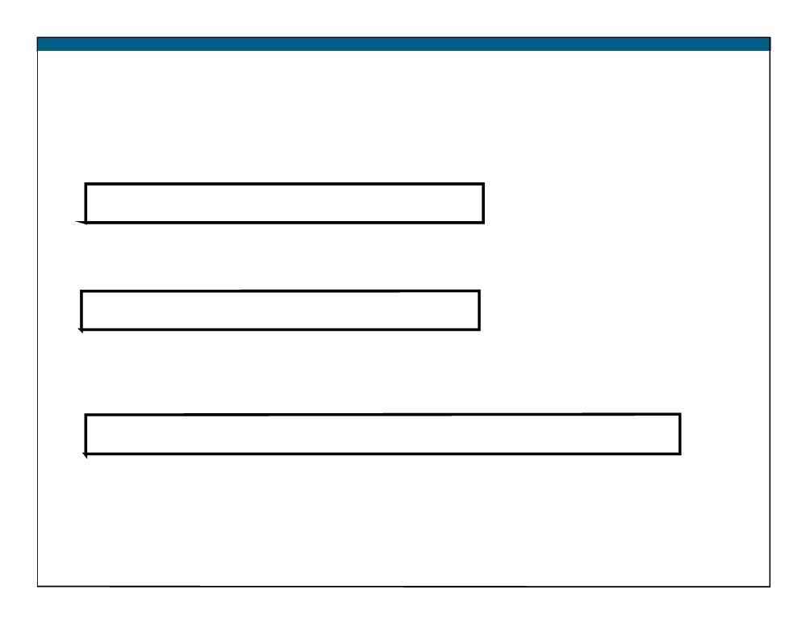
RIP Configuration
RouterX(config)# router rip ƒ Starts the RIP routing process
RouterX(config-router)# version 2 ƒ Enables RIP version 2
RouterX(config-router)# network network-number ƒ Selects participating attached networks
ƒ Requires a major classful network number
© 2007 Cisco Systems, Inc. All rights reserved.
ICND1 v1.0—5-13
The PDF files and any printed representation for this material are the property of Cisco Systems, Inc., for the sole use by Cisco employees for personal study. The files or printed representations may not be used in commercial training, and may not be distributed for purposes other than individual self-study.

Slide 15
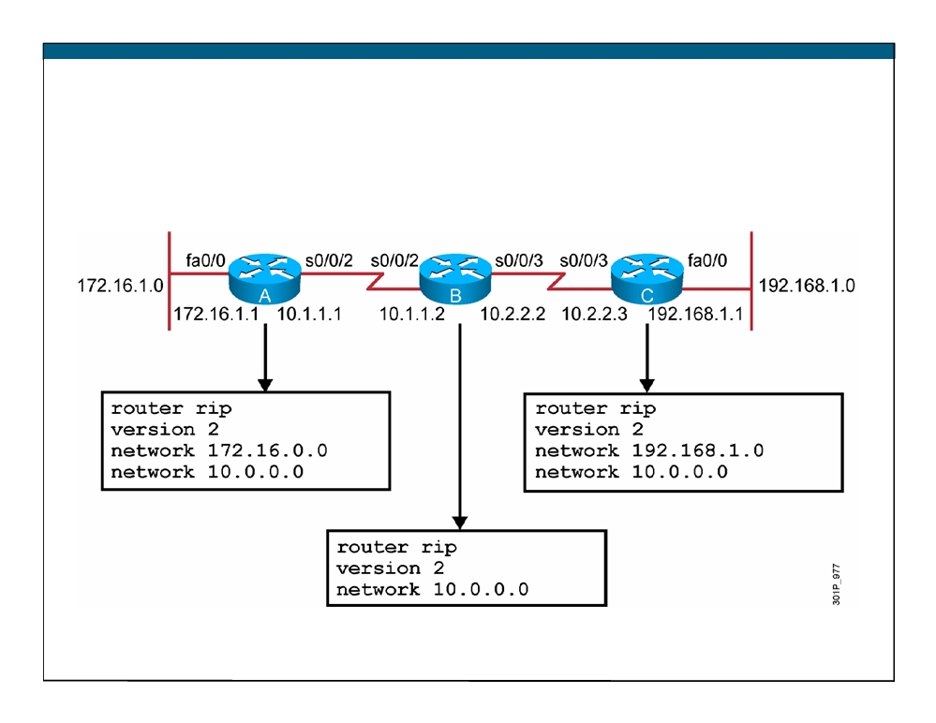
RIP Configuration Example
© 2007 Cisco Systems, Inc. All rights reserved.
ICND1 v1.0—5-14
The PDF files and any printed representation for this material are the property of Cisco Systems, Inc., for the sole use by Cisco employees for personal study. The files or printed representations may not be used in commercial training, and may not be distributed for purposes other than individual self-study.

Slide 16
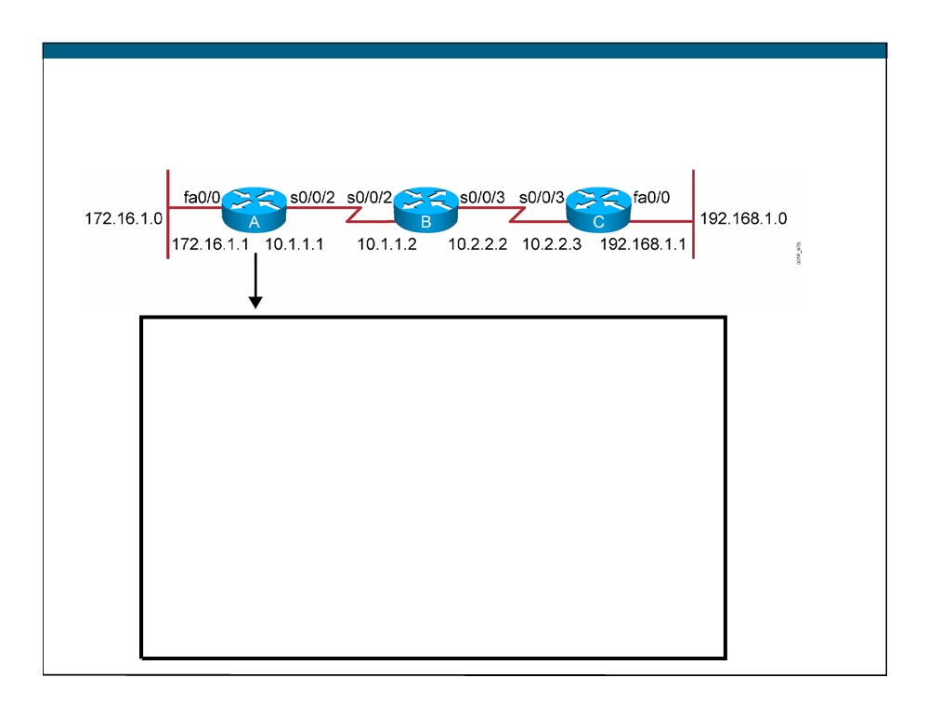
Verifying the RIP Configuration
Routing Protocol is "rip"
Sending updates every 30 seconds, next due in 6 seconds Invalid after 180 seconds, hold down 180, flushed after 240 Outgoing update filter list for all interfaces is not set Incoming update filter list for all interfaces is not set Redistributing: rip
Default version control: send version 2, receive version 2
Interface
Send Recv Triggered RIP Key-chain
FastEthernet0/0
2
2
Serial0/0/2
2
2
Automatic network summarization is in effect Maximum path: 4
Routing for Networks: 10.0.0.0
172.16.0.0
Routing Information Sources:
Gateway
Distance
Last Update
10.1.1.2
120
00:00:25
Distance: (default is 120)
RouterA#
© 2007 Cisco Systems, Inc. All rights reserved.
ICND1 v1.0—5-15
The PDF files and any printed representation for this material are the property of Cisco Systems, Inc., for the sole use by Cisco employees for personal study. The files or printed representations may not be used in commercial training, and may not be distributed for purposes other than individual self-study.

Slide 17
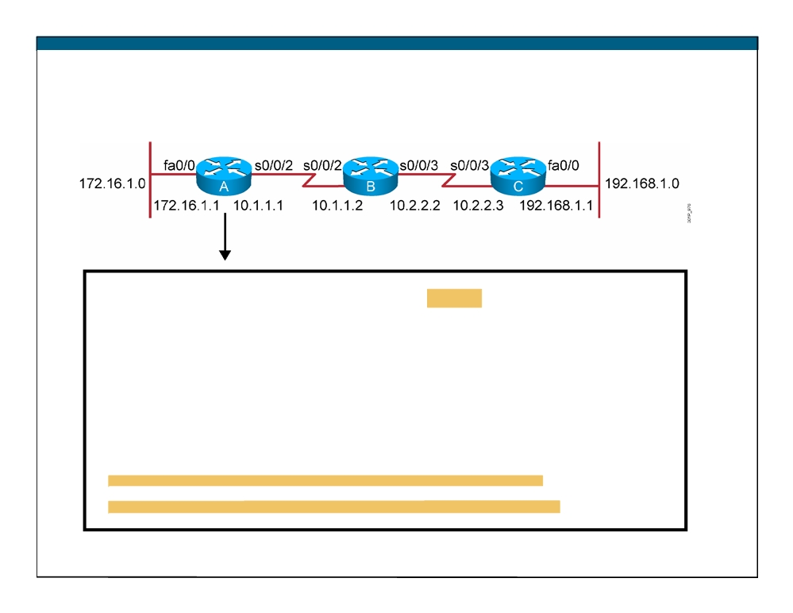
Displaying the IP Routing Table
RouterA# show ip route
Codes: C - connected, S - static, I - IGRP, R - RIP, M - mobile, B - BGP D - EIGRP, EX - EIGRP external, O - OSPF, IA - OSPF inter area N1 - OSPF NSSA external type 1, N2 - OSPF NSSA external type 2 E1 - OSPF external type 1, E2 - OSPF external type 2, E - EGP i - IS-IS, L1 - IS-IS level-1, L2 - IS-IS level-2, * - candidate default U - per-user static route, o - ODR
T - traffic engineered route
Gateway of last resort is not set
172.16.0.0/24 is subnetted, 1 subnets
C
172.16.1.0 is directly connected, fastethernet0/0
10.0.0.0/24 is subnetted, 2 subnets
R
10.2.2.0 [120/1] via 10.1.1.2, 00:00:07, Serial0/0/2
C
10.1.1.0 is directly connected, Serial0/0/2
R
192.168.1.0/24 [120/2] via 10.1.1.2, 00:00:07, Serial0/0/2
© 2007 Cisco Systems, Inc. All rights reserved.
ICND1 v1.0—5-16
The PDF files and any printed representation for this material are the property of Cisco Systems, Inc., for the sole use by Cisco employees for personal study. The files or printed representations may not be used in commercial training, and may not be distributed for purposes other than individual self-study.

Slide 18
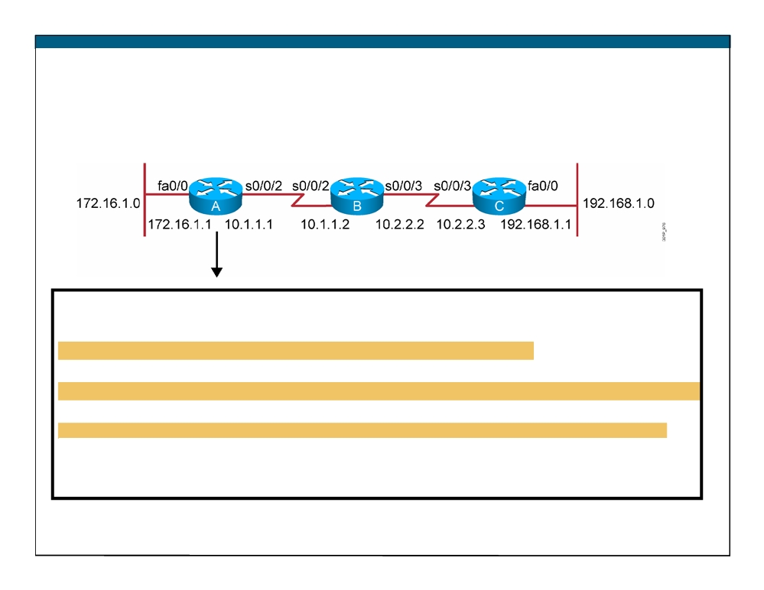
debug ip rip Command
RouterA# debug ip rip
RIP protocol debugging is on RouterA#
00:06:24: RIP: received v1 update from 10.1.1.2 on Serial0/0/2
00:06:24:
10.2.2.0 in 1 hops
00:06:24:
192.168.1.0 in 2 hops
00:06:33: RIP: sending v1 update to 255.255.255.255 via FastEthernet0/0 (172.16.1.1)
00:06:34:
network 10.0.0.0, metric 1
00:06:34:
network 192.168.1.0, metric 3
00:06:34: RIP: sending v1 update to 255.255.255.255 via Serial0/0/2 (10.1.1.1)
00:06:34:
network 172.16.0.0, metric 1
© 2007 Cisco Systems, Inc. All rights reserved.
ICND1 v1.0—5-17
The PDF files and any printed representation for this material are the property of Cisco Systems, Inc., for the sole use by Cisco employees for personal study. The files or printed representations may not be used in commercial training, and may not be distributed for purposes other than individual self-study.

Slide 19
Summary
ƒ Routing is the process by which items get from one location to another.
ƒ Dynamic routing protocols determine how updates are conveyed, what knowledge is conveyed, when to convey knowledge, and how to locate recipients of the updates.
ƒ A routing protocol that has a lower administrative value is more trustworthy than a protocol that has a higher administrative value. ƒ There are three classes of routing protocols: distance vector, link- state, and balanced hybrid.
ƒ The ip classless command can be used to prevent a router from dropping a packet that is destined for an unknown subnetwork of a directly attached network if a default route is configured.
© 2007 Cisco Systems, Inc. All rights reserved.
ICND1 v1.0—5-18
The PDF files and any printed representation for this material are the property of Cisco Systems, Inc., for the sole use by Cisco employees for personal study. The files or printed representations may not be used in commercial training, and may not be distributed for purposes other than individual self-study.

Slide 20
Summary (Cont.)
ƒ RIP is a distance vector routing protocol that uses hop count as the matrix for route selection and broadcasts updates every 30 seconds.
ƒ RIPv1 uses classful routing protocol; RIPv2 uses classless routing protocol. RIPv2 supports VLSM, manual route summarization, and authentication; RIPv1 does not support these activities. ƒ To enable a dynamic routing protocol, first a routing protocol is selected, then IP network numbers are assigned without values being specified (except OSPF).
ƒ The router command starts the routing process. The network command allows the routing process to determine which interfaces will participate in sending and receiving the routing updates.
© 2007 Cisco Systems, Inc. All rights reserved.
ICND1 v1.0—5-19
The PDF files and any printed representation for this material are the property of Cisco Systems, Inc., for the sole use by Cisco employees for personal study. The files or printed representations may not be used in commercial training, and may not be distributed for purposes other than individual self-study.

Slide 21
Summary (Cont.)
ƒ The router RIP command selects RIP as the routing protocol. The network command identifies a participating attached network. ƒ The show ip command displays information about routing protocols and the routing table.
ƒ The debug ip rip command displays information on RIP routing transactions.
© 2007 Cisco Systems, Inc. All rights reserved.
ICND1 v1.0—5-20
The PDF files and any printed representation for this material are the property of Cisco Systems, Inc., for the sole use by Cisco employees for personal study. The files or printed representations may not be used in commercial training, and may not be distributed for purposes other than individual self-study.

Slide 22
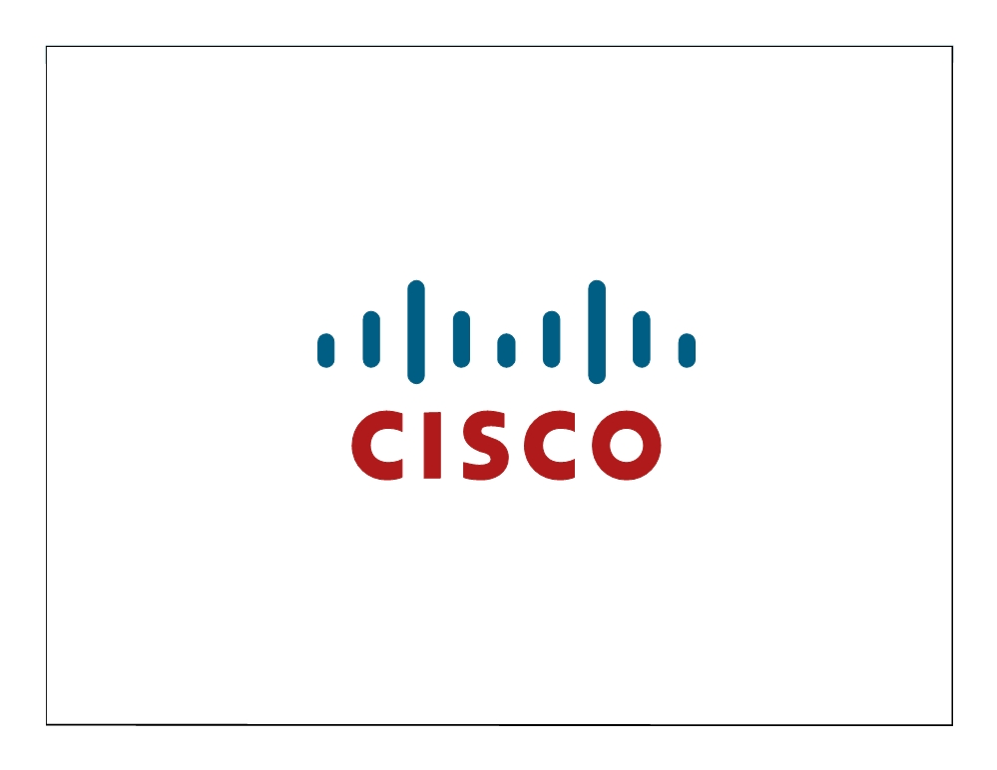
ICND1 v1.0—5-21 The PDF files and any printed representation for this material are the property of Cisco Systems, Inc., for the sole use by Cisco employees for personal study. The files or printed representations may not be used in commercial training, and may not be distributed for purposes other than individual self-study.
© 2007 Cisco Systems, Inc. All rights reserved.

Slide 23
Module Summary
ƒ A WAN allows the transmission of data across broad geographic distances. There are a number of technologies involved in the functioning of WANs, including hardware devices such as routers, communication servers, and modems; and software functions. ƒ A common type of WAN connection is the point-to-point connection, which is also referred to as a serial or leased-line connection because the lines are leased from a carrier (usually a telephone company) and are dedicated for use by the company leasing the lines.
ƒ Circuit switching allows multiple sites to connect to the switched network of a carrier and communicate with each other. This technology provides a more cost-effective means of WAN connection and includes its own set of technologies, including the PSTN.
© 2007 Cisco Systems, Inc. All rights reserved.
ICND1 v1.0—5-1
The PDF files and any printed representation for this material are the property of Cisco Systems, Inc., for the sole use by Cisco employees for personal study. The files or printed representations may not be used in commercial training, and may not be distributed for purposes other than individual self-study.

Slide 24
Module Summary (Cont.)
ƒ Routing information takes the form of entries in a routing table, with one entry for each identified route. The routing table can be updated manually or automatically to accommodate network changes.
ƒ Distance vector routing algorithms enable each router to send all or some portion of its routing table to its neighbors. ƒ Link-state routing algorithms maintain a complex database of topology information, which routers use to maintain full knowledge of distant routers.
© 2007 Cisco Systems, Inc. All rights reserved.
ICND1 v1.0—5-2
The PDF files and any printed representation for this material are the property of Cisco Systems, Inc., for the sole use by Cisco employees for personal study. The files or printed representations may not be used in commercial training, and may not be distributed for purposes other than individual self-study.

Slide 25
Module Summary (Cont.)
ƒ Balanced hybrid routing algorithms combine aspects of both distance vector and link-state routing.
ƒ RIP is used in small, homogeneous networks. ƒ NAT and PAT translate IP addresses within private internal networks into legal IP addresses for transport over public external networks such as the Internet, without requiring a registered subnet address.
ƒ A router can obtain its interface address from a DHCP server.
© 2007 Cisco Systems, Inc. All rights reserved.
ICND1 v1.0—5-3
The PDF files and any printed representation for this material are the property of Cisco Systems, Inc., for the sole use by Cisco employees for personal study. The files or printed representations may not be used in commercial training, and may not be distributed for purposes other than individual self-study.

Slide 26
ICND1 v1.0—5-4 The PDF files and any printed representation for this material are the property of Cisco Systems, Inc., for the sole use by Cisco employees for personal study. The files or printed representations may not be used in commercial training, and may not be distributed for purposes other than individual self-study.
© 2007 Cisco Systems, Inc. All rights reserved.

