Slide 1
SIMPLE NETWORK MANAGEMENT PROTOCOL
SNMP
Information about devices on a TCP/IP-based network—configuration settings, status information ,counters, and so on—could be broken down into a database of variables. Those variables could then be collected by management software to monitor and manage the IP-based network.
The elements of any IP-based machines would have commonalities. For example, a PC, a network printer, and a router would all have commonalities such as interfaces, IP addresses, and buffers . Then creating a standardized database of
these variables and a simple system for monitoring and managing them .
This standardized database called Management Information Base (MIB).
This is called SNMP.
SNMP work as Manager-Agent mode.
Manager maneges the Agents using SNMP protocol.
SNMP is an Application Layer protocol works on UDP port 162.
© 2007 Cisco Systems, Inc. All rights reserved.
ICND2 v1.0—5-14
The PDF files and any printed representation for this material are the property of Cisco Systems, Inc., for the sole use by Cisco employees for personal study. The files or printed representations may not be used in commercial training, and may not be distributed for purposes other than individual self-study.

Slide 2
SIMPLE NETWORK MANAGEMENT PROTOCOL
SNMP
An SNMP manager is a network management application running on a PC or server, with that host typically being called a Network Management Station (NMS). Many SNMP agents exist in the network, one per device that is managed. The SNMP agent is software running inside each device
(router, switch, and so on), with knowledge of all the variables on that device that describe the device’s configuration, status, and counters.
The SNMP manager uses SNMP protocols to communicate with each SNMP agent. Each agent keeps a database of variables that make up the parameters, status, and counters for the operations of the device. This database, called the Management Information Base (MIB), has some core elements in common across most networking devices.
MIBs consists of Object Ids(OID)
© 2007 Cisco Systems, Inc. All rights reserved.
ICND2 v1.0—5-14
The PDF files and any printed representation for this material are the property of Cisco Systems, Inc., for the sole use by Cisco employees for personal study. The files or printed representations may not be used in commercial training, and may not be distributed for purposes other than individual self-study.

Slide 3
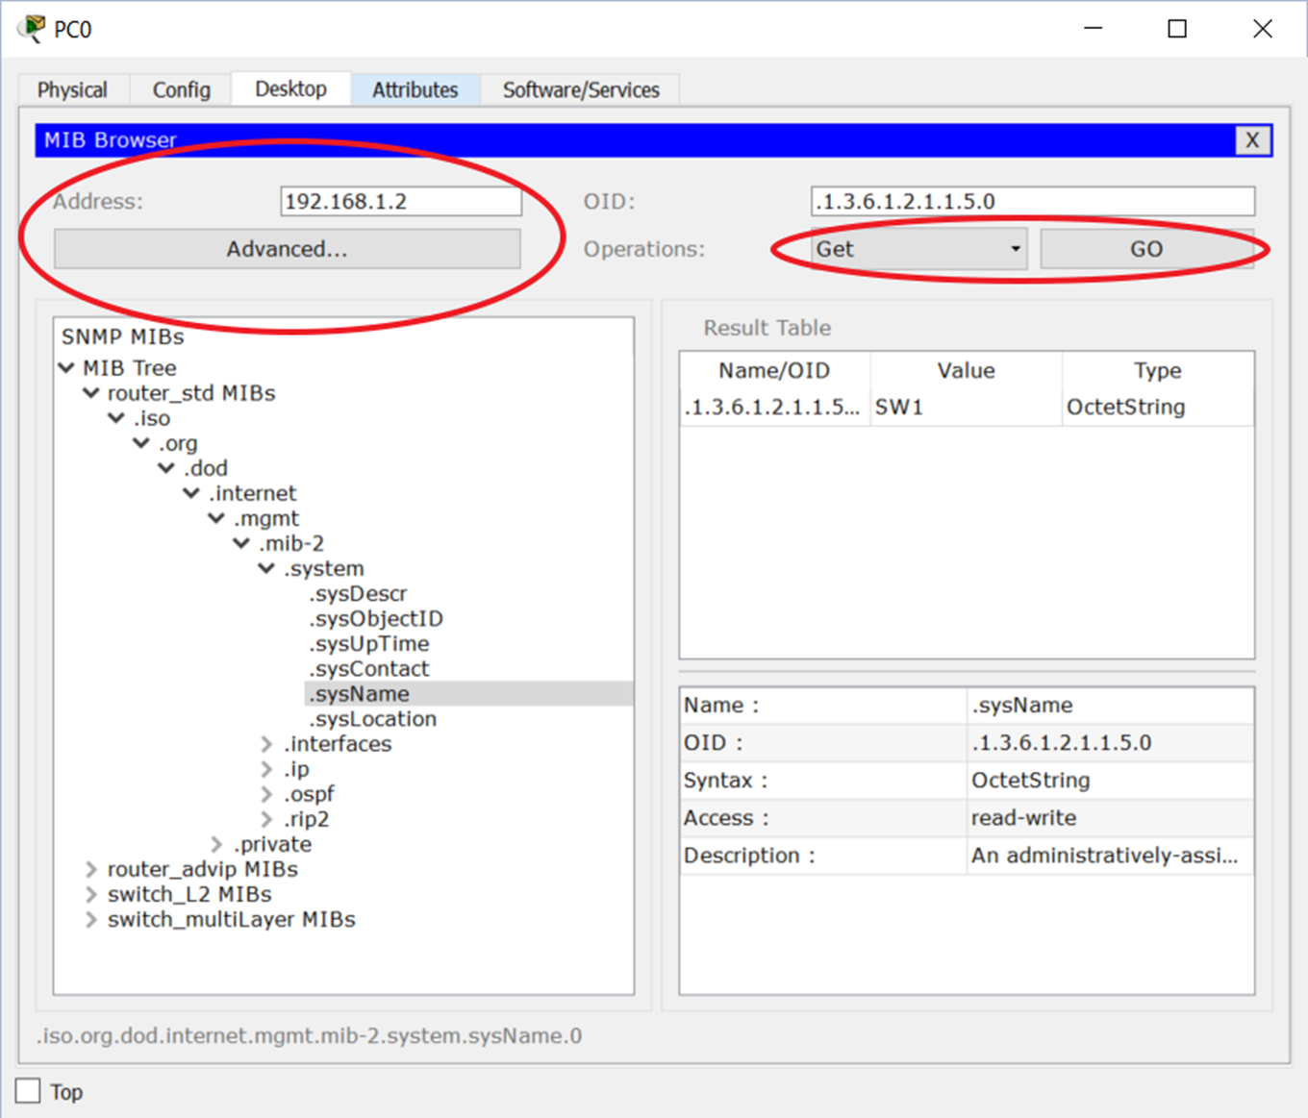
SNMP- MIB
© 2007 Cisco Systems, Inc. All rights reserved.
ICND2 v1.0—5-14
The PDF files and any printed representation for this material are the property of Cisco Systems, Inc., for the sole use by Cisco employees for personal study. The files or printed representations may not be used in commercial training, and may not be distributed for purposes other than individual self-study.

Slide 4
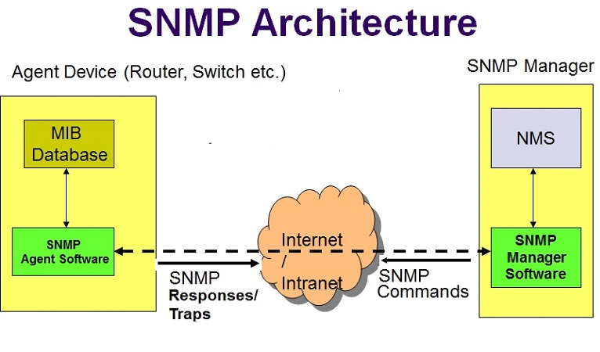
SNMP
© 2007 Cisco Systems, Inc. All rights reserved.
ICND2 v1.0—5-14
The PDF files and any printed representation for this material are the property of Cisco Systems, Inc., for the sole use by Cisco employees for personal study. The files or printed representations may not be used in commercial training, and may not be distributed for purposes other than individual self-study.

Slide 5
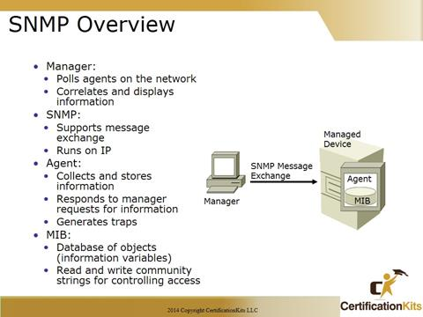
SNMP
© 2007 Cisco Systems, Inc. All rights reserved.
ICND2 v1.0—5-14
The PDF files and any printed representation for this material are the property of Cisco Systems, Inc., for the sole use by Cisco employees for personal study. The files or printed representations may not be used in commercial training, and may not be distributed for purposes other than individual self-study.

Slide 6
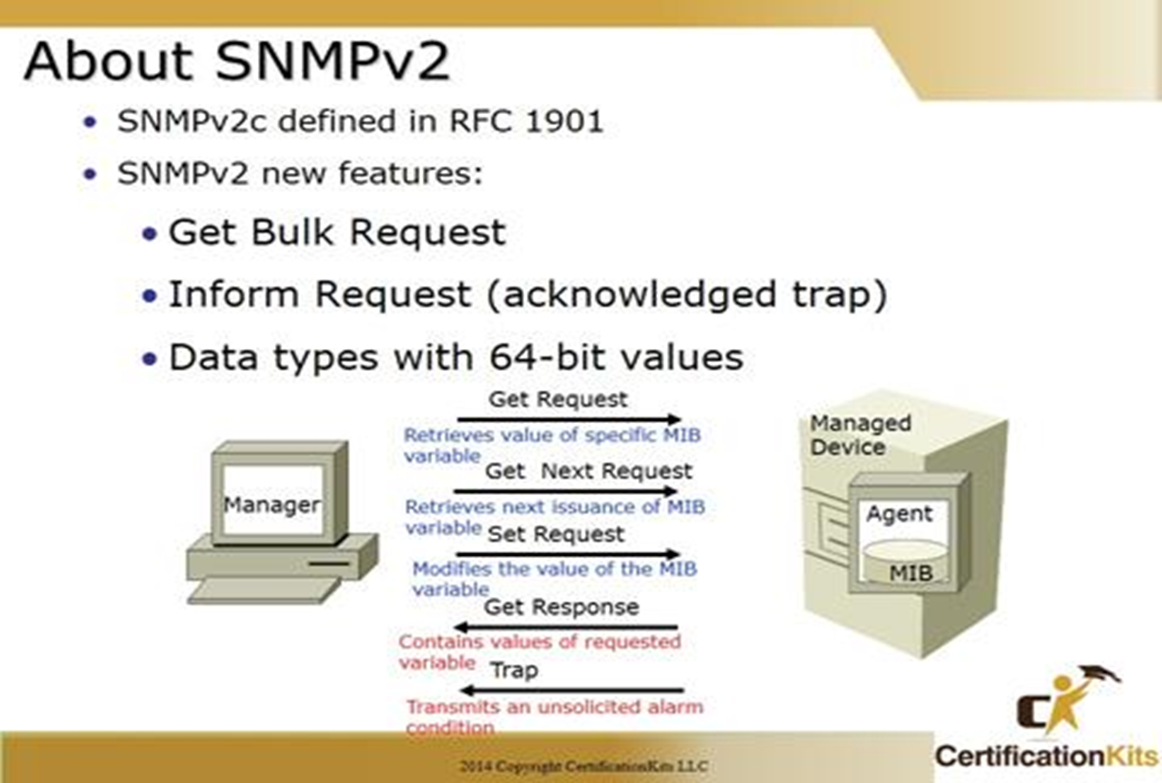
SNMP-Operation
The NMS typically polls(status check) the SNMP agent on each device. The NMS can notify the human user in front of the PC or send emails, texts, and so on to notify the network
operations staff of any issues identified by the data found by polling the devices.
Specifically, the NMS uses the SNMP Get, GetNext, and GetBulk messages (together referenced simply as Get messages) to ask for information from an agent.
The NMS sends an SNMP Set message to write variables on the SNMP agent as a means to change the configuration of the device.
SNMP agents send a Trap or Inform SNMP message to the NMS to list the state of certain MIB variables when those variables reach a certain state. Inform more secure then Trap.
© 2007 Cisco Systems, Inc. All rights reserved.
ICND2 v1.0—5-14
The PDF files and any printed representation for this material are the property of Cisco Systems, Inc., for the sole use by Cisco employees for personal study. The files or printed representations may not be used in commercial training, and may not be distributed for purposes other than individual self-study.

Slide 7
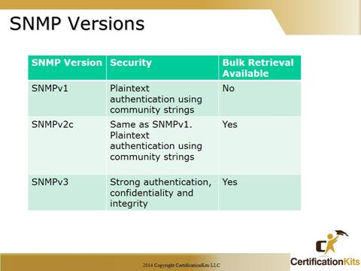
SNMP
SNMP operation can be Read Only(RO) and Read/Write(RW)
Versions of SNMP
The Cisco IOS software supports the following versions of SNMP:
SNMPv1--Simple Network Management Protocol:
a full Internet standard, Security is based on community strings.
Single request.
SNMPv2c--The community string-based Administrative Framework for SNMPv2. SNMPv2c (the "c" is for "community") is an experimental Internet protocol and uses the community-based security model of SNMPv1.
Bulk request and community-string
© 2007 Cisco Systems, Inc. All rights reserved.
ICND2 v1.0—5-14
The PDF files and any printed representation for this material are the property of Cisco Systems, Inc., for the sole use by Cisco employees for personal study. The files or printed representations may not be used in commercial training, and may not be distributed for purposes other than individual self-study.

Slide 8
SNMP
Versions of SNMP
SNMPv3--Version 3 of SNMP. SNMPv3 is an interoperable standards-based protocol defined in RFCs 3413 to 3415. SNMPv3 provides secure access to devices by authenticating and encrypting packets over the network.
The security features provided in SNMPv3 are as follows:
Message integrity--Ensuring that a packet has not been tampered with in transit.
Authentication--Determining that the message is from a valid source.
Encryption--Scrambling the contents of a packet to prevent it from being learned by an unauthorized source.
Both SNMPv1 and SNMPv2c use a community-based form of security.
The community of SNMP managers able to access the agent MIB is defined by an IP address access control list (ACL) and password.
© 2007 Cisco Systems, Inc. All rights reserved.
ICND2 v1.0—5-14
The PDF files and any printed representation for this material are the property of Cisco Systems, Inc., for the sole use by Cisco employees for personal study. The files or printed representations may not be used in commercial training, and may not be distributed for purposes other than individual self-study.

Slide 9
SNMP-Configuration
Simple SNMP configuration with community-string.
ip access-list standard ACL_PROTECTSNMP
permit host 10.1.3.3
!
snmp-server community secretROpw RO ACL_PROTECTSNMP
snmp-server community secretRWpw RW ACL_PROTECTSNMP
snmp-server location Atlanta
snmp-server contact Tyler B
To send Trap and Inform messages(to SNMP Manager) :
snmp-server host 10.1.3.3 version 2c secretTRAPpw
snmp-server host 10.1.3.4 informs version 2c secretT
snmp-server enable traps
Show snmp
Show snmp host
Show snmp community
© 2007 Cisco Systems, Inc. All rights reserved.
ICND2 v1.0—5-14
The PDF files and any printed representation for this material are the property of Cisco Systems, Inc., for the sole use by Cisco employees for personal study. The files or printed representations may not be used in commercial training, and may not be distributed for purposes other than individual self-study.

