Slide 1

SYSTEM MESSAGE LOGGING- SYSLOG
When major (and even not-so major) events take place, these Cisco devices attempt to
notify administrators with detailed system messages.
Network Devices (Routers,SWs etc..) can be configured to generate these messages about events that are happening on the device. These evenet messages are called system messages or SYSLOG messages .
SysLog messages give information about what happened,when happened and how important is the event. And they are shown in consistent format as shown below.
Time Stamp-Facility Code-Severity- Mnemonic-Text
%LINEPROTO-5-UPDOWN: Line protocol on Interface FastEthernet0/0, changed state to down
00:00:45: %OSPF-5-ADJCHG: Process 1, Nbr 2.2.2.2 on FastEthernet6/0 from LOADING to FULL, Loading Done
%SYS-7-NV_BLOCK_INIT: Initialized the geometry of nvram
*Mar 01, 00:05:22.055: %SYS-5-CONFIG_I: Configured from console by console
*Mar 01, 01:03:13.033: %SYS-6-LOGGINGHOST_STARTSTOP: Logging to host 192.168.5.200 port 514 started
© 2007 Cisco Systems, Inc. All rights reserved.
ICND2 v1.0—5-14
The PDF files and any printed representation for this material are the property of Cisco Systems, Inc., for the sole use by Cisco employees for personal study. The files or printed representations may not be used in commercial training, and may not be distributed for purposes other than individual self-study.

Slide 2
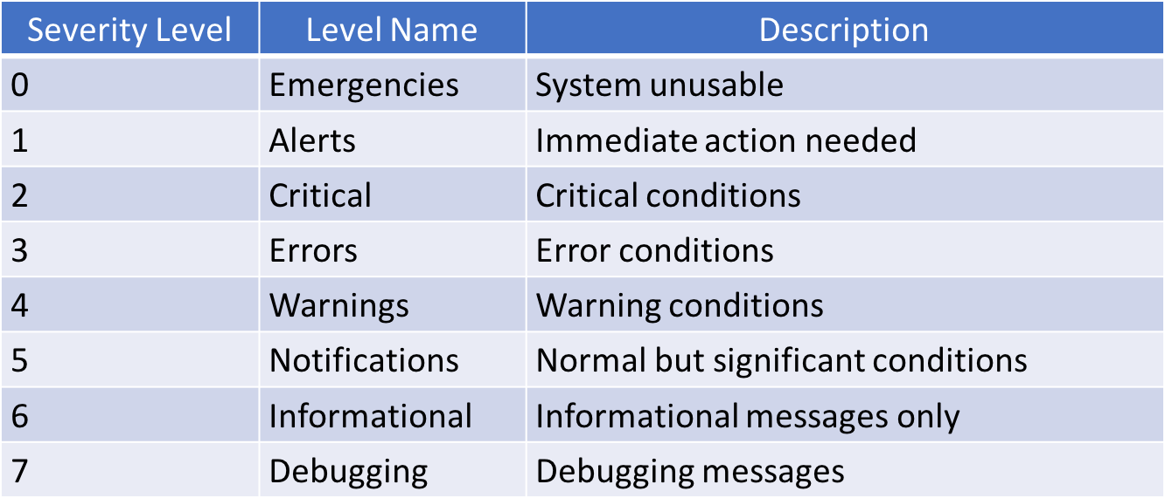
SYSLOG
We can configure the device when to generate the event-syslog messages.
These is called level of event or Severeity Level.
© 2007 Cisco Systems, Inc. All rights reserved.
ICND2 v1.0—5-14
The PDF files and any printed representation for this material are the property of Cisco Systems, Inc., for the sole use by Cisco employees for personal study. The files or printed representations may not be used in commercial training, and may not be distributed for purposes other than individual self-study.

Slide 3
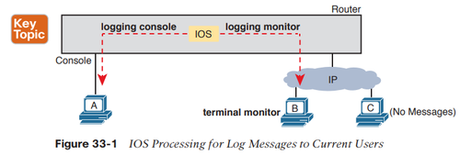
SYSLOG
Tehese syslog messages are send to console by default.
Because global config command logging console given by default.
But you can direct also to a Server,or remote connetions such as Telnet,SSH .
SysLog messages are send by UDP port 515
To send syslog messages to remote connections global config command logging monitor (send all log messages to all logged usres)
Must be given and also remote user has to give terminal monitor(I want to recevie log messages) command when he connected remotely.
© 2007 Cisco Systems, Inc. All rights reserved.
ICND2 v1.0—5-14
The PDF files and any printed representation for this material are the property of Cisco Systems, Inc., for the sole use by Cisco employees for personal study. The files or printed representations may not be used in commercial training, and may not be distributed for purposes other than individual self-study.

Slide 4
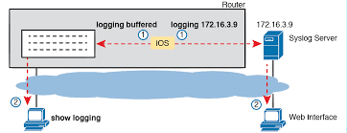
SYSLOG
Logging messages send to Console or Terminals(Telnet) are removet after.
But if we want to review them later we can keep copy of them by two ways.
1) We can copy them to RAM to review later by logging buffered command
And to see show logging command given.
To reset logging messages clear logging command is given.
2) We can copy syslog messages to a SysLog Server.
Router(config)#logging host 172.16.3.9 (syslog server IP)
Router(config)#
© 2007 Cisco Systems, Inc. All rights reserved.
ICND2 v1.0—5-14
The PDF files and any printed representation for this material are the property of Cisco Systems, Inc., for the sole use by Cisco employees for personal study. The files or printed representations may not be used in commercial training, and may not be distributed for purposes other than individual self-study.

Slide 5
SYSLOG
By default all severityl level messages are send to console.
Logging console <severity level> logging console 4 (or warning)
Logging buffered <severity level> logging buffered 5
Logging 192.168.1.1 logging trap 7 (or debug)
İf severity level defined, IOS send all severities between 0 and defined level to the destination. For syslog server trap level defined.
To remove logging
no logging event link-status ( do not show link status log messages)
no logging console
no logging buffered
no logging host
show process cpu
© 2007 Cisco Systems, Inc. All rights reserved.
ICND2 v1.0—5-14
The PDF files and any printed representation for this material are the property of Cisco Systems, Inc., for the sole use by Cisco employees for personal study. The files or printed representations may not be used in commercial training, and may not be distributed for purposes other than individual self-study.

