Slide 1

Implementing VLSM
Medium-Sized Routed Network Construction
© 2007 Cisco Systems, Inc. All rights reserved.
ICND2 v1.0—3-1
The PDF files and any printed representation for this material are the property of Cisco Systems, Inc., for the sole use by Cisco employees for personal study. The files or printed representations may not be used in commercial training, and may not be distributed for purposes other than individual self-study.

Slide 2
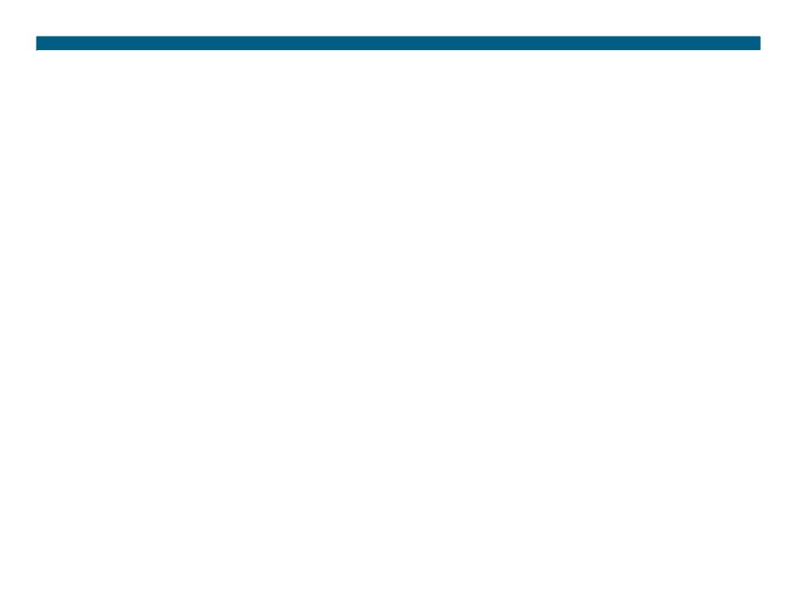
Subnetting Review
To identify subnets, you will “borrow” bits from the host ID portion of the IP address:
ƒ The number of subnets available depends on the number of bits borrowed.
- The available number of subnets = 2s, I which s is the number of bits borrowed.
ƒ The number of hosts per subnet available depends upon the number of host ID bits not borrowed.
- The available number of hosts per subnet = 2h -2, in which h is the number of host bits not borrowed.
- One address is reserved as the network address. - One address is reserved as the broadcast address.
© 2007 Cisco Systems, Inc. All rights reserved.
ICND2 v1.0—3-2
The PDF files and any printed representation for this material are the property of Cisco Systems, Inc., for the sole use by Cisco employees for personal study. The files or printed representations may not be used in commercial training, and may not be distributed for purposes other than individual self-study.

Slide 3
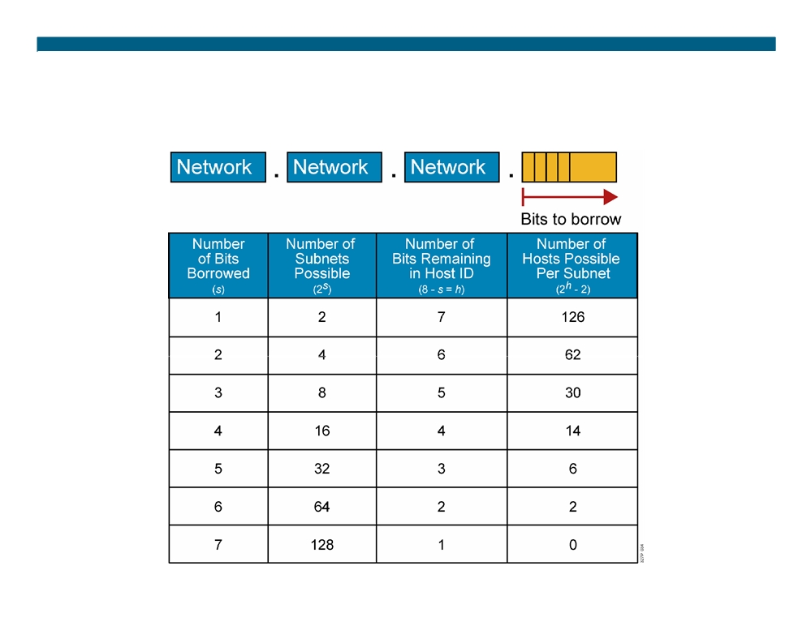
Possible Subnets and Hosts for a Class C Network
© 2007 Cisco Systems, Inc. All rights reserved.
ICND2 v1.0—3-3
The PDF files and any printed representation for this material are the property of Cisco Systems, Inc., for the sole use by Cisco employees for personal study. The files or printed representations may not be used in commercial training, and may not be distributed for purposes other than individual self-study.

Slide 4
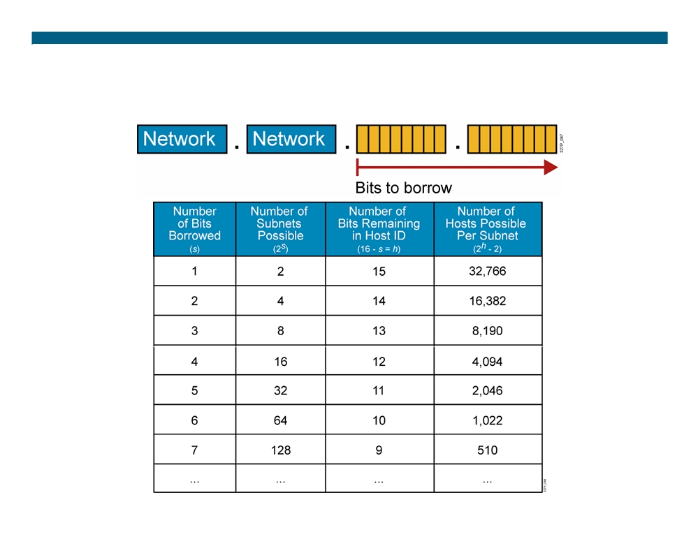
Possible Subnets and Hosts for a Class B Network
© 2007 Cisco Systems, Inc. All rights reserved.
ICND2 v1.0—3-4
The PDF files and any printed representation for this material are the property of Cisco Systems, Inc., for the sole use by Cisco employees for personal study. The files or printed representations may not be used in commercial training, and may not be distributed for purposes other than individual self-study.

Slide 5
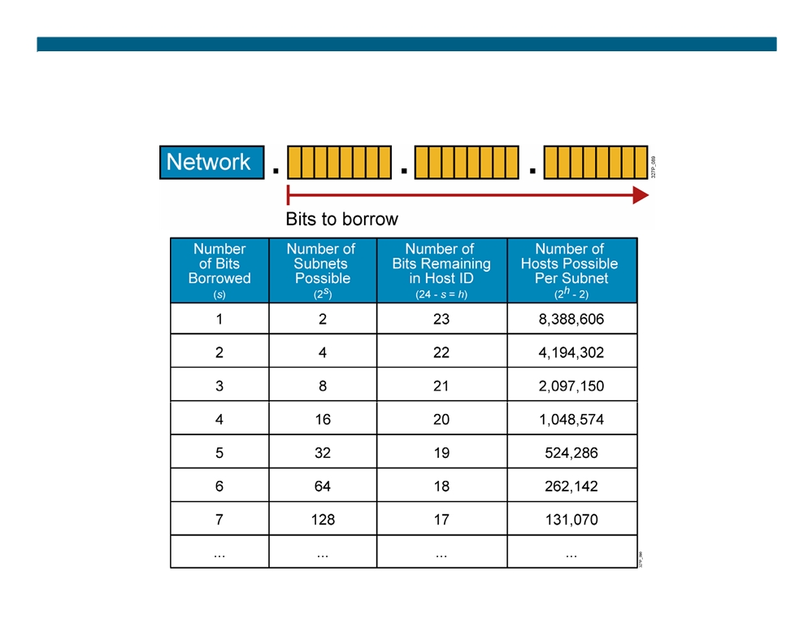
Possible Subnets and Hosts for a Class A Network
© 2007 Cisco Systems, Inc. All rights reserved.
ICND2 v1.0—3-5
The PDF files and any printed representation for this material are the property of Cisco Systems, Inc., for the sole use by Cisco employees for personal study. The files or printed representations may not be used in commercial training, and may not be distributed for purposes other than individual self-study.

Slide 6
Subnetting Review Exercise
Subnet a network with a private network address of 172.16.0.0./16 so that it provides 100 subnets and maximizes the number of host addresses for each subnet.
ƒ How many bits will need to be borrowed? ƒ What is the new subnet mask? ƒ What are the first four subnets?
ƒ What are the range of host addresses for the four subnets?
© 2007 Cisco Systems, Inc. All rights reserved.
ICND2 v1.0—3-6
The PDF files and any printed representation for this material are the property of Cisco Systems, Inc., for the sole use by Cisco employees for personal study. The files or printed representations may not be used in commercial training, and may not be distributed for purposes other than individual self-study.

Slide 7
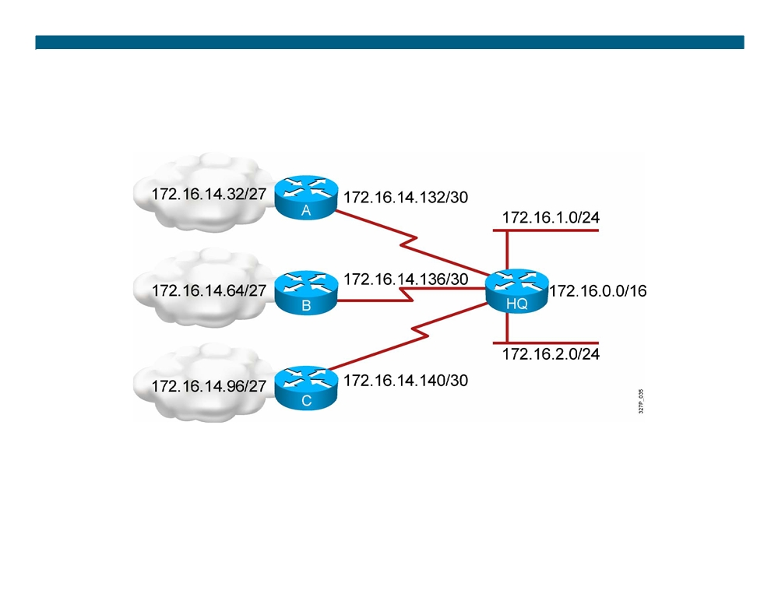
What Is a Variable-Length Subnet Mask?
Subnet 172.16.14.0/24 is divided into smaller subnets.
- Subnet with one mask (/27).
- Then further subnet one of the unused /27 subnets into multiple /30 subnets.
© 2007 Cisco Systems, Inc. All rights reserved.
ICND2 v1.0—3-7
The PDF files and any printed representation for this material are the property of Cisco Systems, Inc., for the sole use by Cisco employees for personal study. The files or printed representations may not be used in commercial training, and may not be distributed for purposes other than individual self-study.

Slide 8
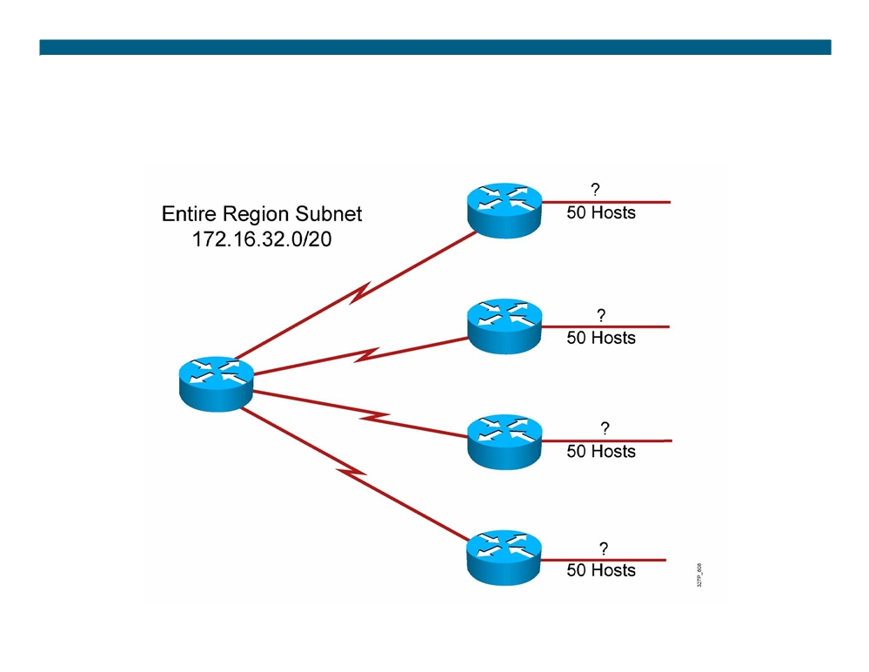
A Working VLSM Example
© 2007 Cisco Systems, Inc. All rights reserved.
ICND2 v1.0—3-8
The PDF files and any printed representation for this material are the property of Cisco Systems, Inc., for the sole use by Cisco employees for personal study. The files or printed representations may not be used in commercial training, and may not be distributed for purposes other than individual self-study.

Slide 9
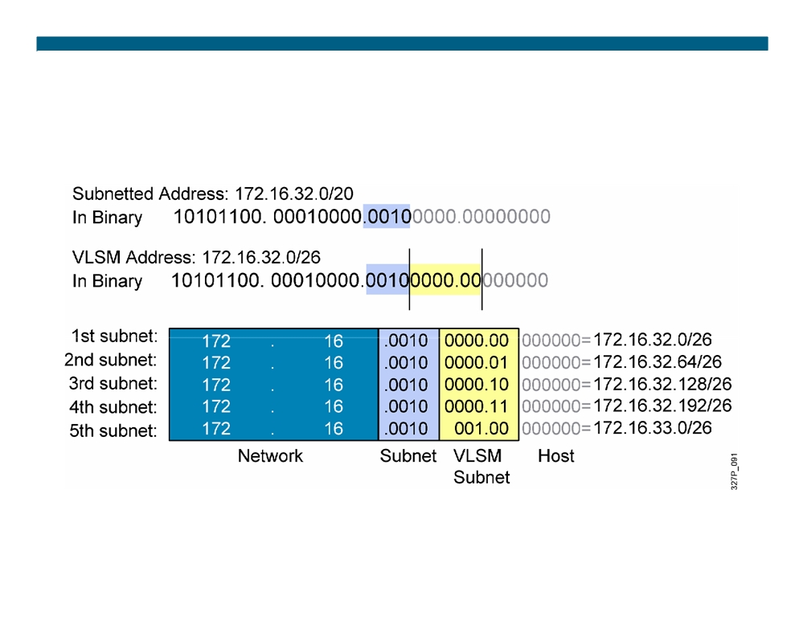
A Working VLSM Example (Cont.)
© 2007 Cisco Systems, Inc. All rights reserved.
ICND2 v1.0—3-9
The PDF files and any printed representation for this material are the property of Cisco Systems, Inc., for the sole use by Cisco employees for personal study. The files or printed representations may not be used in commercial training, and may not be distributed for purposes other than individual self-study.

Slide 10
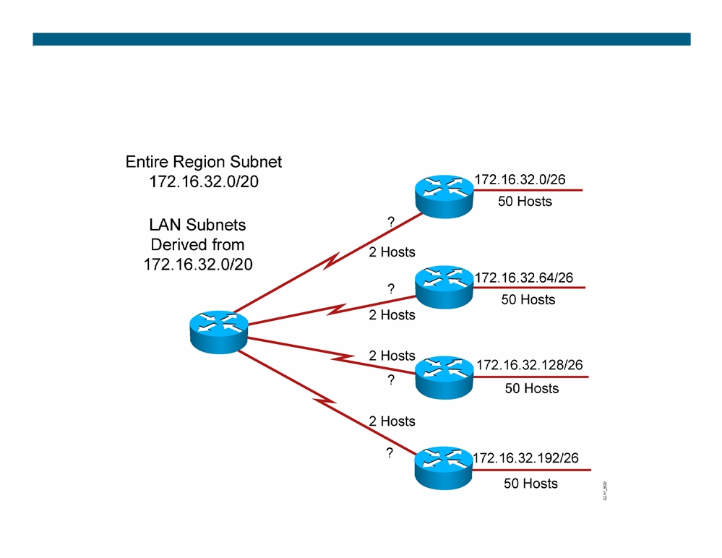
A Working VLSM Example (Cont.)
© 2007 Cisco Systems, Inc. All rights reserved.
ICND2 v1.0—3-10
The PDF files and any printed representation for this material are the property of Cisco Systems, Inc., for the sole use by Cisco employees for personal study. The files or printed representations may not be used in commercial training, and may not be distributed for purposes other than individual self-study.

Slide 11
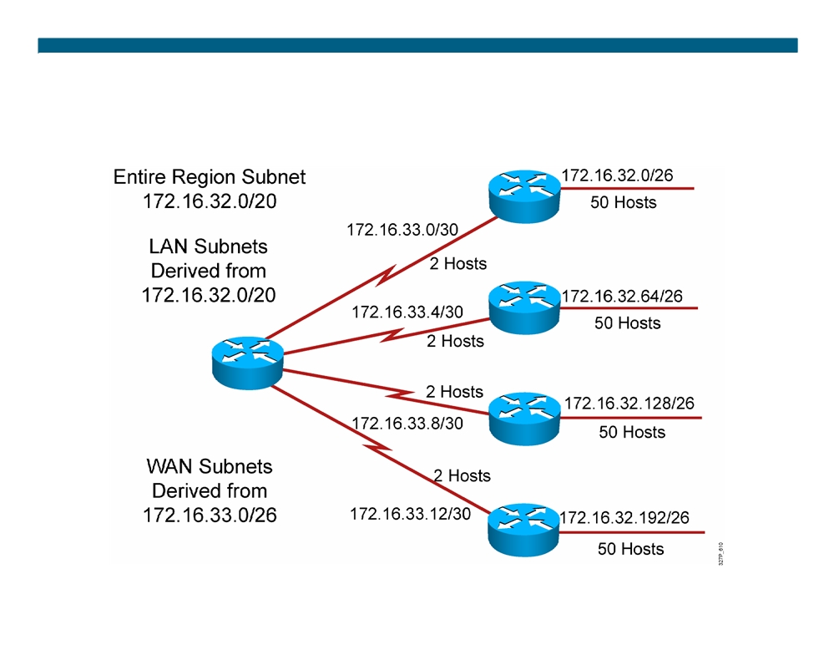
A Working VLSM Example (Cont.)
© 2007 Cisco Systems, Inc. All rights reserved.
ICND2 v1.0—3-11
The PDF files and any printed representation for this material are the property of Cisco Systems, Inc., for the sole use by Cisco employees for personal study. The files or printed representations may not be used in commercial training, and may not be distributed for purposes other than individual self-study.

Slide 12
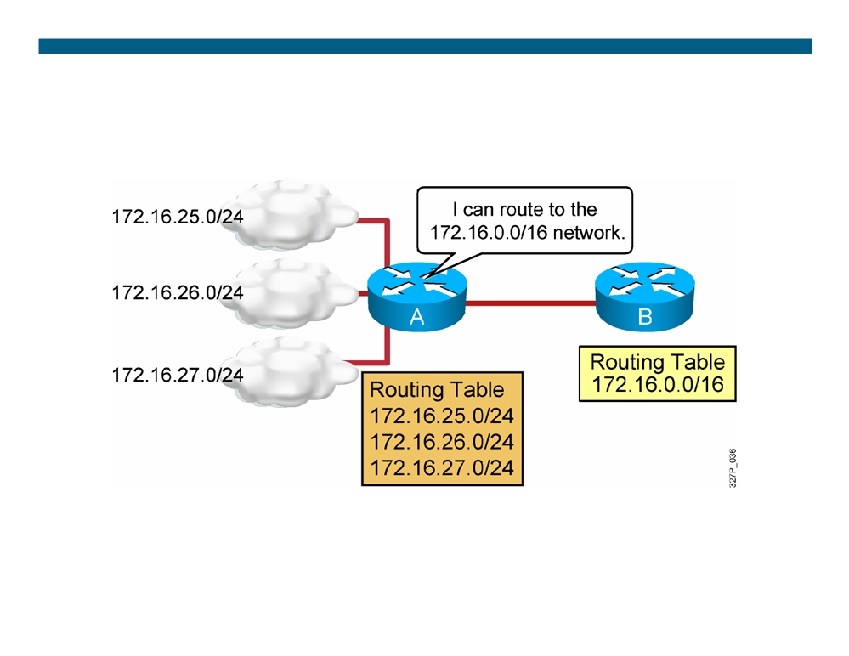
Understanding Route Summarization
Routing protocols can summarize addresses
of several networks into one address.
© 2007 Cisco Systems, Inc. All rights reserved.
ICND2 v1.0—3-12
The PDF files and any printed representation for this material are the property of Cisco Systems, Inc., for the sole use by Cisco employees for personal study. The files or printed representations may not be used in commercial training, and may not be distributed for purposes other than individual self-study.

Slide 13
Classful Routing Overview
ƒ Classful routing protocols do not include the subnet mask with the network in the routing advertisement.
ƒ Within the same network, consistency of the subnet masks is assumed, one subnet mask for the entire network. ƒ Summary routes are exchanged between foreign networks. ƒ Examples of classful routing protocols include: - RIPv1
- IGRP
Note: Classful routing protocols are legacy routing protocols typically used to address compatibility issues. RIP version 1 and Interior Gateway Routing Protocol (IGRP) are introduced to provide examples.
© 2007 Cisco Systems, Inc. All rights reserved.
ICND2 v1.0—3-13
The PDF files and any printed representation for this material are the property of Cisco Systems, Inc., for the sole use by Cisco employees for personal study. The files or printed representations may not be used in commercial training, and may not be distributed for purposes other than individual self-study.

Slide 14
Classless Routing Overview
ƒ Classless routing protocols include the subnet mask with the network in the advertisement.
ƒ Classless routing protocols support VLSM; one network can have multiple masks.
ƒ Summary routes must be manually controlled within the network. ƒ Examples of classless routing protocols include:
- RIPv2
- EIGRP - OSPF
ƒ RIPv2 and EIGRP act classful by default, and summary routes are exchanged between foreign networks.
- The no auto-summary command forces these protocols to behave as if they are classless.
© 2007 Cisco Systems, Inc. All rights reserved.
ICND2 v1.0—3-14
The PDF files and any printed representation for this material are the property of Cisco Systems, Inc., for the sole use by Cisco employees for personal study. The files or printed representations may not be used in commercial training, and may not be distributed for purposes other than individual self-study.

Slide 15
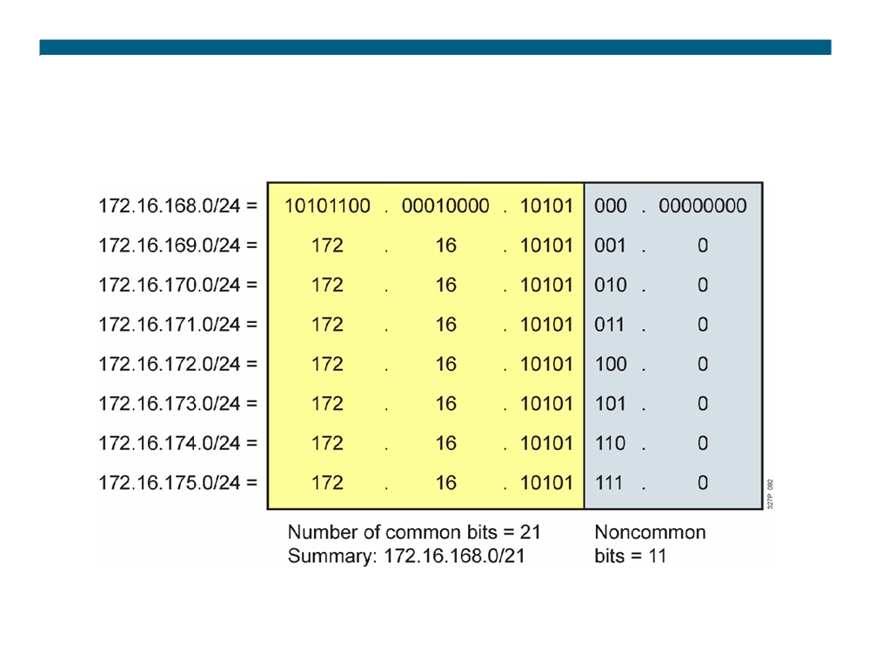
Summarizing Within an Octet
© 2007 Cisco Systems, Inc. All rights reserved.
ICND2 v1.0—3-15
The PDF files and any printed representation for this material are the property of Cisco Systems, Inc., for the sole use by Cisco employees for personal study. The files or printed representations may not be used in commercial training, and may not be distributed for purposes other than individual self-study.

Slide 16
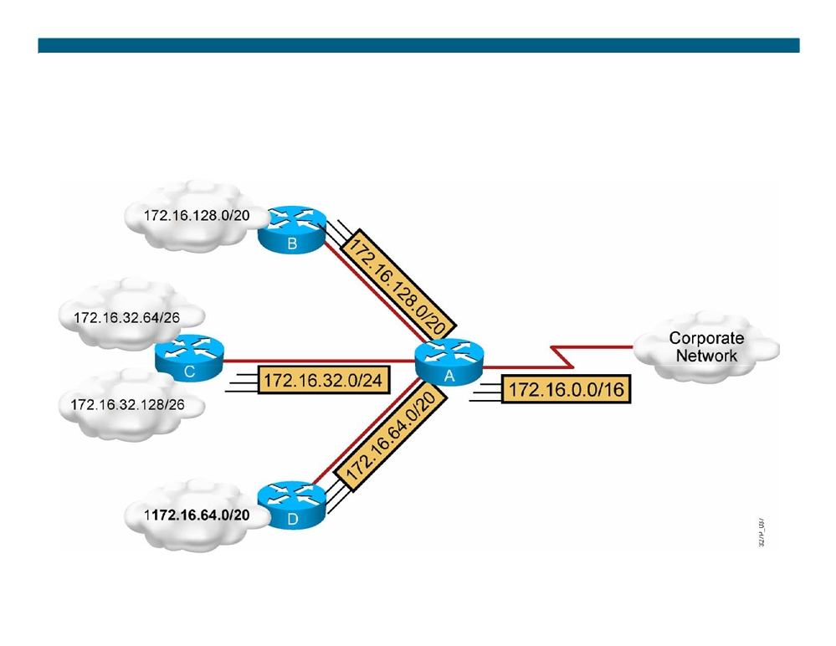
Summarizing Addresses in a VLSM-Designed Network
© 2007 Cisco Systems, Inc. All rights reserved.
ICND2 v1.0—3-16
The PDF files and any printed representation for this material are the property of Cisco Systems, Inc., for the sole use by Cisco employees for personal study. The files or printed representations may not be used in commercial training, and may not be distributed for purposes other than individual self-study.

Slide 17
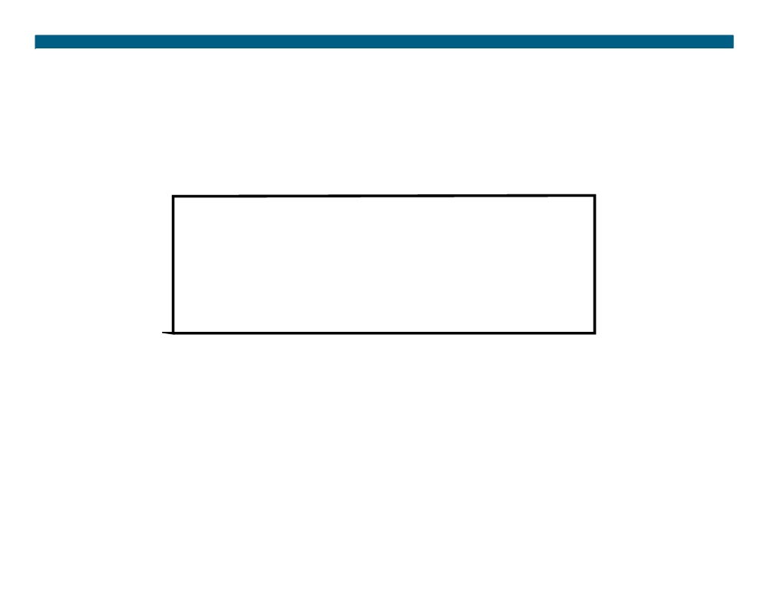
Route Summarization Operation in Cisco Routers
192.16.5.33
/32
Host
192.16.5.32
/27
Subnet
192.16.5.0
/24
Network
192.16.0.0
/16
Block of Networks
0.0.0.0
/0
Default
ƒ Supports host-specific routes, blocks of networks, and default routes
ƒ Routers use longest prefix match
© 2007 Cisco Systems, Inc. All rights reserved.
ICND2 v1.0—3-17
The PDF files and any printed representation for this material are the property of Cisco Systems, Inc., for the sole use by Cisco employees for personal study. The files or printed representations may not be used in commercial training, and may not be distributed for purposes other than individual self-study.

Slide 18
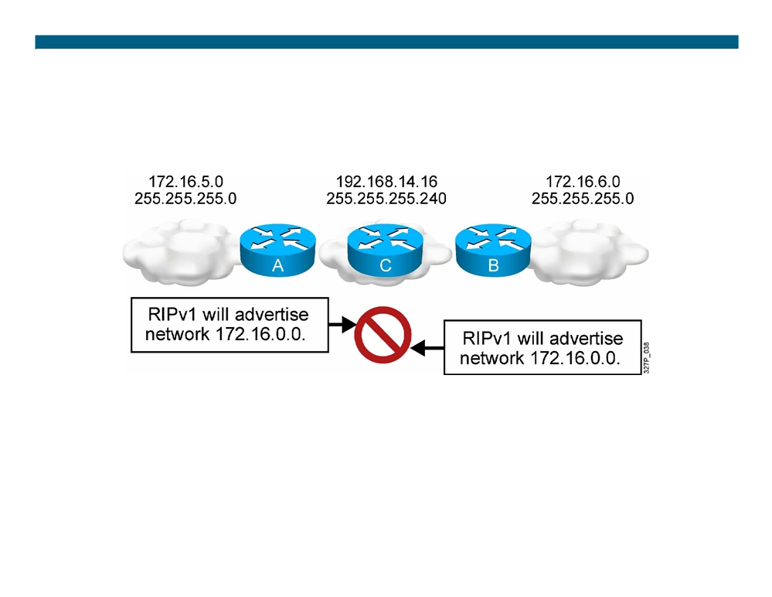
Summarizing Routes in a Discontiguous Network
ƒ Classful RIPv1 and IGRP do not advertise subnets, and therefore cannot support discontiguous subnets. ƒ Classless OSPF, EIGRP, and RIPv2 can advertise subnets, and therefore can support discontiguous subnets.
© 2007 Cisco Systems, Inc. All rights reserved.
ICND2 v1.0—3-18
The PDF files and any printed representation for this material are the property of Cisco Systems, Inc., for the sole use by Cisco employees for personal study. The files or printed representations may not be used in commercial training, and may not be distributed for purposes other than individual self-study.

Slide 19
Summary
ƒ Subnetting lets you efficiently allocate addresses by taking one large broadcast domain and breaking it up into smaller more manageable broadcast domains.
ƒ VLSMs let you more efficiently allocate IP addresses by adding multiple layers of the addressing hierarchy.
ƒ The benefits of route summarization include smaller routing tables and the ability to isolate topology changes.
© 2007 Cisco Systems, Inc. All rights reserved.
ICND2 v1.0—3-19
The PDF files and any printed representation for this material are the property of Cisco Systems, Inc., for the sole use by Cisco employees for personal study. The files or printed representations may not be used in commercial training, and may not be distributed for purposes other than individual self-study.

Slide 20

© 2007 Cisco Systems, Inc. All rights reserved.
ICND2 v1.0—3-20 The PDF files and any printed representation for this material are the property of Cisco Systems, Inc., for the sole use by Cisco employees for personal study. The files or printed representations may not be used in commercial training, and may not be distributed for purposes other than individual self-study.

