Slide 1

Introducing VPN Solutions
LAN Extension into a WAN
© 2007 Cisco Systems, Inc. All rights reserved.
ICND2 v1.0—8-1
The PDF files and any printed representation for this material are the property of Cisco Systems, Inc., for the sole use by Cisco employees for personal study. The files or printed representations may not be used in commercial training, and may not be distributed for purposes other than individual self-study.

Slide 2
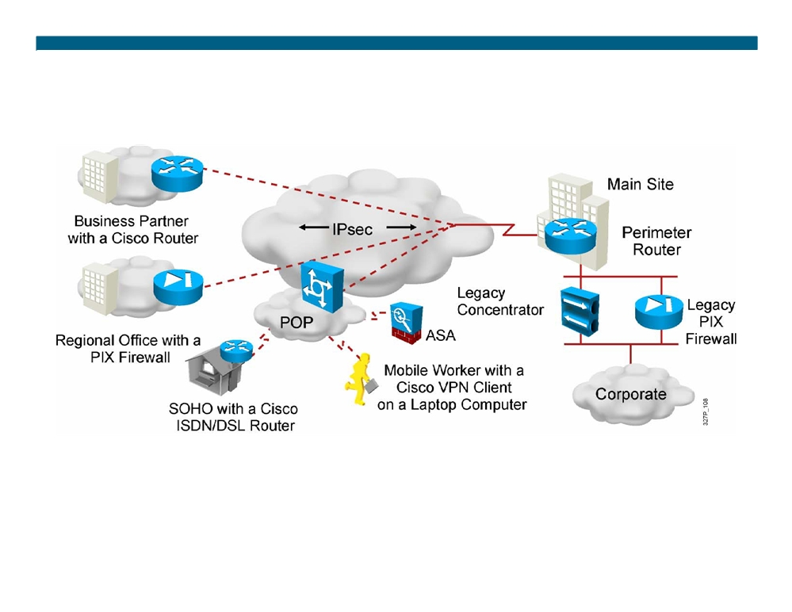
What Is a VPN?
Virtual: Information within a private network is transported over a public network.
Private: The traffic is encrypted to keep the data confidential.
© 2007 Cisco Systems, Inc. All rights reserved.
ICND2 v1.0—8-2
The PDF files and any printed representation for this material are the property of Cisco Systems, Inc., for the sole use by Cisco employees for personal study. The files or printed representations may not be used in commercial training, and may not be distributed for purposes other than individual self-study.

Slide 3
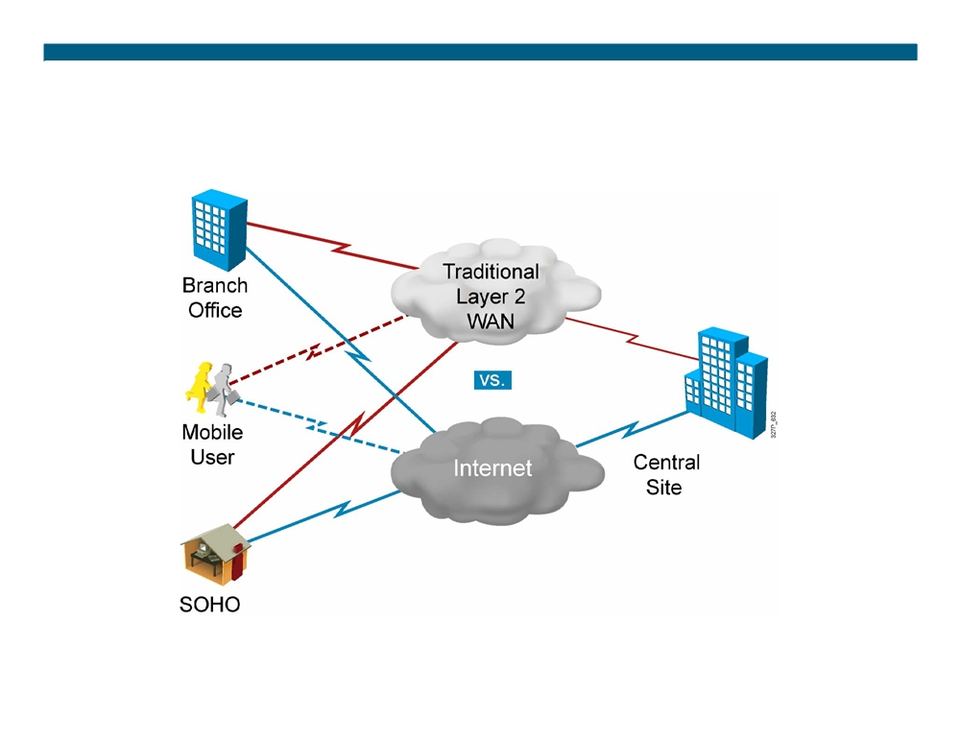
Benefits of VPN
ƒ Cost
ƒ Security ƒ Scalability
© 2007 Cisco Systems, Inc. All rights reserved.
ICND2 v1.0—8-3
The PDF files and any printed representation for this material are the property of Cisco Systems, Inc., for the sole use by Cisco employees for personal study. The files or printed representations may not be used in commercial training, and may not be distributed for purposes other than individual self-study.

Slide 4
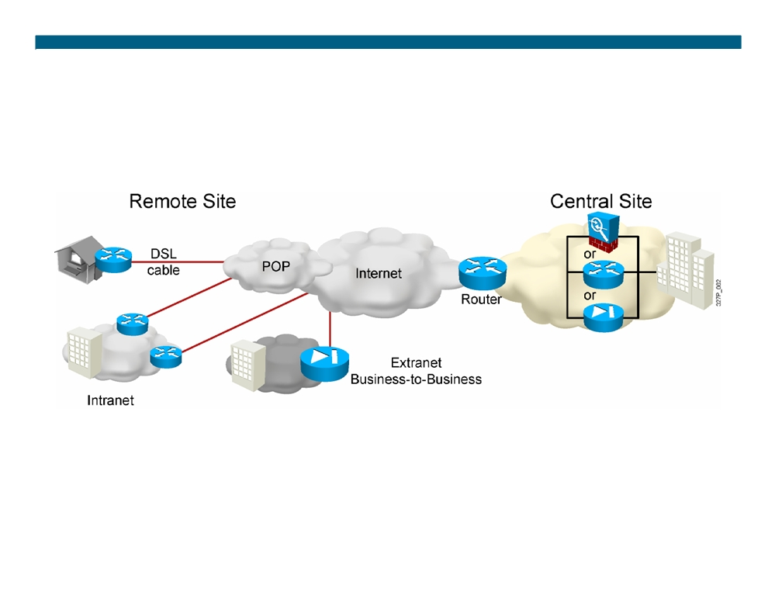
Site-to-Site VPNs
Site-to-site VPN: extension of classic WAN
© 2007 Cisco Systems, Inc. All rights reserved.
ICND2 v1.0—8-4
The PDF files and any printed representation for this material are the property of Cisco Systems, Inc., for the sole use by Cisco employees for personal study. The files or printed representations may not be used in commercial training, and may not be distributed for purposes other than individual self-study.

Slide 5
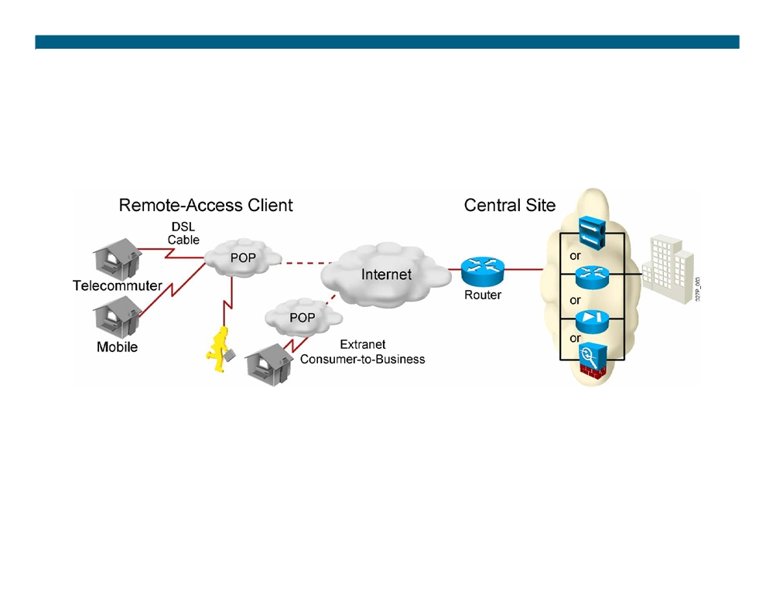
Remote-Access VPNs
Remote-access VPN: evolution of dial-in networks and ISDN
© 2007 Cisco Systems, Inc. All rights reserved.
ICND2 v1.0—8-5
The PDF files and any printed representation for this material are the property of Cisco Systems, Inc., for the sole use by Cisco employees for personal study. The files or printed representations may not be used in commercial training, and may not be distributed for purposes other than individual self-study.

Slide 6
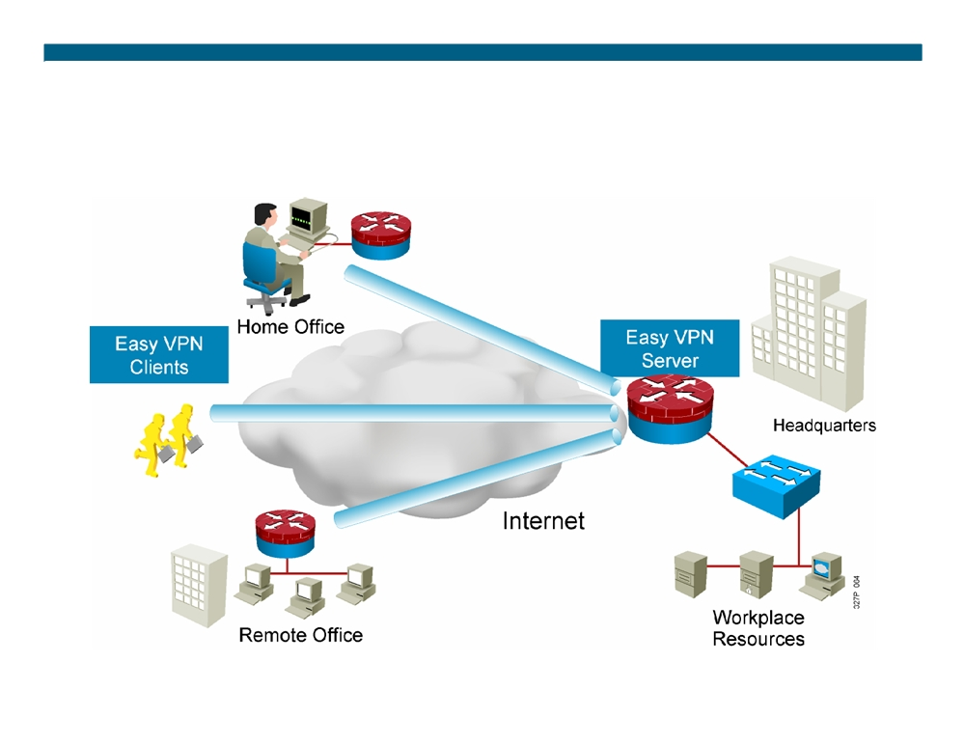
Cisco Easy VPN
© 2007 Cisco Systems, Inc. All rights reserved.
ICND2 v1.0—8-6
The PDF files and any printed representation for this material are the property of Cisco Systems, Inc., for the sole use by Cisco employees for personal study. The files or printed representations may not be used in commercial training, and may not be distributed for purposes other than individual self-study.

Slide 7
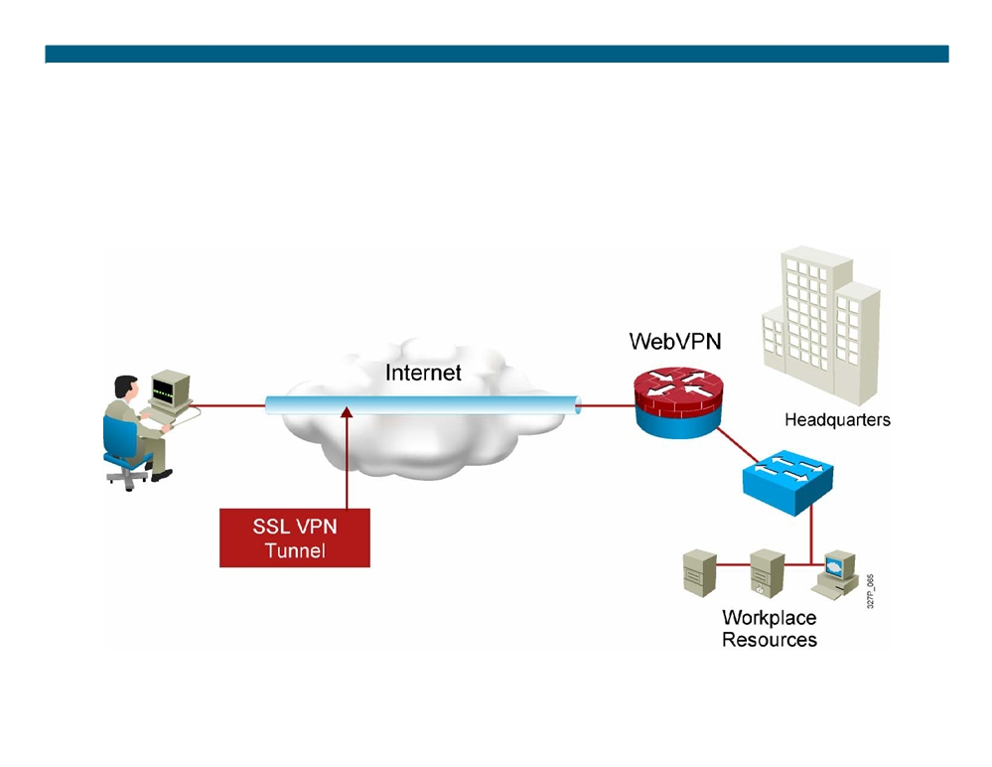
Cisco IOS IPsec SSL VPN (WebVPN)
ƒ Integrated security and routing
ƒ Browser-based full network SSL VPN access
© 2007 Cisco Systems, Inc. All rights reserved.
ICND2 v1.0—8-7
The PDF files and any printed representation for this material are the property of Cisco Systems, Inc., for the sole use by Cisco employees for personal study. The files or printed representations may not be used in commercial training, and may not be distributed for purposes other than individual self-study.

Slide 8
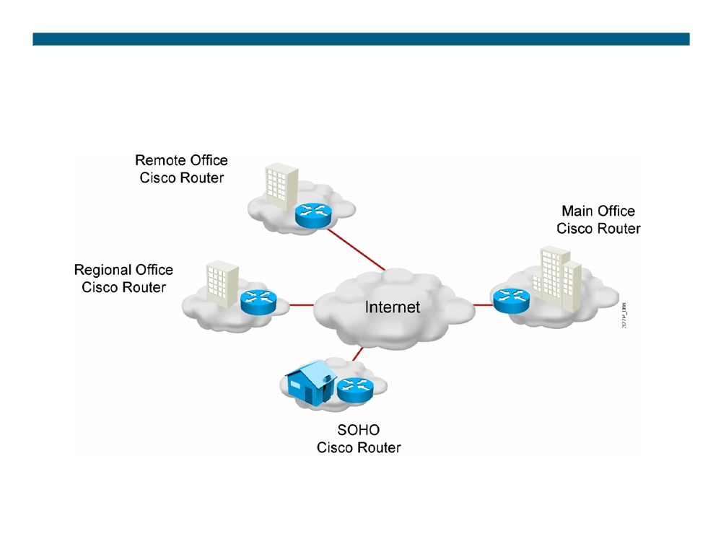
VPN-Enabled Cisco IOS Routers
© 2007 Cisco Systems, Inc. All rights reserved.
ICND2 v1.0—8-8
The PDF files and any printed representation for this material are the property of Cisco Systems, Inc., for the sole use by Cisco employees for personal study. The files or printed representations may not be used in commercial training, and may not be distributed for purposes other than individual self-study.

Slide 9
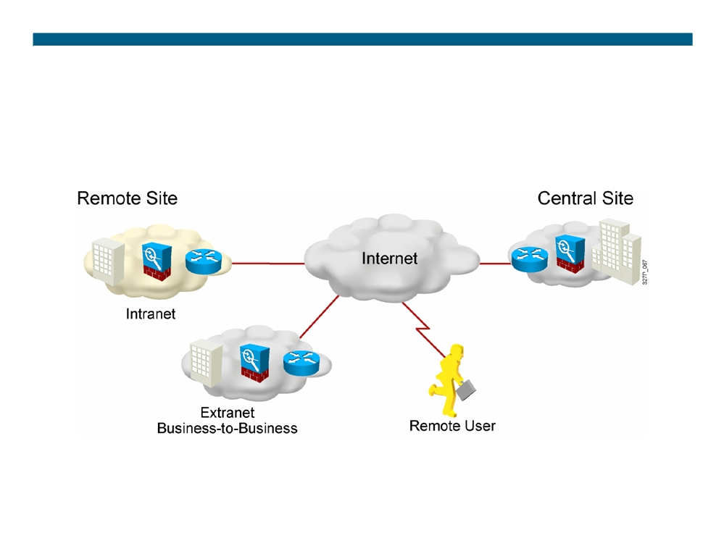
Cisco ASA Adaptive Security Appliances
© 2007 Cisco Systems, Inc. All rights reserved.
ICND2 v1.0—8-9
The PDF files and any printed representation for this material are the property of Cisco Systems, Inc., for the sole use by Cisco employees for personal study. The files or printed representations may not be used in commercial training, and may not be distributed for purposes other than individual self-study.

Slide 10
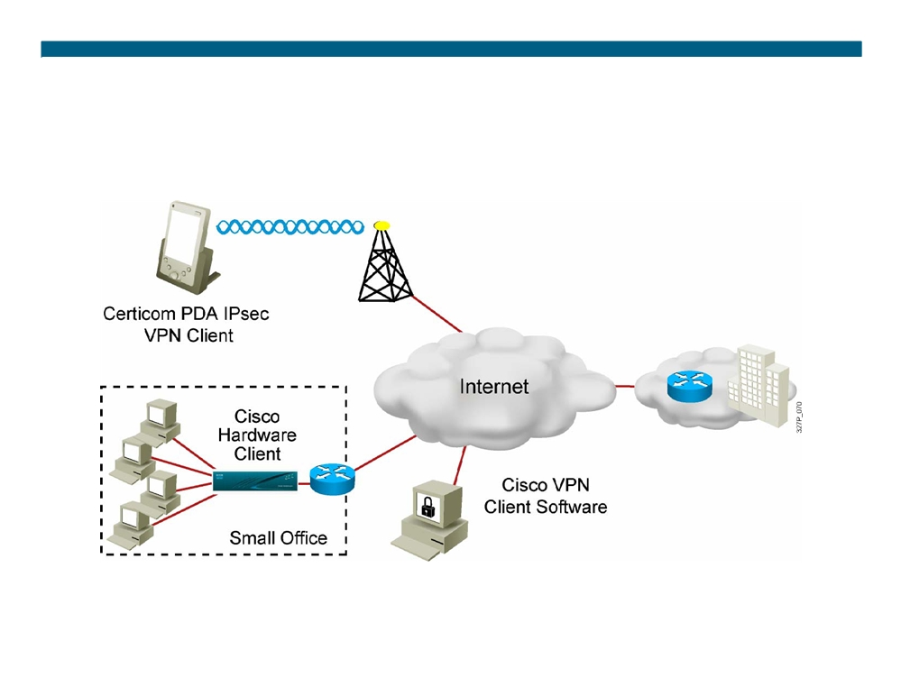
VPN Clients
(legacy)
© 2007 Cisco Systems, Inc. All rights reserved.
ICND2 v1.0—8-10
The PDF files and any printed representation for this material are the property of Cisco Systems, Inc., for the sole use by Cisco employees for personal study. The files or printed representations may not be used in commercial training, and may not be distributed for purposes other than individual self-study.

Slide 11
What Is IPsec?
IPsec acts at the network layer, protecting and authenticating IP packets.
ƒ It is a framework of open standards that is algorithm independent. ƒ It provides data confidentiality, data integrity, and origin authentication.
© 2007 Cisco Systems, Inc. All rights reserved.
ICND2 v1.0—8-11
The PDF files and any printed representation for this material are the property of Cisco Systems, Inc., for the sole use by Cisco employees for personal study. The files or printed representations may not be used in commercial training, and may not be distributed for purposes other than individual self-study.

Slide 12

IPsec Security Services
ƒ Confidentiality
ƒ Data integrity ƒ Authentication
ƒ Antireplay protection
© 2007 Cisco Systems, Inc. All rights reserved.
ICND2 v1.0—8-12
The PDF files and any printed representation for this material are the property of Cisco Systems, Inc., for the sole use by Cisco employees for personal study. The files or printed representations may not be used in commercial training, and may not be distributed for purposes other than individual self-study.

Slide 13
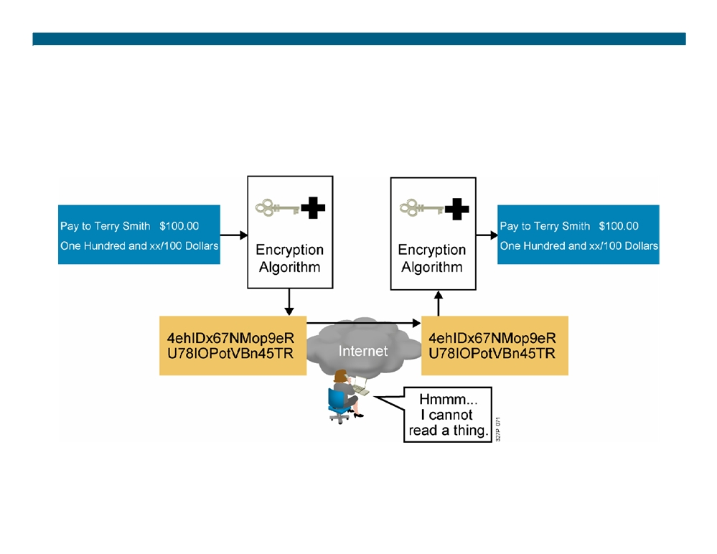
Confidentiality (Encryption)
© 2007 Cisco Systems, Inc. All rights reserved.
ICND2 v1.0—8-13
The PDF files and any printed representation for this material are the property of Cisco Systems, Inc., for the sole use by Cisco employees for personal study. The files or printed representations may not be used in commercial training, and may not be distributed for purposes other than individual self-study.

Slide 14
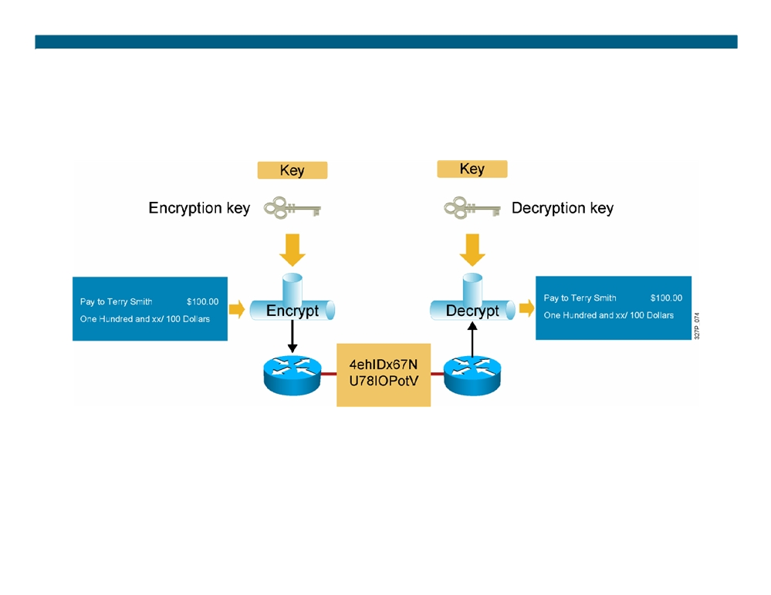
Encryption Algorithms
Encryption algorithms:
ƒ DES
ƒ 3DES
ƒ AES
ƒ RSA
© 2007 Cisco Systems, Inc. All rights reserved.
ICND2 v1.0—8-14
The PDF files and any printed representation for this material are the property of Cisco Systems, Inc., for the sole use by Cisco employees for personal study. The files or printed representations may not be used in commercial training, and may not be distributed for purposes other than individual self-study.

Slide 15
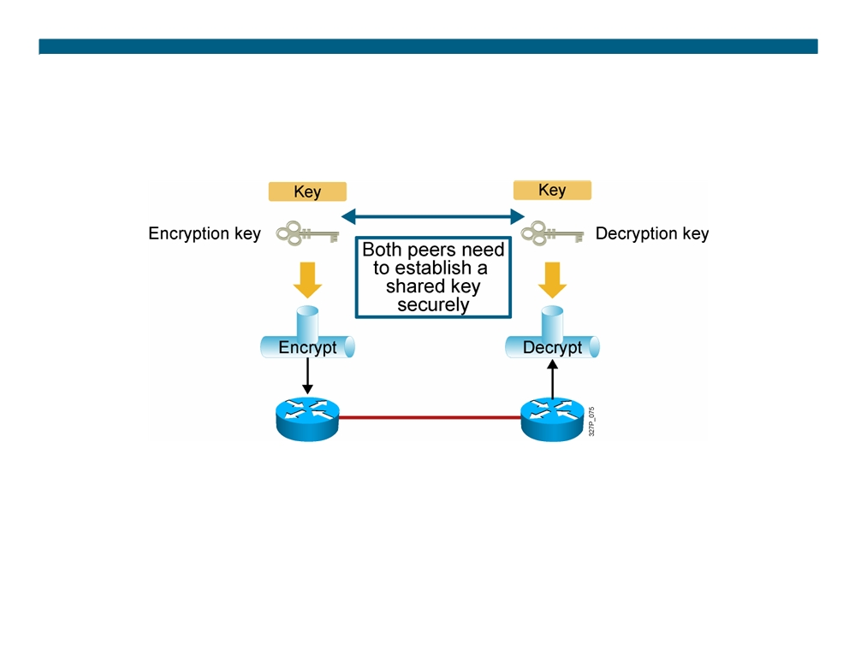
DH Key Exchange
Diffie-Hellman algorithms:
ƒ DH1
ƒ DH2 ƒ DH5
© 2007 Cisco Systems, Inc. All rights reserved.
ICND2 v1.0—8-15
The PDF files and any printed representation for this material are the property of Cisco Systems, Inc., for the sole use by Cisco employees for personal study. The files or printed representations may not be used in commercial training, and may not be distributed for purposes other than individual self-study.

Slide 16
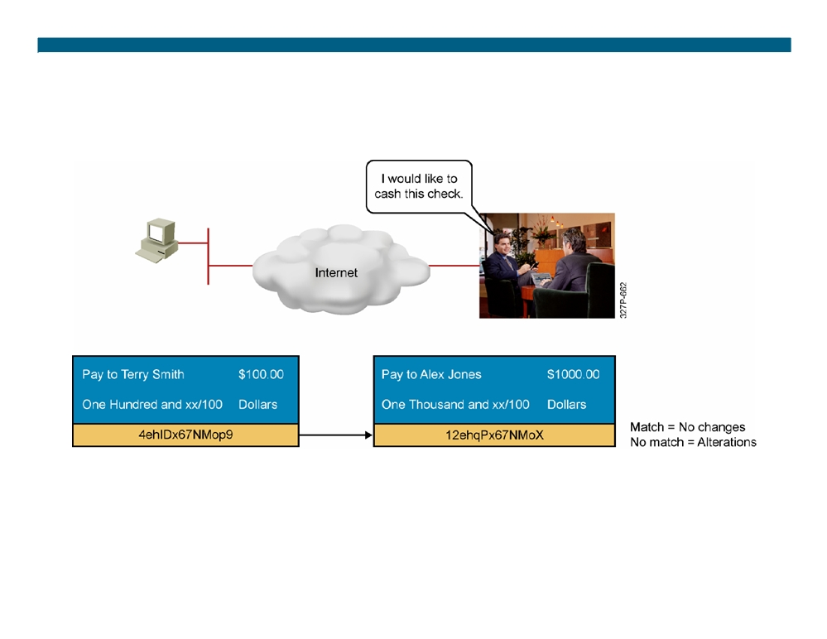
Data Integrity
Hashing algorithms:
ƒ HMAC-MD5
ƒ HMAC-SHA-1
© 2007 Cisco Systems, Inc. All rights reserved.
ICND2 v1.0—8-16
The PDF files and any printed representation for this material are the property of Cisco Systems, Inc., for the sole use by Cisco employees for personal study. The files or printed representations may not be used in commercial training, and may not be distributed for purposes other than individual self-study.

Slide 17
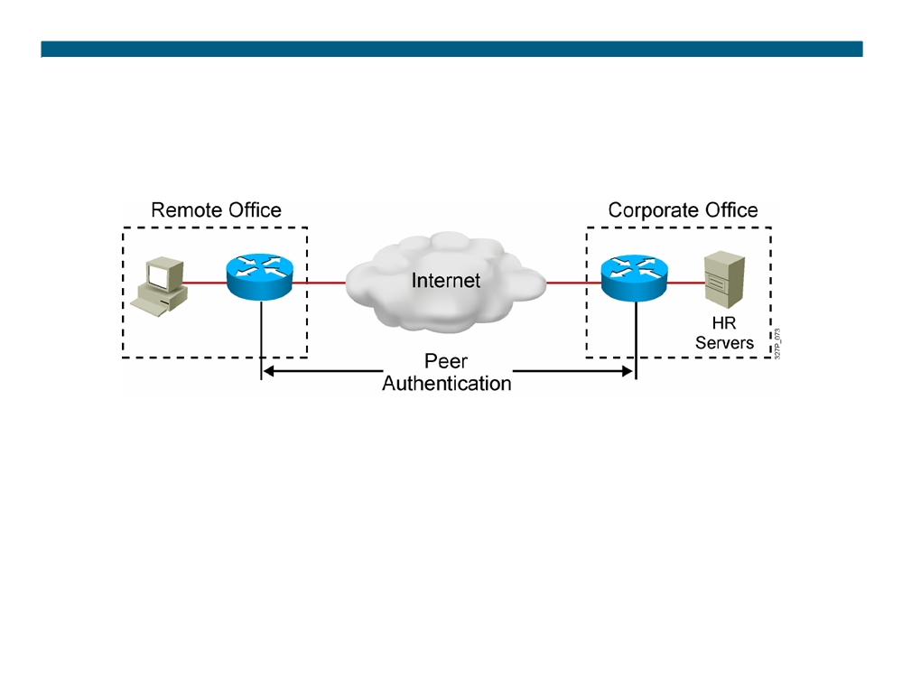
Authentication
Peer authentication methods:
ƒ PSKs
ƒ RSA signatures
© 2007 Cisco Systems, Inc. All rights reserved.
ICND2 v1.0—8-17
The PDF files and any printed representation for this material are the property of Cisco Systems, Inc., for the sole use by Cisco employees for personal study. The files or printed representations may not be used in commercial training, and may not be distributed for purposes other than individual self-study.

Slide 18
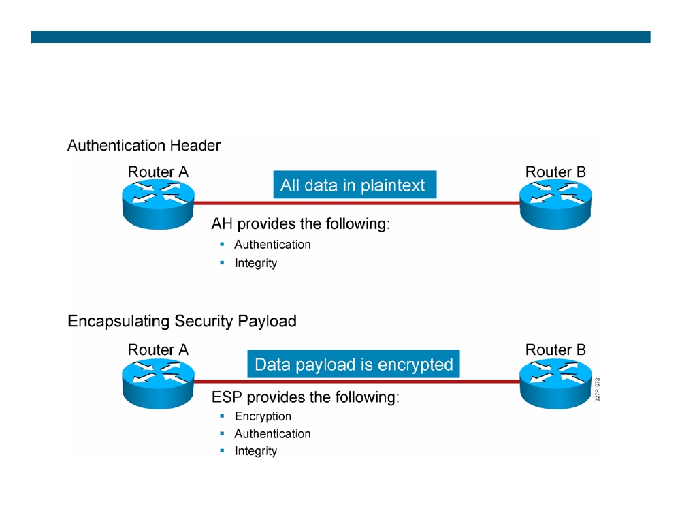
IPsec Security Protocols
© 2007 Cisco Systems, Inc. All rights reserved.
ICND2 v1.0—8-18
The PDF files and any printed representation for this material are the property of Cisco Systems, Inc., for the sole use by Cisco employees for personal study. The files or printed representations may not be used in commercial training, and may not be distributed for purposes other than individual self-study.

Slide 19
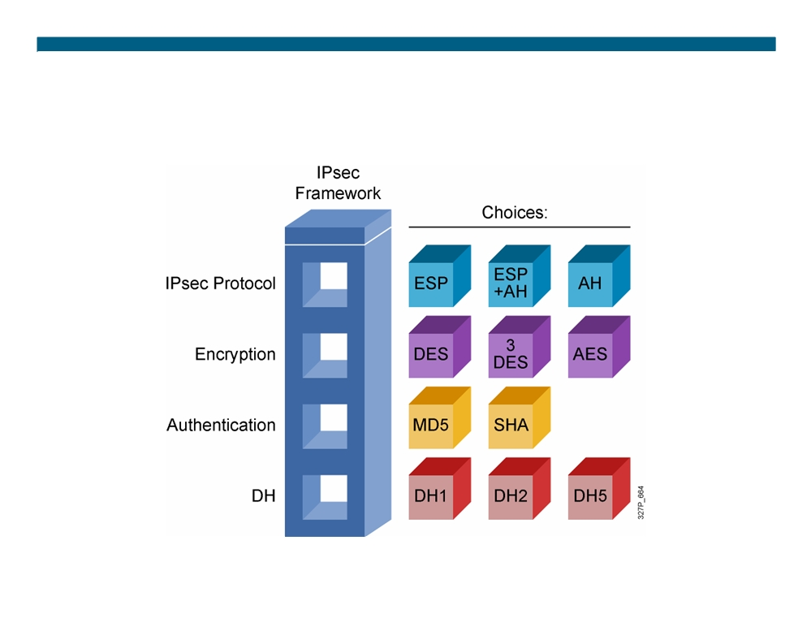
IPsec Framework
© 2007 Cisco Systems, Inc. All rights reserved.
ICND2 v1.0—8-19
The PDF files and any printed representation for this material are the property of Cisco Systems, Inc., for the sole use by Cisco employees for personal study. The files or printed representations may not be used in commercial training, and may not be distributed for purposes other than individual self-study.

Slide 20
Summary
ƒ Organizations implement VPNs because they are less expensive, more secure, and easier to scale than traditional WANs. ƒ Site-to-site VPNs secure traffic between intranet and extranet peers. Remote access VPNs secure communications from the traveling telecommuter to the central office.
ƒ VPNs can be implemented with a variety of different Cisco devices: Cisco IOS routers, ASA 5500 Series Adaptive Security Appliances, and Cisco VPN Client software.
ƒ IPsec is the framework that combines security protocols together and provides VPNs with data confidentiality, integrity, and authentication.
ƒ AH and ESP are the two main IPsec framework protocols.
© 2007 Cisco Systems, Inc. All rights reserved.
ICND2 v1.0—8-20
The PDF files and any printed representation for this material are the property of Cisco Systems, Inc., for the sole use by Cisco employees for personal study. The files or printed representations may not be used in commercial training, and may not be distributed for purposes other than individual self-study.

Slide 21
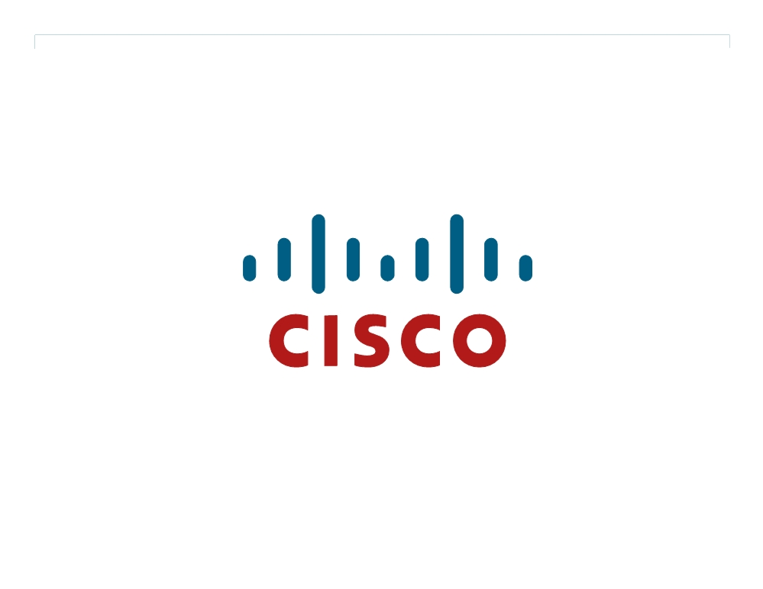
© 2007 Cisco Systems, Inc. All rights reserved.
ICND2 v1.0—8-21 The PDF files and any printed representation for this material are the property of Cisco Systems, Inc., for the sole use by Cisco employees for personal study. The files or printed representations may not be used in commercial training, and may not be distributed for purposes other than individual self-study.

