Slide 1
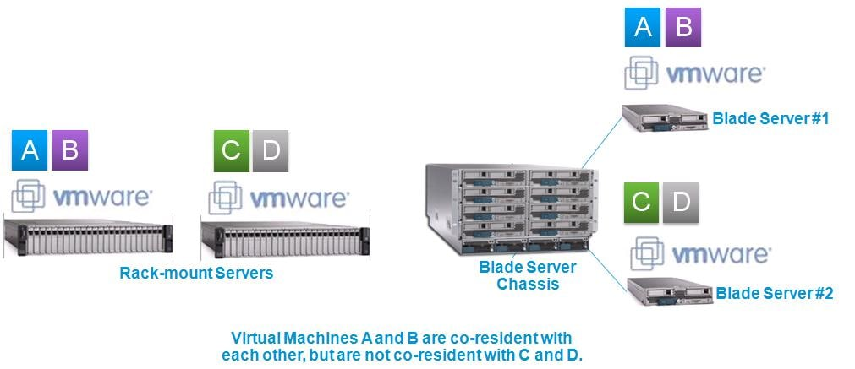
VIRTUALIZATION
From the perspective of most CCNA discussions, a server is a place to run applications, with users connecting to those applications over the network.
No KVM: For most servers, there is no permanent user who sits near the server; all the users and administrators connect to the server over the network. As a result, there is no need for a permanent keyboard, video display, or mouse (collectively referred to as KVM).
Racks of servers in a data center: In the early years of servers, a server was any computer with relatively fast CPU, large amounts of RAM, and so on. Today, companies put many servers into one room—a data center—and one goal is to not waste space.
Cisco expanded its product line into the server market, with the Cisco Unified Computing System (UCS) product line. The photo shows a product from the UCS B-Series (Blade series) that uses a rack-mountable chassis, with slots for server blades.
© 2007 Cisco Systems, Inc. All rights reserved.
ICND2 v1.0—5-14
The PDF files and any printed representation for this material are the property of Cisco Systems, Inc., for the sole use by Cisco employees for personal study. The files or printed representations may not be used in commercial training, and may not be distributed for purposes other than individual self-study.

Slide 2
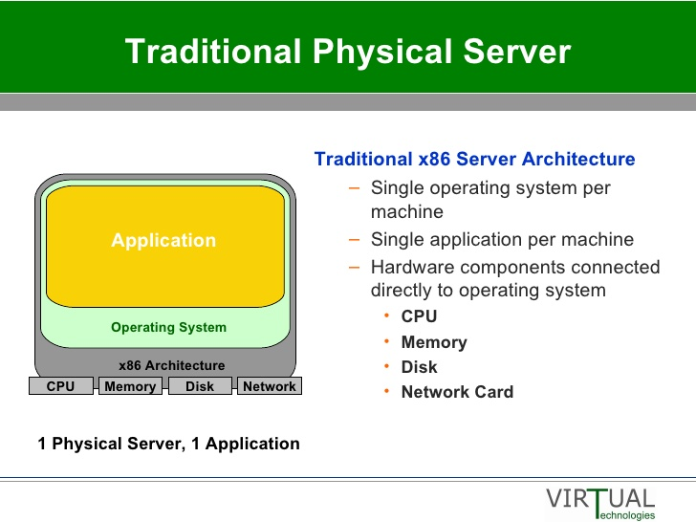
VIRTUALIZATION
Traditionally, when you think of one server, that one server runs one OS. Inside, the hardware includes a CPU, some RAM, some kind of permanent storage (like disk drives), and one or more NICs. And that one OS can use all the hardware inside the server and then run one or more applications.
© 2007 Cisco Systems, Inc. All rights reserved.
ICND2 v1.0—5-14
The PDF files and any printed representation for this material are the property of Cisco Systems, Inc., for the sole use by Cisco employees for personal study. The files or printed representations may not be used in commercial training, and may not be distributed for purposes other than individual self-study.

Slide 3
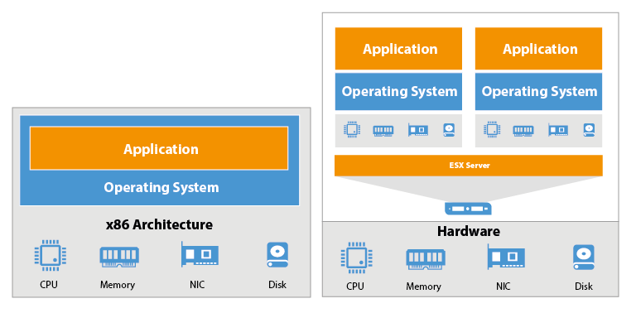
VIRTUALIZATION
A VM(Virtual Machine)—that is, an OS instance that is decoupled from the server hardware—still must execute on hardware. Each VM has configuration as to the minimum number of vCPUs it needs, minimum RAM, and so on. The virtualization system then starts each VM on some physical server so that enough physical server hardware capacity exists to support all the VMs running on that host. So, at any one point in time, each VM is running on a physical server, using a subset of the CPU, RAM, storage, and NICs on that server.
© 2007 Cisco Systems, Inc. All rights reserved.
ICND2 v1.0—5-14
The PDF files and any printed representation for this material are the property of Cisco Systems, Inc., for the sole use by Cisco employees for personal study. The files or printed representations may not be used in commercial training, and may not be distributed for purposes other than individual self-study.

Slide 4
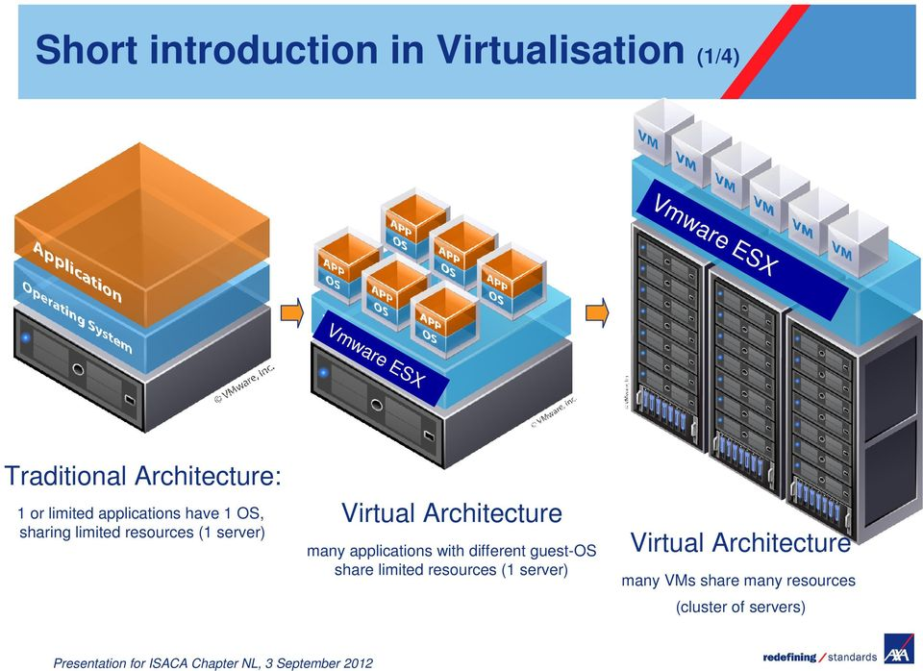
Virtual Servers act as if they are separated single machine server.

Slide 5
VIRTUALIZATION
Ther are two types of HyperVisor. Type1 and Type2.
In Type1 case, Hypervisor is directly insatalled on HW without an OS(called FirmWare Hyperviser). After, VMs installed which can have different OS.
In Type2 case HyperVisor installed over an existing OS on an existing HW( called guest Hypervisor).
In both cases function of HV is:
-to schedule the VMs requests to the HW and
-to distribute the HW resources between VMs.
Some Type1 HVs
1) Hyper-V - Microsoft
2) vCenter - VMware
3) KVM - Red Hat
4) XenServer -Citrix
© 2007 Cisco Systems, Inc. All rights reserved.
ICND2 v1.0—5-14
The PDF files and any printed representation for this material are the property of Cisco Systems, Inc., for the sole use by Cisco employees for personal study. The files or printed representations may not be used in commercial training, and may not be distributed for purposes other than individual self-study.

Slide 6
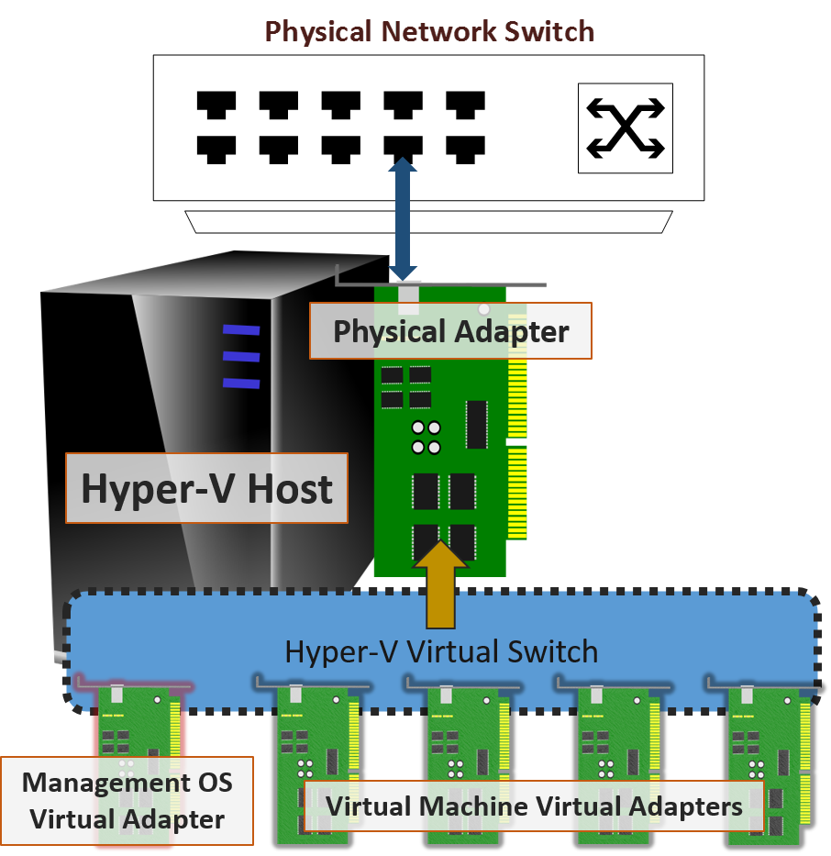
VIRTUALIZATION
HOW TO CONNECT VMs TO REAL NETWORK ?
Each VM has vEthernet Card. And they are connected to VirtualSwitch.
vSwitch can connect to physical SWs.
vSWs can be inside of HyperVisor or can be
externally loaded(as a Cisco Nexus 1000 V virtual switch).
© 2007 Cisco Systems, Inc. All rights reserved.
ICND2 v1.0—5-14
The PDF files and any printed representation for this material are the property of Cisco Systems, Inc., for the sole use by Cisco employees for personal study. The files or printed representations may not be used in commercial training, and may not be distributed for purposes other than individual self-study.

Slide 7
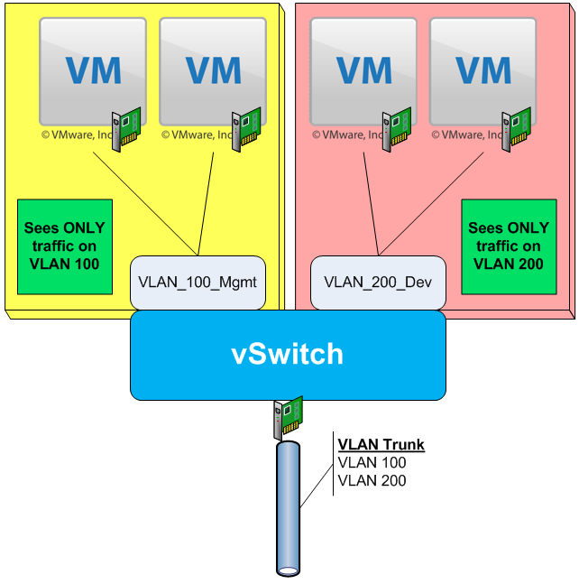
VIRTUALIZATION
vSwitch port can be configured as Trunk port to external network.
© 2007 Cisco Systems, Inc. All rights reserved.
ICND2 v1.0—5-14
The PDF files and any printed representation for this material are the property of Cisco Systems, Inc., for the sole use by Cisco employees for personal study. The files or printed representations may not be used in commercial training, and may not be distributed for purposes other than individual self-study.

Slide 8
VIRTUALIZATION
Advantages of Virtualization
As many VM as HW allows.
All VMs share same HW.
Each VM works independently as they are seperate physical machine.
Reduces cost.
Less storage area
Centeral management
Security
BackUp and Recovery.
Easy migration.
Disadvantages of Virtualization.
Shared resources
Skilled personel for managament.
All aggs are in one basket(Single point of failure).
© 2007 Cisco Systems, Inc. All rights reserved.
ICND2 v1.0—5-14
The PDF files and any printed representation for this material are the property of Cisco Systems, Inc., for the sole use by Cisco employees for personal study. The files or printed representations may not be used in commercial training, and may not be distributed for purposes other than individual self-study.

