Slide 1

Establishing a
Point-to-Point WAN Connection with PPP
LAN Extension into a WAN
© 2007 Cisco Systems, Inc. All rights reserved.
ICND2 v1.0—8-1
The PDF files and any printed representation for this material are the property of Cisco Systems, Inc., for the sole use by Cisco employees for personal study. The files or printed representations may not be used in commercial training, and may not be distributed for purposes other than individual self-study.

Slide 2
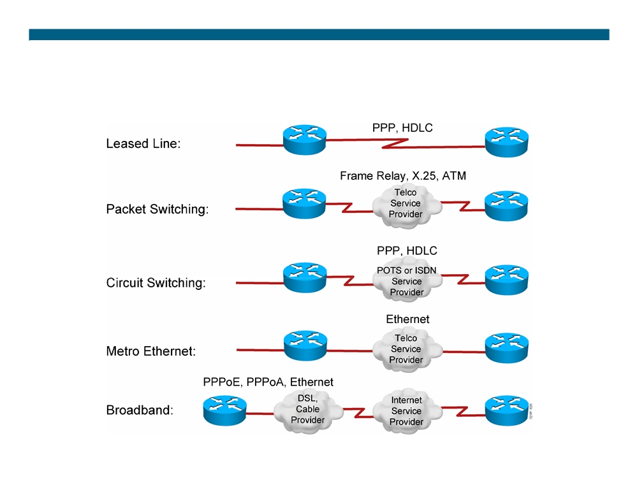
Typical WAN Encapsulation Protocols
© 2007 Cisco Systems, Inc. All rights reserved.
ICND2 v1.0—8-2
The PDF files and any printed representation for this material are the property of Cisco Systems, Inc., for the sole use by Cisco employees for personal study. The files or printed representations may not be used in commercial training, and may not be distributed for purposes other than individual self-study.

Slide 3
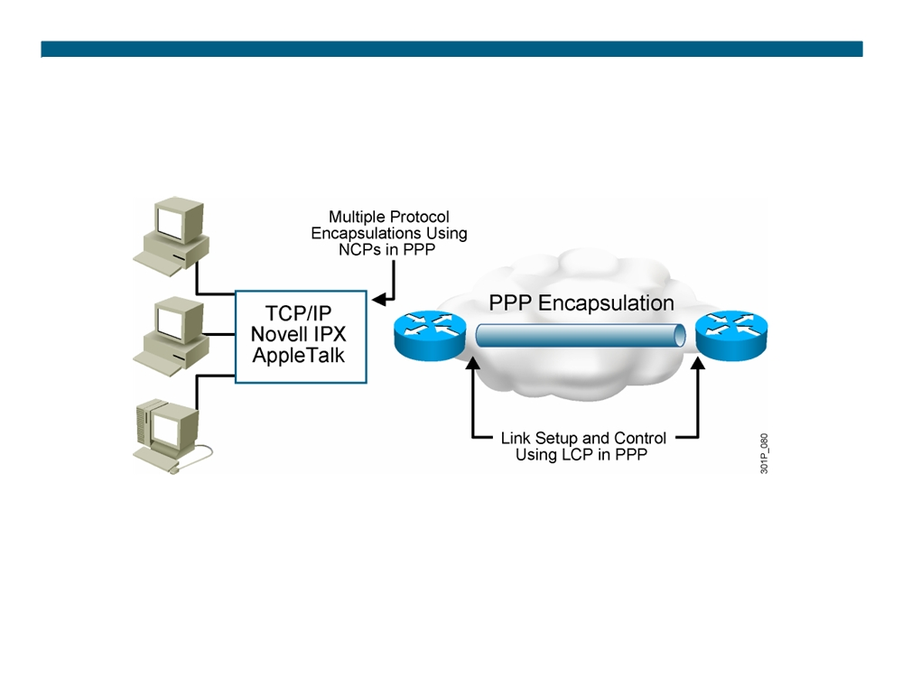
An Overview of PPP
ƒ PPP can carry packets from several protocol suites using NCP. ƒ PPP controls the setup of several link options using LCP.
© 2007 Cisco Systems, Inc. All rights reserved.
ICND2 v1.0—8-3
The PDF files and any printed representation for this material are the property of Cisco Systems, Inc., for the sole use by Cisco employees for personal study. The files or printed representations may not be used in commercial training, and may not be distributed for purposes other than individual self-study.

Slide 4
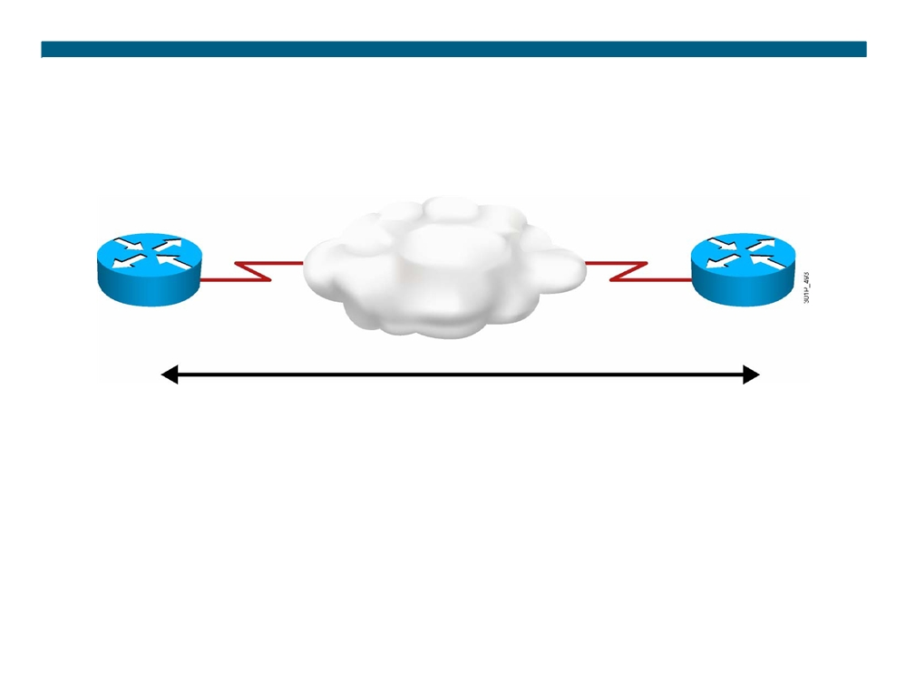
PPP Session Establishment
PPP session establishment:
1. Link establishment phase 2. Authentication phase (optional)
Two PPP authentication protocols: PAP and CHAP 3. Network layer protocol phase
© 2007 Cisco Systems, Inc. All rights reserved.
ICND2 v1.0—8-4
The PDF files and any printed representation for this material are the property of Cisco Systems, Inc., for the sole use by Cisco employees for personal study. The files or printed representations may not be used in commercial training, and may not be distributed for purposes other than individual self-study.

Slide 5
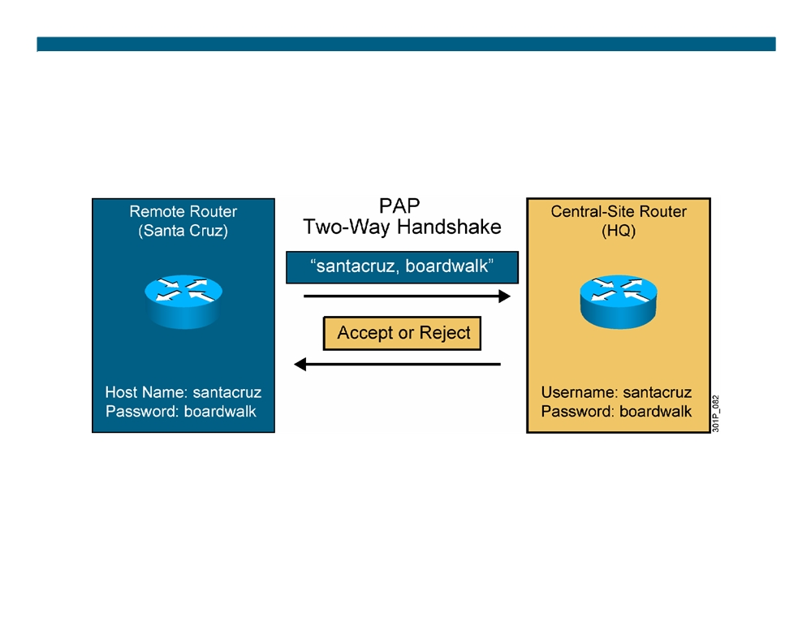
PPP Authentication Protocols: PAP
ƒ Passwords sent in plaintext
ƒ Peer in control of attempts
© 2007 Cisco Systems, Inc. All rights reserved.
ICND2 v1.0—8-5
The PDF files and any printed representation for this material are the property of Cisco Systems, Inc., for the sole use by Cisco employees for personal study. The files or printed representations may not be used in commercial training, and may not be distributed for purposes other than individual self-study.

Slide 6
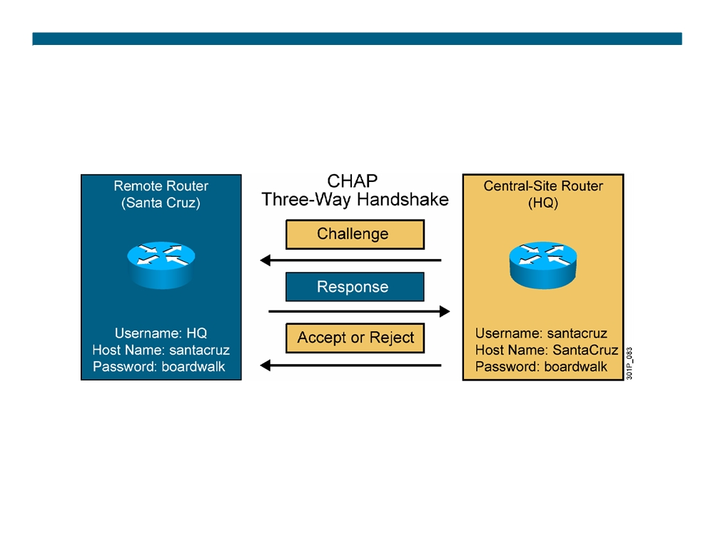
PPP Authentication Protocols: CHAP
ƒ This is an example of the Santa Cruz router authenticating to the HQ router. ƒ Hash values, not actual passwords, are sent across the link. ƒ The local router or external server is in control of authentication attempts.
© 2007 Cisco Systems, Inc. All rights reserved.
ICND2 v1.0—8-6
The PDF files and any printed representation for this material are the property of Cisco Systems, Inc., for the sole use by Cisco employees for personal study. The files or printed representations may not be used in commercial training, and may not be distributed for purposes other than individual self-study.

Slide 7
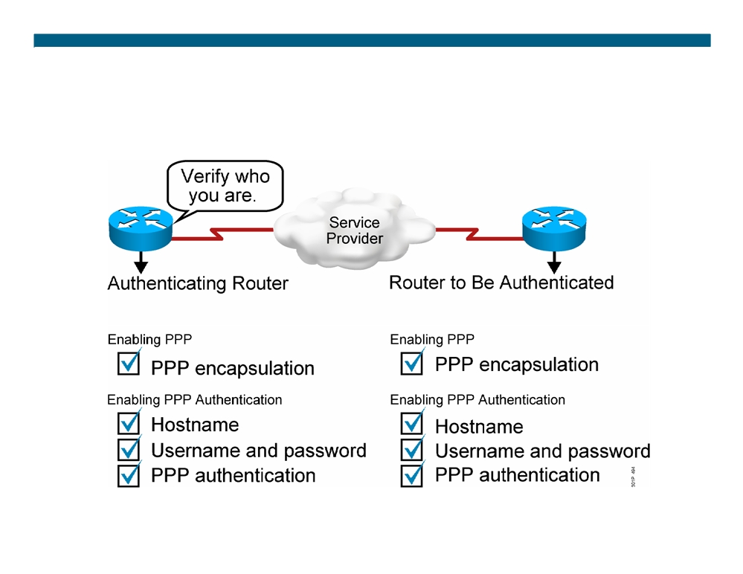
Configuring PPP and Authentication Overview
© 2007 Cisco Systems, Inc. All rights reserved.
ICND2 v1.0—8-7
The PDF files and any printed representation for this material are the property of Cisco Systems, Inc., for the sole use by Cisco employees for personal study. The files or printed representations may not be used in commercial training, and may not be distributed for purposes other than individual self-study.

Slide 8

Configuring PPP and Authentication
RouterX(config-if)# encapsulation ppp
ƒ Enables PPP encapsulation
RouterX(config)# hostname name ƒ Assigns a hostname to your router
RouterX(config)# username name password password ƒ Identifies the username and password of remote router
RouterX(config-if)# ppp authentication {chap | chap pap | pap chap | pap}
ƒ Enables PAP or CHAP authentication
© 2007 Cisco Systems, Inc. All rights reserved.
ICND2 v1.0—8-8
The PDF files and any printed representation for this material are the property of Cisco Systems, Inc., for the sole use by Cisco employees for personal study. The files or printed representations may not be used in commercial training, and may not be distributed for purposes other than individual self-study.

Slide 9
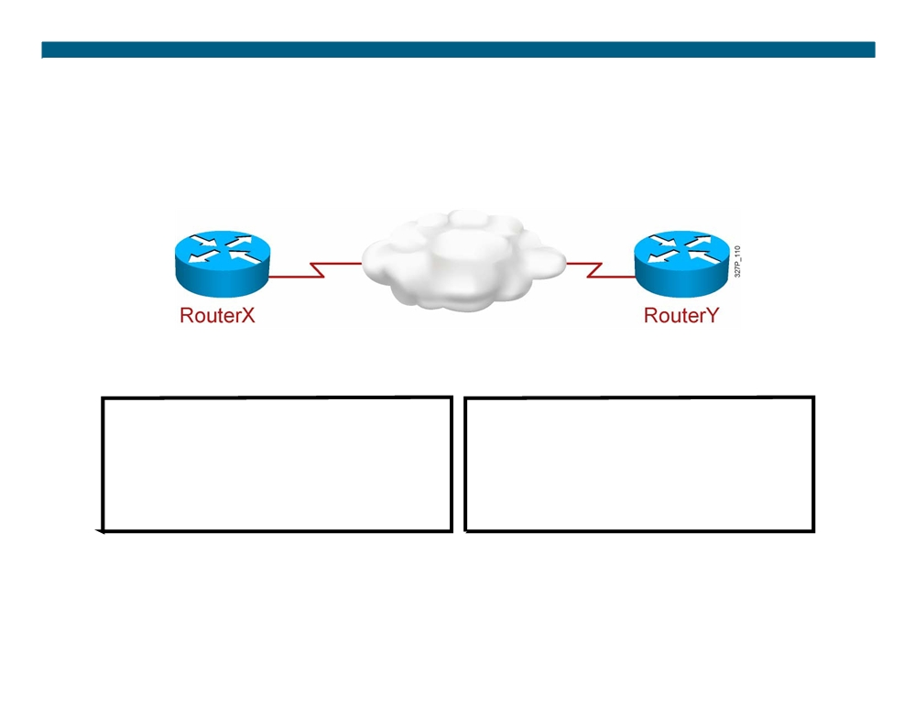
PPP and CHAP Configuration Example
hostname RouterX
hostname RouterY
username RouterY password sameone
username RouterX password sameone
!
!
int serial 0
int serial 0
ip address 10.0.1.1 255.255.255.0
ip address 10.0.1.2 255.255.255.0
encapsulation ppp
encapsulation ppp
ppp authentication chap
ppp authentication chap
© 2007 Cisco Systems, Inc. All rights reserved.
ICND2 v1.0—8-9 The PDF files and any printed representation for this material are the property of Cisco Systems, Inc., for the sole use by Cisco employees for personal study. The files or printed representations may not be used in commercial training, and may not be distributed for purposes other than individual self-study.

Slide 10
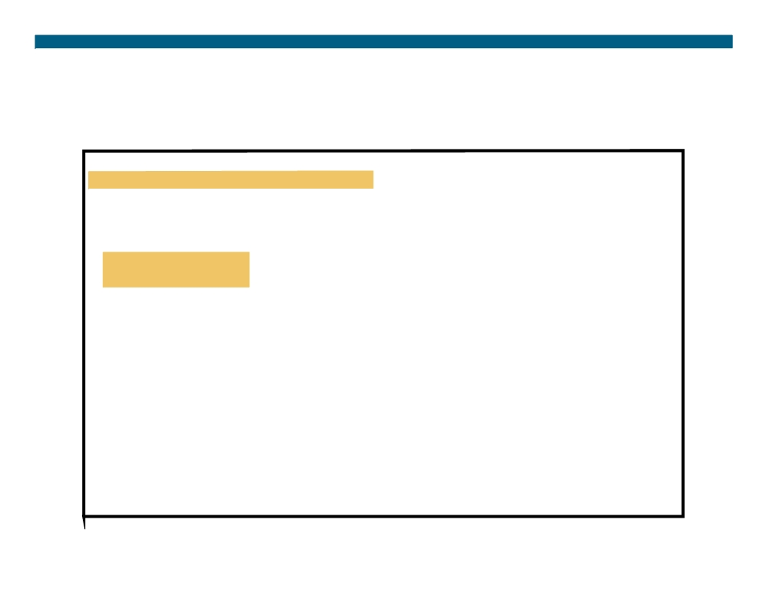
Verifying the PPP Encapsulation Configuration
RouterX# show interface s0 Serial0 is up, line protocol is up Hardware is HD64570
Internet address is 10.140.1.2/24
MTU 1500 bytes, BW 1544 Kbit, DLY 20000 usec, rely 255/255, load 1/255 Encapsulation PPP, loopback not set, keepalive set (10 sec) LCP Open
Open: IPCP, CDPCP
Last input 00:00:05, output 00:00:05, output hang never Last clearing of "show interface" counters never Queueing strategy: fifo
Output queue 0/40, 0 drops; input queue 0/75, 0 drops 5 minute input rate 0 bits/sec, 0 packets/sec 5 minute output rate 0 bits/sec, 0 packets/sec 38021 packets input, 5656110 bytes, 0 no buffer Received 23488 broadcasts, 0 runts, 0 giants, 0 throttles 0 input errors, 0 CRC, 0 frame, 0 overrun, 0 ignored, 0 abort 38097 packets output, 2135697 bytes, 0 underruns 0 output errors, 0 collisions, 6045 interface resets 0 output buffer failures, 0 output buffers swapped out 482 carrier transitions
DCD=up DSR=up DTR=up RTS=up CTS=up
© 2007 Cisco Systems, Inc. All rights reserved.
ICND2 v1.0—8-10
The PDF files and any printed representation for this material are the property of Cisco Systems, Inc., for the sole use by Cisco employees for personal study. The files or printed representations may not be used in commercial training, and may not be distributed for purposes other than individual self-study.

Slide 11
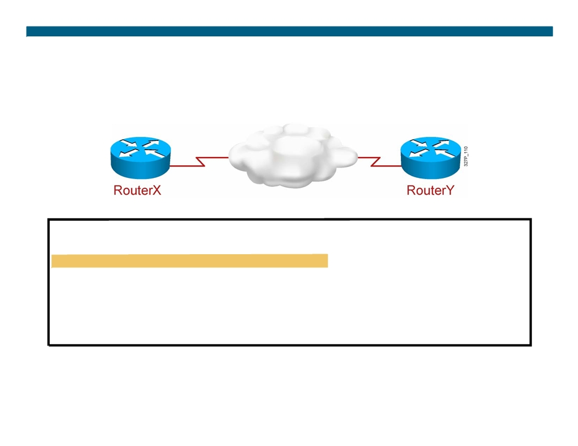
Verifying PPP Authentication
RouterX# debug ppp authentication
4d20h: %LINK-3-UPDOWN: Interface Serial0, changed state to up 4d20h: Se0 PPP: Treating connection as a dedicated line 4d20h: Se0 PPP: Phase is AUTHENTICATING, by both 4d20h: Se0 CHAP: O CHALLENGE id 2 len 28 from ”left" 4d20h: Se0 CHAP: I CHALLENGE id 3 len 28 from ”right" 4d20h: Se0 CHAP: O RESPONSE id 3 len 28 from ”left" 4d20h: Se0 CHAP: I RESPONSE id 2 len 28 from ”right" 4d20h: Se0 CHAP: O SUCCESS id 2 len 4
4d20h: Se0 CHAP: I SUCCESS id 3 len 4
4d20h: %LINEPROTO-5-UPDOWN: Line protocol on Interface Serial0, changed state to up
The debug ppp authentication command shows successful CHAP output
© 2007 Cisco Systems, Inc. All rights reserved.
ICND2 v1.0—8-11
The PDF files and any printed representation for this material are the property of Cisco Systems, Inc., for the sole use by Cisco employees for personal study. The files or printed representations may not be used in commercial training, and may not be distributed for purposes other than individual self-study.

Slide 12
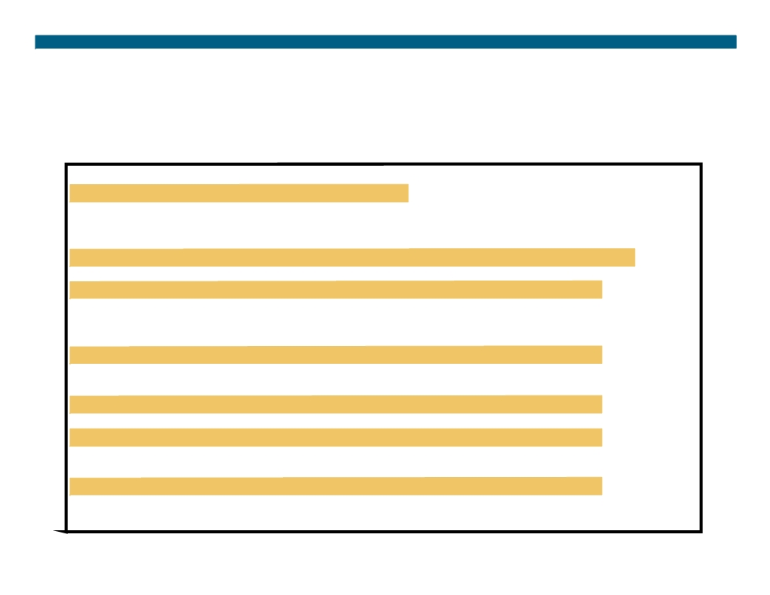
Verifying PPP Negotiation
RouterX# debug ppp negotiation
PPP protocol negotiation debugging is on RouterX#
*Mar
1
00:06:36.645: %LINK-3-UPDOWN: Interface BRI0:1, changed state to up
*Mar
1
00:06:36.661:
BR0:1 PPP: Treating connection as a callin
*Mar
1
00:06:36.665: BR0:1 PPP: Phase is ESTABLISHING, Passive Open
*Mar
1
00:06:36.669: BR0:1 LCP: State is Listen
*Mar
1
00:06:37.034: BR0:1 LCP: I CONFREQ [Listen] id 7 len 17
*Mar
1
00:06:37.038:
BR0:1 LCP:
AuthProto PAP (0x0304C023)
*Mar
1
00:06:37.042: BR0:1 LCP:
MagicNumber 0x507A214D (0x0506507A214D)
*Mar
1
00:06:37.046:
BR0:1 LCP:
Callback 0
(0x0D0300)
*Mar
1
00:06:37.054: BR0:1 LCP: O CONFREQ [Listen] id 4 len 15
*Mar
1
00:06:37.058: BR0:1 LCP:
AuthProto CHAP (0x0305C22305)
*Mar
1
00:06:37.062: BR0:1 LCP:
MagicNumber 0x1081E7E1 (0x05061081E7E1)
*Mar
1
00:06:37.066: BR0:1 LCP: O CONFREJ [Listen] id 7 len 7
*Mar
1
00:06:37.070:
BR0:1 LCP:
Callback 0
(0x0D0300)
*Mar
1
00:06:37.098:
BR0:1 LCP: I CONFACK [REQsent] id 4 len 15
*Mar
1
00:06:37.102: BR0:1 LCP:
AuthProto CHAP (0x0305C22305)
*Mar
1
00:06:37.106: BR0:1 LCP:
MagicNumber 0x1081E7E1 (0x05061081E7E1)
*Mar
1
00:06:37.114:
BR0:1 LCP: I CONFREQ [ACKrcvd] id 8 len 14
*Mar
1
00:06:37.117:
BR0:1 LCP:
AuthProto PAP (0x0304C023)
*Mar
1
00:06:37.121: BR0:1 LCP:
MagicNumber 0x507A214D (0x0506507A214D)
© 2007 Cisco Systems, Inc. All rights reserved.
ICND2 v1.0—8-12
The PDF files and any printed representation for this material are the property of Cisco Systems, Inc., for the sole use by Cisco employees for personal study. The files or printed representations may not be used in commercial training, and may not be distributed for purposes other than individual self-study.

Slide 13

Summary
ƒ PPP is a common Layer 2 protocol for the WAN. There are two components of PPP: LCP negotiates the connection and NCP encapsulates traffic.
ƒ You can configure PPP to use PAP or CHAP. PAP sends everything in plaintext. CHAP uses an MD5 hash.
ƒ Common PPP verification commands include show interface to verify PPP encapsulation and debug ppp negotiation to verify the LCP handshake.
© 2007 Cisco Systems, Inc. All rights reserved.
ICND2 v1.0—8-13
The PDF files and any printed representation for this material are the property of Cisco Systems, Inc., for the sole use by Cisco employees for personal study. The files or printed representations may not be used in commercial training, and may not be distributed for purposes other than individual self-study.

Slide 14

© 2007 Cisco Systems, Inc. All rights reserved.
ICND2 v1.0—8-14 The PDF files and any printed representation for this material are the property of Cisco Systems, Inc., for the sole use by Cisco employees for personal study. The files or printed representations may not be used in commercial training, and may not be distributed for purposes other than individual self-study.

