Slide 1
IMS Project
By Marco Castellana

Slide 2
Topics
Technologies used
Set up
My Approach to git
development
Testing
Sprint review

Slide 3
Technologies used
Git
Github
Jira
Mysql
Java
Maven
Junit
Eclipse ide

Slide 4
Set up
Explore the template
Map to uml diagram
Er diagram
Risk assessment
use of Jira

Slide 5
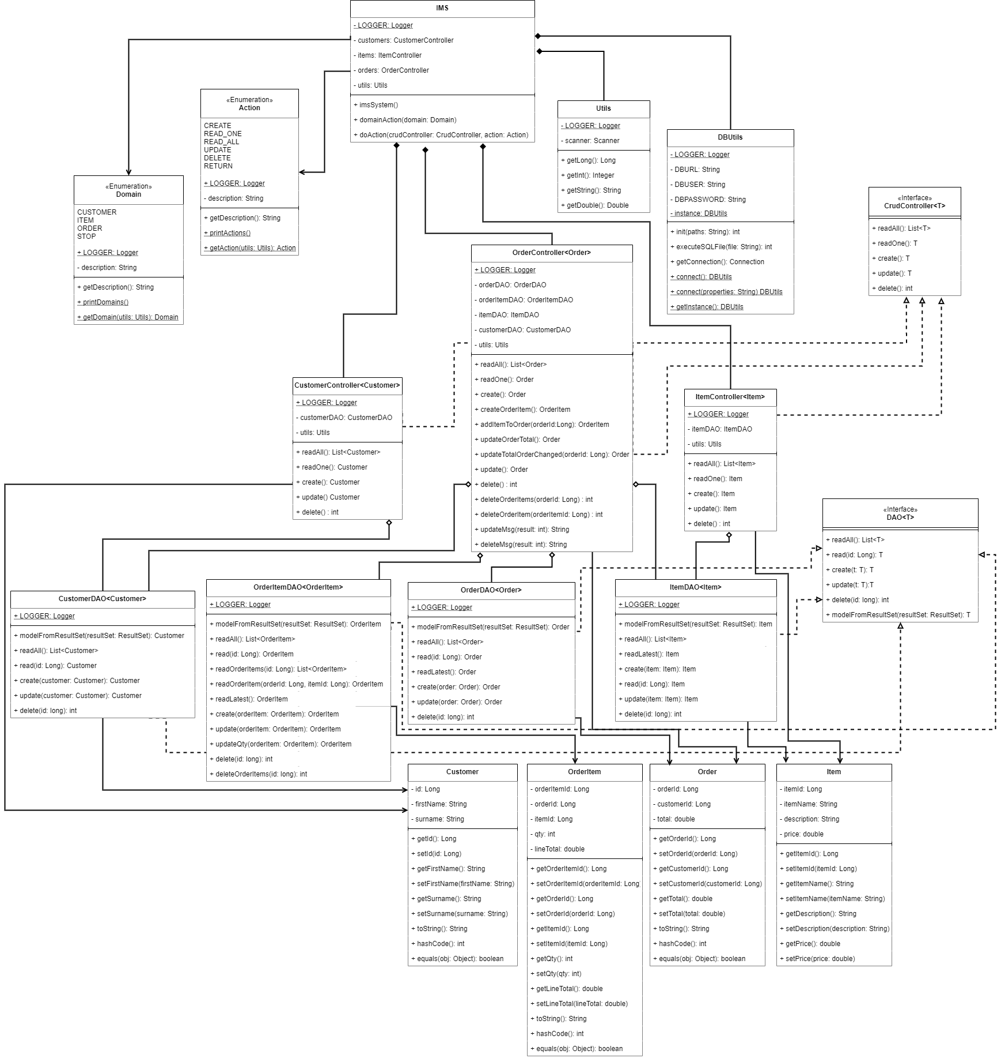
UML

Slide 6
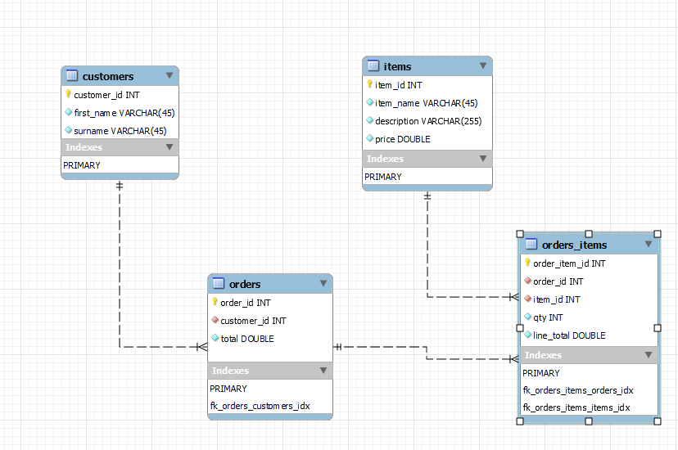
Er diagram

Slide 7
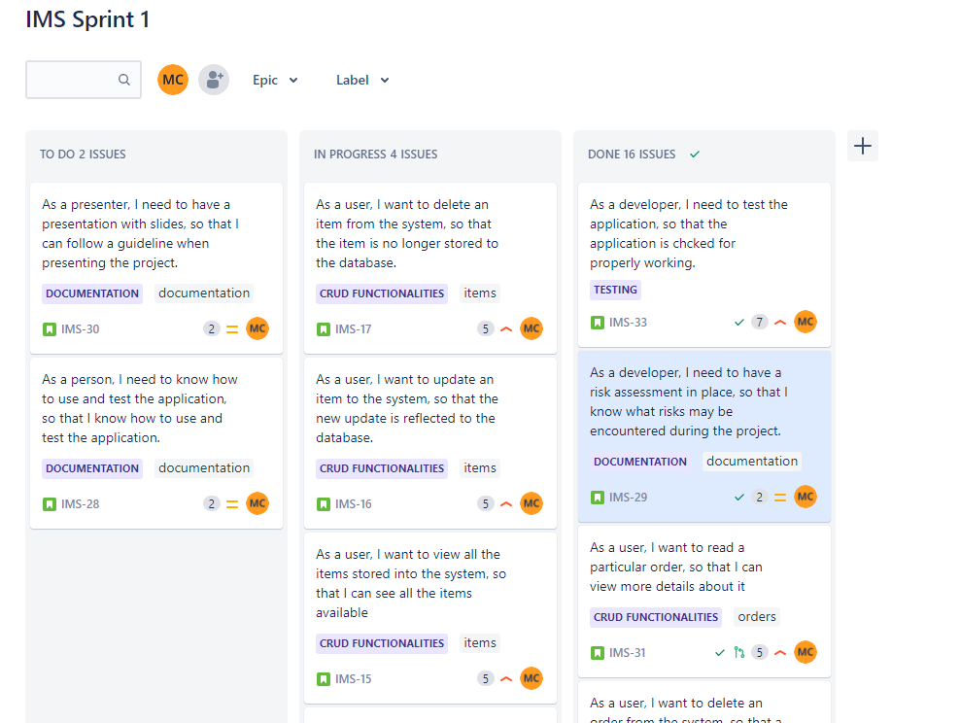
Jira and the Kanban board

Slide 8
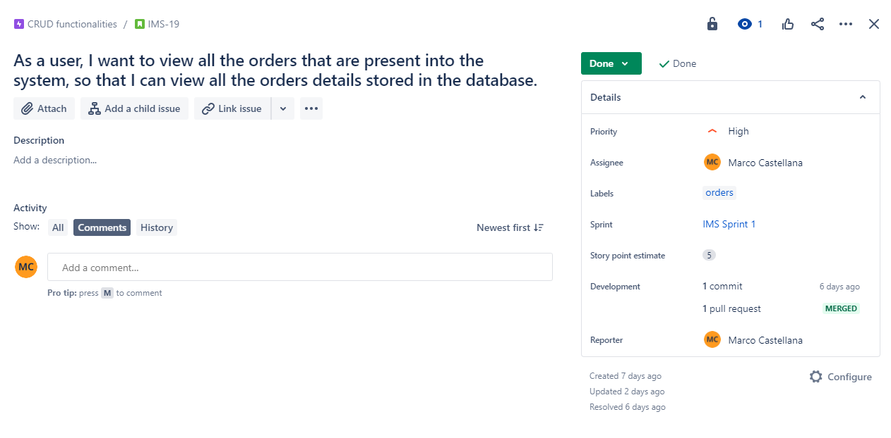
User stories

Slide 9
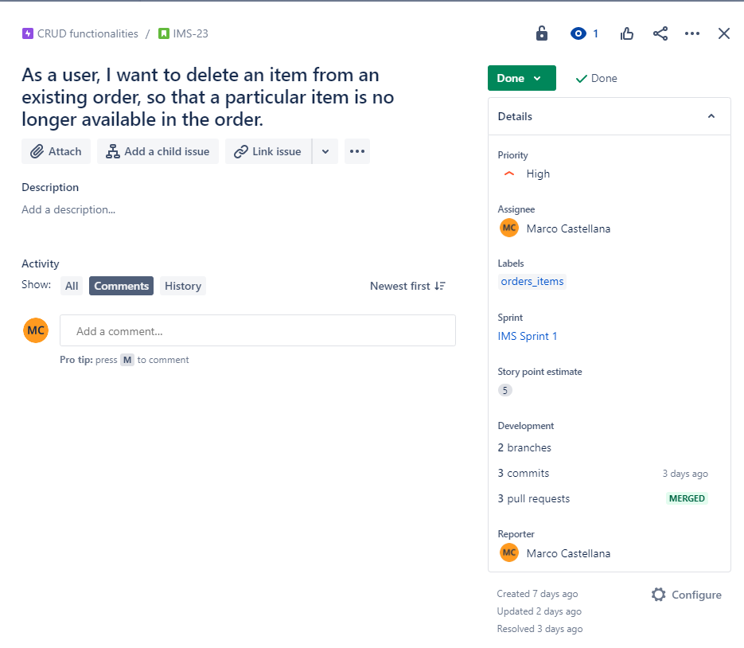
User stories

Slide 10
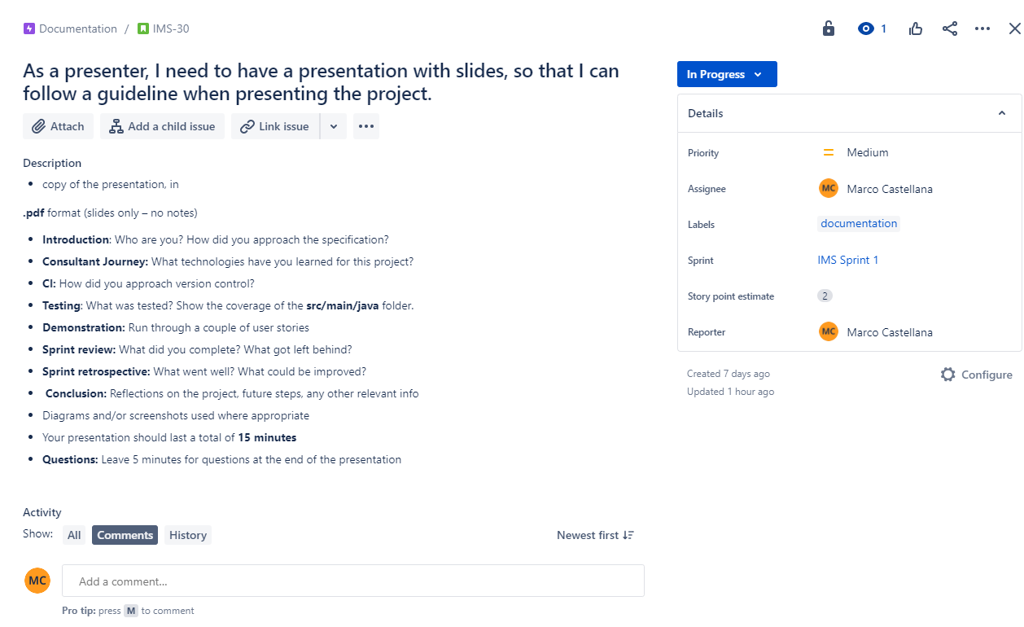
User stories

Slide 11
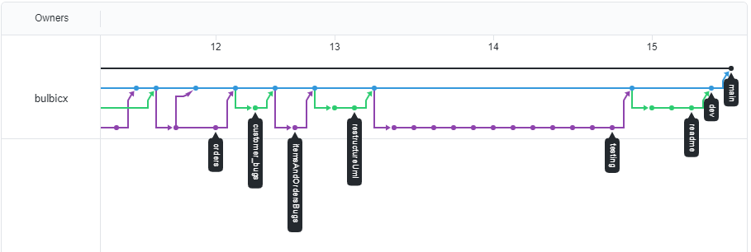
My approach to git
Use of git and GitHub
Use of branches to create features
Use of commits
Merge to main when final product is stable

Slide 12
development
Sql development
Connection database with application
Java application

Slide 13
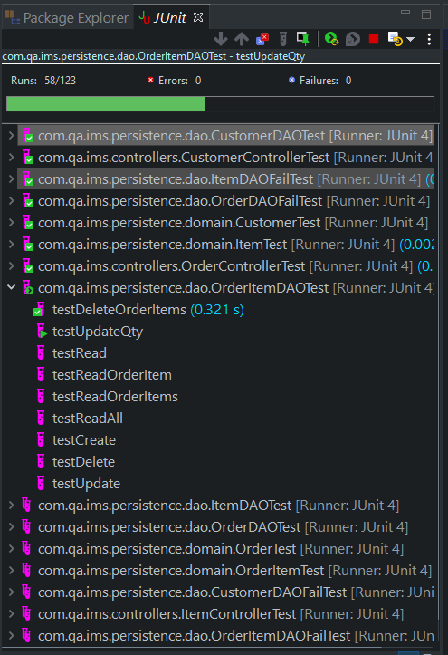
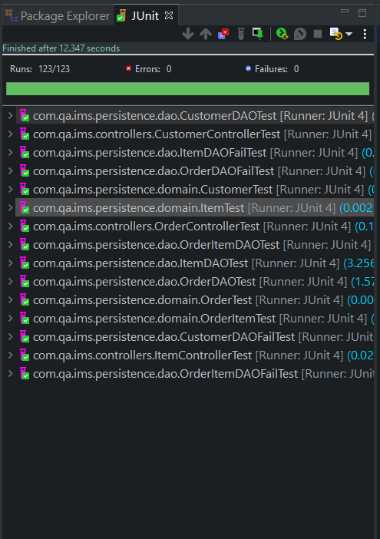
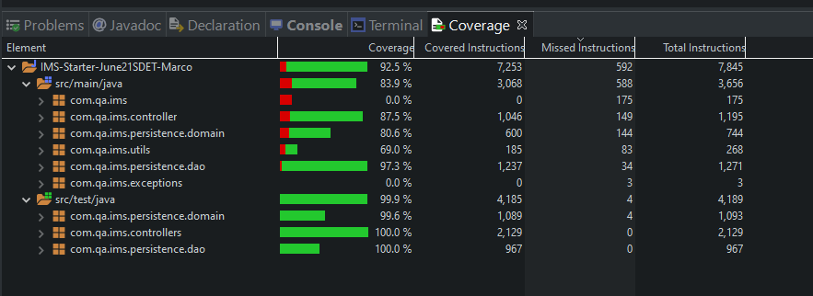
testing
DAO, Controller and domains
Use of Mockito
Test pass above 80%

Slide 14
Sprint review
Completed all user stories determined by mvp
No delays on features
Added some additional features for more user interactivity

Slide 15
Sprint retrospective
Timing was perfect
Points can be better scored
Past Coding experience helped

Slide 16
Conclusion
Learned new technologies
Able to use testing for applications
Project result was a success
Future steps may be adding an interface to it

Slide 17
Thank you
Any Questions?

