Slide 1
TDL PROJECT
By Marco Castellana

Slide 2
TOPICS
Technologies used
Set up
My approach to GIT
Development
Testing phase
Sprint review
Sprint retrospective

Slide 3
Technologies Used
GIT
GitHub
Jira
MySQL
Java
HTML5, CSS, JS
Spring Boot
Maven
Junit
SonarQube
Eclipse IDE
Visual Studio Code

Slide 4
Set up
Understanding the problem
Map UML Diagram
ER Diagram
Risk Assessment
Use of Jira

Slide 5
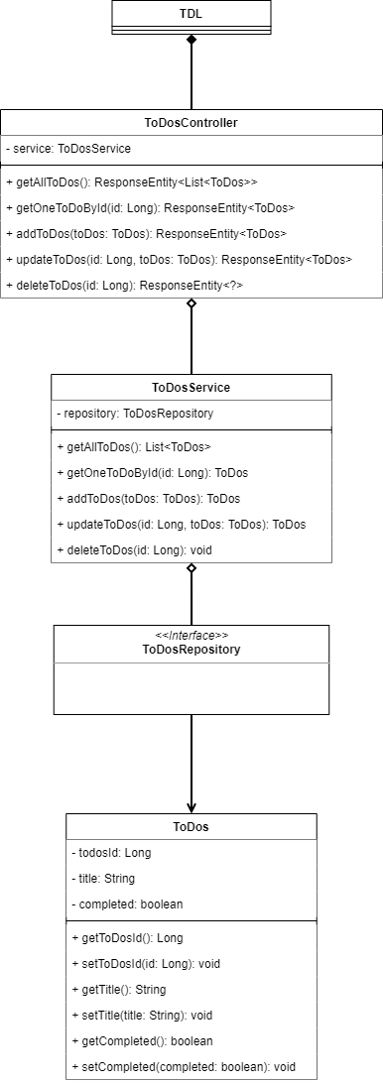
UML
Controller
Service
Repository
Model

Slide 6
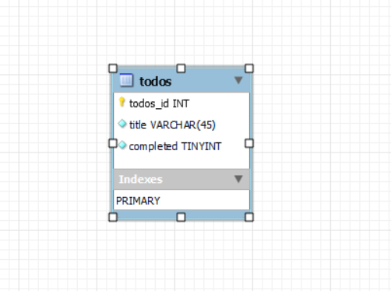
ER Diagram

Slide 7
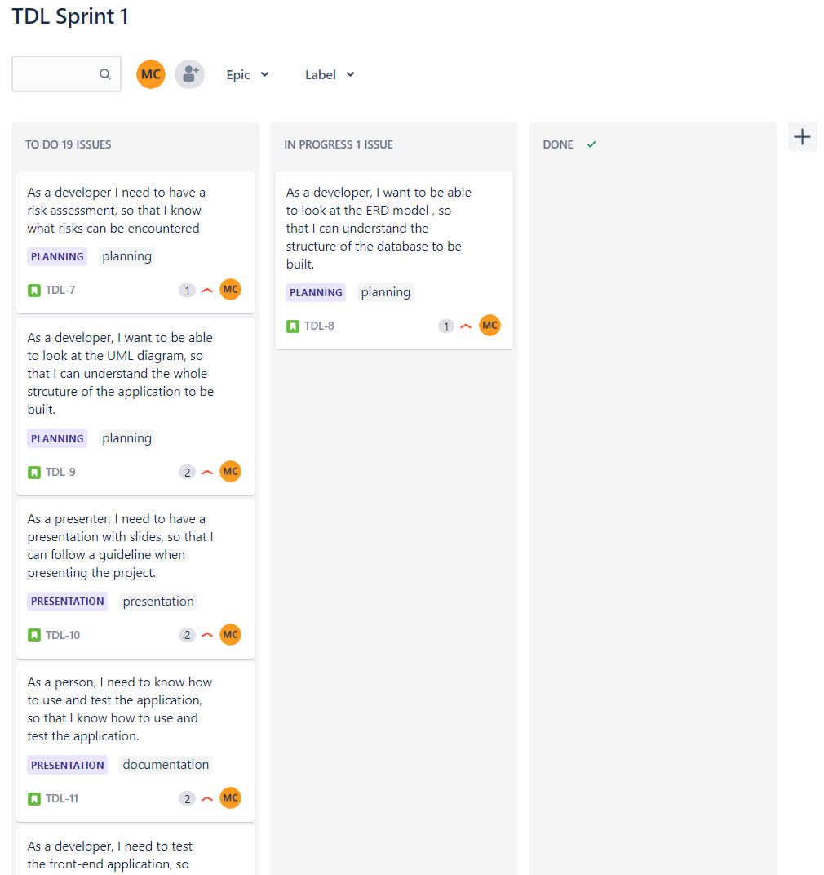
Jira and the Kanban Board

Slide 8
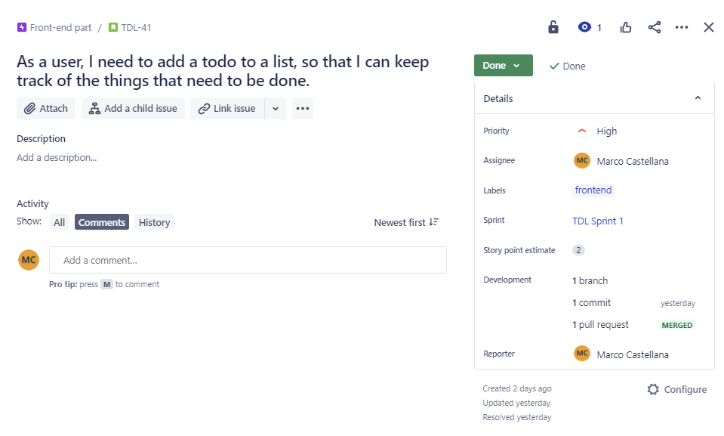
User Stories

Slide 9
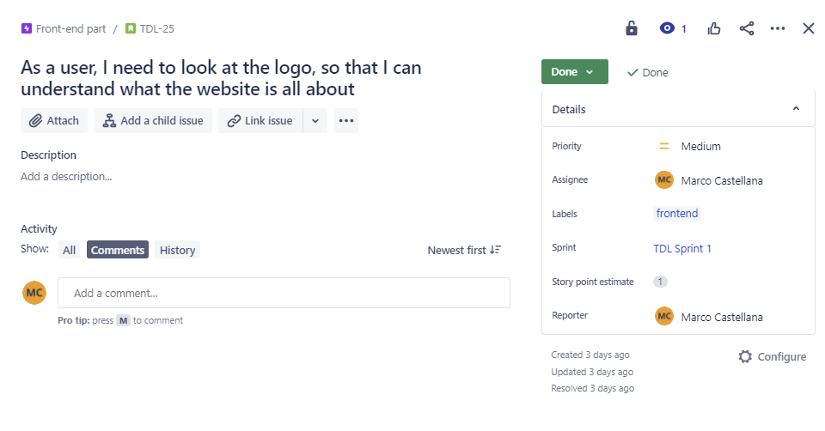
User Stories

Slide 10
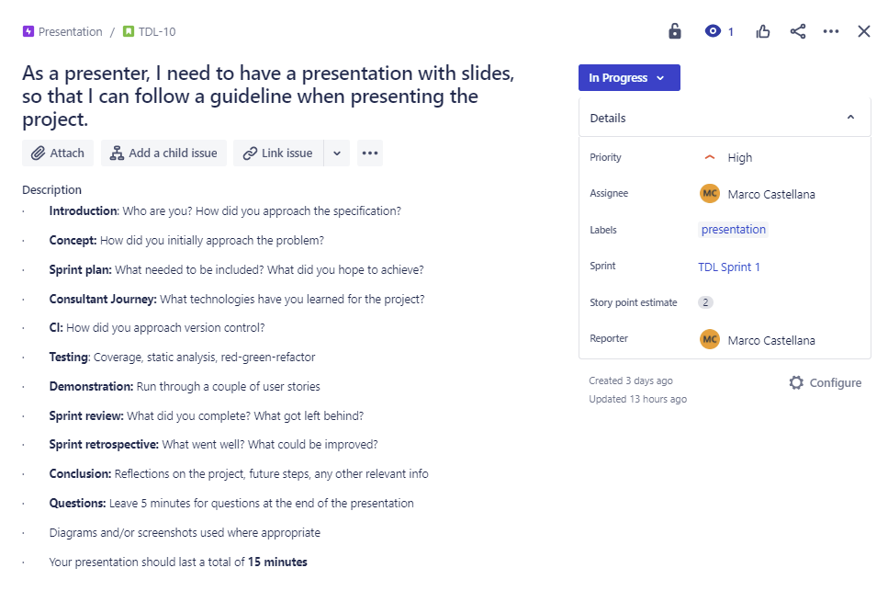
User Stories

Slide 11
My Approach to GIT
Use of GIT and GitHub
Use of branches to create features
Use of Commits
Merge to main when final product is stable and ready

Slide 12
Development
SQL Development
Front-End
Back-End

Slide 13
Testing
Unit
Integration
Selenium

Slide 14
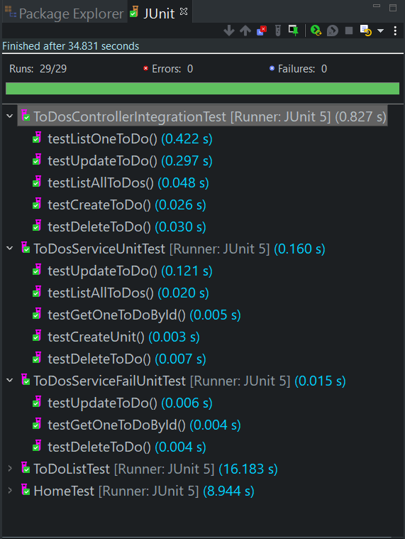
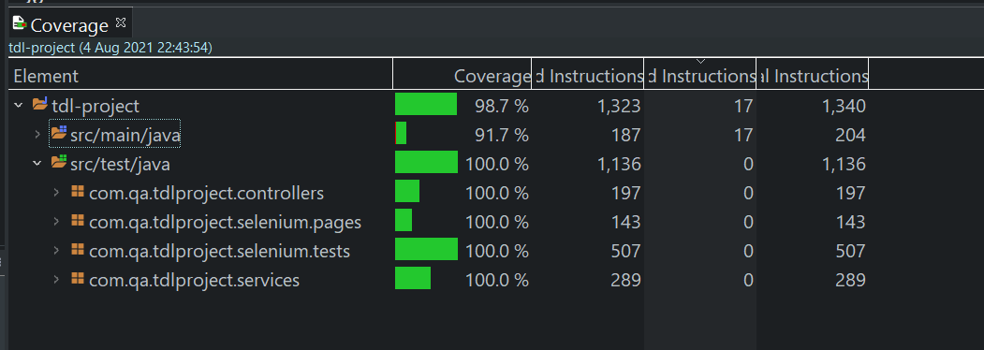
Testing
Service tested with Unit tests (Mockito)
Controller tested with Integration tests
Front-end tested with Selenium

Slide 15
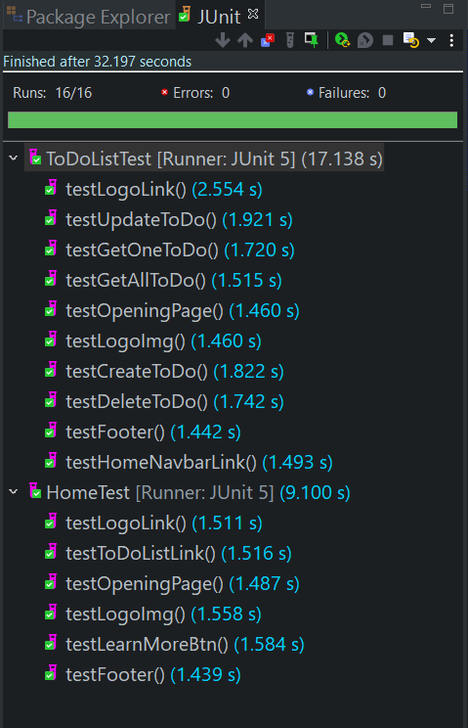
Selenium Tests

Slide 16
Sprint Review
Completed all user stories determined using MVP
No delays

Slide 17
Sprint Retrospective
Past coding experience helped
Points score have improved since last time use
Past project experience helped

Slide 18
Conclusion
Learned new technologies
Exciting experience
Able to use new testing tools
Learned to build a full-stack application
Future steps may be to deploy it to a server

Slide 19
Thank you
Any Questions?

