Slide 1

Data Visualisation – Bike rides in Chicago “Data Visualisation” February 14th, 2023 By Yen & Bulduk IronHack Paris

Slide 2
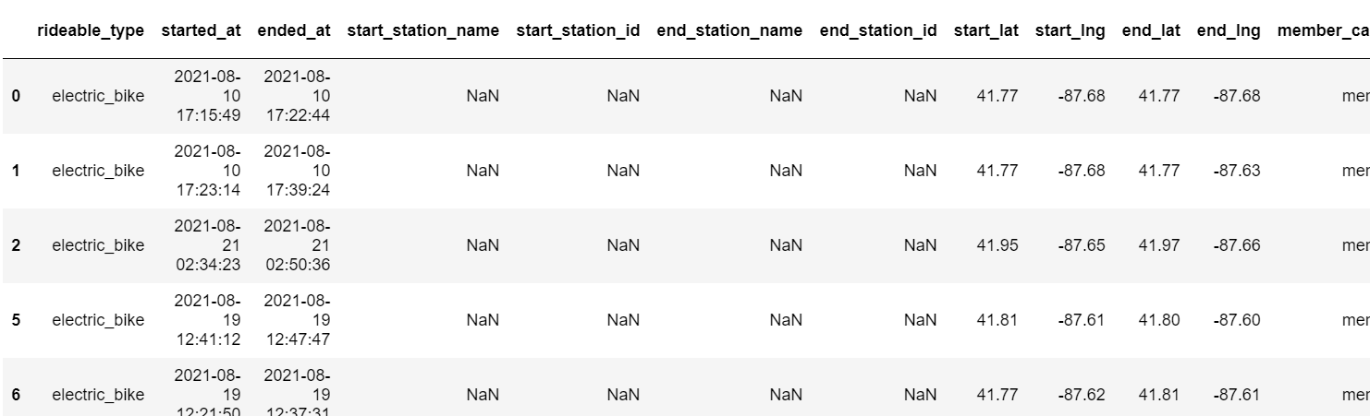
Dataset & Variables
Bike rides from Chicago, from August 2021 to July 2022: 3,2M+ entries, already cleaned.
Variables:
Bike type (Electric, Classic, Docked)
Date & Time of ride start / ride end => To which is extracted Year, Month, Hour, Minute
Station name & id
Starting latitude & longitude / Ending latitude & longitude
Membership (Member or Casual user)
Notes:
Bulduk

Slide 3
Challenges
Further improvements
Find variable to analysis
Only one continuous variable : ride length. Limits the usage of 3D scatter plot for instance.
Size of data
3.2M+ entries, 800 Mo csv file, which makes some codes’ execution long (up to 5 minutes)
Times
Coding complex charts takes long time
Harmonisation of colours, labels name, etc.
Fine tuning the charts
Deeper analysis of the charts, insights, etc.
Notes:
Bulduk

Slide 4
Process
Exploring data (value_counts, unique value, etc.), to see every possible split of analysis that can be interesting
Plan the chart
Making the codes, adjusting the charts
Choosing the most insightful ones to present
Notes:
Bulduk

Slide 5
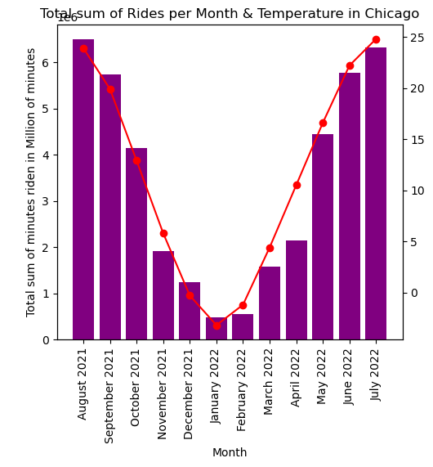
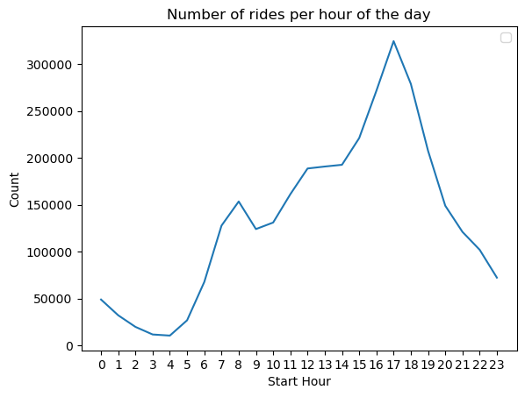
Some QUICK FACTS INSIGHTS
This shows almost total correlation between number of rides and temperatures
This shows that people are more likely to use the bike at the end of the day (coming back home from work)
All those graphics can be used to adapt services, communications, etc.
Notes:
Bulduk

Slide 6
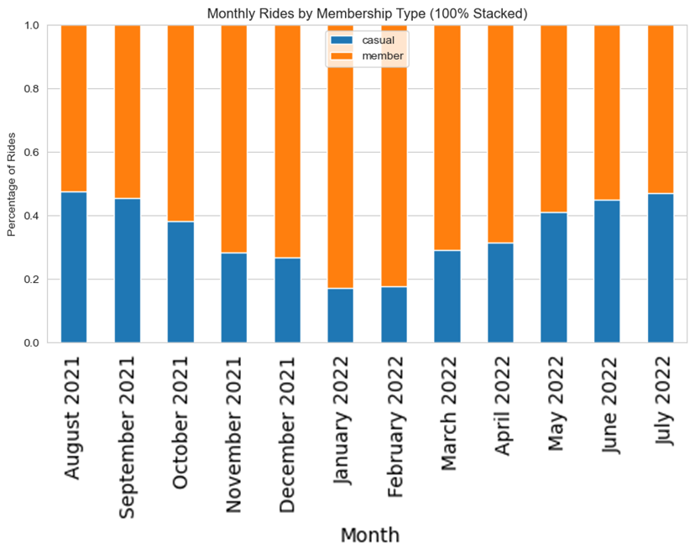
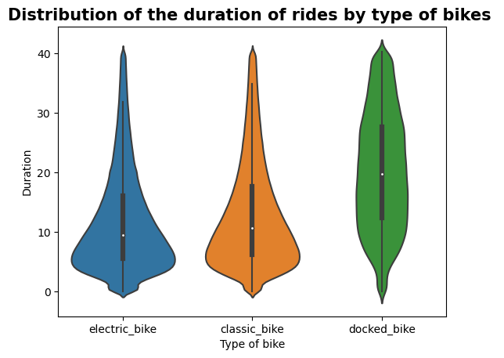
Some QUICK FACTS INSIGHTS
Casual members represents almost half of the users in summer (tourists?), but less than 1/3 during fall & winter
Electric and Classic tends to be used for shorter time (mean ≈ 10), most usage under 10 minutes
Docked bike are used for longer time
All those graphics can be used to adapt services, communications, etc.
Notes:
Bulduk

Slide 7
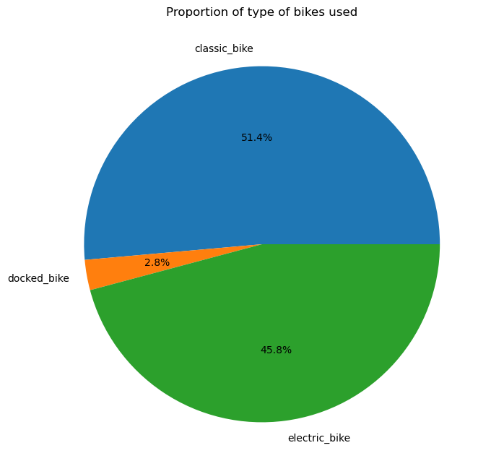
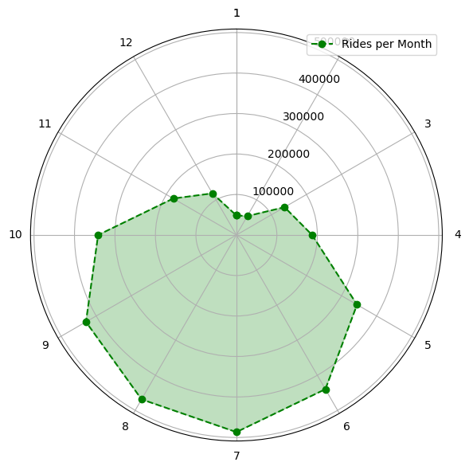
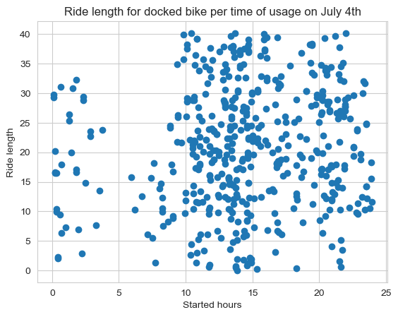
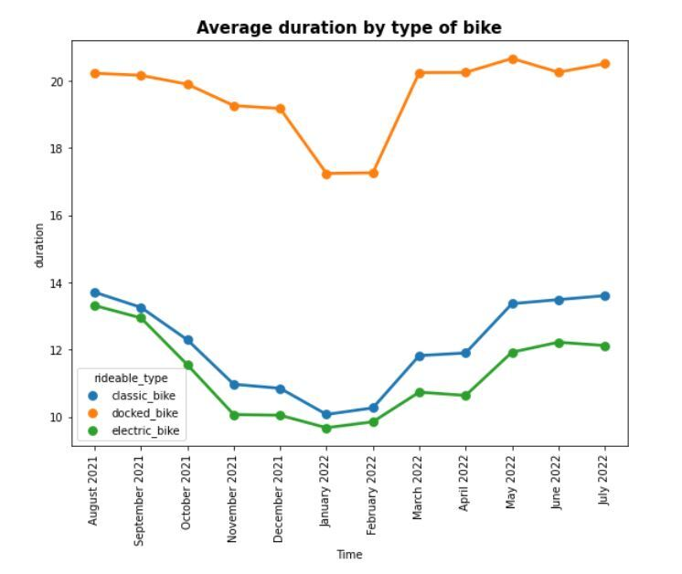
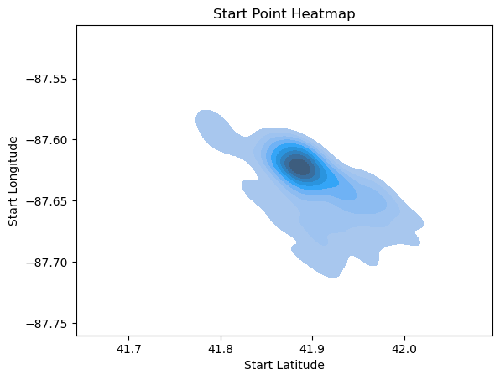
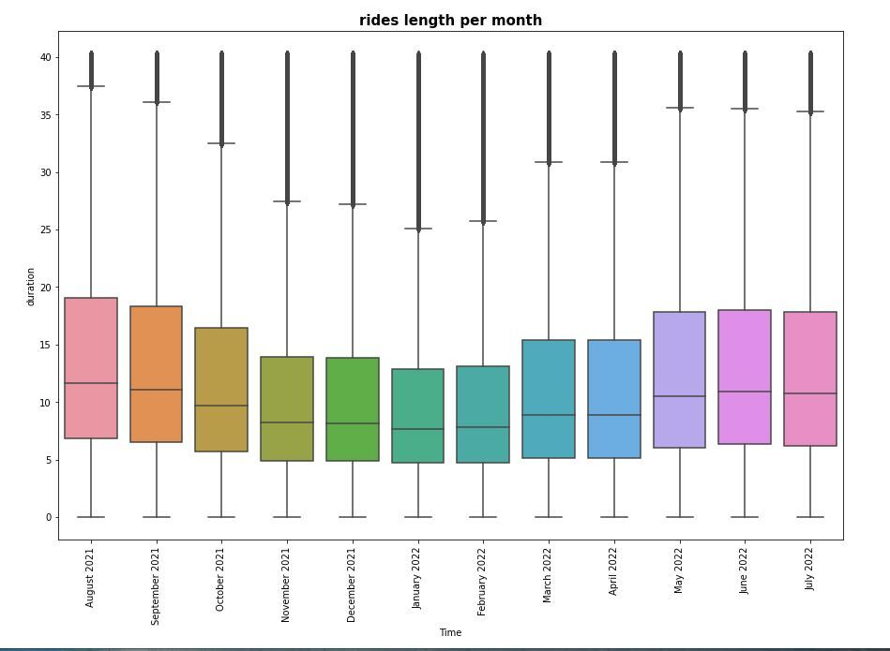
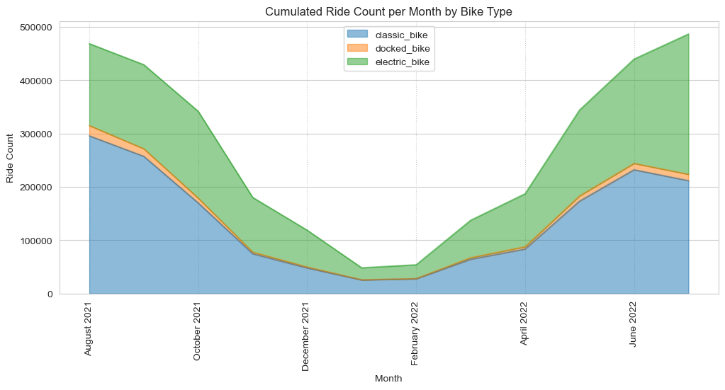
Others graphics in multiple format…
Proportion of usage per type of bike
Sum of rides showed in radar format
Scatter plot of usage of bikes on the 4th July
Line plot of usage of ride length per month
Start point Heatmap, first try
Multiple box plot of rides length per month
Area plot of total rides per month per bikes

Slide 8
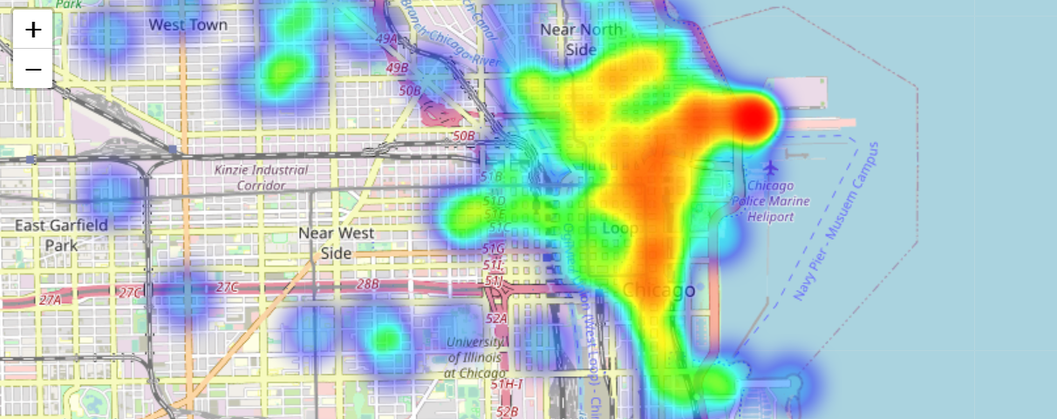
Focus on the heatmap generation
Heatmap of the starting point of docked bikes ride on the 4th of July
Notes:
Bulduk

Slide 9
Thank you !

