Slide 1
Talk Title
Goes Here
Presenter name

Slide 2
Talk Title
Goes Here
Presenter name

Slide 3
Speaker Intro
a
b
c
d
e
f
g
Notes:
Before we jump in here is a brief introduction to me
I have 20+ years experience in IT and I have a developer background
I am currently the Head of Development for Sword IT in Glasgow, Scotland
I help organise the Glasgow Azure User Group
I run the Azure Global Bootcamp, Glasgow edition
I blog on all things Azure at gregorsuttie.com
I am a Microsoft Azure MVP since August 2019
And I help organise some Azure Community events

Slide 4
Agenda
a
b
c
d
e
Notes:
Todays Agenda looks like this
I am going to be covering
My Journey – where I'm gonna talk a little about my journey and how I learned a huge subject area like Azure from scratch.
Next I’ll cover exam information, how to get started with the exams, where to find useful links and info on the Azure exams.
Then we will take a look at the learning resources and materials I have found useful when learning Azure and for studying for the exams.
And to round off I’ll talk about takeaways from this session and then open it up to questions.

Slide 5



title
a
b
c
Notes:
For me its important to have goals
I set goals for myself every 3 months – stretch goals not something simple.
You can see here the long term goals I had before I started with learning Azure.
I had a 4th goal at the back of my head but I didn’t put it up on the slides as I quickly learned that becoming an MVP was not something that should be a goal – becoming an MVP is a by product of what you give back to the community.
I will admit though that I wrote the letters MVP and pinned them on the wall above my monitors at home and when I struggled for motivation, this would remind me of one of my goals.
I would recommend that people have goals – if you don’t have goals its easy to float around and really not get where you want to be.

Slide 6
Title here
Notes:
Ok so lets now switch gears a little but and talk about the Azure Exams.
One thing I’d like to highlight about the Azure exams is that due to the current pandemic the exam labs have been removed – so now might be a good time to do them if you were thinking about it.

Slide 7
Title here
a
b
c
d
e
Notes:
There are new exams coming out every month it seems
Q) People always ask me the best way to take exams, online or go to a test centre? A) First exam test centre, do the rest at home if you can, due to circumstances, online only and no labs at the moment.
Q) How much do the exams normally cost ? A) $165 each unless you have a voucher or sitting a beta exam
Q) Where can you book the exams?
A) browse to the exam page and register their its fairly straight forward
Proctored exams Tips
Before exam: -
Check your computer assessment on the prometric vue website, you don’t want caught out.
Sign in 30 minutes early, Have your id handy, you may need to take photo of your id and room etc before hand so make sure your early.
Do not leave the camera window or cover your mouth – they can and have failed people for things like this.

Slide 8
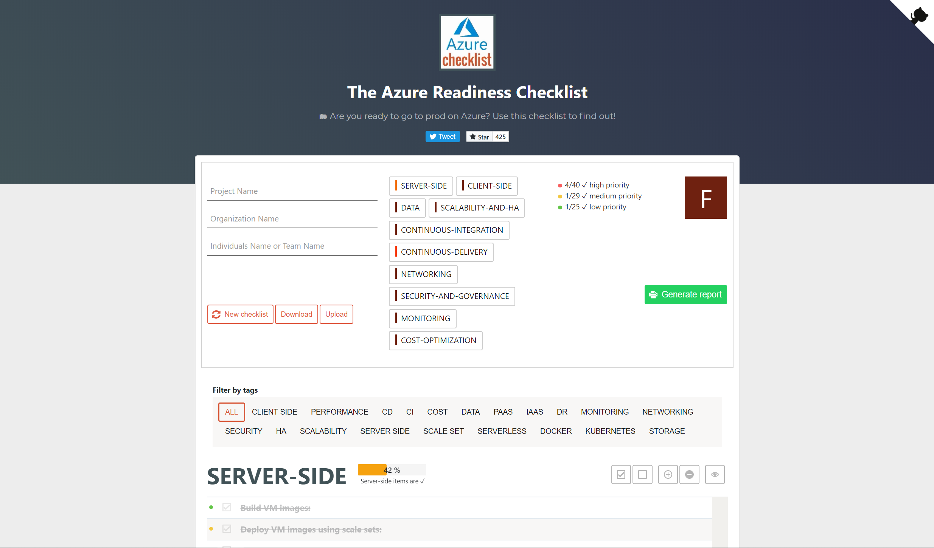
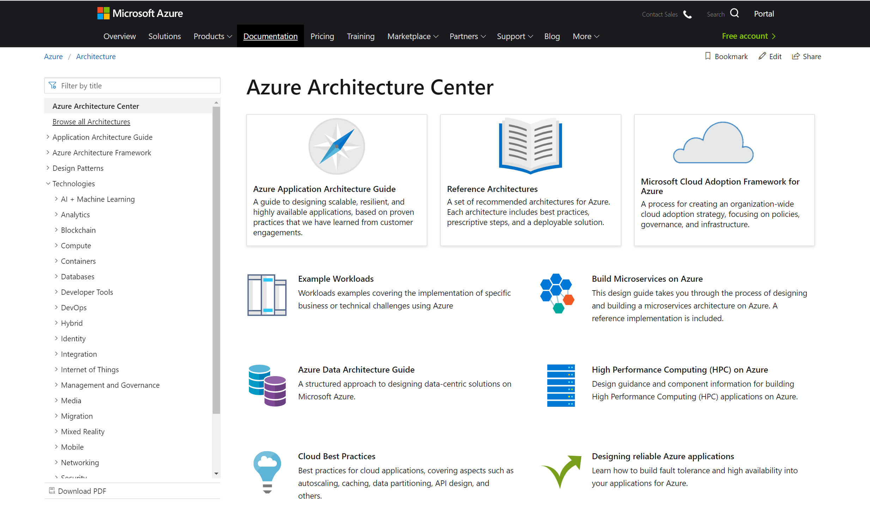
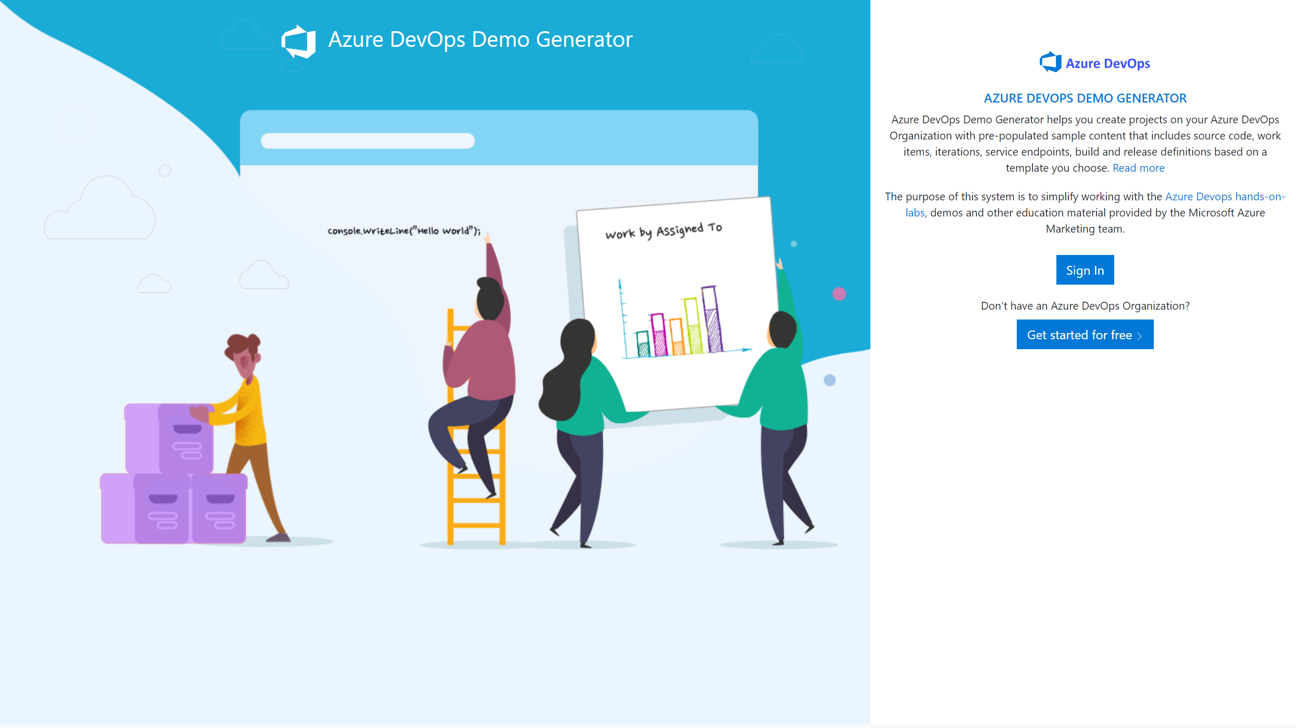
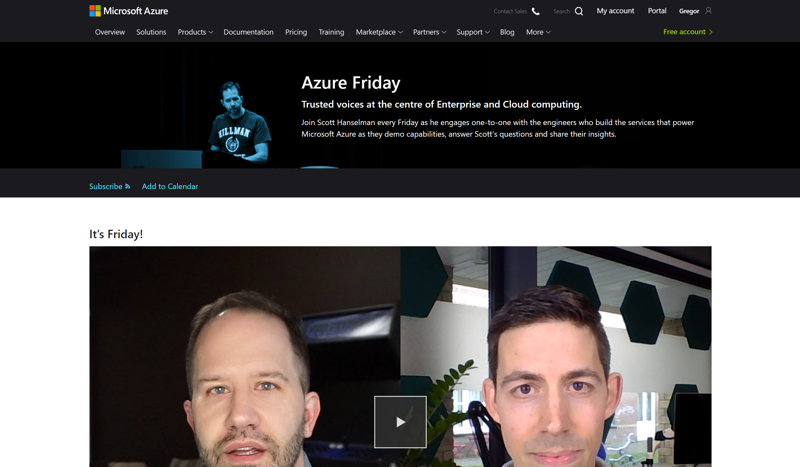
Title goes here
Lot’s of great resources out there
AzureChecklist.com
Azure Architecture Centre
Azure DevOps Demo Generator
Azure Friday
Notes:
Azurechecklist.com – this is handy if your going to production and have a type of project, this is a checklist of things to check off that you have in place before going into production, things like key vault etc
Azure Architecture centre – This is where you will find reference architecture, example workloads, cloud best practices and a tonne more
Azure Devops Generator – This is a great site for learning about Azure Devops and has some cracking Azure Devops labs you can work through.

Slide 9
Title here
Lot’s of great resources out there
a
b
c
d
e
f
g

Slide 10
Title here
a
b
c
d
e
f
Notes:
https://cloudfamily.info/
https://github.com/CloudFamily/
https://github.com/gsuttie/AzureResources

Slide 11
Demo Time
Notes:
Ok I’ve talked about a number of resources, but lets take a look at some of these now
Build5nines
https://build5nines.com/certifications/
microsot learn
https://docs.microsoft.com/en-us/learn/
Microsoft Learn Certifications
https://docs.microsoft.com/en-us/learn/certifications/
Azure OverView
Azure-overview.com
Cloud Adoption Framework
https://azure.microsoft.com/en-gb/cloud-adoption-framework/
https://azure.microsoft.com/mediahandler/files/resourcefiles/cloud-adoption-framework/Cloud%20Adoption%20Framework.pdf
Azure Citadel
https://azurecitadel.com/
AzureCharts
https://azurecharts.com/
https://azurecharts.com/overview/360adv?s=32
Azure tip n tricks
https://microsoft.github.io/AzureTipsAndTricks/
Azure Devops Demo Generator
https://azuredevopsdemogenerator.azurewebsites.net/
Azure Friday
https://azure.microsoft.com/en-us/resources/videos/azure-friday/

Slide 12
Key Takeaways
a
b
c
d
e
f

Slide 13
What Questions do you have?

Slide 14
Contact
Twitter: @twitter handle goes here
LinkedIn:
Blog:
YouTube:

Slide 15

Top 5
5
Title here
1
2
3
4
Top 5

Slide 16
1
3
5
2
4
Another title here
Top 5

Slide 17
Community Content
a
b
c
d
e
f
g
1
5
2
3
4
Top 5

Slide 18
Title goes here
1
5
2
3
Link maybe or some other content here
4
Top 5

Slide 19
Title goes here
1
5
2
3
4
Top 5

Slide 20
Title goes here
1
2
5
3
Content here
4
Top 5

Slide 21
2
5
3
1
4
Top 5
Title here
Content here

