Slide 1
POLCAL
We ensure the image of insurance industry.

Slide 2
Co-Founders
Our company is founded in 2020. Our co-founders are:
Bülent Sefa Yarbaşı
Mehmet Erim Korkmaz
Muhammed Faruk Ozulu
Mustafa Sağlam
Gökhan Varol Çiftkaya

Slide 3
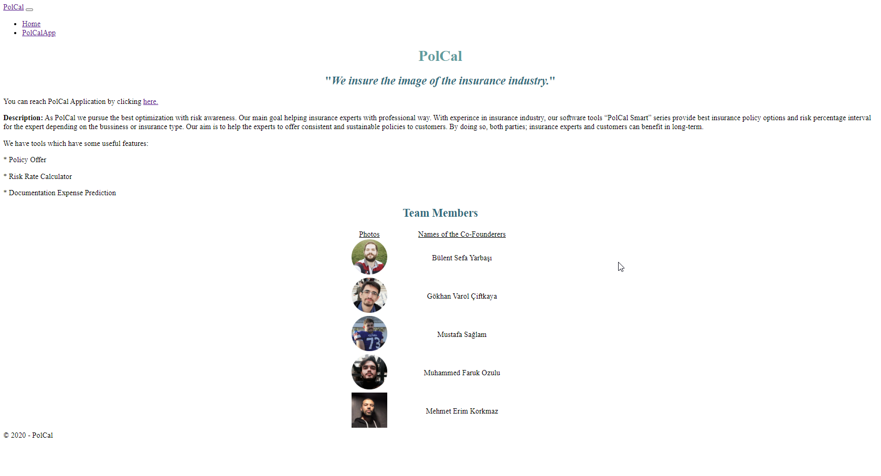
promotion page

Slide 4
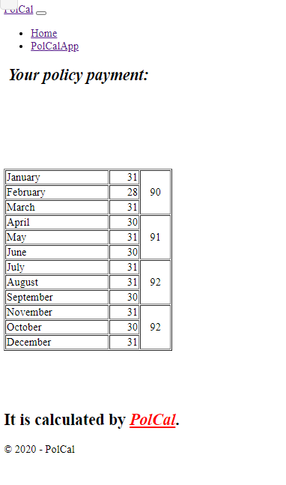
application Target
Our main goal is helping insurance experts and customers by calculating insurance policies.

Slide 5
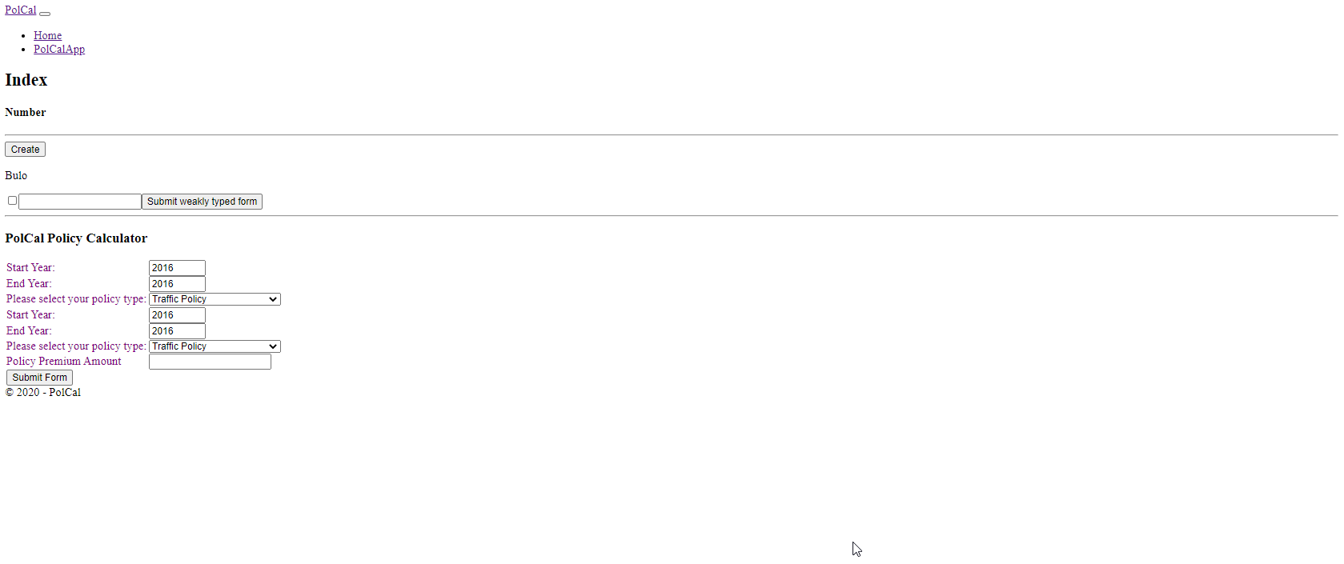
Input page
Our applications takes some inputs in order to calculate policies.

Slide 6
Why do you need polcal?
If you don't know how to pay your policies and you need a tool that calculates it, POLCAL is exactly for you.

