Slide 1
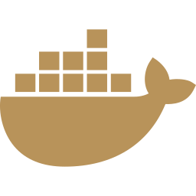



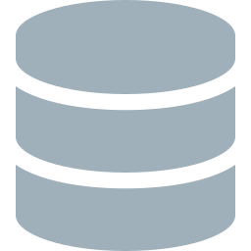
Modern Backend Engineering
CI/CD Pipelines · Containerization · Cloud Deployment
How modern software teams ship reliably, automatically, and at scale
Educational Overview · Technology Series
Notes:
Welcome. This presentation covers the foundational engineering practices that separate hobby projects from production-grade systems: automated testing pipelines, containerization with Docker, and cloud deployment with auto-scaling.

Slide 2
The Problem With Manual Deployments
🐛 Works on my machine
63%
Code that runs locally fails in production due to environment differences
of outages caused by
manual deployment errors
😰 Deployment anxiety
Every release is a manual, stressful event with no rollback plan
2–5×
🔍 No visibility
longer MTTR without
automated rollback
No automated test gate — bugs reach production before anyone notices
10×
🐢 Slow iteration
Days between code complete and live — competitive disadvantage
more deployments per day
with CI/CD vs without
Notes:
Manual deployments are the #1 source of avoidable production incidents. The stats here reflect industry research from DORA (DevOps Research and Assessment) reports.

Slide 3




The Modern Engineering Stack
Four pillars that work together to eliminate manual risk
Automated Testing
Containerization
CI/CD Pipeline
Cloud Run
Every code change is validated by a full test suite before it can merge or deploy. No human gate needed.
Docker packages the app and all its dependencies into a single, portable, reproducible image.
GitHub Actions automatically runs tests, builds the container, and deploys on every push to main.
Serverless container hosting. Zero infrastructure to manage. Auto-scales to zero when idle.
Notes:
These four pillars are interdependent. Testing catches bugs, containers eliminate environment drift, CI/CD automates the release, and Cloud Run handles the infrastructure.

Slide 4
Pillar 1: Automated Testing
The Test Pyramid
✓ Tests run on every push
No code merges without a green test suite — ever.
✓ Real database in tests
Testcontainers spins up a real MongoDB container per test run. No mocks for persistence — test what you actually ship.
✓ Singleton container pattern
Unit Tests ~75%
One container shared across all test classes prevents stale context bugs and keeps test runs fast.
Integration Tests ~20%
✓ Millisecond precision
MongoDB truncates Instant to ms — assertions use isCloseTo(), not isEqualTo(). Real-world details matter.
E2E Tests ~5%
Notes:
38 tests across 5 domains. The integration tests use Testcontainers — a library that spins up real Docker containers for your test database, so you're testing against the exact same MongoDB behavior as production.

Slide 5
Pillar 2: Containerization with Docker
Stage 1: Builder
Stage 2: Runtime
▸ eclipse-temurin:21-jdk
▸ eclipse-temurin:21-jre
▸ Maven + dependencies
▸ Non-root user
→
▸ Compile source code
▸ Copy JAR only
▸ Package fat JAR
▸ JVM tuning flags
Reproducible
Secure
Efficient
Portable
Same image runs identically on every machine and every environment
Non-root user, minimal JRE (not JDK), no build tools in production
Dependency layer cached — source changes don't re-download all deps
Push to any registry, deploy to any container platform
Notes:
Multi-stage builds are critical for production images. The builder stage has the JDK and Maven — everything needed to compile. The runtime stage has only the JRE and the JAR. Result: a much smaller, more secure image.

Slide 6


Pillar 3: CI Pipeline (GitHub Actions)
Push to
main
Run 38
tests
Build
JAR
Build
Docker image
Push to
Artifact Registry
Deploy to
Cloud Run
Triggers:
Workload Identity:
Runs on every push to main AND every pull request — catching bugs before they merge.
No long-lived secrets. GitHub gets a short-lived GCP token per run via OIDC.
Test gate:
Artifact versioning:
If any of the 38 tests fail, the pipeline stops. Nothing deploys until green.
Every image tagged with the git SHA — any version is one command to roll back to.
Speed:
Zero infrastructure:
Full pipeline: ~2 minutes. Docker layer caching keeps builds fast.
GitHub-hosted runners have Docker pre-installed. No CI servers to manage.
Notes:
The CI pipeline is the automated quality gate. Nothing reaches production without passing this gate. Total pipeline time is ~2 minutes, which means developers get feedback within one coffee break of pushing code.

Slide 7
Pillar 4: Cloud Run Deployment
GitHub
Actions
push image
Artifact
Registry
deploy
Cloud Run
(dev)
connect
MongoDB
Atlas
--no-allow-unauthenticated
Dev is IAM-only — not publicly accessible. Reach it via gcloud proxy.
--min-instances=0
Scales to zero when idle. Zero cost when no traffic. Scales up automatically.
--max-instances=10
Hard ceiling protects against runaway cost from traffic spikes or DDoS.
SPRING_PROFILES_ACTIVE=dev
Env vars injected at deploy time — no secrets in code or Docker images.
Workload Identity Federation
No JSON key files. Short-lived OIDC tokens only. Industry best practice.
Notes:
Cloud Run's scale-to-zero is ideal for dev environments — you only pay for actual requests, not idle capacity. Workload Identity Federation is the modern replacement for service account JSON keys, which can be stolen and misused.

Slide 8

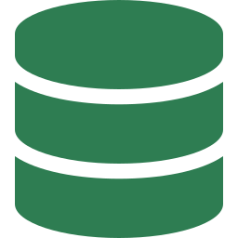



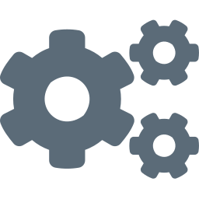
Security By Design
No long-lived credentials
Secrets never in code
Workload Identity Federation replaces JSON key files. GitHub gets a short-lived OIDC token scoped to a single workflow run — it expires automatically.
MONGODB_URI, API keys, and tokens live in GitHub Secrets. They are injected at runtime and never appear in logs, images, or git history.
Non-root container user
IAM-only dev environment
The Docker image runs as a dedicated non-root appuser. A container escape gives an attacker an unprivileged shell, not root access.
--no-allow-unauthenticated means the dev Cloud Run service has no public URL. Access requires an authenticated GCP identity with run.invoker role.
Minimal runtime image
URL-encode special chars
Production image uses eclipse-temurin:21-jre — not the JDK. No compiler, no Maven, no source code. Smaller attack surface, smaller image.
Passwords with @ : / ? # in MongoDB connection strings must be percent-encoded. @ → %40. Failure to encode causes silent auth failures.
Notes:
Security is not an afterthought — it is built into every layer. The org-level policy that prevented JSON key creation actually forced us to use the more secure Workload Identity Federation approach.

Slide 9
The Complete Flow: Code to Production
1
2
3
4
git push
CI triggers
38 tests run
JAR built
Developer pushes code to main branch
GitHub Actions starts automatically
Full suite against real MongoDB container
Maven packages the Spring Boot app
5
6
7
8
Image built
Image pushed
Deploy fired
Live in ~2min
Docker multi-stage build produces lean image
Tagged with git SHA to Artifact Registry
gcloud run deploy with new image SHA
Zero-downtime swap, old revision kept for rollback
Total time from git push to live: ~2 minutes · Zero manual steps · Full audit trail via git SHA
Notes:
This 8-step flow happens automatically every time code is pushed. The developer's only job is to write good code and push it. Everything else is automated.

Slide 10
Key Engineering Lessons
Test against reality, not mocks
Document hard-won debugging lessons
01
02
Testcontainers runs your tests against a real MongoDB instance. Mocking the database hides real-world behaviors like timestamp precision truncation.
Testcontainers + Docker Engine API version incompatibility, singleton container pattern, URL-encoding in connection strings — all documented so no future session re-debugs the same issue.
Security constraints drive better design
Separation of concerns scales
03
04
An org policy blocking JSON key creation forced Workload Identity Federation — a genuinely more secure approach than the original plan.
Five separate domains (people/profile/consent/traffic/contact), each with its own model/repo/service/tests. Each one independently testable, replaceable, and understandable.
Environment parity eliminates surprises
Automate the undifferentiated heavy lifting
05
06
The same Docker image runs locally, in CI, and in production. No more 'works on my machine' — the container IS the machine.
Every deploy is identical, auditable, and reversible via git SHA. Engineers spend time on features, not release ceremonies.
Notes:
These lessons apply to any backend project, not just this one. The specific technologies change — the principles don't.

Slide 11
From Code to Cloud
Automatically. Reliably. Repeatably.
✓ 38 automated tests · Zero manual release steps
✓ Multi-stage Docker build · Non-root, minimal runtime image
✓ GitHub Actions CI/CD · Workload Identity Federation (no JSON keys)
✓ Cloud Run · MongoDB Atlas · Scale to zero · SHA-tagged rollback
Educational Overview · Modern Backend Engineering Series
Notes:
Close with the core message: this isn't magic, it's engineering discipline. Every piece of this stack is learnable, documented, and repeatable.

