Slide 1
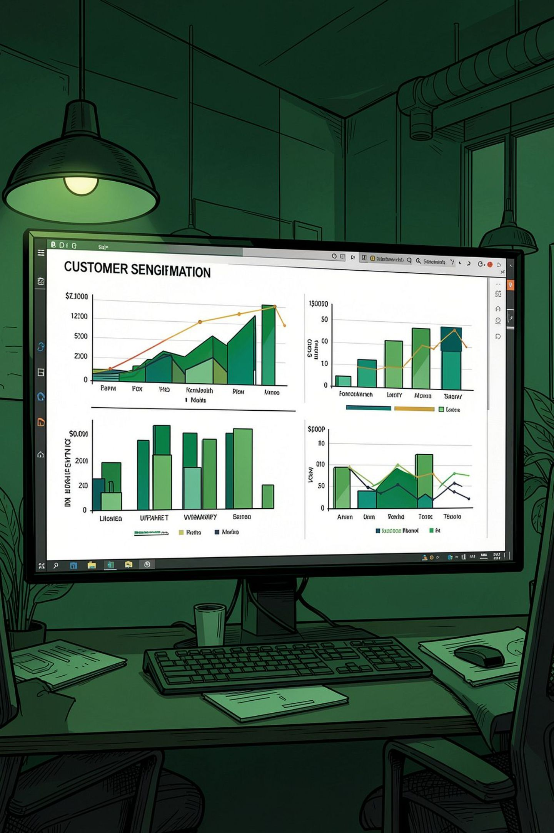
Customer Segmentation Analysis
Using unsupervised ML to identify distinct customer groups — enabling targeted marketing, personalized promotions, and improved retention.

Slide 2
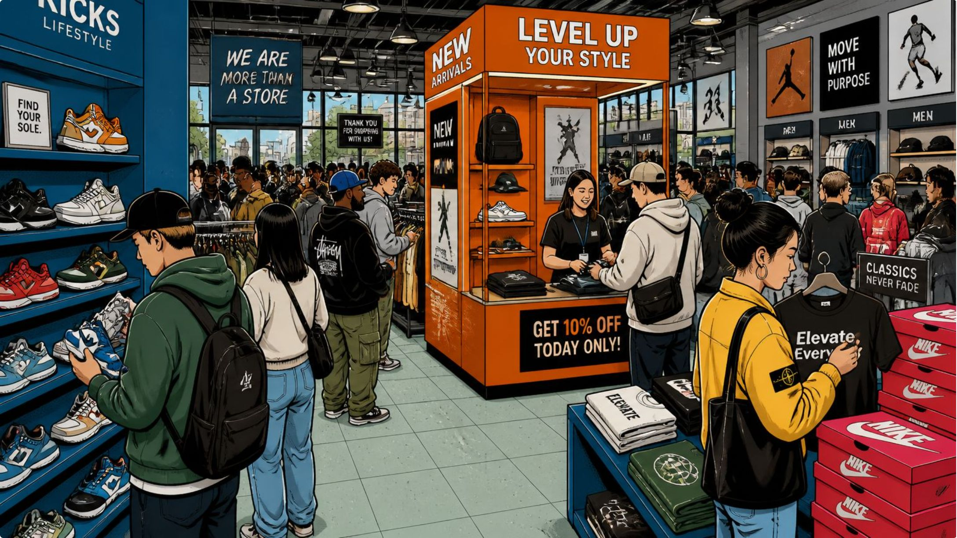
PROJECT OVERVIEW
One-Size-Fits-All Marketing Doesn't Work
The Problem
Same strategies applied to all customers, ignoring behavioral differences.
The Solution
Unsupervised ML to segment customers and drive data-informed decisions.

Slide 3
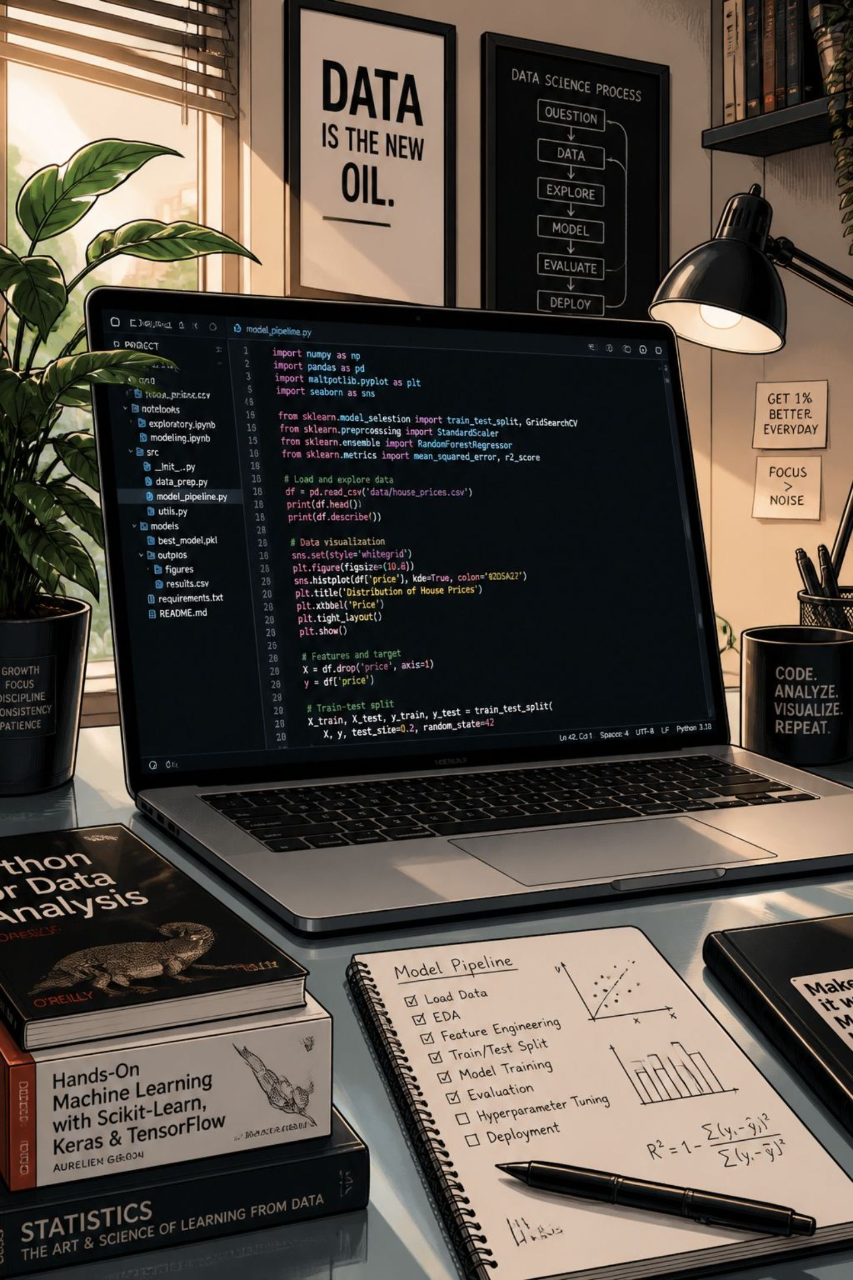
TOOLS & DATA
Dataset at a Glance
3,900
Rows
18
Columns
37
Missing Values
Review Rating only
6
Tools
Python, SQL, Power BI, GitHub, Gammas, Comet

Slide 4
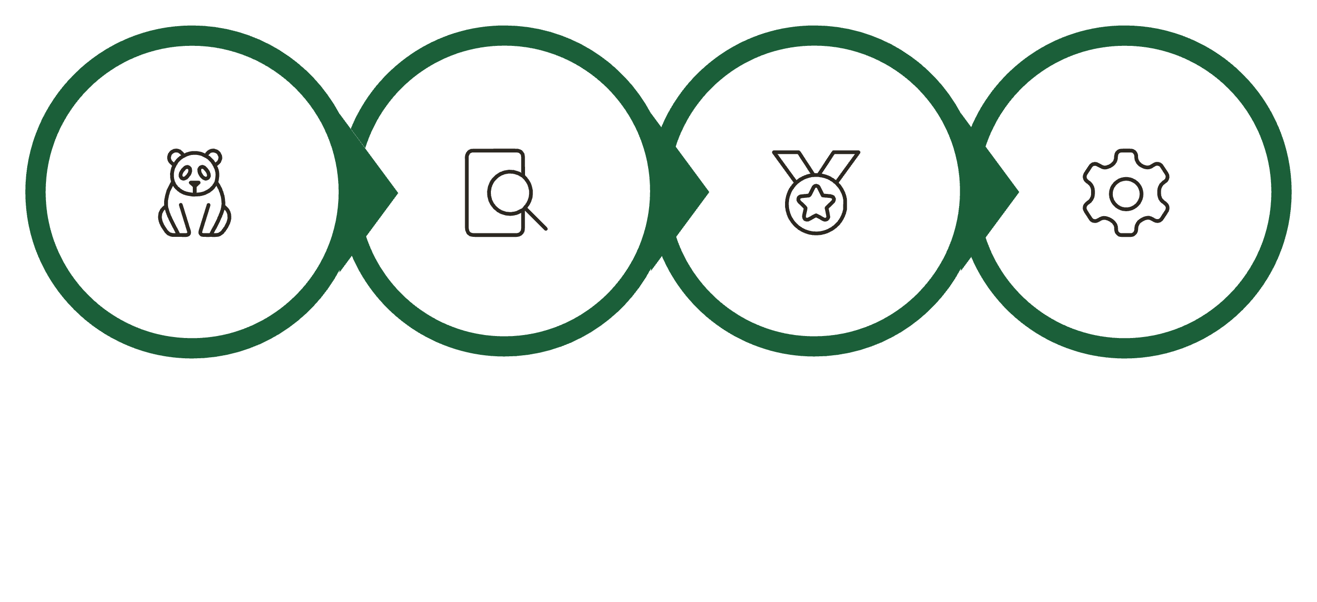
DATA PREPARATION
Data Cleaning Steps
Standardize Names
Load Data
Explore
Impute Rating
37 missing values in Review Rating imputed using category-specific median. Redundant promo_code_used column dropped.

Slide 5
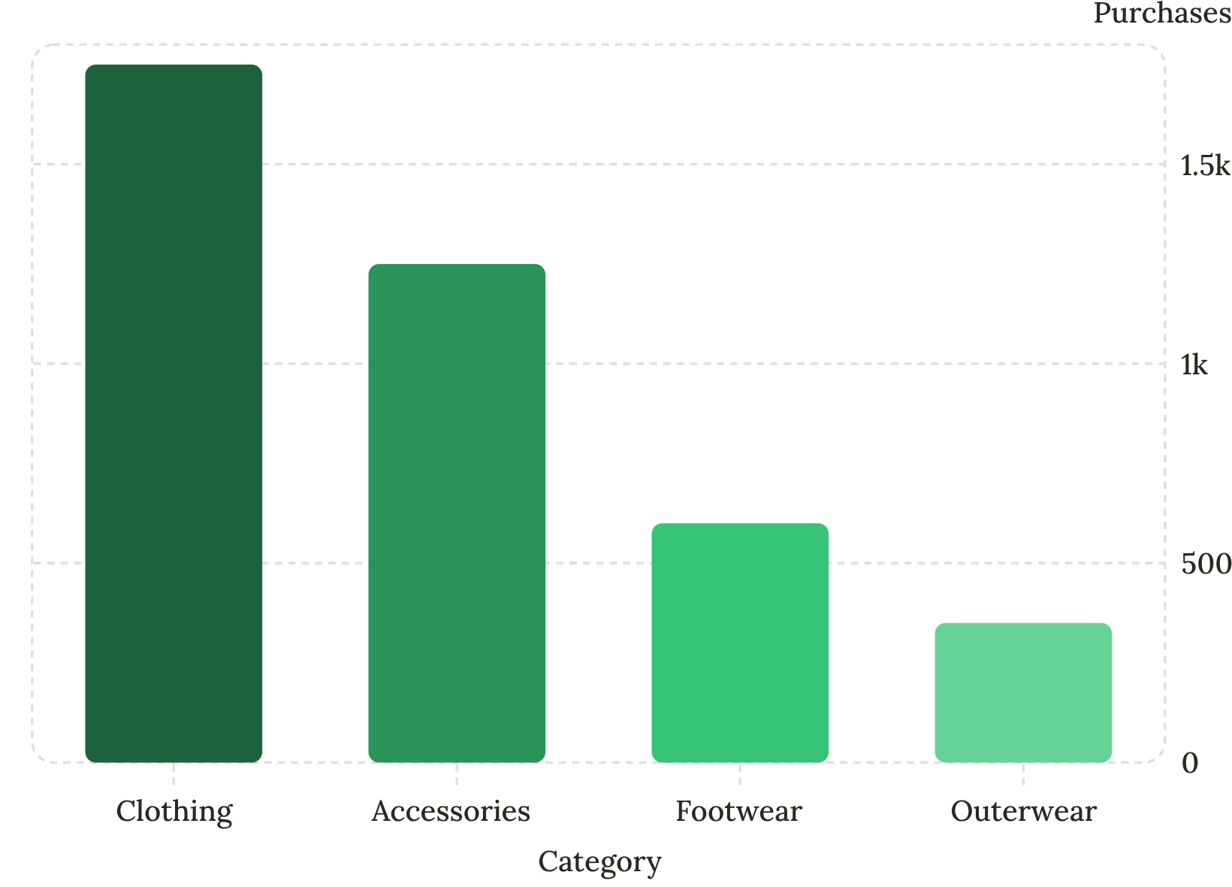
EDA — UNIVARIATE
Key Data Distributions
Highlights
Gender: 2:1 male-to-female ratio
Age: Uniform across 4 groups
Avg spend: ~$60 per purchase
Subscribers: 27% — growth opportunity

Slide 6
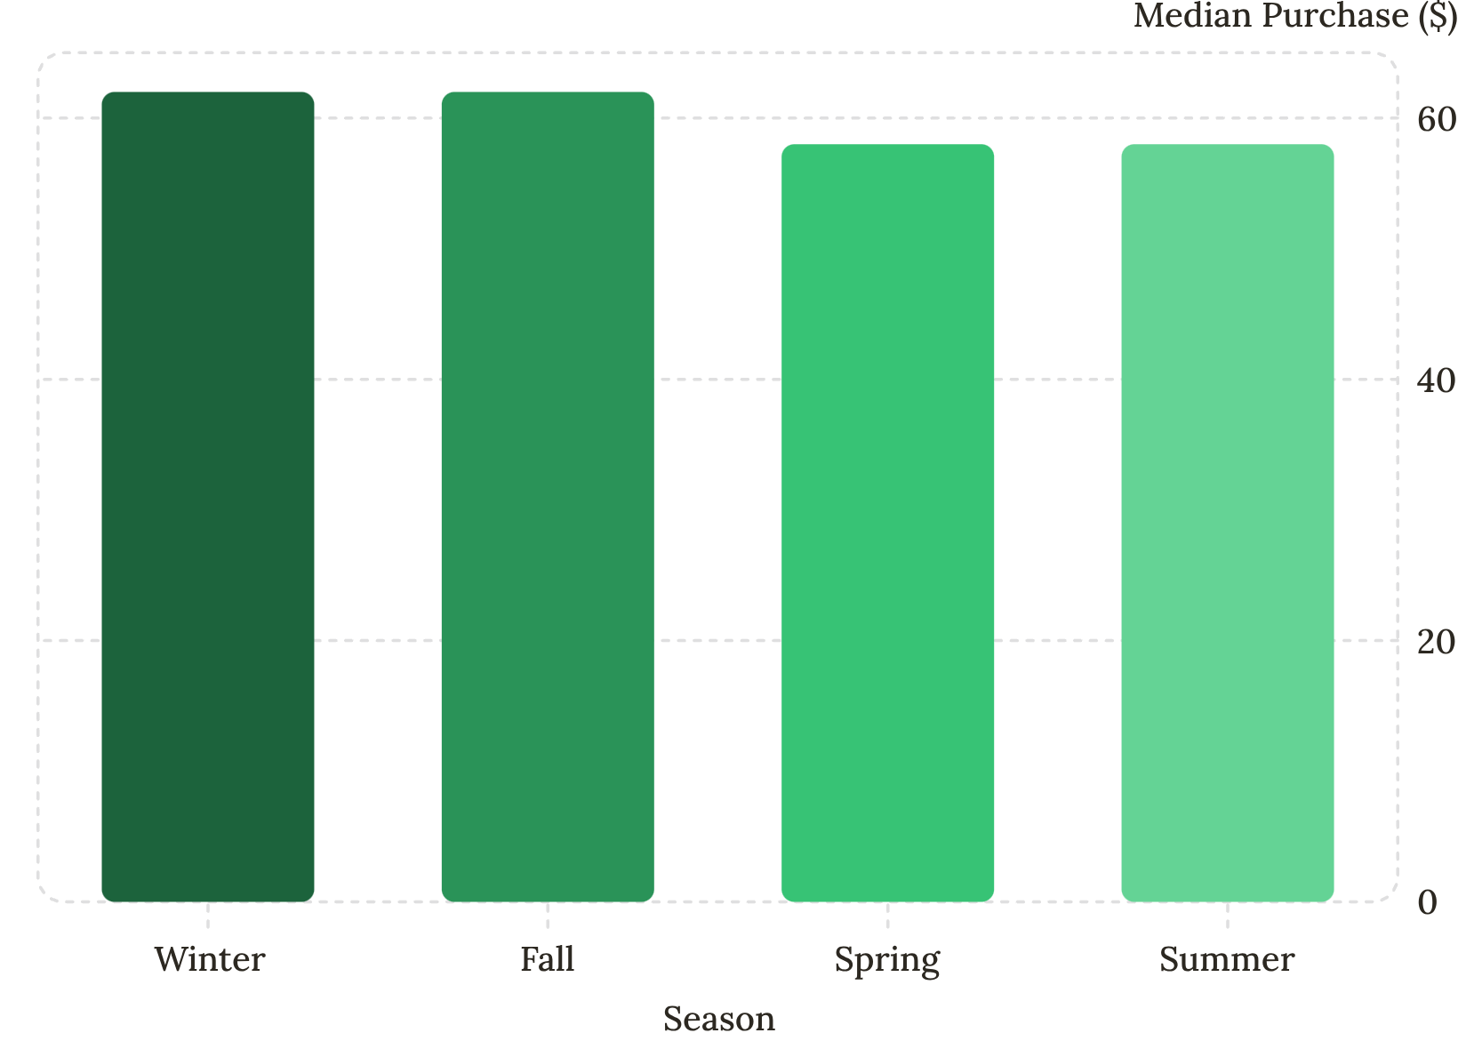
EDA — BIVARIATE & MULTIVARIATE
Spending Patterns
Key Findings
Winter & Fall: higher spend
Gender: minimal spending difference
Outerwear: lowest median spend
Subscribers & non-subscribers spend equally

Slide 7
SQL INSIGHTS
Key Business Findings
Revenue by Gender
Top Rated Products
Male $157K vs Female $75K
Gloves, Sandals, Boots
Customer Segments
Revenue by Age
Loyal 3,116 · Returning 701 · New 83
Young Adult leads at $62K

Slide 8
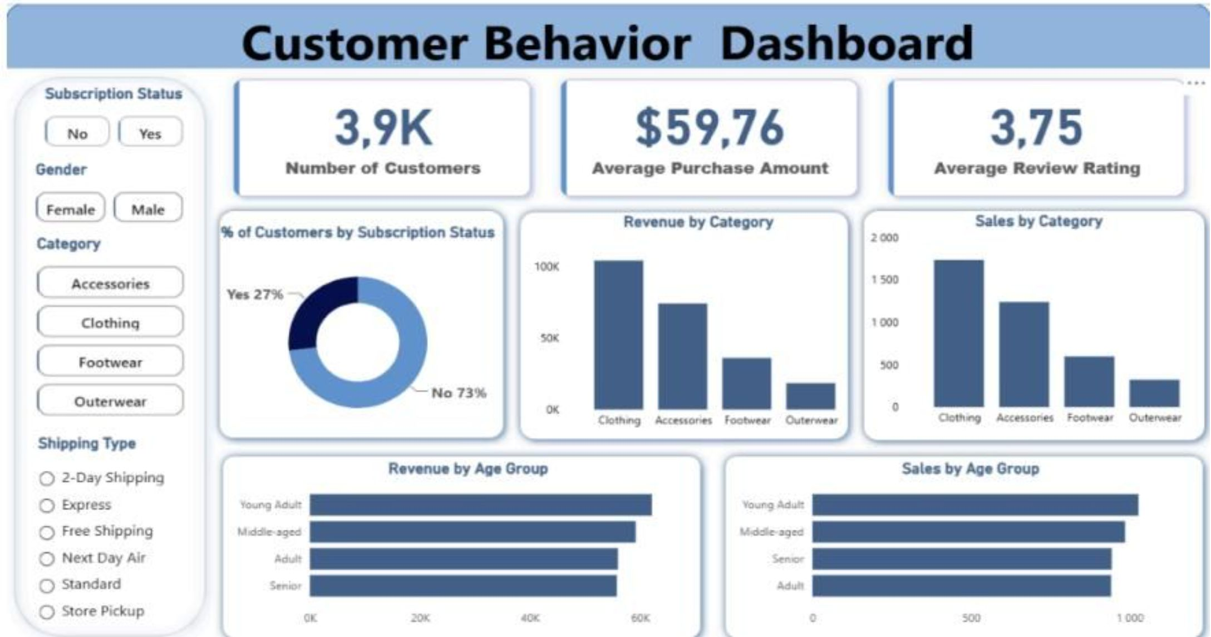
DASHBOARD
Power BI Dashboard
Interactive Filters
Subscription Status
Gender, Category
Shipping Type
Key Metrics
3.9K customers
Avg spend: $59.76
Avg rating: 3.75

Slide 9
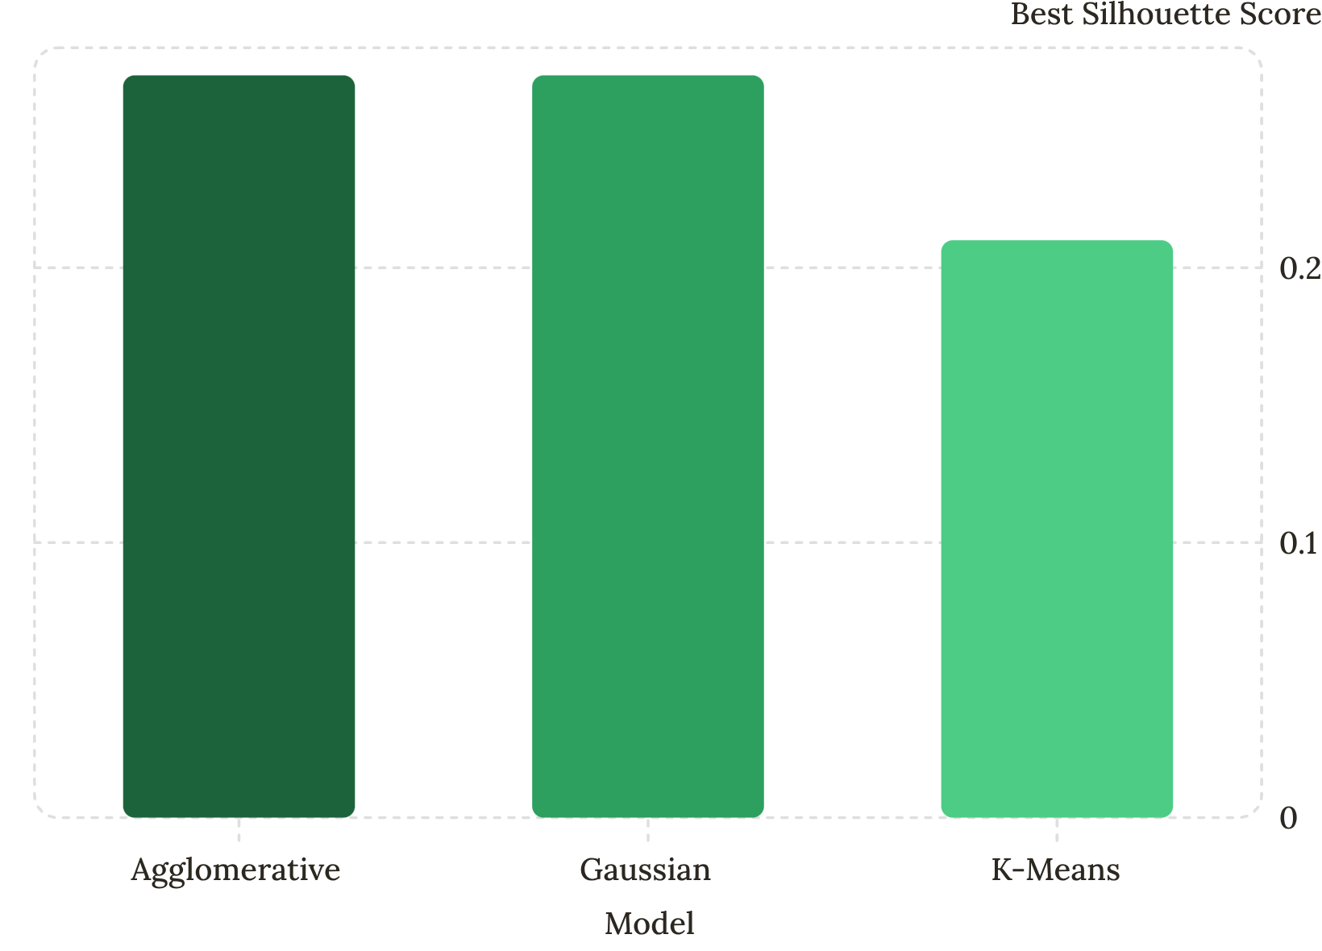
MODELING
Choosing the Right Model
Three Methods Evaluated
Agglomerative Clustering
Gaussian Mixture Models
K-Means
Winner: K-Means, k=3
Lowest Davies-Bouldin Index, balanced scores, computational efficiency.

Slide 10
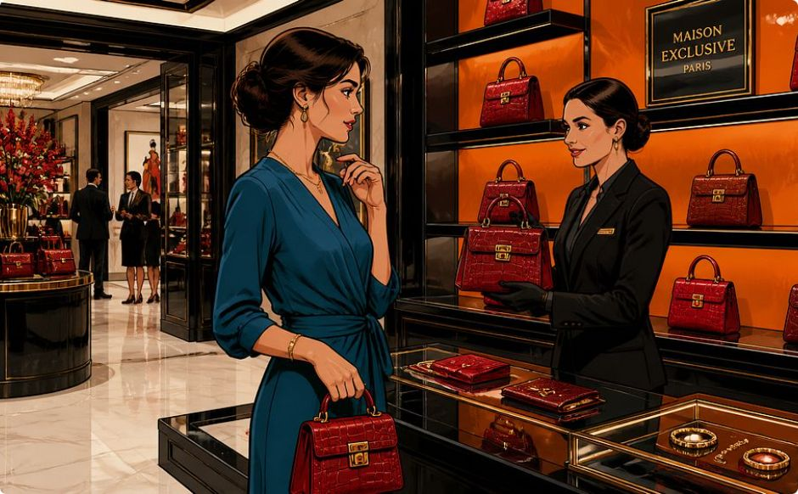
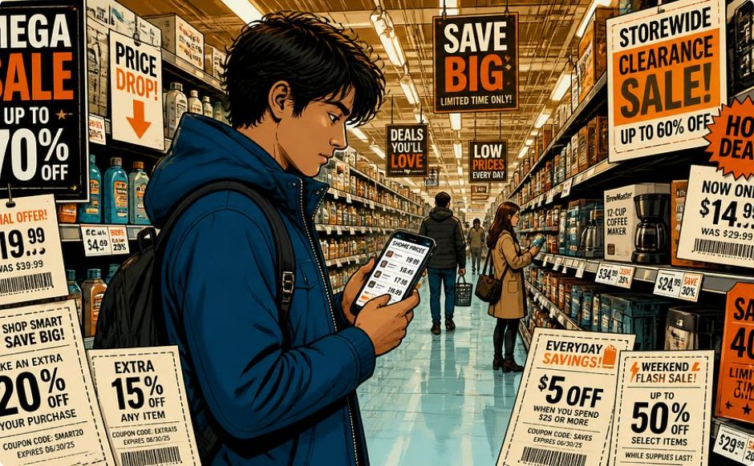
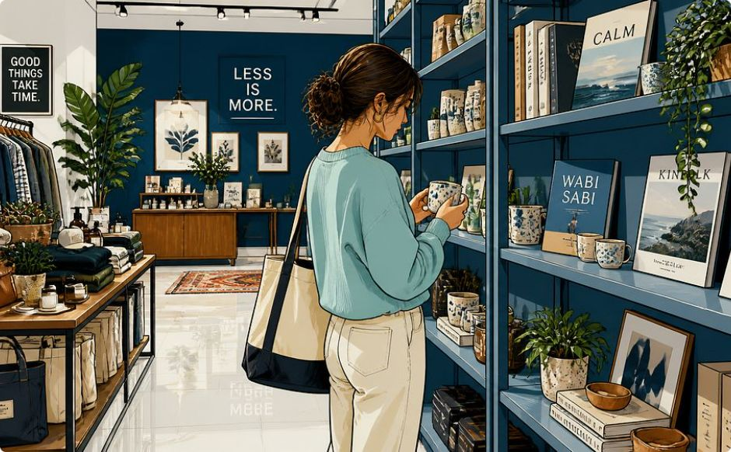
RESULTS
Three Customer Segments
Cluster 0 — High-Value Loyal
Cluster 1 — Budget-Conscious Regular
Cluster 2 — Occasional
1,635 customers · Highest spend & loyalty
572 customers · Annual buyers, high potential
1,693 customers · Frequent, low spend

Slide 11



Business Recommendations
High-Value Loyal Customers
Budget-Conscious Regular Customers
Occasional Customers
Retain and reward
Reactivate with targeted marketing campaigns
Increase spending through upselling and cross-selling

Slide 12
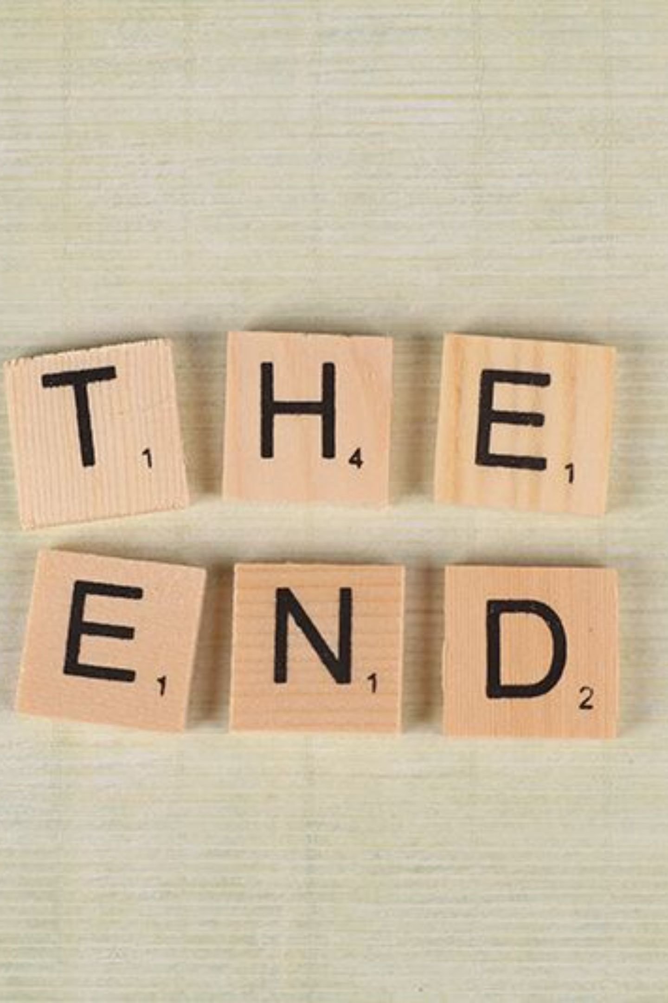
Conclusion
K-Means Clustering model was used to produced meaningful customer segments.
These segments can be used to improve:
marketing campaigns
customer retention
product recommendations
promotional targeting

