Slide 1
Design and Analysis of Algorithms
Complexity Analysis
National University of Computer and Emerging Sciences, Islamabad

Slide 2
Algorithm Characteristics
The necessary features of an algorithm:
Definiteness
  The steps of an algorithm must be precisely defined.
Effectiveness
  Individual steps are all do-able.
Finiteness
  It won’t take forever to produce the desired output for any input in the specified domain.
Output
  Information or data that goes out.

Slide 3
Algorithm Characteristics
Other important features of an algorithm:
Input.
  Information or data that comes in.
Correctness.
  Outputs correctly relate to inputs.
Generality.
  Works for many possible inputs.
Efficiency.
  Takes little time & memory to run.

Slide 4
Complexity Analysis
Want to achieve platform-independence
Use an abstract machine that uses steps of time and units of memory, instead of seconds or bytes
each elementary operation takes 1 step
each elementary instance occupies 1 unit of memory
Notes:
The next issue concerns units for measuring an algorithm’s running time. Of course, we can simply use some standard unit of time measurement—a second, or millisecond, and so on—to measure the running time of a program implementing the algorithm. There are obvious drawbacks to such an approach, however: dependence on the speed of a particular computer, dependence on the quality of a program implementing the algorithm and of the compiler used in generating the
machine code, and the difficulty of clocking the actual running time of the program. Since we are after a measure of an algorithm’s efficiency, we would like to
have a metric that does not depend on these extraneous factors.
The thing to do is to identify the most important operation of the algorithm, called the basic operation, the operation contributing the most to the total running time, and compute the number of times the basic operation is executed.

Slide 5
Standard Analysis Techniques
Constant time statements
Analyzing Loops
Analyzing Nested Loops
Analyzing Sequence of Statements
Analyzing Conditional Statements

Slide 6
Analysing an Algorithm
Simple statement sequence
  s₁; s₂; …. ; s_{k}
  Basic Step = 1 as long as k is constant
Simple loops
  for(i=0; i<n; i++) { s; }
  where s is Basic Step = 1
  Basic Steps : n
Nested loops
  for(i=0; i<n; i++)
  for(j=0; j<n; j++) { s; }
  Basic Steps : n²

Slide 7
Analysing an Algorithm
Loop index depends on outer loop index
  for(j=0;j<=n;j++)
  for(k=0;k<j;k++){
  s;
  }
  Inner loop executed
    1, 2, 3, …., n times
  Basic Steps : n²
n
n(n+1)
Σ i =
i=1
2

Slide 8
Analysing an Algorithm
// Input: int A[N], array of N integers
// Output: Sum of all numbers in array A
int Sum(int A[], int N)
{
int s=0;
for (int i=0; i< N; i++)
s = s + A[i];
return s;
}
How should we analyse this?

Slide 9
Analysing an Algorithm
// Input: int A[N], array of N integers
// Output: Sum of all numbers in array A
int Sum(int A[], int N){
int s=0;
for (int i=0; i< N; i++)
s = s + A[i];
return s;
}
1
2
3
4
5
1,2,8: Once
3,4,5,6,7: Once per each iteration
of for loop, N iteration
Total: 5N + 3
The complexity function of the
algorithm is : f(N) = 5N +3
6
7
8

Slide 10
Constant time statements
Simplest case: O(1) time statements
Assignment statements of simple data types
int x = y;
Arithmetic operations:
x = 5 * y + 4 - z;
Array referencing:
A[j] = 5;
Most conditional tests:
if (x < 12) ...

Slide 11
Analyzing Loops
Any loop has two parts:
  How many iterations are performed?
  How many steps per iteration?
  int sum = 0,j;
  for (j=0; j < N; j++)
  sum = sum +j;

Slide 12
Analyzing Loops
Any loop has two parts:
  How many iterations are performed?
  How many steps per iteration?
  int sum = 0,j;
  for (j=0; j < N; j++)
  sum = sum +j;
  Loop executes N times (0..N-1)
  O(1) steps per iteration
Total time is N * O(1) = O(N*1) = O(N)

Slide 13
Class Activity
  int sum = 0;
  for (i=1;i<n; i=i+2)
  sum = sum +i;

Slide 14
Class Activity
  int sum = 0,j;
  for (i=1;i<n; i=i+2)
  sum = sum +i;
  F(n)= n/2;
  F(n)= O(n)

Slide 15
Analyzing Loops
What about this for loop?
    int sum =0, j;
    for (j=0; j < 100; j++)
    sum = sum +j;
Loop executes 100 times
O(1) steps per iteration
Total time is 100 * O(1) = O(100 * 1) = O(100) = O(1)

Slide 16
Analyzing Nested Loops
Treat just like a single loop and evaluate each level of nesting as needed:
  int j,k;
  for (j=0; j<n; j++)
  for (k=0; k<n; k++)
  sum += k+j;

Slide 17
Analyzing Nested Loops
Treat just like a single loop and evaluate each level of nesting as needed:
  int j,k;
  for (j=0; j<n; j++)
  for (k=0; k<n; k++)
  sum += k+j;
n+1 times
(n) * n+1 times
n * n times
F(n)= 2n²+2n+1
F(n)= O(n²)

Slide 18
Analyzing Nested Loops
Treat just like a single loop and evaluate each level of nesting as needed:
  int j,k;
  for (j=0; j<n; j++)
  for (k=0; k<n; k++)
  sum += k+j;
Start with outer loop:
  How many iterations? N
  How much time per iteration? Need to evaluate inner loop
Inner loop uses O(N) time
Total time is N * O(N) = O(N*N) = O(N²)

Slide 19
Analyzing Nested Loops
Treat just like a single loop and evaluate each level of nesting as needed:
      int j,k;
      for (j=0; j<N; j++)
      for (k=N; k>0; k--)
      sum += k+j;
?

Slide 20
Analyzing Nested Loops
Treat just like a single loop and evaluate each level of nesting as needed:
      int j,k;
      for (j=0; j<N; j++)
      for (k=N; k>0; k--)
      sum += k+j;
Start with outer loop:
  How many iterations? N
  How much time per iteration? Need to evaluate inner loop
Inner loop uses O(N) time
Total time is N * O(N) = O(N*N) = O(N²)

Slide 21
Analyzing Nested Loops
Treat just like a single loop and evaluate each level of nesting as needed:
      int j,k;
      for (j=0; j<N; j++)
      for (k=N; k>0; k--)
      sum += k+j;
Start with outer loop:
  How many iterations? N
  How much time per iteration? Need to evaluate inner loop
Inner loop uses O(N) time
Total time is N * O(N) = O(N*N) = O(N²)

Slide 22
Analyzing Nested Loops
What if the number of iterations of one loop depends on the counter of the other?
  int j,k;
  for (j=0; j < N; j++)
  for (k=0; k < j; k++)
  sum += k+j;
Analyze inner and outer loop together:
Number of iterations of the inner loop is:
0 + 1 + 2 + ... + (N-1) = O(N²)

Slide 23
Class Activity
void add( int A[ ], int B[ ], int n)
{
for (i=0; i<n; i++)
{
for (j=0; j< n; j++)
{
c[i,j] =A[i][k] + B[k][j];
}
}
}

Slide 24
Class Activity
void multiply( int A[ ], int B[ ], int n)
{
for (i=0; i<n; i++)
{
for (j=0; j< n; j++)
{
c[i,j]= 0;
for (k=0; k< n; ++)
{
c[i,j]+=A[i][k]*b[k][j];
}
}
}
}

Slide 25
Another Example
    for (i=1; i < =n; i++)
    for (j =1; j < =i; j++)
    stmt;

Slide 26
Another Example
for (i=1; i <= n; i++)
for (j =1; j <= i; j++)
stmt;
i | j | No of iteration
1 | 1 2 x | 1
2 | 1 2 3 X | 2
3 | 1 2 3 4 x | 3
. . .
n | 1 ….. n n+1 x | n
Steps:
f(n) =1+2+3+4+…..n
f(n)=n(n+1)/2
f(n)=(n²+2)/2
f(n)= O(n²)

Slide 27
Analyzing Sequence of Statements
    for (j=0; j < N; j++)
    for (k =0; k < j; k++)
    sum = sum + j*k;
    for (l=0; l < N; l++)
    sum = sum -l;
    cout<<“Sum=”<<sum;

Slide 28
Analyzing Sequence of Statements
For a sequence of statements, compute their complexity functions individually and add them up
    for (j=0; j < N; j++)
    for (k =0; k < j; k++)
    sum = sum + j*k;
    for (l=0; l < N; l++)
    sum = sum -l;
    cout<<“Sum=”<<sum;
Total cost is O(N²) + O(N) +O(1) = O(N²)
O(N²)
O(N)
O(1)
SUM RULE

Slide 29
Analysing an Algorithm
Loop index doesn’t vary linearly
  i = 1;
  while ( i < n ) {
  s;
  i = 2 * i;
  }

Slide 30
Analysing an Algorithm
Loop index doesn’t vary linearly
  i = 1;
  while ( i < n ) {
  s;
  i = 2 * i;
  }
  i takes values 1, 2, 4, … until it exceeds n

Slide 31
i
1
1x2=2
2x2=2²
2²x2=2³
.
.
.
2^{k}

Slide 32
i
1
1x2=2
2x2=2²
2²x2=2³
.
.
.
2^{k}
Assume
i>=n
i=2^{k}
2^{k} =n
K= log₂(n)

Slide 33
Analyzing Conditional Statements
What about conditional statements such as
        if (condition)
        statement1;
        else
        statement2;
where statement1 runs in O(N) time and statement2 runs in O(N²) time?
We use "worst case" complexity: among all inputs of size N, that is the maximum running time?
The analysis for the example above is O(N²)

Slide 34
Analysing an Algorithm
Growth of 5n+3
Estimated running time for different values of N:
N = 10 => 53 steps
N = 100 => 503 steps
N = 1,000 => 5003 steps
N = 1,000,000 => 5,000,003 steps
As N grows, the number of steps grow in linear proportion to N for this function “Sum”

Slide 35
Take Home Task
  p=0;
  for (i=0; p<n; i++)
  p=p+i

Slide 36
Some helpful mathematics
1 + 2 + 3 + 4 + … + N
  N(N+1)/2 = N²/2 + N/2 is O(N²)
N + N + N + …. + N (total of N times)
  N*N = N² which is O(N²)
1 + 2 + 4 + … + 2^{N}
  2^{N+1} – 1 = 2 x 2^{N} – 1 which is O(2^{N} )

Slide 37
10⁶ instructions/sec, runtimes
N | O(log N) | O(N) | O(N log N) | O(N²)
10 | 0.000003 | 0.00001 | 0.000033 | 0.0001
100 | 0.000007 | 0.00010 | 0.000664 | 0.1000
1,000 | 0.000010 | 0.00100 | 0.010000 | 1.0
10,000 | 0.000013 | 0.01000 | 0.132900 | 1.7 min
100,000 | 0.000017 | 0.10000 | 1.661000 | 2.78 hr
1,000,000 | 0.000020 | 1.0 | 19.9 | 11.6 day
1,000,000,000 | 0.000030 | 16.7 min | 18.3 hr | 318 centuries

Slide 38
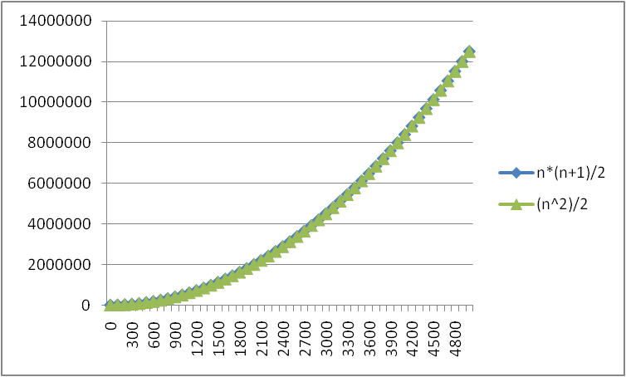
No Need To Be So Exact
Constants do not matter
Consider 6N² and 20N²
When N >> 20, the N² is what is driving the function's increase
Lower-order terms are also less important
N*(N+1)/2 vs.
just N²/2
The linear term is
inconsequential
We need a better notation for performance that focuses on the dominant terms only

Slide 39
What Dominates in Previous Example?
What about the +3 and 5 in 5N+3?
As N gets large, the +3 becomes insignificant
5 is inaccurate, as different operations require varying amounts of time and also does not have any significant importance
What is fundamental is that the time is linear in N.
Asymptotic Complexity: As N gets large, concentrate on the highest order term:
Drop lower order terms such as +3
Drop the constant coefficient of the highest order term i.e. N
Asymptotic Complexity: As N gets large, concentrate on the highest order term:

Slide 40
Asymptotic Complexity
The 5N+3 time bound is said to "grow asymptotically" like N
This gives us an approximation of the complexity of the algorithm
Ignores lots of (machine dependent) details, concentrate on the bigger picture

Slide 41
Asymptotic Analysis
Asymptotic analysis is an analysis of algorithms that focuses on
  Analyzing problems of large input size
  Consider only the leading term of the formula
  Ignore the coefficient of the leading term

Slide 42
Comparing Functions: Asymptotic Notation
Big Oh Notation: Upper bound
Omega Notation: Lower bound
Theta Notation: Tighter bound

Slide 43
Big-Oh Rules
If f(n) is a polynomial of degree d, then f(n) is O(n^{d}), i.e.,
  Drop lower-order terms
  Drop constant factors
Use the smallest possible class of functions
  Say “2n is O(n)” instead of “2n is O(n²)”
Use the simplest expression of the class
  Say “3n + 5 is O(n)” instead of “3n + 5 is O(3n)”
Notes:
If f(n) is a polynomial of degree d, then f(n) is O(n^d):
This rule means that when you have a mathematical expression (a polynomial) that depends on the input size 'n' and its highest power (degree) is 'd', you can simplify it in terms of Big O notation.
For example, if you have a polynomial like 3n^2 + 2n + 1, you can drop the lower-order terms (2n and 1) and the constant factors (3) and simply say it's O(n^2). This simplifies the expression while still describing how it grows with 'n'.
Use the smallest possible class of functions:
When describing the growth rate of a function, try to use the simplest class of functions that accurately represents its behavior.
For instance, if a function's growth is best described as linear (O(n)), don't use a quadratic (O(n^2)) or higher order notation. Stick to the simplest one that fits.
Use the simplest expression of the class:
Within a specific class of functions (e.g., linear functions), use the simplest expression to describe the function's growth.
For example, if you have a function like 3n + 5, you can simplify it to O(n) instead of O(3n). This simplification makes it easier to understand while still capturing the essential information about its growth.
In summary, Big O notation helps simplify the description of how functions grow with input size 'n'. It allows you to focus on the dominant factors affecting growth and use the simplest and most concise notation to represent that behavior.

Slide 44
Big-Oh Notation
Given two functions f(n) & g(n) for input n, we say f(n) is in O(g(n) ) iff there exist positive constants c and n₀ such that
f(n) ≤ c g(n) for all n ≥ n₀
Basically, we want to find a
function g(n) that is eventually
always bigger than f(n)
g
f
n₀
n
Notes:
Big O notation is a way to describe how the performance or behavior of a function changes as the input size (usually denoted as 'n') gets larger.
We have two functions, 'f(n)' and 'g(n),' which both depend on the input size 'n.'
We say that 'f(n)' is in 'O(g(n))' (read as "big O of g(n)") if the following is true:
There exist two positive numbers, 'c' and 'n0.'
When 'n' (the input size) becomes larger than or equal to 'n0,' then 'f(n)' will always be less than or equal to 'c times g(n).' In simpler terms, 'f(n)' won't grow faster than 'c times g(n)' for large enough 'n.'
So, in simpler words, Big O notation helps us find a function 'g(n)' that acts as an upper bound for 'f(n)' as 'n' gets larger. It tells us how 'f(n)' behaves in terms of 'g(n)' when we have sufficiently large inputs. This notation is commonly used to analyze and compare the efficiency of algorithms or functions.

Slide 45
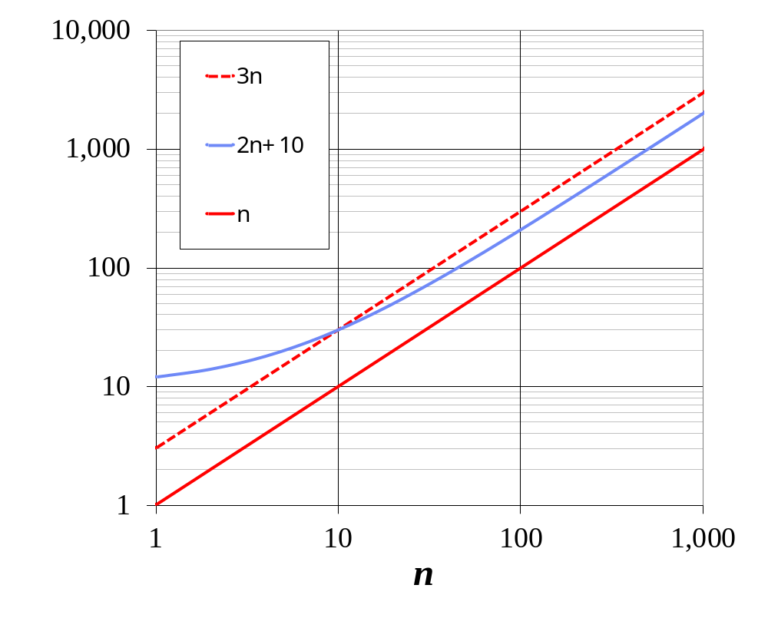
Big-Oh Notation (§3.4)
Given functions f(n) and g(n), we say that f(n) is O(g(n)) if there are positive constants
c and n₀ such that
f(n) ≤ cg(n) for n ≥ n₀
Example: 2n + 10 is O(n)
  2n + 10 ≤ cn
  (c − 2) n ≥ 10
  n ≥ 10/(c − 2)
  Pick c = 3 and n₀ = 10
Notes:
We start with the function 2n + 10.
We want to find a simpler function, let's call it 'g(n),' such that 2n + 10 is O(g(n)), meaning 2n + 10 won't grow faster than 'g(n)' as 'n' gets larger.
Now, let's go through the steps:
We write 2n + 10 <= c * g(n), where 'c' is a positive constant (we're looking for this constant) and 'g(n)' is the function we're trying to find.
We simplify the inequality: (c - 2) * n >= 10.
We want to make sure this inequality holds true for all sufficiently large values of 'n' (remember, Big O is about how functions behave for large 'n').
So, we solve for 'n': n >= 10 / (c - 2).
This equation tells us that as long as 'n' is greater than or equal to 10 / (c - 2), the function 2n + 10 will not grow faster than 'c * g(n).' In other words, for 'n' larger than a certain value (determined by the constant 'c'), the function 2n + 10 is O(g(n)), and 'g(n)' is a linear function (O(n)).
So, the example shows that 2n + 10 is O(n) because it behaves like a linear function (growing at the same rate as 'n') for sufficiently large 'n' values, and we found the condition for this behavior using the constant 'c.'
Substituting 'c' and 'n0': (3 - 2) * n >= 10 n >= 10
So, with 'c' equal to 3 and 'n0' equal to 10, we find that for all 'n' greater than or equal to 10, the function 2n + 10 is indeed less than or equal to 3 * n. This confirms that 2n + 10 is O(n) when 'c' is 3 and 'n0' is 10, as it satisfies the Big O definition.

Slide 46
Showing Order Briefly …
Show 10N² + 15N is O(N²)
.

Slide 47
Showing Order Briefly …
Show 10N² + 15N is O(N²)
Break into terms.
10N² < 10N²
15N < 15N² for N > 1 (Now add)
10N² + 15N < 10N² + 15N² for N > 1
10N² + 15N < 25N² for N > 1
c = 25, N₀ = 1
Note, the choices for c and N₀ are not unique.

Slide 48
Take Home Task
Show 2N³ + 10N is O(N³)
Show 2N³ + 10N is not O(N²)
Show 2N³ + 10N is O(N⁴)

Slide 49
The Gist of Big-Oh
Take functions f(n) & g(n), consider only the most significant term and remove constant multipliers:
  5n+3 → n
  7n+.5n²+2000 → n²
  300n+12+nlogn → n log n
Then compare the functions; if f(n) ≤ g(n), then f(n) is in O(g(n))

Slide 50
Big Oh Notation
If f(N) and g(N) are two complexity functions, we say
f(N) = O(g(N))
(read "f(N) as order g(N)", or "f(N) is big-O of g(N)")
if there are constants c and N₀ such that for N > N₀,
f(N) ≤ c * g(N)
for all sufficiently large N.
*big-O-Upper bound

Slide 51
Comparing Functions
As inputs get larger, any algorithm of a smaller order will be more efficient than an algorithm of a larger order
0.05 N² = O(N²)
3N = O(N)
Time (steps)
N = 60
Input (size)

Slide 52

Big Omega Notation
Big Omega notation helps us determine the minimum growth rate of a function. It tells us how fast the function can grow at its slowest.
Let's say we have an algorithm with a runtime of Ω(N^2). This means that for large input sizes, the algorithm will take at least quadratic time. It may take even longer (e.g., cubic or exponential time), but it will not be faster than N^2

Slide 53
Big Omega (Ω) provides information about the lower bound or best-case scenario, while Big O (O) describes the upper bound or worst-case scenario. Together, they help us understand the range of possible growth rates for an algorithm or function.
In summary, Big Omega notation helps us establish a lower bound on the growth rate of a function, providing insights into its best-case behavior for large inputs. It tells us how efficiently the function can perform at a minimum.

Slide 54
Example
Show 2n +3 is Ω(n)
To show that 2n + 3 is Ω(n), we need to find constants 'c' and 'n0' such that:
2n + 3 ≥ c * n for all n ≥ n0
In this case, we want to prove that 2n + 3 grows at least as fast as a linear function of n. Let's go through the steps to find suitable 'c' and 'n0':
Start with the expression: 2n + 3 ≥ c * n.
Subtract 'c * n' from both sides: 2n - c * n + 3 ≥ 0.
Factor out 'n' from the first two terms: n(2 - c) + 3 ≥ 0.
Now, we need to find a value for 'c' such that for all values of 'n' greater than or equal to some 'n0,' the inequality holds true.
Let's choose 'c' such that '2 - c' is positive, and let's set 'n0' to be 1:
If we choose 'c' such that '2 - c' is positive (for example, 'c' = 1), then the inequality becomes: n(2 - 1) + 3 ≥ 0, which simplifies to n + 3 ≥ 0. This is true for all values of 'n.'
So, with 'c' equal to 1 and 'n0' equal to 1, we have shown that 2n + 3 is Ω(n), as it grows at least as fast as a linear function of 'n' for all 'n' greater than or equal to 1.

Slide 55
Example
Show 2n² + n + 1 is Ω(n²)

Slide 56
Example
Show 2n² + n + 1 is Ω(n²)
2n² + n + 1 >= cn² ;for all n>=1
c=1, n_{o}=1

Slide 57
Take Home Task
Show 8n³ + 5n² + 7 is Ω(n³)

Slide 58

Big Theta Notation
Big Theta provides an exact or tight bound on the growth rate of a function. It tells us that for sufficiently large input values (N), the function being analyzed will grow exactly as fast as the specified bound.
If we have an algorithm with a runtime of Θ(N^2), this means that for large input sizes, the algorithm will take exactly quadratic time, and it will not be faster or slower than N^2.

Slide 59
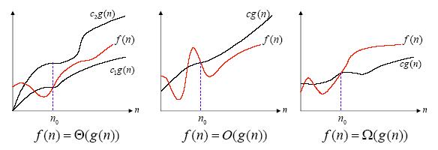
Asymptotic notation
Example:
  f(n) = 3n⁵+n⁴ = Θ(n⁵)

Slide 60
Polynomial and Intractable Algorithms
Polynomial Time complexity
  An algorithm is said to be polynomial if it is
  O( n^{d} ) for some integer d
  Polynomial algorithms are said to be efficient
    They solve problems in reasonable times!
Intractable algorithms
  Algorithms for which there is no known polynomial time algorithm
  We will come back to this important class later
Notes:
Polynomial Time Complexity:
Imagine you have a computer program that solves a problem, and the program takes some time to run based on the size of the input.
In "Polynomial Time Complexity," we're talking about programs that take a reasonable amount of time to run as the input gets bigger.
More formally, if the time it takes to run the program is related to the size of the input by an expression like "n^d," where "n" is the size of the input and "d" is some fixed number (an integer), then we call it a "polynomial" algorithm.
"Polynomial" algorithms are considered efficient because they can handle larger inputs without taking too much time.
Intractable Algorithms:
Now, let's talk about the opposite situation.
Some problems are really, really hard to solve, and as the input gets bigger, the time it takes to solve them grows extremely fast.
These problems don't have a known algorithm that can solve them in a reasonable amount of time, especially as the input size increases.
We call these problems "Intractable."
Essentially, "Intractable" problems are those for which we haven't found any efficient (polynomial) way to solve them yet.
Researchers keep looking for better algorithms to tackle intractable problems, but they remain challenging.

Slide 61
Asymptotic order of growth
A way of comparing functions that ignores constant factors and small input sizes
O(g(n)): class of functions f(n) that grow no faster than g(n)
Θ(g(n)): class of functions f(n) that grow at same rate as g(n)
Ω(g(n)): class of functions f(n) that grow at least as fast as g(n)

Slide 62
>=
Ω(g(n)), functions that grow at least as fast as g(n)
=
Θ(g(n)), functions that grow at the same rate as g(n)
g(n)
<=
O(g(n)), functions that grow no faster than g(n)

Slide 63
Performance Classification
f(n) | Classification
1 | Constant: run time is fixed, and does not depend upon n. Most instructions are executed once, or only a few times, regardless of the amount of information being processed
log n | Logarithmic: when n increases, so does run time, but much slower. When n doubles, log n increases by a constant, but does not double until n increases to n². Common in programs which solve large problems by transforming them into smaller problems.
n | Linear: run time varies directly with n. Typically, a small amount of processing is done on each element.
n log n | When n doubles, run time slightly more than doubles. Common in programs which break a problem down into smaller sub-problems, solves them independently, then combines solutions
n² | Quadratic: when n doubles, runtime increases fourfold. Practical only for small problems; typically the program processes all pairs of input (e.g. in a double nested loop).
n³ | Cubic: when n doubles, runtime increases eightfold
2^{n} | Exponential: when n doubles, run time squares. This is often the result of a natural, “brute force” solution.

Slide 64
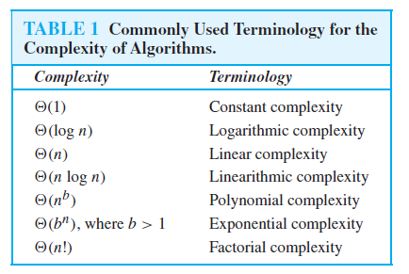

Slide 65
Size does matter
What happens if we double the input size N?
N log₂N 5N N log₂N N² 2^{N}
8 3 40 24 64 256
16 4 80 64 256 65536
32 5 160 160 1024 ~10⁹
64 6 320 384 4096 ~10¹⁹
128 7 640 896 16384 ~10³⁸
256 8 1280 2048 65536 ~10⁷⁶

Slide 66
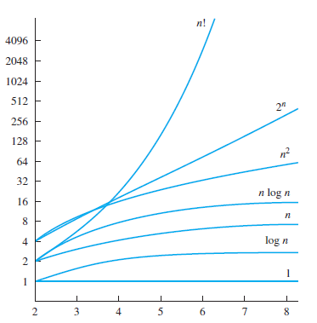
A Display of the Growth of Functions Commonly Used in Big-O Estimates

Slide 67
Typical Big O Functions – "Grades"
Function | Common Name
N! | factorial
2^{N} | Exponential
N^{d}, d > 3 | Polynomial
N³ | Cubic
N² | Quadratic
N N | N Square root N
N log N | N log N
N | Linear
N | Root - n
log N | Logarithmic
1 | Constant
Running
time grows
'quickly' with
more input.
Running
time grows
'slowly' with
more input.

Slide 68
Theorem
If t₁(n) ∈ O(g₁(n)) and t₂(n) ∈ O(g₂(n)), then
t₁(n) + t₂(n) ∈ O(max{g₁(n), g₂(n)}).
  The analogous assertions are true for the Ω-notation and Θ-notation.
Implication: The algorithm’s overall efficiency will be determined by the part with a larger order of growth, i.e., its least efficient part.
  For example, 5n² + 3nlogn ∈ O(n²)
Proof. There exist constants c1, c2, n1, n2 such that
t1(n) ≤ c1*g1(n), for all n ≥ n1
t2(n) ≤ c2*g2(n), for all n ≥ n2
Define c3 = c1 + c2 and n3 = max{n1,n2}. Then
t1(n) + t2(n) ≤ c3*max{g1(n), g2(n)}, for all n ≥ n3
Notes:
The Theorem:
Imagine you have two things (let's call them "t1" and "t2") that we want to measure how fast they grow as we give them bigger and bigger things (like numbers).
If we know that "t1" doesn't grow faster than some function "g1" and "t2" doesn't grow faster than some other function "g2," then we can figure out how fast "t1 + t2" grows when we add them together.
Implication of the Theorem:
When we have an algorithm that consists of multiple parts, like two different steps, the overall efficiency of the algorithm will be determined by the part that grows the fastest. In other words, the least efficient part.
Example:
Suppose you have an algorithm, and one part of it (let's call it "t1") grows as 5n^2 (five times the square of the input size "n"), and another part (let's call it "t2") grows as 3nlogn (three times "n" times the logarithm of "n").
If we add these two parts together (t1 + t2), the overall growth rate is mostly determined by the part that grows the fastest, which is 5n^2.
So, we can say that t1 + t2 is roughly equivalent to O(n^2), meaning the algorithm's overall efficiency is similar to that of something that grows as n^2.
The Proof:
To prove this, we use some constants and numbers (like c1, c2, n1, and n2) to show that "t1" and "t2" don't grow too fast compared to their respective functions "g1" and "g2."
Then, by adding these constants and numbers together in a certain way, we can conclude that when we add "t1" and "t2," their growth rate won't be faster than the larger of the two functions, which is "max{g1(n), g2(n)}."
In simple terms, this theorem helps us understand how the efficiency of an algorithm is determined by its slowest (least efficient) part when we're combining different parts together. It's like saying the chain is only as strong as its weakest link.

Slide 69
Review of Three Common Sets
f(n) = O(g(n)) means c × g(n) is an Upper Bound on f(n)
f(n) = Ω(g(n)) means c × g(n) is a Lower Bound on f(n)
f(n) = Θ(g(n)) means c₁ × g(n) is an Upper Bound on f(n)
and c₂ × g(n) is a Lower Bound on f(n)
These bounds hold for all inputs beyond some threshold n₀.
Notes:
Asymptotic or Big-O notation.
O Omega Sigma

Slide 70
Properties of the O notation
Constant factors may be ignored
  ∀ k > 0, kf is O( f)
Higher powers grow faster
  n^{r} is O( n^{s}) if 0 ≤ r ≤ s
Fastest growing term dominates a sum
  If f is O(g), then f + g is O(g)
  eg an⁴ + bn³ is O(n⁴ )
Polynomial’s growth rate is determined by leading term
  If f is a polynomial of degree d,
  then f is O(n^{d})
Notes:
Property 1: Constant Factors May Be Ignored
Imagine you have a formula to calculate something, and it involves multiplying a number by a constant (like 2 times a number). In Big O notation, we don't really care about that constant.
So, whether it's 2 times a number or 5 times a number, we say it's still "O" the same thing. We ignore the constant part because it doesn't change how fast something grows as we make it bigger.
Property 2: Higher Powers Grow Faster
Think about numbers raised to different powers, like "n^2" (n squared) and "n^3" (n cubed). The one with a bigger power grows faster.
So, if we have something that's "O(n^3)," it means it grows faster than something that's "O(n^2)." Higher powers are like speed levels, and the bigger power is faster.
Property 3: Fastest Growing Term Dominates a Sum
If you have two things, like "an^4" and "bn^3," and you add them together (an^4 + bn^3), the one that grows faster (an^4) dominates the sum.
In other words, when you're adding two things together, the fastest-growing part determines how fast the whole thing grows. So, an^4 + bn^3 is considered "O(n^4)" because n^4 is the fastest-growing part.
Property 4: Polynomial's Growth Rate Is Determined by Leading Term
Imagine you have a polynomial (like "3n^2 + 2n + 1"). The term with the highest power (the biggest exponent) determines how fast the polynomial grows.
In this case, "3n^2" has the highest power (n squared), so we say the whole polynomial is "O(n^2)." It's like the leader of a group sets the pace.

Slide 71
Properties of the O notation
f is O(g) is transitive
  If f is O(g) and g is O(h) then f is O(h)
Product of upper bounds is upper bound for the product
  If f is O(g) and h is O(r) then fh is O(gr)
Exponential functions grow faster than powers
  n^{k} is O( b^{n} ) ∀ b > 1 and k ≥ 0
  e.g. n²⁰ is O( 1.05^{n})
Logarithms grow more slowly than powers
  log_{b}n is O( n^{k}) ∀ b > 1 and k > 0
  e.g. log₂n is O( n^{0.5})
Important!
Notes:
Property 5: Transitive Property
Think of this like a relay race. If one runner (let's call them "f") is faster than another runner ("g"), and that faster runner (f) passes the baton to another runner ("h"), then we can say that the final runner (f) is also faster than the last one (h).
In Big O notation, if f is "O(g)" and g is "O(h)," then we can conclude that f is "O(h)." It's like passing the efficiency from one part of a process to another.
Property 6: Product of Upper Bounds
Imagine you have two separate things, f and h, and you know they each have an upper limit (like "f is O(g)" and "h is O(r)"). Now, if you multiply these two things together (fh), the result (fh) also has an upper limit.
In Big O notation, if f is "O(g)" and h is "O(r)," then the product of f and h (fh) is "O(gr)." It's like saying that even when you combine things, there's still an upper limit to how fast they grow.
Property 7: Exponential Functions vs. Powers
Think of this like a race between different types of functions. Exponential functions (like "b^n" where "b" is greater than 1) grow much faster than simple powers (like "n^k" where "k" is some number).
In Big O notation, if you have an exponential function (b^n) and compare it to a power (n^k), the exponential one (b^n) always wins. It grows faster.
For example, "n^20" is "O(1.05^n)," which means even though "n^20" is pretty big, "1.05^n" grows even faster!
Property 8: Logarithms vs. Powers
Now, flip the scenario. Logarithmic functions (like "log_b(n)" where "b" is greater than 1) grow more slowly than powers (like "n^k" where "k" is some number).
In Big O notation, if you have a logarithmic function (log_b(n)) and compare it to a power (n^k), the logarithmic one (log_b(n)) is the slower one.
For example, "log_2(n)" is "O(n^0.5)," which means that even though logarithms are quite useful, they grow more slowly compared to square roots (n^0.5).

Slide 72
Properties of the O notation
All logarithms grow at the same rate
  log_{b}n is O(log_{d}n) ∀ b, d > 1
Sum of first n r^{th} powers grows as the (r+1)^{th} power
  Σ k^{r} is Θ ( n^{r+1} )
  e.g. Σ k = is Θ ( n² )
n
k=1
n
n(n+1)
k=1
2
Notes:
Property 5: All Logarithms Grow at the Same Rate
This property tells us that logarithmic functions with different bases grow at the same rate. In other words, it doesn't matter what base you use for a logarithm; they all behave similarly in terms of their growth rate.
So, if you have log base "b" of "n" (log_bn) and log base "d" of "n" (log_dn) where both "b" and "d" are greater than 1, they will have similar growth rates.
For example, log_2(n) and log_10(n) both grow at the same rate, and we can write log_2(n) is "O(log_10(n))." The base of the logarithm doesn't change how fast it grows.
Property 6: Sum of First n rth Powers Grows as the (r+1)th Power
This property relates to the sum of powers of integers. It tells us that when we add up the first "n" powers of "r" (like 1^r + 2^r + 3^r + ... + n^r), the result grows as the (r+1)th power of "n."
For example, if you add up the first "n" square numbers (1^2 + 2^2 + 3^2 + ... + n^2), the sum grows as "n^3" (the cube of "n").
In Big O notation, we can say that the sum of the first "n" rth powers is "O(n^(r+1))." This property helps us understand how these sums grow as we increase "n."
For example, when you add up the first "n" natural numbers (1 + 2 + 3 + ... + n), you get the triangular number formula, which is "n(n+1)/2." According to this property, the sum of the first "n" natural numbers is "O(n^2)" because it grows as the square of "n."

Slide 73
Order of growth
We usually consider one algorithm to be more efficient than another if its worst case running time has a lower order of growth.
  Due to constant factors and lower order terms, an algorithm whose running time has a higher order of growth might take less time for small inputs than an algorithm whose running time has a lower order of growth. But for large enough inputs, Θ ( n² ) algorithm, for example, will run more quickly in the worst case than Θ ( n³ ) algorithm

Slide 74
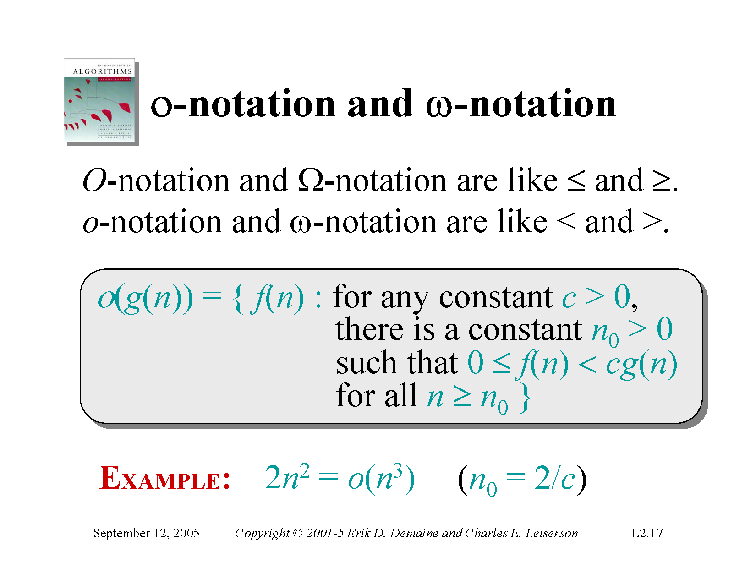
Notes:
In little o-notation, we are expressing that a function on the left side of the equation (in this case, 2n^2) grows strictly slower than the function on the right side (n^3) as the input size (n) becomes larger.
Here's how the example works:
We have "2n^2" on the left side, which represents some function.
On the right side, we have "n^3," which also represents another function.
The notation "2n^2 = o(n^3)" means that as n (the input size) approaches infinity, "2n^2" grows much slower than "n^3." It's not just slower; it's significantly slower.
Now, let's consider the constant "c" and "n0" in the equation:
"n0" represents a specific point or threshold at which this relationship holds true. In this case, "n0 = 2/c" means that for values of "n" greater than or equal to 2/c, the function "2n^2" is indeed growing strictly slower than "n^3."
In simple terms, this example is saying that if you take any constant "c" greater than 2 (for example, 3, 4, 5, etc.), there will be a point (n0) beyond which "2n^2" grows slower than "n^3." As "n" gets larger and larger, the difference in growth rates becomes more evident, and "2n^2" remains much smaller compared to "n^3."

Slide 75
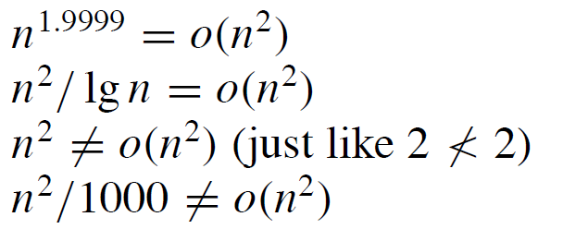
o-Notation
Examples

Slide 76

Notes:
In omega notation, we express that a function on the left side of the equation (in this case, sqrt(n)) grows strictly faster than the function on the right side (log(n)) as the input size (n) becomes larger.
Here's how this example works:
On the left side, we have "sqrt(n)," which represents a function that grows with the square root of "n."
On the right side, we have "log(n)," which represents a logarithmic function.
The notation "sqrt(n) = ω(log(n))" means that as n (the input size) approaches infinity, "sqrt(n)" grows significantly faster than "log(n)." It's not just faster; it's significantly faster.
Now, let's consider the constant "c" and "n0" in the equation:
"n0" represents a specific point or threshold at which this relationship holds true. In this case, "n0 = 1+1/c" means that for values of "n" greater than or equal to 1 + 1/c, the function "sqrt(n)" is indeed growing strictly faster than "log(n)."
In simpler terms, this example is saying that for any positive constant "c" (for example, 1, 2, 3, etc.), there will be a point (n0) beyond which "sqrt(n)" grows faster than "log(n)." As "n" gets larger and larger, the difference in growth rates becomes more evident, and "sqrt(n)" becomes significantly larger compared to "log(n)."

Slide 77

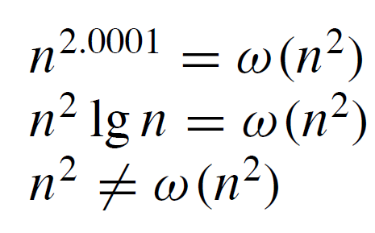
ω- notation

