Slide 1
Design and Analysis of Algorithms
Recursion
National University of Computer and Emerging Sciences, Islamabad

Slide 2
Divide-and-Conquer
Divide the problem into a number of subproblems that are smaller instances of the
same problem.
Conquer the subproblems by solving them recursively. If the subproblem sizes are small enough, however, just solve the subproblems in a straightforward manner.
Combine the solutions to the subproblems into the solution for the original problem.

Slide 3
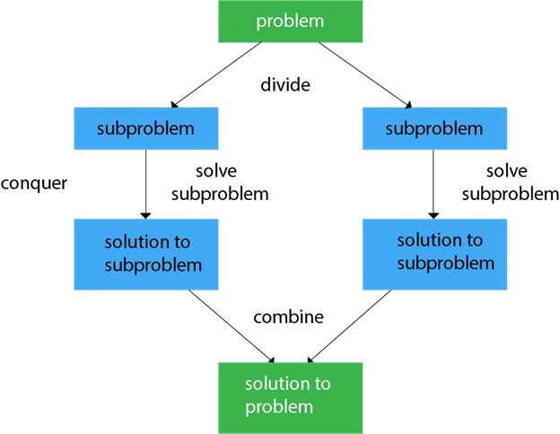
Divide and Conquer

Slide 4
Recursion (2)
To solve problem recursively
Sub-problem must be smaller than the original problem
  Otherwise recursion never terminates
Define the base case(s)
Define the recursive case(s)
  Divide the problem into smaller sub-problems
  Solve the sub-problems
  Combine results to get answer
Sub-problems solved as a recursive call to the same function

Slide 5
Recursion
Recursion occurs when a function/procedure calls itself.
Many algorithms can be best described in terms of recursion.
Example: Factorial function
The product of the positive integers from 1 to n inclusive is called "n factorial", usually denoted by n!:
n! = 1 * 2 * 3 .... (n-2) * (n-1) * n

Slide 6
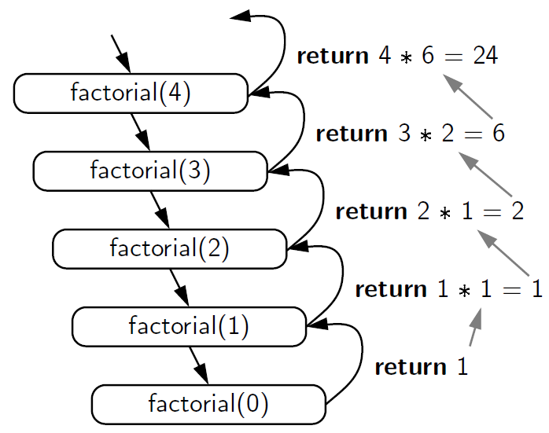
Factorial function
n
n-1
n-2
n-3
n-n

Slide 7
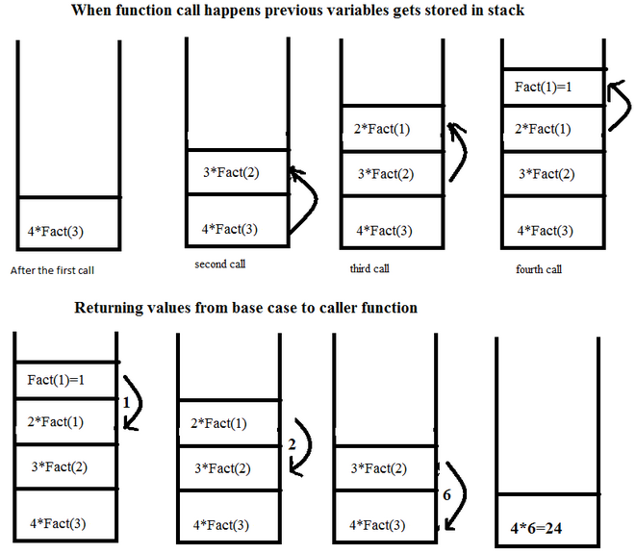
Recursive Definition of the Factorial Function

Slide 8
Stack Overflow!
Recursive functions cannot use statically allocated local variables
  Each instance of the function needs its own copies of local variables
Most modern languages allocate local variables for functions on the run-time stack
Calling a recursive function many times or with large arguments may result in stack overflow

Slide 9
Recursive Definition of the Factorial Function

Slide 10
Recursive Definition of the Factorial Function
1, if n = 0
n * (n-1)! if n > 0
n! =
5! = 5 * 4!
4! = 4 * 3!
3! = 3 * 2!
2! = 2 * 1!
1! = 1 * 0!
= 5 * 24 = 120
= 4 * 3! = 4 * 6 = 24
= 3 * 2! = 3 * 2 = 6
= 2 * 1! = 2 * 1 = 2
= 1 * 0! = 1

Slide 11
Recursive Definition of the Fibonacci Numbers
The Fibonacci Sequence is the series of numbers:
1, 1, 2, 3, 5, 8, 13, 21, 34, ...
The Fibonacci numbers are a series of numbers as follows:

Slide 12
Recursive Definition of the Fibonacci Numbers
The Fibonacci Sequence is the series of numbers:
1, 1, 2, 3, 5, 8, 13, 21, 34, ...
The Fibonacci numbers are a series of numbers as follows:
fib(1) = 1
fib(2) = 1
fib(3) = 2
fib(4) = 3
fib(5) = 5
...
fib(n) =
1, n <= 2
fib(n-1) + fib(n-2), n > 2
fib(3) = 1 + 1 = 2
fib(4) = 2 + 1 = 3
fib(5) = 2 + 3 = 5

Slide 13
How do I write a recursive function?
Determine the size factor
Determine the base case(s)
  (the one for which you know the answer)
Determine the general case(s)
  (the one where the problem is expressed as a smaller version of itself)
Verify the algorithm
  (use the "Three-Question-Method")

Slide 14
Recursive Definition
int BadFactorial(n){
int x = BadFactorial(n-1);
if (n == 1)
return 1;
else
return n*x;
}
What is the value of BadFactorial(2)?
We must make sure that recursion eventually stops, otherwise
it runs forever:

Slide 15
Using Recursion Properly
For correct recursion we need two parts:
1. One (ore more) base cases that are not recursive, i.e. we
can directly give a solution:
if (n==1)
return 1;
2. One (or more) recursive cases that operate on smaller
problems that get closer to the base case(s)
return n * factorial(n-1);
The base case(s) should always be checked before the recursive calls.

Slide 16
Counting Digits
19865 (5 Digit Number)
386(3 Digit Number)

Slide 17
Counting Digits
Recursive definition
  digits(n) = 1 if (–9 <= n <= 9)
  1 + digits(n/10) otherwise
Example
  digits(321) =
  1 + digits(321/10) = 1 +digits(32) =
  1 + [1 + digits(32/10)] = 1 + [1 + digits(3)] =
  1 + [1 + (1)] =
  3
Base Case
Recursive case

Slide 18
Counting Digits in C++
int numberofDigits(int n)
{
if ((-10 < n) && (n < 10))
return 1;
else
return 1 + numberofDigits(n/10);
}
Base Case
Recursive case

Slide 19
Evaluating Exponents Recursively
5 ^ 4 =?
power(5, 4)

Slide 20
Evaluating Exponents Recursively
int power(int k, int n) {
// raise k to the power n
if (n == 0)
return 1;
else
return k * power(k, n – 1);
}
5 ^ 4 =?
power(5, 4)
625
5 * power(5, 3) = 5 *5 ^ 3
125
5 * power(5, 2) = 5 *5 ^ 2
25
5
5 * power(5, 1) = 5 *5 ^ 1
5 * power(5, 0) = 5*1
1
1

Slide 21
Evaluating Exponents Recursively
int power(int k, int n) {
// raise k to the power n
if (n == 0)
return 1;
else
return k * power(k, n – 1);
}

Slide 22
Divide and Conquer
Using this method each recursive subproblem is about one-half the size of the original problem
If we could define power so that each subproblem was based on computing k^{n/2} instead of k^{n – 1} we could use the divide and conquer principle
Recursive divide and conquer algorithms are often more efficient than iterative algorithms

Slide 23
Evaluating Exponents Using Divide and Conquer
int power(int k, int n) {
// raise k to the power n
if (n == 0)
return 1;
else{
int t = power(k, n/2);
if ((n % 2) == 0)
return t * t;
else
return k * t * t;
}

Slide 24
Evaluating Exponents Using Divide and Conquer
int power(int k, int n) {
// raise k to the power n
if (n == 0)
return 1;
else{
int t = power(k, n/2);
if ((n % 2) == 0)
return t * t;
else
return k * t * t;
}
5 ^ 4 =?
power(5, 4)
n=4,
t=25
25*25=625
n=4,
k=5
power(5, 4/2)
= power(5, 2)
5*5=25
n=2,
t=5
n=2,
k=5
power(5, 2/2)
= power(5, 1)
5*1*1
n=1,
t=1
n=1,
k=5
power(5, 1/2)
=power(5, 0)
1
n=0,
k=5
return 1

Slide 25
Disadvantages
May run slower.
  Compilers
  Inefficient Code
May use more space.

Slide 26
Advantages
More natural.
Easier to prove correct.
Easier to analyze.
More flexible.
Notes:
Iteration can be used in place of recursion
An iterative algorithm uses a looping construct
A recursive algorithm uses a branching structure
Recursive solutions are often less efficient, in terms of both time and space, than iterative solutions
Recursion can simplify the solution of a problem, often resulting in shorter, more easily understood source code

