Slide 1


Data Structures
Week10_Lecture1
Tree Data Structures
Subhan Ullah, PhD
subhan.ullah@nu.edu.pk
BS(Cybersecurity) Fall-2023

Slide 2
Data Structures
Binary Tree Implementation

Slide 3
Linked List Storage

Slide 4
As Linked List Structure (1)
We can implement a binary tree by using a class which:
Stores an element
A left child pointer (pointer to first child)
A right child pointer (pointer to second child)
The root pointer points to the root node
Follow pointers to find every other element in the tree
Leaf nodes have LeftChild and RightChild pointers set to NULL
class Node{
Type value;
Node *LeftChild,*RightChild;
};

Slide 5
As Linked List Structure: Example
Root pointer
a
b
c
d
e
f
g
h
i
j
k
l

Slide 6
Tree Traversal

Slide 7
Tree Traversal
To traverse (or walk) the tree is to visit each node in the tree exactly once
Traversal must start at the root node
There is a pointer to the root node of the binary tree
Two types of traversals
Breadth-First Traversal
Depth-First Traversal

Slide 8
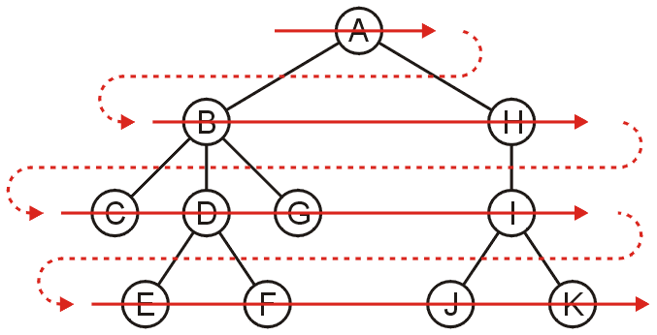
Breadth-First Traversal (For Arbitrary Trees)
All nodes at a given depth d are traversed before nodes at d+1
Can be implemented using a queue
Order: A B H C D G I E F J K

Slide 9
Breadth-First Traversal – Implementation
Create a queue and push the root node onto the queue
While the queue is not empty:
Enqueue all children of the front node onto the queue
Dequeue the front node

Slide 10
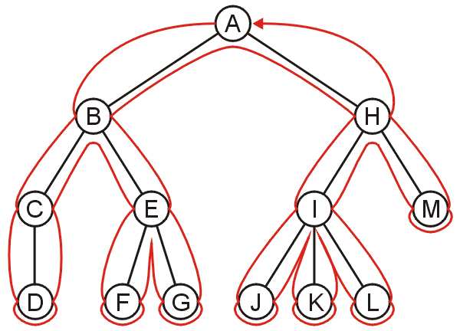
Depth-First Traversal (For Arbitrary Trees)
Traverse as much as possible along the branch of each child before going to the next sibling
Nodes along one branch of the tree are traversed before backtracking
Each node could be visited multiple times in such a scheme
The first time the node is approached (before any children)
The last time it is approached (after all children)

Slide 11
Depth-First Tree Traversal (Binary Trees)
For each node in a binary tree, there are three choices
Visit the node first
Visit one of the subtrees first
Visit both the subtrees first
These choices lead to three commonly used traversals
Inorder traversal: (Left subtree) visit Root (Right subtree)
Preorder traversal: visit Root (Left subtree) (Right subtree)
Postorder traversal: (Left subtree) (Right subtree) visit Root
Notes:
#include <iostream>
using namespace std;
class Node {
public:
int data;
Node* left;
Node* right;
// Val is the key or the value that
// has to be added to the data part
Node(int val)
{
data = val;
// Left and right child for node
// will be initialized to null
left = NULL;
right = NULL;
}
};
int main()
{
/*create root*/
Node* root = new Node(1);
/* following is the tree after above statement
1
/ \
NULL NULL
*/
root->left = new Node(2);
root->right = new Node(3);
/* 2 and 3 become left and right children of 1
1
/ \
2 3
/ \ / \
NULL NULL NULL NULL
*/
root->left->left = new Node(4);
/* 4 becomes left child of 2
1
/ \
2 3
/ \ / \
4 NULL NULL NULL
/ \
NULL NULL
*/
return 0;
}

Slide 12
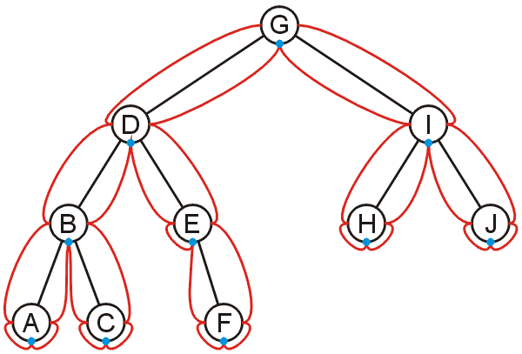
Inorder Traversal
Algorithm
Traverse the left subtree in inorder
Visit the root
Traverse the right subtree in inorder
A, B, C, D, E, F, G, H, I, J

Slide 13
Inorder Traversal
Algorithm
Traverse the left subtree in inorder
Visit the root
Traverse the right subtree in inorder
Example
Left + Right
[Left * Right] + [Left + Right]
(A * B) + [(Left * Right) + E)
(A * B) + [(C * D) + E]
+
*
+
A
B
*
E
C
D

Slide 14
Inorder Traversal – Implementation
void inorder(Node *p) const
{
if (p != NULL)
{
inorder(p->leftChild);
cout << p->info << " ";
inorder(p->rightChild);
}
}
void traverse_inorder () {
. . .
inorder (root);
}

Slide 15
Preorder Traversal
Algorithm
Visit the node
Traverse the left subtree
Traverse the right subtree
Example
+ Left Right
+ [ * Left Right] [+ Left Right]
+ ( * AB) [+ * Left Right E]
+*AB + *C D E
+
*
+
A
B
*
E
C
D

Slide 16
Preorder Traversal – Implementation
void preorder(Node *p) const
{
if (p != NULL)
{
cout << p->info << " ";
preorder(p->leftChild);
preorder(p->rightChild);
}
}
void traverse_preorder () {
. . .
preorder (root);
}

Slide 17
Postorder Traversal
Algorithm
Traverse the left subtree
Traverse the right subtree
Visit the node
Example
Left Right +
[Left Right *] [Left Right+] +
(AB*) [Left Right * E + ]+
(AB*) [C D * E + ]+
AB* C D * E + +
+
*
+
A
B
*
E
C
D

Slide 18
Postorder Traversal – Implementation
void postorder(Node *p) const
{
if (p != NULL)
{
postorder(p->leftChild);
postorder(p->rightChild);
cout << p->info << " ";
}
}
void traverse_postorder () {
. . .
postorder (root);
}

Slide 19
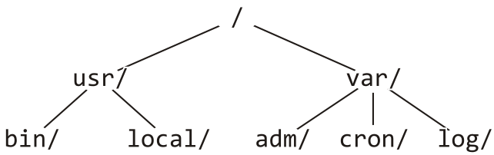
Example: Printing a Directory Hierarchy
Consider the directory structure presented on the left
Which traversal should be used?
/
usr/
bin/
local/
var/
adm/
cron/
log/

Slide 20
Expression Tree

Slide 21
Expression Tree
Each algebraic expression has an inherent tree-like structure
An expression tree is a binary tree in which
The parentheses in the expression do not appear
Tree representation captures the intent of parenthesis
The leaves are the variables or constants in the expression
The non-leaf nodes are the operators in the expression
Binary operator has two non-empty subtrees
Unary operator has one non-empty subtree
+
3
-
*
+
4
5
9
6

Slide 22
Convert Postfix into Expression Tree – Algorithm
1 while(not the end of the expression)
2 {
3 if(the next symbol in the expression is an operand)
4 {
5 create a node for the operand ;
6 push the reference to the created node onto the stack ;
7 }
8 if(the next symbol in the expression is a binary operator)
9 {
10 create a node for the operator ;
11 pop from the stack a reference to an operand ;
12 make the operand the right subtree of the operator node ;
13 pop from the stack a reference to an operand ;
14 make the operand the left subtree of the operator node ;
15 push the reference to the operator node onto the stack ;
16 }
17 }

Slide 23
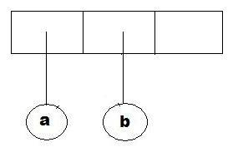
Convert Postfix into Expression Tree – Example (1)
while(not the end of the expression)
{
if(the next symbol is an operand)
{
create a node for the operand ;
push the reference to the created node onto the stack;
}
if(the next symbol is a binary operator)
{
create an operator node;
pop operand from the stack;
make the operand the right subtree ;
pop operand from the stack;
make the operand the left subtree ;
push the operator node onto the stack;
}
}
Example:
a b + c d e + * *

Slide 24
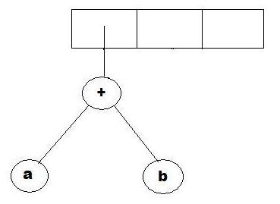
Convert Postfix into Expression Tree – Example (2)
while(not the end of the expression)
{
if(the next symbol is an operand)
{
create a node for the operand ;
push the reference to the created node onto the stack ;
}
if(the next symbol is a binary operator)
{
create an operator node;
pop operant from the stack;
make the operand the right subtree ;
pop operand from the stack;
make the operand the left subtree ;
push the operator node onto the stack;
}
}
Example:
a b + c d e + * *

Slide 25
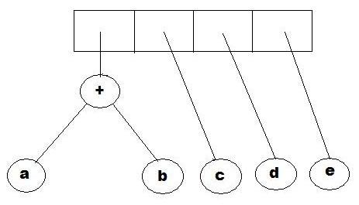
Convert Postfix into Expression Tree – Example (3)
while(not the end of the expression)
{
if(the next symbol is an operand)
{
create a node for the operand ;
push the reference to the created node onto the stack;
}
if(the next symbol is a binary operator)
{
create an operator node;
pop operant from the stack;
make the operand the right subtree ;
pop operand from the stack;
make the operand the left subtree ;
push the operator node onto the stack;
}
}
Example:
a b + c d e + * *

Slide 26
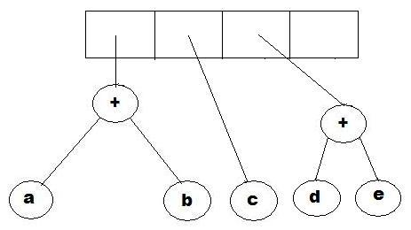
Convert Postfix into Expression Tree – Example (4)
while(not the end of the expression)
{
if(the next symbol is an operand)
{
create a node for the operand ;
push the reference to the created node onto the stack ;
}
if(the next symbol is a binary operator)
{
create an operator node;
pop operant from the stack;
make the operand the right subtree ;
pop operand from the stack;
make the operand the left subtree ;
push the operator node onto the stack;
}
}
Example:
a b + c d e + * *

Slide 27
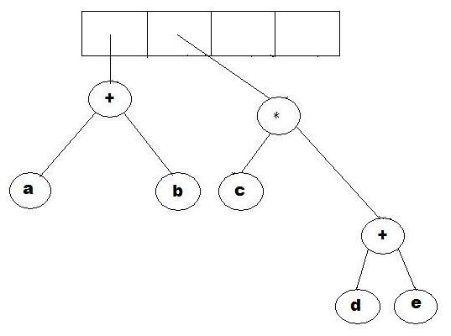
Convert Postfix into Expression Tree – Example (5)
while(not the end of the expression)
{
if(the next symbol is an operand)
{
create a node for the operand ;
push the reference to the created node onto the stack ;
}
if(the next symbol is a binary operator)
{
create an operator node;
pop operant from the stack;
make the operand the right subtree ;
pop operand from the stack;
make the operand the left subtree ;
push the operator node onto the stack;
}
}
Example:
a b + c d e + * *

Slide 28
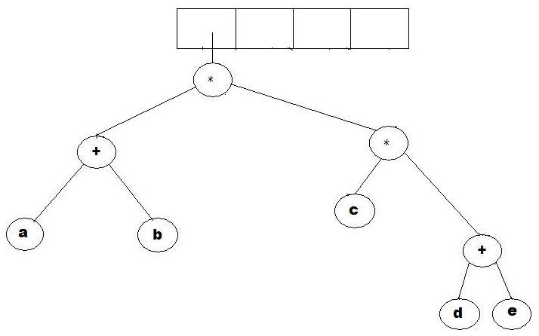
Convert Postfix into Expression Tree – Example (6)
while(not the end of the expression)
{
if(the next symbol is an operand)
{
create a node for the operand ;
push the reference to the created node onto the stack ;
}
if(the next symbol is a binary operator)
{
create an operator node;
pop operant from the stack;
make the operand the right subtree ;
pop operand from the stack;
make the operand the left subtree ;
push the operator node onto the stack;
}
}
Example:
a b + c d e + * *

Slide 29
Why Expression Tree?
Expression trees impose a hierarchy on the operations
Terms deeper in the tree get evaluated first
Establish correct precedence of operations without using parentheses
A compiler will read an expression in a language like C++/Java, and transform it into an expression tree
Expression trees can be very useful for:
Evaluation of the expression
Generating correct compiler code to actually compute the expression's value at execution time

Slide 30
Evaluating an Expression Tree
Perform a post-order traversal of the tree
Ask each node to evaluate itself
An operand node evaluates itself by just returning its value
An operator node has to apply the operator
To the results of evaluations from its left subtree and right subtree
+
Order of evaluation: 3 1 2
(2 + ((5 – 1) * 3))
2
*
-
3
5
1

Slide 31
Evaluating an Expression Tree – Example
Expression: a b + c d e + * *
1 2 + 3 4 5 + * *

Slide 32
Evaluating an Expression Tree - Implementation
1 evaluate(ExpressionTree t){
2 if(t is a leaf)
3 return value of t's operand ;
4 else{
5 operator = t.element ;
6 operand1 = evaluate(t.left) ;
7 operand2 = evaluate(t.right) ;
8 return(applyOperator(operand1, operator, operand2) ;
9 }
10 }

Slide 33
Any Question So Far?

Slide 34
Quiz – Section A
Calculate Preorder, Postorder and Inorder
A
N
D
C
H
L
G
F
E
L
I
J

Slide 35
Quiz – Section B
Calculate preorder, postorder and inorder
A
B
3
C
H
G
K
F
X
L
I
5

Slide 36
Quiz – Section C
Calculate preorder, postorder and inorder
B
Z
C
H
G
K
F
X
L
I
5
O

Slide 37
Array-based Structure (2)
Children of a node at index n is stored at indices 2n and 2n + 1
If array index starts at 1
Unused nodes in tree represented by a predefined bit pattern
[1]
[2]
[3]
[4]
[5]
[6]
[7]
[8]
[9]
…
[16]
A
B
-
C
-
-
-
D
-
…
E
A
B
C
D
E

Slide 38
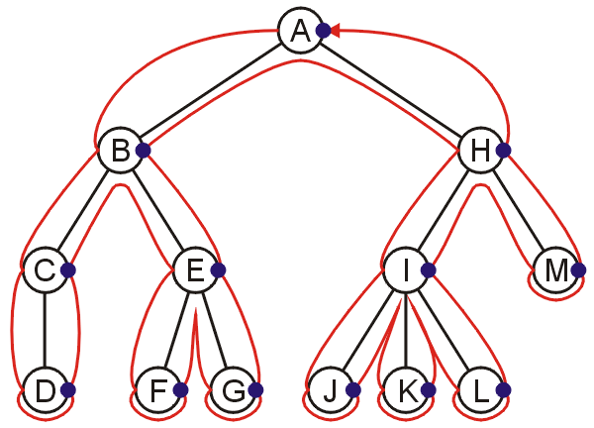
Postorder Traversal
Algorithm
Traverse the left subtree
Traverse the right subtree
Visit the node
D, C, F, G, E, B, J, K, L, I, M, H, A

Slide 39
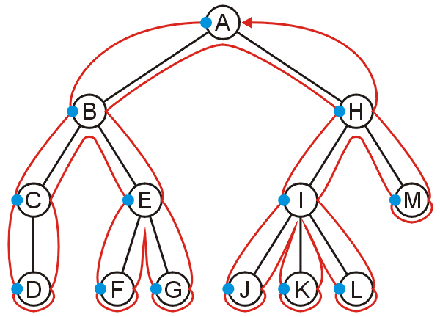
Preorder Traversal
Algorithm
Visit the node
Traverse the left subtree
Traverse the right subtree
A, B, C, D, E, F, G, H, I, J, K, L, M

Slide 40


