Slide 1


Data Structures
Lecture 1
Course organization and introduction
Subhan Ullah, PhD
subhan.ullah@nu.edu.pk
BS(Cybersecurity) Fall-2023

Slide 2
Agenda
Class Introduction
Course Introduction
Aims and objective of the course
Learning outcome
Course outline
Course learning materials
Teaching and assessment methodology
Course policies and some rules for the class discipline
Overview and roadmap of Chapter 1

Slide 3
About me!
Assistant Professor: Department of Cybersecurity, FAST School of Computing (FSC)
Education
Ph.D. (CS/IT under EMJD-ICE Scholarship): University of Klagenfurt, Austria and University of Genova, Italy (2015-2019).
MS(CS) Joint International Master (JIM): Study Exchange Program: Darmstadt, University of applied sciences, Germany (2013-2015)
MS(CS): International Islamic University, Islamabad (2010-2013)
Field of interest (Research + Teaching)
Cybersecurity, Securing IoT Applications, Smart Camera Networks, Sensor Networks and Vehicular Ad-hoc and Programming in C++ and Java
About my office: C-503C, Ext: 501, Office hours (five hours per week)

Slide 4
You and your learning expectations?
Please introduce yourself now ☺
What do you expect to learn from this course?
In this course, we will look at:
Algorithms for solving problems efficiently
Data structures for efficiently storing, accessing, and modifying data
Learn the commonly used data structures form a programmer’s basic data structure “toolkit”
Case studies of data structures
Examine the costs and benefits of every data structure
We will see that all data structures have trade-offs
There is no ultimate data structure...
The choice depends on our requirements

Slide 5
Aims and objective of the course
The main objective of the course is to teach the students:
how to select and design data structures and algorithms that are appropriate for problems that they might encounter.
about showing the correctness of algorithms and studying their computational complexities.
a mixture of theoretical knowledge and practical experience.
familiarity with algorithm analysis and design techniques.

Slide 6
Course outline
Introduction to data structures and abstract data types
Arrays
Background: Templates and Algorithm Analysis
Searching and sorting techniques
Linked Lists, Queues and Stacks
Trees: Definitions and terminology
Trees: Binary Search Trees, AVL Trees
Heap, Graphs
B+ Trees, Hashing
Note: Detailed outline would be uploaded on SLATE/Google Classroom
Notes:
Adelson-Velsky and Landis

Slide 7
Learning outcome
After completion of the course, you will be able to:
Define basic static and dynamic data structures and standard sorting/searching/insertion algorithms for them.
Recognize and justify the appropriate data structure to be used for a given problem and scenario, based on understanding of the advantages and disadvantages of each data structure.
Apply the knowledge to implement appropriate data structures to solve a given programming problem.
Evaluate data structures and algorithms for time and space complexity.

Slide 8
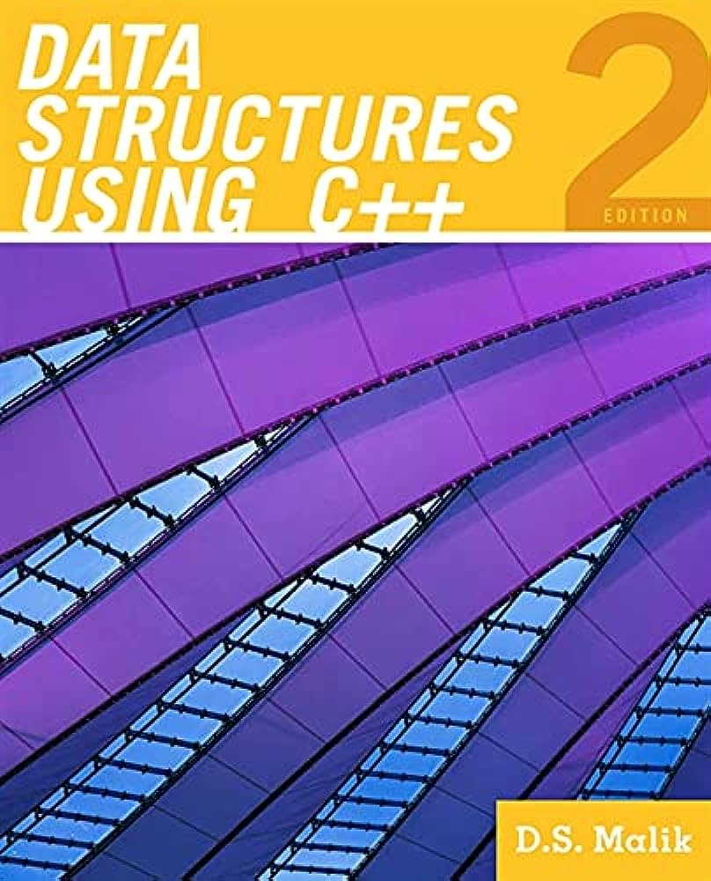
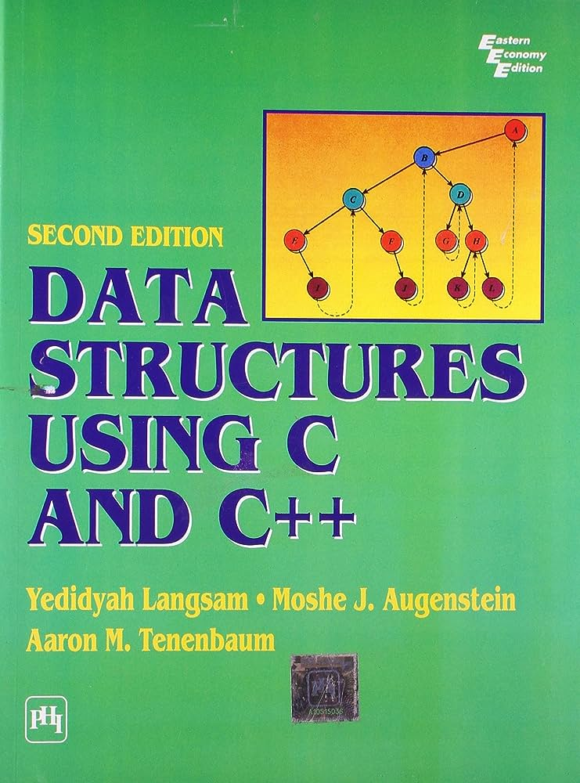
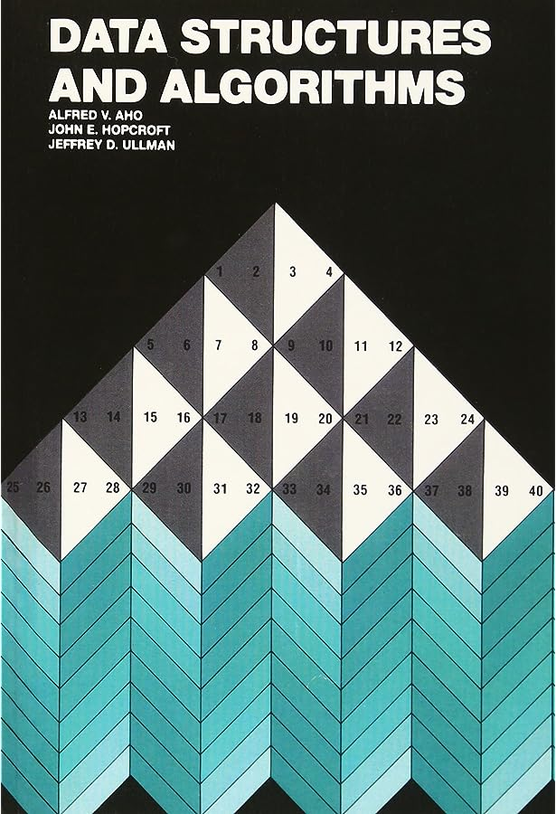
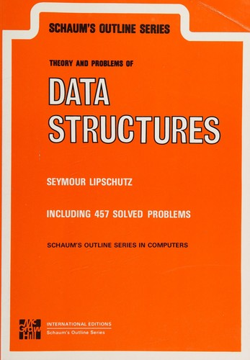
Course learning materials
Text Books and Reference Books:
Data Structures Using C++ (By D.S. Malik)
Data Structures Using C and C++ (By Y. Langsam, M. J. Augenstein, A. M. Tenenbaum)
Data Structures and Algorithms (By A. V. Aho, J. E. Hopcroft, J. D. Ullman)
Schaum's Outline Series, Theory and problems of Data Structures (By Seymour Lipschutz)

Slide 9
Teaching and assessment methodology
Teaching
Lectures + class activities, quizzes etc.,
Schedule: two teaching units (1 hour and 20 min each) per week
Tentative evaluation and assessment method (100 absolutes)
Assignments (5): 10%
Quizzes and class activities (5): 10%
Exams (Sessional-1, Sessional-2 and final Exam):15%, 15% and 40%
Project (1): 10%
All the materials and announcements will be shared on Google classroom
Google classroom code: eg6hm7b
Google classroom Link: https://classroom.google.com/c/NjE4NzM5ODk0MzAw?cjc=eg6hm7b

Slide 10
Course policies
Grading policy
Absolute grading scheme
Missed assessment items
Retake of missed assessment items (other than sessional/ final exam) will not be held
For a missed sessional/ final exam, an exam retake/ pretake application along with necessary evidence are required to be submitted to the department secretary
The examination assessment and retake committee will decide the exam retake/ pre-take cases

Slide 11
Consequences of dishonesty
Plagiarism/cheating in sessional or final exams may result in F grade in the course
Any kind of cheating or plagiarism in project or in an assignment will result in zero marks in that project or assignment
Please do not cheat yourself!
☺
“I would prefer even to fail with honor than win by cheating”
Sophocles

Slide 12


Some rules for the class discipline
Raise your hand before asking any question and then WAIT for the permission
Never ever miss a class
No attendance for late comers (Be aware attendance less than 80% will debar you and not allow you for the final exam)
Never use mobile phone in the class
Mobiles must be switched off at the start of a lecture and must be put in pocket i.e., mobile should not be seen in anyone’s hand or on desk
Never ever sleep during the lecture
Be active,
and never try a fake awake

Slide 13
General Overview
How to organize information/data, usually in memory, so that it can be used efficiently?
Data Structures
How to analyze the performance of algorithms to evaluate their suitability for solving complex problems?
Algorithm Analysis

Slide 14
What is a Data Structure?
In a general sense, any representation that is used for storing information is a data structure
Example: integers, structures, classes, arrays, etc.
More typically, a data structure provides a way for organizing a collection of data items
Storing, accessing and modifying data items
Most data structures have associated algorithms to perform operations on data
Search, insert, remove etc.

Slide 15
Costs and Benefits
Each data structure requires
Space for storing data items
Time to perform each basic operation
Programming efforts
Cost of a data structure
Time and space resources it consumes
Choice of data structure depends on many factors
Type of data
Frequency with which various data operations are applied
Hard to define data structure that performs better in all situations
Time and space tradeoff

Slide 16
Motivational Example
A cellular service company provides contract to its 10 million users
Due to new security enforcements, the company wants to prevent issuing of multiple contracts to users
Method of Detecting Multiple Contracts
Before issuing a new contract to user
First search the id of user in existing contracts database
In case of failure → issue a new contract
In case of success → do not issue a new contract to user

Slide 17
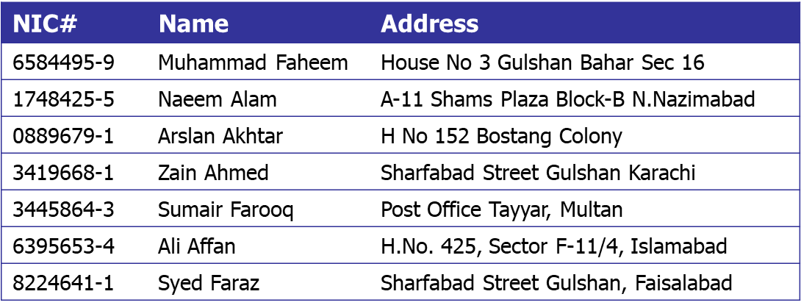
Example: Linear Array Data Structure (1)
Linear Array (with 10 million entries)
3 arrays (NIC, Name, Address)
Structured array
Class’s object array

Slide 18
Example: Linear Array Data Structure (2)
New Contract
New Contract
NIC# | Name | Address
6584495-9 | Muhammad Faheem | House No 3 Gulshan Bahar Sec 16
1748425-5 | Naeem Alam | A-11 Shams Plaza Block-B N.Nazimabad
0889679-1 | Arslan Akhtar | H No 152 Bostang Colony
3419668-1 | Zain Ahmed | Sharfabad Street Gulshan Karachi
3445864-3 | Sumair Farooq | Post Office Tayyar, Multan
6395653-4 | Ali Affan | H.No. 425, Sector F-11/4, Islamabad
8224641-1 | Syed Faraz | Sharfabad Street Gulshan, Faisalabad
NIC# | Name | Address
6584495-9 | Muhammad Faheem | House No 3 Gulshan Bahar Sec 16
1748425-5 | Naeem Alam | A-11 Shams Plaza Block-B N.Nazimabad
0889679-1 | Arslan Akhtar | H No 152 Bostang Colony
3419668-1 | Zain Ahmed | Sharfabad Street Gulshan Karachi
3445864-3 | Sumair Farooq | Post Office Tayyar, Multan
6395653-4 | Ali Affan | H.No. 425, Sector F-11/4, Islamabad
8224641-1 | Syed Faraz | Sharfabad Street Gulshan, Faisalabad
Not Issue
Issue
Any disadvantage of linear array data structure?
How to improve?

Slide 19
Example: Improved Data Structure
Create a dictionary data structure
Group similar records together
Similarity in terms of first digit of NIC number
Add a dictionary entry for each distinct digit (0 – 9)
Example: 3419668-1, 3445864-3, 1748425-5.
3 and 1 are dictionary entries
Existing contracts are searched in two steps
Search the dictionary entry (i.e., group searching)
Search contract within the group (i.e., with the same NIC digit)
How much improvement w.r.t. linear array?

Slide 20
Example: Dictionary Data Structure (1)
NIC# | Name | Address
6584495-9 | Muhammad Faheem | House No 3 Gulshan Bahar Sec 16
1748425-5 | Naeem Alam | A-11 Shams Plaza Block-B N.Nazimabad
0889679-1 | Arslan Akhtar | H No 152 Bostang Colony
3419668-1 | Zain Ahmed | Sharfabad Street Gulshan Karachi
3445864-3 | Sumair Farooq | Post Office Tayyar, Multan
6395653-4 | Ali Affan | H.No. 425, Sector F-11/4, Islamabad
8224641-1 | Syed Faraz | Sharfabad Street Gulshan, Faisalabad
0
2
3
3
4
6
0
5
Dictionary Item
Array Elements

Slide 21
Example: Dictionary Data Structure (2)
Another possibility
Maintain pointers with structures (or records)
Non NULL pointer indicates presence of next record
0
NIC# | Name | Address
6584495-9 | Muhammad Faheem | House No 3 Gulshan Bahar Sec 16
1748425-5 | Naeem Alam | A-11 Shams Plaza Block-B N.Nazimabad
0889679-1 | Arslan Akhtar | H No 152 Bostang Colony
3419668-1 | Zain Ahmed | Sharfabad Street Gulshan Karachi
3445864-3 | Sumair Farooq | Post Office Tayyar, Multan
6395653-4 | Ali Affan | H.No. 425, Sector F-11/4, Islamabad
8224641-1 | Syed Faraz | Sharfabad Street Gulshan, Faisalabad
3
6

Slide 22
Practice Task
Implement the example on the previous slides in C++ in two different programs. In the first, implement the data structure as a single array. In the second, implement the dictionary approach where the data is indexed by the first digit of the CNIC. In both programs, generate a random CNIC and search for it in your data structure. Do this searching operation in a loop of 500, to simulate 500 searches.
Now, one by one, run both programs and note the running time. Use a Linux utility for checking the running time. Submit your programs and your result of running time for both (in a separate txt file).

Slide 23
What is Data Structure Efficiency?
Two major measures of efficiency of a data structure or algorithm
Time and space
Cost of data structure
Time and space resources it consumes
Efficiency of a data structure depends on its operations
Makes a difference between program running in few seconds or days
Difficult to define data structure that performs better in all situations

Slide 24
Abstract Data Types (1)
User
A definition of data type solely in terms of
Set of related data items (or values)
Set of operations on the data
Separation of logical properties from the implementation details
Hide implementation details (Encapsulation!)
What not how is focus
Interface
Implementation
Operations

Slide 25
Data Structures vs. ADT
A data structure is physical implementation of an ADT
Each operation associated with ADT is implemented by one or more subroutines in the implementation
Data structure usually refers to an organization of data in main memory
Example: Stack, or Queue are ADTs, but a C++ Queue implemented in a particular class with particular functions is a concrete data structure.
The relationship between ADT and Data Structure is a bit like the relationship between an interface (class.h file – tells WHAT is done) and a class implementation (the class.cpp file – tells HOW it is done).

Slide 26
Array as an ADT
An array is defined as
Ordered collection of a fixed number of elements
All elements are of the same data type
Basic operations
Direct access to each element in the array
Values can be retrieved or stored in each element

Slide 27
C/C++ Implementation of an Array ADT
datatype arrayName[intExp];
As an ADT | In C/C++
Ordered | Index: 0,1,2, … SIZE-1
Fixed Size | intExp is constant
Homogeneous | dataType is the type of all elements
Direct Access | Array subscripting operator [ ]

Slide 28
Summary
What is a data structure?
In a general sense, any representation that is used for storing information is a data structure
Example: An integer, structures, classes, arrays, etc.
More typically, a data structure provides a way for organizing a collection of data items
Where is a data structure helpful?
Data structure can make the difference between a program running in a few seconds or many days
Efficiency of data structure
What is an ADT?
A logical representation of a data structure.

Slide 29
Thank You All
☺
?
A note on the origin of these ppt slides: Thanks to Dr. Zainab FAST-NUCES, ISB and Douglas Wilhelm Harder, M.Math. LEL Department of Electrical and Computer Engineering University of Waterloo Waterloo, Ontario, Canada, I have adopted my slides from their slides.

