Slide 1


Data Structures
Week9_Lecture1
Tree Data Structures
Subhan Ullah, PhD
subhan.ullah@nu.edu.pk
BS(Cybersecurity) Fall-2023

Slide 2
Data Structures
Binary Tree Implementation

Slide 3
Tree ADT
Data Type: Any type of objects can be stored in a tree
Accessor methods
root() – return the root of the tree
parent(p) – return the parent of a node
children(p) – return the children of a node
Query methods
size() – return the number of nodes in the tree
isEmpty() – return true if the tree is empty
elements() – return all elements
isRoot(p) – return true if node p is the root
Other methods
Tree traversal, Node addition/deletion, create/destroy

Slide 4
Binary Tree Storage
Contiguous storage
Linked list based storage

Slide 5
Contiguous Storage

Slide 6
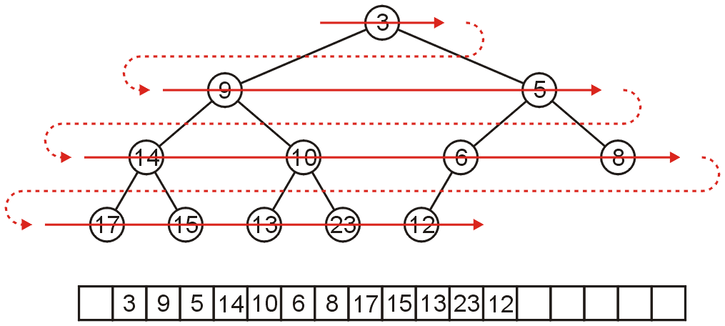
Array Storage (1)
We can store a binary tree as an array
Traverse tree in breadth-first order, placing the entries into array
Storage of elements (i.e., objects/data) starts from root node
Nodes at each level of the tree are stored left to right

Slide 7
Array Storage Example (1)
A
[1]
[2]
[3]
[4]
[5]
[6]
[7]
[8]
[9]
A
B
C
D
E
F
G
H
I
B
C
D
E
F
G
H
I

Slide 8
Array Storage Example (2)
Unused nodes in tree represented by a predefined bit pattern
A
[1]
[2]
[3]
[4]
[5]
[6]
[7]
[8]
[9]
…
[16]
A
B
-
C
-
-
-
D
-
…
E
B
C
D
E

Slide 9
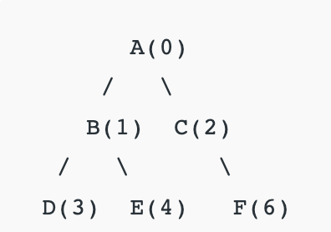
Exercise
If the following tree is stored in an array, what does the tree look like? (Draw it)
ABCDE-F
Solution:

Slide 10
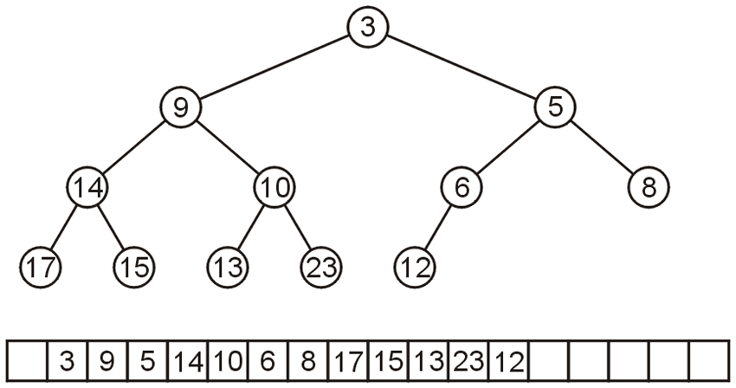
Array Storage (3)
The children of the node with index k are in 2k and 2k + 1
The parent of node with index k is in k ÷ 2
0 1 2 3 4 5 6 7 8 9 10 11 12 13 14 15 16 17

Slide 11
Array Storage Example (3)
Node 10 has index 5
Its children 13 and 23 have indices 10 and 11, respectively
0 1 2 3 4 5 6 7 8 9 10 11 12 13 14 15 16 17

Slide 12
Array Storage Example (4)
Node 10 has index 5
Its children 13 and 23 have indices 10 and 11, respectively
Its parent is node 9 with index 5/2 = 2
0 1 2 3 4 5 6 7 8 9 10 11 12 13 14 15 16 17

Slide 13
Array Storage (4)
Why array index is not started from 0
In C++, this simplifies the calculations
parent = k >> 1;
left_child = k << 1;
right_child = left_child | 1;
0 1 2 3 4 5 6 7 8 9 10 11 12 13 14 15 16 17

Slide 14
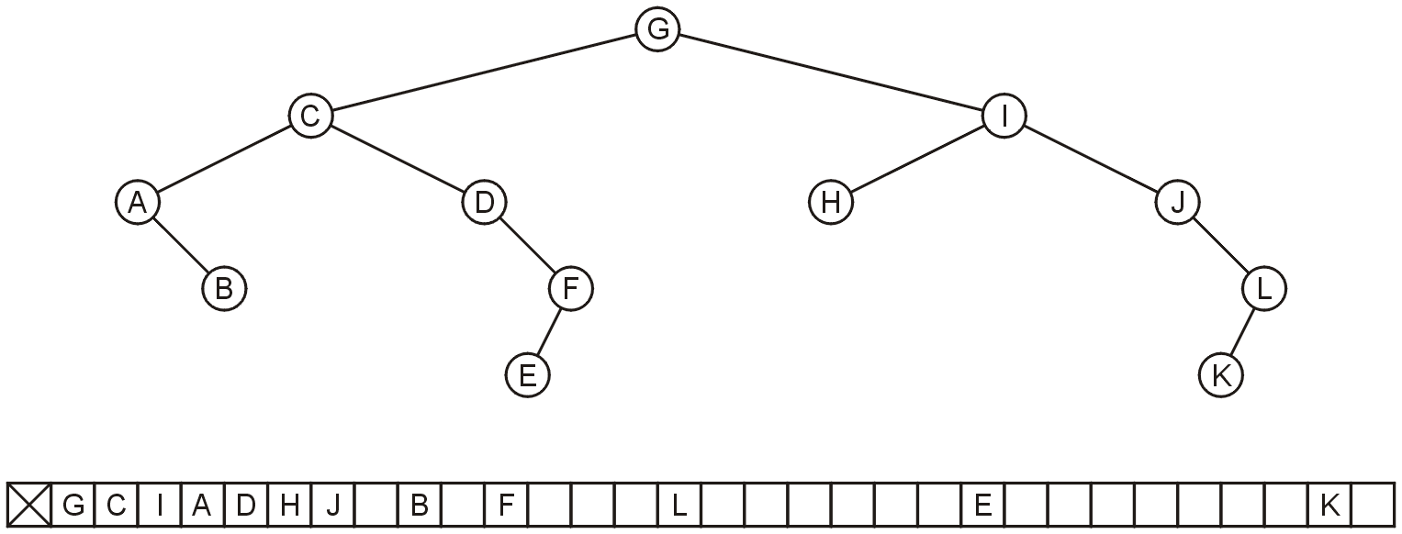
Array Storage: Disadvantage
Why not store any tree as an array using breadth-first traversals?
There is a significant potential for a lot of wasted memory
Consider the following tree with 12 nodes
What is the required size of array?

Slide 15
Array Storage: Disadvantage
Why not store any tree as an array using breadth-first traversals?
There is a significant potential for a lot of wasted memory
Consider the following tree with 12 nodes
What is the required size of array? 32
What will be the array size if a child is added to node K?

Slide 16
Array Storage: Disadvantage
Why not store any tree as an array using breadth-first traversals?
There is a significant potential for a lot of wasted memory
Consider the following tree with 12 nodes
What is the required size of array? 32
What will be the array size if a child is added to node K? double

Slide 17
Implementation Exercise
How to write code for implementing a tree in an array?
One possible approach: Start with an empty array representing the size of the tree.
First add the root node in tree[0] (or tree[1], if you want to use the shift operators).
Then write a set_left and set_right function to add a left child and right child to the root node.
Then keep making calls to set_left and set_right to set children of all subsequent nodes.

Slide 18
Solution
// C++ implementation of tree using array
// numbering starting from 0 to n-1.
#include<bits/stdc++.h>
using namespace std;
char tree[10];
int root(char key) {
if (tree[0] != '\0')
cout << "Tree already had root";
else
tree[0] = key;
return 0;
}
int set_left(char key, int parent) {
if (tree[parent] == '\0')
cout << "\nCan't set child at "
<< (parent * 2) + 1
<< " , no parent found";
else
tree[(parent * 2) + 1] = key;
return 0;
}
}
int set_right(char key, int parent) {
if (tree[parent] == '\0')
cout << "\nCan't set child at "
<< (parent * 2) + 2
<< " , no parent found";
else
tree[(parent * 2) + 2] = key;
return 0;
}
int print_tree() {
cout << "\n";
for (int i = 0; i < 10; i++) {
if (tree[i] != '\0')
cout << tree[i];
else
cout << "-";
}
return 0;
}
// Driver Code
int main() {
root('A');
set_left('B',0);
set_right('C', 0);
set_left('D', 1);
set_right('E', 1);
set_right('F', 2);
print_tree();
return 0;

Slide 19
Practice exercise 1
Write an alternate print function that prints the tree visually as a tree, something like this:

Slide 20
Practice Exercise 2
Using the recursive definition of a perfect binary tree, determine, for a given array representing a tree, whether it is a perfect binary tree.
Recursive definition:
A binary tree of height h = 0 is perfect.
A binary tree with height h > 0 is perfect
If both sub-trees are prefect binary trees of height h – 1
Write a recursive function bool isPerfect(char*, int) which should take a char array representing the tree and return a Boolean value of true if the tree is perfect and false if it is not.

Slide 21
Linked List Storage

Slide 22
As Linked List Structure (1)
We can implement a binary tree by using a class which:
Stores an element
A left child pointer (pointer to first child)
A right child pointer (pointer to second child)
The root pointer points to the root node
Follow pointers to find every other element in the tree
Leaf nodes have LeftChild and RightChild pointers set to NULL
class Node{
Type value;
Node *LeftChild,*RightChild;
};

Slide 23
As Linked List Structure: Example
Root pointer
a
b
c
d
e
f
g
h
i
j
k
l

Slide 24


