Slide 1
BigQueue
A Big, Fast and Persistent Queue
- by William
http://bulldog2011.github.com/

Slide 2
Feature Highlights
Fast
  enqueue and dequeue are close to O(1) direct memory access.
Big
  Only limited by available disk space.
Persistent
  Data persisted on disk and is crash resistant.
Memory-efficient
  Automatic pagging & swapping algorithm, only most recently accessed data is kept in memory.
Thread-safe
  Multiple threads can concurrently enqueue and dequeue without data corruption.
Simple & Light-weight
  Current number of source is 12 and the library jar is less than 20K.

Slide 3
Performance Highlights
In concurrent producing and consuming case, average throughput is around 166MBps.
In sequential producing and consuming case, average throughput is around 333MBps.

Slide 4
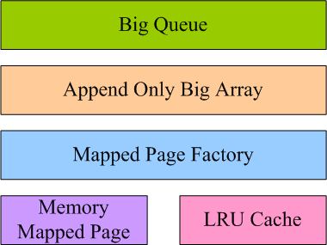
Design

Slide 5
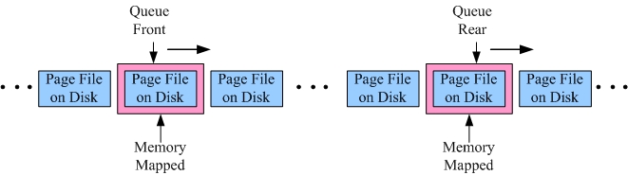
Memory Mapped Sliding Window

Slide 6
Simple Interface
Creation
IBigQueue bigQueue = new BigQueueImpl("d:/bigqueue/tutorial", "demo");
Enqueue
for(int i = 0; i < 10; i++) {
String item = String.valueOf(i);
bigQueue.enqueue(item.getBytes());
}
Dequeue
for(int i = 0; i < 5; i++) {
String item = new String(bigQueue.dequeue());
}
Peek
byte[] data = bigQueue.peek();

Slide 7
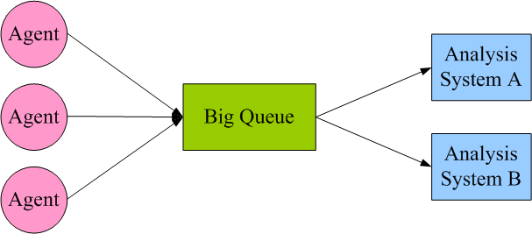
Use Case 1 :
Log Collecting & Consuming

Slide 8
Use Case 2 :
Big Data Sorting
Queue Only Algorithm:
  Put all data into a source queue
  Build a queueOfSortedQueues by dividing and sorting the source queue
  Merge sort the queueOfSortedQueues
  The last one left in the queueOfSortedQueues is the final sorted queue

Slide 9
Reference
Big Queue GitHub Source
  https://github.com/bulldog2011/bigqueue
Big Queue Design Doc
  http://bulldog2011.github.com/blog/2013/01/23/big-queue-design/
Big Queue Tutorial
  http://bulldog2011.github.com/blog/2013/01/24/big-queue-tutorial/
Turn BigQueue into a Thrift Based Queue Service
  http://bulldog2011.github.com/blog/2013/01/27/thrift-queue/
Producing and consuming 4TB log daily on one commodity machine
  http://bulldog2011.github.com/blog/2013/01/28/log-collecting/
Sort and search 100GB data on a single commodity machine
  http://bulldog2011.github.com/blog/2013/01/25/merge-sort-using-big-queue/

Slide 10
Other Alternatives
Apache ActiveMQ
  http://activemq.apache.org
RabbitMQ
  http://www.rabbitmq.com/
ZeroMQ
  http://www.zeromq.org
Kestrel
  https://github.com/robey/kestrel
Apache Kafka
  http://kafka.apache.org

