Slide 1
Project in Distributed and Parallel Programming
By Layana Bishara and Sari Abed

Slide 2
Github Repo
All of our code is in the GitHub repo: https://github.com/bulldog9800/project
It contains a README file to explain more about the code files and on how to run the project.

Slide 3
What We Did
In this project we have implemented a byzantine fault tolerant consensus algorithm named Snowball made by a blockchain platform called Avalanche.
We have implemented the algorithm in C++, using several tools and components to aid us in creating a distributed system and communicating within the cluster.
The main tools and libraries we have used are:
gRPC
Docker
etcd

Slide 4
About Snowball
Snowball is a consensus algorithm used for a proof-of-stake blockchain. It is the last stage of an evolution of protocols called the Snow Family Protocol.
Some key properties of Snowball:
No node processes more than a logarithmic number of bits in the number of total nodes, unlike traditional consensus protocols where one or more nodes typically process a linear number of bits.
Snowball guarantees, in high probability, safety against the presence of Byzantine nodes while maintaining high throughput and scalability.
Snowball does not require accurate knowledge of all the participating nodes.

Slide 5
Safety and Liveness
The Snowball protocol provides the following guarantees:
Safety: When decisions are made by any two correct nodes, they decide on conflicting transactions with negligible probability (≤ ε).
Liveness (Upper Bound): Snow protocols terminate with a strictly positive probability within tmax rounds.
Liveness (Lower Bound): If the number of byzantine nodes is ≤ O( √ n), then the protocol terminates with high probability (≥ 1−ε) in O(logn) rounds.

Slide 6
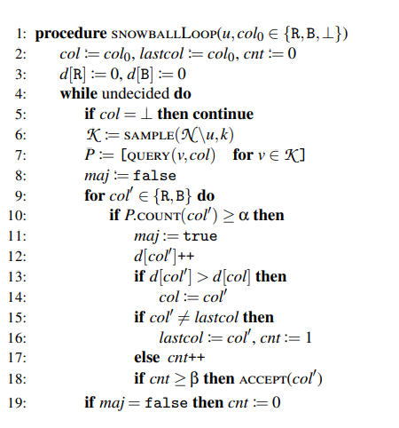
The Snowball Algorithm

Slide 7
Our Journey to Achieving a Full Distributed System
Started with learning about and getting familiar with gRPC, which is a cross platform RPC (Remote Procedure Call) framework made by Google.
At first, simulated each node by a different process on our local machines, we used constant port numbers and localhost as the address for each node. We used files on our machines’ filesystem to pass the start parameters to each node and when each node finished its run, it wrote out its decision to a file, and we had a script that counted the number of lines in that file to determine if all the nodes finished.
We then added a coordinator process that awaits all nodes to be ready, and then signaling them to start. But we still relied on our local filesystem and our local machine’s ports and IP.
We used a docker container to simulate each node, had them all be part of the same network, while having a single etcd server as the coordinator: When each node was ready, it inserted its address (IP and port) into the etcd node, and the nodes queried the server for the number of nodes that are ready. When a node finishes, it writes its final decision and finish time to the etcd server. With that we got rid of all reliance on our local machine’s resources.

Slide 8
Additional Notes
The byzantine nodes in our system can behave in two ways: 1. When getting a request for a color, reply with the other color, simulating a node that’s deliberately trying to sabotage our protocol. 2. When getting a request, reply with an empty string, thus simulating a faulty node.
Our RPC communication is asynchronous.

Slide 9
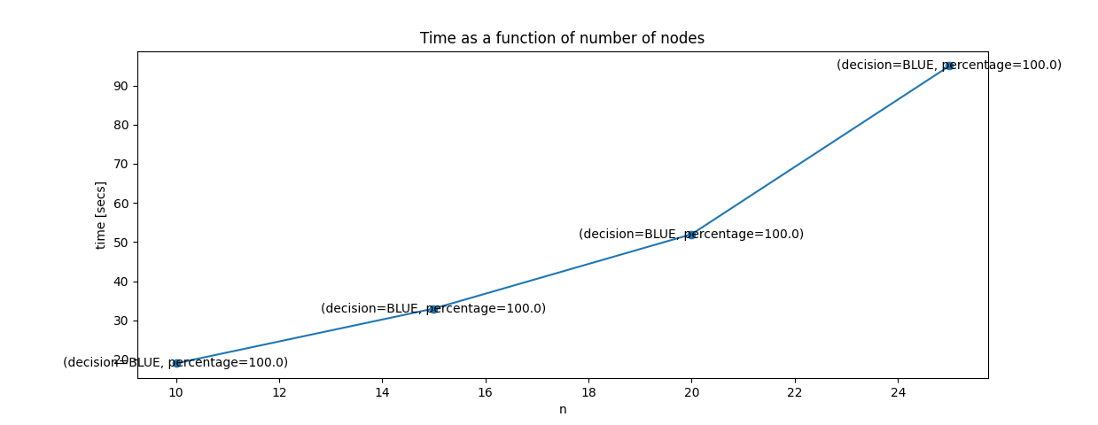

Measurements: Variable Cluster Size (n)
$$k=0.4n, α=\frac{k}{2}+1, β=3,byzantines=0.1n+1,$$
$$reds=0.4n,blues=0.5n, uncolored=0.1n$$

Slide 10
Insights From Last Slide
The more nodes we have in our cluster the longer it takes to reach a decision. And we can see that the rate at which the time increases is bigger than a linear rate.
We achieved liveness (reached a consensus) in all runs, and that is because we used the “ideal parameters” for this, according to the whitepaper.
We can see that since most of the nodes are blue, the nodes always decide on that color.

Slide 11
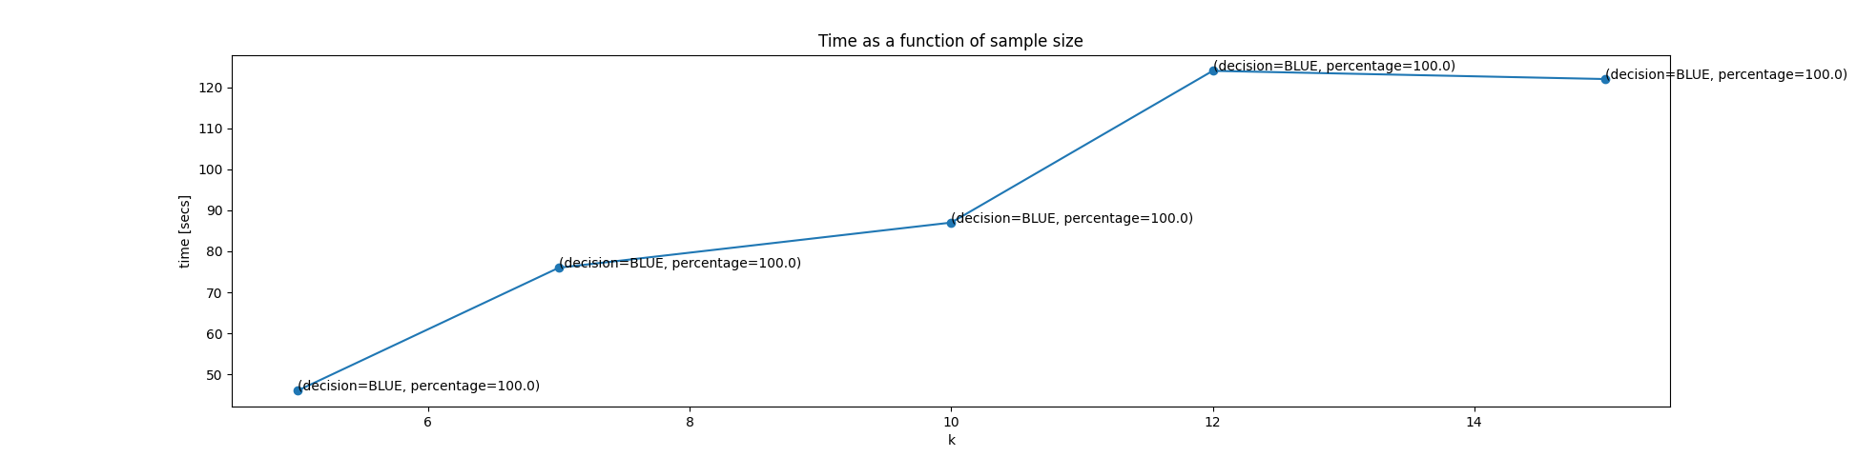
Measurements: Variable Sample Size (k)
$$n=25, α=\frac{k}{2}+1, β=3,byzantines=3, reds=10,blues=13,unclolored=2$$

Slide 12
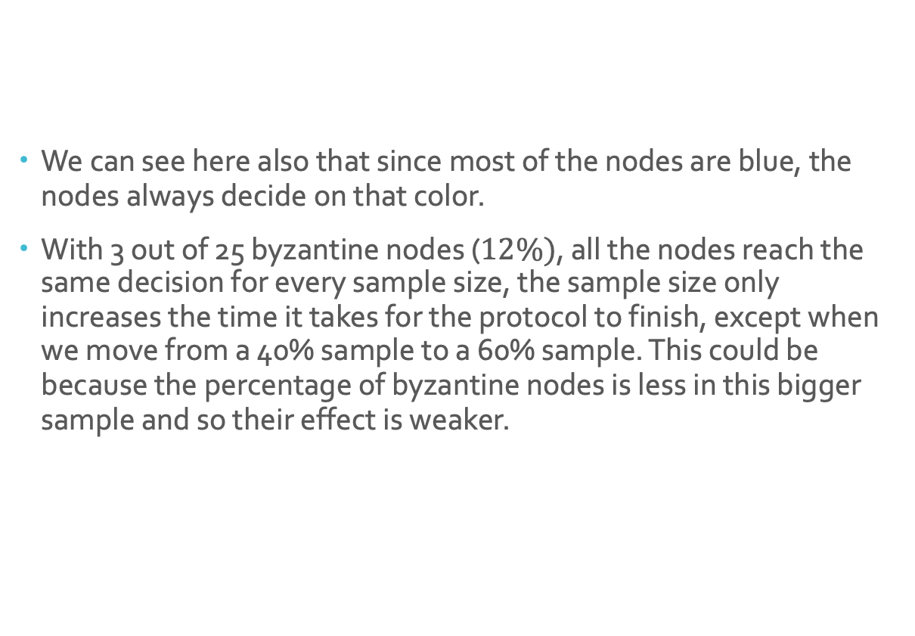
Insights From Last Slide
We can see here also that since most of the nodes are blue, the nodes always decide on that color.
With 3 out of 25 byzantine nodes ($12\%)$, all the nodes reach the same decision for every sample size, the sample size only increases the time it takes for the protocol to finish, except when we move from a 40% sample to a 60% sample. This could be because the percentage of byzantine nodes is less in this bigger sample and so their effect is weaker.

Slide 13
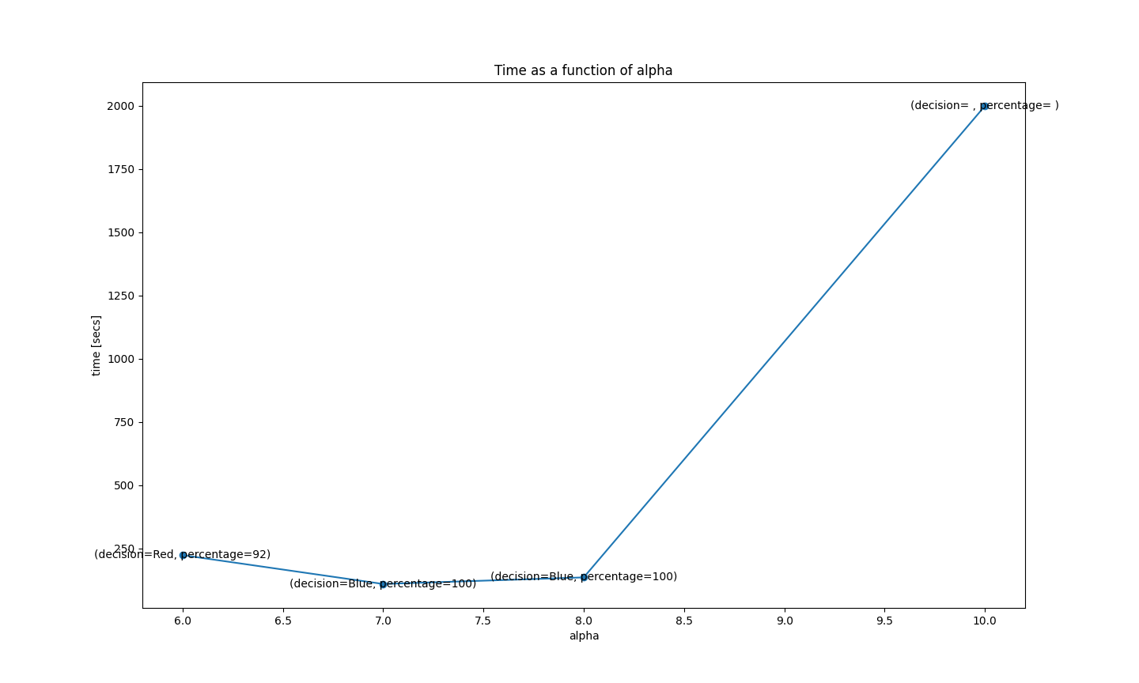
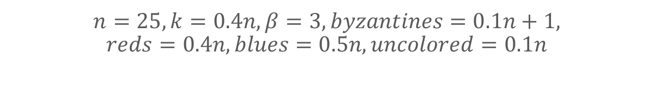
Measurements: Variable Alpha Value
$$n=25, k=0.4n, β=3,byzantines=0.1n+1,$$
$$reds=0.4n,blues=0.5n, uncolored=0.1n$$

Slide 14
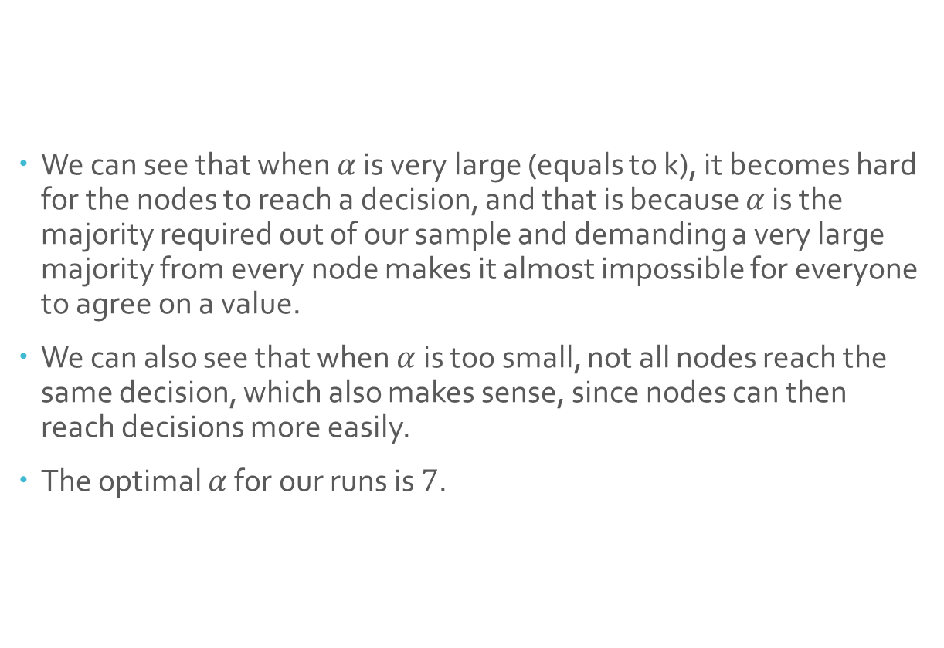
Insights From Last Slide
We can see that when $α$ is very large (equals to k), it becomes hard for the nodes to reach a decision, and that is because $α$ is the majority required out of our sample and demanding a very large majority from every node makes it almost impossible for everyone to agree on a value.
We can also see that when $α$ is too small, not all nodes reach the same decision, which also makes sense, since nodes can then reach decisions more easily.
The optimal $α$ for our runs is $7$.

Slide 15
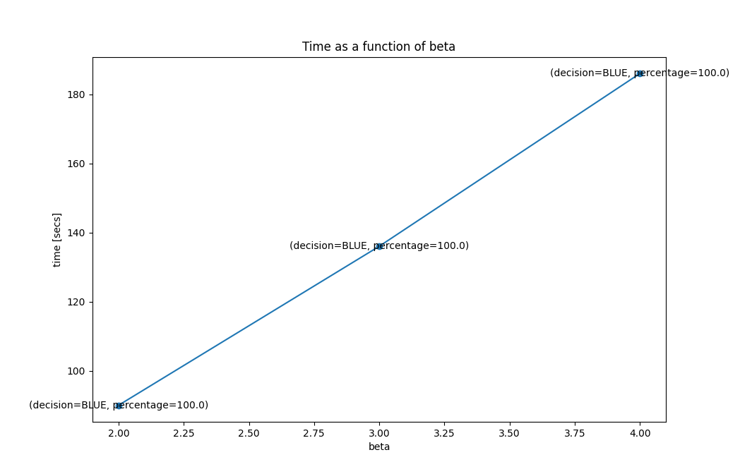

Measurments: Variable Beta
$$n=25,k=10,α=7,byzantines=0.1n+1 \\ reds=10,blues=13,uncolored=2$$

Slide 16
Insights From Last Slide
Beta is the parameter that we use in the algorithm to configure how many times in a row a decision must be made in order to accept this decision. It is expected to get an almost linear increase in time with beta like we got in our graph.

Slide 17
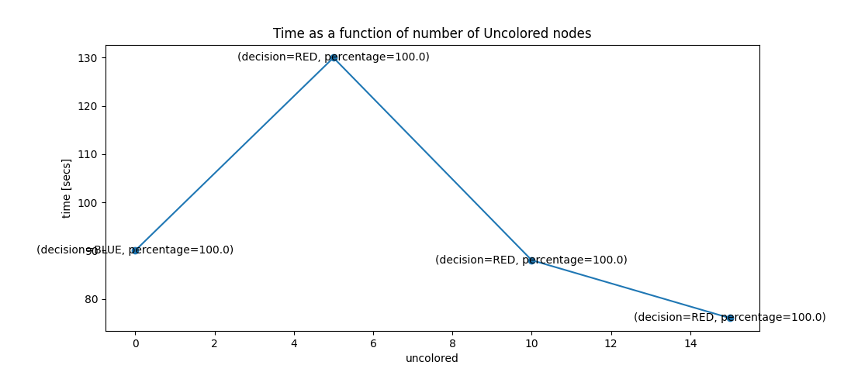
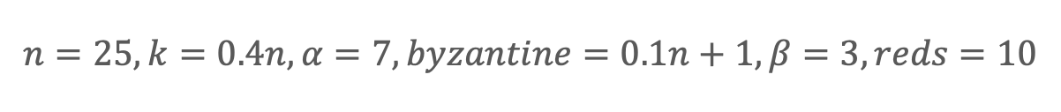
Measurements: Variable Starting State
$$n=25, k=0.4n, α=7, byzantine=0.1n+1, β=3,reds=10$$

Slide 18
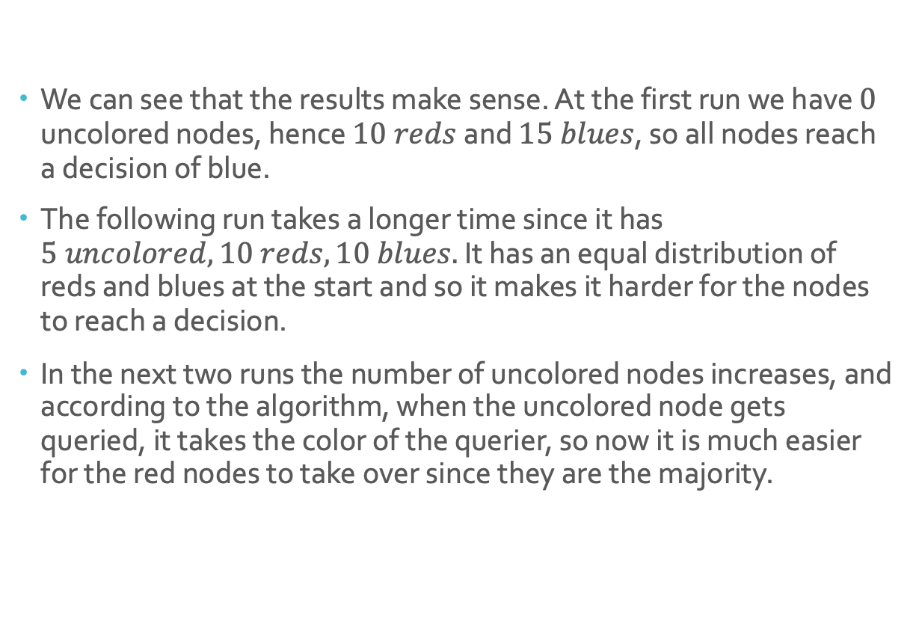
Insights From Last Slide
We can see that the results make sense. At the first run we have $0$ uncolored nodes, hence $10 reds$and $15 blues$, so all nodes reach a decision of blue.
The following run takes a longer time since it has $5 uncolored, 10 reds, 10 blues.$ It has an equal distribution of reds and blues at the start and so it makes it harder for the nodes to reach a decision.
In the next two runs the number of uncolored nodes increases, and according to the algorithm, when the uncolored node gets queried, it takes the color of the querier, so now it is much easier for the red nodes to take over since they are the majority.

Slide 19
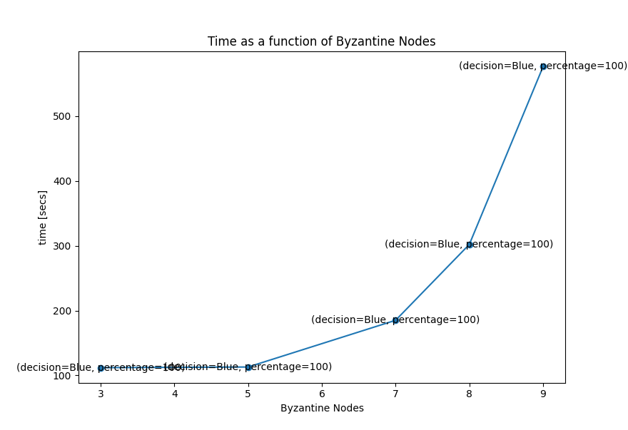
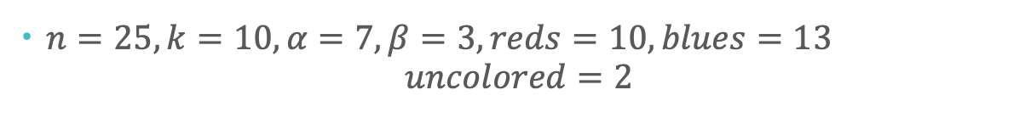
Measurements: Variable Byzantine Nodes
$n=25,k=10,α=7,β=3, reds=10,blues=13$ $uncolored=2$

Slide 20
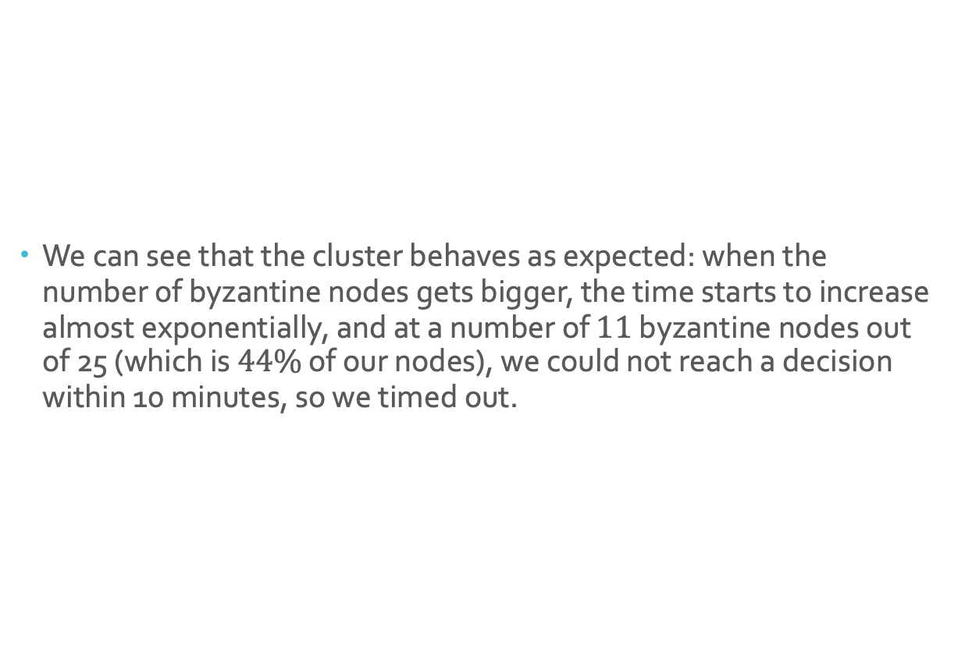
Insights From Last Slide
We can see that the cluster behaves as expected: when the number of byzantine nodes gets bigger, the time starts to increase almost exponentially, and at a number of $11$ byzantine nodes out of 25 (which is $44\%$ of our nodes), we could not reach a decision within 10 minutes, so we timed out.

Slide 21
Possible Improvements to Our Project
We were limited by the ability of our local machines and so we were not able to run more than 25 nodes on our computers. We could use a cloud provider to set up a better measurement infastructure, and thus would be able to run a much larger amount of nodes and have statistics on the power consumption of the protocol.

Slide 22
References
Snowball Whitepaper: https://assets.website-files.com/5d80307810123f5ffbb34d6e/6009805681b416f34dcae012_Avalanche%20Consensus%20Whitepaper.pdf
gRPC Documentation: https://grpc.io/docs/languages/cpp/quickstart/
Docker Documentation: https://docs.docker.com/
etcd Documentation: https://etcd.io/docs/v3.5/

