Slide 1
Meeting 05-26-2021

Slide 2
Overview
Literature review
Previous findings of geographical- or study-based patterns
New Pangenome Analyses
Correlation between genome completeness and CAZymes and gene clusters predicted
Added more metadata (year, geographical location, BioProject accession)
Removed genome that had failed taxonomy check on NCBI and likely was not a CP isolate
Complete genomes-only analysis
CAZyme ortholog based clustering
Ortholog categorization results so far

Slide 3
Literature Review

Slide 4
Lacey et al. 2018
Wanted to perform genetic analysis of poultry and non-poultry strains from around the world and from different years, as well as compare gene content vs sequence based phylogenetic methods
59 isolates evaluated (38 poultry strains and 21 non-poultry strains)
First created a matrix of gene presence-absence of orthologs in chromosome of strains, and performed PCA on matrix to group strains into clades
Based on variable regions in chromosome (rather than plasmids)
Then evaluated whether these clades based on gene presence-absence could be recaptured with phylogenetic analysis of gene content or sequence

Slide 5
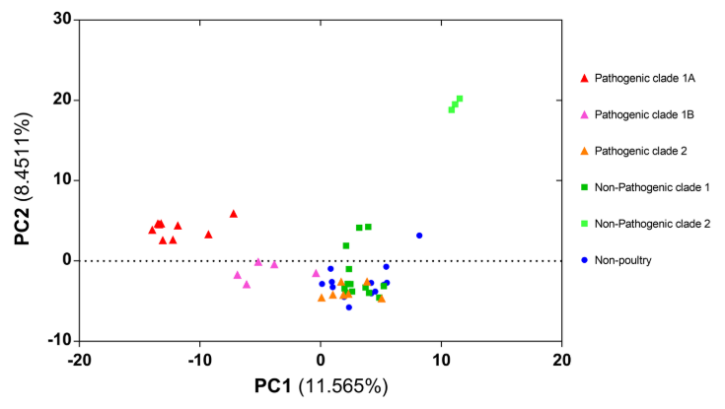

Slide 6
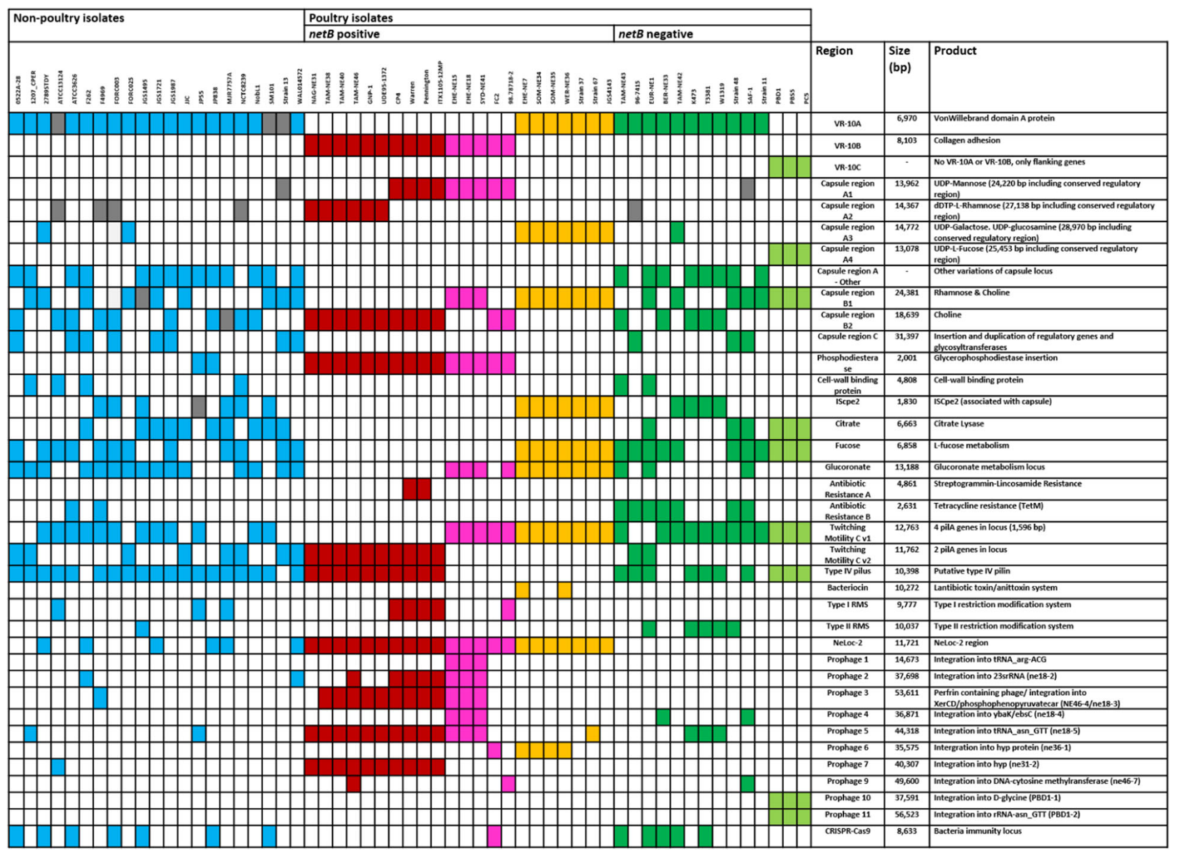

Slide 7
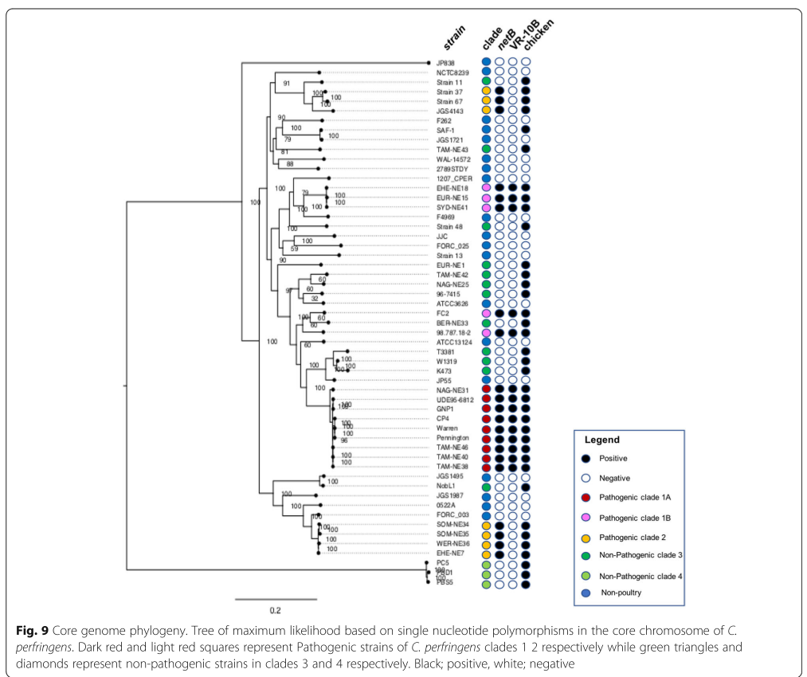
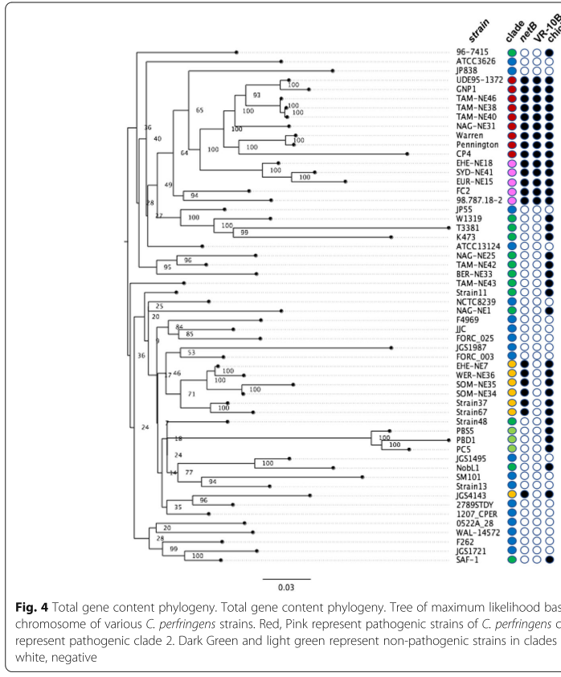

Slide 8
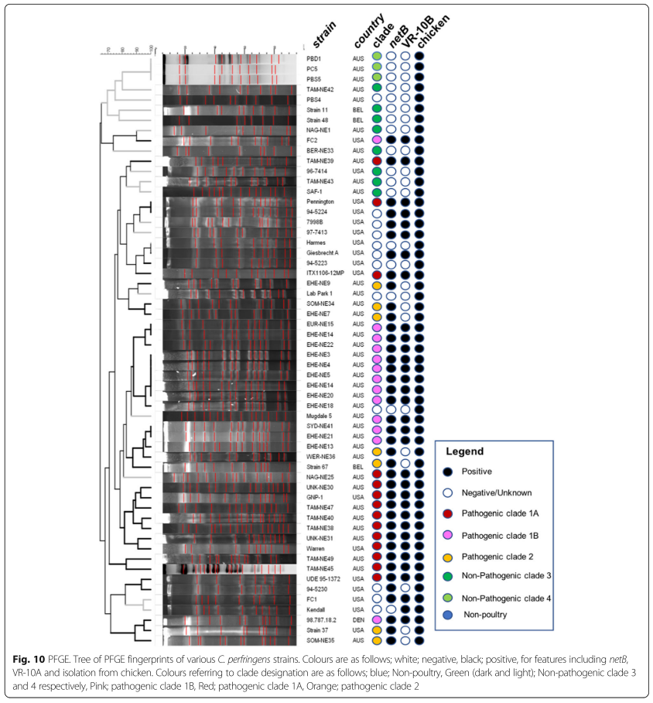
Lacey et al. 2018
"clades showed no correlation with country of origin or time of isolation, with exception of a clade of Australian isolates from 2005“
No measures of correlation mentioned, likely eyeballed

Slide 9
Kiu et al. 2017
Study that performed pangenome analysis of CP, found open pangenome of 12.6% core gene content
56 isolates studied
Aligned core genome to build core genome phylogeny with a Neighbor-Joining tree using the Jukes-Cantor model of DNA evolution on a set of 1,000 bootstrap replicates
Food poisoning isolates clustered into clade 1, whereas clade 2 and 3 comprised of isolates from animals, humans and soil.
Clade 4 made up of all ‘JFP’ strains – all from same study of dog and horse haemorrhagic enteritis isolates; authors stated that because 2 of the isolates were from Switzerland, while rest from North America, discounts any correlations due to geography

Slide 10
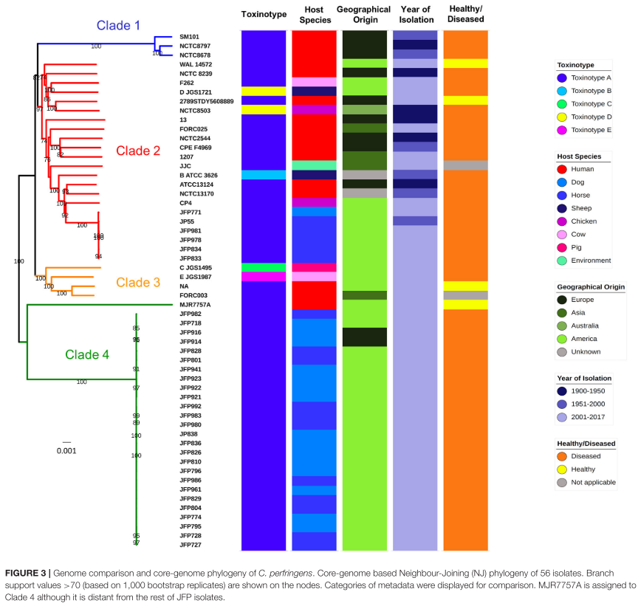

Slide 11
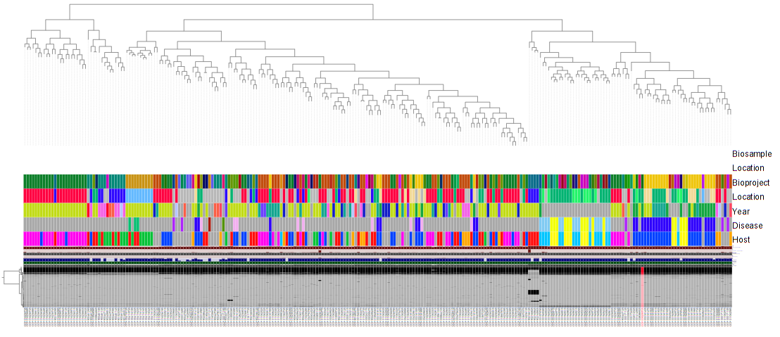
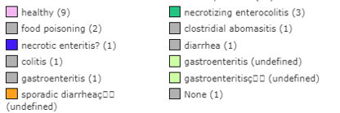
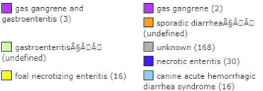



Slide 12
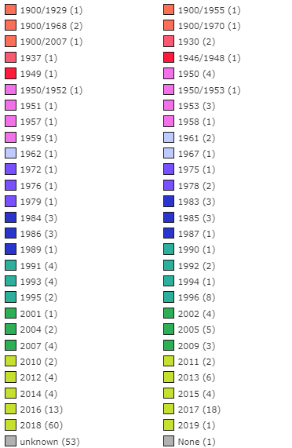
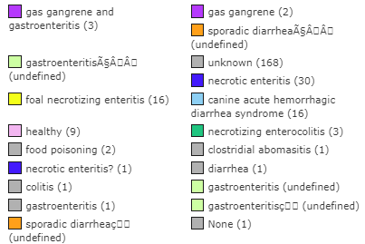

Slide 13
New Pangenome Analyses

Slide 14
New Pangenome Analyses
What was done differently:
Used 82 genomes instead of 258 genomes
Only used genomes that had disease and host data
So mainly no unknown disease or host, namely chicken, human, horse and dog
Ran with same parameters for pangenomics pipeline as other runs

Slide 15
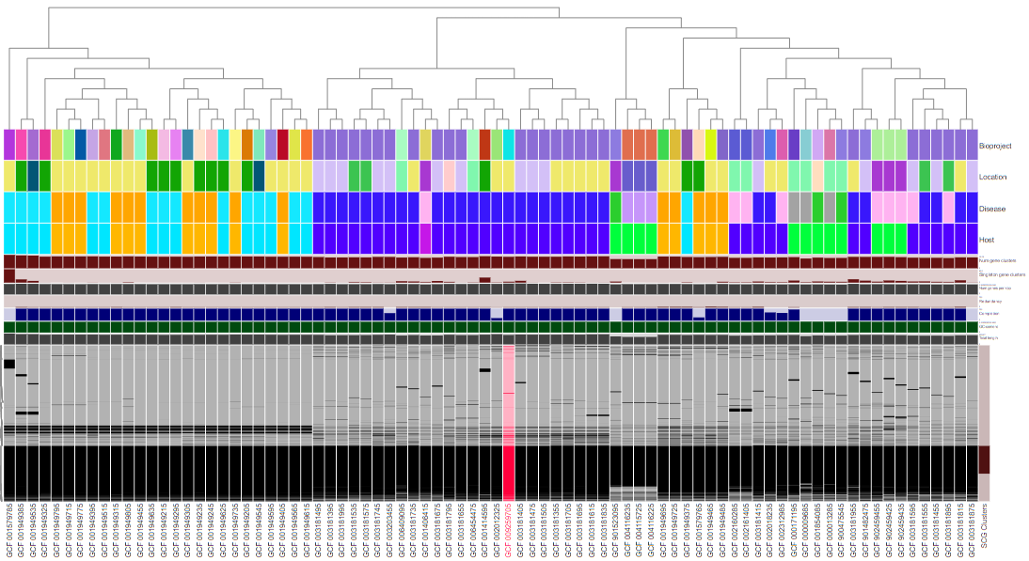
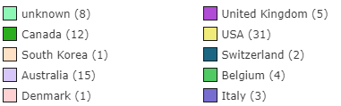
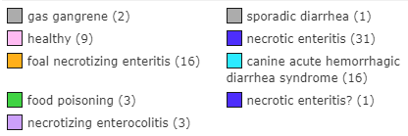


Slide 16
Gene Cluster Stats
Anvio predicted 8,086 (previously 17,743) gene clusters
Number of singletons: 2,228 (previously 6,021)
dbCAN2 predicted that 191 (previously 531) of these gene clusters were CAZymes
Number of singletons: 30 (previously 172; based on dbCAN2)
Number of total genes predicted to be CAZymes: 8,121 (previously 33,190)
59 unique CAZyme annotations

Slide 17
CAZyme gene cluster family breakdowns
Gene Cluster annotations by type*
GH - 88
PL - 4
CE - 9
GT - 85
AA – 0
*doesn’t add up to 191 because several clusters were annotated with carbohydrate binding modules but no catalytic CAZyme family
Top 5 families by number of clusters with annotation (‘redundancy’)
GT4 – 45
GT2 – 22
GH13 – 7
GH2 - 6
CE4 - 6
Top 5 families by number of genomes represented
163 - GC_00000043 – CE4
162 GC_00000059 – GH13
162 GC_00000054 – GH33
154 GC_00000027 – GH25
130 GC_00000062 – “NA” – CBM without catalytic family

Slide 18
Ortholog Categorization Analysis

Slide 19
Methods
Categorized CAZyme anvi’o gene clusters from the 82 genomes based on the following categories:
Core: present in all 82 genomes
Strain specific: only present in that strain (singletons)
Disease specific: only present in genomes that have been annotated for a particular disease or host state (i.e. ‘’healthy” can be a ‘disease’ category)
Host specific: only present in genomes associated with a single host, but maybe from diseased or healthy hosts
Cloud/accessory: everything else

Slide 20
Results from ortholog categorization (number clusters categorized)
Core - 43
‘Cloud’/accessory genome - 93
Strain specific (singletons) – 30
Disease specific - 13
NE - 10
Healthy - 3
Host specific - 12
Chicken - 7
Human - 5

