Slide 2
MusicScroller:
Automating the Traversal
of a Digital Composition
Bryan Hutto

Slide 3
A Musician’s Predicament
Public domain compositions and original arrangements are easily accessible over the internet.
Digital sheet music falls short in usability.
Page turning.
Musicians should be able to sight read any piece in their library, hands-free.
Scrolling is a replacement for the page turn.
MusicScroller is proposed as a template for a light-weight solution to this problem.

Slide 4
Background
How sheet music is read:
Music is played at a deterministic speed, as a function of the tempo and the time signature.
The basic unit of this speed is the measure, denoted by a bar music notation.
Musician’s visual focus travels forward and back across the eye-hand span. [1]
EHS is the difference between where the sight-reader is looking and what notes they are currently playing.
How scrolling is implemented:
Windows Messages can execute scrolling independent of device interaction.
The distance scrolled is a function of WHEEL_DELTA and the user setting determined SPI_GETWHEELSCROLLLINES [2]
WHEEL_DELTA is the basic unit of a scroll, but is set to 120, allowing smaller increments if the target application supports it.
Smaller increments of scrolling translates to less motion blue, resulting in better readability. [3]

Slide 5
Prior Work
Taele, Barreto, and Hammond [4] built an education tool that could analyze a user’s sketch and identify articles of music notation.
Utilized straight line tests to register simple geometric shapes, as a function of page width.
The only article necessary for computing speed is the bar.

Slide 6
Targets and Dependencies
The MusicScroller application is intended for use on PDFs.
Most common format, other image types also supported.
Intend for computer-generated sheet music (as opposed to scans)
Built to run on Windows 10
Uses Google Chrome to render and scroll through the document.
Ubiquity, scroll resolution.
Requires Image Magick to be installed on the system.

Slide 7
Requirements
Must correctly identify measures on a page.
Must translate these positions into a scroll speed consistent with:
Their locations relative to page dimensions
The speed as determined by the tempo and time signature
The presumed EHS of the user
Avoiding jumps and motion blur
Must provide an intuitive mode of operation and termination.
User should not need technical knowledge to use
Operation must not interrupt play, nor discourage replayability

Slide 8
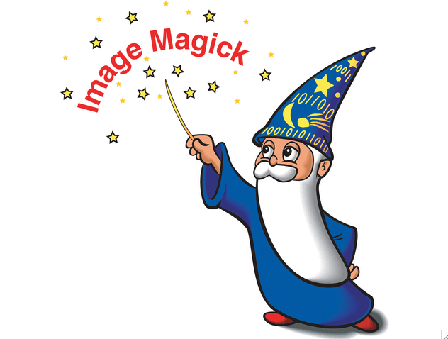
Magick++
MusicScroller uses the Image Magick library (via the Magick++ API)
Image Magick provides a wide range of image processing services
Image Magick, along with its dependency: Ghostscript, allow for efficient conversion of PDF files, and others, to a prescribed format.
https://www.southampton.ac.uk/~fangohr/computing/imagemagick.html

Slide 9
Implementation: Image Processing
Main method calls the handler function.
Prompts user for tempo and time signature values in console
Presents user with a File Dialog window
Magick++ library objects/methods are used to:
Open the selected file, as a list of images
Convert the images to Windows Bitmap (BMP) files, with 24 bit depth, and the alpha channel stripped
Save them temporarily into a project folder, with sequential identifiers in the file names
The resultant BMP files are read into a pixel array
Height, Width and Offset are retrieved from the header
For loops iterate through each pixel, populate pixel array with 1s and 0s
Pixel array passed to Page class constructor

Slide 10
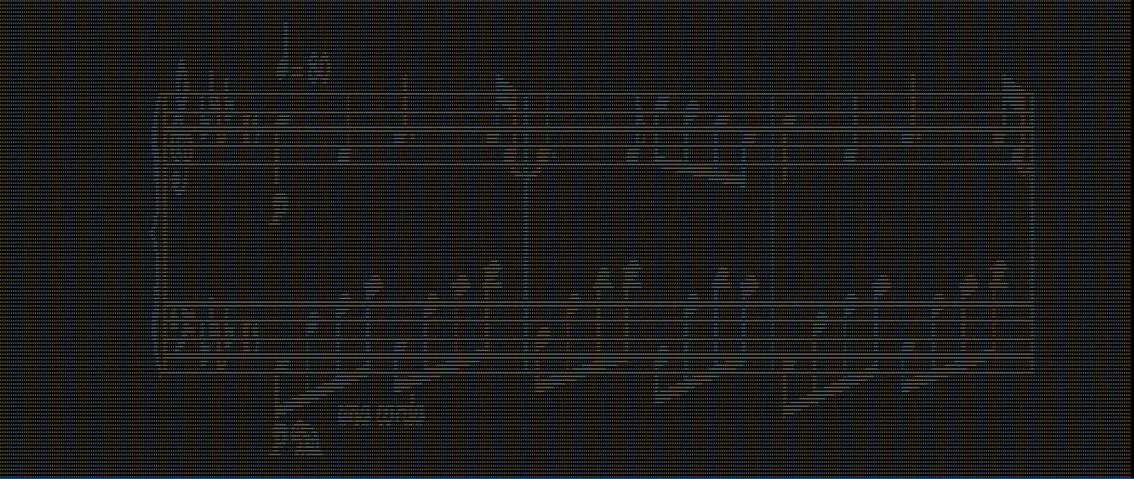
1 and 0 pixel array inputs (BMP format stores data “upside-down”)

Slide 11
Implementation: Element Triage
The Page class member EnumMeasures() receives and analyzes the pixel array.
Iterates through array elements applying a straight line test to identify measure bars in the image.
If a zero is encountered:
Checks that it is sufficiently distanced from the last bar (as a function of page width)
Iterates down the page checking for more zeroes
If the length > the bar threshold a new measure is recorded for that line
If the bottommost position is on a different horizontal plane a new line is recorded
Bar threshold is initially a function of page height, but is superseded if a longer line is recorded..

Slide 12
Implementation: Element Triage cont.
The relevant data is stored in Page class variables
Line count, measure count per line, locations and vertical length of measures on page
Page object is appended to a storage vector
EnumMeasures() is called on the next pixel array

Slide 13
Implementation: Scrolling
Iterates through each line on each page sequentially.
For each page:
Calculates ticks per page, the number of atomic scroll units needed to traverse the current page.
A tick is one scroll unit of WHEEL_DELTA/30 (small steps = seemingly continuous scroll)
A simple factor of page height, since the program controls for WHEEL_DELTA and the user scroll setting.
For each line:
Averages the height difference between the current and previous line & the current and next line.
This result divided by the height of the page is the Line Factor
Ticks per line = ( Line Factor ) x ( ticks per page )
Answers the question: “For how much of the total scrolling done on this page should this line be in view”

Slide 14
Implementation: Scrolling cont.
Calculates pace, in seconds/measure
Pace = ( 60 / tempo ) x ( beats per measure )
For each line:
Time to be spent on current line ( Line Pace ) = ( pace ) x ( number of measures on line )
Seconds per Tick = Line Pace / Ticks per line
For each tick:
A synchronous thread sleeps for the designated Seconds per Tick
A Windows API message executes a single tick of downward scrolling
Scroll speeds up if next row is further away, slows down if closer
Ticks per line is a function of Line Factor
Scroll speeds up if current row has fewer measures, slows down if more
There are never “leftover” ticks; the end of play matches the end of scrolling.

Slide 15
Implementation: User Interfacing
After receiving user input, the program opens the originally selected file in new, maximized Google Chrome window.
From there an asynchronous key listener waits for the user to press ENTER before scrolling is commenced.
Scrolling can be terminated at any time by pressing ESC
Once scrolling ends or is terminated, the user is prompted to select 0, 1 or 2 where:
0 exits the application, after cleaning up temporary image files.
1 restarts the Scroller and asks for new inputs.
2 restarts the Scroller with the same inputs.
Session information is passed back to the main method.
Results in smooth and, hopefully, intuitive operation.
For example: a user can restart playing a piece in just three key presses (ESC -> 2 -> ENTER -> ENTER)

Slide 16
Results
MusicScroller was tested against 3 downloaded sheet music PDFs it had never seen before.
This selection was limited based on the following characteristics: apparently computer-generated, stave count cannot decrease, bars must be continuous.

Slide 17
The first page of test files A, B, and C, respectively

Slide 18
Results
First, the scroller ran each file, outputting the saved line measure count and locations.

Slide 19


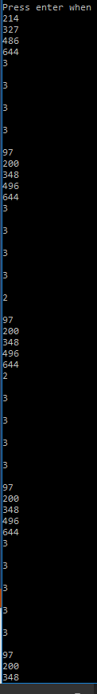
Results
A
B
C
MusicScroller correctly located the measures in for each file.
Line heights and measure counts

Slide 20
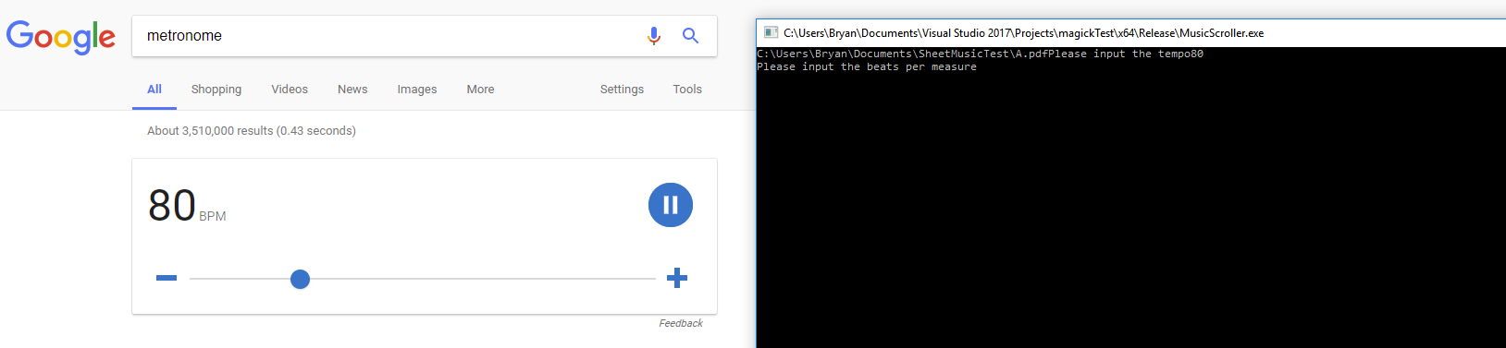
Results
Second, the scroller ran the test files at 80, 100 and 140 bpm tempos.
A browser metronome kept the tempo while I counted out the beats per measure.
If the current position of play left the screen, MusicScroller would receive a mark for that piece.
If the current position left the screen and did not return, MusicScroller would have become out of sync with the music, resulting in failure.

Slide 21
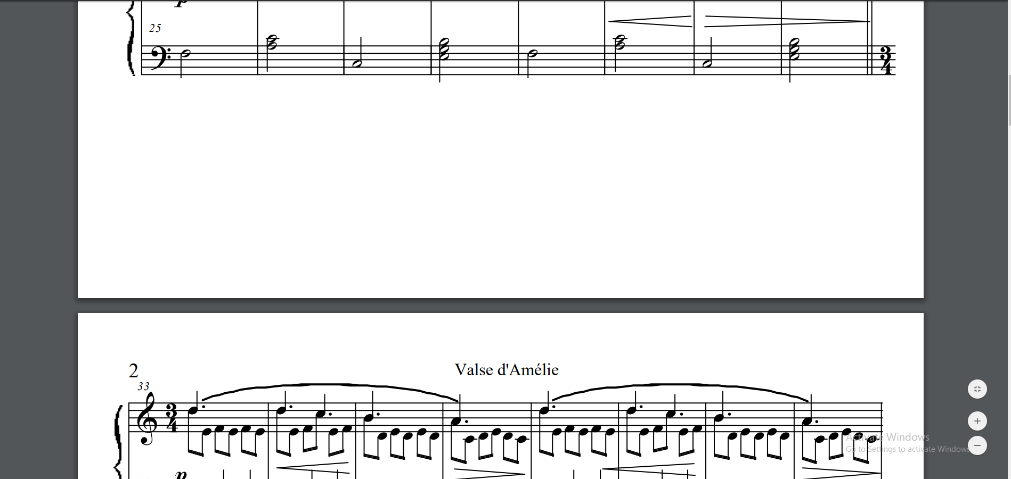
Results
For test files B and C the scroller kept pace with the metronome for the entire piece.
For test file A, the current measure of play left the screen on 3 occasions.
Each of these occurred at a page break, where test file A had a larger than usual distance between lines.

Slide 22
Demonstration…

Slide 23
*Demo Removed Due to Github File Size Constraints*

Slide 24
Future Work
Jump function to quickly skip over large sections of nothing.
Expand capability to handle scans
Diagonal line test
Tolerance for missing/anomalistic pixels
Auditory feedback scrolling.
Refactor for a wide array of platforms.
Android, iOS, etc…
Explore new solutions.

Slide 25
Summary
The need for a scrolling solution
Background
How music is read
How scrolling is achieved
Implementation
Image processing
Image analysis
Scroll execution
Results
Element detection
Scroll quality

Slide 26
References
[1] Stephanie Rosemann, Eckart Altenmüller, and Manfred Fahle. 2016. The art of sight-reading: Influence of practice, playing tempo, complexity and cognitive skills on the eye–hand span in pianists. Psychology of Music 44, 4 (2016), 658–673. DOI=http://dx.doi.org/10.1177/0305735615585398
[2] Philip Quinn, Andy Cockburn, Géry Casiez, Nicolas Roussel, and Carl Gutwin. 2012. Exposing and understanding scrolling transfer functions. In Proceedings of the 25th annual ACM symposium on User interface software and technology (UIST '12). ACM, New York, NY, USA, 341-350. DOI:
[3] Andrew Wallace, Joshua Savage, and Andy Cockburn. 2004. Rapid visual flow: how fast is too fast?. In Proceedings of the fifth conference on Australasian user interface - Volume 28 (AUIC '04), A. Cockburn (Ed.), Vol. 28. Australian Computer Society, Inc., Darlinghurst, Australia, Australia, 117-122.
[4] Paul Taele, Laura Barreto, and Tracy Hammond. 2015. Maestoso: An Intelligent Educational Sketching Tool for Learning Music Theory. In Proceedings of the Twenty-Seventh Conference on Innovative Applications of Artificial Intelligence. Association for the Advancement of Artificial In Conference on Innovative the Network (www.aaai.org). Retrieved June 17, 2017 from

