Slide 1
End-to-end testing of two business journeys: web portal + provider app
ROADSIDE QA AUTOMATION
Job: create, dispatch, finish on the phone | Announcement: publish on the web, show on the phone
APAC Aspire Digital | 22 October 2026 | RSA UAT
Notes:
Two real business journeys, each starting on the agent portal and ending on the driver's phone. Every step is traced to a test case in our suites, and every run gives a video as evidence.

Slide 2
Where we are: two suites, now joined by two end-to-end journeys
560
72
2
RoadSide web test cases (23 areas)
RoadSide app test cases (12 areas)
end-to-end journeys across web + app
What end-to-end adds
The web suite proves the portal. The app suite proves the phone. Neither proves that what the agent does on the portal reaches the driver - and that what the driver does comes back.
The two journeys test exactly that hand-off. Both are test cases in the RoadSide web suite (sheet 23-E2E Journeys), written step by step.
Notes:
Three numbers. 560 web cases, 72 app cases, and two journeys that connect them.

Slide 3
RoadSide web suite: 560 cases across 23 areas
Job Create & Edit
95
308
Provider Dispatch
61
Benefit & Redemption
38
P1 cases - must pass before production
Job Lifecycle & Status
32
371
Cross-Cutting & NFR
27
Job List & Search
25
automatable in the browser today; 189 need the app, test data, a stub or a BA answer
Reports
24
Announcements
23
Provider Portal
20
After the review (22 Oct)
Provider Admin (GAN)
19
+108 business-rule cases: one per job field, dispatch and provider rules, duplicates, failures, roles. 7 expected results corrected from the code. History per case.
Top 10 areas shown; 13 more areas hold the other 196 cases.
Notes:
The biggest areas are job creation and dispatch - where the review asked for more depth. P1 is about half the suite. The partly-automatable cases each have a written reason.

Slide 4
RoadSide app suite: 72 cases across 12 areas
Policy & Login
11
30
Job Execution
9
Vehicle & OTP
8
P1 cases
Dashboard & Ready
8
48
Receive Job
6
Job Photos
6
fully automatable on the emulator; 23 partly (need the web portal or UAT data), 1 real phone only
Settings
6
Map & Location
5
Job History
4
9 automated and passing
Resilience & NFR
4
Login, OTP binding, and the full job flow (receive, take, arrive, mileage, photo, finish) inside the E2E-01 journey.
Top 10 areas shown; Announcements (3) and App Update (2) hold the other 5 cases.
Notes:
Most app cases that are only partly automatable need something from the web side first - which is what the journeys provide.

Slide 5
Two journeys that cross web, server and phone
E2E-01 Job
TC-23-001
Agent creates a job and dispatches it → driver receives it, takes it, drives there, arrives, enters mileage, takes a photo, finishes → portal shows CLOSED with the driver's timestamps
PASSED 22 Oct 2026 · 3.7 min · 11 steps · job 26JB049155
E2E-02 Announcement
TC-23-003
Admin creates and publishes an announcement → drivers see it in the app (News + high-priority banner) → admin switches it off → it disappears from the app
PASSED 22 Oct 2026 · 1.6 min · 8 steps · switched off at the end
Notes:
Both start on the web and finish on the phone. A job is our core business; announcements are how operations reach every driver at once.

Slide 6
E2E-01 Job: eleven steps, alternating between portal and phone
2
3
4
11
WEB
Agent creates the job (Thai address)
Agent sets the incident pin
Agent assigns truck v3036 and dispatches
Portal shows CLOSED with the driver's timestamps
SERVER
1
5
6
7
8
9
10
APP
Driver signs in, truck v3036, Ready on
Job card appears on the phone
Driver taps Take Job
Truck drives ~5 km by road
Arrived, odometer 48215
Photo taken and uploaded
Driver finishes the job
The server sits in the middle: the phone asks it for jobs every few seconds while Ready; every driver action is written back and read by the portal.
Notes:
Read it left to right. Blue is the portal, orange is the phone. Every arrow between rows is a hand-off that the test checks.

Slide 7
TC-23-001 in the RoadSide web suite: steps and expected results
Step | Side | Action | Expected result
1 | App | Sign in as the driver, choose truck v3036, switch Ready on | Dashboard shows VIN v3036 and Ready = On
2 | Web | Sign in as the agent and create a Basic Repair job: client Honda, program HOT UAT Program, customer [AUTO-TEST] Jaidee, Thai incident address (ถ.ราชดำริ หน้าสวนลุมพินี, ปทุมวัน, กทม.), licence 1กข 2345, location note and service condition; Save | Job number is issued; the values are kept after reload
3 | Web | Set the incident pin on the map at 13.7334, 100.5408 | Incident location is saved
4 | Web | Assign truck v3036 and click Dispatch | Truck and dispatch time are saved; status stays OPEN
5 | App | Wait on the dashboard without refreshing | A job card with the same job number appears, more than 2 km away (9.70 km on 20 Oct)
6 | App | Open the job and tap Take Job | Job is accepted; the portal shows the accept time and status ONPROCESS
7 | App | Drive ~5 km by road to the customer (GPS point every ~150 m: Victory Monument - Phaya Thai - Rama I - Ratchadamri) | App follows the route; the portal road distance is more than 2 km
8 | App | Tap Arrived, enter odometer 48215, Confirm | Portal shows the reach time and mileage 48215
9 | App | Take a photo with the camera and tap Done | Photo is listed in the app; portal photo count is 1
10 | App | Tap Finish job and confirm | Completed screen is shown
11 | Web | Reload the job | Status CLOSED; request < accept < reach < complete; ACCEPT, REACH and COMPLETE rows stamped by truck v3036 with GPS; KPI Pass
Workbook sheet "23-E2E Journeys" - the same 11 steps, one row each. The test (TC-23-001.spec.ts) runs them in this order.
Notes:
This is the test case exactly as it is in the suite. Each row is one step of the automated run, and each step is a caption in the video.

Slide 8
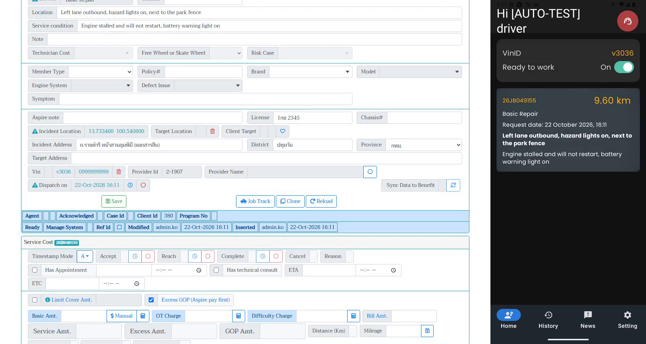
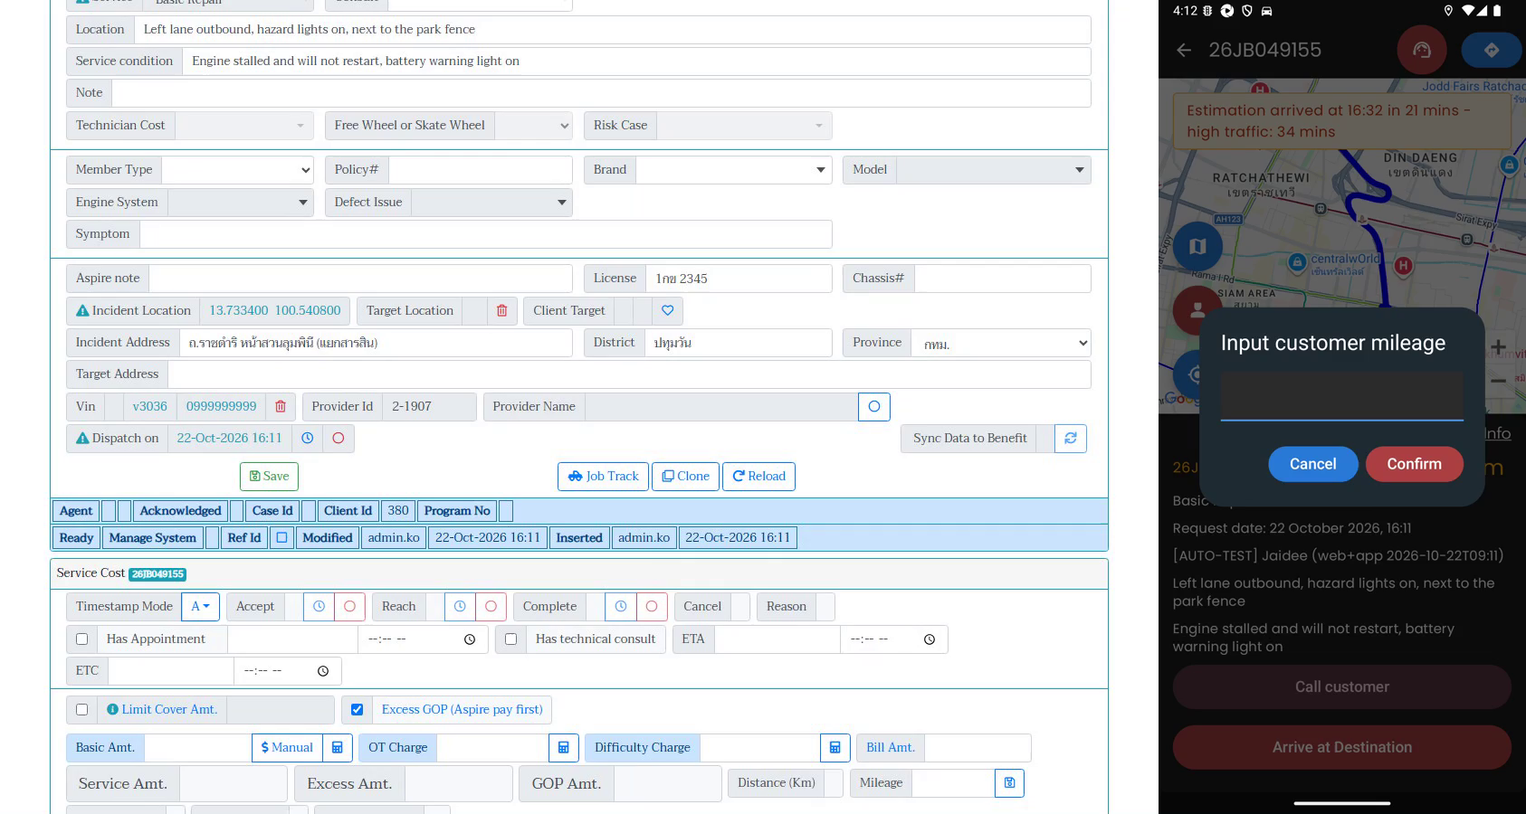
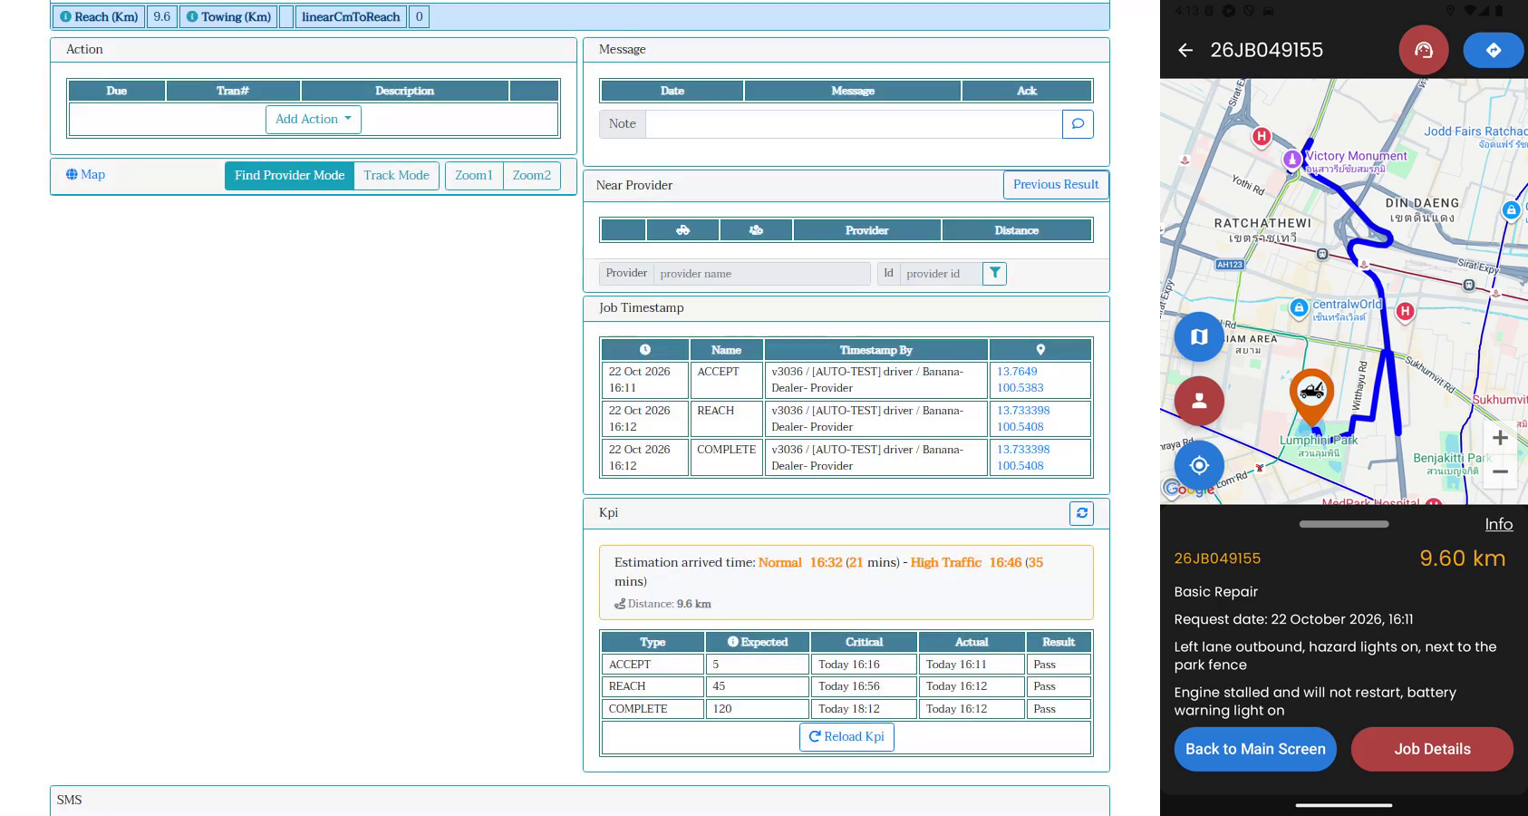
E2E-01 in the video: portal left, phone right, same run
Step 5: dispatched on the portal; the job card is on the phone, 9.60 km away
Step 8: driver arrives and enters odometer 48215
Step 11: portal shows ACCEPT / REACH / COMPLETE by truck v3036, KPI Pass; phone shows the route
Result 22 Oct 2026: PASSED in 3.7 min, job 26JB049155
All 11 steps passed. Job card 9.60 km, portal road distance 9.6 km, mileage 48215, 1 photo, status CLOSED, KPI Pass on accept / reach / complete. Evidence: captioned side-by-side video, Playwright report and trace. Also passed on 20 Oct (job 26JB049153).
Notes:
Three frames from the 22 Oct run. The caption bar in the video names the step from the suite.

Slide 9
E2E-02 Announcement: publish on the web, see it on every phone
2
3
7
WEB
Admin creates a High announcement and publishes
List shows Approved, Active, High
Admin unticks Active
4
SERVER
Mobile feed contains it
1
5
6
8
APP
Driver on the dashboard
News tab shows the card
Home shows the high-priority banner
Gone from the News tab
Administrators publish at once ("Submit & Publish"). Announcements cannot be targeted - every UAT phone sees it - so the test always switches it off at the end.
Notes:
The announcement journey has a server step: the test reads the same feed the phone reads, so we know whether a failure is on the server or on the phone.

Slide 10
TC-23-003 in the RoadSide web suite: steps and expected results
Step | Side | Action | Expected result
1 | App | Driver is signed in, on the dashboard | Dashboard is shown
2 | Web | Sign in as administrator; Announcements > Create New: title, priority High, content, effective today, expiry tomorrow, Active; click Submit & Publish | Announcement is saved and approved at once
3 | Web | Open the announcement list | Row shows priority High, Active, status Approved
4 | Server | Read the feed the app uses: GET api/pmws/announcements | Feed contains the new announcement
5 | App | Open the News tab and tap the card | Card shows the title; the content expands
6 | App | Open Home | High-priority banner shows the title
7 | Web | Edit the announcement, untick Active, Update | Feed no longer contains it
8 | App | Re-open the News tab | The announcement is gone
Workbook sheet "23-E2E Journeys" - the same 8 steps, one row each.
Notes:
Same format as TC-23-001: the test case as written in the suite, step by step.

Slide 11
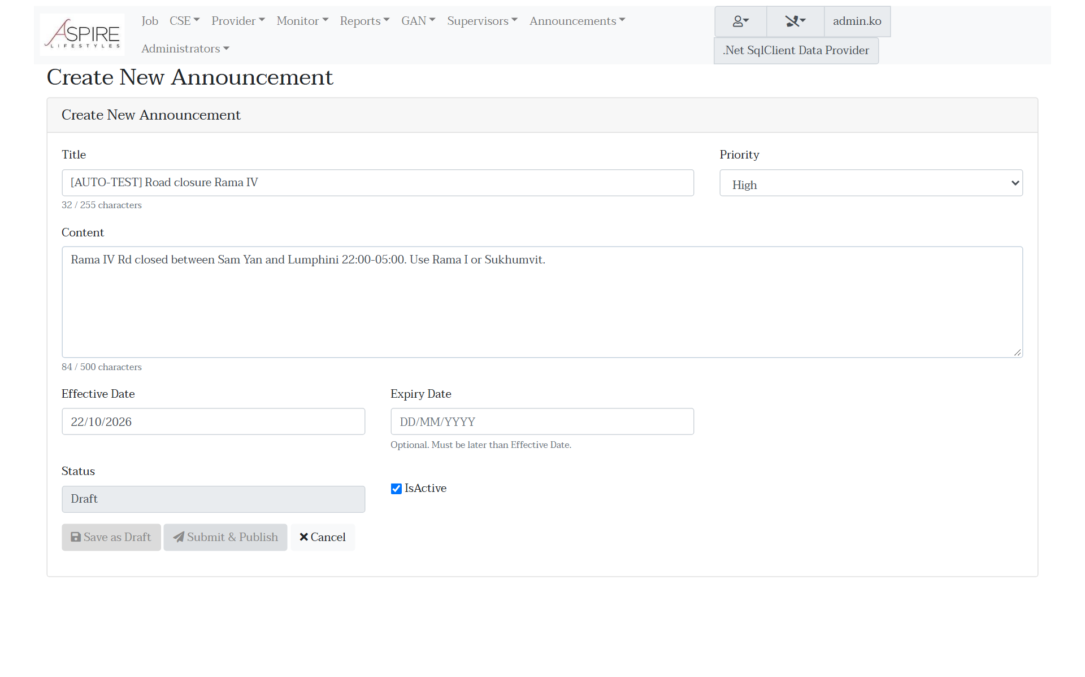
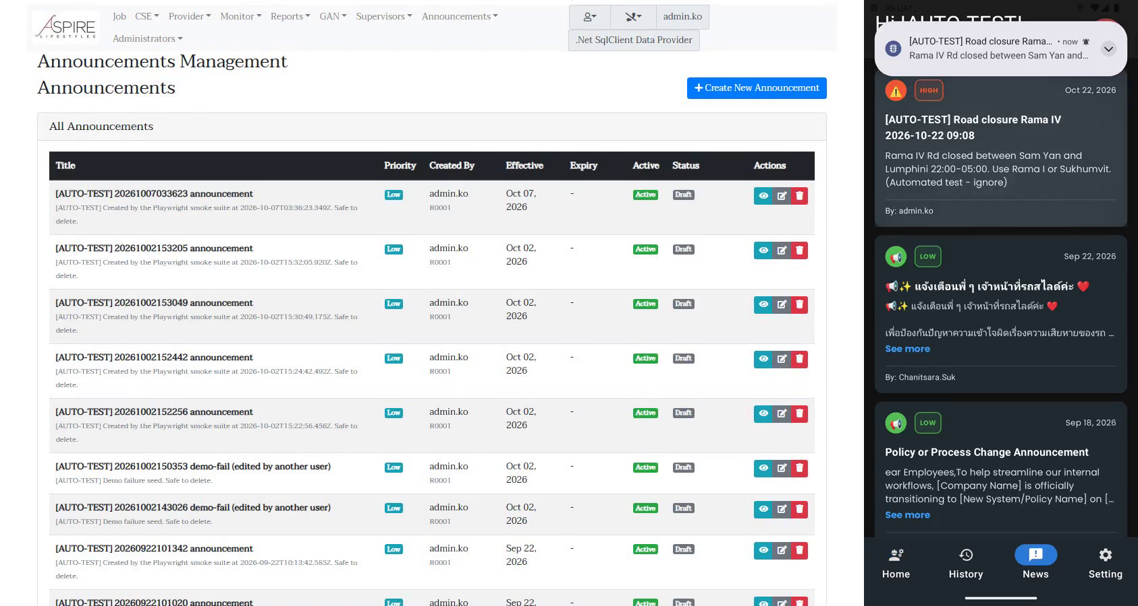
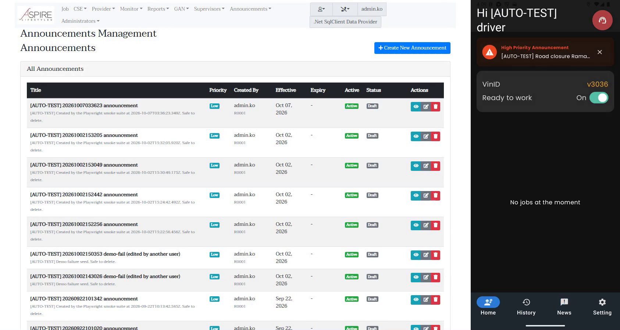
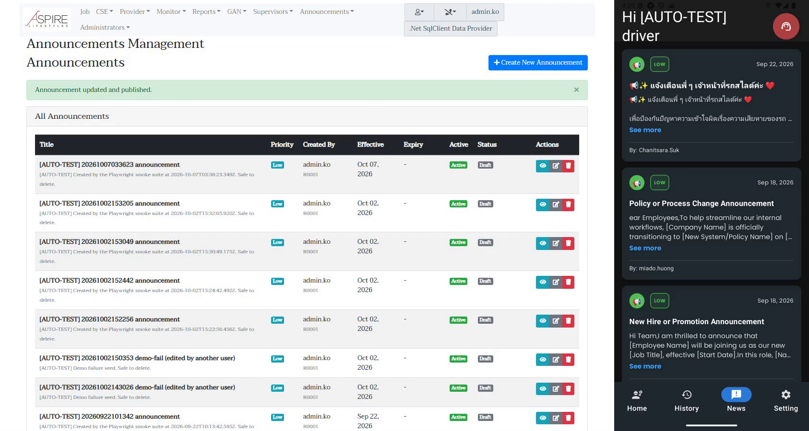
E2E-02 in the video: publish on the portal, see it on the phone
Step 2: the create form an administrator fills (UAT screenshot)
Step 5: News tab shows the High card (and the push notification)
Step 6: Home shows the high-priority banner
Step 8: after "untick Active" the card is gone from News
Result 22 Oct 2026: PASSED in 1.6 min, all 8 steps. The announcement was switched off at the end and is no longer in the mobile feed.
Notes:
Four moments from the 22 Oct run. Step 4 (not shown) checks the server feed the phone reads, so a failure points at server or phone.

Slide 12
Demo: watch the journeys
E2E-01 Job (2 min 25 s)
TC-23-001-web-and-app.mp4 (22 Oct)
Portal left, phone right; a caption bar names each of the 11 steps.
E2E-02 Announcement (55 s)
TC-23-003-web-and-app.mp4 (22 Oct)
Same layout, 8 captioned steps.
What to watch: the job number appearing on the phone after Dispatch, and the timestamps arriving on the portal after each tap.
Notes:
Play the video here. Point out: dispatch on the left, job appears on the right; each driver tap, then the timestamp row on the portal.

Slide 13
What the work found, and what we need next
Found while building the suites
Next
Job save checks no mandatory fields; dispatch does not check service or location
Double-click Save / Dispatch and two agents at once are not blocked
Load Provider lists busy trucks nationwide; stale GPS never excluded
Benefit timeout + retry can strand a job (31 Aug incident)
No role checks on job actions
Announcements cannot be targeted; no read tracking
App writes the login password to the device log (UAT build)
BA: mark mandatory fields per stage (sheet 24) and answer the review questions (sheet 25)
Run both journeys before each release; keep the report and video as release evidence
Next journeys: customer cancels while the driver is on the way (TC-23-002); towing job
Decide where journeys run before each release (desktop runner, cloud instance or device farm)
Notes:
Each finding has its own test case in the suite, so it stays visible until it is fixed or accepted.

