Slide 1
End-to-end testing of two business journeys: web portal + provider app
ROADSIDE QA AUTOMATION
Job: create, dispatch, finish on the phone | Announcement: publish on the web, show on the phone
APAC Aspire Digital | 22 October 2026 | RSA UAT
Notes:
Two real business journeys, each starting on the agent portal and ending on the driver's phone. Every step is traced to a test case in our suites, and every run gives a video as evidence.

Slide 2
Where we are: two suites, now joined by two end-to-end journeys
560
72
2
RoadSide web test cases (23 areas)
RoadSide app test cases (12 areas)
end-to-end journeys across web + app
What end-to-end adds
The web suite proves the portal. The app suite proves the phone. Neither proves that what the agent does on the portal reaches the driver - and that what the driver does comes back.
The two journeys test exactly that hand-off, step by step, and each step is mapped to the cases it proves in both suites.
Notes:
Three numbers. 560 web cases, 72 app cases, and two journeys that connect them.

Slide 3
RoadSide web suite: 560 cases across 23 areas
Job Create & Edit
95
308
Provider Dispatch
61
Benefit & Redemption
38
P1 cases - must pass before production
Job Lifecycle & Status
32
371
Cross-Cutting & NFR
27
Job List & Search
25
automatable in the browser today; 189 need the app, test data, a stub or a BA answer
Reports
24
Announcements
23
Provider Portal
20
After the review (22 Oct)
Provider Admin (GAN)
19
+108 business-rule cases: one per job field, dispatch and provider rules, duplicates, failures, roles. 7 expected results corrected from the code. History per case.
Top 10 areas shown; 13 more areas hold the other 196 cases.
Notes:
The biggest areas are job creation and dispatch - where the review asked for more depth. P1 is about half the suite. The partly-automatable cases each have a written reason.

Slide 4
RoadSide app suite: 72 cases across 12 areas
Policy & Login
11
30
Job Execution
9
Vehicle & OTP
8
P1 cases
Dashboard & Ready
8
48
Receive Job
6
Job Photos
6
fully automatable on the emulator; 23 partly (need the web portal or UAT data), 1 real phone only
Settings
6
Map & Location
5
Job History
4
9 automated and passing
Resilience & NFR
4
Login, OTP binding, and the full job flow (receive, take, arrive, mileage, photo, finish) inside the E2E-01 journey.
Top 10 areas shown; Announcements (3) and App Update (2) hold the other 5 cases.
Notes:
Most app cases that are only partly automatable need something from the web side first - which is what the journeys provide.

Slide 5
Two journeys that cross web, server and phone
E2E-01 Job
TC-23-001
Agent creates a job and dispatches it → driver receives it, takes it, drives there, arrives, enters mileage, takes a photo, finishes → portal shows CLOSED with the driver's timestamps
PASSED 20 Oct 2026 · ~4.5 min · 11 steps
E2E-02 Announcement
TC-23-003
Admin creates and publishes an announcement → drivers see it in the app (News + high-priority banner) → admin switches it off → it disappears from the app
Built 22 Oct 2026 · first run next · 8 steps
Notes:
Both start on the web and finish on the phone. A job is our core business; announcements are how operations reach every driver at once.

Slide 6
E2E-01 Job: eleven steps, alternating between portal and phone
2
3
4
11
WEB
Agent creates job (Thai address)
Sets incident pin
Assigns truck, Dispatch
CLOSED, timestamps by truck
SERVER
1
5
6
7
8
9
10
APP
Driver signed in, Ready on
Job appears, 9.7 km
Take Job
Drives ~5 km by road
Arrive + mileage 48215
Photo, upload
Finish job
The server sits in the middle: the phone asks it for jobs every few seconds while Ready; every driver action is written back and read by the portal.
Notes:
Read it left to right. Blue is the portal, orange is the phone. Every arrow between rows is a hand-off that the test checks.

Slide 7
E2E-01: each step is mapped to the cases it proves
# | Side | Step | Checked | Web suite cases | App suite cases
1 | App | Driver signs in, truck chosen, Ready on | Dashboard, VIN, Ready On |  | M01-002, M02-002, M03-001/002
2 | Web | Create Basic Repair job, Thai address | Job number; values saved | TC-01-001, 03-004/010/012/013/026/029/030
3 | Web | Set incident pin | Location saved | TC-04-004
4 | Web | Assign truck v3036, Dispatch | Dispatch time; status OPEN | TC-04-019, 04-022, 04-045
5 | App | Job card appears without refresh | Same job no.; > 2 km | TC-04-025, 04-046 | M04-001, M04-002
6 | App | Take Job | Portal accept time; ONPROCESS | TC-05-019 | M04-003
7 | App | Drive ~5 km by road | Road distance > 2 km |  | M06-004
8 | App | Arrive, mileage 48215 | Reach time; mileage = 48215 | TC-05-019 | M05-001
9 | App | Photo with camera, upload | Photo count 1 |  | M07-001
10 | App | Finish job | Completed screen |  | M05-005, M05-007
11 | Web | Reload the job | CLOSED; timestamps in order, by truck, with GPS; KPI Pass | TC-05-023, 04-060, 05-020
Same table in the workbooks: web suite sheet 26 "E2E Journeys", app suite sheet 13 - filterable by case id.
Notes:
This is the traceability: when E2E-01 passes, these 25 cases across both suites are proven by a single run.

Slide 8
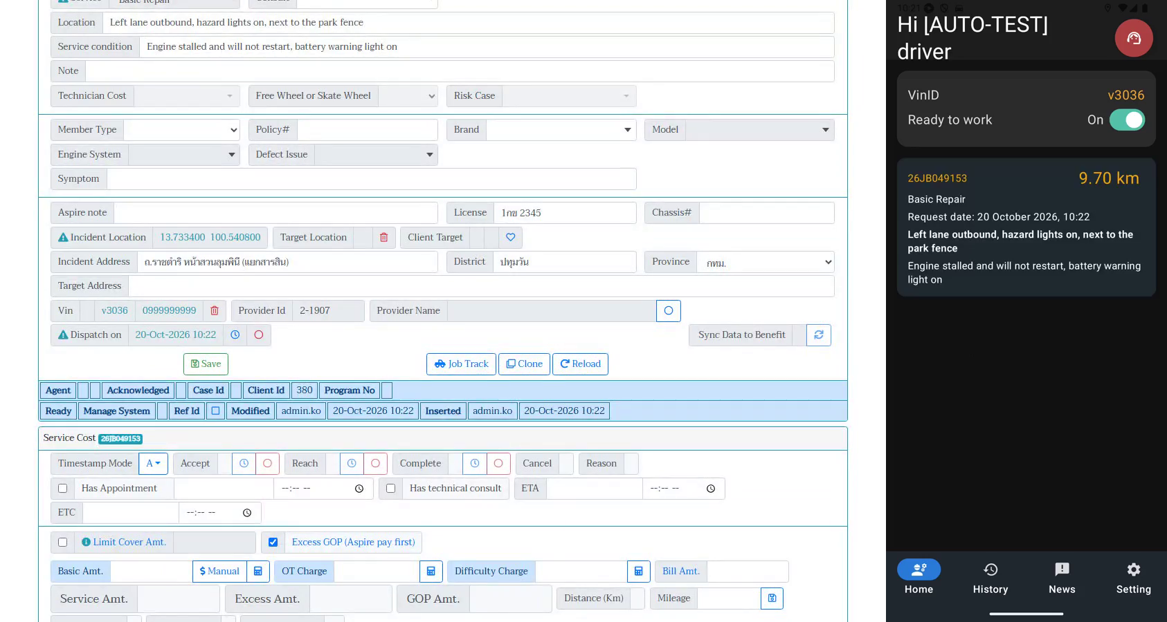
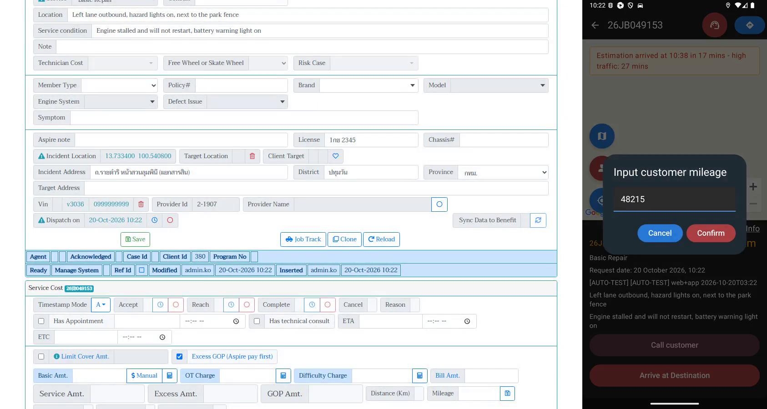
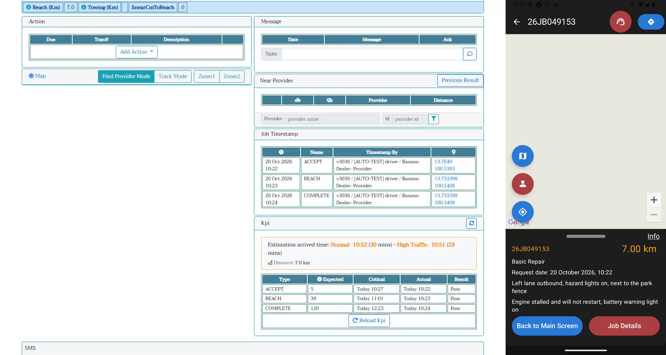
E2E-01 in the video: portal left, phone right, same run
Step 5: dispatched on the portal, the job is on the phone 9.70 km away
Step 8: driver arrives and enters odometer 48215
Step 11: portal shows ACCEPT / REACH / COMPLETE by truck v3036, KPI Pass
Result 20 Oct 2026: PASSED, job 26JB049153
Job card 9.70 km, portal road distance 7 km, mileage 48215, 1 photo, status CLOSED, KPI Pass on accept / reach / complete. Evidence: side-by-side video, Playwright report and trace.
Notes:
Three frames from the recorded run. The full three-minute video plays in the demo.

Slide 9
E2E-02 Announcement: publish on the web, see it on every phone
2
3
7
WEB
Admin creates High announcement
List: Approved, Active
Admin unticks Active
4
SERVER
Mobile feed contains it
1
5
6
8
APP
Driver on the dashboard
News tab shows the card
Home: high-priority banner
Gone from News
Administrators publish at once ("Submit & Publish"). Announcements cannot be targeted - every UAT phone sees it - so the test always switches it off at the end.
Notes:
The announcement journey has a server step: the test reads the same feed the phone reads, so we know whether a failure is on the server or on the phone.

Slide 10
E2E-02: each step is mapped to the cases it proves
# | Side | Step | Checked | Web suite cases | App suite cases
1 | App | Driver signed in, on the dashboard | Dashboard shown |  | M01-002, M03-001
2 | Web | Create High announcement, Submit & Publish | Saved; approved at once | TC-14-004/005/006/007
3 | Web | Announcement list | Approved, Active, High | TC-14-001
4 | Server | GET api/pmws/announcements | Contains the new one | TC-14-019
5 | App | News tab, tap the card | Title + content |  | M09-001
6 | App | Home | High-priority banner |  | M03-008
7 | Web | Edit, untick Active | Feed no longer has it | TC-14-010, 14-022
8 | App | Re-open News | Announcement gone |  | M09-001
Same table in the workbooks: web suite sheet 26 "E2E Journeys", app suite sheet 13.
Notes:
Same idea as E2E-01: when this journey passes, these 12 cases are proven in one run.

Slide 11
Demo: watch the journeys
E2E-01 Job (3 min)
TC-23-001-web-and-app_20Oct-real-location.mp4
Portal left, phone right. Step names appear as captions from the next run.
E2E-02 Announcement
Video from the first run (on the faster machine). Until then: the steps and the mapping on the previous two slides.
What to watch: the job number appearing on the phone after Dispatch, and the timestamps arriving on the portal after each tap.
Notes:
Play the video here. Point out: dispatch on the left, job appears on the right; each driver tap, then the timestamp row on the portal.

Slide 12
What the work found, and what we need next
Found while building the suites
Next
Job save checks no mandatory fields; dispatch does not check service or location
Double-click Save / Dispatch and two agents at once are not blocked
Load Provider lists busy trucks nationwide; stale GPS never excluded
Benefit timeout + retry can strand a job (31 Aug incident)
No role checks on job actions
Announcements cannot be targeted; no read tracking
App writes the login password to the device log (UAT build)
BA: mark mandatory fields per stage (sheet 24) and answer the review questions (sheet 25)
Run E2E-02 and record both journeys with step captions
Next journeys: customer cancels while the driver is on the way (TC-23-002); towing job
Decide where journeys run before each release (desktop runner, cloud instance or device farm)
Notes:
Each finding has its own test case in the suite, so it stays visible until it is fixed or accepted.

