Slide 1
APAC ASPIRE DIGITAL
Web QA Automation
A management decision backed by POC evidence
RSA and Benefit · Web testing
Management briefing · 9 October 2026
Notes:
Playwright for execution. Claude Code for broader suite authoring. Codex for focused vendor and CMS checks. Evidence limitations and pipeline next steps are explicit.
Sources: https://internationalsos.atlassian.net/wiki/spaces/AD/pages/6895960137
https://internationalsos.atlassian.net/wiki/spaces/AD/pages/6896910361
https://internationalsos.atlassian.net/wiki/spaces/AD/pages/6896287838
https://internationalsos.atlassian.net/wiki/spaces/AD/pages/6895534237
https://internationalsos.atlassian.net/wiki/spaces/AD/pages/6896681063
https://internationalsos.atlassian.net/wiki/spaces/AD/pages/6896681090
POC supporting evidence: https://internationalsos.atlassian.net/wiki/spaces/AD/pages/6896156677

Slide 2
Why Playwright
Playwright fits our complete web workflows
Decision point | Playwright | Selenium | Cypress
Workflow coverage | Forms, tabs and service checks | Broad coverage; more setup | Strong frontend focus
Failure evidence | Reports and step replay | Additional reporting tools | Interactive debugging
Maintenance | Automatic waits for controls | More explicit waiting rules | Built-in retry behaviour
Framework licence | Apache 2.0 · $0 | Apache 2.0 · $0 | MIT · $0 core
Recommendation: Playwright balances workflow coverage, evidence and setup.
02
Notes:
All three are viable. Playwright best matches RSA and Benefit workflows spanning forms, popups and connected data. Framework licence cost excludes hosting, labour and optional services. Cypress Cloud is optional and paid.
Sources: https://internationalsos.atlassian.net/wiki/spaces/AD/pages/6895960137
POC supporting evidence: https://internationalsos.atlassian.net/wiki/spaces/AD/pages/6896156677

Slide 3
Why Playwright
The fit comes from our project needs
Our workflow | Why Playwright fits
RSA agent journeys | Follow a journey across pages and popups
Benefit vendor creation | Select dependencies, fill fields and verify Save
Data consistency | Compare rendered values with service or CMS data
QA investigation | Replay failed steps with screenshots and traces
Choose for these capabilities and the work we need to test.
03
Notes:
This is a capability-based selection. We do not use existing implementation or avoiding a restart as the reason to choose Playwright. Database and CMS comparisons require a defined expected result and access.
Sources: https://internationalsos.atlassian.net/wiki/spaces/AD/pages/6895960137
POC supporting evidence: https://internationalsos.atlassian.net/wiki/spaces/AD/pages/6896156677

Slide 4
Why Playwright
Repeatable checks and clearer failures
Strong point | Business benefit | Cost boundary
Repeatable journeys | Run the same checks after changes | Maintain test data and expectations
Clear failure evidence | QA can see where the journey failed | Store reports securely
Automatic waiting | Reduce timing-related false failures | Review unstable tests
Free framework | No framework licence fee | Runner, AI and team time still cost
The benefit is reliable release evidence; savings have not been measured.
04
Notes:
No ROI or time-saving percentage has been established in this POC. Tool capability supports the recommendation; teams must still review business assertions, account access and data cleanup.
Sources: https://internationalsos.atlassian.net/wiki/spaces/AD/pages/6895960137
POC supporting evidence: https://internationalsos.atlassian.net/wiki/spaces/AD/pages/6896156677

Slide 5
Codex versus Claude Code
Recommend Claude Code for the broader web suite
Job | Recommended role | Evidence supporting it
Build the broader RSA pack | Claude Code as primary author | Broader documented delivery
Focused vendor / CMS checks | Codex as a capable option | Saved vendor and 19 value checks
Accept the result | QA reviews either tool’s work | Business rules still need review
This is a job-specific recommendation based on available POC evidence.
05
Notes:
Claude Code has the broader documented delivery for this job. This is not proof of universal superiority, lower cost or greater accuracy. Codex demonstrated a narrower but detailed vendor creation and CMS validation workflow.
Sources: https://internationalsos.atlassian.net/wiki/spaces/AD/pages/6896910361
Canonical RSA POC: https://internationalsos.atlassian.net/wiki/spaces/AD/pages/6772031506
POC supporting evidence: https://internationalsos.atlassian.net/wiki/spaces/AD/pages/6896156677

Slide 6
Codex versus Claude Code
The results support different strengths
Evidence | Claude Code / RSA | Codex / Benefit
Scope | 61 cases → 71 executable tests | Vendor flow + login setup
Recorded outcome | 57 passed · 14 skipped | 2 passed
Detailed data check | Equivalent vendor proof unavailable | 19 rendered values matched CMS
Evidence status | Reported in the RSA POC | Saved local test evidence
Different tasks and scope: these numbers are not an equal-task competition.
06
Notes:
The RSA results are reported from the source POC, not rerun here. Benefit’s two passing executable tests are one vendor business check and one login setup. Nineteen value comparisons are field checks, not nineteen business cases. Full corrected BenefitDB/CMS comparison remains pending.
Sources: https://internationalsos.atlassian.net/wiki/spaces/AD/pages/6896910361
Canonical RSA POC: https://internationalsos.atlassian.net/wiki/spaces/AD/pages/6772031506
POC supporting evidence: https://internationalsos.atlassian.net/wiki/spaces/AD/pages/6896156677

Slide 7
Codex versus Claude Code
Confirm the AI choice with the same assignment
Measure | Fair comparison
Delivery time | Same journeys, access and acceptance rules
Review effort | Record corrections needed before QA accepts
Defect detection | Use the same known failures and expected results
Operating cost | Compare actual usage plus reviewer time
Proposed next step: a matched-task trial before claiming speed or cost superiority.
07
Notes:
This benchmark is a plan and has not been completed. Both tools should receive identical project access, test cases, environment, data and review criteria. Compare accepted outcomes rather than the number of generated tests.
Sources: https://internationalsos.atlassian.net/wiki/spaces/AD/pages/6896910361
Canonical RSA POC: https://internationalsos.atlassian.net/wiki/spaces/AD/pages/6772031506
POC supporting evidence: https://internationalsos.atlassian.net/wiki/spaces/AD/pages/6896156677

Slide 8
Recommendation and proof
Use each tool for a clear responsibility
Tool | Strength | Limit to manage
Playwright: execution | Complete journeys + clear failure evidence | Needs correct assertions and stable data
Claude Code: broad authoring | Broader documented RSA case delivery | Skipped cases and QA review remain
Codex: focused checks | Detailed vendor and CMS verification | Setup assumptions needed correction
Recommended combination: Playwright executes; AI helps author; QA owns acceptance.
08
Notes:
Evidence: reported Claude RSA suite 61 cases, 57 passes and 14 skips; saved local RSA subset six passes; saved Codex Benefit vendor flow plus login two passes and nineteen CMS checks. Authoring and execution have different responsibilities.
Sources: https://internationalsos.atlassian.net/wiki/spaces/AD/pages/6896287838
POC supporting evidence: https://internationalsos.atlassian.net/wiki/spaces/AD/pages/6896156677

Slide 9
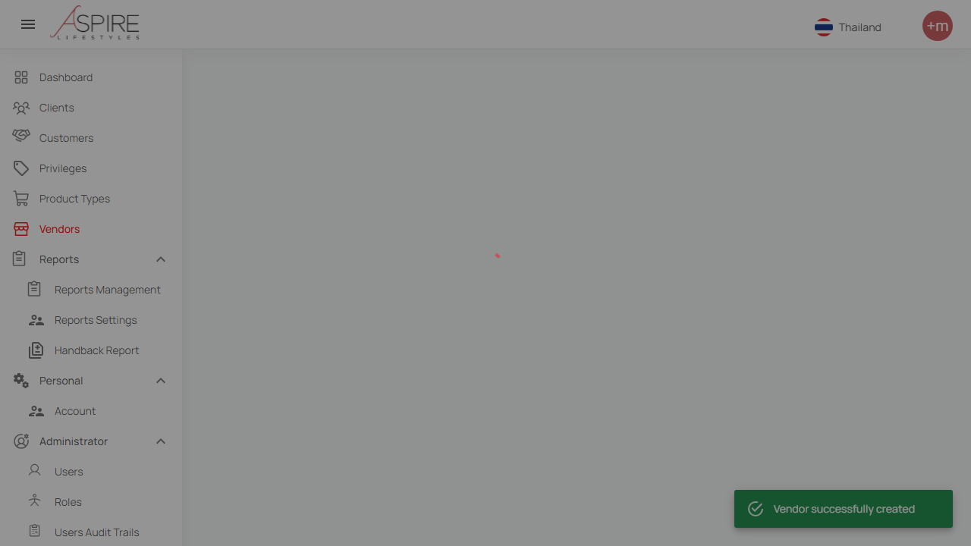
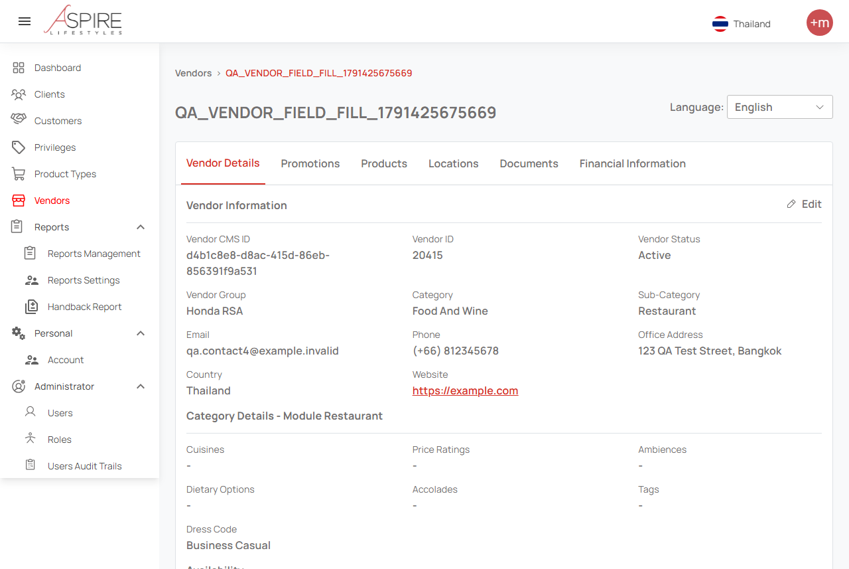
Recommendation and proof
Benefit POC: saved vendor and visible details
Creation confirmation
Vendor details (upper section)
Synthetic vendor 20415 · 19 rendered values matched CMS · full DB comparison pending.
09
Notes:
Saved evidence from 8 October 2026. The left image captures the successful creation toast. The right image shows the upper portion of vendor details. Vendor ID 20415 and CMS item d4b1c8e8-d8ac-415d-86eb-856391f9a531. This demonstrates save, detail display and nineteen CMS-rendered value comparisons. It does not prove every optional field persisted or full database parity.
Sources: https://internationalsos.atlassian.net/wiki/spaces/AD/pages/6896287838
POC supporting evidence: https://internationalsos.atlassian.net/wiki/spaces/AD/pages/6896156677

Slide 10
Recommendation and proof
The POC shows progress and specific next actions
Observed gap | Action | Why it matters
RSA account / identity skips | Provide approved test accounts | Run role and sign-in journeys
Missing job fixtures | Create controlled test records | Repeat the same expected journey
Full DB / CMS comparison pending | Restore access and finish the check | Prove persistence as well as display
AI-generated assumptions | QA reviews expected outcomes | Avoid accepting a misleading pass
Resolve prerequisites, then expand the accepted test pack.
10
Notes:
A successful UI/CMS comparison is narrower than full end-to-end integration proof. Some earlier Benefit assumptions about disabled fields were corrected by selecting Thailand at the top right, English and reloading. Access expiry prevented completion of the corrected full DB comparison.
Sources: https://internationalsos.atlassian.net/wiki/spaces/AD/pages/6896287838
POC supporting evidence: https://internationalsos.atlassian.net/wiki/spaces/AD/pages/6896156677

Slide 11
Completed automation
Coverage needs a confirmed baseline
Reported RSA catalogue: 449 business cases
61 implemented (13.6%) • 388 not started
“300 of 400” is unverified. Confirm that case pack before reporting 75%.
11
Notes:
The canonical RSA POC reports a catalogue of 449 cases across 22 sheets, 61 implemented cases and 388 not started. 61/449 is 13.6% implemented coverage of that reported catalogue. This is not passing coverage. No verified 300/400 inventory has been supplied.
Sources: https://internationalsos.atlassian.net/wiki/spaces/AD/pages/6895534237
Canonical RSA POC: https://internationalsos.atlassian.net/wiki/spaces/AD/pages/6772031506
POC supporting evidence: https://internationalsos.atlassian.net/wiki/spaces/AD/pages/6896156677

Slide 12
Completed automation
Separate cases, executable tests and results
Measure | Recorded value | What it means
RSA business cases | 61 implemented / 449 catalogue | Reported business scope
RSA executable tests | 71: 57 passed + 14 skipped | Reported run; not rerun here
Local RSA workshop run | 6 passed; 13 tests listed | Saved subset, not full-pack proof
Benefit focused run | 2 passed; 19 value checks | Vendor check + login setup
Report completed business scope and passing execution separately.
12
Notes:
A business case may produce multiple executable tests. Setup tests should not be presented as additional business coverage. The local RSA six-test saved result includes five functional tests and setup; the thirteen-test inventory includes twelve functional tests and setup.
Sources: https://internationalsos.atlassian.net/wiki/spaces/AD/pages/6895534237
Canonical RSA POC: https://internationalsos.atlassian.net/wiki/spaces/AD/pages/6772031506
POC supporting evidence: https://internationalsos.atlassian.net/wiki/spaces/AD/pages/6896156677

Slide 13
Completed automation
The 14 reported skips have concrete prerequisites
Reason | Tests | What enables execution
Role accounts | 9 | Approved accounts with the required roles
Identity sign-in | 2 | Test identities for the sign-in service
Signed authentication | 1 | Valid signed authentication fixture
Job records | 2 | Controlled job data for the scenarios
A missing prerequisite does not establish that a scenario cannot be automated.
13
Notes:
These counts explain the fourteen reported RSA skips. They do not explain a supposed remaining one hundred cases. The 388 not-started catalogue cases need individual assessment; they are not all impossible. Source POC dated 8 October 2026.
Sources: https://internationalsos.atlassian.net/wiki/spaces/AD/pages/6895534237
Canonical RSA POC: https://internationalsos.atlassian.net/wiki/spaces/AD/pages/6772031506
POC supporting evidence: https://internationalsos.atlassian.net/wiki/spaces/AD/pages/6896156677

Slide 14
Automation boundaries
Fully automate the digital checks we can observe
Scenario | Automation scope | Prerequisite
Web forms and rules | Input, validation, save and details | Agreed expected outcomes
Role-based journeys | Sign in and verify permitted actions | Approved role accounts
Assigned jobs | Verify digital assignment and status | Controlled job records
DB / CMS consistency | Compare defined persisted / shown values | Access and agreed field mapping
Full automation is possible within a defined digital scope and available access.
14
Notes:
Full means all assertions of a defined digital scenario can be checked. It does not imply every integration has been proven. Benefit’s corrected complete DB/CMS comparison remains pending.
Sources: https://internationalsos.atlassian.net/wiki/spaces/AD/pages/6896681063
POC supporting evidence: https://internationalsos.atlassian.net/wiki/spaces/AD/pages/6896156677

Slide 15
Automation boundaries
Some journeys need automated and human evidence
Journey | Automated part | Remaining proof
Notifications | Request, callback or controlled inbox | Actual external delivery when uncontrolled
Third-party fulfilment | Request and returned status | External service completion
Roadside assistance | Assignment and digital status updates | Physical arrival and towing
Label these journeys as partial when the external outcome is not verified.
15
Notes:
A digital status update does not independently prove physical roadside service completion. Controlled integration checks can be automated; real external outcomes may require provider evidence or a human check.
Sources: https://internationalsos.atlassian.net/wiki/spaces/AD/pages/6896681063
POC supporting evidence: https://internationalsos.atlassian.net/wiki/spaces/AD/pages/6896156677

Slide 16
Automation boundaries
Keep human judgement explicit
Human check | Why it remains | How to report it
Usability and clarity | Requires judgement about the experience | Manual acceptance alongside digital tests
Human approval / protected MFA | Depends on a person or protected challenge | Approved test path, otherwise manual step
Physical service acceptance | Outside the observable web workflow | Attach operational confirmation
Unassessed cases | Scope has not yet been reviewed | Classify before declaring impossible
Classify each remaining case: full, partial, prerequisite-blocked or manual.
16
Notes:
MFA and CAPTCHA should not be bypassed. Approved test identities or test-environment paths may enable digital automation. These are scenario categories, not a verified breakdown of one hundred remaining cases.
Sources: https://internationalsos.atlassian.net/wiki/spaces/AD/pages/6896681063
POC supporting evidence: https://internationalsos.atlassian.net/wiki/spaces/AD/pages/6896156677

Slide 17
Pipeline plan
Move from local proof to an unattended pilot
Phase | Deliverable | Acceptance evidence
1. Agree the pack | Case list, required count and owner | Approved expected coverage
2. Run after test deployment | Cloud runner with controlled access | Actual hosted run and report link
3. Stabilise the pilot | Repeat runs and failure recovery | Proposed target: 10 unattended runs
4. Expand triggers | Nightly and release checks | Reliable evidence and agreed release gate
Proposed plan: prove one hosted pilot before expanding release controls.
17
Notes:
The POC contains a draft CodeBuild setup and local gate checks. No cloud QA run or deployed QA pipeline has been demonstrated. Ten unattended runs is a proposed acceptance target, not a completed result.
Sources: https://internationalsos.atlassian.net/wiki/spaces/AD/pages/6896681090
POC supporting evidence: https://internationalsos.atlassian.net/wiki/spaces/AD/pages/6896156677

Slide 18
Pipeline plan
The local gate rejects incomplete success
Local check | Result | Management meaning
Gate policy self-check | 5 checks passed | Pass / fail / skip / empty / incomplete handled
RSA: 6 passed, 13 expected | Rejected | A green subset cannot stand for the full pack
Benefit: 2 passed, 2 expected | Accepted | Saved focused pack met its required count
Hosted cloud pipeline | Not demonstrated | Infrastructure proof still needed
Local gate proof is complete; hosted execution is the next evidence milestone.
18
Notes:
Local validator rerun 9 October 2026 against saved results: complete passing run accepted; failed, skipped, empty and incomplete runs rejected. No browser rerun or cloud pipeline deployment was performed for this presentation.
Sources: https://internationalsos.atlassian.net/wiki/spaces/AD/pages/6896681090
POC supporting evidence: https://internationalsos.atlassian.net/wiki/spaces/AD/pages/6896156677

Slide 19
Pipeline plan
The pilot needs an owner and evidence of recovery
Need | Owner / proof to agree
Accounts, data and network | Approved test access; predictable data and cleanup
Secure evidence storage | Restricted reports, screenshots, traces and videos
Hosted success | Run ID and accessible results for the complete pack
Hosted failure and recovery | Deliberate failure blocks the gate; corrected rerun passes
Use these checks to decide when the pipeline is ready for release use.
19
Notes:
Runner image, environment configuration, secrets, network access and cleanup need ownership. Evidence should avoid credentials and customer data. A hosted run ID, report link and demonstrated failure/recovery are needed before claiming pipeline readiness.
Sources: https://internationalsos.atlassian.net/wiki/spaces/AD/pages/6896681090
POC supporting evidence: https://internationalsos.atlassian.net/wiki/spaces/AD/pages/6896156677

Slide 20
Decision and next steps
The management decision and next steps
Decision | Next action
Web execution: Playwright | Use complete workflows and reportable evidence
Claude Code: primary author | Confirm with a matched-task trial; Codex for focused checks
Coverage | Approve one inventory; resolve the 300 / 400 discrepancy
Pipeline investment | Assign a pilot owner and prove unattended execution
Proceed with a controlled web pilot and publish only evidenced results.
20
Notes:
Supporting project: https://github.com/bulubuloa/AS.APAC.AI.Workshop . Roadside-web is the published example. Benefit focused project is local and has not been published to that repository. The approved Confluence pages contain the supporting detail.
Sources: https://internationalsos.atlassian.net/wiki/spaces/AD/pages/6895960137
https://internationalsos.atlassian.net/wiki/spaces/AD/pages/6896910361
https://internationalsos.atlassian.net/wiki/spaces/AD/pages/6896287838
https://internationalsos.atlassian.net/wiki/spaces/AD/pages/6895534237
https://internationalsos.atlassian.net/wiki/spaces/AD/pages/6896681063
https://internationalsos.atlassian.net/wiki/spaces/AD/pages/6896681090
POC supporting evidence: https://internationalsos.atlassian.net/wiki/spaces/AD/pages/6896156677

