Slide 1
APAC ASPIRE DIGITAL
QA automation: tools and POC results
Six questions for the APAC Aspire AI workshop
RoadSide web • Benefit admin • Aspire Partner Android
Decision evidence and a staged pipeline plan
8 October 2026
Notes:
Source: https://internationalsos.atlassian.net/wiki/spaces/AD/pages/6896156677
Evidence snapshot: 8 October 2026.
Examples are abbreviated unless explicitly identified as executed POC evidence. Pricing is an 8 October 2026 snapshot.

Slide 2
1. Tools and why Playwright
Requirements behind the tool choice
Requirement | Our example
Browser navigation | RSA dealer detail opens in a new tab
Business assertions | Dealer code/name; vendor values versus CMS
Evidence | HTML/JUnit, screenshots, trace and video
Execution control | Required pack count and failure/skip gate
Native Android | Login, vehicle, fresh OTP and dashboard
Playwright for web; Appium + WebdriverIO for native mobile.
02
Notes:
Source: https://internationalsos.atlassian.net/wiki/spaces/AD/pages/6895960137
Evidence snapshot: 8 October 2026.
Topic 1 of six.
Examples are abbreviated unless explicitly identified as executed POC evidence. Pricing is an 8 October 2026 snapshot.

Slide 3
1. Tools and why Playwright
Playwright: popup detail and field assertions
Apache-2.0; $0 core framework fee
const popup = page.waitForEvent('popup');
await dealerLink.click();
const detail = await popup;
await expect(detailName)
.toHaveValue(expectedName);
Built-in runner, HTML/JUnit and traces
Our RSA popup test compares code and name
Existing executable example: roadside-web / TC02.2
03
Notes:
https://playwright.dev/docs/pages
https://playwright.dev/docs/test-reporters
https://github.com/microsoft/playwright/blob/main/LICENSE
https://github.com/bulubuloa/AS.APAC.AI.Workshop/blob/main/roadside-web/tests/02-dealer.spec.ts
Code sketch reuses fixture locators; it is not a standalone script.
Source: https://internationalsos.atlassian.net/wiki/spaces/AD/pages/6895960137
Evidence snapshot: 8 October 2026.
Topic 1 of six.
Examples are abbreviated unless explicitly identified as executed POC evidence. Pricing is an 8 October 2026 snapshot.

Slide 4
1. Tools and why Playwright
Selenium: established language and Grid assets
Apache-2.0; $0 core framework fee
field = WebDriverWait(driver, 10).until(
EC.visibility_of_element_located(
(By.ID, "vendorName")))
assert field.get_attribute("value") == expected
Good fit for an existing Java/C# ecosystem
Runner and evidence conventions need assembly
Can test the same values; no comparative run was performed.
04
Notes:
https://github.com/SeleniumHQ/selenium/blob/trunk/LICENSE
https://www.selenium.dev/documentation/webdriver/interactions/windows/
Illustrative Python sketch; imports/fixture/driver omitted.
Source: https://internationalsos.atlassian.net/wiki/spaces/AD/pages/6895960137
Evidence snapshot: 8 October 2026.
Topic 1 of six.
Examples are abbreviated unless explicitly identified as executed POC evidence. Pricing is an 8 October 2026 snapshot.

Slide 5
1. Tools and why Playwright
Cypress: interactive single-tab workflow
MIT; Cypress App is free
cy.visit(detailUrl);
cy.get('[data-testid=vendor-name]')
.should('have.value', expectedName);
Cloud recording is an optional service
RSA new-tab checks use a plugin or adaptation
Strong frontend alternative; our popup fits Playwright directly.
05
Notes:
https://docs.cypress.io/app/faq
https://docs.cypress.io/app/references/trade-offs
Cypress documents multi-tab through @cypress/puppeteer. Code is illustrative, not executed here.
Source: https://internationalsos.atlassian.net/wiki/spaces/AD/pages/6895960137
Evidence snapshot: 8 October 2026.
Topic 1 of six.
Examples are abbreviated unless explicitly identified as executed POC evidence. Pricing is an 8 October 2026 snapshot.

Slide 6
1. Tools and why Playwright
Robot Framework: keywords over Playwright
Apache-2.0 core and Browser library
*** Settings ***
Library Browser
*** Test Cases ***
Vendor Name Matches
New Page %{DETAIL_URL}
Get Property id=vendorName
... value == QA Vendor
Readable keywords for QA authoring
CMS/DB helpers still need custom integration
A different authoring layer; Browser uses Playwright underneath.
06
Notes:
https://robotframework.org/
https://robotframework-browser.org/
https://github.com/MarketSquare/robotframework-browser
Illustrative keywords; browser/context setup omitted.
Source: https://internationalsos.atlassian.net/wiki/spaces/AD/pages/6895960137
Evidence snapshot: 8 October 2026.
Topic 1 of six.
Examples are abbreviated unless explicitly identified as executed POC evidence. Pricing is an 8 October 2026 snapshot.

Slide 7
1. Tools and why Playwright
Katalon: guided authoring and object repository
Vendor commercial terms; local Free tier
WebUI.navigateToUrl(detailUrl)
WebUI.verifyElementAttributeValue(
findTestObject('Vendor/Name'),
'value', 'QA Vendor', 10)
Recorded flows and curated test objects
CI requires a Runtime Engine add-on
Consider when low-code and vendor support outweigh added licensing.
07
Notes:
https://katalon.com/pricing
https://www.katalon.com/terms
https://docs.katalon.com/katalon-studio/keywords/keyword-description-in-katalon-studio/web-ui-keywords/webui-verify-element-attribute-value
Illustrative Groovy sketch; object repository/fixtures/imports required.
Source: https://internationalsos.atlassian.net/wiki/spaces/AD/pages/6895960137
Evidence snapshot: 8 October 2026.
Topic 1 of six.
Examples are abbreviated unless explicitly identified as executed POC evidence. Pricing is an 8 October 2026 snapshot.

Slide 8
1. Tools and why Playwright
Appium + WebdriverIO: native Android control
Appium Apache-2.0; WebdriverIO MIT
await LoginScreen.open();
await LoginScreen.signIn(user, password);
await expect(vehiclePicker)
.toBeDisplayed();
UiAutomator2 drives native screens
Existing vehicle/OTP helpers can be reused
Retain for Aspire Partner; a browser viewport is not native evidence.
08
Notes:
https://github.com/appium/appium/blob/master/LICENSE
https://github.com/webdriverio/webdriverio/blob/main/LICENSE
https://appium.io/docs/en/latest/intro/
https://github.com/bulubuloa/AS.APAC.AI.Workshop/tree/main/roadside-android
Illustrative Page Object sketch; adapt method names to source.
Source: https://internationalsos.atlassian.net/wiki/spaces/AD/pages/6895960137
Evidence snapshot: 8 October 2026.
Topic 1 of six.
Examples are abbreviated unless explicitly identified as executed POC evidence. Pricing is an 8 October 2026 snapshot.

Slide 9
1. Tools and why Playwright
Maestro: concise mobile smoke flows
Apache-2.0; local CLI free
appId: com.aspire.partner.uat
---
- launchApp
- tapOn: "Username"
- inputText: ${TEST_USERNAME}
- tapOn: "Sign in"
- assertVisible: "Select vehicle"
YAML for a readable native journey
Our fresh-OTP helper needs adaptation
Candidate mobile alternative; not benchmarked against our Appium pack.
09
Notes:
https://github.com/mobile-dev-inc/maestro/blob/main/LICENSE
https://docs.maestro.dev/get-started/quickstart
Illustrative abbreviated YAML; password/policy steps omitted.
Source: https://internationalsos.atlassian.net/wiki/spaces/AD/pages/6895960137
Evidence snapshot: 8 October 2026.
Topic 1 of six.
Examples are abbreviated unless explicitly identified as executed POC evidence. Pricing is an 8 October 2026 snapshot.

Slide 10
1. Tools and why Playwright
Web licensing and optional cloud costs
Product | Advertised USD price | Boundary
Playwright / Selenium / Robot | $0 core fee | CI, storage and engineering extra
Cypress App | $0; MIT | Cloud optional
Cypress Cloud Team | $799/year | 120k results/year in annual plan
Cypress Cloud Business | $3,199/year | 120k results/year; extra usage
Katalon Professional | $2,199/seat/year displayed | $1,000 eligible promotion; CI add-on
Checked 8 Oct 2026. Free execution does not mean zero operating cost.
10
Notes:
https://www.cypress.io/pricing
https://katalon.com/pricing
Cypress annual monthly equivalents are rounded $67/$267. Katalon promotion first 3 eligible seats, first online purchase, until 31 Oct 2026; renewal and Runtime Engine/TestCloud add-ons require confirmation. Enterprise plans are quote-based.
Source: https://internationalsos.atlassian.net/wiki/spaces/AD/pages/6895960137
Evidence snapshot: 8 October 2026.
Topic 1 of six.
Examples are abbreviated unless explicitly identified as executed POC evidence. Pricing is an 8 October 2026 snapshot.

Slide 11
1. Tools and why Playwright
Mobile and workload cost examples
Assumed scenario | License/subscription impact
Appium/WDIO on own emulator | $0 core; runner and device operation extra
Maestro: 2 concurrent cloud devices | 2 × $250 = $500/month
3 Katalon Professional authors | 3 × $2,199 = $6,597/year standard basis
100 cases × 10 daily runs × 22 days | 22,000 results/month; 264,000/year
Cypress Team at assumed volume | 144k/year above included 120k
Assumptions for budgeting, not measured spend or savings.
11
Notes:
https://maestro.dev/pricing
https://katalon.com/pricing
https://www.cypress.io/pricing
Maestro annual equivalent $6,000 at unchanged rate; web-device rate requires inquiry. Eligible Katalon temporary promotion totals $3,000/year for 3 seats, excluding add-ons. Cypress extra-result fees depend on contracted billing.
Source: https://internationalsos.atlassian.net/wiki/spaces/AD/pages/6895960137
Evidence snapshot: 8 October 2026.
Topic 1 of six.
Examples are abbreviated unless explicitly identified as executed POC evidence. Pricing is an 8 October 2026 snapshot.

Slide 12
1. Tools and why Playwright
Why we choose Playwright for web
The actual RSA popup workflow already has reviewed assertions.
Benefit creation/detail checks demonstrate CMS value comparison.
One runner produces inspectable HTML/JUnit and retained evidence.
Existing TypeScript examples avoid a migration for this POC.
No mandatory framework or hosted-report subscription.
A justified project fit; no universal speed or cost superiority is claimed.
12
Notes:
https://playwright.dev/docs/trace-viewer
https://playwright.dev/docs/actionability
https://github.com/bulubuloa/AS.APAC.AI.Workshop/tree/main/roadside-web
Source: https://internationalsos.atlassian.net/wiki/spaces/AD/pages/6895960137
Evidence snapshot: 8 October 2026.
Topic 1 of six.
Examples are abbreviated unless explicitly identified as executed POC evidence. Pricing is an 8 October 2026 snapshot.

Slide 13
2. Codex versus Claude Code
Codex and Claude: evidence from different workloads
Dimension | Claude Code RSA POC | Codex Benefit POC
Attribution | Reported in company source | This working session
Output | 61 cases → 71 tests reported | Creation + Save/detail/CMS checks
Last result | 57 passed / 14 skipped reported | TC002 + setup passed; 19 comparisons
Scope | RSA catalogue subset | Benefit vendor workflow
Interpretation | No matched benchmark | No agent winner established
Test execution time is not AI authoring productivity.
13
Notes:
Source: https://internationalsos.atlassian.net/wiki/spaces/AD/pages/6896910361
Evidence snapshot: 8 October 2026.
Topic 2 of six.
Examples are abbreviated unless explicitly identified as executed POC evidence. Pricing is an 8 October 2026 snapshot.

Slide 14
2. Codex versus Claude Code
What worked and what needed correction
Reported Claude evidence
Measured Codex evidence
Source review corrected NEW badge expectations.
Save success and CMS rendering checks passed.
Search/prefix rules were identified.
Thailand/global reload prerequisite needed a user correction.
Accounts, identity and fixtures blocked 14 tests.
Asset-ID and comparison assumptions needed fixes.
Human review and valid environment access were necessary in both POCs.
14
Notes:
Source: https://internationalsos.atlassian.net/wiki/spaces/AD/pages/6896910361
Evidence snapshot: 8 October 2026.
Topic 2 of six.
Examples are abbreviated unless explicitly identified as executed POC evidence. Pricing is an 8 October 2026 snapshot.

Slide 15
2. Codex versus Claude Code
A fair agent benchmark
Use the same five reviewed cases, repo commit and UAT fixtures.
Provide equal access, permissions and authoring time.
Record model version, prompts and human interventions.
Measure accepted-test time, false defect reports and seeded-fault detection.
Capture actual billed usage and maintenance after a UI change.
Choose an authoring standard after matched evidence; keep one reviewed runtime.
15
Notes:
Proposed benchmark, not executed. Suggested cases: dependent job creation, popup detail, API fallback, vendor Save/detail/CMS, read-only DB consistency.
Source: https://internationalsos.atlassian.net/wiki/spaces/AD/pages/6896910361
Evidence snapshot: 8 October 2026.
Topic 2 of six.
Examples are abbreviated unless explicitly identified as executed POC evidence. Pricing is an 8 October 2026 snapshot.

Slide 16
3. Recommendation and POC proof
Recommended tools and their boundaries
Workstream | Recommendation | Reason / boundary
Web regression | Playwright Test | Existing popup and vendor POC
Native Android | Appium + WebdriverIO | Resource IDs and native screens
AI authoring | Continue controlled dual-tool pilot | No matched Codex/Claude result
CMS / database verification | API + read-only adapters | Access and correlation required
Physical service acceptance | Operational observation | Digital status is not service proof
Choose the runtime per system and review the generated business assertions.
16
Notes:
Source: https://internationalsos.atlassian.net/wiki/spaces/AD/pages/6896287838
Evidence snapshot: 8 October 2026.
Topic 3 of six.
Examples are abbreviated unless explicitly identified as executed POC evidence. Pricing is an 8 October 2026 snapshot.

Slide 17
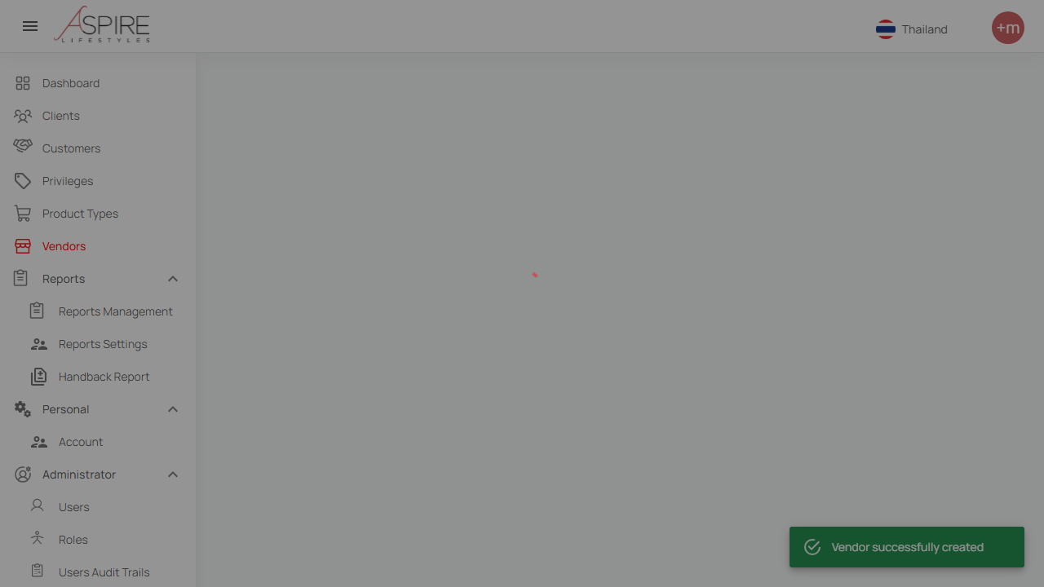
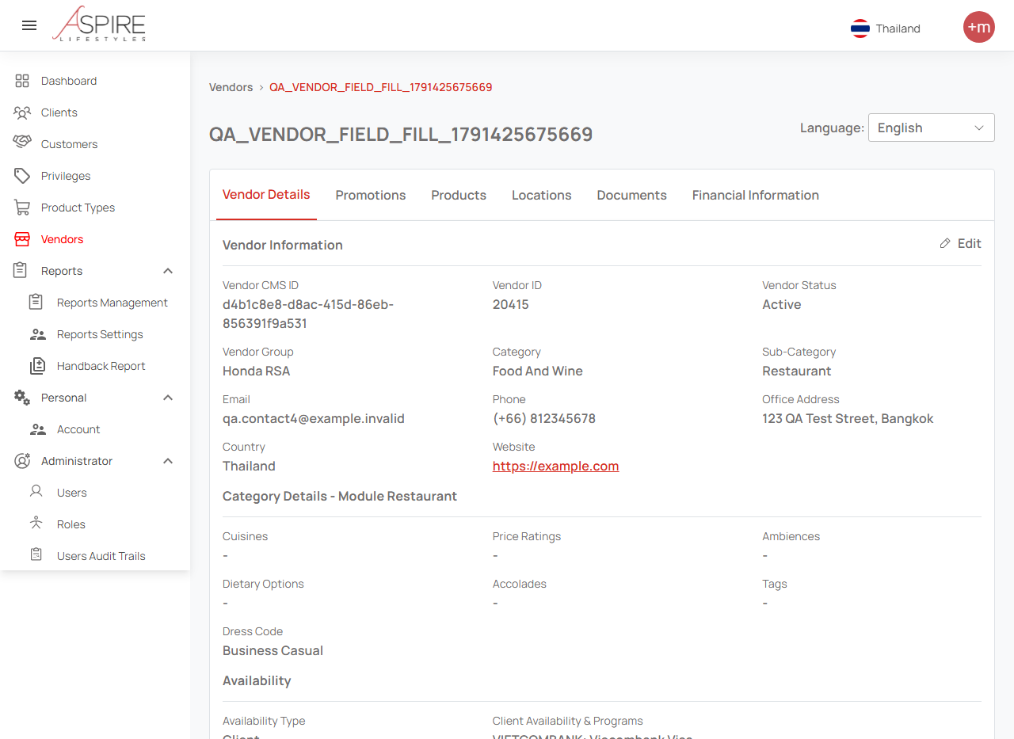
3. Recommendation and POC proof
Save success and resulting vendor detail
Post-save feedback
Resulting vendor detail (upper section)
Synthetic vendor 20415; 19 CMS-to-rendering comparisons passed.
17
Notes:
Saved TC-VENDOR-CREATE-002 evidence, 8 Oct 2026. Full DB consistency is a separate check. Screenshots show the exercised flow, not every optional field.
Source: https://internationalsos.atlassian.net/wiki/spaces/AD/pages/6896287838
Evidence snapshot: 8 October 2026.
Topic 3 of six.
Examples are abbreviated unless explicitly identified as executed POC evidence. Pricing is an 8 October 2026 snapshot.

Slide 18
3. Recommendation and POC proof
A green test can still leave integration gaps
TC002 compares CMS values with the rendered detail.
The corrected full BenefitDB replay remains incomplete after AWS expiry.
Vendor 20414 payload had blank optional mailing/restaurant collections.
A blank request matching a blank stored value does not prove input retention.
Add reviewed UI-to-payload and DB/CMS checks before broad coverage claims.
Separate app defects, test defects and environment blockers.
18
Notes:
Source: https://internationalsos.atlassian.net/wiki/spaces/AD/pages/6896287838
Evidence snapshot: 8 October 2026.
Topic 3 of six.
Examples are abbreviated unless explicitly identified as executed POC evidence. Pricing is an 8 October 2026 snapshot.

Slide 19
4. Completed automation and coverage
RSA catalogue and implementation coverage
Reported measure | Count | Meaning
Catalogue | 449 cases / 22 sheets | Business case inventory
Implemented | 61 cases → 71 tests | 13.6% case implementation
Last reported run | 57 pass / 14 skip / 0 fail | Not complete product coverage
Not started | 388 cases | Not evidence of impossibility
300 of 400 | Unverified | Need workbook version and case IDs
Do not present the unverified 300/400 figure as measured coverage.
19
Notes:
Source page 6772031506; larger original suite and artifacts were unavailable in current checkout. 61/449 = 13.5857%; rounded 13.6%.
Source: https://internationalsos.atlassian.net/wiki/spaces/AD/pages/6895534237
Evidence snapshot: 8 October 2026.
Topic 4 of six.
Examples are abbreviated unless explicitly identified as executed POC evidence. Pricing is an 8 October 2026 snapshot.

Slide 20
4. Completed automation and coverage
Saved workshop and Benefit results
Pack | Inventory / saved result | Boundary
RSA runnable inventory | 13 tests: 12 functional + setup | Measured test listing
Saved RSA run, 7 Oct | 6 pass; 38.882 seconds | 5 functional + setup
Benefit UI, 8 Oct | 2 pass; 286.861 seconds | TC002 + setup
Benefit CMS rendering | 19 comparisons passed | One exercised synthetic vendor
Mobile archived reports | 3 passing checks | No fresh combined run
Inventory, executed tests and assertions are different units.
20
Notes:
Source: https://internationalsos.atlassian.net/wiki/spaces/AD/pages/6895534237
Evidence snapshot: 8 October 2026.
Topic 4 of six.
Examples are abbreviated unless explicitly identified as executed POC evidence. Pricing is an 8 October 2026 snapshot.

Slide 21
4. Completed automation and coverage
How to report completion without inflating it
Implemented coverage = unique implemented cases / catalogued cases.
Executed coverage = unique executed cases / catalogued cases.
Pass rate = passed tests / executed tests, with skips shown separately.
Track setup tests, assertions and repeated runs outside business-case totals.
Publish case IDs, pack version, source SHA and latest artifact links.
Reconcile the actual 400-case pack before claiming 75% completion.
21
Notes:
Source: https://internationalsos.atlassian.net/wiki/spaces/AD/pages/6895534237
Evidence snapshot: 8 October 2026.
Topic 4 of six.
Examples are abbreviated unless explicitly identified as executed POC evidence. Pricing is an 8 October 2026 snapshot.

Slide 22
5. Partial automation and blockers
The 14 reported skips have enabling conditions
Block | Tests | Enabling action
Role and account fixtures | 9 | Dedicated approved UAT accounts
Okta test identity | 2 | Approved identity/session design
Signed authentication hash | 1 | Controlled minting fixture
Reference/assigned-truck jobs | 2 | Reproducible fixture relationships
Missing prerequisites are blocked automation, not inherently manual cases.
22
Notes:
Source: https://internationalsos.atlassian.net/wiki/spaces/AD/pages/6896681063
Evidence snapshot: 8 October 2026.
Topic 5 of six.
Examples are abbreviated unless explicitly identified as executed POC evidence. Pricing is an 8 October 2026 snapshot.

Slide 23
5. Partial automation and blockers
Full automation and conditional integration checks
Full with reviewed fixtures
Full when access is ready
CRUD, filtering and negative validation
CMS and BenefitDB field consistency
Dealer popup and dependent selections
Assigned-provider/truck relationships
Save/detail with known expected values
Signed paths and callback correlation
Resolve credentials, test data and network routes; use bounded polling.
23
Notes:
Source: https://internationalsos.atlassian.net/wiki/spaces/AD/pages/6896681063
Evidence snapshot: 8 October 2026.
Topic 5 of six.
Examples are abbreviated unless explicitly identified as executed POC evidence. Pricing is an 8 October 2026 snapshot.

Slide 24
5. Partial automation and blockers
Partial automation: messages, devices and dispatch
Scenario | Automated proof | Remaining evidence
OTP / notifications | Request, event and newer test SMS row | Physical handset delivery
GPS / camera / background | Appium harness on controlled device | Field/network/OS experience
Roadside dispatch | Assignment and digital status transitions | Travel, towing and actual service
Visual / accessibility | Rule checks and approved screenshot diffs | Usability and baseline judgement
Mocks prove a contract path; they do not prove the external service happened.
24
Notes:
Source: https://internationalsos.atlassian.net/wiki/spaces/AD/pages/6896681063
Evidence snapshot: 8 October 2026.
Topic 5 of six.
Examples are abbreviated unless explicitly identified as executed POC evidence. Pricing is an 8 October 2026 snapshot.

Slide 25
5. Partial automation and blockers
Manual portions and a clear unblock plan
Real MFA approval and CAPTCHA remain human actions in that process.
Physical service quality and subjective usability require acceptance checks.
Unreviewed cases remain “not assessed,” not “cannot automate.”
For each case, record owner, blocker, enabling action and acceptance evidence.
Split manual portions from the automated surrounding application checks.
Assess the remaining scope case by case rather than labeling a whole remainder manual.
25
Notes:
Source: https://internationalsos.atlassian.net/wiki/spaces/AD/pages/6896681063
Evidence snapshot: 8 October 2026.
Topic 5 of six.
Examples are abbreviated unless explicitly identified as executed POC evidence. Pricing is an 8 October 2026 snapshot.

Slide 26
6. Pipeline integration
Pipeline plan: target execution sequence
Stage | Expected proof
Deploy approved SIT/UAT build | Target URL and deployed source/version
Preflight | Account, fixtures, DNS/TLS and DB route
Required smoke pack | Complete count and per-case results
API / CMS / SELECT checks | Correlated independent expected values
Report and quality gate | Restricted evidence; fail/skip/incomplete rejection
Proposed flow; no new cloud QA pipeline was deployed.
26
Notes:
Source: https://internationalsos.atlassian.net/wiki/spaces/AD/pages/6896681090
Evidence snapshot: 8 October 2026.
Topic 6 of six.
Examples are abbreviated unless explicitly identified as executed POC evidence. Pricing is an 8 October 2026 snapshot.

Slide 27
6. Pipeline integration
Local pipeline POC and result gate
Evidence already available
Evidence still required
Draft CodeBuild buildspec and JUnit output
Actual CodeBuild project and run ID
Five local gate policy checks
Unattended credentials and private DB route
Saved 6-test RSA run rejected when 13 required
Restricted artifact/report links
Saved 2-test Benefit pack accepted when 2 required
Before/fault/after runs and cleanup
Local gate proof does not establish hosted CI integration.
27
Notes:
Source: https://internationalsos.atlassian.net/wiki/spaces/AD/pages/6896681090
Evidence snapshot: 8 October 2026.
Topic 6 of six.
Examples are abbreviated unless explicitly identified as executed POC evidence. Pricing is an 8 October 2026 snapshot.

Slide 28
6. Pipeline integration
Draft runner commands and unattended prerequisites
Use locked dependencies and compatible browser image
npm ci
npx playwright install --with-deps chromium
POC=../docs/qa-automation-poc/pipeline
node "$POC/preflight.cjs"
npx playwright test --workers=1 --retries=0
node "$POC/validate-junit.cjs" reports/junit.xml 13
Use a runner/VPC route, not a desktop tunnel
Run controlled create packs without automatic retry
Draft Linux runner commands; project secrets, image and network still need setup.
28
Notes:
https://playwright.dev/docs/ci
https://docs.aws.amazon.com/codebuild/latest/userguide/test-reporting.html
https://docs.aws.amazon.com/codebuild/latest/userguide/vpc-support.html
Draft at docs/qa-automation-poc/pipeline/buildspec.poc.yml; source repository root contains roadside-web. Requires project secrets/image/network setup.
Source: https://internationalsos.atlassian.net/wiki/spaces/AD/pages/6896681090
Evidence snapshot: 8 October 2026.
Topic 6 of six.
Examples are abbreviated unless explicitly identified as executed POC evidence. Pricing is an 8 October 2026 snapshot.

Slide 29
6. Pipeline integration
Milestones before making it a release gate
Milestone | Required evidence
Freeze reviewed pack | Case manifest and executable inventory
Prove one hosted run | Run ID, SHA, counts and artifacts
Prove defect detection | Isolated before/fault/after with cleanup
Stabilize | Proposed: 10 unattended runs, no unexplained skips
Enable triggers | Post-deploy smoke, nightly regression, release pack
QA owns triage; add native mobile and contract coverage separately.
29
Notes:
Source: https://internationalsos.atlassian.net/wiki/spaces/AD/pages/6896681090
Evidence snapshot: 8 October 2026.
Topic 6 of six.
Examples are abbreviated unless explicitly identified as executed POC evidence. Pricing is an 8 October 2026 snapshot.

Slide 30
Decisions and evidence to collect next
Adopt Playwright for new RSA/Benefit web checks; retain native Appium coverage.
Use matched evidence before choosing Codex or Claude as the authoring standard.
Reconcile the 400-case workbook and its implemented/passed case IDs.
Complete the pending BenefitDB consistency replay.
Run one controlled CI pilot and retain fault-detection proof.
All six topic pages and workshop repositories are linked in the speaker notes.
30
Notes:
https://internationalsos.atlassian.net/wiki/spaces/AD/pages/6895960137
https://internationalsos.atlassian.net/wiki/spaces/AD/pages/6896910361
https://internationalsos.atlassian.net/wiki/spaces/AD/pages/6896287838
https://internationalsos.atlassian.net/wiki/spaces/AD/pages/6895534237
https://internationalsos.atlassian.net/wiki/spaces/AD/pages/6896681063
https://internationalsos.atlassian.net/wiki/spaces/AD/pages/6896681090
https://github.com/bulubuloa/AS.APAC.AI.Workshop
https://internationalsos.atlassian.net/wiki/spaces/AD/pages/6896091147
https://internationalsos.atlassian.net/wiki/spaces/AD/pages/6894092390
Source: https://internationalsos.atlassian.net/wiki/spaces/AD/pages/6896156677
Evidence snapshot: 8 October 2026.
Examples are abbreviated unless explicitly identified as executed POC evidence. Pricing is an 8 October 2026 snapshot.

