Slide 1
APAC ASPIRE DIGITAL
Web QA Automation
POC evidence and Analysis
RSA and Benefit · Web testing
Management briefing · October 2026

Slide 2
What we test
449 RoadSide test cases: 347 can be fully automated
Every case in our full regression list, reviewed one by one
347 run fully by machine (77%) • 102 need a person for one step
Not every test case can be fully automated - Aspire Digital - Confluence
02

Slide 3
Automation boundaries
Not every test case can be fully automated
Scenario | Example from our test list | Why a person is still needed
Okta SSO login | Sign in through Okta (TC-01-007) | One-time code (OTP); Okta gives no test mock
Real SMS delivery | Send SMS via ClickNext (TC-12-012) | Must arrive on a real phone
Push to provider app | Dispatch job to driver (TC-04-025) | Job-list API tested; web + phone not joined
Live GPS tracking | Truck trail on the map (TC-08-002) | Needs trucks actually moving
Time-based rules | Job past agreed service time (TC-09-004) | Must wait real time or fake the dates
Forced failures | CMS outage (TC-10-009) | Must break a live service on purpose
Human judgement | Control-room alert sound (TC-09-016) | A person judges if agents notice it
102 of 449 cases are partly automatable; a person checks what a machine cannot.
03

Slide 4
Automation boundaries
Human judgement: what a machine cannot see
Where in the app | What the machine checks | What a person judges
Monitor alert sound (TC-09-016) | Sound plays without an error | Loud enough for the control room?
Failed SMS in the SMS log (TC-12-003) | Failed rows have a colour or label | Can staff spot it and retry?
Unread provider message (TC-09-009) | Unread rows are marked differently | Does an agent notice no reply?
Overdue task on a job (TC-07-005) | A highlight colour is shown | Obvious enough to act on?
Truck stops sending location (TC-11-006) | A warning icon is shown | Does someone notice it is lost?
Job detail PDF (TC-13-021) | File downloads with the job number | Readable and fit to send a client?
Keyboard-only use (TC-22-024) | Tab key reaches every control | Can you always see where you are?
The machine checks it is there; a person checks it is noticed and usable.
04

Slide 5
Why Playwright
Why Playwright: fits our journeys, free to use
What we need | Playwright | Selenium | Cypress
Follow full journeys across pages and popups | Built in | Possible; more setup | Weak across tabs and popups
See where a failed test broke | Report with step-by-step replay | Needs extra reporting tools | Interactive debugging
Fewer false failures | Waits for screens automatically | Waiting rules written by hand | Built-in retry
Check saved data against the CMS | Screen and data checks in one test | Needs extra libraries | Possible
Licence cost | Free (Apache 2.0) | Free (Apache 2.0) | Free core (MIT)
Free licence; the real costs are pipeline time, AI seats and QA review.
05

Slide 6
How we use AI
How AI helps us build tests, step by step
Step | Who does it | What comes out
1. Pick a case from the 449-case list | QA | The case and its expected result
2. Write the Playwright test | AI (Claude Code) | Test code in a few minutes
3. Run it and fix any failure | AI, checked by a developer | A test that passes for the right reason
4. Review and approve | QA | Only approved tests join the pack
5. Run at every release | Build pipeline (no AI) | Report with screenshots of any failure
AI writes and fixes the tests; people decide what is tested and what counts as a pass.
06

Slide 7
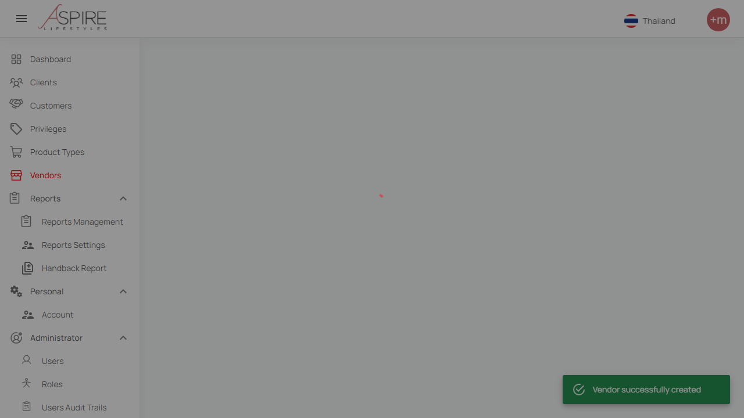
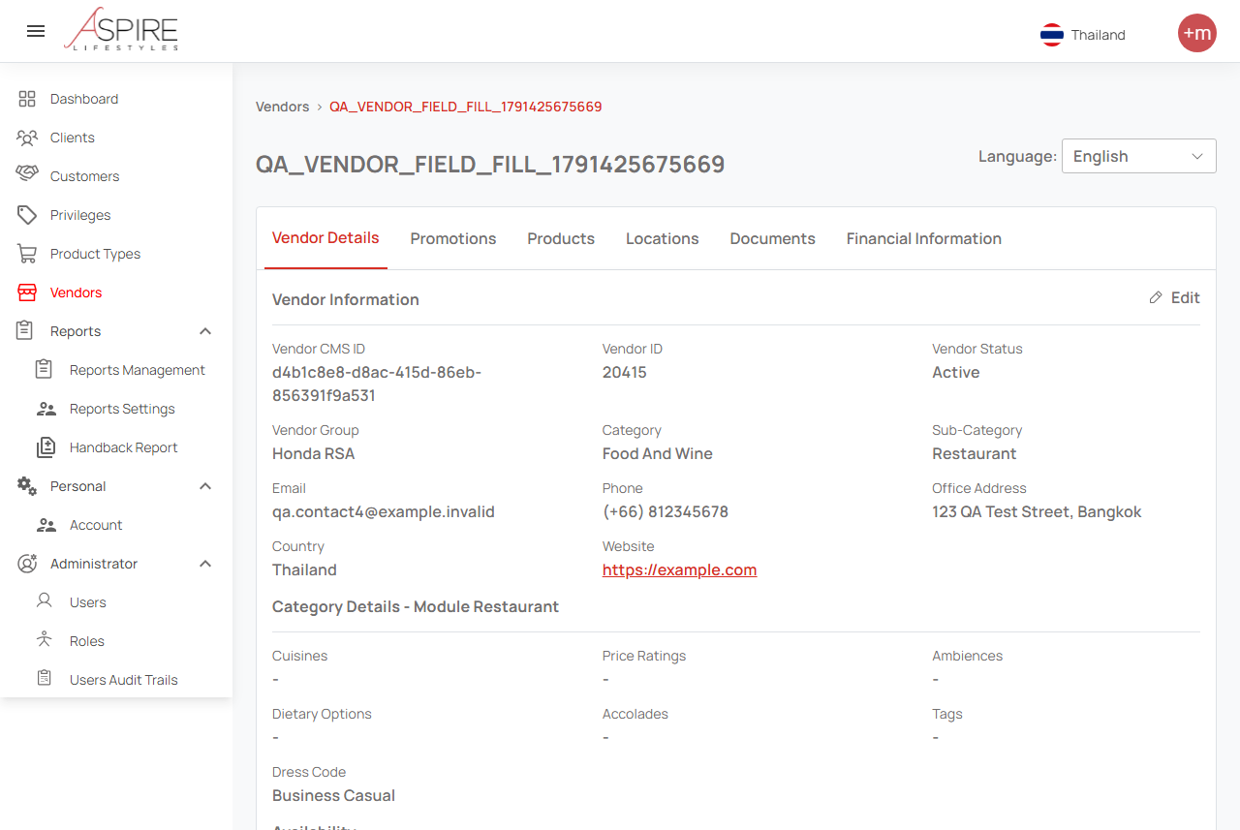
Trial proof
Trial: a robot created a vendor and checked it
1. Fills in the form and saves
2. Checks the saved details on screen
Test vendor 20415: saved, then 19 on-screen values matched the content system (CMS).
07
Notes:
Saved evidence from 8 October 2026. The left image captures the successful creation toast. The right image shows the upper portion of vendor details. Vendor ID 20415 and CMS item d4b1c8e8-d8ac-415d-86eb-856391f9a531. This demonstrates save, detail display and nineteen CMS-rendered value comparisons. It does not prove every optional field persisted or full database parity.
Sources: https://internationalsos.atlassian.net/wiki/spaces/AD/pages/6896287838
POC supporting evidence: https://internationalsos.atlassian.net/wiki/spaces/AD/pages/6896156677

Slide 8
Our AI choice
Claude Code or Codex: why we chose Claude Code
What matters to us | Claude Code | Codex
Writes and runs tests on our laptops | Yes | Yes
Our Jira-to-release AI workflow | Already built on it | Would need rebuilding
Setup on our Windows laptops | Worked as is | Needed extra fixes
Usage per USD 20 seat | 1.25 × the personal plan | 1 × the personal plan
Heavy-user seat (USD 100) | Available now | Waitlist only
Both can do the job; Claude Code fits our team today. Our two trials had different tasks.
08

Slide 9
AI cost
AI cost: USD 20 per person, with a usage allowance
Plan option | Claude Team | ChatGPT Business
Standard seat (billed yearly) | USD 20 / person / month | USD 20 / person / month
Premium seat (heavy user) | USD 100 · available now | USD 100 · waitlist only
Enterprise plan | USD 20 + pay per use · 20+ people | Price on request · ~150 people
When the allowance runs out | Wait for the refill, or buy extra | Wait for the refill, or buy extra
Running tests in the pipeline | Uses no AI allowance | Uses no AI allowance
A token is the AI’s “mobile data” (about ¾ of a word); each seat refills every 5 hours and weekly.
09

Slide 10
Build pipeline
When the tests run: once per release
When | Our plan | Why
Every code change (PR) | No | A full run takes about 1–2 hours; pipeline time is billed per minute
Every day (nightly) | No | Pays for runs when nothing has changed
Each release | Yes: the full test pack | One run gives the evidence to approve the release
AI cost per run | None | Playwright runs the tests; AI only writes and fixes them
Expectation: one full run per release; the cost is pipeline minutes, not AI.
10

Slide 11
Next steps
What we need to finish the job
What is missing | What we need | Why it matters
Test accounts for each role | Approved test accounts | Run sign-in and permission tests
Test jobs to work with | A fixed set of test jobs | Same result on every run
Database access for checks | Restore test database access | Prove data is saved, not just shown
AI-written expected results | QA reviews each test | No false “pass” results
With these in place, we build out the remaining test cases.
11
Notes:
A successful UI/CMS comparison is narrower than full end-to-end integration proof. Some earlier Benefit assumptions about disabled fields were corrected by selecting Thailand at the top right, English and reloading. Access expiry prevented completion of the corrected full DB comparison.
Sources: https://internationalsos.atlassian.net/wiki/spaces/AD/pages/6896287838
POC supporting evidence: https://internationalsos.atlassian.net/wiki/spaces/AD/pages/6896156677

Slide 12
Decision requested
For approval: Playwright + Claude Code
Tool | What it does for us | Cost
Playwright | Clicks through the website like a user | Free (open source)
Claude Team (AI) | Writes and fixes the tests for us | Min: USD 20 per person / month
Build pipeline | Runs the full test pack once per release | Existing; no new tool
QA team | Reviews results; does the manual checks | Existing staff
We ask approval for Claude Team seats and Playwright as our test standard.
12

