Slide 1
APAC ASPIRE DIGITAL
Web QA Automation
POC evidence and Analysis
RSA and Benefit · Web testing
Management briefing · October 2026

Slide 2
Why Playwright
Playwright fits our complete web workflows
Decision point | Playwright | Selenium | Cypress
Workflow coverage | Forms, tabs and service checks | Broad coverage; more setup | Strong frontend focus
Failure evidence | Reports and step replay | Additional reporting tools | Interactive debugging
Maintenance | Automatic waits for controls | More explicit waiting rules | Built-in retry behaviour
Framework license | Apache 2.0 · $0 | Apache 2.0 · $0 | MIT · $0 core
Recommendation: Playwright balances workflow coverage, evidence and setup.
02

Slide 3
Why Playwright
The fit comes from our project needs
Our workflow | Why Playwright fits
RSA agent journeys | Follow a journey across pages and popups
Benefit vendor creation | Select dependencies, fill fields and verify Save
Data consistency | Compare rendered values with service or CMS data
QA investigation | Replay failed steps with screenshots and traces
Choose for these capabilities and the work we need to test.
03

Slide 4
Why Playwright
Repeatable checks and clearer failures
Strong point | Business benefit | Cost boundary
Repeatable journeys | Run the same checks after changes | Maintain test data and expectations
Clear failure evidence | QA can see where the journey failed | Store reports securely
Automatic waiting | Reduce timing-related false failures | Review unstable tests
Free framework | No framework licence fee | Runner, AI and team time still cost
The benefit is reliable release evidence; savings have not been measured.
04

Slide 5
Codex versus Claude Code
Recommend Claude Code for the broader web suite
Job | Recommended role | Evidence supporting it
Build the broader RSA pack | Claude Code as primary author | Broader documented delivery
Focused vendor / CMS checks | Codex as a capable option | Saved vendor and 19 value checks
Accept the result | QA reviews either tool’s work | Business rules still need review
This is a job-specific recommendation based on available POC evidence.
05

Slide 6
Codex versus Claude Code
The results support different strengths
Evidence | Claude Code / RSA | Codex / Benefit
Scope | 61 cases → 71 executable tests | Vendor flow + login setup
Recorded outcome | 57 passed · 14 skipped | 2 passed
Detailed data check | Equivalent vendor proof unavailable | 19 rendered values matched CMS
Evidence status | Reported in the RSA POC | Saved local test evidence
Different tasks and scope: these numbers are not an equal-task competition.
06

Slide 7
Codex versus Claude Code
Confirm the AI choice with the same assignment
Measure | Fair comparison
Delivery time | Same journeys, access and acceptance rules
Review effort | Record corrections needed before QA accepts
Defect detection | Use the same known failures and expected results
Operating cost | Compare actual usage plus reviewer time
Proposed next step: a matched-task trial before claiming speed or cost superiority.
07

Slide 8
Codex versus Claude Code
Same price, Claude Code delivered more
What we compared | Claude Code | Codex
Strength: tests built | 71 working tests | 2 working tests
Speed: time to build | 13 tests in about 46 minutes | 2 tests in about 3¾ hours
Accuracy: results | 0 failed · 4 real issues found | 0 failed · 5 fixes by a person
Cost: subscription | USD 20 per person / month | USD 20 per person / month
Same monthly price: Claude Code built more tests, faster, and found real issues.
08

Slide 9
Codex versus Claude Code
Our choice: Claude Code as the team standard
Reason | What it means for the team
Proven at scale | 71 working tests already built for RoadSide
Fits how we work | Our Jira-to-release AI workflow already runs on it
Easy to set up | Works on our laptops as is; Codex needed extra fixes
Nothing is lost | Codex’s CMS screen check can be reused by Claude Code
Decision: Claude Code for all new test automation; Codex only as a second opinion.
09

Slide 10
Recommendation and proof
Use each tool for a clear responsibility
Tool | Strength | Limit to manage
Playwright: execution | Complete journeys + clear failure evidence | Needs correct assertions and stable data
Claude Code: broad authoring | Broader documented RSA case delivery | Skipped cases and QA review remain
Codex: focused checks | Detailed vendor and CMS verification | Setup assumptions needed correction
Recommended combination: Playwright executes; AI helps author; QA owns acceptance.
08

Slide 11
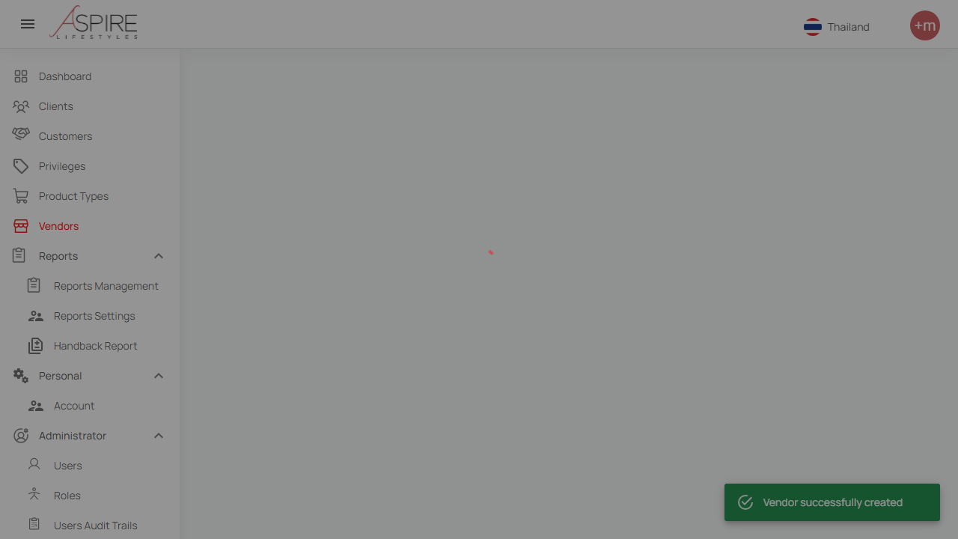
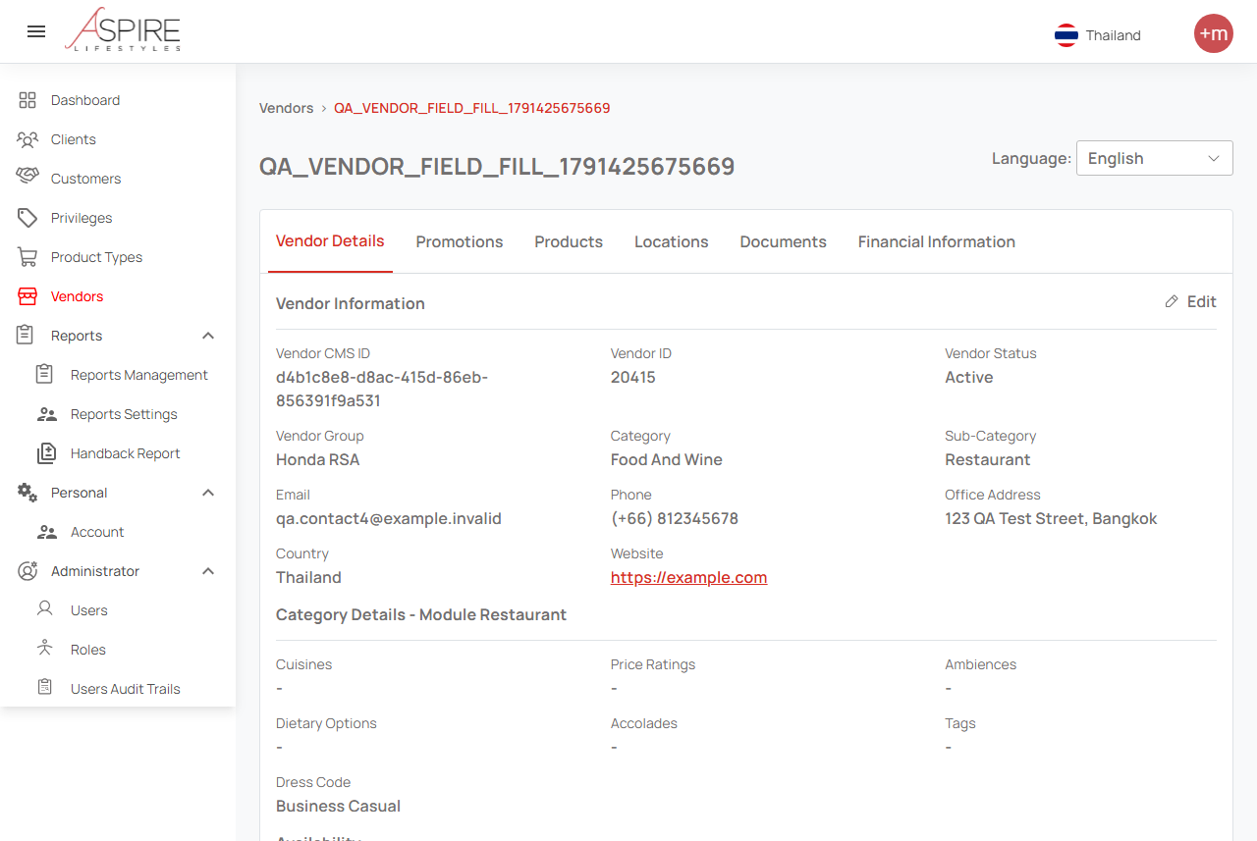
Recommendation and proof
Benefit POC: saved vendor and visible details
Creation confirmation
Vendor details (upper section)
Synthetic vendor 20415 · 19 rendered values matched CMS · full DB comparison pending.
09
Notes:
Saved evidence from 8 October 2026. The left image captures the successful creation toast. The right image shows the upper portion of vendor details. Vendor ID 20415 and CMS item d4b1c8e8-d8ac-415d-86eb-856391f9a531. This demonstrates save, detail display and nineteen CMS-rendered value comparisons. It does not prove every optional field persisted or full database parity.
Sources: https://internationalsos.atlassian.net/wiki/spaces/AD/pages/6896287838
POC supporting evidence: https://internationalsos.atlassian.net/wiki/spaces/AD/pages/6896156677

Slide 12
Recommendation and proof
The POC shows progress and specific next actions
Observed gap | Action | Why it matters
RSA account / identity skips | Provide approved test accounts | Run role and sign-in journeys
Missing job fixtures | Create controlled test records | Repeat the same expected journey
Full DB / CMS comparison pending | Restore access and finish the check | Prove persistence as well as display
AI-generated assumptions | QA reviews expected outcomes | Avoid accepting a misleading pass
Resolve prerequisites, then expand the accepted test pack.
10
Notes:
A successful UI/CMS comparison is narrower than full end-to-end integration proof. Some earlier Benefit assumptions about disabled fields were corrected by selecting Thailand at the top right, English and reloading. Access expiry prevented completion of the corrected full DB comparison.
Sources: https://internationalsos.atlassian.net/wiki/spaces/AD/pages/6896287838
POC supporting evidence: https://internationalsos.atlassian.net/wiki/spaces/AD/pages/6896156677

Slide 13
Completed automation
Coverage needs a confirmed baseline
Reported RSA catalogue: 449 business cases
345 implemented (76.8%) • 104 Cannot fully cover with automation
Not every test case can be fully automated - Aspire Digital - Confluence
11

Slide 14
Completed automation
Separate cases, executable tests and results
Measure | Recorded value | What it means
RSA business cases | 61 implemented / 449 catalogue | Reported business scope
RSA executable tests | 71: 57 passed + 14 skipped | Reported run; not rerun here
Local RSA workshop run | 6 passed; 13 tests listed | Saved subset, not full-pack proof
Benefit focused run | 2 passed; 19 value checks | Vendor check + login setup
Report completed business scope and passing execution separately.
12

Slide 15
Completed automation
The 14 reported skips have concrete prerequisites
Reason | Tests | What enables execution
Role accounts | 9 | Approved accounts with the required roles
Identity sign-in | 2 | Test identities for the sign-in service
Signed authentication | 1 | Valid signed authentication fixture
Job records | 2 | Controlled job data for the scenarios
A missing prerequisite does not establish that a scenario cannot be automated.
13
Notes:
=

Slide 16
Automation boundaries
Fully automate the digital checks we can observe
Scenario | Automation scope | Prerequisite
Web forms and rules | Input, validation, save and details | Agreed expected outcomes
Role-based journeys | Sign in and verify permitted actions | Approved role accounts
Assigned jobs | Verify digital assignment and status | Controlled job records
DB / CMS consistency | Compare defined persisted / shown values | Access and agreed field mapping
Full automation is possible within a defined digital scope and available access.
14
Notes:
F

Slide 17
Automation boundaries
Some journeys need automated and human evidence
Journey | Automated part | Remaining proof
Notifications | Request, callback or controlled inbox | Actual external delivery when uncontrolled
Third-party fulfilment | Request and returned status | External service completion
Roadside assistance | Assignment and digital status updates | Physical arrival and towing
Label these journeys as partial when the external outcome is not verified.
15

Slide 18
Automation boundaries
Not every test case can be fully automated
Scenario | Example from our test list | Why a person is still needed
Okta SSO login | Sign in through Okta (TC-01-007) | One-time code (OTP); Okta gives no test mock
Real SMS delivery | Send SMS via ClickNext (TC-12-012) | Must arrive on a real phone
Push to provider app | Dispatch job to driver (TC-04-025) | Job-list API tested; web + phone not joined
Live GPS tracking | Truck trail on the map (TC-08-002) | Needs trucks actually moving
Time-based rules | Job past agreed service time (TC-09-004) | Must wait real time or fake the dates
Forced failures | CMS outage (TC-10-009) | Must break a live service on purpose
Human judgement | Control-room alert sound (TC-09-016) | A person judges if agents notice it
102 of 449 cases are partly automatable; a person checks what a machine cannot.
21

Slide 19
Automation boundaries
Human judgement: what a machine cannot see
Where in the app | What the machine checks | What a person judges
Monitor alert sound (TC-09-016) | Sound plays without an error | Loud enough for the control room?
Failed SMS in the SMS log (TC-12-003) | Failed rows have a colour or label | Can staff spot it and retry?
Unread provider message (TC-09-009) | Unread rows are marked differently | Does an agent notice no reply?
Overdue task on a job (TC-07-005) | A highlight colour is shown | Obvious enough to act on?
Truck stops sending location (TC-11-006) | A warning icon is shown | Does someone notice it is lost?
Job detail PDF (TC-13-021) | File downloads with the job number | Readable and fit to send a client?
Keyboard-only use (TC-22-024) | Tab key reaches every control | Can you always see where you are?
The machine checks it is there; a person checks it is noticed and usable.
22

Slide 20
Automation boundaries
Keep human judgement explicit
Human check | Why it remains | How to report it
Usability and clarity | Requires judgement about the experience | Manual acceptance alongside digital tests
Human approval / protected MFA | Depends on a person or protected challenge | Approved test path, otherwise manual step
Physical service acceptance | Outside the observable web workflow | Attach operational confirmation
Unassessed cases | Scope has not yet been reviewed | Classify before declaring impossible
Classify each remaining case: full, partial, prerequisite-blocked or manual.
16

Slide 21
Pipeline plan
Move from local proof to an unattended pilot
Phase | Deliverable | Acceptance evidence
1. Agree the pack | Case list, required count and owner | Approved expected coverage
2. Run after test deployment | Cloud runner with controlled access | Actual hosted run and report link
3. Stabilise the pilot | Repeat runs and failure recovery | Proposed target: 10 unattended runs
4. Expand triggers | Nightly and release checks | Reliable evidence and agreed release gate
Proposed plan: prove one hosted pilot before expanding release controls.
17

Slide 22
Pipeline plan
The local gate rejects incomplete success
Local check | Result | Management meaning
Gate policy self-check | 5 checks passed | Pass / fail / skip / empty / incomplete handled
RSA: 6 passed, 13 expected | Rejected | A green subset cannot stand for the full pack
Benefit: 2 passed, 2 expected | Accepted | Saved focused pack met its required count
Hosted cloud pipeline | Not demonstrated | Infrastructure proof still needed
Local gate proof is complete; hosted execution is the next evidence milestone.
18

Slide 23
Pipeline plan
The pilot needs an owner and evidence of recovery
Need | Owner / proof to agree
Accounts, data and network | Approved test access; predictable data and cleanup
Secure evidence storage | Restricted reports, screenshots, traces and videos
Hosted success | Run ID and accessible results for the complete pack
Hosted failure and recovery | Deliberate failure blocks the gate; corrected rerun passes
Use these checks to decide when the pipeline is ready for release use.
19

Slide 24
Decision requested
For approval: Playwright + Claude Code
Tool | What it does for us | Cost
Playwright | Clicks through the website like a user | Free (open source)
Claude Team (AI) | Writes and fixes tests; built 71 already | Min: USD 20 per person / month
Build pipeline | Runs every test on each release | Existing; no new tool
QA team | Reviews results; does the manual checks | Existing staff
We ask approval for Claude Team seats and Playwright as our test standard.
26

Slide 25
Decision requested
Company plans: same price, Claude delivers more
Plan option | Claude (Claude Code) | ChatGPT (Codex)
Team plan, standard | USD 20 / person / month | USD 20 / person / month
Team plan, premium | USD 100 · available now | USD 100 · waitlist only
Enterprise plan | USD 20 + pay per use · 20+ people | Price on request · ~150 people
Minimum team | 2 people | 2 people
Prices billed annually (USD 25 if monthly). Our choice: Claude Team plan.
25

Slide 26
Tokens and usage limits
Same USD 20, Claude gets more work done
What we compared | Claude Team | ChatGPT Business
Standard seat: allowance every 5 hours | 1.25 × the personal plan | 1 × the personal plan (same as Plus)
Premium seat (USD 100) | 6.25 × the personal plan | Not published yet
AI text written per test (our trial) | about 3,800 tokens | about 64,000 tokens
Weekly allowance used (our trial) | Not measured | 51% of the week for 2 tests
A token is the AI’s “mobile data”, about ¾ of a word. Every seat has a weekly limit.
26

Slide 27
Decision and next steps
The management decision and next steps
Decision | Next action
Web execution: Playwright | Use complete workflows and reportable evidence
Claude Code: primary author | Confirm with a matched-task trial; Codex for focused checks
Coverage | Approve one inventory; resolve the 300 / 400 discrepancy
Pipeline investment | Assign a pilot owner and prove unattended execution
Proceed with a controlled web pilot and publish only evidenced results.
20

