Slide 1
APAC ASPIRE DIGITAL
Web QA Automation
POC evidence and Analysis
RSA and Benefit · Web testing
Management briefing · October 2026

Slide 2
Why Playwright
Why Playwright: fits our journeys, free to use
What we need | Playwright | Selenium | Cypress
Follow full journeys across pages and popups | Built in | Possible; more setup | Weak across tabs and popups
See where a failed test broke | Report with step-by-step replay | Needs extra reporting tools | Interactive debugging
Fewer false failures | Waits for screens automatically | Waiting rules written by hand | Built-in retry
Check saved data against the CMS | Screen and data checks in one test | Needs extra libraries | Possible
Licence cost | Free (Apache 2.0) | Free (Apache 2.0) | Free core (MIT)
Free licence; the real costs are pipeline time, AI seats and QA review.
05

Slide 3
How we use AI
How AI helps us build tests, step by step
Step | Who does it | What comes out
1. Pick a case from the 449-case list | QA | The case and its expected result
2. Write the Playwright test | AI (Claude Code) | Test code in a few minutes
3. Run it and fix any failure | AI, checked by a developer | A test that passes for the right reason
4. Review and approve | QA | Only approved tests join the pack
5. Run at every release | Build pipeline (no AI) | Report with screenshots of any failure
AI writes and fixes the tests; people decide what is tested and what counts as a pass.
06

Slide 4
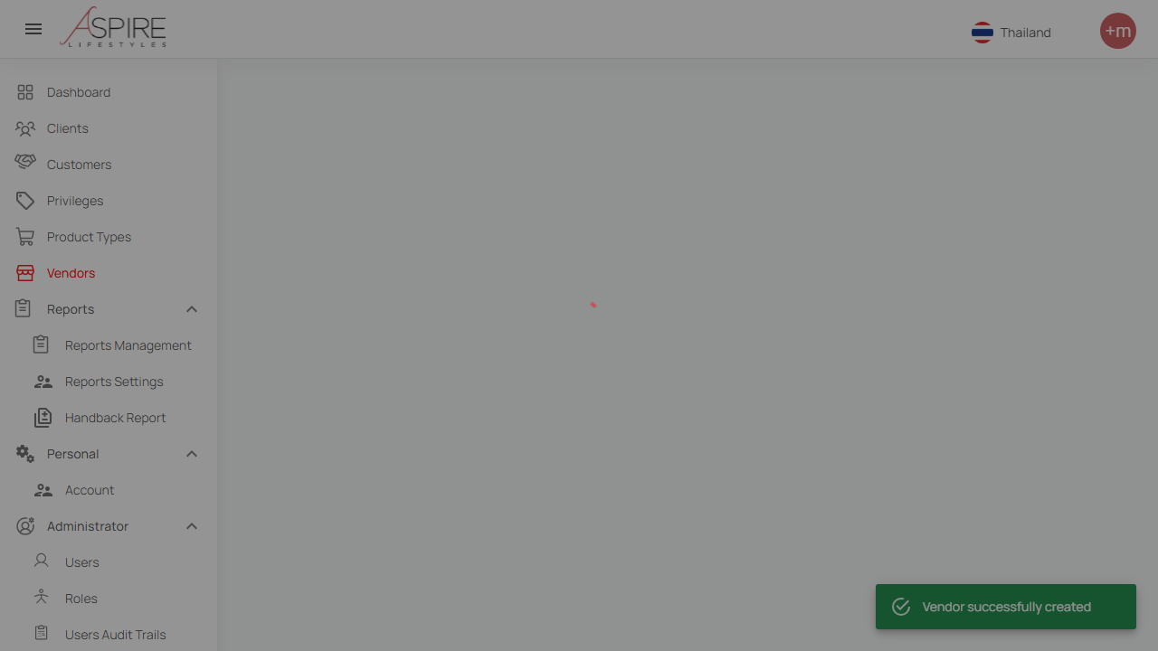
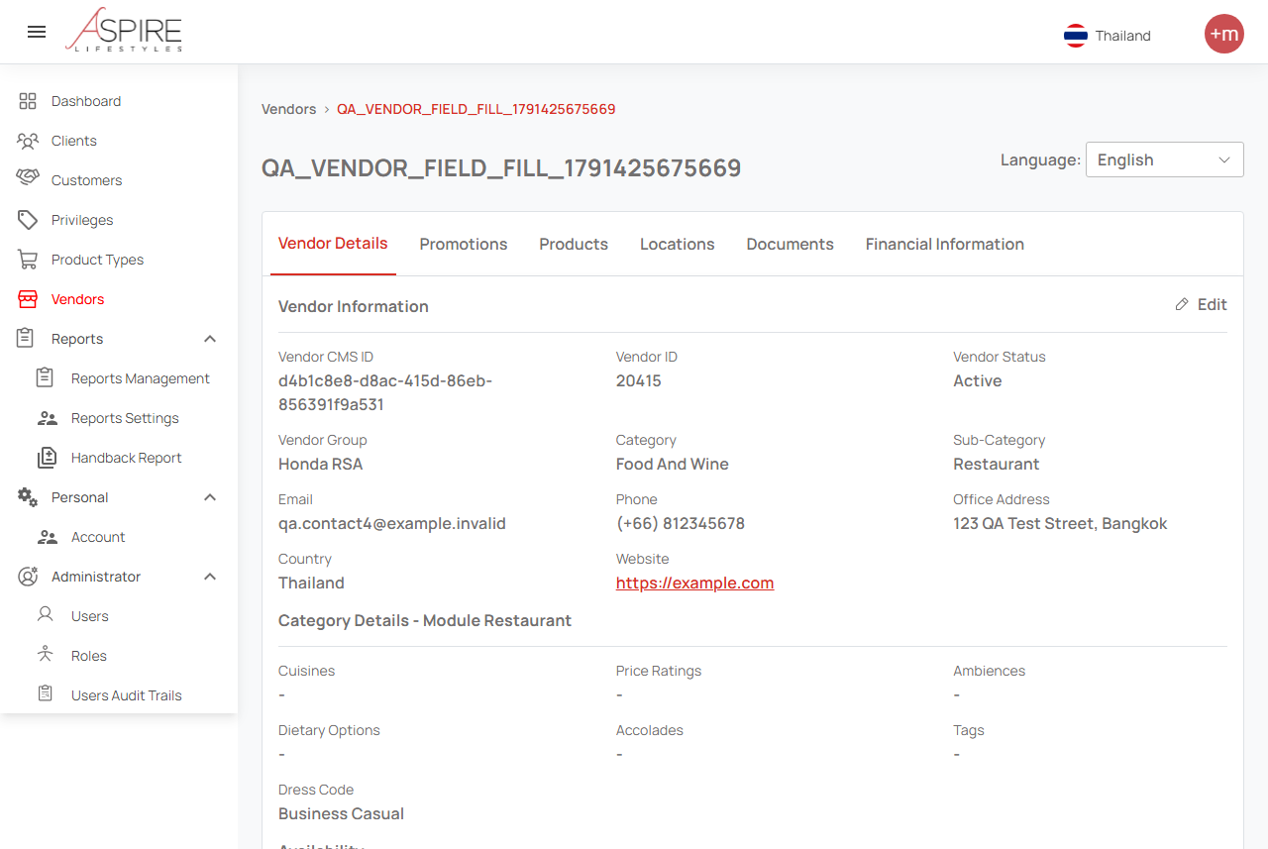
Trial proof
Trial: a robot created a vendor and checked it
1. Fills in the form and saves
2. Checks the saved details on screen
Test vendor 20415: saved, then 19 on-screen values matched the content system (CMS).
07
Notes:
Saved evidence from 8 October 2026. The left image captures the successful creation toast. The right image shows the upper portion of vendor details. Vendor ID 20415 and CMS item d4b1c8e8-d8ac-415d-86eb-856391f9a531. This demonstrates save, detail display and nineteen CMS-rendered value comparisons. It does not prove every optional field persisted or full database parity.
Sources: https://internationalsos.atlassian.net/wiki/spaces/AD/pages/6896287838
POC supporting evidence: https://internationalsos.atlassian.net/wiki/spaces/AD/pages/6896156677

Slide 5
What we test
449 RoadSide test cases: 347 can be fully automated
Every case in our full regression list, reviewed one by one
347 run fully by machine (77%) • 102 need a person for one step
Not every test case can be fully automated - Aspire Digital - Confluence
02

Slide 6
Automation boundaries
Not every test case can be fully automated
Scenario | Example from our test list | Why a person is still needed
Okta SSO login | Sign in through Okta (TC-01-007) | One-time code (OTP); Okta gives no test mock
Real SMS delivery | Send SMS via ClickNext (TC-12-012) | Must arrive on a real phone
Push to provider app | Dispatch job to driver (TC-04-025) | Job-list API tested; web + phone not joined
Live GPS tracking | Truck trail on the map (TC-08-002) | Needs trucks actually moving
Time-based rules | Job past agreed service time (TC-09-004) | Must wait real time or fake the dates
Forced failures | CMS outage (TC-10-009) | Must break a live service on purpose
Human judgement | Control-room alert sound (TC-09-016) | A person judges if agents notice it
102 of 449 cases are partly automatable; a person checks what a machine cannot.
03

Slide 7
Automation boundaries
Human judgement: what a machine cannot see
Where in the app | What the machine checks | What a person judges
Monitor alert sound (TC-09-016) | Sound plays without an error | Loud enough for the control room?
Failed SMS in the SMS log (TC-12-003) | Failed rows have a colour or label | Can staff spot it and retry?
Unread provider message (TC-09-009) | Unread rows are marked differently | Does an agent notice no reply?
Overdue task on a job (TC-07-005) | A highlight colour is shown | Obvious enough to act on?
Truck stops sending location (TC-11-006) | A warning icon is shown | Does someone notice it is lost?
Job detail PDF (TC-13-021) | File downloads with the job number | Readable and fit to send a client?
Keyboard-only use (TC-22-024) | Tab key reaches every control | Can you always see where you are?
The machine checks it is there; a person checks it is noticed and usable.
04

Slide 8
Our AI choice
Claude Code or Codex: why we chose Claude Code
What matters to us | Claude Code | Codex
Writes and runs tests on our laptops | Yes | Yes
Our Jira-to-release AI workflow | Already built on it | Would need rebuilding
Setup on our Windows laptops | Worked as is | Needed extra fixes
Usage per USD 20 seat | 1.25 × the personal plan | 1 × the personal plan
Heavy-user seat (USD 100) | Available now | Waitlist only
Both can do the job; Claude Code fits our team today. Our two trials had different tasks.
08

Slide 9
AI cost
Company plans: the same price per person
Plan option | Claude Team | ChatGPT Business
Standard seat | USD 20 / person / month | USD 20 / person / month
Premium seat (heavy user) | USD 100 · available now | USD 100 · waitlist only
Enterprise plan | USD 20 + pay per use · 20+ people | Price on request · ~150 people
Minimum team | 2 people | 2 people
Prices billed yearly (USD 25 if monthly). Our choice: Claude Team plan.
09

Slide 10
AI cost
What USD 20 buys: an AI usage allowance
What we compared | Claude Team | ChatGPT Business
Standard seat: allowance every 5 hours | 1.25 × the personal plan | 1 × the personal plan (same as Plus)
Premium seat (USD 100) | 6.25 × the personal plan | Not published yet
When the allowance runs out | Wait for the refill, or buy extra | Wait for the refill, or buy extra
Running tests in the pipeline | Uses no AI allowance | Uses no AI allowance
A token is the AI’s “mobile data” (about ¾ of a word). Only writing tests uses it.
10

Slide 11
Build pipeline
When the tests run: once per release
When | Our plan | Why
Every code change (PR) | No | A full run takes about 1–2 hours; pipeline time is billed per minute
Every day (nightly) | No | Pays for runs when nothing has changed
Each release | Yes: the full test pack | One run gives the evidence to approve the release
AI cost per run | None | Playwright runs the tests; AI only writes and fixes them
Expectation: one full run per release; the cost is pipeline minutes, not AI.
11

Slide 12
Decision requested
For approval: Playwright + Claude Code
Tool | What it does for us | Cost
Playwright | Clicks through the website like a user | Free (open source)
Claude Team (AI) | Writes and fixes the tests for us | Min: USD 20 per person / month
Build pipeline | Runs the full test pack once per release | Existing; no new tool
QA team | Reviews results; does the manual checks | Existing staff
We ask approval for Claude Team seats and Playwright as our test standard.
13

