Slide 1
One test, two screens: a RoadSide job from the agent portal to the driver's phone
ROADSIDE AUTOMATION TESTING
How TC-23-001 tests the whole job end to end - web and provider app together, recorded as one video
APAC Aspire Digital | 21 October 2026 | measured on RSA UAT, 20 Oct 2026 run
Notes:
One automated test now covers a roadside job from the moment the agent creates it on the portal until the driver finishes it on the phone and the portal shows it closed. This deck shows how it works and what it covers.

Slide 2
One automated run now tests the whole job hand-off
PASS
9
4.5 min
1 video
TC-23-001 on 20 Oct 2026, job 26JB049153
steps across web and app, one pass/fail
test time for the full job
portal left, phone right, same run
What it proves
A job created and dispatched on the agent portal reaches a real provider app, is taken, travelled to, arrived at, photographed and finished - and the portal shows every one of those events, stamped by the right truck.
Before this, web and app were tested separately. The hand-off between them - where real jobs get stuck - had no automated check.
Notes:
Four numbers to remember. It passed on 20 October against UAT. Nine steps that alternate between the portal and the phone. About four and a half minutes. And one side-by-side video anyone can watch without reading code.

Slide 3
Why test them together: a job is never only web or only app
WEB
RSA server
APP
Agent portal
api/pmws/* - offers the job to trucks nearby, stores every status
Provider app
Create job, Load Provider, Dispatch
Take job, drive, Arrive, mileage, photo, Finish
Where jobs get stuck in real life - and what a web-only or app-only test cannot see
Job never reaches the truck
Status does not come back
Data lost on the way
Wrong location, truck not Ready, outside the service area, polling broken.
Driver taps Take Job / Arrived / Finish, but the portal never shows it.
Mileage, photo or the driver's GPS position missing on the job.
Notes:
The agent creates and dispatches on the portal; the driver does the rest on the phone; the server sits in between. Each side can pass its own tests and the job can still get stuck in the middle. That middle is what this test covers.

Slide 4
The journey: nine steps, alternating between portal and phone
1
APP
Driver signed in, truck v3036 chosen, Ready = On
15.3 s
One runner
2
WEB
Agent creates a Basic Repair job at the incident address
11.5 s
All nine steps are one Playwright test. It drives the browser and, in the same test, the phone through Appium.
If any step fails, the whole test fails - with the video and trace showing exactly where.
No agent close step: Finish in the app closes the job.
3
WEB
Load Provider, pick truck v3036, Dispatch
6.6 s
4
APP
Job card appears without refresh, 9.70 km away; Take Job
13.4 s
5
APP
Truck drives ~5 km by road to the customer (GPS points)
50.8 s
6
APP
Arrive at destination, enter odometer 48215
5.1 s
7
APP
Take a photo with the camera, upload
36.5 s
8
APP
Finish job
9.8 s
9
WEB
Job is CLOSED, timestamps stamped by the truck
10.1 s
Notes:
Times are from the 20 October run as shown in the Playwright report. The drive and the photo take longest because they are real: the GPS moves along the road and the camera actually captures and uploads.

Slide 5
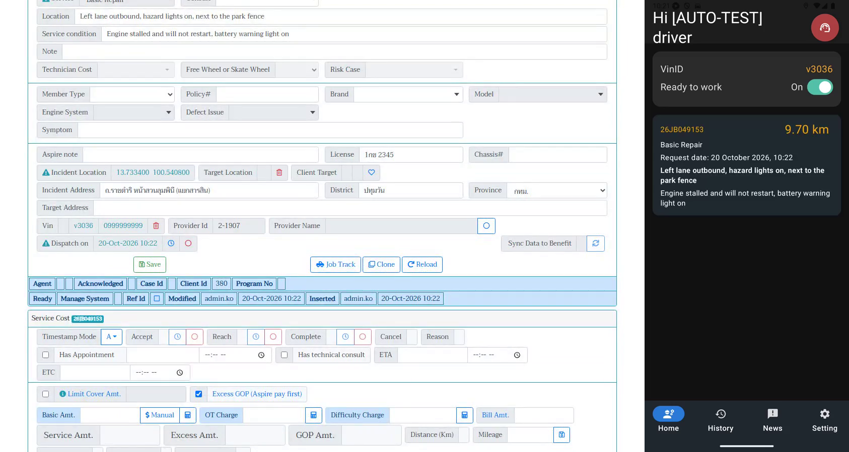
Dispatch on the portal: the job reaches the phone in seconds
1
Portal: job 26JB049153
Real Thai incident address, district, province; truck v3036 assigned and dispatched at 10:22.
2
Phone: job card, 9.70 km
The app polls the server while Ready. The job shows up without any tap, with the same job number.
3
Checked automatically
Same job number on both sides; distance on the card is more than 2 km (a real trip, not 0 km).
Notes:
A frame from the recorded video. Left is the agent portal right after dispatch; right is the phone a few seconds later. The test reads the job number on both and compares them.

Slide 6
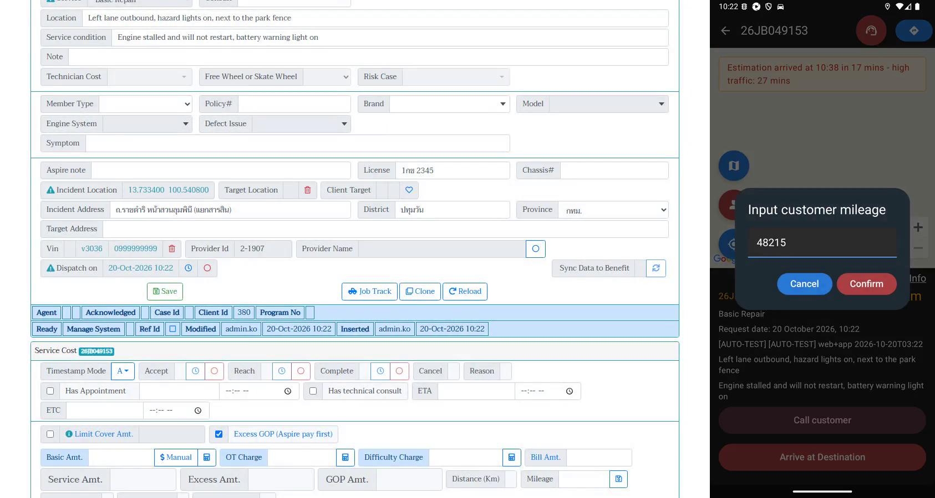
On the phone: drive, arrive, record mileage, like a real driver
1
Truck moves by road
Emulator GPS steps every ~150 m from Victory Monument through Phaya Thai and Ratchaprasong to the customer.
2
Arrive + mileage 48215
The app asks for the odometer; the test types it and confirms, exactly as a driver taps.
3
Then photo and Finish
Emulator camera takes a real photo, it uploads, and the driver finishes the job.
Notes:
The app is the real installed UAT build, not a mock. Appium taps the same buttons a driver would. GPS is simulated along a real road route, so the ETA and distance the app shows are real Google directions.

Slide 7
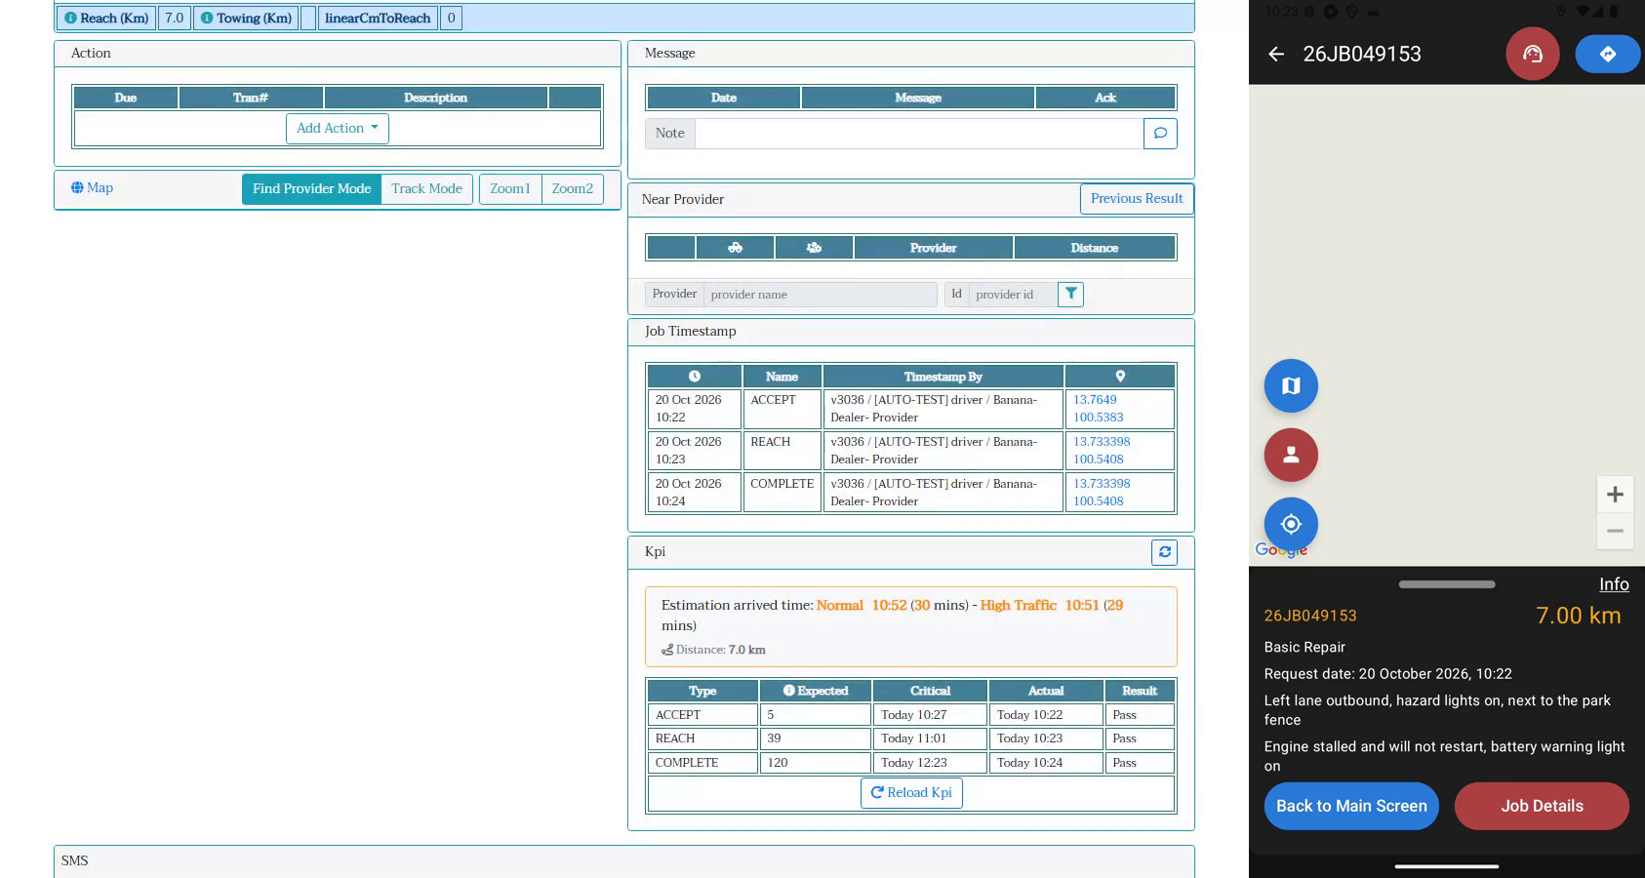
Back on the portal: every driver action is there, stamped by the truck
1
ACCEPT: ~5 km away
GPS 13.7649, 100.5383 - where the truck really was when it took the job, not on top of the customer.
2
REACH + COMPLETE
At the customer point. Truck v3036 and the driver name on each row; status CLOSED.
3
KPI: Pass on all three
Accept, Reach and Complete within the expected times; reach distance 7.0 km.
Notes:
This is the proof the hand-off worked in both directions. The portal shows three timestamps, each written by the truck, with the GPS position at that moment. The test checks the order of the timestamps, the mileage, the photo count and the closed status.

Slide 8
Under the hood: one Playwright test drives the browser and the phone
TC-23-001.spec.ts - one test, one report, one pass/fail
Playwright
Agent portal
RSA server
Assertions
WEB
Chromium, records web video + trace
roadside-uat, page objects JobPage.ts
job, dispatch, read job model
status, timestamps, mileage, photo
WebdriverIO
Appium 2
Android emulator
RSA server
APP
remote() session in the same test
UiAutomator2, taps by test ids
UAT app, GPS route, camera
api/pmws: whenready, job/{id}
Test ids in the app
ffmpeg side-by-side
Self-healing setup
The app ships ~229 ids; tests click by id, not by screen position or text, so Thai/English and layout changes do not break them.
Web video and phone recording are joined into one MP4 after the run. Nothing to install.
If the truck is not Ready, not bound, or holds a job from an aborted run, the test fixes it first.
Notes:
Both lanes are inside one test function. Playwright owns the browser. In the same test, WebdriverIO opens an Appium session to the Android emulator running the real UAT app. Both talk to the same RSA UAT server, so what one does, the other must see.

Slide 9
Made to look like a real call, not a lab shortcut
Before | Now (20 Oct run)
Truck GPS set on the incident point: distance 0 km | Truck starts ~5 km away at Victory Monument
Phone teleports to the customer | Drives the road route, a GPS point every ~150 m
Placeholder customer details | Thai address, district, province, licence plate, location note, service condition
Odometer 12345 | Odometer 48215
Distance not checked | Card shows 9.70 km, web distanceKm 7 - both asserted > 2 km
The server rule we test against
The app does not get a push. While Ready, it asks the server every few seconds: "any job for me here?" (whenready).
The server offers a job only if the truck is within the service area (10 km in the first minute, then 20 km), measured by Google road distance - or if the agent dispatched to that exact truck.
So the test places the truck inside that area but far enough to be a real trip.
Notes:
The first version put the phone exactly on the incident point, so the distance was zero and it did not look like a real job. Now the truck starts five kilometres away and drives there, and the test checks the distance on both sides.

Slide 10
What is checked at each hand-off
Hand-off | Driver does (app) | Portal / server must show (web)
Dispatch → phone | Job card appears, same job number | Truck VIN on the job, dtRequest set
Take job | Taps Take Job (ACCEPT) | dtAccept; timestamp row with truck + GPS
Travel | GPS moves along the road | distanceKm > 2; card distance > 2 km
Arrive | Arrive + odometer 48215 (REACH) | dtReach; mileage = 48215
Photo | Camera photo, upload | nPhoto = 1
Finish | Finish job (COMPLETE) | Status CLOSED; dtRequest < dtAccept < dtReach < dtComplete
The web checks read the job straight from the portal's own data, so they prove what an agent would see - not just what the app thinks it sent.
Notes:
Every row is an assertion in the test. Left is what the driver does, right is what must appear on the portal. If the app says it sent REACH but the portal has no dtReach, the test fails.

Slide 11
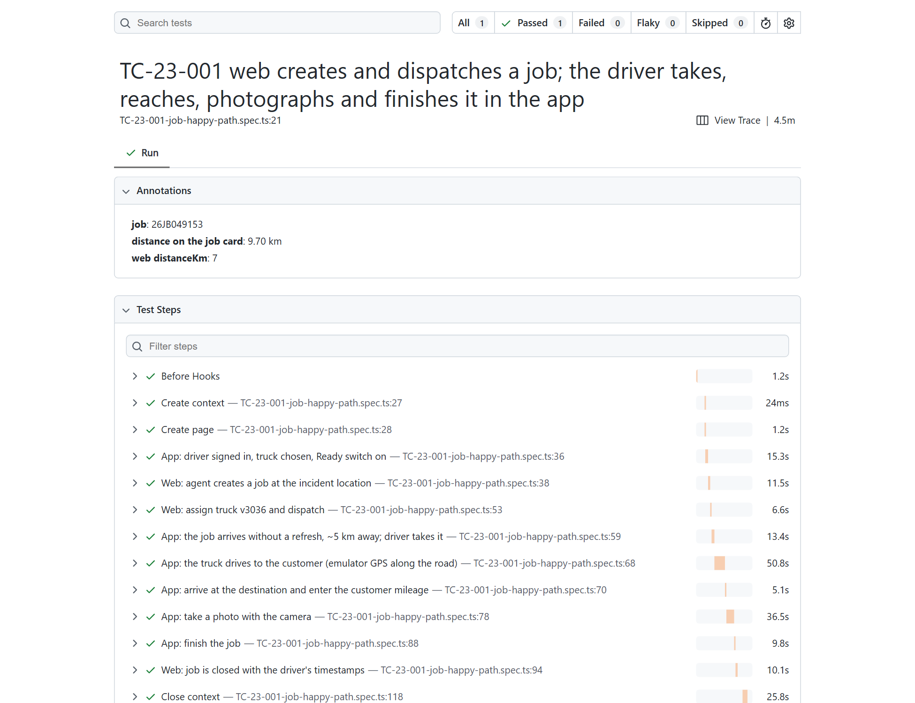
Evidence from every run: a report developers can open and replay
Playwright HTML report
Every step with pass/fail and time; job number and distances as annotations.
Side-by-side video
Portal left, phone right, one MP4 - for managers and BAs.
Trace
Every portal click, network call and page snapshot - for developers to replay a failure.
junit.xml
For a CI dashboard later.
Notes:
This is the report from the 20 October run. Developers get it as a zip and open it with npx playwright show-report. Hosting it online: Amplify with a password does not work on company laptops because the browser policy blocks that login box; S3 with CloudFront and a login page is the option if we want a link.

Slide 12
How far it covers today - and what is still open
Covered end to end (automated)
Not covered yet
Create job, dispatch to a truck
Job offered to the app by location; Take Job
Travel, arrive, mileage, photo, finish
Portal shows CLOSED, timestamps, GPS, KPI
Driver rejects / agent cancels (TC-23-002, catalogued)
Towing job (second destination)
Several photos, offline and retry
Real phone: camera hardware, battery saver - manual release check
451
web regression cases catalogued; 347 fully automatable
14
of the 104 partly-automatable web cases need the app or a truck - this runner is how they get done
72
mobile app cases catalogued; 9 automated so far
Notes:
The happy path of a repair job is fully covered. The next most valuable journeys are reject/cancel and towing. The catalogue numbers come from the regression workbooks on Confluence.

Slide 13
Where it runs, what it costs, and what we need decided
Today
Next steps and decisions
Runs on a developer laptop: Android emulator (~4 GB RAM) + Appium + Playwright.
~4.5 min test, ~8.6 min with setup. Each run creates and closes one [AUTO-TEST] job on UAT; never touches PROD.
Depends on shared UAT data: test truck v3036 free, OTP test number valid.
Normal CodeBuild containers cannot run the emulator (no nested virtualisation).
Decide: where it runs before each release - a desktop runner (cheapest), an EC2 nested-virt instance, or a device farm.
Decide: a QA owner for fixed test data on UAT (truck, provider, OTP number).
Build TC-23-002 (reject / cancel) and a towing journey.
Publish the report and video with each release.
App team: login password visible in logcat on the UAT build; photo preview shows "Image not available".
Notes:
The ask: pick where this runs before each release, and give QA ownership of the fixed UAT test data. With those two, the journey can run on every release and the next two journeys can be added.

