Slide 1
CSS
Cascading Style Sheets

Slide 2
CSS3 size unit?
CSS has several different units for expressing a length.
Many CSS properties take "length" values, such as width, margin, padding, font-size, border-width, etc.
Length is a number followed by a length unit, such as 10px, 2em, etc.
A whitespace cannot appear between the number and the unit. However, if the value is 0, the unit can be omitted.
For some CSS properties, negative(-) lengths are allowed.
Notes:
많은 CSS 속성은 width, margin, padding, font-size, border-width 등과 같은 "길이"값을 사용합니다.
길이는 10px, 2em 등과 같은 길이 단위가 뒤에 오는 숫자입니다.
공백은 숫자와 단위 사이에 나타날 수 없습니다. 그러나 값이 0이면 단위를 생략 할 수 있습니다.
일부 CSS 속성의 경우 음수 (-) 길이가 허용됩니다.

Slide 3
Absolute Lengths
The absolute length units are fixed and a length expressed in any of these will appear as exactly that size.
Absolute length units are not recommended for use on screen, because screen sizes vary so much. However, they can be used if the output medium is known, such as for print layout.
Unit | Description
cm | centimeters
mm | millimeters
in | inches (1in = 96px = 2.54cm)
px | pixels (1px = 1/96th of 1in)
pt | points (1pt = 1/72 of 1in)
pc | picas (1pc = 12 pt)
Notes:
절대 길이 단위는 고정되어 있으며이 중 임의의 길이로 표현 된 길이는 정확히 같은 크기로 표시됩니다.
절대 길이 단위는 화면 크기가 너무 다양하기 때문에 화면에서 사용하지 않는 것이 좋습니다. 그러나 프린트 레이아웃과 같이 출력 매체가 알려져있는 경우 사용할 수 있습니다.

Slide 4
Relative Lengths
Relative length units specify a length relative to another length property. Relative length units scales better between different rendering mediums.
Unit | Description
em | Relative to the font-size of the element (2em means 2 times the size of the current font)
ex | Relative to the x-height of the current font (rarely used)
ch | Relative to width of the "0" (zero)
rem | Relative to font-size of the root element
vw | Relative to 1% of the width of the viewport
vh | Relative to 1% of the height of the viewport
vmin | Relative to 1% of viewport's smaller dimension
vmax | Relative to 1% of viewport's larger dimension
% | Relative to the parent element
Notes:
상대 길이 단위는 다른 길이 등록 정보와 관련된 길이를 지정합니다. 상대 길이 단위는 여러 렌더링 매체간에보다 잘 확장됩니다.

Slide 5
Color Property
The color property specifies the color of text.
body { color: red; } h1 { color: #00ff00; }
- HEX code color => Rad Green Blue p.ex { color: rgb(0,0,255); }
HTML Color Picker
https://www.w3schools.com/colors/colors_picker.asp

Slide 6
Background-image Property
The background-image property sets one or more background images for an element.
By default, a background-image is placed at the top-left corner of an element, and repeated both vertically and horizontally.
body { background-image: url("images/bg01.jpeg"); }

Slide 7
Display Property
The display property specifies the display behavior (the type of rendering box) of an element.
#box {display: none;} #box {display: inline;} #box {display: block;} #box {display: inline-block;}
div: block, span: inline
inline: Displays an element as an inline element (like <span>). Any height and width properties will have no effect
inline-block: The element itself is formatted as an inline element, but you can apply height and width values

Slide 8
Visibility Property
The visibility property specifies whether or not an element is visible.
Hidden elements take up space on the page. Use the display property to both hide and remove an element from the document layout!
#box { visibility: visible; } #box { visibility: hidden; }

Slide 9
Box-sizing Property
The CSS box-sizing property allows us to include the padding and border in an element's total width and height.
By default, the width and height of an element is calculated like this:
width + padding + border = actual width of an element
height + padding + border = actual height of an element

Slide 10
Example
.div1 { width: 300px; height: 100px; border: 1px solid blue; } .div2 { width: 300px; height: 100px; padding: 50px; border: 1px solid red; }
This div is smaller (width is 300px and height is 100px).
This div is bigger (width is also 300px and height is 100px).

Slide 11
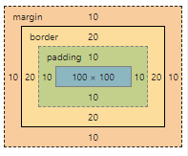
Example
div{
width: 100px; height: 100px;
background-color: red;
border: 20px solid black;
margin: 10px; padding: 10px;
}
<div></div>
Total width size = width + 2 x (margin + border + padding)
Total height size = height + 2 x (margin + border + padding)

Slide 12
Box-sizing Property
Margin
Padding
Example
Margin: 10px 20px 30px 40px;
(top right bottom left)
Margin: 0 30px;
(top/bottom right/left)
Example
padding: 10px 20px 30px 40px;
(top right bottom left)
padding: 0 30px;
(top/bottom right/left)

Slide 13
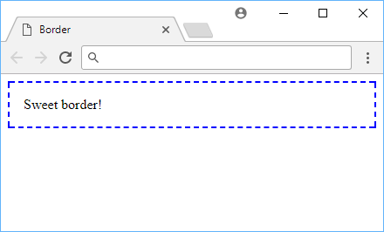
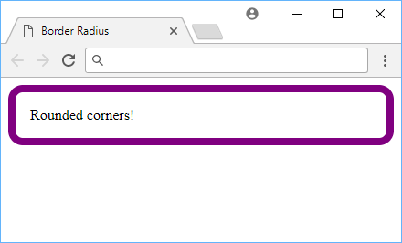
Box-sizing Property
Border style
Border Radius
solid
dotted
dashed
double
inset
outset
groove
ridge
Example
Border-radius: 50px 40px 20px 10px;
(left-top right-top right-bottom left-bottom)
1
2
4
3

Slide 14
Background-image Property
Example
background-image: url("photographer.jpg"); /* The image used */ background-color: #cccccc; /* Used if the image is unavailable */ height: 500px; /* You must set a specified height */ background-position: center; /* Center the image */ background-repeat: no-repeat; /* Do not repeat the image */ background-size: cover; /* Resize the background image to cover the entire container */
Example
background-image: url('backgroundFront.png’), url('backgroundBack.png');
background-size: 50% 250px;
(width height)

Slide 15
Font Property
Font-size
Font-family
Example
.a { font-size: 15px; } .b { font-size: large; } .c { font-size: 150%; } .d { font-size: 2em; }
<div class="a">This is some text.</div>
<div class="b">This is some text.</div>
<div class="c">This is some text.</div>
<div class=“d">This is some text.</div>
.a {font-family: ’Times New Roman’, Times, serif;} .b {font-family: Arial, Helvetica, sans-serif;}
The font-family property specifies the font for an element.
If the browser does not support the first font, it tries the next font.
Separate each value with a comma.
If a font name contains white-space, it must be quoted. Single quotes must be used when using the "style" attribute in HTML.

Slide 16
Font Property
Font-style
Example
p.a { font-style: normal; } p.b { font-style: italic; } p.c { font-style: oblique; }
<p class="a">This is a paragraph, normal.</p>
<p class="b">This is a paragraph, italic.</p>
<p class="c">This is a paragraph, oblique.</p>
Value | Description
normal | The browser displays a normal font style. This is default
italic | The browser displays an italic font style
oblique | The browser displays an oblique font style
initial | Sets this property to its default value.
inherit | Inherits this property from its parent element.

Slide 17
Font Property
Font-weight
Line-height
Example
p.normal {font-weight: normal;} p.light {font-weight: lighter;} p.thick {font-weight: bold;} p.thicker {font-weight: 900;}
(100 ~ 900 : 400 is the same as normal, and 700 is the same as bold)
<p class="normal">This is a paragraph.</p>
<p class="light">This is a paragraph.</p>
<p class="thick">This is a paragraph.</p>
<p class="thicker">This is a paragraph.</p>
Example
div.a {line-height: normal;} div.b {line-height: 1.6;} div.c {line-height: 80%;} div.d {line-height: 200%;}
The line-height property specifies the height of a line.
Negative values are not allowed.

Slide 18
Font Property
Text-align
Text-decoration
div.a {text-align: center;} div.b {text-align: left;} div.c {text-align: right;} div.c {text-align: justify;}
Left: Aligns the text to the left
Right: Aligns the text to the right
Center: Centers the text
Justify: Stretches the lines so that each line has equal width (like in newspapers and magazines)
Initial: Sets this property to its default value.
Inherit: Inherits this property from its parent element.
h1 {text-decoration: overline;} h2 {text-decoration: line-through;} h3 {text-decoration: underline;} h3 {text-decoration: underline overline;}
<h1>This is heading 1</h1>
<h2>This is heading 2</h2>
<h3>This is heading 3</h3>
<h4>This is heading 4</h4>

Slide 19
Position Property
position: static
position: relative
static is the default value and not affected by the top, bottom, left, and right properties.
z-index
The z-index property specifies the stack order of an element.
An element with greater stack order is always in front of an element with a lower stack order.
z-index only works on positioned elements (absolute, relative, fixed).
relative behaves the same as static unless you add some extra properties.
Setting the top, right, bottom, and left properties of a relatively-positioned element will cause it to be adjusted away from its normal position.

Slide 20
Position Property
position: fixed
position: absolute
A fixed element is positioned relative to the viewport, which means it always stays in the same place even if the page is scrolled. The top, right, bottom, and left properties are used to position the element.
absolute behaves like fixed except relative to the nearest positioned ancestor instead of relative to the viewport.
If an absolutely-positioned element has no positioned ancestors, it uses the document body, and still moves along with page scrolling.

Slide 21
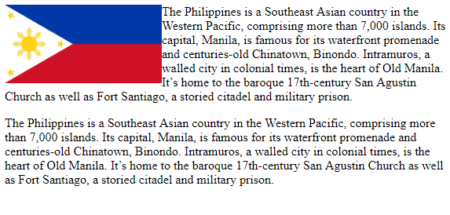
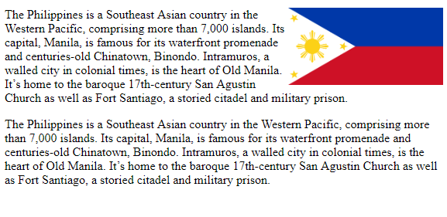
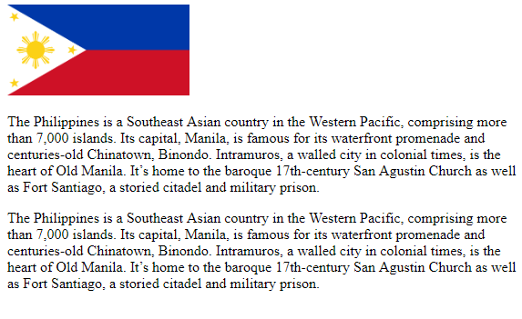
Float Property
The float property specifies how an element should float.
Absolutely positioned elements ignores the float property!
Let an image float to the right
img { float: left; }
Let an image float to the left
img { float: right; }
Let image be displayed just where it occurs in the text (float: none)
img { float: none; }

Slide 22
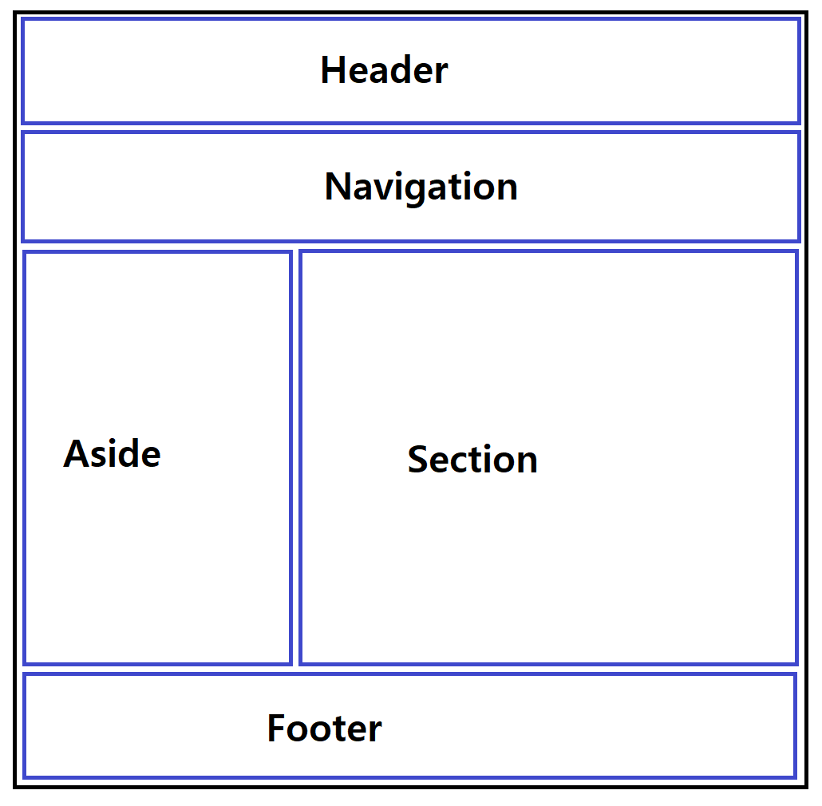
Float Layout
<style>
/* body tag -> align center */
body { width: 960px; margin: 0 auto; }
#aside{ width: 200px; float: left; }
#section { width: 760px; float: left; }
#wrap { overflow: hidden; }
</style>
<div id="header">Header</div>
<div id="navigation">Navigation</div>
<div id="wrap">
<div id="aside">
<h1>Aside</h1>
<p>Aside test Aside test </p>
</div>
<div id="section">
<h1>Section</h1>
<p>Section test Section test </p>
</div>
</div>
<div id="footer">
<h1>Footer</h1>
</div>

Slide 23
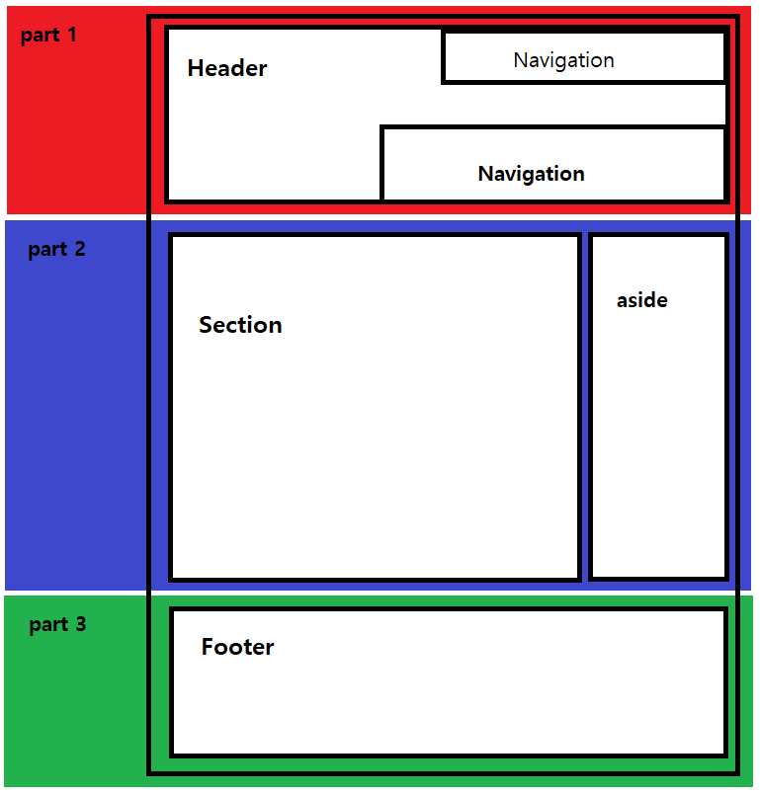
Layout sample
<body>
<header>
<nav></nav>
<nav></nav>
</header>
<div id="content">
<section></section>
<aside></aside>
</div>
<footer></footer>
</body>

