Slide 1

Marvin Arcilla

Slide 2
What we will learn today
Why use Node.js?
Callback Concept
Node.js File-Based Module System (require, exports)
Event Emitters
Common Core Modules

Slide 3
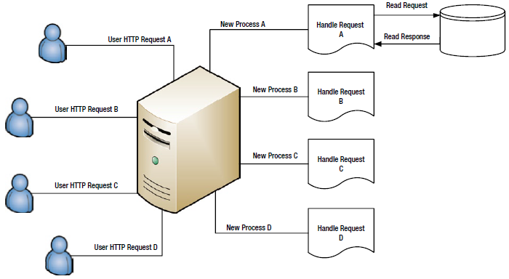
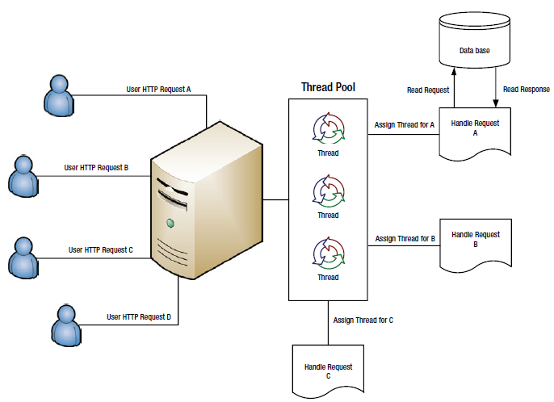
Why use Node.js
Better performance than traditional servers
Node.js performance secret is because of JS language properties
At the heart of Node.js there is an event loop
Notes:
and is highly performant, and it uses JavaScript because JavaScript supports first-class functions and closures
<number>

Slide 4
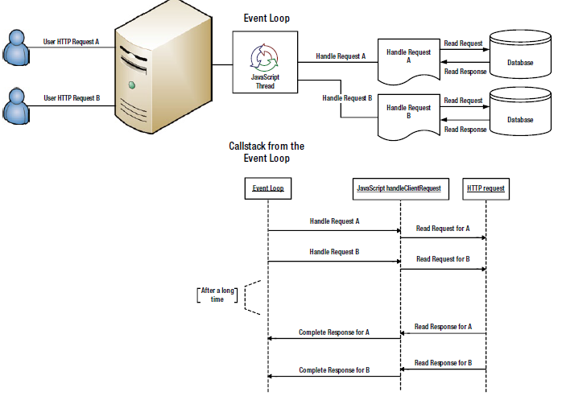
Why use Node.js
Notes:
<number>

Slide 5
Why use Node.js
Sample Performance
function longRunningOperation(callback) {
// simulate a 3 second operation
setTimeout(callback, 3000);
}
function webRequest(request) {
console.log('starting a long operation for request:', request.id);
longRunningOperation(function () {
console.log('ending a long operation for request:', request.id);
});
}
// simulate a web request
webRequest({ id: 1 });
// simulate a second web request
webRequest({ id: 2 });
Notes:
because of closures, we have access to the correct user request after the long-running operation
completes. We just handled two requests on a single thread without breaking a sweat.
<number>

Slide 6
Why use Node.js
One lesson here is that Node.js is not the best option if you have a high CPU task
console.time('timeit');
function fibonacci(n) {
if (n < 2)
return 1;
else
return fibonacci(n - 2) + fibonacci(n - 1);
}
fibonacci(44); // modify this number based on your system performance
console.timeEnd('timeit');
Notes:
Since JS is single threaded, it sucky suck sucks with high cpu task
and this tasks should be done by other components like database servers
<number>

Slide 7
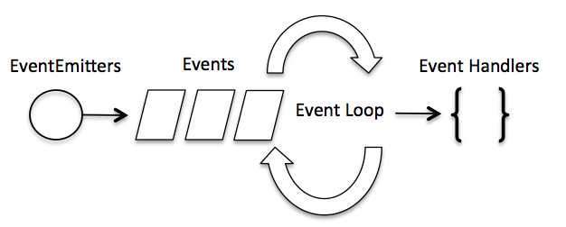
Event Emitters
// Import events module
var events = require('events');
// Create an eventEmitter object
var eventEmitter = new events.EventEmitter();
// Bind event and even handler as follows
eventEmitter.on('eventName', eventHandler);
// Fire an event
eventEmitter.emit('eventName');
Notes:
Since JS is single threaded, it sucky suck sucks with high cpu task
and this tasks should be done by other components like database servers
<number>

Slide 8
Node.js File-Based Module System
• Each file is its own module.
• Each file has access to the current module definition using the module variable.
• The export of the current module is determined by the module.exports variable.
• To import a module, use the globally available require function.
Notes:
<number>

Slide 9
Node.js File-Based Module System
Three kinds of Modules:
Core Module - native modules, can be found in lib/
i.e. path, fs, http
File Module - modules that you created
- omit .js extension
Node Module - modules inside “node_modules”
Notes:
Deal with node modules later
<number>

Slide 10
Node.js Exports
By default all module exports an empty object if not set
module.exports = { }
Aliasing exports cause it is quite cumbersome
module.exports = {
a:dummyFunction,
b:somefunction
}
module.exports.a=dummyFunction;
module.exports.b=somefunction;
Better yet
exports.a=dummyFunction;
exports.b=someFunction;
Notes:
<number>

Slide 11
Node.js Require
“require” function – main way of importing a module into a file
– doesn’t pollute the global scope
Blocks the thread until the module has been loaded
// Blocks execution till module is loaded
var foo = require('./foo');
// Continue execution after it is loaded
console.log('loaded foo');
foo();
Cached - next time a call is made to require that resolves to the same file(same destination), the module.exports variable of the destination file is returned from memory, keeping things fast
var t1 = new Date().getTime();
var foo1 = require('./foo');
console.log(new Date().getTime() - t1); // > 0
var t2 = new Date().getTime();
var foo2 = require('./foo');
console.log(new Date().getTime() - t2); // approx 0
Notes:
<number>

Slide 12
Node.js Exports
By default all module exports an empty object if not set
module.exports = { }
Aliasing exports cause it is quite cumbersome
module.exports = {
a:dummyFunction,
b:somefunction
}
module.exports.a=dummyFunction;
module.exports.b=somefunction;
Better yet
exports.a=dummyFunction;
exports.b=someFunction;
Notes:
<number>

Slide 13
Node.js Require
Shared State
foo.js
module.exports = {
something: 123
};
app.js
var foo = require('./foo');
console.log('initial something:', foo.something); // 123
foo.something = 456;
var bas = require('./bar');
bar.js
var foo = require('./foo');
console.log('in another module:', foo.something); // 456
$ node app.js
initial something: 123
in another module: 456
Notes:
Use object factories if you don’t want a share-able attribute
module.exports = function () {
return {
something: 123
};
};
<number>

Slide 14
Deeper use of require w/ Node Modules
Recursive just like prototypes, it searches all node_modules
Folder-Based Modules
// bar/bar1.js // bar/bar2.js
module.exports = function () { module.exports = function () {
console.log('bar1'); console.log('bar2');
} }
// bar/index.js // foo.js
module.exports.bar1 = require('./bar1'); var bar = require('./bar');
module.exports.bar2 = require('./bar2');
or put this in node_modules so we don’t use relative paths
Great Reusability
Fast due to Module Caching
Notes:
• /home/ryo/project/node_modules/bar.js
• /home/ryo/node_modules/bar.js
• /home/node_modules/bar.js
• /node_modules/bar.js
When it sees a folder it looks for index.js
allows you to safely do partial upgrades, solves dependency problems
<number>

Slide 15
Important global objects
require
module
console
log, error, time
timers
setTimeout, setInterval
process
process.argv
process.nextTick
__dirname, __filename
Notes:
<number>

Slide 16
Common Core Modules
path
fs
os
util
http
Notes:
Normalize – cleans the url
Basename – filename+ext
Extname – ext with dot
var os = require('os');
var gigaByte = 1 / (Math.pow(1024, 3));
console.log('Total Memory', os.totalmem() * gigaByte, 'GBs');
console.log('Available Memory', os.freemem() * gigaByte, 'GBs');
console.log('Percent consumed', 100 * (1 - os.freemem() / os.totalmem()));
<number>

Slide 17
Marvin Arcilla
Marvin Arcilla

Slide 18
What we will learn today
Why use Node.js?
Node.js File-Based Module System (require, exports)
Common Core Modules
The NPM and Node Packages
If time permits, Events and Streams

Slide 19
NPM – Node Package Manager
Integral part of NPM is the file package.json
Create your own by typing
> npm init
How to install a Node Module
> npm install [--save] // gets all the node modules located in package.json
> npm install <module> // i.e. npm install underscore
> npm install –g some-package // installs it globally
Check Dependencies
npm ls
Remove Dependencies
npm rm underscore
npm uninstall underscore [--save]
Notes:
"dependencies": {
"underscore": "^1.6.0"
}
--save, also places a ^ sign
Refreshes- gets a fresh copy
It is important to note that if you installed a node_module, you also install its dependency
<number>

Slide 20
NPM – Node Package Manager
Better understanding of that number
"dependencies": {
"underscore": "1.6.0"
} 1 Major Version 6 Minor Version 0 Patch Version
~2.0.0 - downloads any patch versions changes
^1.0.0 – downloads any minor version changes
You can also use mathematical operators like >=, <=, or a wild card *(1.0.*)
Notes:
• Patch versions must be incremented if backward compatible fixes are introduced.
• Minor versions must be incremented if backward compatible new features are introduced.
• Major versions must be incremented if backward incompatible fixes/features/changes are
introduced.
<number>

Slide 21
NPM – Node Package Manager
Example
npm install request@1.0.0 –save
"dependencies": {
"request": "^1.0.0"
}
To find the latest version of a node module you can use
npm outdated
And if you want to update it
npm update --save
Notes:
"dependencies": {
"underscore": "^1.6.0"
}
--save, also places a ^ sign
Refreshes- gets a fresh copy
It is important to note that if you installed a node_module, you also install its dependency
<number>

Slide 22
NPM – Node Package Manager
|-- app.js
|-- node_modules
|-- foo
|-- package.json
|-- lib
|-- main.js
node_modules/foo/lib/main.js
console.log('foo main.js was loaded');
package.json
{
"main" : "./lib/main.js"
}
app.js
require(“foo”) // prints foo main.js was loaded
Notes:
This means that if anybody were to require('foo'), Node.js would look at package.json, see the main property,
and run './lib/main.js'. So let’s
Require(foo)
<number>

Slide 23
Modules shortened
If something is a core module, return it.
• If something is a relative path (starts with ‘./’ , ‘../’) return that file OR folder.
• If not, look for node_modules/filename or node_modules/foldername each level up until you find a file OR folder that matches something.
When matching a file OR folder:, follow these steps:
• If it matched a file name, return it.
• If it matched a folder name and it has package.json with main, return that file.
• If it matched a folder name and it has an index file, return it.
Notes:
<number>

