Slide 1
Data Mining
Task 3 : Descriptive Mining part 3

Slide 2
Re-Analysis of Reviews
Mistake in the previous analysis
The City of Rome was confused with a district
Cities : Milan, London, Amsterdam, Vienna, Barcelona, Paris
Change in bins
Distribution of Hotel Ratings

Slide 3
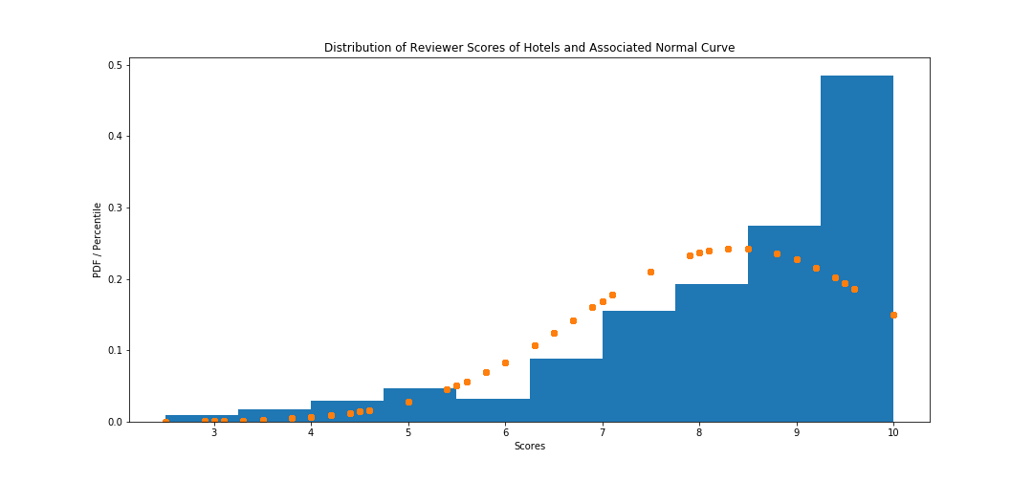
Reviewer Scores vs Hotel Average Ratings

Slide 4
Bins
Bin Name | Above Percentile | Score
Bad | 0% | 0.0 - 7.5
Sufficient | 20% | 7.6 - 8.3
Satisfactory | 40% | 8.4 - 9.1
Good | 60% | 9.2 - 9.5
Very Good | 80% | 9.6 - 10

Slide 5
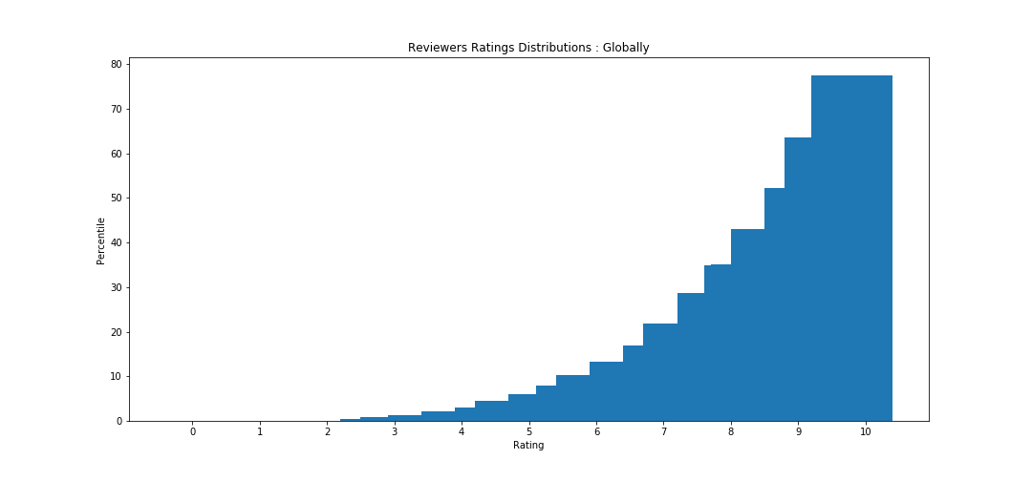
Bins Contd

Slide 6
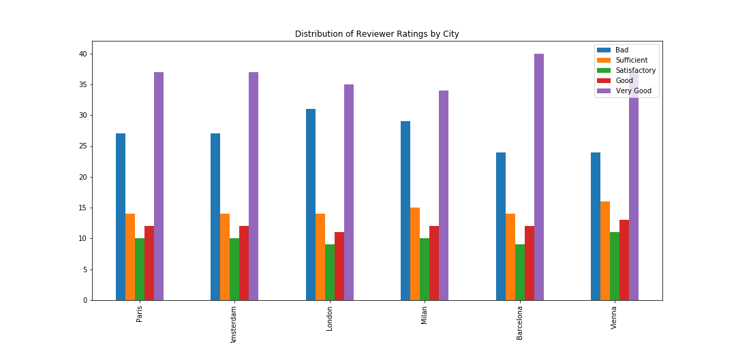
City reviewer score analysis

Slide 7
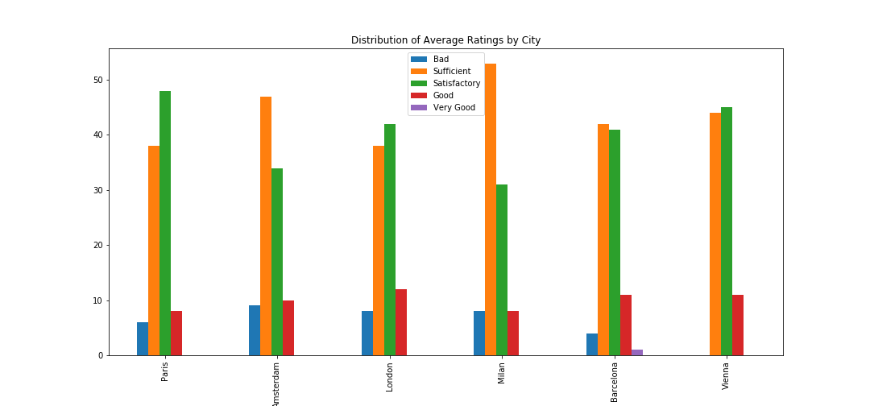
City Average Score analysis

Slide 8
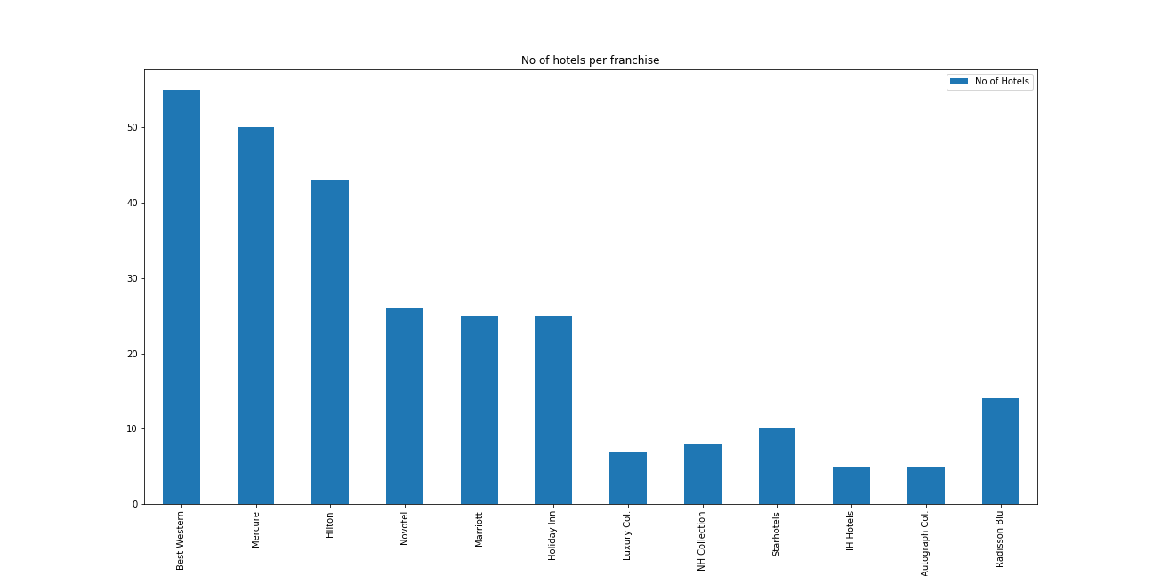
Franchise hotel analysis

Slide 9
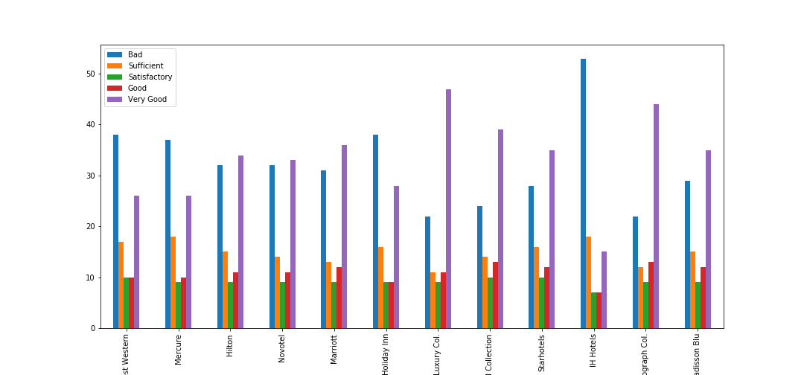
Franchise hotel analysis

Slide 10
Questions?

