Slide 1
Data Mining
Task 3 : Descriptive Mining part 2

Slide 2
Re-Analysis of Reviews
Mistake in the previous analysis
The City of Rome was confused with a district
Cities : Milan, London, Amsterdam, Vienna, Barcelona, Paris
Change in bins
Distribution of Hotel Ratings

Slide 3
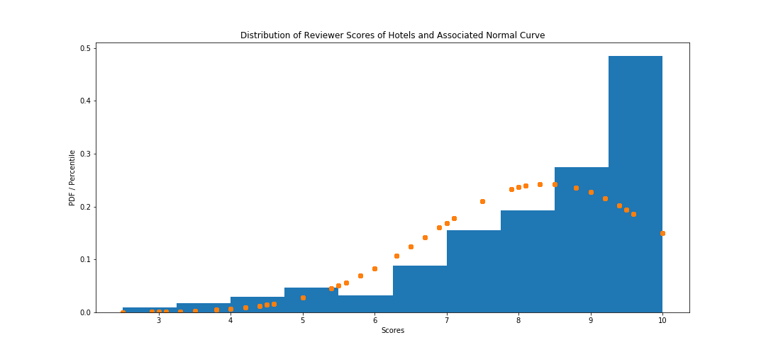
Reviewer Score Distribution

Slide 4
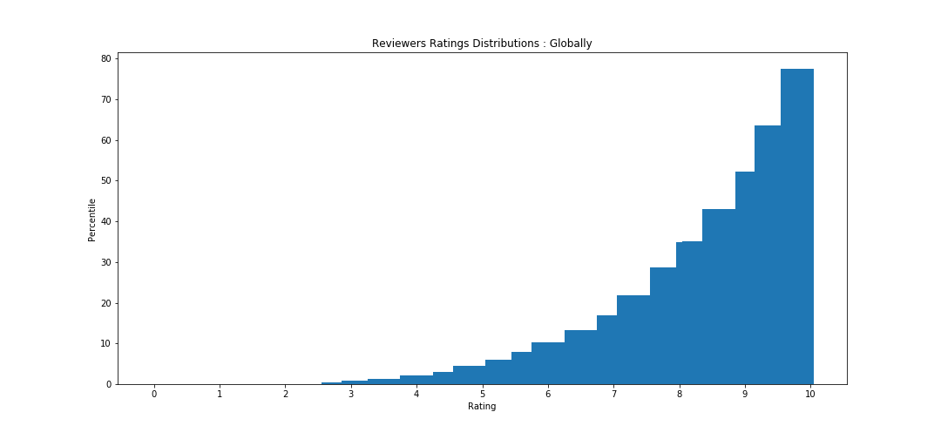
Reviewer Score Distribution

Slide 5
Reviewer Score Distribution

Slide 6
Bins
Bin Name | Score
Bad | 0.0 - 7.4
Average | 7.5 - 8.3
Good | 8.4 - 9.5
Very Good | 9.6 - 10

Slide 7
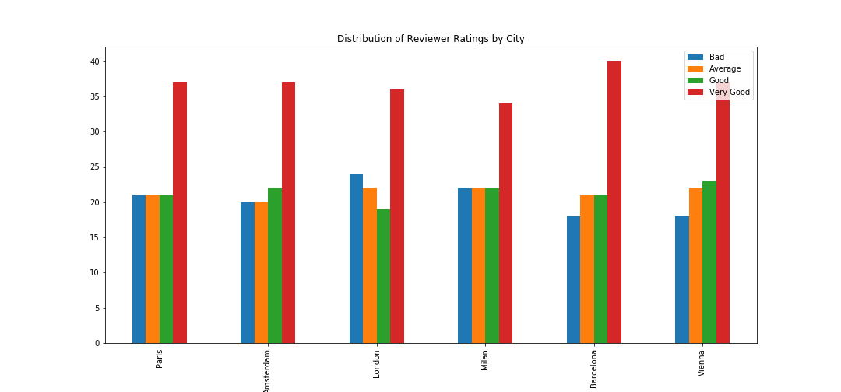
City reviewer score analysis

Slide 8
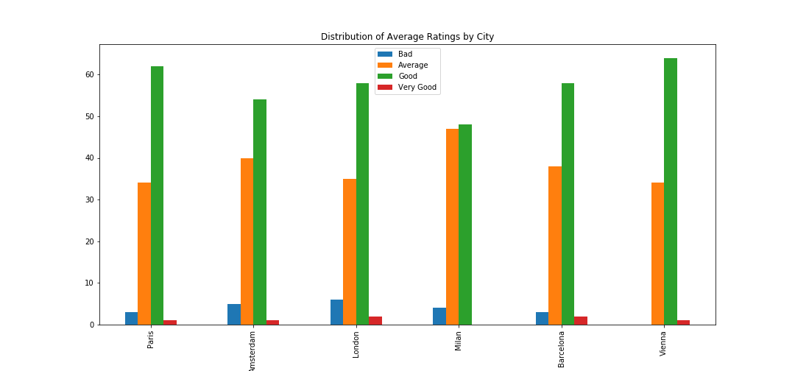
City Average Score analysis

Slide 9
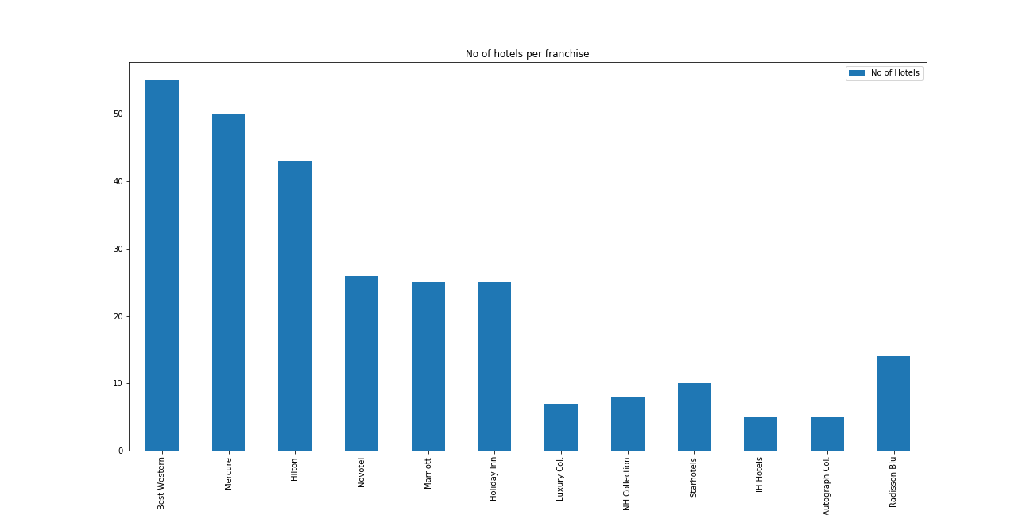
Franchise hotel analysis

Slide 10
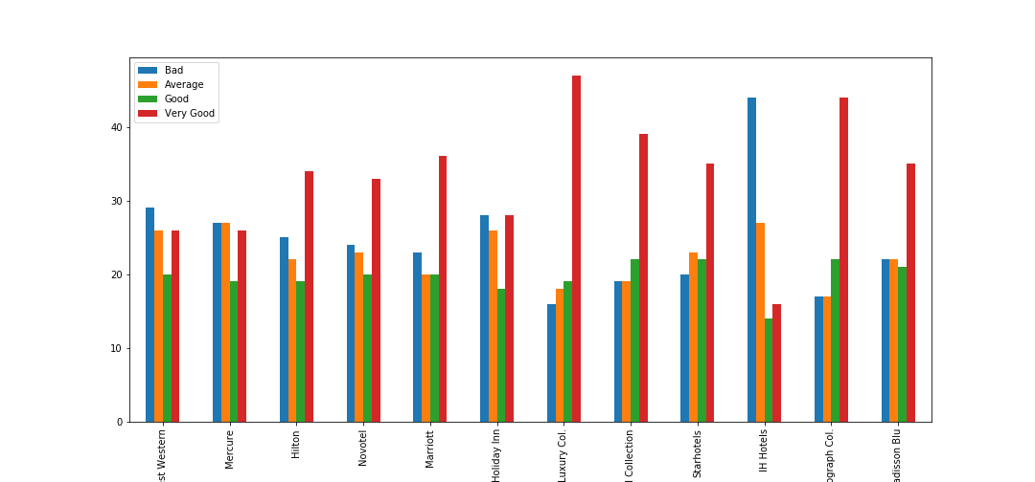
Franchise hotel analysis

Slide 11
Questions?

