Slide 1
Building the User Interface by Using HTML5: Text, Graphics, and Media
Vyacheslav Koldovskyy Last update: 25/06/2015

Slide 2
Agenta
Tags
Elements
Attributes
Nesting
Entities
Doctype
Modified HTML 4.01 elements and new HTML5 elements
Deprecation
Figures and figure captions
Canvas and SVG
Audio and video

Slide 3
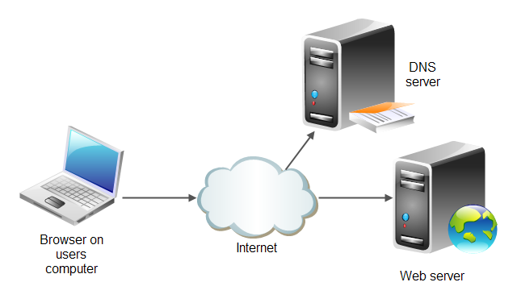

HTML Documents and HTTP Protocol
Hypertext Markup Language (HTML) is a markup language for Web pages
Hypertext Transport Protocol (HTTP) is a protocol that ensures transport of pages to clients
DNS
DNS, HTTP
HTTP
Notes:
Tip: Add your own speaker notes here.

Slide 4
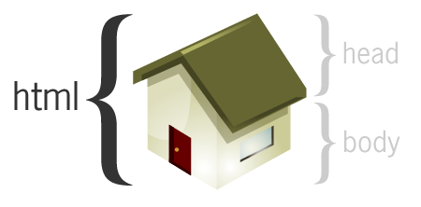
HTML Document
HTML document is a text document created to represent formatted information including text, vide, images, sounds
HTML document is created by tags and consists of sections
<!doctype html> <html lang="en"> <head> <meta charset="utf-8"> <title>Sample website</title> </head> <body> <p>Hello World!</p> </body> </html>
<!doctype html> <title>Sample website</title> <p>Hello World!</p>
Notes:
Tip: Add your own speaker notes here.

Slide 5
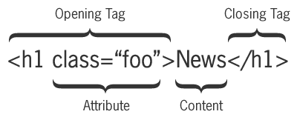
Tag Pairs
Tags are keywords that determine structure of an HTML page
Keyword is surrounded by angled brackets
Most tags come in pairs
Opening or start tag
Closing or end tag
<h1>Pet Care 101</h1>
Closing tag must have same case as opening tag
Notes:
Tip: Add your own speaker notes here.

Slide 6
Empty Tags
Empty tags don’t require an end tag
Examples:
<br> for a line break
<hr> for a horizontal line
Notes:
Tip: Add your own speaker notes here.

Slide 7
Minimal set of HTML Tags
Minimal set of tags on every Web page (note: some of them are actually optional in specs):
<!doctype> directive
<html>
<head>
<title>
<body>
<!doctype html> <html lang="en"> <head> <meta charset="utf-8"> <title>Sample website</title> </head> <body> <p>Hello World!</p> </body> </html>
Notes:
Tip: Add your own speaker notes here.

Slide 8
Doctype
A declaration found at the very top of almost every HTML document
Specifies the language or rules the page uses
In HTML, the DOCTYPE is case insensitive. The following DOCTYPEs are all valid:
<!doctype html>
<!DOCTYPE html>
<!DOCTYPE HTML>
<!DoCtYpE hTmL>
Notes:
Tip: Add your own speaker notes here.

Slide 9
Doctype
HTML 4.01 doctype example:
<!DOCTYPE html PUBLIC "-//W3C//DTD XHTML 1.1//EN" "http://www.example.com/TR/xhtml11/ DTD/xhtml11.dtd">
HTML5 doctype:
<!doctype html>
Notes:
Tip: Add your own speaker notes here.

Slide 10
Common HTML Tags
<html>: Identifies the page as an HTML document
<head>: Contains markup and code used by the browser, such as scripts that add interactivity, and keywords to help search engines find the page
<title>: Displays the title of the Web page, which appears at the top of the Web browser, usually on the page’s tab in a tabbed browser
<body>: Surrounds content that’s visible on the Web page when viewed in a Web browser
Notes:
Tip: Add your own speaker notes here.

Slide 11
Common HTML Tags (Continued)
<a href=URL>: Generally used to anchor a URL to text or an image; can create a named anchor within a document to allow for linking to sections of the document
<b>: Applies boldface to text
<hx>: Creates a heading, which can be first level (h1) through sixth level (h6)
<img>: Inserts an image from a file or another Web site
<p>: Defines text as a paragraph
Notes:
Tip: Add your own speaker notes here.

Slide 12
Elements
A tag pair or an empty tag is also called an element.
An element can describe content, insert graphics, and create hyperlinks.
Notes:
Tip: Add your own speaker notes here.

Slide 13
Attributes
Modifiers of HTML elements that provide additional information
Are extensions of elements
Syntax: <tag attribute="value">
Notes:
Tip: Add your own speaker notes here.

Slide 14
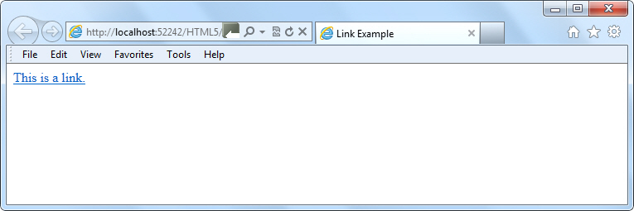
Creating a Link
Example:
<a href="http://www.example.com">This is a link.</a>
Notes:
Tip: Add your own speaker notes here.

Slide 15
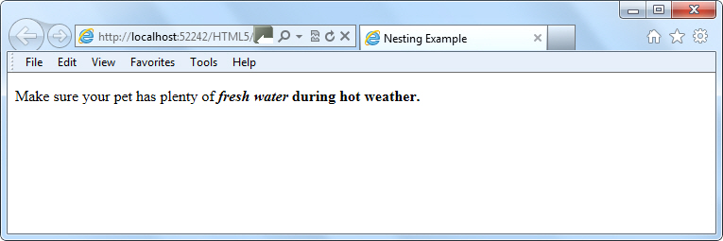
Nesting
To place one element inside another
Example:
<p>Make sure your pet has plenty of <i><b>fresh water</i> during hot weather.</p></b>
Notes:
Tip: Add your own speaker notes here.

Slide 16
Entities
A special character, such as the dollar symbol, the registered trademark (a capital R within a circle), and accented letters
Begins with an ampersand (&) and ends with a semicolon (;)
Examples:
entity &reg; represents the registered trademark symbol
Its numerical code is &#174;
Notes:
Tip: Add your own speaker notes here.

Slide 17
Entities (Continued)
Called character encoding
Use UTF-8 encoding whenever possible
Add the following declaration to the head element:
<meta charset="UTF-8">
Notes:
Tip: Add your own speaker notes here.

Slide 18
HTML 4 Text-related Elements with New Meaning or Functionality in HTML5
The <b> element should now be used to offset text without conveying importance, such as for keywords or product names.
The <i> element now indicates content in an alternate voice or mood, like spoken text.
The <strong> element indicates strong importance.
The <em> element indicates emphatic stress.
The <small> element should be used for small print, like a copyright line.
Notes:
Tip: Add your own speaker notes here.

Slide 19
Some New HTML5 Elements
The <mark> element highlights text on a page, similar to the highlighting feature in Microsoft Word.
The <time> element displays a machine-readable time and date, such as 10:10 A.M., CST, July 19, 2012, which is handy for blogs and calendars, and potentially helps search engines provide better results when time and date are part of the search criteria.
The <wbr> defines possible line-break.
Notes:
Tip: Add your own speaker notes here.

Slide 20
Deprecation
While new elements become available, the W3C earmarks other elements for eventual removal because their functionality is no longer useful.
Removing elements from the list of available HTML elements is referred to as deprecation.
Note: The same thing applies to attributes and CSS properties.
Notes:
Tip: Add your own speaker notes here.

Slide 21
Examples of Deprecated HTML Elements
<big>: Makes text bigger relative to the current font size
<center>: Center-aligns text and content
The fix: Use CSS instead
Notes:
Tip: Add your own speaker notes here.

Slide 22
Image Basics
A raster image is made up of pixels.
Example: A photograph
Formats: JPG, PNG, GIF, BMP
A vector image is made up of lines and curves based on mathematical expressions.
Example: Adobe Illustrator AI file
Formats: PNG or GIF for Web display
Notes:
Tip: Add your own speaker notes here.

Slide 23
The img element
Use img to add images to an HTML document
Example: <img src="images/redball.jpg" alt="Red ball graphic" />
The src attribute and the alt attribute are required to be fully valid.
The W3C requires the alt attribute for accessibility by people with disabilities.
Notes:
Tip: Add your own speaker notes here.

Slide 24
figure and figcaption Elements
The figure element specifies the type of figure you’re adding
The figcaption element adds a caption to an image on a Web page
Can display the caption before or after the image
Notes:
Tip: Add your own speaker notes here.

Slide 25
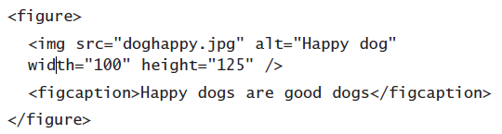
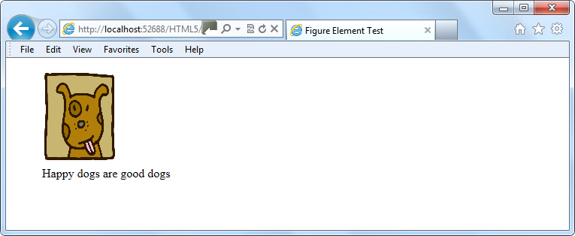
figure and figcaption Example
Illustration: © MightyIsland/iStockphoto
Notes:
Tip: Add your own speaker notes here.

Slide 26
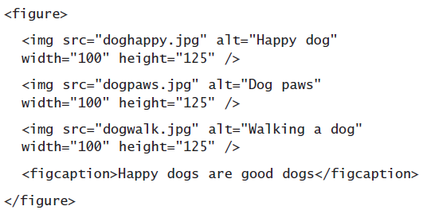
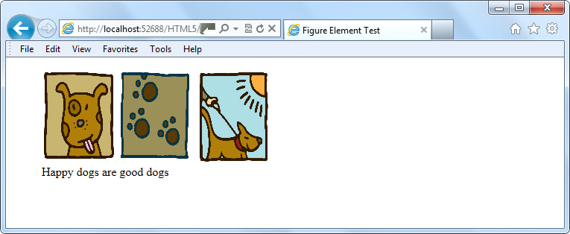
Side by Side Example
Illustrations: © MightyIsland/iStockphoto
Notes:
Tip: Add your own speaker notes here.

Slide 27
Canvas
Use JavaScript to draw pixel-based shapes on a canvas
Include color, gradients, and pattern fills
Render text with various embellishments
Animate objects by making them move, change scale, and so on
Basic syntax for the canvas element:
<canvas id="smlRectangle" height="100"
width="200"></canvas>
Notes:
Tip: Add your own speaker notes here.

Slide 28
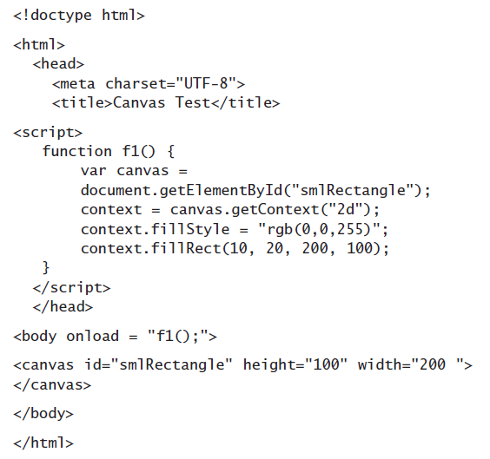
Canvas Example
Notes:
Tip: Add your own speaker notes here.

Slide 29
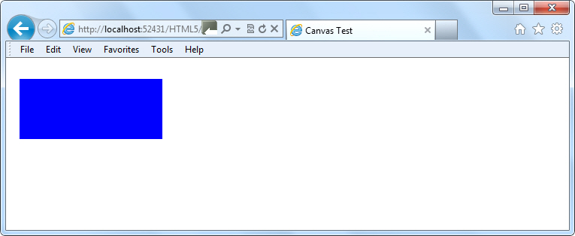
Canvas Example
Notes:
Tip: Add your own speaker notes here.

Slide 30
Fallback
“Backup” content that displays if primary content cannot
Can be a problem with some older browsers
Cannot render canvas drawings or animation, for example
Fallback adds an image, text, or some other HTML content within the canvas element that displays if the drawing cannot
Notes:
Tip: Add your own speaker notes here.

Slide 31
Scalable Vector Graphics (SVG)
A language for describing 2D vector graphics in Extensible Markup Language (XML)
SVG graphics referred to as objects
SVG loads into the DOM
Vector graphic changes size to fit screen, whether 32-inch PC monitor or smartphone
SVG is not new, but HTML5 can embed SVG objects in Web pages without using <object> or <embed> tags
Notes:
Tip: Add your own speaker notes here.

Slide 32
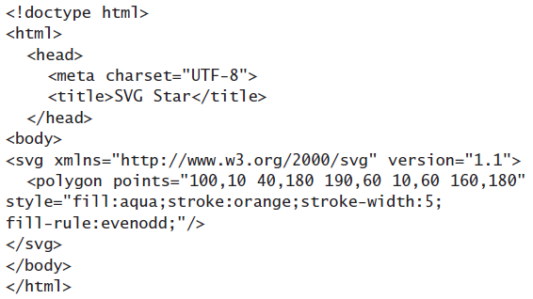
SVG Example
Notes:
Tip: Add your own speaker notes here.

Slide 33
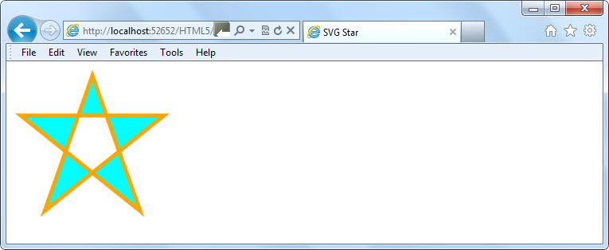
SVG Example
Notes:
Tip: Add your own speaker notes here.

Slide 34
When to Use Canvas Instead of SVG
If the drawing is relatively small, use canvas.
If the drawing requires a large number of objects, use canvas; SVG degrades as it continually adds objects to the DOM
Generally, use canvas for small screens and SVG for larger screens.
If you must create highly detailed vector documents that must scale well, go with SVG.
If you are displaying real-time data output, such as maps, map overlays, weather data, and so on, use canvas.
Notes:
Tip: Add your own speaker notes here.

Slide 35
video Element
Enables you to incorporate videos in HTML documents using minimal code
Markup example:
<video src="intro.mp4" width="400" height="300">
</video>
Notes:
Tip: Add your own speaker notes here.

Slide 36
video Attributes
poster: Displays a static image file before the video loads
autoplay: Start playing the video automatically upon page load
controls: Displays a set of controls for playing, pausing, and stopping the video, and controlling the volume
loop: Repeats the video
Notes:
Tip: Add your own speaker notes here.

Slide 37
Video Markup Example
<video width="320" height="240" controls> <source src="movie.mp4" type="video/mp4"> <source src="movie.ogg" type="video/ogg"> Your browser does not support the video tag. </video>
Notes:
Tip: Add your own speaker notes here.

Slide 38
audio Element
Enables you to incorporate audio (music, other sounds) in HTML documents using minimal code
Markup example:
<audio src="sample.mp3" controls="controls">
</audio>
Notes:
Tip: Add your own speaker notes here.

Slide 39
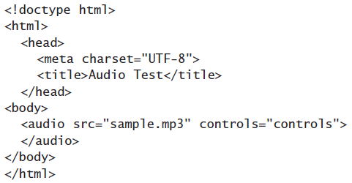
audio Example
Notes:
Tip: Add your own speaker notes here.

Slide 40
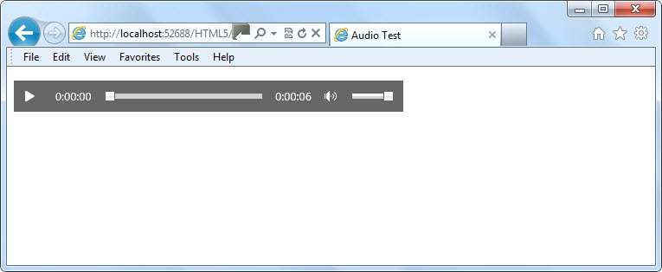
audio Example
Notes:
Tip: Add your own speaker notes here.

Slide 41
Practice Task

Slide 42
Contacts
Europe Headquarters
52 V. Velykoho Str.
Lviv 79053, Ukraine
Tel: +380-32-240-9090 Fax: +380-32-240-9080
E-mail: info@softserveinc.com
Website: www.softserveinc.com
US Headquarters
12800 University Drive, Suite 250 Fort Myers, FL 33907, USA
Tel: 239-690-3111 Fax: 239-690-3116
Thank You!
Copyright © 2010 SoftServe, Inc.

