Slide 1
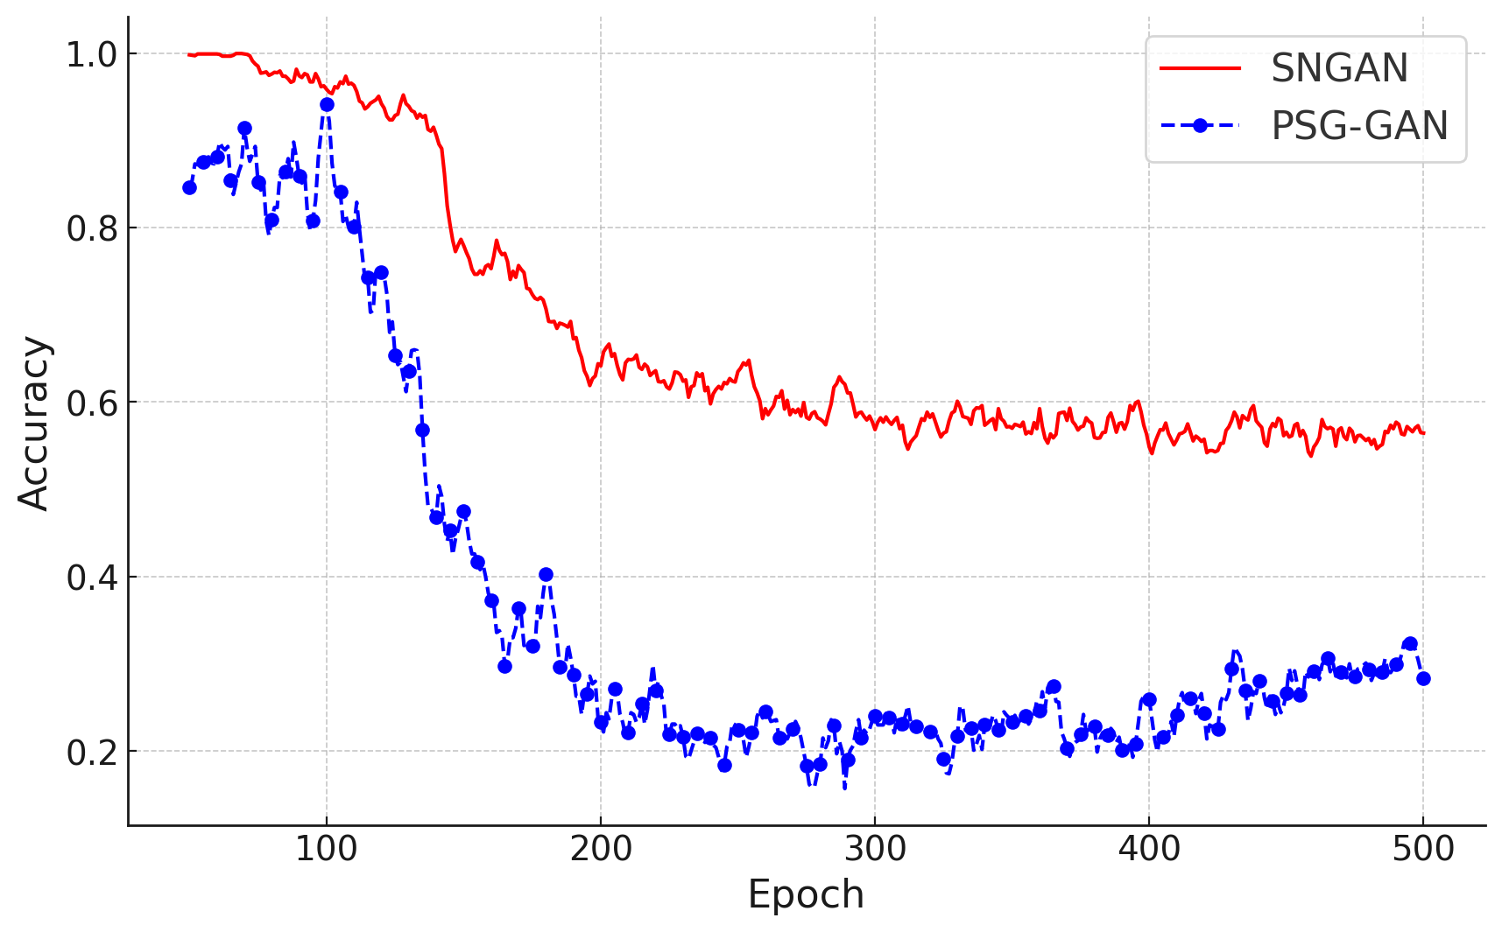
PSG-GAN Convergence
SNGAN Convergence
0.5
0.33

