Slide 1
Who Am I
Yoonsoo P. Bach

Slide 2
Intro
박윤수 Yoonsoo Bach (GitHub @ysBach)
2009 IOAA 3rd
Not from science high school
KAIST (2011-2016), BS Physics
SNU since 2016 Mar
ROKA Expert Research Personnel (2019 Mar -)
@Ishiguro's lab
Asteroids – polarimetry, thermal modeling, reflectance, experiments
Statistics, data analysis, coding, …
010-2259-3199 // dbstn95@gmail.com

Slide 3
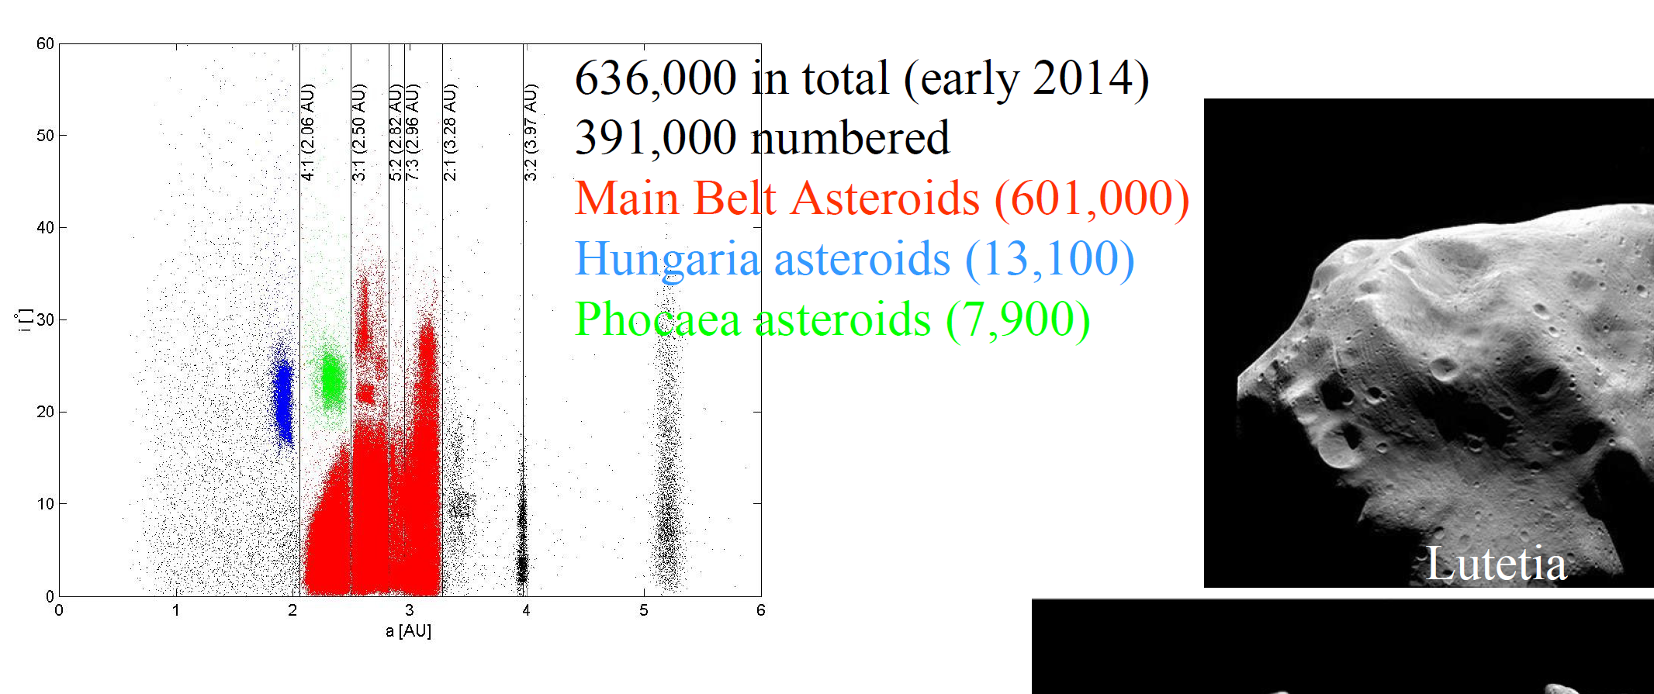
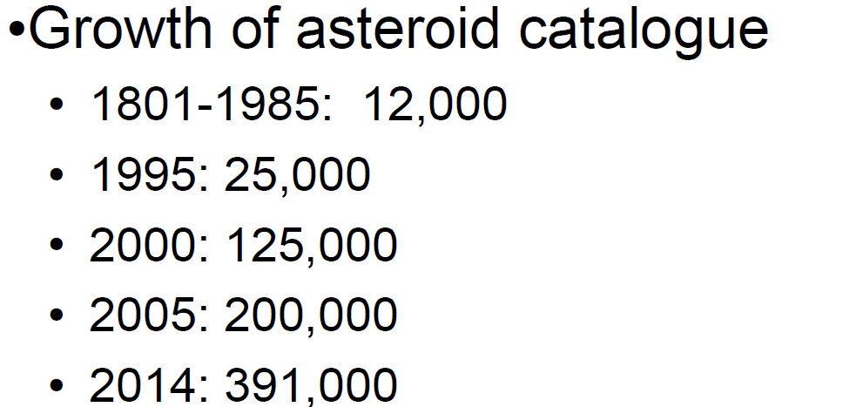
Intro
B. Davidsson+ 2014, Lecture notes on Physics of Planetary Systems, Uppsala University, lecture 01

Slide 4
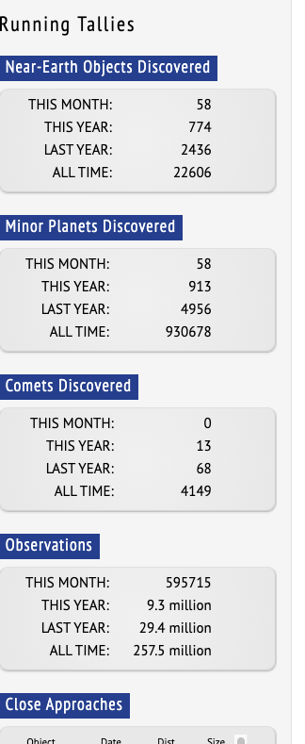
https://www.minorplanetcenter.net/
2020-04-13

Slide 5
Intro
How should you call me?
윤수 Yoonsoo
형/오빠
I don't care which gender you specify yourself; choose whatever you want.
TA (조교님)
여어 조교
선배 (님)
존댓말 (honorifics / polite words)
Either (1) we both should use or (2) we both do not use.
This is because I believe we do have social 'rank' if only one of us use 존댓말, while the opponent use 반말.
Since 2017, I never used 반말 to whoever has taken AO class.
I speak 반말 only if students, i.e., those who have lower social rank than me, used it to me first.

Slide 6
조교 (TA)
助敎
(To) Help Teaching
(the professor)
The person who helps the professor of the course
(I am not a professor or THE teacher of the course!)

Slide 7
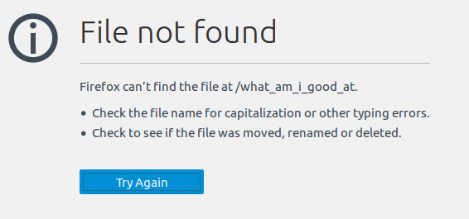
Intro
What am I good at?

Slide 8
Intro
But I am a TA… What are we going to do?
Intro
Intro to softwares and tools (IRAF, SAO Image ds9, Python, Git(Hub), Slack)
Statistics
Basics of Photometry
Practical Photometry
Much more (you will learn during your projects…?)

