Slide 1
Area Under the ROC Curve
Binary Dependent Variables:
Evaluating a Logistic Regression Model

Slide 2
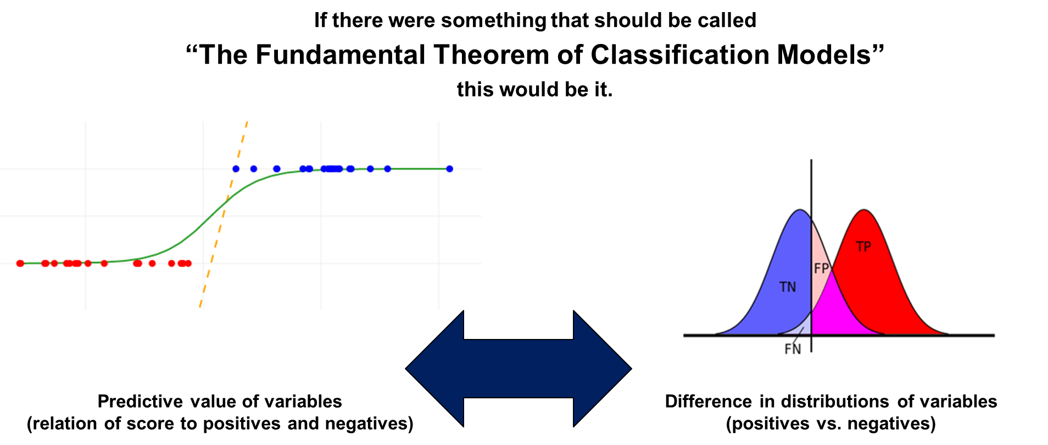
Evaluating a Logistic Regression Model
Notes:
1

Slide 3
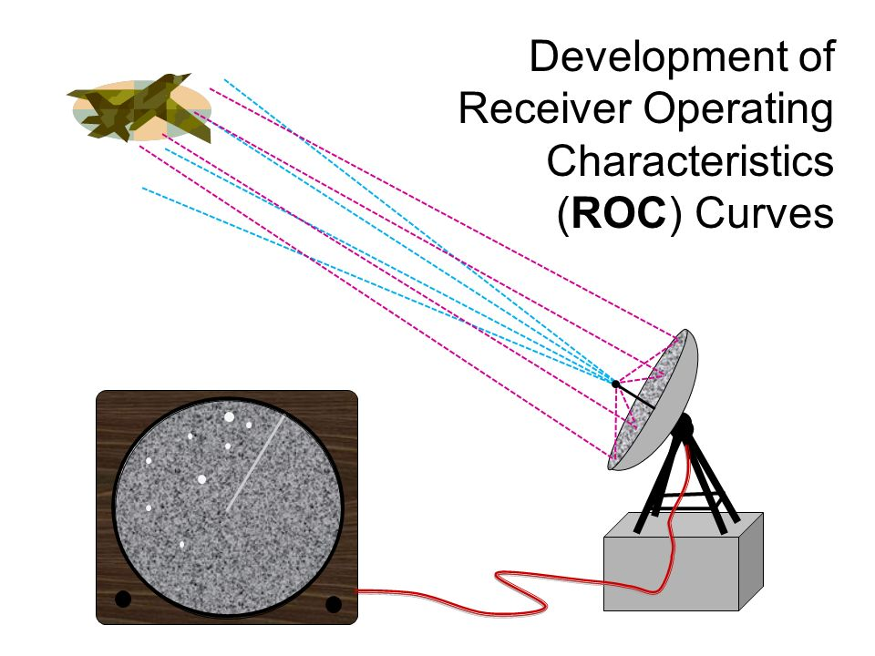
Evaluating a Logistic Regression Model: Receiver Operating Characteristic Curve
Notes:
2

Slide 4
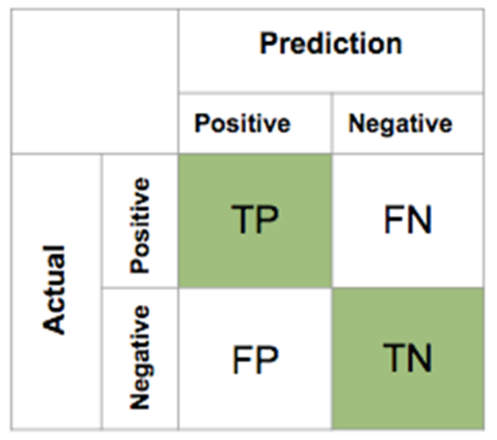
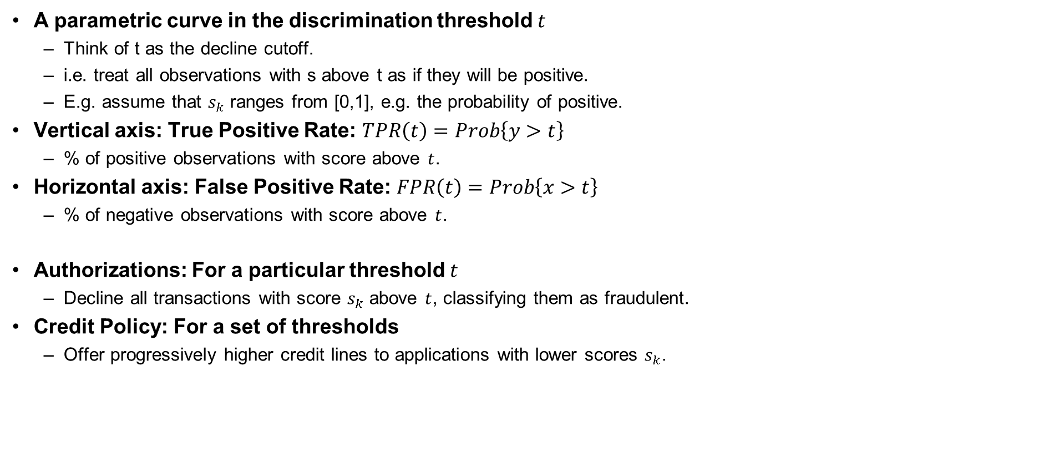
Evaluating a Logistic Regression Model: Receiver Operating Characteristic Curve
Notes:
3

Slide 5
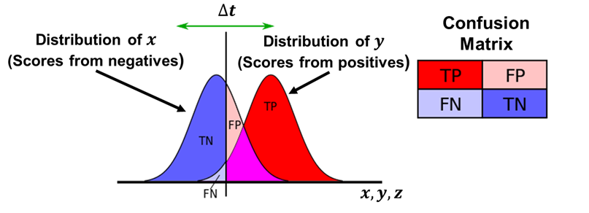
Evaluating a Logistic Regression Model
Notes:
4

Slide 6
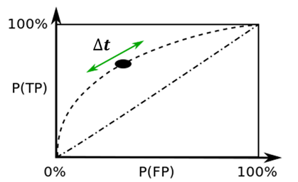
Evaluating a Logistic Regression Model: Receiver Operating Characteristic Curve
Notes:
5

Slide 7
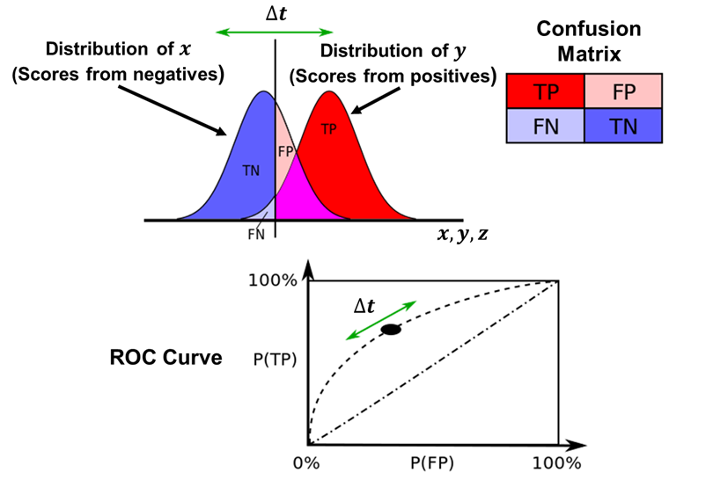
Evaluating a Logistic Regression Model: Receiver Operating Characteristic Curve
Notes:
6

Slide 8
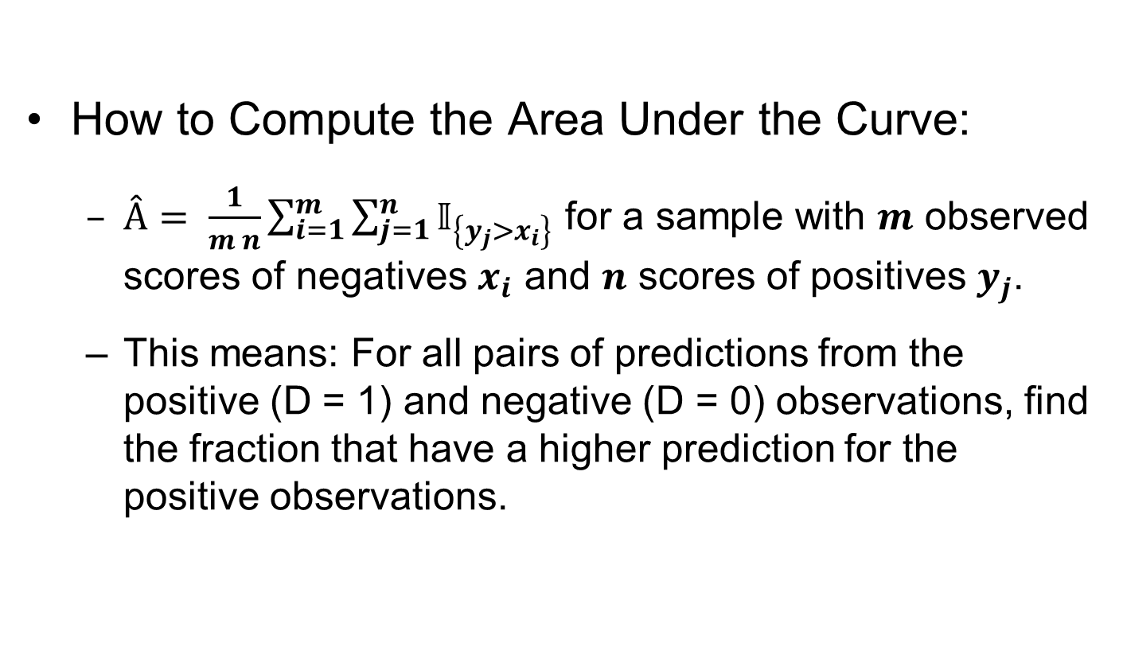
Evaluating a Logistic Regression Model: Receiver Operating Characteristic Curve
How to Compute the Area Under the Curve:
$Â= \frac{1}{m n}\sum_{i=1}^{m}{\sum_{j=1}^{n}{𝕀_{\left\{y_{j}>x_{i}\right\}}}}$ for a sample with $m$ observed scores of negatives $x_{i}$ and $n$ scores of positives $y_{j}$.
This means: For all pairs of predictions from the positive (D = 1) and negative (D = 0) observations, find the fraction that have a higher prediction for the positive observations.
Notes:
7

Slide 9
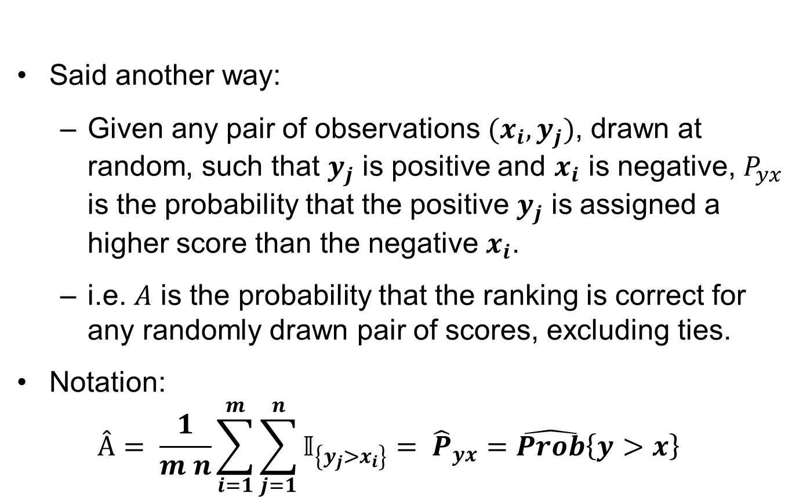
Evaluating a Logistic Regression Model: Receiver Operating Characteristic Curve
Said another way:
Given any pair of observations ${(x}_{i},y_{j})$, drawn at random, such that $y_{j}$ is positive and $x_{i}$ is negative, $P_{yx}$ is the probability that the positive $y_{j}$ is assigned a higher score than the negative $x_{i}$.
i.e. $A$ is the probability that the ranking is correct for any randomly drawn pair of scores, excluding ties.
Notation:
$$Â= \frac{1}{m n}\sum_{i=1}^{m}{\sum_{j=1}^{n}{𝕀_{\left\{y_{j}>x_{i}\right\}}}}= {\hat{P}}_{yx}=\hat{Prob}\left\{y>x\right\}$$
Notes:
8

