Slide 1
LCK LOL Champions Korea
FRONTEND 1ST PROJECT

Slide 2
INDEX
기획의도
사이트 구현
추가 개발 방향

Slide 3
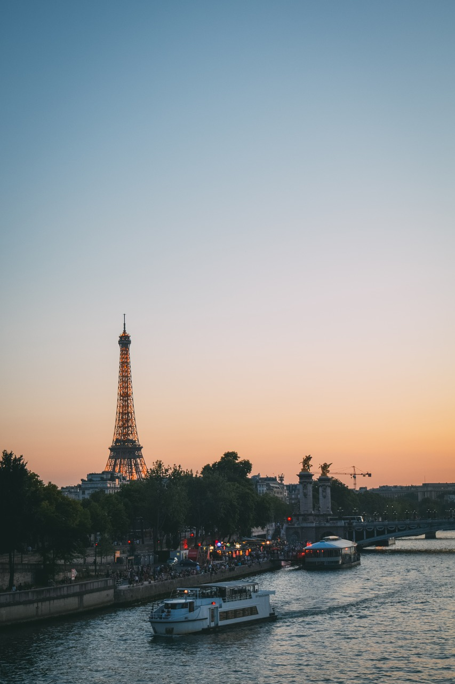
Something Just Like This
기획의도
Textbox Layout
You look so proud
Standing there with
a frown and a cigarette
기획의도 사이트구현 추가개발방향

Slide 4

We were staying in Paris
LINE LAYOUT
Mood Concept Design Marketing Summary
Textbox Layout
We were staying in Paris. To get away from your parents
You look so proud Standing there with a frown and a cigarette

