Slide 1

PIC 10A 2B
TA: Bumsu Kim

Slide 2
Today…
Random Numbers
Applications to Loop Exercises
Functions
More Loop Exercises
Collatz Conjecture

Slide 3
Random Numbers
Syntax, Libraries, and Usage

Slide 4
rand()
<cstdlib>
rand() generates a (pseudo-) random integer,
Between 0 and RAND_MAX
RAND_MAX depends on the library
But at least 0x7fff = $2^{15}−1=32767$ on any stand library implementation
Using a “seed”
Using the same seed, rand() will generate the same sequence of random numbers
More on this later

Slide 5
Using rand() – Floating Point numbers
Since it generates an int between 0 and RAND_MAX, you can generate a random number between 0 and X (inclusive) by
rand_num = (rand()*1./RAND_MAX)*X;
Or,
rand_num = (static_cast<double>(rand())/RAND_MAX)*X;
which is preferable
Normalized to
0 ~ 1
Type
Conversion

Slide 6
Using rand() – Floating Point numbers
If you want a real number between A and B,
The size of interval = ( B – A )
Starts from A
rand_num = ((rand()*1./RAND_MAX)*(B-A) + A;
Between 0 and (B-A)

Slide 7
Using rand() – Integers
For integers, we can use the % (mod/remainder) operator
Random int between 0 and N (inclusive):
n = rand()%(N+1)
The remainder is always between 0 and N
Note that, there are N+1 different integers in [0,N]
Random int between A and B:
= A + (random int between 0 and (B-A))
n = A + rand() % (B-A+1)

Slide 8
A Seed for rand()
The function rand() generates a sequence of random numbers using a seed
The seed can be set by srand(some_number);
Ex) some_number == 1 → rand() gives
41
18467
6334
26500
19169
15724 …
Exercise: Use rand() several times without srand() commands, and verify that you get the sequence above

Slide 9
Seed for rand()
With the same seed, you’ll have the same sequence of random numbers
So, to get a random-like numbers (pseudo-random numbers), use different seed every time you run the code
Commonly used trick: use a current time as a seed
time(nullptr) in <ctime> library returns the current time in seconds, since 00:00, Jan 1 1970 UTC
Ex) time(nullptr) == 1666067370 when this slide was created

Slide 10
Summary
#include <cstdlib> for rand() and srand()
#include <ctime> for time()
Use time(nullptr) to generate a seed:
srand(time(nullptr));
And then use rand()
Intervals:
r_double = (rand()*1./RAND_MAX)*(B-A) + A;
r_int = A + rand()%(B-A+1);

Slide 11
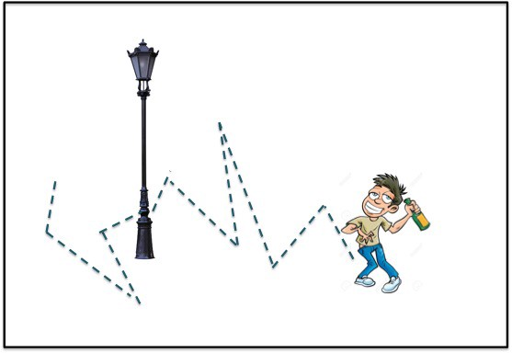
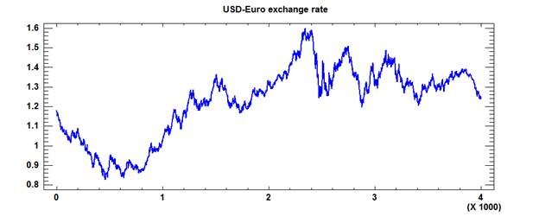
Exercise – Random Walk Simulator
Suppose someone walks in a constant speed, but chooses the direction randomly in each step
The path (to be more precise, this stochastic process) is called a random walk
We will simulate a 1-D random walk:
An object can only move forward or backward at each step
When the object hits the wall (upper/lower bounds), it stops walking
The time that it hits the wall is called the “stopping time”
Important in mathematical finance

Slide 12
Functions
Basic Syntax and Terminology

Slide 13
Functions
Functions can be
Declared and then defined later
If you declare the function first (not define it right now) then need ;
Defined when it is declared (so both are done at the same time)
The declaration determines a “signature” of the function
[Return Type] [Function Name] [Input Parameters] (and other options later)

Slide 14
Functions
The declaration determines a “signature” of the function
[Return Type] [Function Name] [Input Parameters] (and other options later)
Return Type
The type of the expression returned by the function
If the function returns nothing, can be void
Function Name
Name of the function; cannot be a reserved word, the same naming rule applies with variables
Input Parameters
The objects passed to the function
Number of arguments can be 0, 1, or more
Still need parentheses () even when the function gets zero parameters

Slide 15
Functions – Examples
A function returning the maximum of two numbers
A procedure is a function returning void
Which means, it doesn’t return anything
Example: a function printing the max to the console
Recall: The ternary operator
A ? B : C
is (almost) equivalent to
if (A) { B; }
else {C;}
double find_max(double a, double b) {
return (a > b) ? a : b;
}
void print_max(double a, double b) {
cout << "The max of " << a << " and " << b
<< " is " << find_max(a, b);
}
Possible if find_max is declared before this expression
Q: [true or false?]
Using “return” keyword in a procedure results in a syntax error.

Slide 16
Functions – Examples
A function that inputs several different types of arguments
A predicate function is a function returning bool
The following function checks whether the first letter of the string is capitalized or not
void func(unsigned int i, string str) {
cout << str[i];
}
Here i cannot be negative
bool isCapitalized(string str) {
if ('A' <= str[0] && str[0] <= 'Z’) {
return true;
} else {
return false;
}
}
True if str[0] is between ‘A’ and ‘Z’ (otherwise it is not a capital letter)

Slide 17
More Loop Exercises
Collatz Conjecture

Slide 18
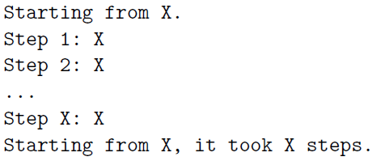
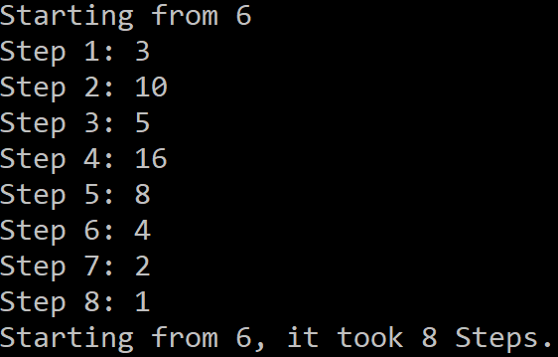
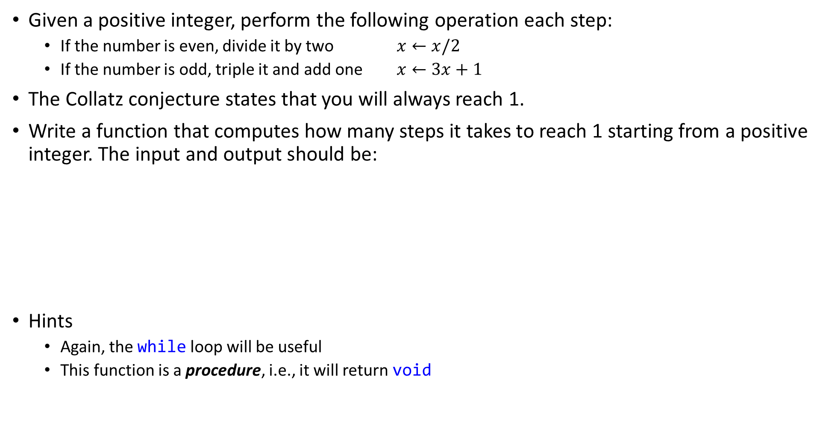
Exercise – Collatz Conjecture
Given a positive integer, perform the following operation each step:
If the number is even, divide it by two $x←x/2$
If the number is odd, triple it and add one $x←3x+1$
The Collatz conjecture states that you will always reach 1.
Write a function that computes how many steps it takes to reach 1 starting from a positive integer. The input and output should be:
Hints
Again, the while loop will be useful
This function is a procedure, i.e., it will return void
Output example starting from 6

Slide 19
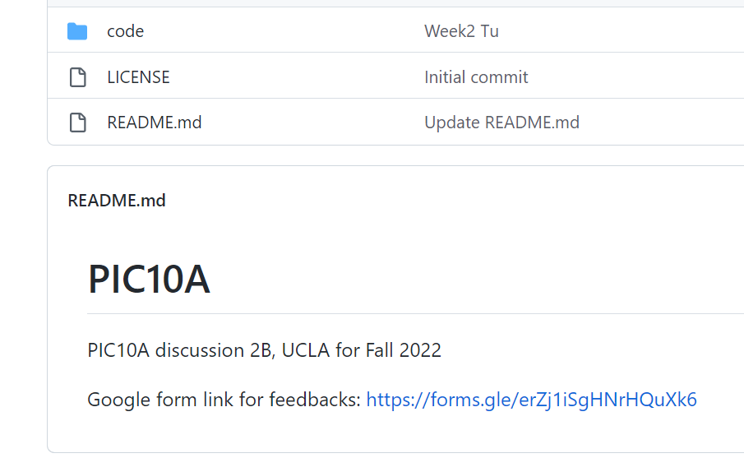
Your Feedback is welcome
Don’t hesitate to give a feedback on the discussion
Use the link on my Github repo, or the link below:
https://forms.gle/erZj1iSgHNrHQuXk6
My Github repo on the web looks like:
Click this link

