Slide 1
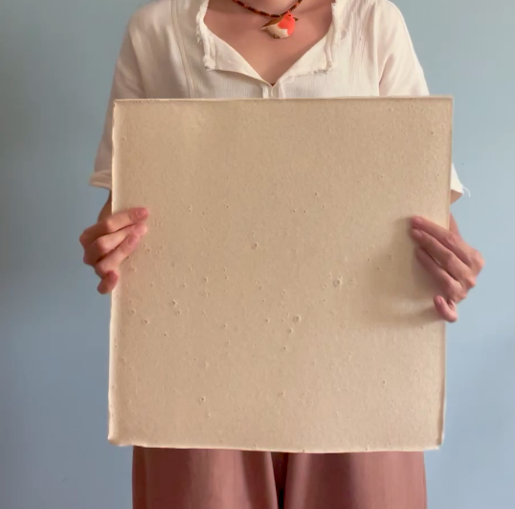
Eggshell–Agar
Biocomposites
Development and characterisation for sustainable interior applications
Betül Ünal
Department of Interior Architecture
Cappadocia University
ICSMMEP-26 · MECCA · 3–4 NOVEMBER 2026
1
Notes:
1 · COVER — 0:15
Good morning. I am Betül Ünal, from Department of Interior Architecture, Cappadocia University. The panel in the photograph is the subject of this paper: a composite of waste eggshell bound in agar.

Slide 2
Background
Material basis
Two routes
94–97%
Food processing
calcium carbonate by mass
Waste eggshell
0.85–2.66
specific gravity, below most mineral fillers
Landfill
Mineral resource
William & Owen (1995) · Torres et al. (2010) · Owuamanam & Cree (2020)
The case for eggshell as a mineral phase is settled. This paper is about the phase that binds it.
2
Notes:
2 · BACKGROUND — 0:30
Eggshell is produced continuously as a by-product of food processing, and almost all of it goes to landfill. Chemically it is very close to pure calcium carbonate, and its specific gravity is lower than that of most mineral fillers used in construction.
[Sağdaki şemaya işaret et]
It therefore has two possible routes: landfill, or use as a secondary mineral resource. The case for eggshell as a mineral phase is settled.

Slide 3
Prior applications
Established uses of eggshell waste in engineered materials
Application | Binding phase | Reference
Partial cement replacement in concrete | Portland clinker | Teara et al. (2019); Bhartiya & Dubey (2018)
Compressed laterite brick | Soil – lime | Adogla et al. (2016)
Hot-mix asphalt | Bitumen | Razzaq & Yousif (2017)
Clay stabilisation | Clay mineral | Soundara & Vilasini (2015)
Eco-ceramic wall tile | Ceramic body | Vilarinho et al. (2022)
Particulate filler in PVC | Poly(vinyl chloride) | Skórczewska et al. (2020)
Filler in flexible polyurethane foam | Polyurethane | Victor et al. (2019)
Ceramic–metal composite | Metal matrix | Bilici et al. (2023); Yönetken et al. (2016)
Bone tissue scaffold | Calcium phosphate | Shafiei et al. (2019)
Wallpaper | Cellulosic furnish | Tutuş et al. (2018)
The burden is carried by the binder, and the binder is left untouched.
MINERAL PHASE · recovered from waste
BINDING PHASE · cementitious, ceramic or petrochemical
3
Notes:
3 · PRIOR APPLICATIONS — 0:30
This table is the literature the study departs from. Eggshell has already been used in concrete, in brick and clay stabilisation, in asphalt, in ceramic tile, in PVC and polyurethane foam, and even in bone scaffolds.
[Elini orta sütuna götür, aşağı indir]
Reading down the middle column, the pattern is consistent. In every case the mineral is recovered from waste, but the binding phase remains cementitious, ceramic or petrochemical. The burden is carried by the binder, and the binder is left untouched.

Slide 4
Research gap
Three gaps follow from the preceding two slides
01
The binding phase is never biological
No study reports an eggshell composite in which both phases are of biological origin.
02
Agar is characterised only as an unfilled film
Never as the binder of a mineral-filled solid in bending.
03
Property sets are reported in fragments
Property data is scattered across separate studies on separate formulations.
This is not a novel constituent. It is a documented protocol and a single coherent property set.
4
Notes:
4 · RESEARCH GAP — 0:35
Three gaps follow. The first is that the binding phase is never biological. The second concerns agar, which has been characterised only as an unfilled film in tension, and never as the binder of a mineral-filled solid in bending. The third is that property data is scattered across separate studies on separate formulations.

Slide 5
Aim
To document a reproducible production protocol for a fully bio-based eggshell–agar composite, and to characterise it against published test standards.
Objectives
01
02
03
04
Document the protocol
Characterise to standards
Position against two families
Derive an evaluation criterion
Standards applied: ASTM D790-17 · ISO 11925-2:2020 · ASTM D570-98(2018).
5
Notes:
5 · AIM — 0:20
The aim is to document a reproducible production protocol for a fully bio-based eggshell–agar composite, and to characterise it against published test standards. Four objectives follow, and the fourth objective is the one the paper will discuss.

Slide 6
Scope
Within scope
Outside scope
Dimension | This study
Formulations | Five — three compressive, two flexural
Specimens | Three per formulation for mechanical testing
Properties | Compression, flexure, ignitability, water absorption, bulk density
Standards | ASTM D790-17 · ISO 11925-2:2020 · ASTM D570-98(2018)
Conditions | Ambient cure, single laboratory, single operator
Application | Non-loadbearing interior surfaces
Durability and ageing
Fire classification
Life-cycle assessment
Structural use
Property coverage
Compression
Flexure
Ignitability
Water absorption
Bulk density
Durability
Fire classification
Life-cycle
Structural use
The filled boxes were determined in this study. The outlined boxes were not.
6
Notes:
6 · SCOPE — 0:15
Five formulations were produced, with three specimens each for the mechanical tests, and three published standards were applied. The whole series was cured at ambient conditions in a single laboratory, and the application envelope throughout is non-loadbearing interior surfaces.
[Alttaki şeride işaret et]
The filled boxes were determined in this study. The outlined boxes were not determined.

Slide 7
Method
A material-driven sequence in four stages
1
2
3
4
Produce
Measure
Position
Propose
every parameter recorded
against published standards
against two material families
from the observed behaviour
The properties came first, and the application envelope was derived from them.
Material-driven design after Karana et al. (2015)
7
Notes:
7 · METHOD — 0:20
The method has four stages. The material was produced with every parameter recorded, measured against published standards, positioned against two material families, and only then was a criterion for evaluating it proposed. The properties came first, and the application envelope was derived from them.

Slide 8
Research questions
01
Which formulation variable governs compressive strength?
Formulation
02
How does plasticiser content affect flexural behaviour?
Formulation
03
How does the composite compare with conventional interior materials?
Benchmark
04
How does it compare with other bio-based composites?
Benchmark
05
Is compressive strength an adequate evaluation criterion for this class?
Criterion
The first four are answered by measurement. The fifth is answered by argument.
8
Notes:
8 · RESEARCH QUESTIONS — 0:15
There are five questions. The first four concern formulation and benchmarking; the fifth asks whether compressive strength is an adequate criterion for this class of material at all. The first four are answered by measurement. The fifth is answered by argument.

Slide 9
Hypothesis
A fully bio-based eggshell–agar composite can be produced repeatably under ambient conditions, and its performance as an interior surface material is governed by deformation capacity rather than by compressive strength.
Two clauses, tested separately
Clause 1
Producible repeatably under ambient conditions
tested on slides 10–13
Clause 2
Governed by deformation capacity rather than strength
tested on slides 15–22
The dissertation behind this paper frames a broader hypothesis around spatial resilience; this is its materials-engineering component.
9
Notes:
9 · HYPOTHESIS — 0:25
The hypothesis is a fully bio-based eggshell–agar composite can be produced repeatably under ambient conditions, and its performance as an interior surface material is governed by deformation capacity rather than by compressive strength. Those are two separate claims, tested by different parts of the paper.
The dissertation behind this paper frames a broader hypothesis around spatial resilience; this is its materials-engineering component.

Slide 10
Stage 1 · Mineral phase
Progressive size reduction of the shell to a sieved powder
Whole shell
Cleaned
Heat-treated
Milled
Sieved
collected from a single bakery
membrane and residue removed manually
decontamination and drying
laboratory mechanical grinder
passing fraction retained
—
—
120 °C, 20 min
to homogeneous powder
150 µm mesh
The 150 µm fraction was selected so that the mineral phase would be comparable with the eggshell polymer-composite literature.
The heat step is decontamination and drying rather than sterilisation, because sterility was never verified.
10
Notes:
10 · STAGE 1 · MINERAL PHASE — 0:25
The first stage prepares the mineral. The shell comes from a single bakery, and it is cleaned by hand, heat-treated at one hundred and twenty degrees for twenty minutes, milled, and sieved. The 150 micrometre fraction was selected so that the mineral phase would be comparable with the eggshell polymer-composite literature. The heat step is decontamination and drying rather than sterilisation, because sterility was never verified.

Slide 11
Stage 2 · Binder preparation
Temperature–time profile of the 55-minute preparation
95 °C
80 °C
55 min total
ambient
Water and glycerol
Agar dissolution
Viscosity development
Shell addition
pre-mixed, no solids present
added incrementally, stirred
continuous stirring
incremental, near the end
Agar is thermoreversible: it melts on heating and sets again on cooling, so no hardener and no cure temperature are needed.
The agar is added a little at a time under constant stirring, because added all at once it forms agglomerates that never redisperse.
11
Schematic. The set points and the total time are recorded; the ramp rates are not, and stirring was manual.
Notes:
11 · STAGE 2 · BINDER PREPARATION — 0:35
The second stage prepares the binder. Agar is thermoreversible: it melts on heating and sets again on cooling, so no hardener and no cure temperature are needed. The agar is added a little at a time under constant stirring, because added all at once it forms agglomerates that never redisperse. The mixture is held at ninety-five degrees until fully dissolved, brought down to eighty while the viscosity builds, and the shell goes in near the end. The whole preparation takes fifty-five minutes.

Slide 12
Stage 3 · Casting and cure
Eleven days from casting to finished specimen, without thermal input
Day 0
Day 4
Day 11
In mould
Ambient consolidation
setting and initial drying
≈ 23 °C, shielded from direct sun and air movement
cast into silicone moulds
demoulded
finished specimen, three shellac coats
After the 55-minute preparation the material receives no further heat, so the entire cure happens at room temperature.
Silicone moulds · 50 mm cube moulds for compression, flat moulds otherwise.
Limitation the composite shrinks as the water evaporates, and the dried dimensions were not logged, so every dimension reported here is a mould dimension.
12
Notes:
12 · STAGE 3 · CASTING AND CURE — 0:25
The third stage is casting and curing. The mixture is cast into silicone moulds, demoulded on the fourth day, and left for a further seven days at around twenty-three degrees. After the 55-minute preparation the material receives no further heat, so the entire cure happens at room temperature.
[Panele işaret et]
The composite shrinks as the water evaporates, and the dried dimensions were not logged, so every dimension reported here is a mould dimension.

Slide 13
Formulations
Five mixes, with the derived ratios that govern the results
ID | Test | Water g | Shell g | Agar g | Glycerol g | Shell : binder | Solids : water
C1 | Compression | 325 | 80 | 35 | 5 | 2.00 | 0.37
C2 | Compression | 310 | 90 | 40 | 5 | 2.00 | 0.44
C3 | Compression | 280 | 110 | 45 | 10 | 2.00 | 0.59
F1 | Flexure | 450 | 190 | 70 | 60 | 1.46 | 0.71
F2 | Flexure | 480 | 190 | 70 | 30 | 1.90 | 0.60
Batch composition by mass
Solids concentration is the only variable, and the bars show it: the water band gets shorter from C1 to C3.
water
shell
agar
glycerol
C1
73% water
C2
70% water
C3
63% water
F1
58% water
The glycerol was halved while the batch mass stayed the same, so the water rose to compensate.
F2
62% water
13
Notes:
13 · FORMULATIONS — 0:30
There are two things to notice in this matrix. In the compression series the shell-to-binder ratio is exactly two in all three mixes, which means that solids concentration is the only variable, and the bars show it: the water band gets shorter from C1 to C3.
In the flexural series a confound has to be declared. The glycerol was halved while the batch mass stayed the same, so the water rose to compensate.

Slide 14
Test programme
Four specimen geometries
45°
120 mm
Cube compression
Three-point flexure
Edge ignition
Immersion
50 mm cube, platen-loaded
180 × 60 × 20 mm, 120 mm span
40 × 50 mm at 45°, 15 s flame
40 × 50 mm, shellac-coated, 24 h
n = 3 per mix
ASTM D790-17 · n = 3 per mix
ISO 11925-2:2020 · n = 2
ASTM D570-98 · n = 1
The mechanical values are means of three specimens, and since the individual values were not retained, standard deviations cannot be reported.
The fire, absorption and density figures are single determinations.
14
All testing: Advanced Construction Materials Research Laboratory, Hacettepe University. · Schematic, not to scale.
Notes:
14 · TEST PROGRAMME — 0:20
There are four specimen geometries, with the standard and the number of specimens beneath each. The reporting convention belongs on the record before any numbers appear. The mechanical values are means of three specimens, and since the individual values were not retained, standard deviations cannot be reported. The fire, absorption and density figures are single determinations.

Slide 15
Compression
Measured values
ID | Solids : water | Fₘₐₓ kN | σᴄ MPa
C1 | 0.37 | 3.89 | 2.55
C2 | 0.44 | 4.30 | 3.12
C3 | 0.59 | 6.80 | 4.10
Strength here is governed by packing density, not by mineral content.
The way to a stronger composite is to take water out, not to put more shell in.
Linear over the range tested, R² = 0.99 — three formulations, therefore a hypothesis rather than a law. · Fitted relation: σᴄ = 6.93 (solids : water) + 0.04
Solids : water ratio shown beneath each formulation identifier.
15
Notes:
15 · COMPRESSION — 0:30
Compressive stress rises linearly with solids concentration, from two and a half to four megapascals. Three points will fit almost any line, so this is offered as a hypothesis. Strength here is governed by packing density, not by mineral content. The way to a stronger composite is to take water out, not to put more shell in.

Slide 16


Compressive failure
Compressive stress (MPa) – strain, C3
Failure proceeds by progressive crushing rather than by fracture.
The cube has barrelled: shorter, wider, and still a single body.
Observed response
Linear to approximately 1 MPa, then progressive loss of stiffness
Peak stress near 10% strain, with no abrupt load drop
Continued deformation beyond peak with retained integrity
16
The strain scale assumes ten per cent deformation from observation, not instrumented measurement. · Bulk density 1.38 g/cm³, mould-volume basis.
Notes:
16 · COMPRESSIVE FAILURE — 0:30
The curve is linear to about one megapascal, and then the stiffness falls away as the agar network yields and the mineral redistributes. The peak arrives at around ten per cent strain, with no sudden drop in load.
[Fotoğrafı göster]
The cube has barrelled: shorter, wider, and still a single body. Failure proceeds by progressive crushing rather than by fracture. The strain scale assumes ten per cent deformation from observation, not instrumented measurement.

Slide 17

Flexure
Measured values — ASTM D790-17, three-point
Limitation
ID | Glycerol % solids | Fₘₐₓ N | σꜰ MPa | Eꜰ MPa | ε peak
F1 | 18.8 | — | not measurable | — | —
F2 | 10.3 | 310 | 2.325 | 192 | 0.0121
The specimen is kerfed on its tension face while the standard assumes a solid rectangle, so the modulus reported here is a lower bound.
Flexural stress (MPa) – strain, F2
The transition is sharp, and it lies between those two compositions.
Confounded with solids concentration: batch mass was held constant, so water rose as glycerol fell.
Flexural strength computed as σꜰ = 3FL / 2bd² on the full rectangular section.
17
Notes:
17 · FLEXURE — 0:30
In bending the decisive variable is the plasticiser. At eighteen point eight per cent glycerol the specimen deformed without developing any measurable resistance; halving the glycerol gave two point three megapascals at a modulus of one hundred and ninety-two. The transition is sharp, and it lies between those two compositions.
The specimen is kerfed on its tension face while the standard assumes a solid rectangle, so the modulus reported here is a lower bound.

Slide 18

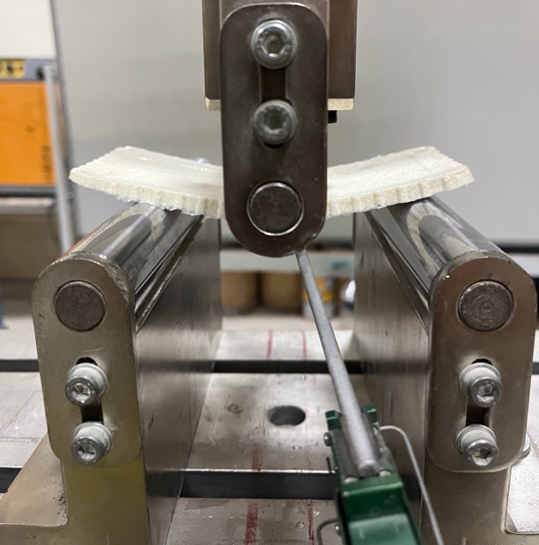
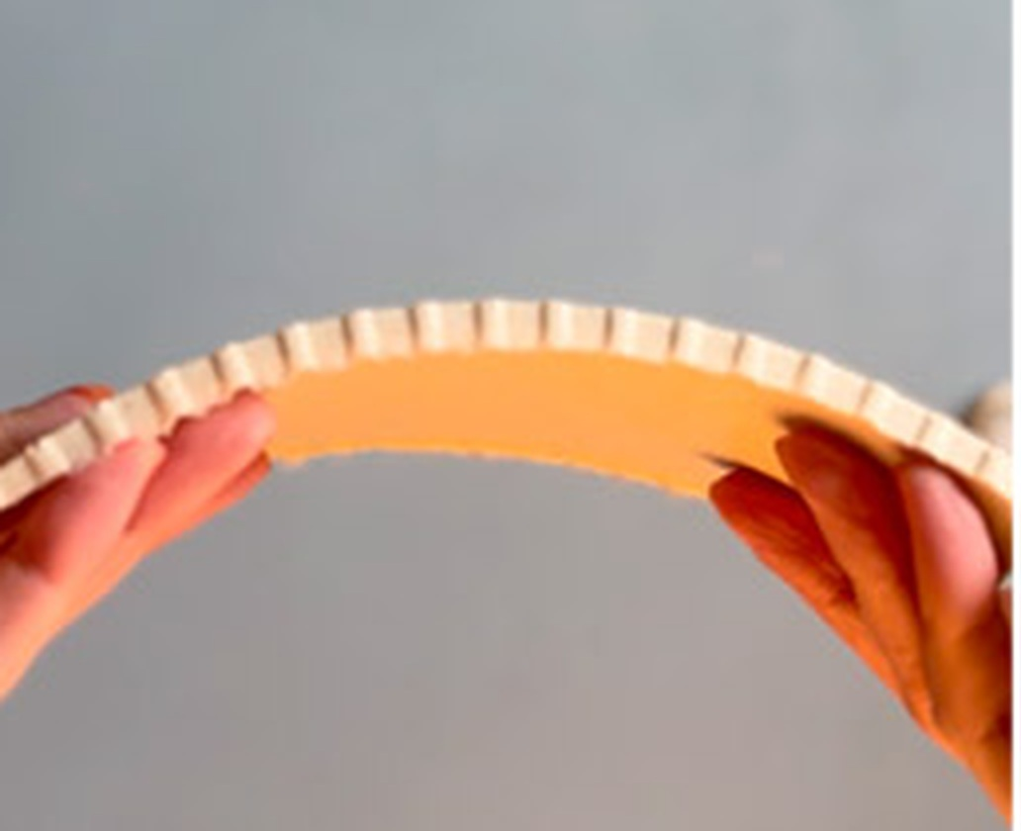
Flexural deformation
Both test programmes gave the same result: substantial deformation with the integrity retained.
The beam is deflected well past the point where a comparable ceramic would have parted, and it is still intact.
Three-point rig at high deflection · kerfed tension face · panel arched by hand
18
Notes:
18 · FLEXURAL DEFORMATION — 0:15
The beam is deflected well past the point where a comparable ceramic would have parted, and it is still intact. Both test programmes gave the same result: substantial deformation with the integrity retained.

Slide 19
Fire, water, density
Ignitability
Water absorption, 24 h immersion
≈ 10 s
0.7%
mass gain. It is the coating that limits humid service rather than the composite itself.
to ignition under direct flame
4 s
Bulk density
to self-extinguish after flame removal
Material | g/cm³ | Reference
This study (C3) | 1.38 | —
Mycelium, cellulose | 0.3 – 0.8 | Jones et al. (2020)
Fired clay brick | 1.6 – 2.0 | William & Owen (1995)
Charring remains local
No lateral flame spread
No melting and no dripping
It is an ignitability test, and there is no Euroclass classification behind it.
Mould-volume basis, therefore a lower bound.
ISO 11925-2:2020. No cone calorimetry, smoke or toxicity data.
19
Notes:
19 · FIRE, WATER, DENSITY — 0:30
The material ignites at around ten seconds under a direct flame and extinguishes itself four seconds after the flame is removed, with no lateral spread and no dripping. It is an ignitability test, and there is no classification behind it.
The mass gain over twenty-four hours of immersion was zero point seven per cent, so it is the coating that limits humid service rather than the composite itself.

Slide 20
Conventional materials
Compressive and flexural strength against interior surface materials
On strength alone this composite is not competitive with engineered wood or stone.
It has one sixth the compressive strength of MDF and one twentieth that of travertine.
Velasco & Gaona (2011) · Klyosov (2007) · Nemli & Aydın (2007) · Altun (2006)
20
Notes:
20 · CONVENTIONAL MATERIALS — 0:20
The first benchmark is against the materials this would sit beside in an interior. It has one sixth the compressive strength of MDF and one twentieth that of travertine. On strength alone this composite is not competitive with engineered wood or stone.

Slide 21
Bio-based composites
Compressive strength
Elastic modulus, MPa, logarithmic
Material | σᴄ MPa | Reference
This study (C3) | 4.1 | —
Mycelium composite | 0.145 – 0.452 | Jones et al. (2020)
Hempcrete | 0.3 – 0.6 | Arnaud & Gourlay (2012)
Eggshell-filled PLA | 2 – 5 | Kim & Pal (2010)
Mineral-filled biocomposite | 2.1 – 39.6 | Shah et al. (2016)
This study 192
LDPE
Mycelium
1
10
100
1,000
10,000
Pine
Unlabelled points: soy-based bioplastic 124, flax-fibre PLA 198, pine 11 000.
It was cast from water and dried at room temperature, with no oven, no autoclave and no extruder, and it still reaches the stiffness of melt-processed bio-polymers.
An order of magnitude above the fungal and lime-binder family in compression; wood remains two orders of magnitude above. · Values are reported as published; specimen geometry and test method differ between sources.
21
Notes:
21 · BIO-BASED COMPOSITES — 0:30
The second benchmark is the one that matters. In compression the composite stands an order of magnitude above mycelium and hempcrete, and in stiffness, at one hundred and ninety-two megapascals, it sits inside the LDPE band.
[Logaritmik eksene işaret et]
It was cast from water and dried at room temperature, with no oven, no autoclave and no extruder, and it still reaches the stiffness of melt-processed bio-polymers.

Slide 22
Modulus of resilience
Elastic energy absorbed per unit volume
Limitation
Ur = σ² / 2E
A comparative table cannot be assembled, because the literature reports strength and modulus in separate studies.
stress
14.1 kJ/m³
computed from this study's own σꜰ = 2.325 MPa and Eꜰ = 192 MPa
The modulus sits in the denominator.
Ur
Strength records the load at which a material stops performing. It does not record whether failure is then graceful or catastrophic.
strain
The shaded area is the energy absorbed per unit volume before permanent damage: ½ σ ε, and with ε = σ / E it reduces to the expression at right.
Resilience as a property of systems that absorb disturbance and retain function, after Holling (1973).
22
Notes:
22 · MODULUS OF RESILIENCE — 0:50
This brings the talk to the fifth question, and the diagram is the argument.
The shaded area is the energy a material absorbs per unit volume before permanent damage. So the low stiffness that counted against the material a moment ago is exactly what raises this quantity: about fourteen kilojoules per cubic metre.
Strength records the load at which a material stops performing. It does not record whether failure is then graceful or catastrophic — and for a demountable component, that is what decides service life.

Slide 23

Application envelope
Modular proposal derived from the measurements
Conditions of use, each traced to a measured result
Non-loadbearing surfaces
self-weight and handling loads only; σᴄ = 4.1 MPa
Dry interiors
not wet rooms, not façades; absorption depends on coating integrity
Away from ignition sources
self-extinguishing, but unclassified for reaction to fire
Modular rather than sheet
damage is replaced one unit at a time
Demountable modules on a reversible fixing, replaceable one unit at a time.
Every constituent, the shellac included, is biodegradable; reversible fixing recovers the module intact. What is displaced is quarried limestone.
No life-cycle assessment was carried out, so these are qualitative potentials rather than quantified claims.
23
Notes:
23 · APPLICATION ENVELOPE — 0:20
The application envelope follows from the measurements: non-loadbearing surfaces, dry interiors, away from ignition sources, and modular, so that damage can be replaced one unit at a time. No life-cycle assessment was carried out, so these are qualitative potentials rather than quantified claims.

Slide 24
Limitations and further work
Each limitation, and the experiment that resolves it
Limitation | Resolved by
No dispersion data — individual specimen values not retained | Repeat the series with individual values retained
Compressive strain assumed from observation | Instrument the strain; measure the curve
Shrinkage unquantified, so density is a lower bound | Record post-drying geometry
Kerfed section calculated as a solid rectangle | Test an un-kerfed section
Flexural series confounded — glycerol and solids moved together | Vary glycerol at constant solids concentration
Durability, fire classification and life-cycle assessment untested | Outside this paper; named as further work
Every value reported here is a lower bound.
24
Notes:
24 · LIMITATIONS AND FURTHER WORK — 0:25
Each limitation is placed beside the experiment that resolves it, because that pairing is the point. There is no dispersion data, the strain was assumed rather than instrumented, and the shrinkage was never quantified. Every value reported here is a lower bound.

Slide 25
Conclusions
01
A protocol that can be repeated
every production parameter reported
02
Packing density governs compressive strength
not mineral content
03
Plasticiser content sets brittle or ductile response
the transition is sharp
04
Bio-polymer stiffness without thermal processing
water-cast, ambient-dried
05
Strength on its own is not an adequate criterion
report σ and E together
Betül Ünal · b.unal91@gmail.com
Testing: Advanced Construction Materials Research Laboratory, Hacettepe University, with thanks to Dr Hüseyin İlcan. Derived from the author's doctoral dissertation, Hacettepe University, 2025.
25
Notes:
25 · CONCLUSIONS — 0:25
There are five conclusions. The protocol can be repeated. Packing density, not mineral content, governs compressive strength. Plasticiser content decides whether the material is brittle or ductile. A water-cast, ambient-dried material can reach bio-polymer stiffness. And strength on its own is not an adequate criterion for this research: strength and modulus should be reported together.
Thank you.

Slide 26
References
Adogla, F., Yalley, P.P.K. & Arkoh, M. (2016) Improving compressed laterite bricks using powdered eggshells. The International Journal of Engineering and Science, 5(4), 65–70.
Altun, İ.A. (2006) Mechanical properties of travertine. Afyon Kocatepe University.
Arnaud, L. & Gourlay, E. (2012) Experimental study of parameters influencing mechanical properties of hemp concretes. Construction and Building Materials, 28(1), 50–56.
Ashby, M.F. (2011) Materials selection in mechanical design. 4th edn. Oxford: Butterworth-Heinemann.
ASTM International (2017) ASTM D790-17: Flexural properties of unreinforced and reinforced plastics. West Conshohocken, PA.
ASTM International (2018) ASTM D570-98: Water absorption of plastics. West Conshohocken, PA.
Bhartiya, A. & Dubey, M. (2018) Replacement of cement with coconut shell ash and egg shell powder. IRJET, 5(6).
Bilici, V.O., Peşmen, G., Yönetken, A. & Erol, A. (2023) Effect of egg-shell particulate reinforcement in ceramic-metal composites. Thermal Science, 27(4B), 3179–3188.
Faruk, O., Bledzki, A.K., Fink, H.-P. & Sain, M. (2012) Biocomposites reinforced with natural fibers. Progress in Polymer Science, 37(11), 1552–1596.
Hernández, V. et al. (2022) Agar biopolymer films for biodegradable packaging: a reference dataset. Materials, 15(11), 3954.
Hirschler, M.M. (2013) Flammability and fire testing. In: Handbook of environmental degradation of materials. Oxford: William Andrew, 197–230.
Holling, C.S. (1973) Resilience and stability of ecological systems. Annual Review of Ecology and Systematics, 4, 1–23.
International Organization for Standardization (2020) ISO 11925-2: Ignitability of products subjected to direct impingement of flame — single-flame source test. Geneva.
Islam, M.R., Tudryn, G., Bucinell, R., Schadler, L. & Picu, R.C. (2018) Mechanical behavior of mycelium-based particulate composites. Journal of Materials Science, 53, 16371–16382.
Jones, M., Mautner, A., Luenco, S., Bismarck, A. & John, S. (2020) Engineered mycelium composite construction materials. Journal of Bionanoscience, 14(1), 1–10.
Karana, E., Barati, B., Rognoli, V. & Zeeuw van der Laan, A. (2015) Material driven design (MDD). International Journal of Design, 9(2), 35–54.
Kim, H.-S. & Pal, K. (2010) Mechanical properties of eggshell-filled poly(lactic acid) composites. Macromolecular Research.
Klyosov, A.A. (2007) Wood-plastic composites. Hoboken, NJ: Wiley-Interscience.
Mansour, G., Zoumaki, M., Tsongas, K. & Tzetzis, D. (2021) Microstructural and finite element analysis of soy protein isolate bioplastics. Materials, 14(19), 5479.
Nemli, G. & Aydın, A. (2007) Evaluation of the physical and mechanical properties of particleboard. Building and Environment, 42(3), 1210–1214.
Owuamanam, S. & Cree, D. (2020) Progress of bio-calcium carbonate waste eggshell and seashell fillers in polymer composites: a review. Journal of Composites Science, 4(2), 70.
Pope, D.G. & Hudson, R.G. (1989) Mechanical properties of timber. Structural Engineer.
Razzaq, A.K. & Yousif, R.A. (2017) Sustainability of HMA by using of egg shell powder. International Conference on Sustainable Futures, Bahrain.
Shafiei, S. et al. (2019) Egg shell-derived calcium phosphate/carbon dot nanofibrous scaffolds. Materials Science and Engineering: C, 100, 564–575.
Shah, D.U., Vollrath, F., Stires, J. & Deheyn, D.D. (2016) Housing fly larvae in silk: mechanical properties of mineral-filled biocomposites. Materials & Design, 109, 723–731.
Skórczewska, K., Kwiatkowski, W. & Kwiatkowski, M. (2020) Poly(vinyl chloride) composites with waste eggshell as a natural filler. Polymer Composites, 41(9), 3580–3589.
Soundara, B. & Vilasini, P.P. (2015) Effect of egg shell powder on the properties of clay. 50th Indian Geotechnical Conference, Pune.
Teara, A. et al. (2019) Durability of fly ash and eggshell powder to replace cement in concrete. IOP Conf. Series: Earth and Environmental Science, 244, 012025.
Torres, F.G., Troncoso, O.P., Piaggio, F. & Hijar, A. (2010) Structure–property relationships of a biopolymer network: the eggshell membrane. Acta Biomaterialia, 6(9), 3687–3693.
Tutuş, A. et al. (2018) Evaluation of egg shells in wallpaper production. 1st International Technological Sciences and Design Symposium, Giresun.
Velasco, P.M. & Gaona, J.L. (2011) Mechanical characterisation of compressed agricultural-waste panels. Construction and Building Materials.
Victor, E.I., Louis, I.C., Alfred, N.O. & Ozioma, U.N. (2019) Use of chicken eggshells as fillers in flexible polyurethane foam. International Journal of Industrial Engineering, 3(1), 1–6.
Vilarinho, I.S., Filippi, E. & Seabra, M.P. (2022) Development of eco-ceramic wall tiles with bioCaCO₃ from eggshells waste. Open Ceramics, 9, 100220.
William, J.S. & Owen, J.C. (1995) Egg science and technology. 4th edn. Boca Raton, FL: CRC Press.
Yönetken, A., Erol, A., Yakar, A. & Peşmen, G. (2016) Ceramic-metal composites produced by electroless Ni plating of AlN-Astaloy Cr-M. IJCMNMME, 10(3).
Zhao, X. et al. (2022) Mechanical recycling of low-density polyethylene: property evolution. Resources, Conservation and Recycling.
26
Standards applied: ASTM D790-17 · ISO 11925-2:2020 · ASTM D570-98(2018).
Notes:
26 · REFERENCES — 0:00
[Slaytı açık bırak, bir şey söyleme. Soru gelirse kaynağı buradan göster.]

Slide 27
thank you
for further questions: b.unal91@gmail.com
Notes:
SORU – CEVAP
Thank you.
Burada birinci tekil şahıs doğal; soru sana sorulmuş oluyor. Kısa tut: sınırlılığı kabul et, sonraki deneyi söyle, sus.
"Standart sapma yok, nasıl güveneceğiz?" That is correct, and it was stated before any numbers were shown. There were three specimens per formulation and the individual values were not retained. Repeating the series with dispersion reported is the first row of the limitations table.
"Basma testi hangi standarda göre?" Cube compression rather than a named standard, and that is flagged as a deviation. The flexural work follows ASTM D790-17, the ignitability test ISO 11925-2, and the absorption test ASTM D570.
"Ölçüler kalıp ölçüsü, gerçek gerilme değil." Correct. The composite shrinks as the water evaporates and the dried dimensions were not logged, so every value reported is a lower bound. Recording the dried geometry is in the limitations table.
"Yivli numuneden modül hesaplanmaz." Agreed, which is why it was reported as a lower bound rather than a material constant. Testing an un-kerfed section is in the table.
"R² = 0.99 ama üç nokta var." Which is exactly why it was offered as a hypothesis rather than a law. The claim is the physical reading: packing density, not mineral content, governs strength.
"Neden agar? Nişasta ya da jelatin olmaz mıydı?" Agar sets thermoreversibly without a hardener, and it carried sixty-six per cent mineral loading without a coupling agent. Comparing binders would be a separate study, and a fair one to ask for.
"Yangın mekanizması nedir?" The probable mechanism is endothermic decomposition of the carbonate fraction, which dilutes the flame front. Probable, because it was not verified calorimetrically.
"Nem, küf, yaşlanma?" All untested, and named as such on the limitations slide. Durability of any kind is outside the scope of this paper.
"Ölçeklenebilir mi?" There is no data on that. What can be said is that the protocol needs a hotplate, a mould and ambient drying, and nothing else.
"Yangın sınıflandırması olmadan iç mekanda nasıl kullanılacak?" It cannot be specified without one, and the application slide says so. What is reported is ignitability behaviour, which is the precondition for seeking a classification rather than a substitute for it.

