Slide 1

Development and Characterisation of Eggshell–Agar Biocomposites for Sustainable Interior Applications
Betül Ünal
Department of Interior Architecture, Cappadocia University, Nevşehir, Türkiye
ICSMMEP-26 · Mecca, Saudi Arabia · 3–4 November 2026
Notes:
Good morning. Betul Unal, Department of Interior Architecture, Cappadocia University. This paper reports the production protocol and mechanical characterisation of a fully bio-based composite made from waste eggshell bound in an agar-glycerol matrix, and proposes an evaluation criterion better suited to this class of material than compressive strength alone.

Slide 2
Problem statement: the filler is bio-based, the binder is not
ESTABLISHED USES OF EGGSHELL WASTE
Application | Matrix | Reference
Cement replacement | Portland clinker | Teara et al. 2020
Laterite brick stabilisation | Cement | Adogla et al. 2016
Asphalt binder modification | Bitumen | Razzaq & Yousif 2017
Soil stabilisation | Lime substitute | Soundara et al. 2015
Ceramic wall tile | Ceramic body | Vilarinho et al. 2020
Particulate filler | PLA, epoxy, PVC, PU | Kim & Pal 2010
THIS STUDY
Mineral phase
Waste eggshell powder, 150 µm
Binding phase
Agar (seaweed polysaccharide) plasticised with glycerol
Protective finish
Shellac, three coats
In every reported case the binding phase remains petrochemical or clinker-based. The waste is valorised; the matrix is not.
Both phases are biological and biodegradable.
Scope note: this is a non-loadbearing interior surface material. It is not proposed as a structural substitute for any material in the table above.
Notes:
Eggshell valorisation is well established. What the literature shares is that the shell always enters a synthetic or clinker matrix - cement, bitumen, lime, ceramic, or a thermoplastic. So the waste is valorised while the binder is not. This study replaces the binder as well. I should set the scope immediately: this is a non-loadbearing interior surface material, and I am not proposing it against any structural material.

Slide 3
Aim, scope and research questions
AIM
RESEARCH QUESTIONS
To document a reproducible production protocol for a fully bio-based eggshell composite, and to characterise its mechanical, thermal and hygric response against both conventional and bio-based interior materials.
Q1
Which formulation variable governs compressive strength, and over what range?
Q2
What is the effect of plasticiser content on flexural behaviour?
Q3
How does the material compare with conventional interior surface materials?
SCOPE
Five formulations, two mechanical test programmes
Three specimens per formulation
Standardised tests: ASTM D790, ISO 11925-1, ASTM D570
Single laboratory, ambient curing, no accelerated ageing
Q4
How does it compare with other bio-based composites?
Q5
Is compressive strength the appropriate criterion for this material class?
Notes:
Five questions. The first two are formulation questions, the next two are benchmarking questions, and the fifth is the one I actually care about and will come back to at the end.

Slide 4
Constituents and their function
Constituent | Origin | Function in the composite | Relevant property
Eggshell powder | Food waste | Mineral filler; load-bearing phase | 94% CaCO₃; porous shell structure
Agar | Red seaweed | Binder; forms the continuous phase | Thermoreversible gel; high water retention
Glycerol | Vegetable oil | Plasticiser; controls ductility | Humectant; low vapour pressure
Water | — | Carrier; governs solids concentration | Fully evaporated during drying
Shellac | Kerria lacca resin | Surface finish; hydrophobic barrier | Biodegradable; film-forming
Design logic: the mineral phase carries load, the agar network holds it together, and glycerol sets where the composite sits on the brittle–ductile axis. Water is not a component of the final material; it is the process variable that determines how densely the solids pack.
Gelatine, starch and vinegar were trialled during development and are not part of the reported formulations.
Notes:
Five constituents. The division of labour matters: eggshell carries load, agar forms the continuous network, glycerol decides whether the composite behaves brittle or ductile, and water is not in the final material at all - it is the process variable that sets how densely the solids pack. Keep that last point in mind, because it turns out to be the controlling variable.

Slide 5
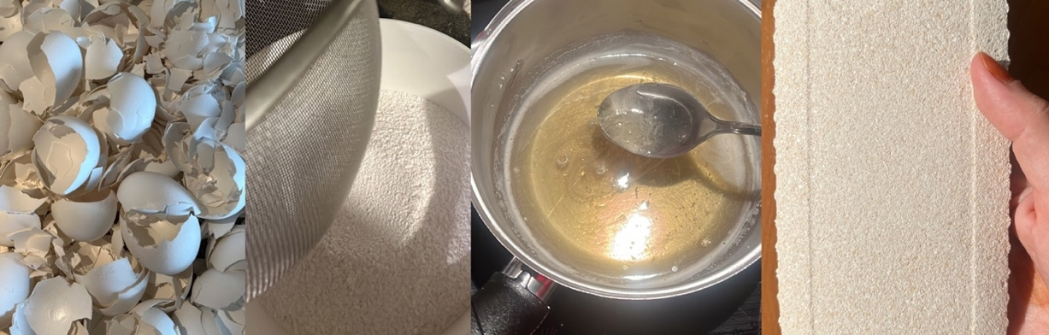
Protocol I — preparation of the mineral fraction
1
Collection and cleaning
Shells from a single local bakery, collected over more than one year. Membrane and organic residue removed by hand.
2
Thermal treatment
Laboratory oven, 120 °C for 20 minutes. Described as decontamination and drying; sterility was not verified and dry-heat sterilisation requires higher temperatures.
CONTROLLED PARAMETERS
3
Cooling and drying
Cooled to ambient, then dried until no residual moisture remained by mass.
Treatment temperature | 120 °C
Treatment duration | 20 min
Sieve aperture | 150 µm
Collection period | > 12 months
4
Milling
Laboratory mechanical grinder; milling continued until a visually homogeneous fine powder was obtained.
5
Sieving
150 µm mesh. Only the passing fraction was used, consistent with eggshell powder procedures reported for polymer composites.
Notes:
Shell preparation. Two points worth flagging. First, I call the 120 degree step decontamination and drying rather than sterilisation, because dry-heat sterilisation needs around 160 to 170 degrees for one to two hours and we did not verify sterility. Second, the 150 micrometre sieve was chosen to match the particle size used in the polymer-composite eggshell literature, so that the mineral phase here is comparable to that work.

Slide 6
Protocol II — the binder phase and its thermal regime
1
Pre-mixing
Water and glycerol combined and stirred to a homogeneous liquid before any solids are introduced.
THERMAL REGIME
95 °C
2
Agar dispersion
dissolution set point
Powdered agar added incrementally under continuous stirring. Bulk addition causes agglomeration that does not redisperse.
80 °C
3
Dissolution stage
controlled cooking set point
Heated to 95 °C and held until the agar is fully in solution. Below full dissolution the gel network does not form continuously.
55 min total heating, across both stages
4
Cooking stage
The two-stage regime follows the 70–90 °C band reported for agar-based biomaterial preparation.
Reduced to 80 °C and held, stirring maintained, while viscosity develops into a pourable but cohesive binder.
Reproducibility limit: stirring was manual throughout, so shear rate and mixing energy are not controlled quantities. The regime is reproducible in a studio; it is not yet specified tightly enough for an instrumented laboratory.
Notes:
The binder is a two-stage thermal regime: dissolution at 95, then a controlled cooking hold at 80, 55 minutes in total. The reason for two stages is that agar must be fully in solution before viscosity is allowed to build, otherwise the gel network forms in patches. And I will say plainly: stirring was manual, so shear rate is not a controlled quantity. This protocol is reproducible in a studio. It is not yet tight enough for an instrumented laboratory, and that is a real limit.

Slide 7
Protocol III — compositing, casting and drying
1
Mineral incorporation
Sieved shell fraction added incrementally into the binder held at 80 °C, under continuous stirring. Earlier addition causes sedimentation of the mineral phase.
DISCLOSURE — DIMENSIONAL LOSS
The composite shrinks appreciably as the water phase evaporates. Cross-sections were measured at the time of testing, but post-drying dimensions were not logged in the original study. Dimensions quoted in this presentation are mould dimensions unless stated otherwise.
Anyone applying this protocol should record specimen geometry after drying, not at casting.
2
Casting
Poured into silicone moulds and levelled. Silicone was selected for flexibility: it releases without a parting agent and without damaging the partially consolidated specimen.
3
In-mould setting
Four days. Mould geometry follows the test: 50 mm cube moulds for compression, flat moulds for flexural, flame and absorption specimens.
4
Ambient consolidation
Demoulded, then a further seven days at approximately 23 °C, shielded from direct sunlight and forced air movement. No oven drying at any stage.
23 °C · 11 days · no oven
Total time from casting to a finished specimen: 11 days, entirely at ambient temperature. No energy input beyond the 55-minute cook.
Notes:
Compositing, casting and drying. The mineral goes in at 80 degrees, late, because adding it earlier lets it settle out. Silicone moulds release without a parting agent. Then four days in mould and seven days consolidating, all at ambient - no oven at any point, which matters for the energy argument. And the disclosure: the material shrinks as water leaves. Cross-sections were measured at test time, but the dried dimensions were not logged, so unless I say otherwise the dimensions here are mould dimensions.

Slide 8
Formulation matrix and derived ratios
ID | Test | Water (g) | Shell (g) | Agar (g) | Glycerol (g) | Solids (g) | Shell : binder | Solids : water | Glycerol % of solids
C1 | Compression | 325 | 80 | 35 | 5 | 120 | 2.00 | 0.37 | 4.2
C2 | Compression | 310 | 90 | 40 | 5 | 135 | 2.00 | 0.44 | 3.7
C3 | Compression | 280 | 110 | 45 | 10 | 165 | 2.00 | 0.59 | 6.1
F1 | Flexure | 450 | 190 | 70 | 60 | 320 | 1.46 | 0.71 | 18.8
F2 | Flexure | 480 | 190 | 70 | 30 | 290 | 1.90 | 0.60 | 10.3
COMPRESSION SERIES
FLEXURAL SERIES — CONFOUND
The shell-to-binder mass ratio is held at exactly 2.00 across all three formulations. The single variable that changes is solids concentration, which rises from 0.37 to 0.59.
Glycerol was halved, but total batch mass was held at 770 g, so water rose to compensate. Shell-to-binder and solids concentration therefore moved as well. The glycerol effect is not fully isolated.
Notes:
This is the formulation matrix with the derived ratios added, and the two right-hand columns are the ones to read. In the compression series the shell-to-binder ratio is exactly two point zero zero in all three mixes - that was not planned as a control, but it means the only thing that actually varies is solids concentration. In the flexural series I have to declare a confound: glycerol was halved, but total batch mass was fixed at 770 grams, so water rose to compensate and the other two ratios shifted with it. The glycerol effect is therefore not cleanly isolated.

Slide 9
Test programme
Property | Standard | Specimen geometry | n | Measured quantity
Compressive behaviour | — (cube compression) | 50 mm cube moulds | 3 per mix | Maximum load; compressive stress
Flexural behaviour | ASTM D790, three-point | 180 × 60 × 20 mm, 120 mm span | 3 per mix | Flexural strength; flexural modulus
Reaction to fire | ISO 11925-1 | 40 × 50 mm, 45°, 15 s edge flame | 2 ignitions | Time to ignition; time to self-extinguish
Water absorption | ASTM D570 | 40 × 50 mm, shellac-coated | 1 | Mass gain after 24 h immersion
Bulk density | Gravimetric | 50 mm cube | 1 | Mass / mould volume
REPORTING CONVENTION
All mechanical values reported in this presentation are means of three specimens. Individual specimen values were not retained in the original study, so standard deviations cannot be reported. Fire, absorption and density figures rest on single determinations and are presented as indicative rather than characteristic values.
All testing: Advanced Construction Materials Research Laboratory, Hacettepe University.
Notes:
The test programme, with the standards and specimen geometries. I want the reporting convention on the record before any numbers appear: mechanical values are means of three specimens, individual values were not retained so I cannot give you standard deviations, and the fire, absorption and density figures are single determinations - indicative, not characteristic. All testing was at the Advanced Construction Materials Research Laboratory at Hacettepe.

Slide 10
Compressive strength scales with solids concentration
ID | Solids : water | Fₘₐₓ (kN) | σᴄ (MPa)
C1 | 0.37 | 3.89 | 2.55
C2 | 0.44 | 4.30 | 3.12
C3 | 0.59 | 6.80 | 4.10
OBSERVED RELATIONSHIP
σᴄ = 6.93 · (solids : water) + 0.04
R² = 0.994 over the range 0.37 – 0.59
With shell : binder fixed at 2.00, compressive stress is a linear function of solids concentration across the range tested. Three formulations cannot establish this as a law — but it is a testable hypothesis, and it predicts that strength is set by packing density rather than by mineral content as such.
Notes:
Here is the compression result, and it is tidier than I expected. Because shell-to-binder is fixed at two, solids concentration is the only variable - and compressive stress is linear in it, with an R-squared of 0.994 over the range 0.37 to 0.59. Now, three points will fit almost any line, so I am not claiming a law. What I am claiming is a testable hypothesis with a clear physical reading: strength here is governed by packing density, not by mineral content as such. If that is right, the way to a stronger composite is to remove water, not to add shell.

Slide 11


Failure mode: progressive crushing, not fracture
Compressive stress – strain, C3
READING THE CURVE
Initial linear elastic region to approximately 1 MPa.
Progressive stiffness loss as the agar network yields and the mineral phase redistributes.
Peak stress reached at roughly 10% strain, with no abrupt load drop.
Beyond peak the specimen continues to deform while retaining integrity: energy is absorbed rather than released.
Stress (MPa)
Strain
Bulk density 1.38 g/cm³ (mould volume basis) · specific compressive strength 2.96 MPa per g/cm³
Strain values were derived from an assumed 10% maximum deformation based on observation during testing, not from instrumented strain measurement.
C3 specimen after loading: barrelled, shortened, still a single body
Notes:
The failure mode is the part I would ask about if I were sitting where you are. The curve is initially linear to about one megapascal, then stiffness falls away progressively as the agar network yields and the mineral phase redistributes. Peak stress arrives at roughly ten percent strain with no abrupt drop, and beyond peak the specimen keeps deforming while holding together. Energy is absorbed rather than released. One honesty point: the strain axis is derived from an assumed ten percent maximum deformation based on observation, not from instrumented strain measurement.

Slide 12

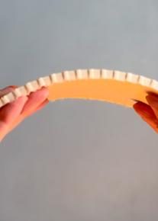

Flexural behaviour: plasticiser content is decisive
ID | Glycerol % of solids | Fₘₐₓ (N) | σꜰ (MPa) | Eꜰ (MPa) | ε at peak
F1 | 18.8 | — | not measurable | — | —
F2 | 10.3 | 310 | 2.325 | 192 | 0.0121
DISCLOSURE — SECTION GEOMETRY
The specimen carries transverse kerfs on its tension face, visible in both photographs. ASTM D790 assumes a solid rectangular section and the calculation above uses the full 60 × 20 mm. Part of the measured compliance is geometric, not material, and the reported modulus is therefore a lower bound on the bulk material.
σꜰ = 3FL / 2bd² with F = 310 N, L = 120 mm, b = 60 mm, d = 20 mm · ε = σꜰ / Eꜰ (Hooke, elastic region)
Flexural stress – strain, F2
INTERPRETATION
At 18.8% glycerol the composite deformed without developing measurable resistance — the testing machine registered no usable load. Halving the plasticiser produced a section that resists while still flexing. The transition is sharp, and it sits between these two values.
Three-point rig at high deflection; kerfed panel arched by hand
Notes:
Flexure, to ASTM D790. The decisive variable is plasticiser. At 18.8 percent glycerol the composite deformed without developing measurable resistance - the machine registered nothing usable. Halving it produced a section that resists while still flexing: 2.325 megapascals at a modulus of 192. The transition is sharp and it lies between those two values, which is itself useful to know. Two disclosures. First, as I showed earlier, the glycerol effect is confounded with solids concentration. Second, look at the tension face - it is kerfed. D790 assumes a solid rectangle and my calculation uses the full twenty millimetre depth, so some of this compliance is geometric. The modulus I am quoting is a lower bound on the bulk material.

Slide 13

Reaction to fire
ISO 11925-1, SINGLE-FLAME EDGE IGNITION
MECHANISM
40 × 50 mm dried specimen, flame applied at 45° to the upper corner for 15 s; repeated at the lower corner.
The calcium carbonate fraction is the probable contributor: carbonates endothermically decompose and release CO₂, which dilutes the flame front locally. This is consistent with the absence of lateral spread, but was not verified calorimetrically here.
~10 s
4 s
to ignition under direct flame
to self-extinguish after flame removal
Charring remained local to the point of flame contact.
No lateral flame spread in either ignition.
No melting and no dripping — no thermoplastic behaviour.
Physical integrity retained outside the charred zone.
WHAT THIS IS NOT
ISO 11925-1 is an ignitability test. No Euroclass reaction-to-fire classification was determined, and no cone calorimetry, smoke density or toxicity data were obtained.
Notes:
Reaction to fire, by single-flame ignitability. Ignition at around ten seconds under direct flame, self-extinguishing four seconds after the flame is removed. Charring stayed local, there was no lateral spread, and - importantly for a polymer-adjacent material - no melting and no dripping. The probable mechanism is the carbonate fraction: carbonates decompose endothermically and release carbon dioxide, which dilutes the flame front locally. I did not verify that calorimetrically. And to be clear about what this is not: 11925-1 is an ignitability test. There is no Euroclass classification here, no cone calorimetry, no smoke density, no toxicity data.

Slide 14
Hygric response and bulk density
WATER ABSORPTION — ASTM D570
BULK DENSITY — COMPARATIVE POSITION
40 × 50 mm specimen, fully dried, three coats of shellac. Initial mass 10 g, full immersion in distilled water at ambient temperature for 24 h.
C3 specimen: 173 g over a 125 cm³ mould volume.
Material | Density (g/cm³) | Reference
This study (C3) | 1.38 | —
Mycelium, cellulose composites | 0.3 – 0.8 | Jones et al. 2020
Fired clay brick | 1.6 – 2.0 | William & Owen 1995
Normal-weight concrete | 2.4 | William & Owen 1995
0.7%
mass gain over 24 h, shellac-coated
Slight dimensional expansion observed, consistent with water penetrating inter-fibre voids.
Where the coating was thin, local dissolution and surface loss occurred.
Coating integrity, not the composite itself, is the limiting factor for any humid application.
Denser than the fungal and cellulosic bio-material family, lighter than fired clay and concrete. The density is quoted on a mould-volume basis and is therefore a lower bound: the dried specimen occupies less volume than the mould.
Notes:
Two environmental properties. On water: with three shellac coats, 0.7 percent mass gain over twenty-four hours of full immersion. There was slight dimensional expansion, and where the coating was thin the surface dissolved locally - so coating integrity, not the composite, is the limiting factor for humid use. On density: 1.38 grams per cubic centimetre, which places the material between the fungal and cellulosic bio-materials below it and fired clay above it. And note that this is on a mould-volume basis, so it is a lower bound - the dried specimen occupies less volume than the mould did.

Slide 15
Benchmark I — conventional interior surface materials
POSITION
Compressive strength is one sixth that of MDF and one twentieth that of travertine — a stone the material visually resembles.
It exceeds compressed mushroom panel, the only other fully bio-based board in this set, by a factor of three.
On strength alone, the material does not compete with engineered wood or stone, and this presentation does not claim that it does.
Velasco & Gaona 2011 · Klyosov 2007 · Nemli & Aydın 2007 · Altun 2006
Notes:
First benchmark, against the conventional interior materials this would sit alongside. Let me be blunt. Compressive strength is one sixth of MDF and one twentieth of travertine - and travertine is the relevant comparison aesthetically, because the material looks like it. It does beat compressed mushroom panel, which is the only other fully bio-based board in the set, by a factor of three. But on strength alone it does not compete with engineered wood or stone, and I am not going to claim that it does.

Slide 16
Benchmark II — bio-based composites
COMPRESSIVE STRENGTH
ELASTIC MODULUS
Material | σᴄ (MPa) | Reference
This study (C3) | 4.1 | —
Mycelium-based composite | 0.145 – 0.452 | Jones et al. 2020
Hempcrete | 0.3 – 0.6 | Arnaud & Gourlay 2012
Eggshell-filled PLA | 2 – 5 | Kim & Pal 2010
Mineral-filled biocomposite | 2.1 – 39.6 | Shah et al. 2016
30% algae-filled composite | 21.3 | Kim & Pal 2010
Material | E (MPa) | Reference
This study (F2) | 192 | —
Mycelium-based composite | 1.8 – 5 | Islam et al. 2018
Soy-based bioplastic | 124 | Mansour et al. 2021
Corn starch + hemp fibre | 158 | Dweib et al. 2004
Flax-fibre PLA | 198 | Faruk et al. 2012
LDPE | 100 – 300 | Zhao et al. 2022
Wood (pine) | 11 000 | Pope & Hudson 1989
WHERE THE MATERIAL SITS
An order of magnitude above the fungal and lime-binder family in compression, and squarely inside the bio-polymer band in stiffness — between soy bioplastic at 124 MPa and flax-fibre PLA at 198 MPa, within the LDPE range. A mineral-filled, water-cast, oven-free material reaches the stiffness of melt-processed bio-polymers.
Notes:
Second benchmark, and this is the one that matters. Against the bio-based family the position changes completely. In compression the material is an order of magnitude above mycelium composites and hempcrete - the fungal and lime-binder family. In stiffness it sits squarely inside the bio-polymer band: 192 megapascals, between soy bioplastic at 124 and flax-fibre PLA at 198, inside the LDPE range. I want to underline what that means. This is a water-cast material, dried at room temperature, with no oven and no extrusion - and it reaches the stiffness of melt-processed bio-polymers. Wood is still two orders of magnitude above, and I am not going to pretend otherwise.

Slide 17
A derived property: modulus of resilience
DEFINITION
WHY IT FITS THIS MATERIAL CLASS
Ur = σꜰ² / 2Eꜰ
Both test programmes produced the same qualitative result: the specimens deformed substantially and retained integrity rather than fracturing. Strength figures record the load at which a material stops performing. They do not record whether it then fails gracefully or catastrophically — which, for a demountable non-loadbearing component, is the behaviour that governs service life.
The elastic strain energy absorbed per unit volume up to the onset of permanent deformation — the area under the stress–strain curve to yield.
Ur = 2.325² / (2 × 192) = 0.0141 MPa = 14.1 kJ/m³
PROPOSAL, AND ITS CURRENT LIMIT
from this study's own measured σꜰ and Eꜰ for F2
Report σꜰ and Eꜰ from the same specimen set for bio-based materials, so that Ur can be derived. At present it rarely can: the literature reports strength and modulus in separate studies on different formulations, so a comparative Ur table cannot yet be assembled. This value is offered as a single data point and a measurement convention, not as a ranking.
Stiffness sits in the denominator. The low modulus reported as a deficiency in Benchmark I is precisely what raises this quantity.
Notes:
This brings me to the fifth research question. The modulus of resilience is the elastic strain energy absorbed per unit volume up to permanent deformation - the area under the curve to yield. Note where stiffness sits: in the denominator. So the low modulus that counted against the material in the first benchmark is exactly what raises this quantity. For F2 it works out at 14.1 kilojoules per cubic metre, from this study's own two measurements. Why does this fit the material class? Because both test programmes gave the same qualitative result - substantial deformation with retained integrity. Strength tells you the load at which a material stops performing. It does not tell you whether it then fails gracefully or catastrophically, and for a demountable non-loadbearing component that is the behaviour that governs service life. Now the honest limit: I cannot give you a comparative table, because the literature reports strength and modulus in separate studies on different formulations. So this is a data point and a measurement convention, not a ranking.

Slide 18
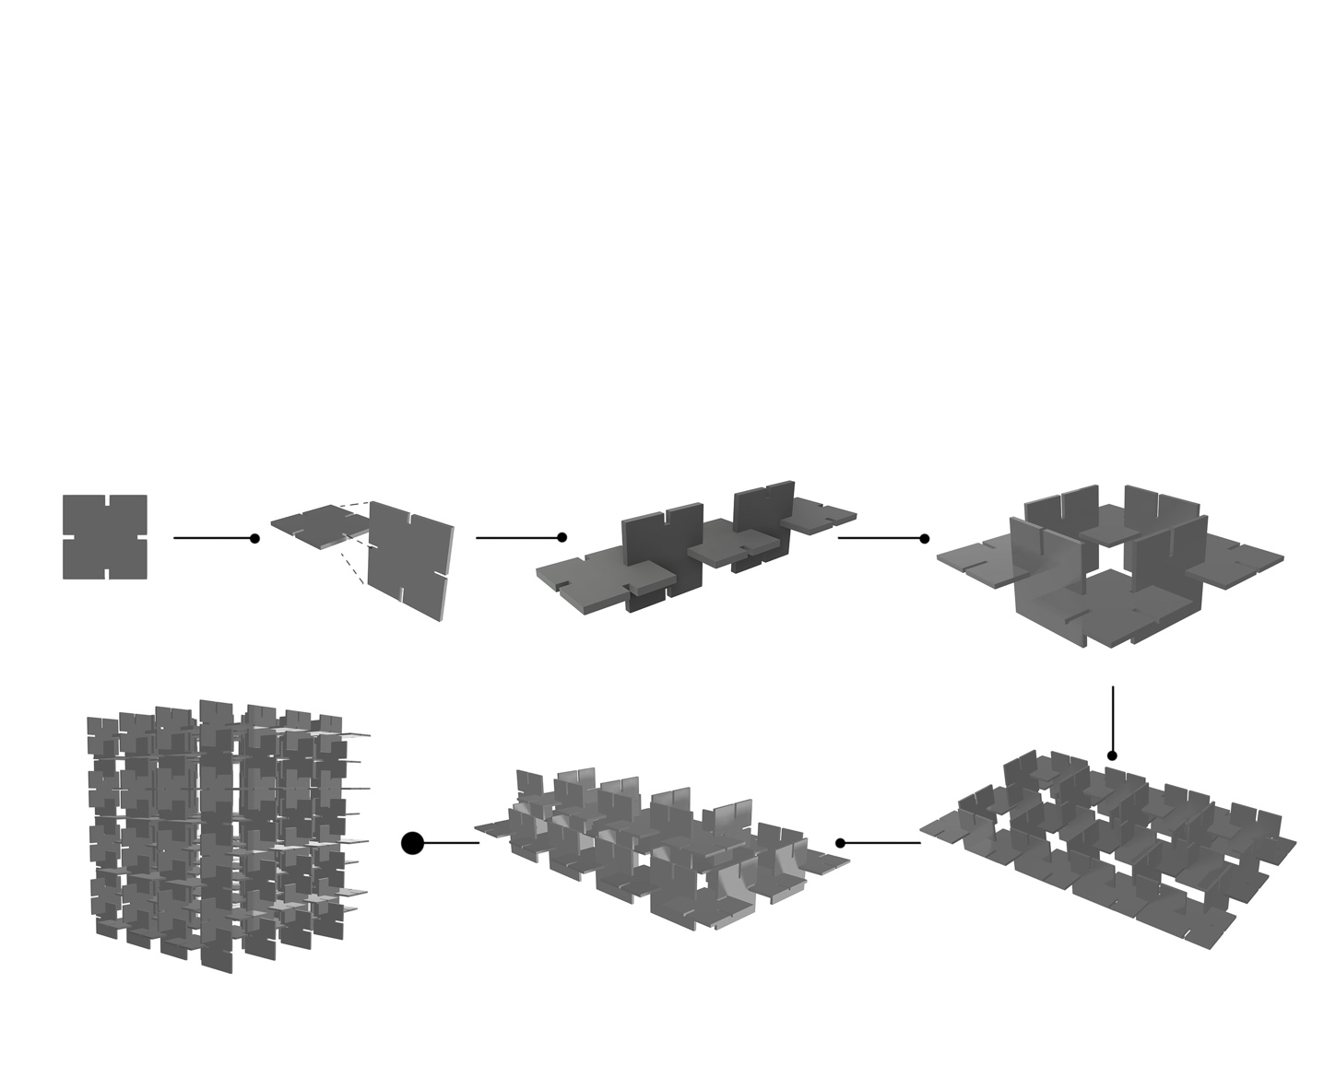

Product proposal — a modular, demountable interior system
DERIVED FROM THE MEASURED PROPERTIES, NOT IMPOSED ON THEM
Low strength, high deformation capacity → component carries its own weight and handling loads only; no structural duty.
Self-extinguishing, no dripping → acceptable for interior surfaces away from ignition sources.
Coating-dependent water resistance → dry interior environments; not wet rooms or facades.
Repeatable small-format casting → a module, not a sheet. Failure is replaced one unit at a time.
SYSTEM CHARACTERISTICS
Modularity — repeated cast units assembled without adhesive, so the assembly is reversible.
Connectivity — units interlock, distributing load across neighbours rather than through a frame.
Redundancy — a damaged unit is replaceable; the system does not depend on any single component.
Diversity — colour, texture and format vary within one formulation family, from pigments and mould geometry.
Notes:
The product proposal follows from the measurements rather than being imposed on them. Low strength with high deformation capacity means the component carries its own weight and handling loads and nothing else. Self-extinguishing with no dripping means interior surfaces away from ignition sources. Coating-dependent water resistance means dry interiors, not wet rooms and not facades. And repeatable small-format casting means a module rather than a sheet - which matters, because it means failure is replaced one unit at a time. The system is assembled without adhesive, so it is reversible; units interlock so load distributes across neighbours; a damaged unit is replaceable; and colour and texture vary within a single formulation family.

Slide 19
Potentials for sustainable interiors
Waste valorisation at source
Low-energy production
A locally available food-waste stream becomes a surface material without an intermediate industry. The shells for this study came from one bakery.
No oven, no autoclave, no extrusion. A single 55-minute cook near 95 °C, then ambient drying. The thermal budget is a fraction of ceramic or cement-based surfaces.
End-of-life by design
Reversible assembly
Every constituent is biodegradable, including the shellac finish. The material returns to a biological cycle rather than requiring separation and disposal.
Adhesive-free modular assembly means the material can be recovered intact, so reuse precedes recycling in the hierarchy.
Replacing a mineral extraction
Local, low-barrier manufacture
The calcium carbonate here substitutes quarried limestone in a surface application, which is a direct displacement rather than a downcycled use.
The protocol requires a grinder, a sieve, a hotplate and silicone moulds. Production can be distributed rather than centralised.
No life-cycle assessment was carried out. These are qualitative potentials grounded in the production protocol, not quantified environmental claims.
Notes:
Six potentials, and I want to be careful to call them potentials. Waste valorisation at source - a local food-waste stream becomes a surface material with no intermediate industry. Low-energy production - no oven, no autoclave, no extrusion; one 55-minute cook and then ambient drying. End-of-life by design - every constituent biodegrades, including the shellac. Reversible assembly, so reuse precedes recycling. A direct displacement of quarried limestone rather than a downcycled use. And low-barrier manufacture: a grinder, a sieve, a hotplate, silicone moulds. One caveat that matters: no life-cycle assessment was carried out, so these are qualitative potentials grounded in the protocol, not quantified environmental claims.

Slide 20
Limitations of the study
Dispersion not reported
Formulation confound in flexure
Means of three specimens per formulation; individual values were not retained, so no standard deviations or coefficients of variation can be given.
Glycerol, solids concentration and shell-to-binder ratio moved together between F1 and F2. The plasticiser effect is not isolated.
Section geometry in flexure
Strain not instrumented
The ASTM D790 calculation treats a kerfed specimen as a solid rectangle. The reported modulus is a lower bound.
Compressive strain was derived from an assumed 10% maximum deformation based on observation, not measured directly.
Shrinkage unquantified
Process not instrumented
Post-drying dimensions were not logged. Density is quoted on a mould-volume basis and is a lower bound.
Manual stirring leaves shear rate and mixing energy uncontrolled. Single laboratory, single operator, no inter-laboratory reproduction.
No durability data
No fire classification or LCA
No humidity cycling, thermal cycling, UV exposure, microbial resistance or accelerated ageing was performed.
Ignitability only, with no Euroclass determination, and no life-cycle assessment to support the environmental argument.
A protocol offered for others to repeat has to state where it is thin. Each of these is addressable, and each defines a specific next experiment.
Notes:
I would rather set out the limitations precisely than have them found. Dispersion is not reported. The flexural comparison carries a formulation confound. The D790 calculation treats a kerfed section as solid. Compressive strain was assumed, not instrumented. Shrinkage is unquantified, so density is a lower bound. The process is not instrumented - manual stirring, one laboratory, one operator, no inter-laboratory reproduction. There is no durability data of any kind. And there is no fire classification and no LCA. A protocol offered for others to repeat has to say where it is thin, and each of these defines a specific next experiment rather than a vague caveat.

Slide 21
Conclusions
01
A reproducible protocol
Every parameter required to produce the composite is reported: 120 °C shell treatment, 150 µm fraction, 95 °C dissolution, 80 °C cook, 55 min, silicone casting, 11 days ambient.
02
Solids concentration governs strength
With shell : binder fixed at 2.00, compressive stress is linear in solids concentration across 0.37–0.59 (R² = 0.994, three formulations). Strength is set by packing density.
03
Plasticiser sets the brittle–ductile transition
Between 18.8% and 10.3% glycerol the composite moves from unmeasurable compliance to 2.33 MPa at 192 MPa.
04
Bio-polymer stiffness, oven-free
192 MPa places a water-cast, ambient-dried material inside the band occupied by melt-processed bio-polymers.
05
Strength is the wrong sole criterion
Deformation capacity governs service behaviour for demountable non-loadbearing components. σ and E should be reported together so that Ur can be derived.
Betül Ünal · Department of Interior Architecture, Cappadocia University · b.unal91@gmail.com
Testing: Advanced Construction Materials Research Laboratory, Hacettepe University, with thanks to Dr Hüseyin İlcan. Derived from the author's doctoral dissertation, Hacettepe University, 2025.
Notes:
Five conclusions. A reproducible protocol, reported parameter by parameter. Solids concentration, not mineral content, governs compressive strength - linear across the range tested. Plasticiser content sets the brittle-ductile transition, and that transition lies between 18.8 and 10.3 percent glycerol. A water-cast, ambient-dried material reaches bio-polymer stiffness without an oven. And strength alone is the wrong criterion for this class: deformation capacity governs service behaviour, and strength and modulus should be reported together so that the modulus of resilience can be derived. Thank you. I am happy to take questions.

