Slide 1
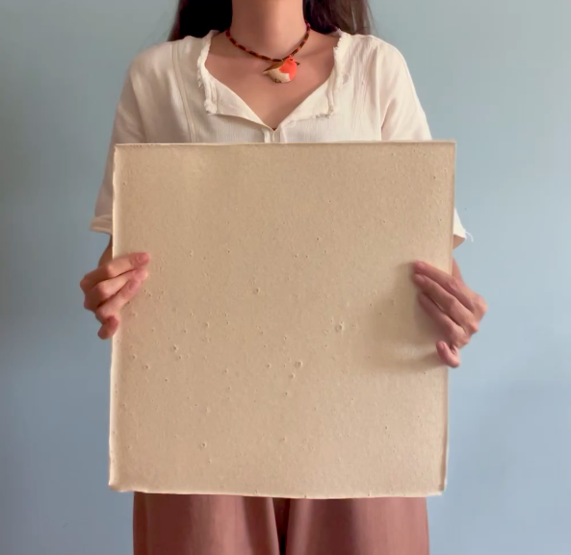
Eggshell–Agar
Biocomposites
Development and characterisation for sustainable interior applications
Betül Ünal
Department of Interior Architecture
Cappadocia University
ICSMMEP-26 · MECCA · 3–4 NOVEMBER 2026
Notes:
Good morning. Betul Unal, Department of Interior Architecture, Cappadocia University. The panel in the photograph is the subject of this paper: a composite of waste eggshell bound in agar, cast at 300 by 300 millimetres. Over the next fifteen minutes I will set out the production protocol, the characterisation results, and an argument about how materials of this class should be evaluated.

Slide 2
Background
Point of departure
Material basis
Eggshell arises continuously as a food-processing by-product and is predominantly landfilled. It accounts for roughly a tenth of the mass of every egg, so the stream is neither small nor intermittent. Chemically it is almost pure calcium carbonate held in a porous, protein-bound crystalline structure, with a specific gravity below that of most mineral fillers used in construction.
Its composition and its uninterrupted supply have made it an established secondary mineral resource, and a substantial body of work has incorporated it into construction and polymer materials.
94–97%
calcium carbonate by mass
0.85–2.66
specific gravity, below most mineral fillers
William & Owen (1995) · Torres et al. (2010) · Owuamanam & Cree (2020)
Disposal and valorisation routes
Landfill — current practice
The case for eggshell as a mineral phase is settled. This paper is concerned with the phase that binds it.
Food processing
Waste eggshell
Secondary mineral resource
Notes:
The point of departure. Eggshell arises continuously as a food-processing by-product and is predominantly landfilled. Chemically it is almost pure calcium carbonate, between ninety-four and ninety-seven percent by mass, held in a porous protein-bound crystalline structure, and its specific gravity sits below that of most mineral fillers used in construction. That composition and that uninterrupted supply are why a substantial literature already incorporates it into construction and polymer materials. All shell used in this study came from a single bakery, collected over more than a year. I want to be clear at the outset: the case for eggshell as a mineral phase is settled, and this paper does not re-make it. The paper is concerned with the phase that binds it.

Slide 3
Prior applications
Established uses of eggshell waste in engineered materials
Application | Binding phase | Reference
Partial cement replacement in concrete | Portland clinker | Teara et al. (2019); Bhartiya & Dubey (2018)
Compressed laterite brick | Soil – lime | Adogla et al. (2016)
Hot-mix asphalt | Bitumen | Razzaq & Yousif (2017)
Clay stabilisation | Clay mineral | Soundara & Vilasini (2015)
Eco-ceramic wall tile | Ceramic body | Vilarinho et al. (2022)
Particulate filler in PVC | Poly(vinyl chloride) | Skórczewska et al. (2020)
Filler in flexible polyurethane foam | Polyurethane | Victor et al. (2019)
Ceramic–metal composite | Metal matrix | Bilici et al. (2023); Yönetken et al. (2016)
Bone tissue scaffold | Calcium phosphate | Shafiei et al. (2019)
Wallpaper | Cellulosic furnish | Tutuş et al. (2018)
What every row above has in common
MINERAL PHASE · recovered from waste in every study above
BINDING PHASE · cementitious, ceramic or petrochemical in every study above
Notes:
This is the literature the study departs from, and reading down the middle column is the whole argument. Eggshell has been used as a partial cement replacement in concrete, as a stabiliser in compressed laterite brick and in clay, as a filler in hot-mix asphalt, in eco-ceramic wall tile, as a particulate filler in PVC and in flexible polyurethane foam, in ceramic-metal composites, in bone scaffolds, and even in wallpaper. The valorisation is real and it is well evidenced. But in every one of those cases the mineral is recovered from waste while the binding phase remains cementitious, ceramic or petrochemical. The environmental burden of the material is carried by the binder, and the binder is untouched.

Slide 4
Agar as binder
Properties and existing characterisation
Form and loading case in this study
Agar is a thermoreversible polysaccharide extracted from red seaweed. It melts on heating and sets on cooling without chemical crosslinking, so no reactive hardener is required. Its behaviour with glycerol has been mapped systematically across 32 formulations and released as an open reference dataset.
— | Film literature | This study
Form | Thin cast film | Cast solid, 20–50 mm
Mineral phase | Unfilled | 66% of solids
Loading | Uniaxial tension | Compression and bending
Scope of that characterisation
Unfilled thin films, loaded in uniaxial tension, evaluated for packaging. Agar has not been characterised as the binding phase of a mineral-filled cast solid in bending.
The compositional logic transfers. The form and the loading case do not, and it is the loading case that governs use as an interior surface.
Thermoreversible setting
heat, 95 °C
Gel — solid
Sol — in solution
cool, ambient
Hernández et al. (2022), Materials 15(11), 3954 — 32 agar / glycerin / water formulations, released as an open dataset.
The transition is physical, not chemical: no reactive hardener, no cure temperature, and at 66% mineral loading no coupling agent.
Notes:
The binder is agar, a thermoreversible polysaccharide extracted from red seaweed. It melts on heating and sets on cooling without chemical crosslinking, which means no reactive hardener and no elevated-temperature cure. Its behaviour with glycerol is reasonably well mapped: Hernandez and colleagues ran thirty-two agar, glycerin and water formulations by design of experiments in 2022 and released the dataset openly. But note the scope of that work. Unfilled thin films, loaded in uniaxial tension, evaluated for packaging. The compositional logic transfers to this study. The form and the loading case do not, and for an interior surface the loading case is bending.

Slide 5
Research gap
Three gaps follow from the preceding two slides
01
The binding phase is never biological
Across the eggshell literature the mineral is recovered from waste while the matrix remains Portland clinker, bitumen, lime, a ceramic body or a thermoplastic. No study reports an eggshell composite in which both phases are of biological origin and fully biodegradable.
02
Agar is characterised only as an unfilled film
The reference dataset covers thin films in uniaxial tension for packaging. The behaviour of agar as the binding phase of a highly mineral-filled cast solid, loaded in bending, is not reported.
03
Property sets are reported in fragments
Compressive, flexural, reaction-to-fire and hygric behaviour are reported in separate studies on separate formulations. No single study gives all four for one eggshell–biopolymer formulation family.
The contribution is therefore a documented protocol and a single coherent property set, not a novel constituent.
Notes:
Three gaps follow directly from those two slides. First, the binding phase is never biological. Across the whole eggshell literature the mineral is recovered from waste while the matrix stays Portland clinker, bitumen, lime, a ceramic body or a thermoplastic - no study reports an eggshell composite in which both phases are biological and fully biodegradable. Second, agar is characterised only as an unfilled film in tension for packaging, not as the binder of a highly mineral-filled cast solid in bending. Third, property sets are reported in fragments: compressive, flexural, fire and hygric behaviour appear in separate studies on separate formulations, and no single study gives all four for one formulation family. I want to state the contribution precisely, because overclaiming here would be easy. It is not a novel constituent. It is a documented protocol and a single coherent property set.

Slide 6
Aim
To document a reproducible production protocol for a fully bio-based eggshell–agar composite, and to characterise its mechanical, reaction-to-fire and hygric behaviour against published test standards.
Objectives
01
Document the protocol in full
Every parameter, in a form another laboratory can repeat.
02
Characterise against published standards
ASTM D790-17 · ISO 11925-2:2020 · ASTM D570-98.
03
Position the results
Against conventional interior materials and against bio-based composites.
04
Derive an evaluation criterion
Which measured quantity governs service behaviour for this class.
Notes:
The aim, stated narrowly on purpose: document a reproducible production protocol for a fully bio-based eggshell-agar composite, and characterise its mechanical, reaction-to-fire and hygric behaviour against published test standards. Four objectives follow. One, document the protocol in full, every parameter, in a form another laboratory can repeat. Two, characterise against published standards rather than ad hoc procedures. Three, position the results against two material families using published property data. Four, derive an evaluation criterion appropriate to this material class - and that fourth objective is the one I will spend most time on at the end.

Slide 7
Scope
Within scope
Outside scope
Dimension | This study
Formulations | Five — three compressive, two flexural
Specimens | Three per formulation for mechanical testing
Properties | Compression, flexure, ignitability, water absorption, bulk density
Standards | ASTM D790-17 · ISO 11925-2:2020 · ASTM D570-98(2018)
Conditions | Ambient cure, single laboratory, single operator
Application | Non-loadbearing interior surfaces
No durability, classification or life-cycle data were generated. The results reported here are characterisation data, not a performance specification.
Each exclusion is revisited as a defined next experiment in the closing section.
Property coverage
Compression
Flexure
Ignitability
Water absorption
Bulk density
Durability
Fire classification
Life-cycle
Structural use
Filled: determined in this study. Outlined: not determined, and therefore outside every claim made in this presentation.
Notes:
Scope, set out explicitly so that nothing I say today is read beyond it. Within scope: five formulations, three specimens per formulation for the mechanical work, five properties, three published standards, ambient cure in a single laboratory by a single operator, and an application envelope of non-loadbearing interior surfaces. Outside scope: structural use, durability and accelerated ageing, reaction-to-fire classification, and life-cycle assessment. None of those four was generated in this work. What follows is characterisation data, not a performance specification, and I will return to each exclusion at the end as a defined next experiment.

Slide 8
Method
A material-driven sequence in four stages
1
2
3
4
Produce
Measure
Position
Propose
Develop the composite and record every production parameter.
Characterise the cured material against published test standards.
Benchmark the results against two material families.
Derive an evaluation criterion from the observed behaviour.
Iterative formulation over twelve months
Compression · flexure · ignitability · absorption
Conventional interior materials · bio-based composites
Deformation capacity reported alongside strength
The order is material-driven: properties are measured first and the application envelope is derived from them, rather than the material being selected to satisfy a predetermined form. The design proposal presented later follows from the measurements and not the reverse.
Material-driven design after Karana et al. (2015)
Notes:
Four stages, and the order is the method. Produce, recording every production parameter. Measure against published standards. Position against two material families, conventional interior materials and bio-based composites. And propose an evaluation criterion derived from the observed behaviour. This is a material-driven sequence in the sense of Karana and colleagues: the properties are measured first and the application envelope is derived from them, rather than the material being selected to satisfy a form decided in advance. The design proposal I show near the end follows from the measurements and not the reverse.

Slide 9
Research questions
01
Which formulation variable governs compressive strength?
Formulation
02
How does plasticiser content affect flexural behaviour?
Formulation
03
How does the composite compare with conventional interior materials?
Benchmark
04
How does it compare with other bio-based composites?
Benchmark
05
Is compressive strength an adequate evaluation criterion for this class?
Criterion
Questions one to four are answered by measurement. Question five is answered by argument from those measurements.
Notes:
Five research questions. The first two are formulation questions - which variable governs compressive strength, and what plasticiser content does to flexural behaviour. The next two are benchmarking questions against the two material families. The fifth asks whether compressive strength is an adequate evaluation criterion for this class of material at all, and it is the question I care most about. Questions one to four are answered by measurement. Question five is answered by argument from those measurements, which is a different kind of claim and I will flag it as such when I get there.

Slide 10
Hypothesis
A fully bio-based eggshell–agar composite can be produced repeatably under ambient conditions, and its performance as an interior surface material is governed by deformation capacity rather than by compressive strength.
Two clauses, tested separately
Clause 1
Producible repeatably under ambient conditions
Tested by the protocol and the formulation series.
Slides
12–15
Clause 2
Governed by deformation capacity rather than strength
Tested by the mechanical results and the two benchmarks.
Slides
17–24
Provenance. The dissertation from which this work derives states a broader hypothesis framed on spatial resilience in interior design. The formulation above is the materials-engineering component of it, restated within the scope of the tests reported here.
Notes:
The hypothesis, in two clauses, because the two are tested by different parts of the paper. First clause: a fully bio-based eggshell-agar composite can be produced repeatably under ambient conditions. That is tested by the protocol and the formulation series - a defined procedure, a fixed shell-to-binder ratio, five formulations, and a cure that requires no thermal input after mixing. Second clause: its performance as an interior surface material is governed by deformation capacity rather than by compressive strength. That is tested by the mechanical results and the two benchmarks. On provenance, and I would rather say this than have it asked: the dissertation this derives from states a broader hypothesis framed on spatial resilience in interior design. What you see here is the materials-engineering component of that, restated within the scope of the tests actually reported.

Slide 11

Four constituents, each biodegradable
Waste eggshell powder · agar · glycerol · water, with a shellac finish. Colour and texture vary with natural pigment and mould geometry at constant composition.
Notes:
The material. Four constituents: waste eggshell powder as the mineral phase, agar as the binder, glycerol as the plasticiser, water as the carrier, with a shellac finish where water resistance is required. Everything in this photograph is one formulation family - the variation in colour and texture comes from natural pigment and mould geometry, not from different compositions. The dark tones are beetroot.

Slide 12
Stage 1 · Mineral phase
Progressive size reduction of the shell to a sieved powder
Whole shell
Cleaned
Heat-treated
Milled
Sieved
collected from a single bakery
membrane and residue removed manually
decontamination and drying
laboratory mechanical grinder
passing fraction retained
—
—
120 °C, 20 min
to homogeneous powder
150 µm mesh
Particle size rationale
The 150 µm fraction was selected to match the particle size used in the eggshell polymer-composite literature, so that the mineral phase in this study is comparable with that body of work.
The 120 °C step is reported as decontamination and drying, not sterilisation: dry-heat sterilisation requires higher temperatures for longer, and sterility was not verified.
Notes:
Stage one, the mineral phase. Whole shell from a single bakery, cleaned of membrane and residue by hand, heat-treated at 120 degrees for twenty minutes, milled in a laboratory grinder to a homogeneous powder, and sieved through a 150 micrometre mesh with only the passing fraction retained. The circles contract across the diagram to show what the stage actually does, which is progressive size reduction. Two points of precision. The 150 micrometre figure was selected to match the particle size used in the eggshell polymer-composite literature, so that the mineral phase here is comparable with that work. And I report the 120 degree step as decontamination and drying rather than sterilisation, because dry-heat sterilisation requires around 160 to 170 degrees for one to two hours and sterility was not verified.

Slide 13
Stage 2 · Binder preparation
Temperature–time profile of the 55-minute preparation
95 °C
80 °C
55 min total
ambient
Water and glycerol
Agar dissolution
Viscosity development
Shell addition
pre-mixed, no solids present
added incrementally, stirred
continuous stirring
incremental, near the end
Agar is taken into solution before viscosity develops; incremental addition prevents agglomeration, and the shell fraction is introduced late to prevent sedimentation.
Schematic. The two set points and the total heating time are recorded; intermediate ramp rates are not, and are drawn indicatively. Stirring was manual, so shear rate is not a controlled quantity.
Notes:
Stage two, binder preparation, drawn as a temperature-time profile because that is what the stage is. Water and glycerol are pre-mixed first, before any solids are present. Agar is then added incrementally under continuous stirring - bulk addition forms agglomerates that do not redisperse. The mixture is taken to 95 degrees and held until the agar is fully in solution, because if viscosity builds before complete dissolution the gel network is patchy. The temperature is then reduced to 80 and held while viscosity develops, and the shell fraction is introduced incrementally near the end; introduced earlier, it sediments. Fifty-five minutes in total. This is a schematic: the two set points and the total time are recorded, the intermediate ramp rates are not, and stirring was manual so shear rate is not a controlled quantity.

Slide 14
Stage 3 · Casting and cure
Eleven days from casting to finished specimen, without thermal input
Day 0
Day 4
Day 11
In mould
Ambient consolidation
setting and initial drying
≈ 23 °C, shielded from direct sun and air movement
cast into silicone moulds
demoulded
finished specimen, three shellac coats
Thermal input
None after the 55-minute preparation. The entire cure proceeds at room temperature.
Silicone moulds release without a parting agent and without damaging a partially consolidated specimen. 50 mm cube moulds for compression, flat moulds otherwise.
Limitation the composite shrinks appreciably as water evaporates. Cross-sections were measured at test time, but post-drying dimensions were not logged, so every dimension quoted in this presentation is a mould dimension.
Notes:
Stage three, casting and cure, drawn as a timeline. Day zero, cast into silicone moulds - silicone because it flexes enough to release without a parting agent and without damaging a specimen that has not fully consolidated. Four days in mould for setting and initial drying, demoulded on day four, then seven further days at around 23 degrees shielded from direct sun and forced air movement. Day eleven, finished specimen, with three shellac coats where water resistance is required. Note that there is no thermal input at all after the fifty-five minute preparation: the entire cure proceeds at room temperature, which matters for the embodied-energy argument later. The limitation, which I will repeat because it affects every number that follows: the composite shrinks appreciably as water evaporates, cross-sections were measured at test time but post-drying dimensions were not logged, so every dimension I quote is a mould dimension.

Slide 15
Formulations
Five mixes, with the derived ratios that govern the results
ID | Test | Water g | Shell g | Agar g | Glycerol g | Shell : binder | Solids : water
C1 | Compression | 325 | 80 | 35 | 5 | 2.00 | 0.37
C2 | Compression | 310 | 90 | 40 | 5 | 2.00 | 0.44
C3 | Compression | 280 | 110 | 45 | 10 | 2.00 | 0.59
F1 | Flexure | 450 | 190 | 70 | 60 | 1.46 | 0.71
F2 | Flexure | 480 | 190 | 70 | 30 | 1.90 | 0.60
Batch composition by mass
Compressive series
water
shell
agar
glycerol
Shell-to-binder is held at exactly 2.00 across all three mixes, so solids concentration is the only variable — the water band shortens from C1 to C3.
C1
73% water
C2
70% water
C3
63% water
Flexural series
F1
58% water
Glycerol was halved at fixed batch mass, so water rose with it. The plasticiser effect is not isolated.
F2
62% water
Three specimens per formulation. Values reported later are means; individual values were not retained, so standard deviations cannot be given.
Notes:
The formulation matrix with the derived ratios, and there are two things to read in it. In the compressive series shell-to-binder is exactly two point zero zero in all three mixes. That was not planned as a control, but the consequence is that solids concentration is the only variable in the series, which makes the compression result interpretable. In the flexural series I declare a confound: glycerol was halved but batch mass was held at 770 grams, so water rose to compensate and the other ratios shifted with it. The plasticiser effect is therefore not cleanly isolated, and I will say so again when I present the flexural data.

Slide 16
Test programme
Four specimen geometries
45°
120 mm
Cube compression
Three-point flexure
Edge ignition
Immersion
50 mm cube, platen-loaded
180 × 60 × 20 mm, 120 mm span
40 × 50 mm at 45°, 15 s flame
40 × 50 mm, shellac-coated, 24 h
n = 3 per mix
ASTM D790-17 · n = 3 per mix
ISO 11925-2:2020 · n = 2
ASTM D570-98 · n = 1
Reporting convention
Mechanical values are means of three specimens; individual values were not retained, so standard deviations cannot be reported. Ignitability, absorption and density rest on single determinations.
All testing: Advanced Construction Materials Research Laboratory, Hacettepe University. · Schematic, not to scale.
Notes:
The test programme. I want the reporting convention on the record before any numbers appear. Mechanical values are means of three specimens; individual values were not retained, so I cannot give standard deviations. The ignitability, absorption and density figures rest on single determinations and are indicative rather than characteristic values. Compression was run as cube compression rather than to a named standard, and I flag that as a deviation.

Slide 17
Compression
Measured values
ID | Solids : water | Fₘₐₓ kN | σᴄ MPa
C1 | 0.37 | 3.89 | 2.55
C2 | 0.44 | 4.30 | 3.12
C3 | 0.59 | 6.80 | 4.10
Compressive strength rises with solids concentration, not with mineral content.
Shell-to-binder is fixed at 2.00 across the series, so packing density is the only variable. The relation is linear over the range tested, R² = 0.99 — three formulations, and therefore a hypothesis rather than a law.
Fitted relation: σᴄ = 6.93 (solids : water) + 0.04
Solids : water ratio shown beneath each formulation identifier.
Notes:
The compression result, and this answers research question one. Because shell-to-binder is fixed at two point zero zero across the series, solids concentration is the only variable - and compressive stress rises linearly with it, R-squared of 0.99 over the range 0.37 to 0.59. Three points will fit almost any line, so I am calling this a hypothesis rather than a law. But it has a clear physical reading: strength here is governed by packing density, not by mineral content as such. If that is right, the route to a stronger composite is to remove water rather than to add shell. The fitted relation is sigma equals 6.93 times the solids-to-water ratio plus 0.04.

Slide 18


Compressive failure
Compressive stress (MPa) – strain, C3
Interpretation
The agar network yields and the mineral redistributes rather than the section parting. Energy is absorbed rather than released, and the specimen remains a single body after test.
Failure proceeds by progressive crushing rather than by fracture.
Observed response
Linear to approximately 1 MPa, then progressive loss of stiffness
Peak stress near 10% strain, with no abrupt load drop
Continued deformation beyond peak with retained integrity
Strain derived from an assumed 10% maximum deformation based on observation, not instrumented measurement. · Bulk density 1.38 g/cm³, mould-volume basis.
Notes:
This is the failure mode, and it is what I would ask about from where you are sitting. The curve is linear to about one megapascal, then stiffness falls away progressively as the agar network yields and the mineral redistributes. Peak arrives near ten percent strain with no abrupt load drop, and beyond peak the specimen continues to deform while holding together. The photograph shows the consequence: the cube has barrelled, it is shorter and wider, and it is still a single body. Energy is absorbed rather than released. One honesty point on the axis: the strain scale derives from an assumed ten percent maximum deformation based on observation, not from instrumented measurement.

Slide 19

Flexure
Measured values — ASTM D790-17, three-point
Limitation
ID | Glycerol % solids | Fₘₐₓ N | σꜰ MPa | Eꜰ MPa | ε peak
F1 | 18.8 | — | not measurable | — | —
F2 | 10.3 | 310 | 2.325 | 192 | 0.0121
The specimen is kerfed on its tension face. The standard assumes a solid rectangular section and the calculation uses the full section, so part of the measured compliance is geometric and the reported modulus is a lower bound.
Flexural stress (MPa) – strain, F2
At 18.8% glycerol the instrument registered no usable resistance. Halving the plasticiser gave a section that resists while still deforming substantially.
Flexural resistance is governed by plasticiser content.
The transition lies between these two values.
Confounded with solids concentration: batch mass was held constant, so water rose as glycerol fell.
Flexural strength computed as σꜰ = 3FL / 2bd² on the full rectangular section.
Notes:
Flexure, to ASTM D790. The decisive variable is plasticiser content. At 18.8 percent glycerol the composite deformed without developing measurable resistance - the instrument registered nothing usable at all. Halving it gives 2.325 megapascals at a modulus of 192. The transition is sharp and it lies between those two values, which is itself a useful thing to know and a target for the next formulation series. Two limitations. The glycerol effect is confounded with solids concentration, as I flagged on the formulation slide. And the specimen is kerfed on its tension face while the standard assumes a solid rectangle, so the modulus I am quoting is a lower bound on the bulk material rather than a material constant.

Slide 20

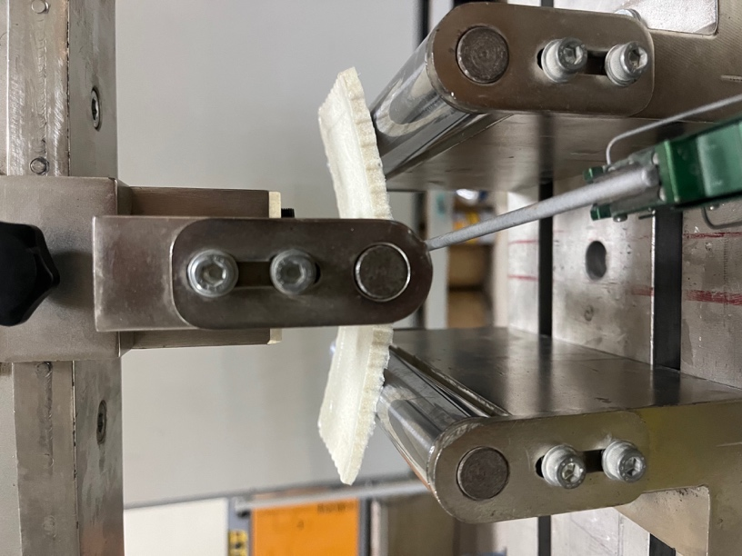
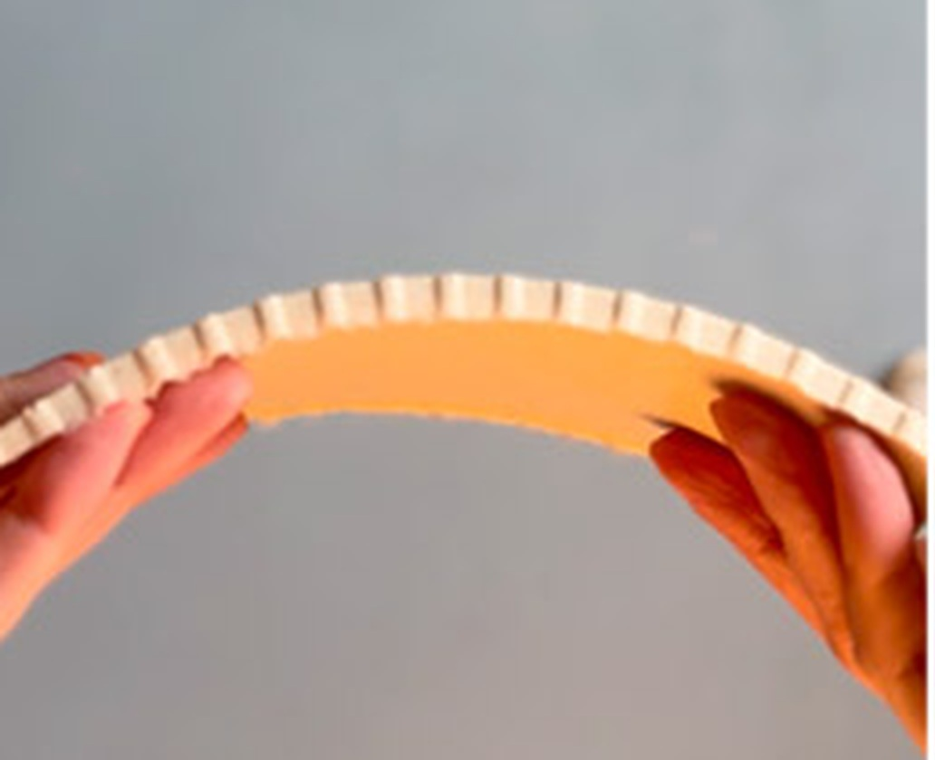
Flexural deformation
The beam is deflected well beyond the failure point of a comparable ceramic without parting. Transverse kerfs on the tension face permit the panel to be arched by hand.
The kerfs are also why the measured compliance is partly geometric, and why the reported modulus is a lower bound rather than a material constant.
Substantial deformation with retained integrity, in both test programmes.
Three-point rig at high deflection · close-up of the kerfed tension face · panel arched by hand
Notes:
I would rather show this than ask you to take it on the numbers. On the left, the three-point rig at high deflection: the beam is deflected well past the failure point of a comparable ceramic and it has not parted. In the middle, a close-up of the tension face, where the transverse kerfs are visible. Below, the same panel arched by hand. The kerfs are why it arches, and they are also why I report the modulus as a lower bound rather than a material constant. The common result across both test programmes is substantial deformation with retained integrity, and that is the observation the final argument rests on.

Slide 21

Fire, water, density
Ignitability
Water absorption, 24 h immersion
≈ 10 s
0.7%
mass gain, shellac-coated. Coating integrity rather than the composite is the limiting factor for humid service.
to ignition under direct flame
4 s
Bulk density
to self-extinguish after flame removal
Material | g/cm³ | Reference
This study (C3) | 1.38 | —
Mycelium, cellulose | 0.3 – 0.8 | Jones et al. (2020)
Fired clay brick | 1.6 – 2.0 | William & Owen (1995)
Charring remains local
No lateral flame spread
No melting and no dripping
The probable mechanism is endothermic decomposition of the carbonate fraction, diluting the flame front. This was not verified calorimetrically.
Denser than the fungal and cellulosic family, lighter than fired clay. Mould-volume basis, therefore a lower bound.
ISO 11925-2:2020. Ignitability only: no Euroclass classification, cone calorimetry, smoke or toxicity data.
Notes:
Fire, water and density together. On ignitability: ignition at around ten seconds under direct flame, self-extinguishing four seconds after the flame is removed, with charring confined locally, no lateral spread, and no melting or dripping - which matters for a polymer-adjacent material. The probable mechanism is endothermic decomposition of the carbonate fraction releasing carbon dioxide and diluting the flame front, and I state that as a probable mechanism because it was not verified calorimetrically. To be precise: this is an ignitability test. There is no Euroclass classification, no cone calorimetry, no smoke or toxicity data. On water: 0.7 percent mass gain over twenty-four hours of full immersion with three shellac coats, with local dissolution where the coating was thin, so coating integrity is the limiting factor. On density: 1.38, above the fungal and cellulosic bio-materials and below fired clay, on a mould-volume basis and therefore a lower bound.

Slide 22
Conventional materials
Compressive and flexural strength against interior surface materials
Position
One sixth the compressive strength of MDF and one twentieth that of travertine, a stone the material visually resembles. Three times the compressive strength of compressed mushroom panel, the only other fully bio-based board in the set.
On strength alone the composite is not competitive with engineered wood or stone.
Velasco & Gaona (2011) · Klyosov (2007) · Nemli & Aydın (2007) · Altun (2006)
Notes:
First benchmark, against the materials this would sit alongside in an interior. Let me be direct. One sixth the compressive strength of MDF and one twentieth that of travertine - and travertine is the relevant aesthetic comparison, because the material resembles it. It does exceed compressed mushroom panel, the only other fully bio-based board in the set, by a factor of three in compression. But on strength alone the composite is not competitive with engineered wood or stone, and I am not going to claim otherwise.

Slide 23
Bio-based composites
Compressive strength
Elastic modulus, MPa, logarithmic
Material | σᴄ MPa | Reference
This study (C3) | 4.1 | —
Mycelium composite | 0.145 – 0.452 | Jones et al. (2020)
Hempcrete | 0.3 – 0.6 | Arnaud & Gourlay (2012)
Eggshell-filled PLA | 2 – 5 | Kim & Pal (2010)
Mineral-filled biocomposite | 2.1 – 39.6 | Shah et al. (2016)
This study 192
LDPE
Mycelium
1
10
100
1,000
10,000
Pine
Unlabelled points: soy-based bioplastic 124, flax-fibre PLA 198, pine 11 000.
Water-cast and ambient-dried, the composite attains the stiffness range of melt-processed bio-polymers.
An order of magnitude above the fungal and lime-binder family in compression, and inside the LDPE band in stiffness — without an oven, an autoclave or an extruder. Wood remains two orders of magnitude above.
Values are reported as published; specimen geometry and test method differ between sources.
Notes:
Second benchmark, and this is the one that matters. Against the bio-based family the position changes completely. In compression, an order of magnitude above mycelium composites and hempcrete, and within the range reported for eggshell-filled PLA. In stiffness, 192 megapascals - between soy bioplastic at 124 and flax-fibre PLA at 198, inside the LDPE range. Note what that means in process terms. This is water-cast and dried at room temperature, with no oven, no autoclave and no extruder, and it reaches the stiffness of melt-processed bio-polymers. One caution: the cited values come from studies with differing specimen geometry and test method, so this is a position statement rather than a controlled comparison. And wood remains two orders of magnitude above in modulus.

Slide 24
Modulus of resilience
Elastic energy absorbed per unit volume
Limitation
Ur = σ² / 2E
A comparative table cannot yet be assembled: the literature reports strength and modulus in separate studies on separate formulations.
This is a data point and a proposed reporting convention, not a ranking, and the value inherits the lower-bound modulus.
stress
14.1 kJ/m³
computed from this study's own σꜰ = 2.325 MPa and Eꜰ = 192 MPa
Elastic modulus appears in the denominator.
Ur
The low modulus that counted against the material on the preceding slide is the same property that raises this quantity. Strength records the load at which performance ceases; it does not record whether failure is graceful or catastrophic.
strain
The shaded area is the energy absorbed per unit volume before permanent damage: ½ σ ε, and with ε = σ / E it reduces to the expression at right.
Resilience as a property of systems that absorb disturbance and retain function, after Holling (1973).
Notes:
This brings me to research question five, and the diagram is the argument. The shaded area under the elastic region is the energy a material absorbs per unit volume before it takes permanent damage. Because that area is one half sigma epsilon, and epsilon is sigma over E, the area reduces to sigma squared over two E. Notice where the elastic modulus sits: in the denominator. So the low modulus that counted against the material on the previous slide is the same property that raises this quantity. For this formulation it comes to about 14 kilojoules per cubic metre, computed from this study's own two measurements. Both test programmes gave the same qualitative result, substantial deformation with retained integrity. Strength records the load at which a material ceases to perform. It does not record whether it then fails gracefully or catastrophically, and for a demountable non-loadbearing component that is what governs service life. The limitation, stated plainly: I cannot give you a comparative table, because the literature reports strength and modulus in separate studies on separate formulations. This is a data point and a proposed reporting convention, not a ranking, and the value inherits the lower-bound modulus.

Slide 25

Application envelope
Modular proposal derived from the measurements
Conditions of use, each traced to a measured result
Non-loadbearing surfaces
self-weight and handling loads only; σᴄ = 4.1 MPa
Dry interiors
not wet rooms, not façades; absorption depends on coating integrity
Away from ignition sources
self-extinguishing, but unclassified for reaction to fire
Modular rather than sheet
damage is replaced one unit at a time
Demountable modules on a reversible fixing, replaceable one unit at a time.
End of life
Every constituent, the shellac included, is biodegradable, and reversible fixing recovers the module intact. What is displaced is quarried limestone.
No life-cycle assessment was carried out. These are qualitative potentials grounded in the protocol, not quantified claims.
Notes:
The application envelope follows from the measurements rather than being imposed on them, and each condition traces to a specific result. Non-loadbearing surfaces, carrying self-weight and handling loads only, because 4.1 megapascals supports nothing more. Dry interiors, not wet rooms and not facades, because water performance depends on coating integrity. Away from ignition sources: it self-extinguishes, but it carries no classification. And modular rather than sheet, which matters because damage is then replaced one unit at a time rather than refinishing a surface. On end of life: every constituent including the shellac is biodegradable, and reversible fixing allows the module to be recovered intact. What is displaced is quarried limestone, in a surface application rather than a downcycled one. The caveat: no life-cycle assessment was carried out, so these are qualitative potentials grounded in the protocol and not quantified claims.

Slide 26
Limitations and further work
Each limitation, and the experiment that resolves it
Limitation | Resolved by
No dispersion data — individual specimen values not retained | Repeat the series with individual values retained
Compressive strain assumed from observation | Instrument the strain; measure the curve
Shrinkage unquantified, so density is a lower bound | Record post-drying geometry
Kerfed section calculated as a solid rectangle | Test an un-kerfed section
Flexural series confounded — glycerol and solids moved together | Vary glycerol at constant solids concentration
Durability, fire classification and life-cycle assessment untested | Outside this paper; named as further work
Every value reported today is a lower bound. None of these limitations is unknown, and each one has a defined next experiment.
Beyond the table: humidity and thermal cycling, microbial resistance, and a life-cycle assessment to support the environmental argument quantitatively.
Notes:
The limitations, each next to the experiment that resolves it, because that pairing is the point. No dispersion data, because individual specimen values were not retained - repeat the series and retain them. Compressive strain assumed from observation - instrument it. Shrinkage unquantified, so density is a lower bound - record the post-drying geometry. The kerfed section was calculated as a solid rectangle - test an un-kerfed one. The flexural series is confounded - vary glycerol at constant solids concentration. And durability, fire classification and life-cycle assessment are simply untested and outside this paper. Every value I reported today is a lower bound. I would rather set these out than have them found, and none of them is unknown to me.

Slide 27
Conclusions
01
A protocol that can be repeated
every production parameter reported
02
Packing density governs compressive strength
not mineral content
03
Plasticiser content sets brittle or ductile response
the transition is sharp
04
Bio-polymer stiffness without thermal processing
water-cast, ambient-dried
05
Strength alone is an insufficient criterion
report σ and E together
Betül Ünal · b.unal91@gmail.com
Testing: Advanced Construction Materials Research Laboratory, Hacettepe University, with thanks to Dr Hüseyin İlcan. Derived from the author's doctoral dissertation, Hacettepe University, 2025.
Notes:
Five conclusions. A protocol that can be repeated, reported parameter by parameter. Packing density, not mineral content, governs compressive strength. Plasticiser content sets a brittle or a ductile response, and the transition is sharp. A water-cast, ambient-dried material reaches bio-polymer stiffness without thermal processing. And strength alone is an insufficient criterion for this class: deformation capacity governs service behaviour, so strength and modulus should be reported together. Thank you. I am happy to take questions.

Slide 28
References
Adogla, F., Yalley, P.P.K. & Arkoh, M. (2016) Improving compressed laterite bricks using powdered eggshells. The International Journal of Engineering and Science, 5(4), 65–70.
Altun, İ.A. (2006) Mechanical properties of travertine. Afyon Kocatepe University.
Arnaud, L. & Gourlay, E. (2012) Experimental study of parameters influencing mechanical properties of hemp concretes. Construction and Building Materials, 28(1), 50–56.
Ashby, M.F. (2011) Materials selection in mechanical design. 4th edn. Oxford: Butterworth-Heinemann.
ASTM International (2017) ASTM D790-17: Flexural properties of unreinforced and reinforced plastics. West Conshohocken, PA.
ASTM International (2018) ASTM D570-98: Water absorption of plastics. West Conshohocken, PA.
Bhartiya, A. & Dubey, M. (2018) Replacement of cement with coconut shell ash and egg shell powder. IRJET, 5(6).
Bilici, V.O., Peşmen, G., Yönetken, A. & Erol, A. (2023) Effect of egg-shell particulate reinforcement in ceramic-metal composites. Thermal Science, 27(4B), 3179–3188.
Faruk, O., Bledzki, A.K., Fink, H.-P. & Sain, M. (2012) Biocomposites reinforced with natural fibers. Progress in Polymer Science, 37(11), 1552–1596.
Hernández, V. et al. (2022) Agar biopolymer films for biodegradable packaging: a reference dataset. Materials, 15(11), 3954.
Hirschler, M.M. (2013) Flammability and fire testing. In: Handbook of environmental degradation of materials. Oxford: William Andrew, 197–230.
Holling, C.S. (1973) Resilience and stability of ecological systems. Annual Review of Ecology and Systematics, 4, 1–23.
International Organization for Standardization (2020) ISO 11925-2: Ignitability of products subjected to direct impingement of flame — single-flame source test. Geneva.
Islam, M.R., Tudryn, G., Bucinell, R., Schadler, L. & Picu, R.C. (2018) Mechanical behavior of mycelium-based particulate composites. Journal of Materials Science, 53, 16371–16382.
Jones, M., Mautner, A., Luenco, S., Bismarck, A. & John, S. (2020) Engineered mycelium composite construction materials. Journal of Bionanoscience, 14(1), 1–10.
Karana, E., Barati, B., Rognoli, V. & Zeeuw van der Laan, A. (2015) Material driven design (MDD). International Journal of Design, 9(2), 35–54.
Kim, H.-S. & Pal, K. (2010) Mechanical properties of eggshell-filled poly(lactic acid) composites. Macromolecular Research.
Klyosov, A.A. (2007) Wood-plastic composites. Hoboken, NJ: Wiley-Interscience.
Mansour, G., Zoumaki, M., Tsongas, K. & Tzetzis, D. (2021) Microstructural and finite element analysis of soy protein isolate bioplastics. Materials, 14(19), 5479.
Nemli, G. & Aydın, A. (2007) Evaluation of the physical and mechanical properties of particleboard. Building and Environment, 42(3), 1210–1214.
Owuamanam, S. & Cree, D. (2020) Progress of bio-calcium carbonate waste eggshell and seashell fillers in polymer composites: a review. Journal of Composites Science, 4(2), 70.
Pope, D.G. & Hudson, R.G. (1989) Mechanical properties of timber. Structural Engineer.
Razzaq, A.K. & Yousif, R.A. (2017) Sustainability of HMA by using of egg shell powder. International Conference on Sustainable Futures, Bahrain.
Shafiei, S. et al. (2019) Egg shell-derived calcium phosphate/carbon dot nanofibrous scaffolds. Materials Science and Engineering: C, 100, 564–575.
Shah, D.U., Vollrath, F., Stires, J. & Deheyn, D.D. (2016) Housing fly larvae in silk: mechanical properties of mineral-filled biocomposites. Materials & Design, 109, 723–731.
Skórczewska, K., Kwiatkowski, W. & Kwiatkowski, M. (2020) Poly(vinyl chloride) composites with waste eggshell as a natural filler. Polymer Composites, 41(9), 3580–3589.
Soundara, B. & Vilasini, P.P. (2015) Effect of egg shell powder on the properties of clay. 50th Indian Geotechnical Conference, Pune.
Teara, A. et al. (2019) Durability of fly ash and eggshell powder to replace cement in concrete. IOP Conf. Series: Earth and Environmental Science, 244, 012025.
Torres, F.G., Troncoso, O.P., Piaggio, F. & Hijar, A. (2010) Structure–property relationships of a biopolymer network: the eggshell membrane. Acta Biomaterialia, 6(9), 3687–3693.
Tutuş, A. et al. (2018) Evaluation of egg shells in wallpaper production. 1st International Technological Sciences and Design Symposium, Giresun.
Velasco, P.M. & Gaona, J.L. (2011) Mechanical characterisation of compressed agricultural-waste panels. Construction and Building Materials.
Victor, E.I., Louis, I.C., Alfred, N.O. & Ozioma, U.N. (2019) Use of chicken eggshells as fillers in flexible polyurethane foam. International Journal of Industrial Engineering, 3(1), 1–6.
Vilarinho, I.S., Filippi, E. & Seabra, M.P. (2022) Development of eco-ceramic wall tiles with bioCaCO₃ from eggshells waste. Open Ceramics, 9, 100220.
William, J.S. & Owen, J.C. (1995) Egg science and technology. 4th edn. Boca Raton, FL: CRC Press.
Yönetken, A., Erol, A., Yakar, A. & Peşmen, G. (2016) Ceramic-metal composites produced by electroless Ni plating of AlN-Astaloy Cr-M. IJCMNMME, 10(3).
Zhao, X. et al. (2022) Mechanical recycling of low-density polyethylene: property evolution. Resources, Conservation and Recycling.
Standards applied: ASTM D790-17 · ISO 11925-2:2020 · ASTM D570-98(2018).
Notes:
References, left up for questions.

