Slide 1

Eggshell–Agar
Biocomposites
Development and characterisation for sustainable interior applications
Betül Ünal
Department of Interior Architecture
Cappadocia University
ICSMMEP-26 · MECCA · 3–4 NOVEMBER 2026
Notes:
Good morning. Betul Unal, Department of Interior Architecture, Cappadocia University. What you are looking at is the material: a composite of waste eggshell bound in agar. Over the next fifteen minutes I will give you the production protocol, the characterisation, and an argument about how materials like this should be evaluated.

Slide 2
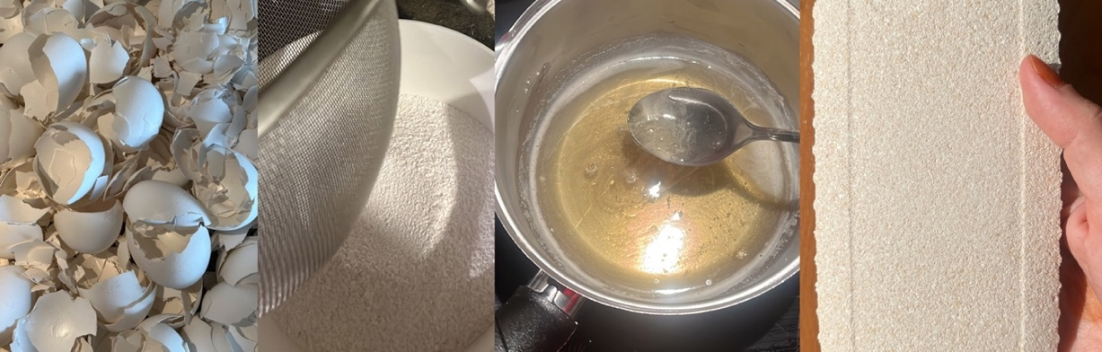
The waste
94%
> 12
1
Porous, protein-bound crystalline structure. Specific gravity 0.85–2.66 — lighter than most mineral fillers.
calcium carbonate
months of collection
local bakery
Notes:
This is where the material starts. Eggshell is generated continuously as food waste and landfilled at scale. Chemically it is almost pure calcium carbonate, with a porous, protein-bound crystalline structure and a specific gravity lower than most mineral fillers. Every shell in this study came from one bakery, collected over more than a year. The material argument for eggshell is settled - that is not what this paper is about.

Slide 3
The problem
ESTABLISHED PRACTICE
THIS STUDY
Mineral phase
Mineral phase
waste eggshell, 5–30% of matrix
waste eggshell, 66% of solids
Binding phase
Binding phase
Portland clinker · bitumen · lime · ceramic body · PLA, epoxy, PVC, PU
agar, plasticised with glycerol
The waste is valorised. The matrix is not.
Both phases biological and biodegradable.
Teara et al. 2019 · Adogla et al. 2016 · Razzaq & Yousif 2017 · Soundara & Vilasini 2015 · Vilarinho et al. 2022 · Owuamanam & Cree 2020
Notes:
Here is the problem, and it is a problem about the binder rather than the filler. Eggshell valorisation is well established - cement replacement, brick stabilisation, asphalt binders, lime substitution, ceramic bodies, particulate filler in thermoplastics, with loadings from five to thirty percent. But look at the lower block in each stack. In every one of those cases the binding phase is petrochemical, clinker-based or ceramic. The waste is valorised; the matrix is not. This study replaces the binder too, so both phases are biological.

Slide 4
The binder
Agar is a thermoreversible polysaccharide from red seaweed. Its behaviour with glycerol has been mapped systematically — 32 formulations, released as an open dataset.
THE SHIFT
— | Film literature | This study
Form | Thin cast film | Cast solid, 20–50 mm
Filler | Unfilled | Mineral, 66% of solids
Loading | Uniaxial tension | Compression, bending
Use | Packaging | Interior surfaces
Hernández et al. (2022), Materials 15(11), 3954
BUT ONLY AS A FILM
Unfilled, thin, tested in uniaxial tension, for packaging. Never as the binder of a mineral-filled cast solid in bending.
The compositional logic carries over. The form and the loading case do not.
Notes:
The binder is agar - a thermoreversible polysaccharide from red seaweed, which melts on heating and sets on cooling without chemical crosslinking. Its behaviour with glycerol is reasonably well mapped: Hernandez and colleagues ran thirty-two agar, glycerin and water formulations by design of experiments in 2022 and released the dataset openly. But all of that is unfilled thin film, tested in tension, for packaging. Nobody has characterised agar as the binder of a mineral-filled cast solid in bending, which is the actual loading case for an interior surface. The compositional logic carries over. The form and the loading case do not.

Slide 5
The gap
Materiom publishes biomaterial recipes under CC-BY-SA, archives each as prior art, and indexes property data with citable DOIs. The infrastructure for shared procedures is built.
WHAT THAT MEANS
The nearest analogue is the mussel shell–sucrose ceramic: a shell mineral in a biological binder. Nothing couples a shell mineral to agar. Nothing reports compressive, flexural, ignitability and hygric data for one formulation family.
4
WHICH ARE
agar bioplastic
gelatin bioplastic
mycelium–walnut shell
mussel shell–sucrose ceramic
A protocol and a property set entering that commons.
recipes with published property data
materiom.org/data, accessed October 2026
Notes:
Claiming a gap is cheap, so let me measure it. Materiom is an open commons for biomaterial recipes - CC-BY-SA licensed, each recipe archived as prior art, property data indexed with citable DOIs. The infrastructure exists. But property data exists for four recipes. Four. The nearest analogue to this work is the last one, a shell mineral in a biological binder. Nothing couples a shell mineral to agar, and nothing reports compressive, flexural, ignitability and hygric data for one formulation family. So the contribution is not originality of idea. It is a protocol and a property set entering a commons that is four recipes deep.

Slide 6
Questions
01
Which formulation variable governs compressive strength?
02
What does plasticiser content do to flexural behaviour?
03
How does it compare with conventional interior materials?
04
How does it compare with other bio-based composites?
05
Is compressive strength the right criterion at all?
Notes:
Five questions. The first two are formulation questions, the next two benchmarking, and the fifth is the one I actually care about and will come back to at the end.

Slide 7
Four constituents, all biodegradable
Waste eggshell powder · agar · glycerol · water, with a shellac finish. Colour and texture vary from natural pigments and mould geometry at constant composition.
Notes:
This is the material. Four constituents: waste eggshell powder as the mineral phase, agar as the binder, glycerol as the plasticiser, water as the carrier, and a shellac finish where water resistance matters. Everything you see here is one formulation family - the variation in colour and texture comes from natural pigments and mould geometry, not from different compositions. Beetroot gives the dark tones.

Slide 8
What each does
Constituent | Origin | Function | Relevant property
Eggshell powder | Food waste | Mineral filler; carries load | 94% CaCO₃; porous structure
Agar | Red seaweed | Continuous binding phase | Thermoreversible gel
Glycerol | Vegetable oil | Plasticiser; sets ductility | Humectant; low vapour pressure
Water | — | Carrier; sets solids packing | Fully evaporated on drying
Shellac | Kerria lacca | Hydrophobic surface finish | Biodegradable film-former
Water is not in the finished material. It is the process variable that sets how densely the solids pack.
Gelatine, starch and vinegar were trialled during development and are not part of the reported formulations.
Notes:
Five constituents and a clear division of labour. Eggshell carries load. Agar forms the continuous network. Glycerol decides whether the composite behaves brittle or ductile. Shellac is a surface finish only. And water is not in the final material at all - it is the process variable that sets how densely the solids pack. Hold that, because it turns out to be the controlling variable.

Slide 9
Protocol
120 °C
95 °C
80 °C
23 °C
20 min
55 min total
11 days
01
02
03
04
Mineral fraction
Binder phase
Compositing
Casting and cure
Clean of membrane
Heat-treat, then dry
Mill to fine powder
Sieve, 150 µm passing
Water and glycerol first
Agar added incrementally
Held until fully dissolved
Temperature reduced
Viscosity develops
Shell added incrementally
Silicone moulds
Four days in mould
Seven days ambient
No oven at any stage
Disclosure — the composite shrinks appreciably as water evaporates; post-drying dimensions were not logged, so dimensions quoted are mould dimensions. Stirring was manual: shear rate is not a controlled quantity.
Notes:
This is the protocol, and it is the contribution. Read it left to right with the temperatures above. Shell preparation at 120 degrees for twenty minutes - decontamination and drying, not sterilisation, because dry-heat sterilisation needs far higher temperatures and we did not verify sterility. Then the binder: water and glycerol first, agar added incrementally because bulk addition forms agglomerates that never redisperse, dissolved at 95. Temperature drops to 80 and the mineral goes in late, because adding it earlier lets it settle out. Fifty-five minutes of heating in total. Then silicone moulds, four days in mould, seven days ambient, no oven at any point. Two disclosures, and I will be explicit: the material shrinks as water leaves and we did not log the dried dimensions, and stirring was manual so shear rate is uncontrolled.

Slide 10
Formulations
ID | Test | Water g | Shell g | Agar g | Glycerol g | Solids g | Shell : binder | Solids : water | Glycerol % solids
C1 | Compression | 325 | 80 | 35 | 5 | 120 | 2.00 | 0.37 | 4.2
C2 | Compression | 310 | 90 | 40 | 5 | 135 | 2.00 | 0.44 | 3.7
C3 | Compression | 280 | 110 | 45 | 10 | 165 | 2.00 | 0.59 | 6.1
F1 | Flexure | 450 | 190 | 70 | 60 | 320 | 1.46 | 0.71 | 18.8
F2 | Flexure | 480 | 190 | 70 | 30 | 290 | 1.90 | 0.60 | 10.3
COMPRESSION SERIES
FLEXURAL SERIES — CONFOUND
Shell : binder is held at exactly 2.00. The only variable is solids concentration.
Glycerol was halved at fixed batch mass, so water rose with it. The plasticiser effect is not isolated.
Three specimens per formulation. Values are means; individual specimen values were not retained, so standard deviations are not available.
Notes:
The formulation matrix with derived ratios. Two things to read. In the compression series shell-to-binder is exactly two point zero zero in all three mixes - that was not planned as a control, but it means the only thing that varies is solids concentration. In the flexural series I declare a confound: glycerol was halved but batch mass was fixed at 770 grams, so water rose to compensate and the other ratios shifted with it. The plasticiser effect is not cleanly isolated.

Slide 11
Tests
Property | Standard | Specimen | n | Measured
Compressive behaviour | Cube compression | 50 mm cube moulds | 3 per mix | Max load; compressive stress
Flexural behaviour | ASTM D790-17 | 180 × 60 × 20 mm, 120 mm span | 3 per mix | Flexural strength; modulus
Reaction to fire | ISO 11925-2:2020 | 40 × 50 mm, 45°, 15 s edge flame | 2 | Time to ignition; to extinguish
Water absorption | ASTM D570-98 | 40 × 50 mm, shellac-coated | 1 | Mass gain, 24 h immersion
Bulk density | Gravimetric | 50 mm cube | 1 | Mass / mould volume
Mechanical values are means of three specimens; individual values were not retained, so standard deviations cannot be reported. Fire, absorption and density rest on single determinations and are indicative, not characteristic.
All testing: Advanced Construction Materials Research Laboratory, Hacettepe University.
Notes:
The test programme. I want the reporting convention on the record before any numbers appear: mechanical values are means of three specimens, individual values were not retained so I cannot give standard deviations, and the fire, absorption and density figures are single determinations - indicative, not characteristic.

Slide 12
Compression
ID | Solids : water | Fₘₐₓ kN | σᴄ MPa
C1 | 0.37 | 3.89 | 2.55
C2 | 0.44 | 4.30 | 3.12
C3 | 0.59 | 6.80 | 4.10
Strength rises with solids concentration, not with mineral content.
Shell : binder is fixed at 2.00 across the series, so packing density is the only variable. Linear across the range tested, R² = 0.99 — three formulations, so a hypothesis, not a law.
Notes:
The compression result. Because shell-to-binder is fixed at two point zero zero across the series, solids concentration is the only variable - and compressive stress rises linearly with it, R-squared of 0.99 over the range 0.37 to 0.59. Three points will fit almost any line, so I am calling this a hypothesis rather than a law. But it has a clear physical reading: strength here is governed by packing density, not by mineral content as such. If that is right, the route to a stronger composite is to remove water, not to add shell. The fitted relation is sigma equals 6.93 times the solids-to-water ratio plus 0.04, if anyone wants it.

Slide 13


Crushing
THE CURVE
COMPRESSIVE STRESS – STRAIN, C3
Linear to about 1 MPa
Progressive stiffness loss
Peak near 10% strain
No abrupt load drop
Deformation with retained integrity
It crushes.
It does not fracture.
Strain derived from an assumed 10% maximum deformation based on observation, not instrumented measurement. · Bulk density 1.38 g/cm³, mould-volume basis.
Notes:
This is the failure mode, and it is what I would ask about if I were sitting where you are. The curve is linear to about one megapascal, then stiffness falls away progressively as the agar network yields and the mineral redistributes. Peak arrives near ten percent strain with no abrupt drop, and beyond peak the specimen keeps deforming while holding together. Look at the photograph: the cube has barrelled, it is shorter and wider, and it is still one object. Energy is absorbed rather than released. One honesty point: the strain axis derives from an assumed ten percent maximum deformation based on observation, not instrumented measurement.

Slide 14

Flexure
ID | Glycerol % solids | Fₘₐₓ N | σꜰ MPa | Eꜰ MPa | ε peak
F1 | 18.8 | — | not measurable | — | —
F2 | 10.3 | 310 | 2.325 | 192 | 0.0121
DISCLOSURE
The specimen is kerfed on its tension face. The standard assumes a solid rectangle, and the calculation uses the full section. Part of the compliance is geometric: the modulus is a lower bound.
FLEXURAL STRESS – STRAIN, F2
Three specimens per formulation. The two formulations differ in glycerol, but batch mass was fixed, so solids concentration moved as well.
Plasticiser decides whether it resists at all.
At 18.8% glycerol the machine registered nothing usable. Halving it gave a section that resists while still flexing.
Notes:
Flexure, to ASTM D790. The decisive variable is plasticiser. At 18.8 percent glycerol the composite deformed without developing measurable resistance - the machine registered nothing usable at all. Halving it gives 2.325 megapascals at a modulus of 192. The transition is sharp and it lies between those two values, which is itself useful to know. Two disclosures: the glycerol effect is confounded with solids concentration, and the specimen is kerfed on its tension face while the standard assumes a solid rectangle, so the modulus I am quoting is a lower bound on the bulk material. The flexural strength formula is three F L over two b d squared, if anyone wants to check it.

Slide 15

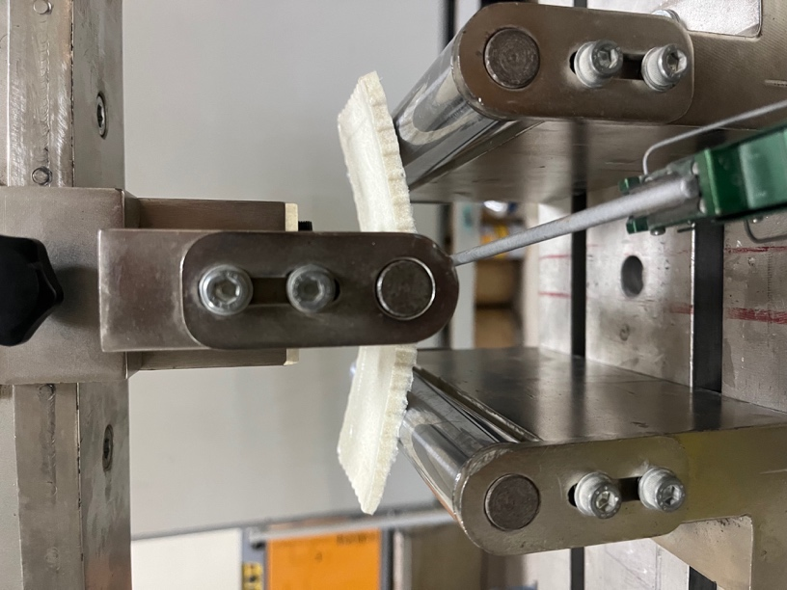
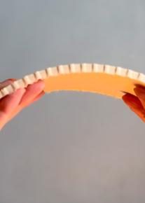
BENDING
The kerfs are visible, and so is the consequence.
Transverse kerfs on the tension face let the panel arch by hand. They also mean the measured compliance is partly geometric, which is why the reported modulus is a lower bound rather than a material constant.
Three-point rig at high deflection · close-up of the kerfed tension face · panel arched by hand
Notes:
I want you to see this rather than take my word for it. On the left, the three-point rig at high deflection - the beam is bent well past anything a ceramic would survive, and it has not fractured. In the middle, a close-up of the tension face: those are transverse kerfs. And below, the same panel arched by hand. The kerfs are why it arches, and they are also why I am calling the modulus a lower bound rather than a material constant. I would rather point at this than have someone find it in the photograph later.

Slide 16

Fire
~10 s
MECHANISM
The carbonate fraction decomposes endothermically and releases CO₂, diluting the flame front locally. Consistent with the absence of spread, but not verified calorimetrically.
to ignition under direct flame
4 s
to self-extinguish after the flame is removed
WHAT THIS IS NOT
ISO 11925-2 is an ignitability test. No Euroclass classification was determined. No cone calorimetry, smoke density or toxicity data were obtained.
Charring stays local
No lateral spread
No melting, no dripping
Notes:
Reaction to fire. Ignition at around ten seconds under direct flame; self-extinguishing four seconds after the flame is removed. Charring stayed local, no lateral spread in either ignition, and - importantly for a polymer-adjacent material - no melting and no dripping. The probable mechanism is the carbonate fraction decomposing endothermically and releasing carbon dioxide, which dilutes the flame front locally. I did not verify that calorimetrically. And to be clear about what this is not: 11925-2 is an ignitability test. There is no Euroclass classification here, no cone calorimetry, no smoke density, no toxicity data.

Slide 17
Water and weight
ABSORPTION — 24 H FULL IMMERSION
BULK DENSITY
0.7%
Local dissolution where the coating was thin. Coating integrity, not the composite, is the limiting factor for humid use.
Material | g/cm³ | Reference
This study (C3) | 1.38 | —
Mycelium, cellulose | 0.3 – 0.8 | Jones et al. 2020
Fired clay brick | 1.6 – 2.0 | William & Owen 1995
Normal-weight concrete | 2.4 | William & Owen 1995
mass gain, shellac-coated
Denser than the fungal and cellulosic family, lighter than fired clay and concrete. Quoted on a mould-volume basis and therefore a lower bound.
Three coats of shellac — a natural, biodegradable, hydrophobic resin. Slight dimensional expansion was observed.
Notes:
Two more properties. On water: with three coats of shellac - a natural, biodegradable, hydrophobic resin - the specimen gained 0.7 percent of its mass over twenty-four hours of full immersion. There was slight dimensional expansion, and where the coating was thin the surface dissolved locally. So coating integrity, not the composite, is the limiting factor for humid use. On density: 1.38, which places it between the fungal and cellulosic bio-materials below and fired clay above. That is on a mould-volume basis, so it is a lower bound.

Slide 18
Versus stone and board
On strength alone it does not compete.
One sixth the compressive strength of MDF. One twentieth that of travertine — a stone it visually resembles. Three times compressed mushroom panel, the only other fully bio-based board here.
Velasco & Gaona 2011 · Klyosov 2007 · Nemli & Aydın 2007 · Altun 2006
Notes:
First benchmark, against the materials this would sit alongside. Let me be blunt. One sixth of MDF, one twentieth of travertine - and travertine is the relevant comparison aesthetically, because the material actually looks like it. It does beat compressed mushroom panel, the only other fully bio-based board in the set, by a factor of three. But on strength alone it does not compete with engineered wood or stone, and I am not going to claim that it does.

Slide 19
Versus bio-based
COMPRESSIVE STRENGTH
ELASTIC MODULUS
Material | σᴄ MPa | Reference
This study (C3) | 4.1 | —
Mycelium composite | 0.145 – 0.452 | Jones et al. 2020
Hempcrete | 0.3 – 0.6 | Arnaud & Gourlay 2012
Eggshell-filled PLA | 2 – 5 | Kim & Pal 2010
Mineral-filled biocomposite | 2.1 – 39.6 | Shah et al. 2016
Material | E MPa | Reference
This study (F2) | 192 | —
Mycelium composite | 1.8 – 5 | Islam et al. 2018
Soy-based bioplastic | 124 | Mansour et al. 2021
Flax-fibre PLA | 198 | Faruk et al. 2012
LDPE | 100 – 300 | Zhao et al. 2022
Wood (pine) | 11 000 | Pope & Hudson 1989
Water-cast and ambient-dried, at melt-processed stiffness.
An order of magnitude above the fungal and lime-binder family in compression, and inside the bio-polymer band in stiffness — between soy bioplastic and flax-fibre PLA, within the LDPE range. No oven, no autoclave, no extrusion. Wood remains two orders of magnitude above.
Notes:
Second benchmark, and this is the one that matters. Against the bio-based family the position changes completely. In compression, an order of magnitude above mycelium composites and hempcrete. In stiffness, 192 megapascals - between soy bioplastic at 124 and flax-fibre PLA at 198, inside the LDPE range. Note what that means. This is water-cast, dried at room temperature, no oven, no autoclave, no extrusion, and it reaches the stiffness of melt-processed bio-polymers. Wood is still two orders of magnitude above, and I will not pretend otherwise.

Slide 20
Resilience
THE LIMIT
Ur = σ² / 2E
A comparative table cannot yet be assembled: the literature reports strength and modulus in separate studies on different formulations. This is a data point and a measurement convention, not a ranking.
stress
14.1 kJ/m³
for the formulation measured here
Stiffness sits in the denominator.
Ur
The low modulus that counted against the material on the previous slide is exactly what raises this quantity.
strain
The shaded area is the elastic energy absorbed per unit volume before permanent damage.
Notes:
This brings me to the fifth question. The diagram is the argument. The shaded area under the elastic region is the energy a material absorbs per unit volume before it takes permanent damage - and because that area is one half sigma epsilon, and epsilon is sigma over E, the area is sigma squared over two E. Notice where stiffness sits: in the denominator. So the low modulus that counted against the material on the previous slide is exactly what raises this quantity. For this formulation it comes to about 14 kilojoules per cubic metre, from this study's own two measurements - 2.325 squared over twice 192. Both test programmes gave the same qualitative result: substantial deformation with retained integrity. Strength records the load at which a material stops performing. It does not record whether it then fails gracefully or catastrophically, and for a demountable non-loadbearing component that is what governs service life. The honest limit: I cannot give you a comparative table, because the literature reports strength and modulus in separate studies on different formulations. This is a data point and a measurement convention, not a ranking.

Slide 21

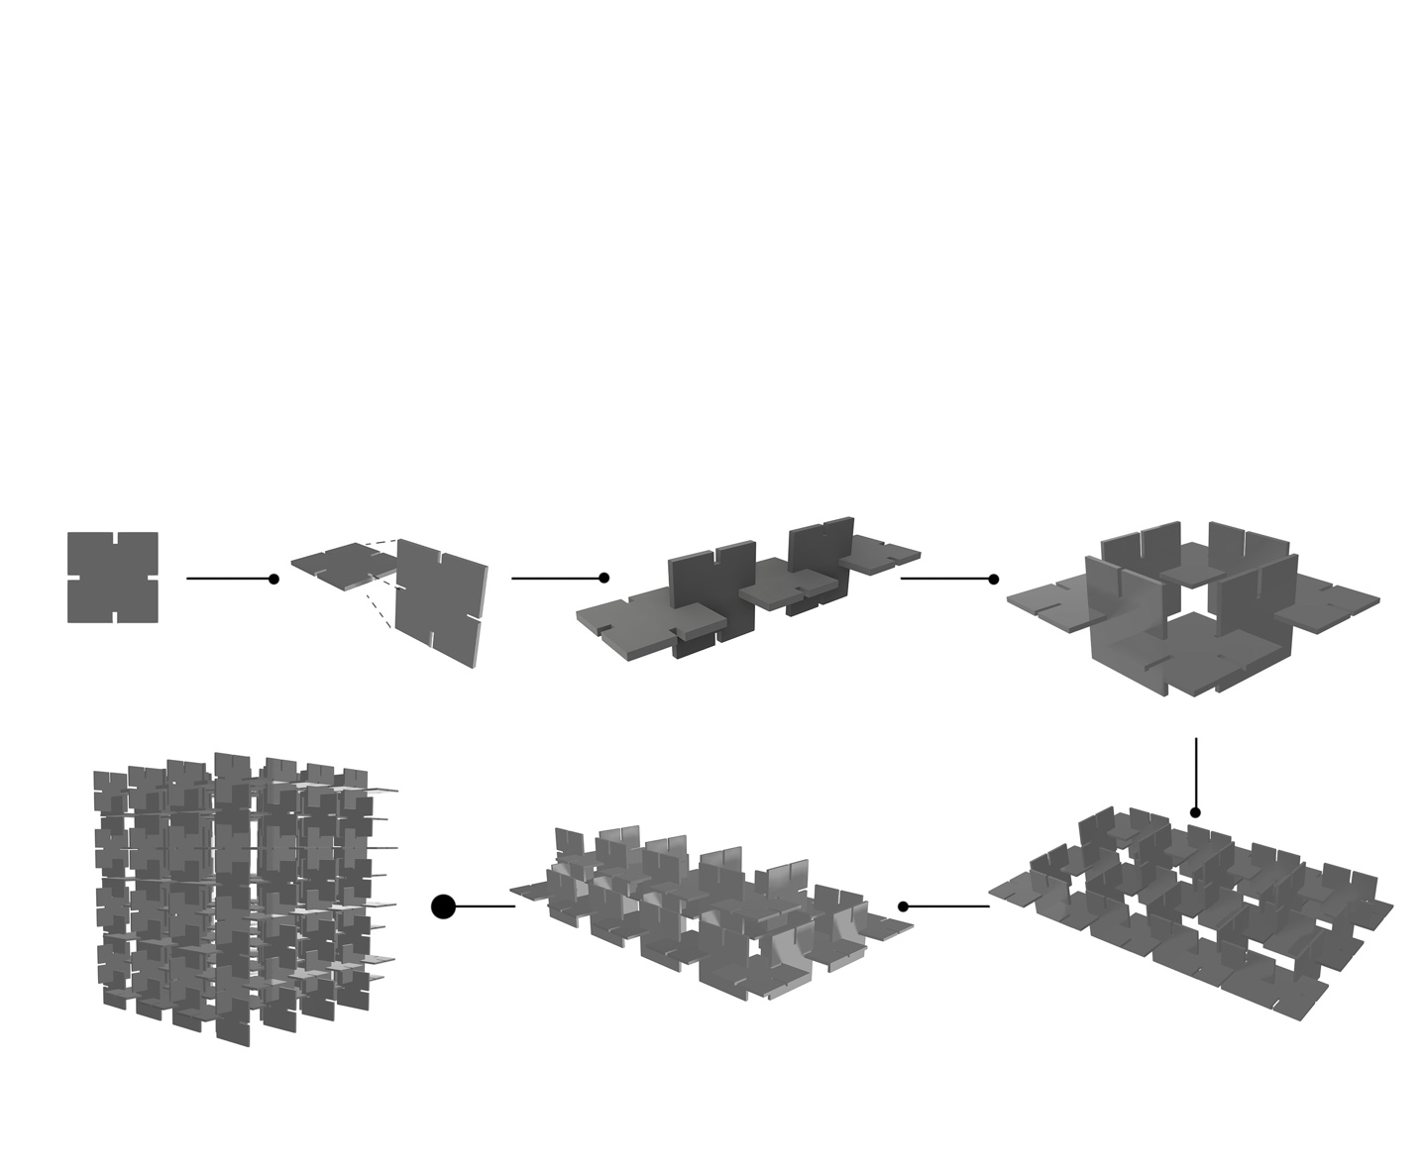
Where it fits
Non-loadbearing surfaces
self-weight and handling loads only
Dry interiors
not wet rooms, not facades
Assembled without adhesive, so components can be recovered intact. Units interlock and share load. A damaged unit is exchanged without dismantling.
Away from ignition sources
self-extinguishing, but unclassified
Modular, not sheet
failure replaced one unit at a time
Modular interior proposal developed from the measured properties
Notes:
The application envelope follows from the measurements rather than being imposed on them. Non-loadbearing surfaces, carrying self-weight and handling loads only. Dry interiors - not wet rooms and not facades, because water performance depends on the coating. Away from ignition sources: it self-extinguishes, but it is unclassified. And modular rather than sheet, which matters because failure is then replaced one unit at a time. The assembly is adhesive-free and therefore reversible, units interlock and share load, and a damaged unit can be exchanged without dismantling the whole.

Slide 22
Why it matters
01
02
03
04
05
06
Bakery waste
Shell powder
One 55-min cook
Cast module
Reversible assembly
Biological cycle
one local stream
grind, sieve
no oven, no extrusion
ambient dried
recovered intact
all constituents degrade
The loop closes: the material returns to the stream it came from.
WHAT IS DISPLACED
Quarried limestone, in a surface application rather than a downcycled one. A grinder, a sieve, a hotplate and silicone moulds: production can be distributed rather than centralised.
No life-cycle assessment was carried out. These are qualitative potentials grounded in the protocol, not quantified environmental claims.
Notes:
Why this matters, as a loop rather than a list. A local bakery stream becomes shell powder with a grinder and a sieve. One fifty-five minute cook - no oven, no autoclave, no extrusion. A cast module, dried at ambient. Assembled reversibly, so it can be recovered intact. And at end of life every constituent degrades, including the shellac finish, so the material returns to the biological stream it came from. What is displaced is quarried limestone, in a surface application rather than a downcycled one. And the equipment list is a grinder, a sieve, a hotplate and silicone moulds, so production can be distributed rather than centralised. One caveat that matters: no life-cycle assessment was carried out. These are qualitative potentials grounded in the protocol, not quantified environmental claims.

Slide 23
Limits
No dispersion data
Confounded flexural series
Means of three specimens; individual values not retained.
Glycerol, solids concentration and shell : binder moved together.
Kerfed section, solid assumption
Strain not instrumented
The modulus is a lower bound, not a material constant.
Compressive strain assumed from observation.
Shrinkage unquantified
Process not instrumented
Density is a lower bound on a mould-volume basis.
Manual stirring; one laboratory, one operator.
No durability testing
No fire class, no LCA
No humidity or thermal cycling, UV, microbial or ageing.
Ignitability only; no quantified environmental assessment.
Each defines a specific next experiment.
Notes:
I would rather set these out than have them found. No dispersion data. A confounded flexural series. A kerfed section treated as solid. Strain assumed rather than instrumented. Shrinkage unquantified. The process not instrumented - manual stirring, one laboratory, one operator. No durability testing of any kind. No fire classification and no life-cycle assessment. Each of these defines a specific next experiment rather than a vague caveat, and that is the programme for the next phase.

Slide 24
Conclusions
01
A protocol others can repeat
Every parameter reported: 120 °C · 150 µm · 95 °C · 80 °C · 55 min · silicone · 11 days ambient
02
Packing density governs strength
With shell : binder fixed, compressive stress rises linearly with solids concentration
03
Plasticiser sets brittle or ductile
Between 18.8% and 10.3% glycerol, from unmeasurable to 2.33 MPa at 192 MPa
04
Bio-polymer stiffness, oven-free
Water-cast and ambient-dried, inside the melt-processed bio-polymer band
05
Strength is not the only criterion
Deformation capacity governs service behaviour; report σ and E together
Betül Ünal · b.unal91@gmail.com
Testing: Advanced Construction Materials Research Laboratory, Hacettepe University, with thanks to Dr Hüseyin İlcan. Derived from the author's doctoral dissertation, Hacettepe University, 2025.
Notes:
Five conclusions. A protocol others can repeat, reported parameter by parameter. Packing density, not mineral content, governs compressive strength. Plasticiser content sets brittle or ductile, and the transition lies between 18.8 and 10.3 percent glycerol. A water-cast, ambient-dried material reaches bio-polymer stiffness without an oven. And strength is not the only criterion: deformation capacity governs service behaviour for this class, so strength and modulus should be reported together. Thank you. I am happy to take questions.

Slide 25
References
REVIEWS AND STATE OF THE ART
Ngayakamo, B. & Onwualu, A.P. (2022). Valorisation of eggshell waste for sustainable construction materials. Heliyon.
Owuamanam, S. & Cree, D. (2020). Progress of bio-calcium carbonate waste eggshell and seashell fillers in polymer composites. Journal of Composites Science, 4(2), 70.
Biogenic calcium carbonate from waste shells for advanced material applications (2022). Frontiers in Materials, 9, 1024977.
AGAR AND BIO-POLYMER SYSTEMS
Hernández, V. et al. (2022). Agar biopolymer films for biodegradable packaging: a reference dataset. Materials, 15(11), 3954.
Materiom (2026). Open biomaterial recipe commons and property database. materiom.org/data.
Mansour et al. (2021) · Faruk et al. (2012) · Zhao et al. (2022) — bio-polymer elastic moduli.
COMPARATIVE MATERIAL DATA
Jones, M. et al. (2020) · Islam et al. (2018) — mycelium composites. Arnaud & Gourlay (2012) — hempcrete.
Kim & Pal (2010) — eggshell-filled PLA. Shah et al. (2016) — mineral-filled biocomposites.
Nemli & Aydın (2007) — MDF. Altun (2006) — travertine. Klyosov (2007) — WPC. Velasco & Gaona (2011) — mushroom panel.
Standards: ASTM D790-17 · ISO 11925-2:2020 · ASTM D570-98(2018).
Notes:
References, left up for questions.

