Slide 1
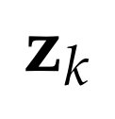






Time Update (“Predict”)
Measurement Update (“Correct”)
(1) Project the state ahead
(2) Project the error covariance ahead
(1) Compute the Kalman gain
(2) Update estimate with measurement
(3) Update the error covariance
Initial estimates:

